Slide 1
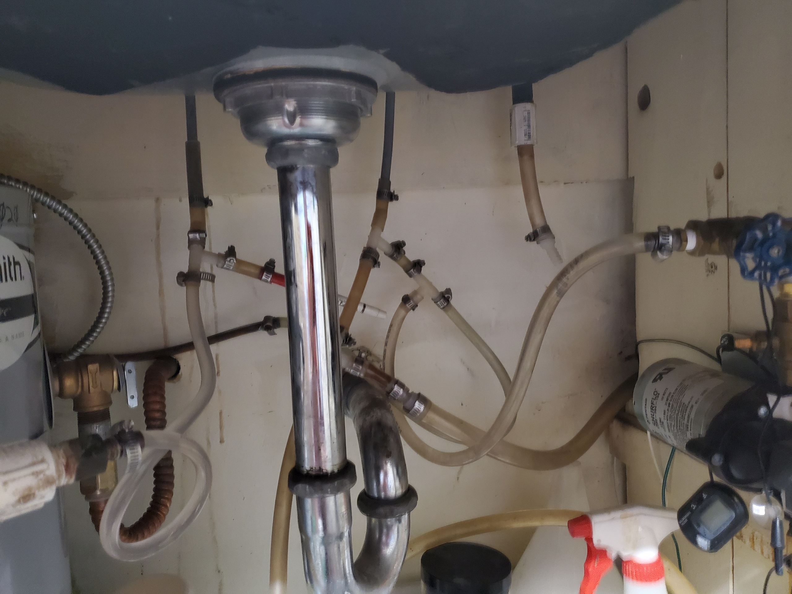
Where is the line from the
35 gal tank above?
Is this the line up to the
cold faucet of the sink?
Is this the line up to the
hot faucet of the sink?
Is this the line from the
outside tanks?
Get some of these plugs
Or, is this the line from the
outside tanks?
What is this the line?

Slide 2
