Slide 1
DUNE Near Detectors
Kirk T McDonald, for the DUNE Collaboration
Princeton University
NuFact15
Centro Brasileiro de Pesquisas Físicas, Rio de Janeiro
(August 11, 2015)
Compiled from the LBNF/DUNE DOE CD-1 Refresh Review (July 14, 2015)
https://web.fnal.gov/project/LBNF/ReviewsAndAssessments/LBNF_DUNE%20DOE%20CD-1%20Refresh%20Review/SitePages/Agenda.aspx

Slide 5
Geoffrey Mills

Slide 6
Geoffrey Mills

Slide 7
Geoffrey Mills

Slide 11
, i.e., ∼ 10⁵ of the ∼ 10⁸ ND ν events

Slide 15
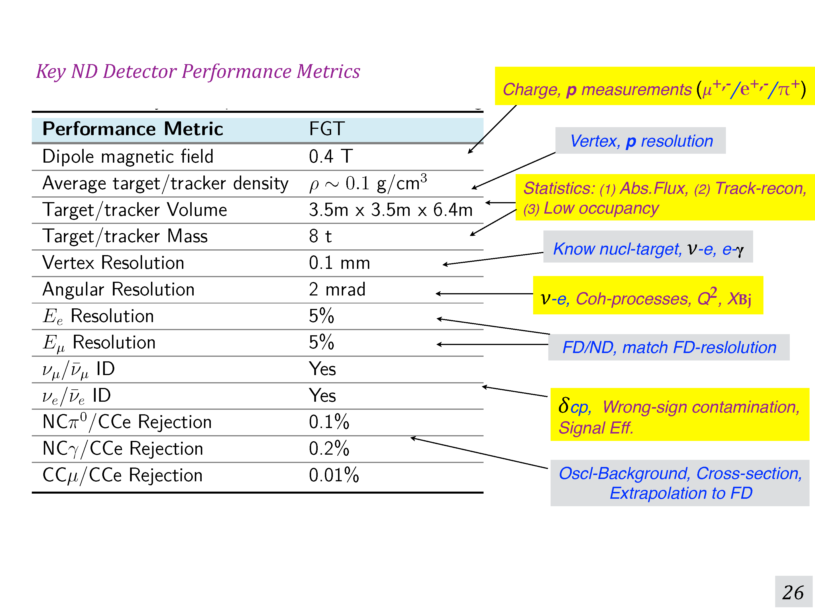
Near Detector parameter list at
http://lbne2-docdb.fnal.gov:8080/cgi-bin/RetrieveFile?docid=10873&filename=LBNF-DUNE-V1.8-parameters.xlsx&version=26
Sanjib R Mishra

Slide 16
Sanjib R Mishra

Slide 17
Sanjib R Mishra

Slide 18
Sanjib R Mishra

Slide 24
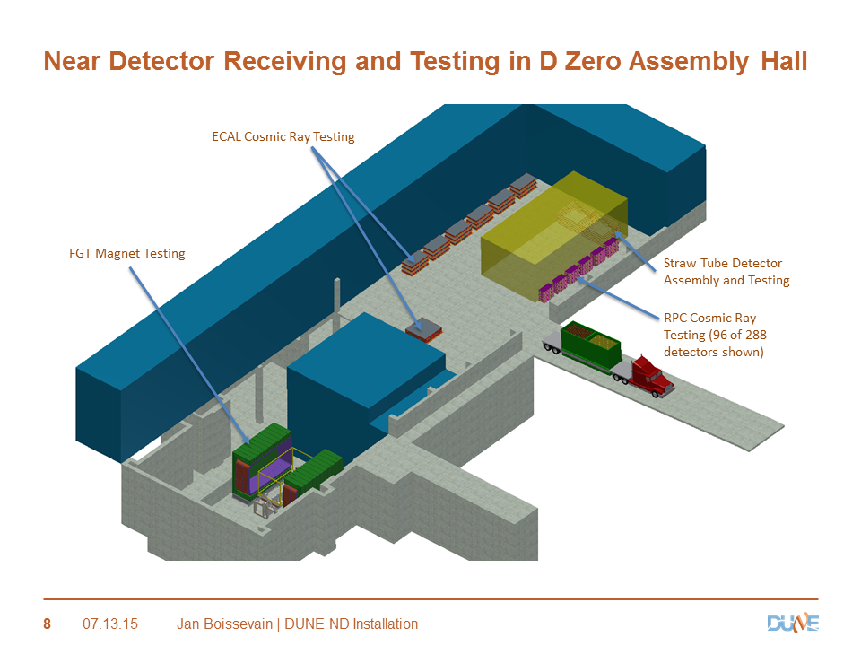
24

