Slide 1
Taper magnets
Decay-Channel Triplets
Target
On axis field [scale /20 T]
Target Magnets

Slide 2
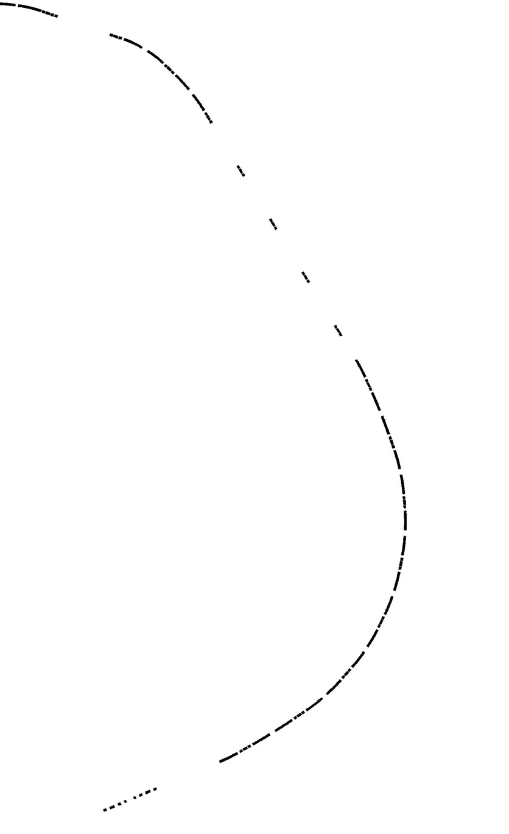
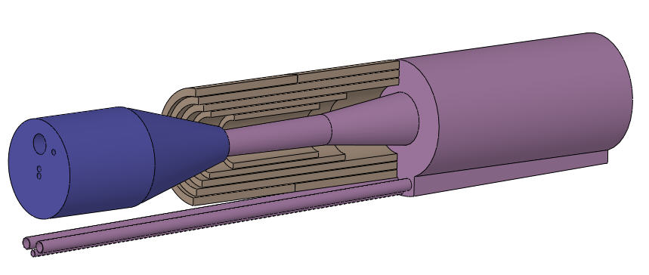
RCS or
Compressor
Matching
Septum
Beam dump
230 m
Collimation
Beam
Window
Arc
Final focus
Target

Slide 3
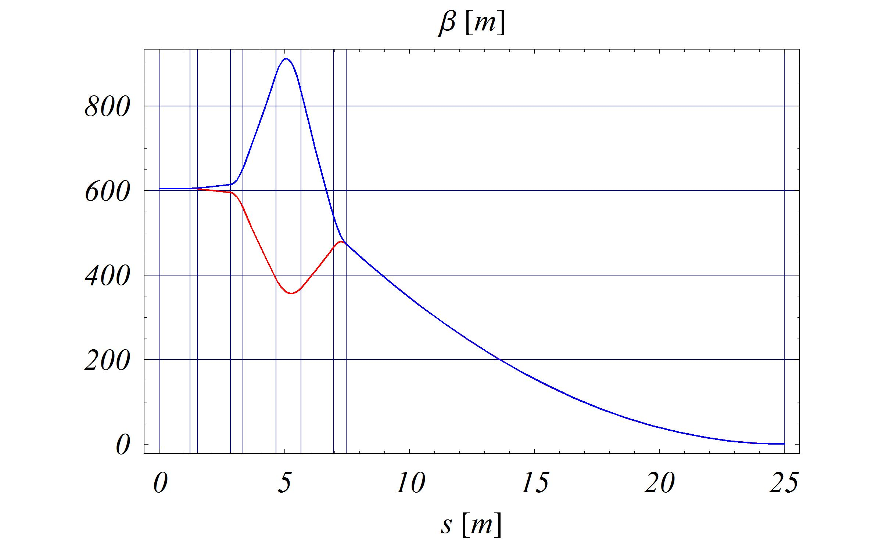
Target
Position

Slide 4
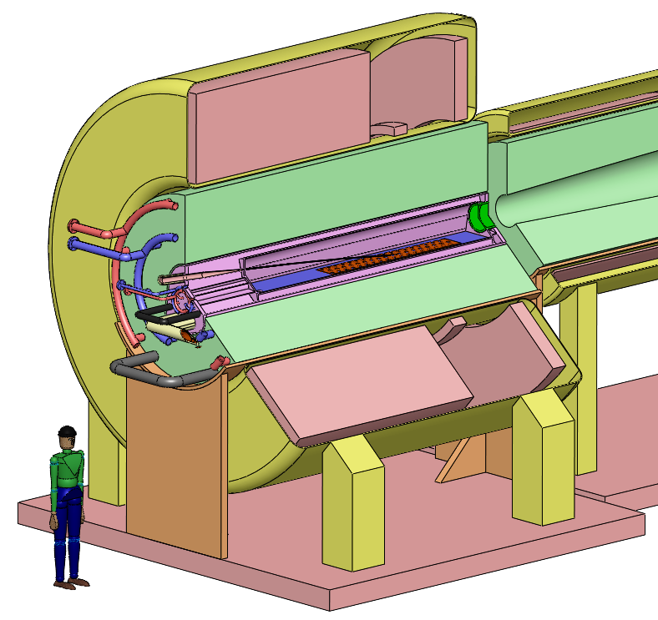
Mercury Module: collection pool,
mercury jet
Superconducting coils
Cryostat
Shielding Module:
Tungsten beads,
He-gas cooled

Slide 5
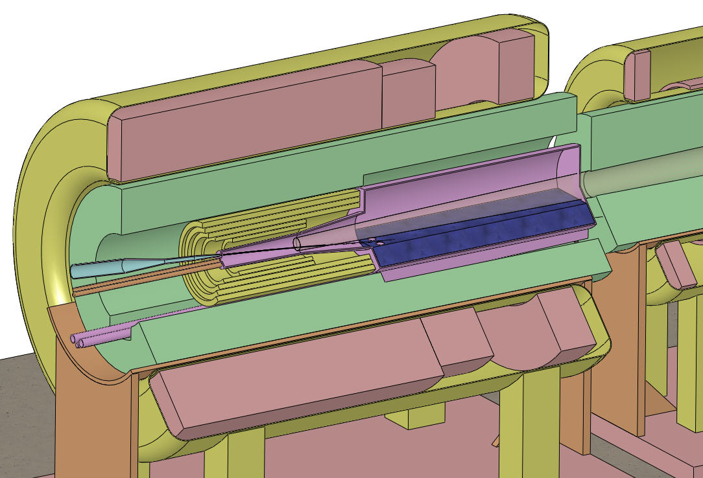
Superconducting magnets
Tungsten beads,
He gas cooled
Be window
Proton beam and
Mercury jet
Resistive magnets
Mercury collection pool
with splash mitigator

Slide 6
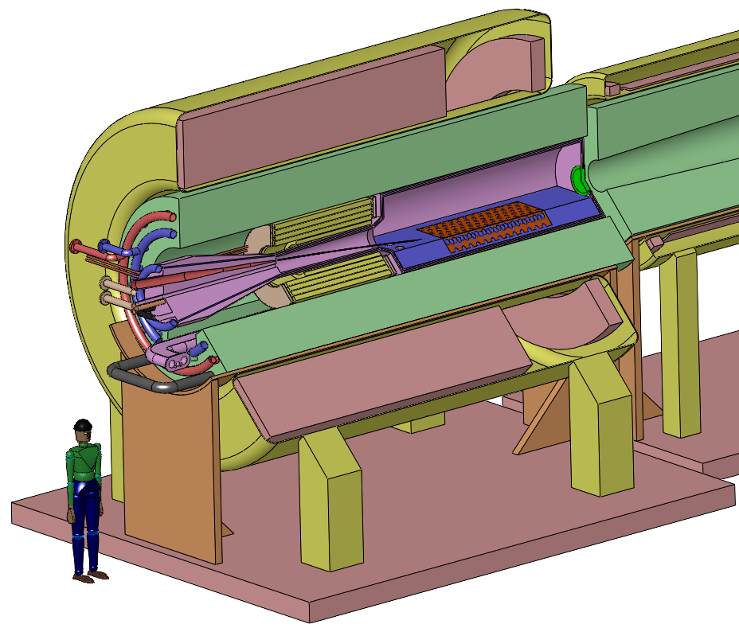
Superconducting coils
Resistive coils
Proton beam,
Hg jet
Tungsten beads,
He-gas cooled
Mercury pool +
Splash mitigator

Slide 7
Mercury Module: mercury jet, collection pool + resistive coils
Superconducting coils
Cryostat
Shielding Module:
Tungsten beads,
He-gas cooled

Slide 8
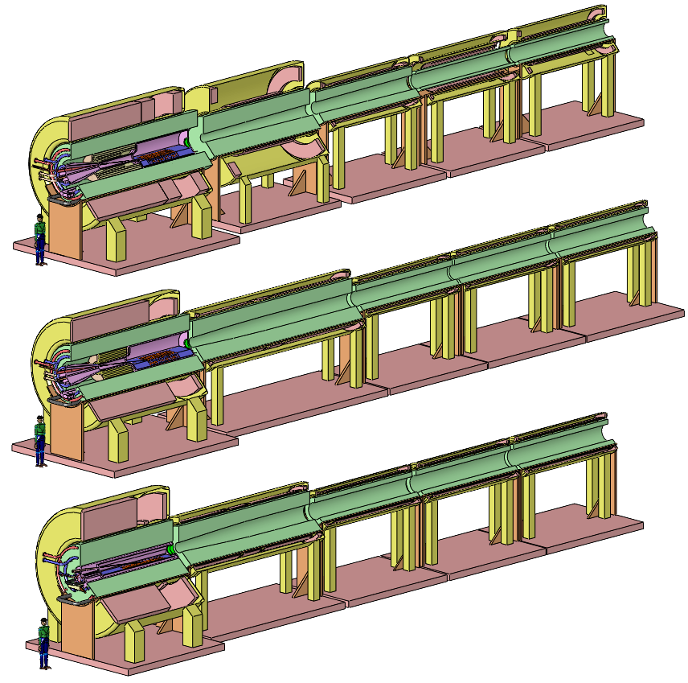

Slide 9
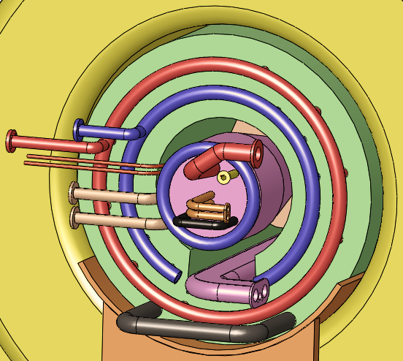
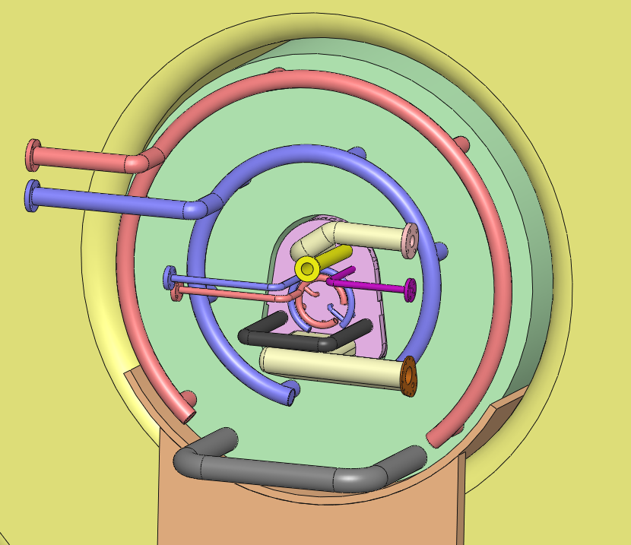
IDS120_15-1.5T7m3+4 Utility Connections

Slide 10
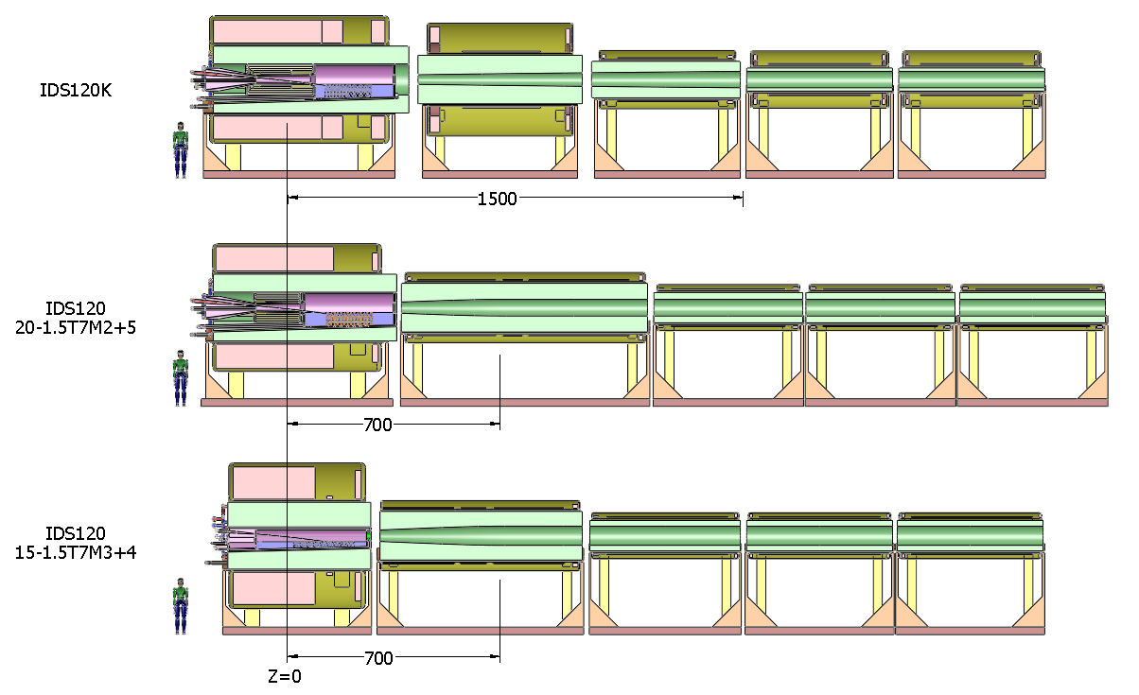
IDS120k, IDS12020-1.5T7m2+5, IDS120_15-15.7m3+4

Slide 11

Particle
Beam
Lasers

Slide 12
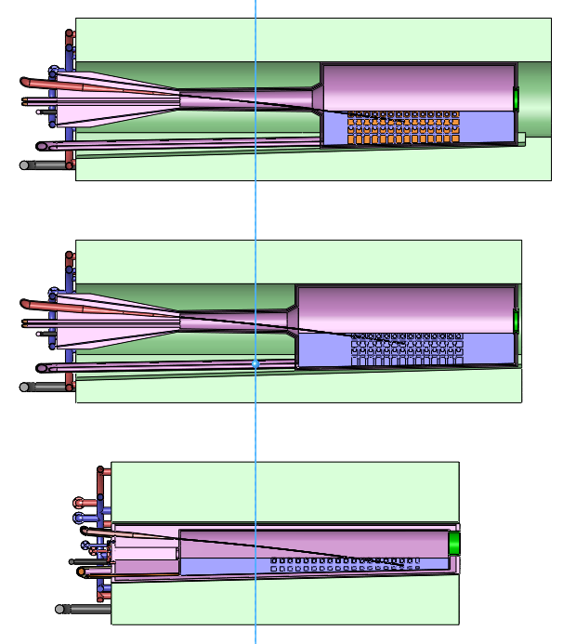

Slide 13
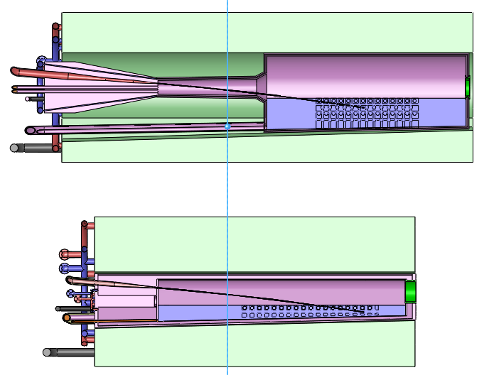

Slide 14
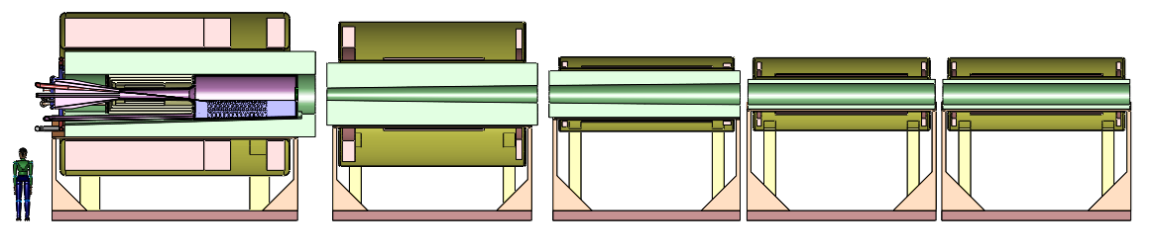
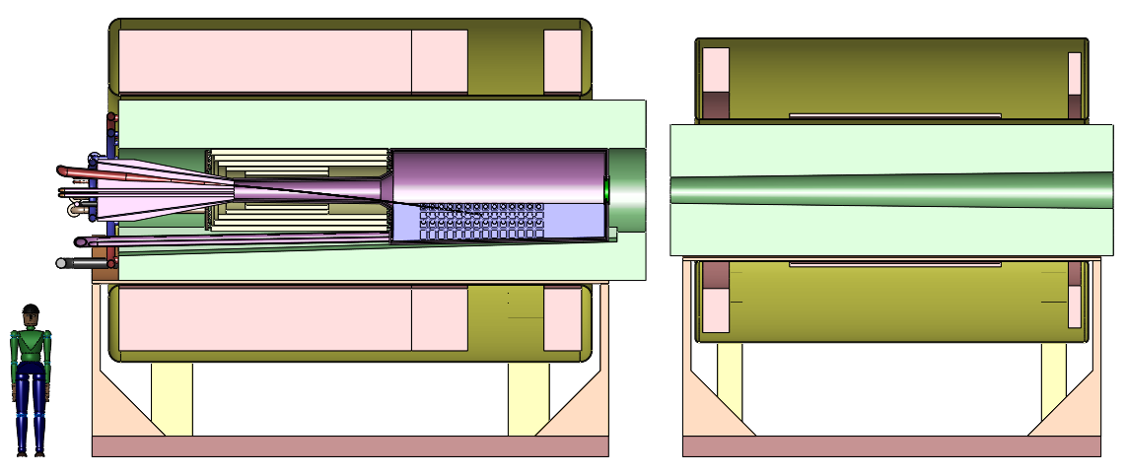

Slide 15
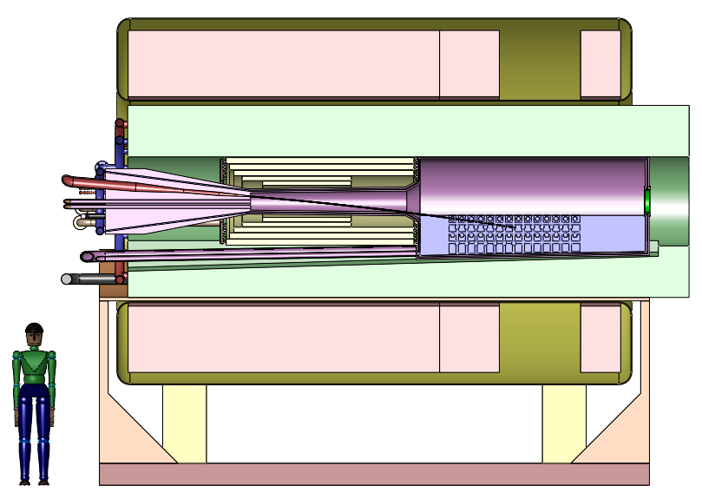

Slide 16
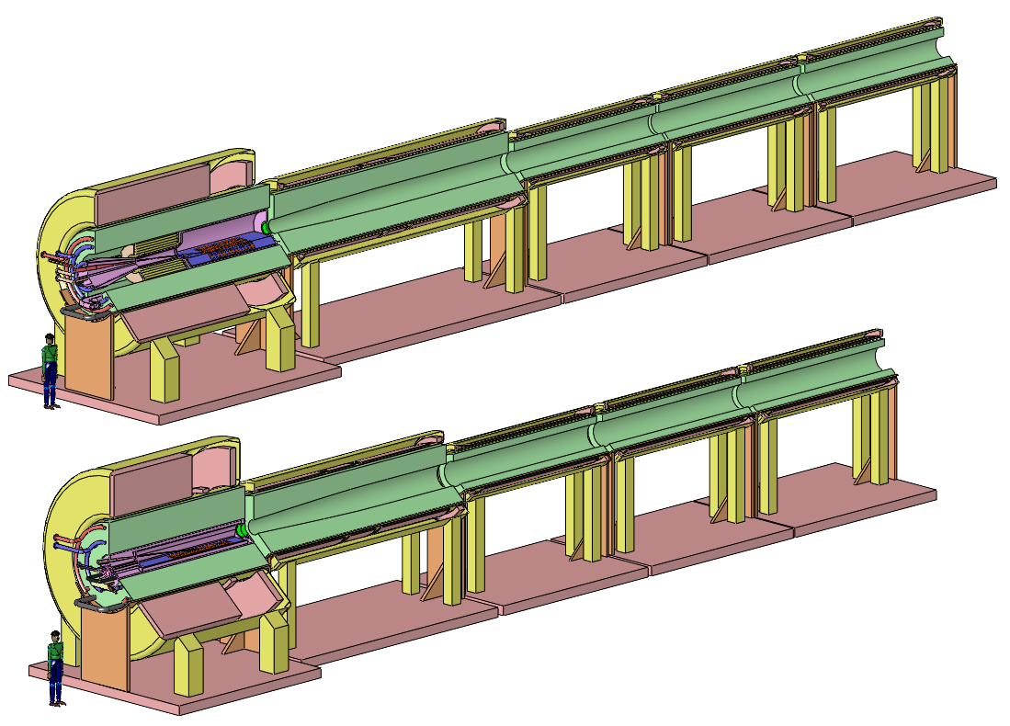

Slide 17
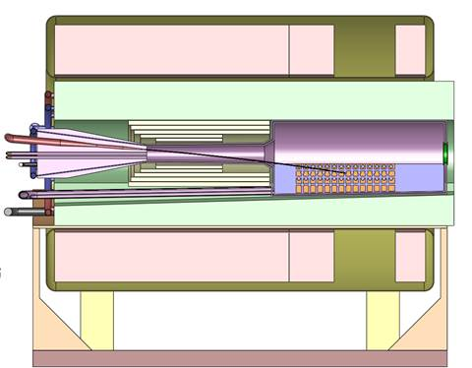

Slide 18
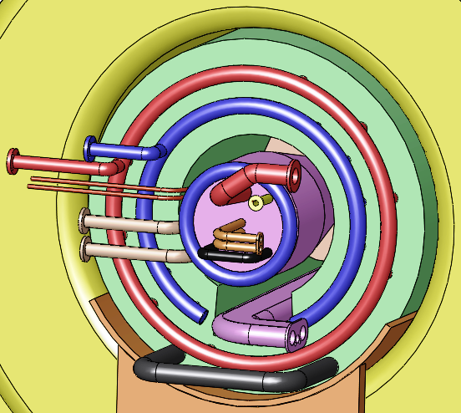
IDS120_20-1.5T7m2+5
Shielding Helium
Mercury Supply
Beam Entrance
Resistive Coil
Power
Vents
Resistive Coil
Cooling
Shielding Remote Handling
Mercury Drains

Slide 19
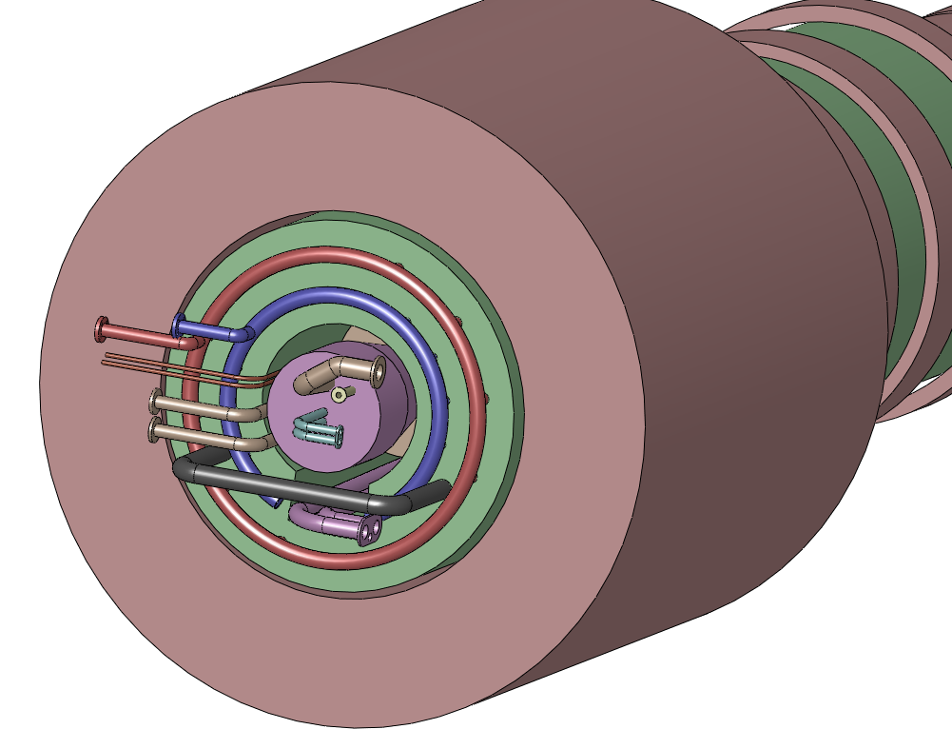
IDS120_20-1.5T7m2+5 Utility Connections
Shielding Helium
Resistive Coil
Power
Nozzle Supply
Resistive Coil
Cooling
Beam Entrance
Vents
Shielding Remote Handling
Mercury Drains

Slide 20
IDS120_15-1.5T7m3+4 Utility Connections

Slide 21
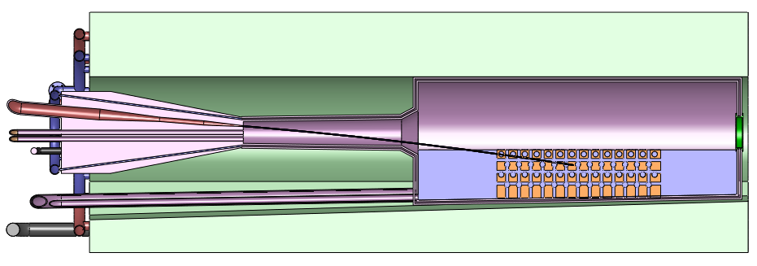
IDS120_20-1.5T7m2+5

Slide 22
IDS120_15-1.5T7m3+4

Slide 23
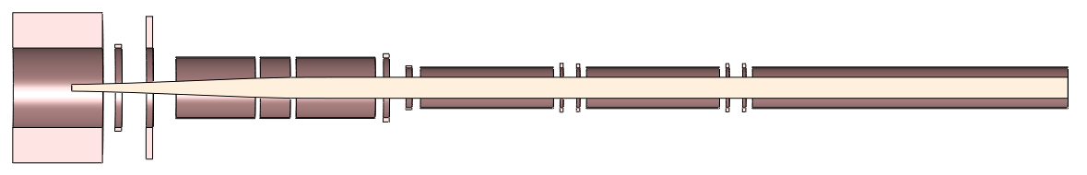
IDS120_15-1.5T7m3+4

Slide 24
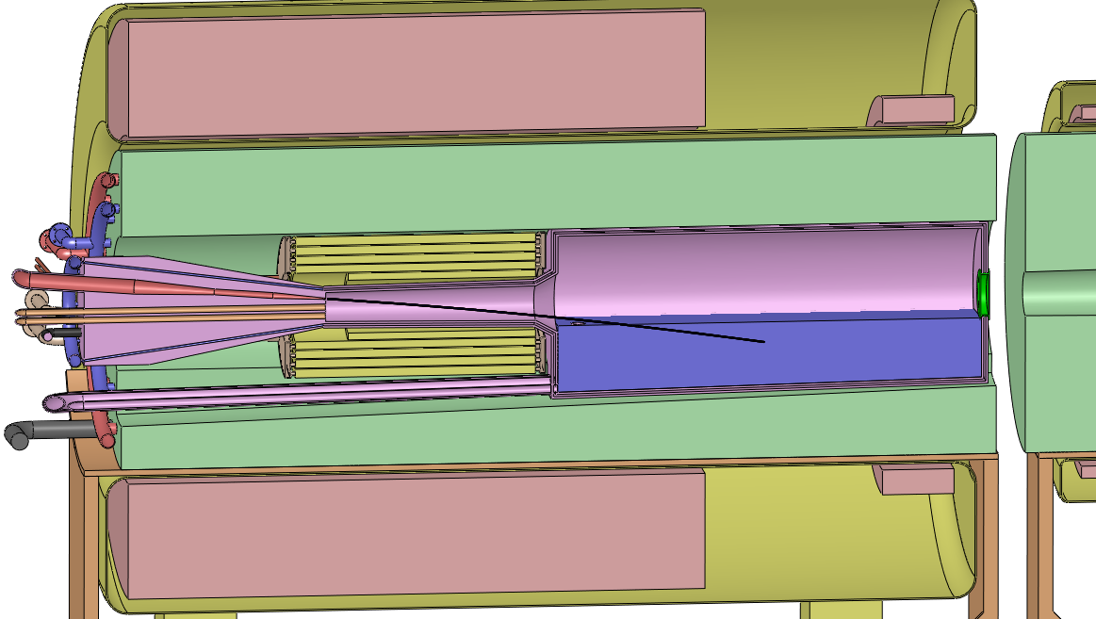
IDS120_20to1.5T7m

Slide 25
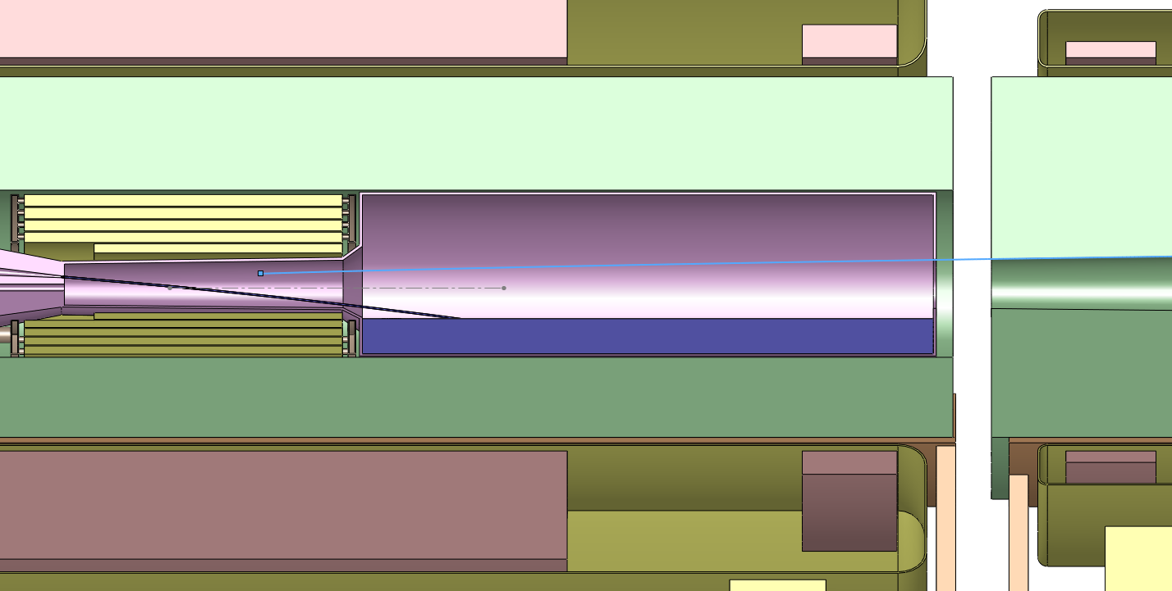
IDS120_20to1.5T7m

Slide 26
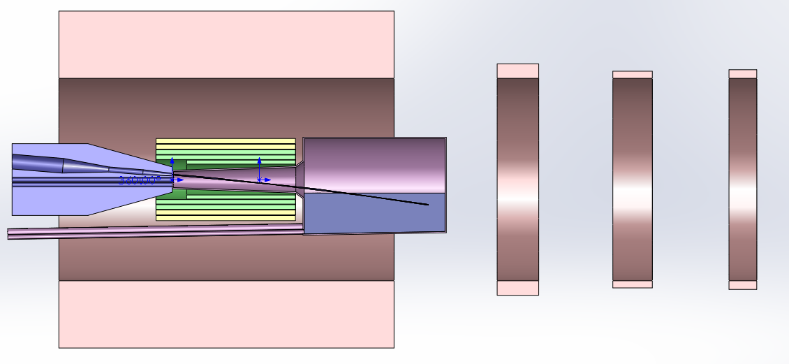
IDS120_20to1.5T7m

Slide 27
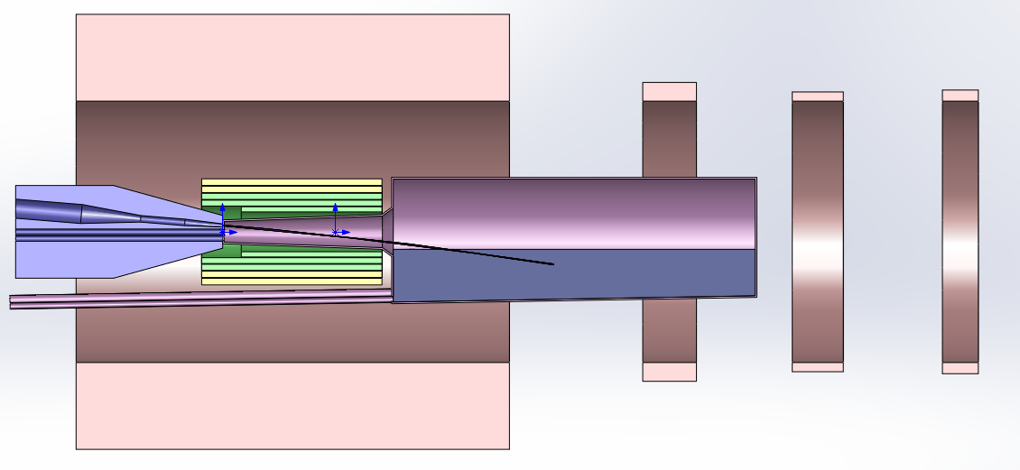
IDS120_20to1.5T7m

Slide 28
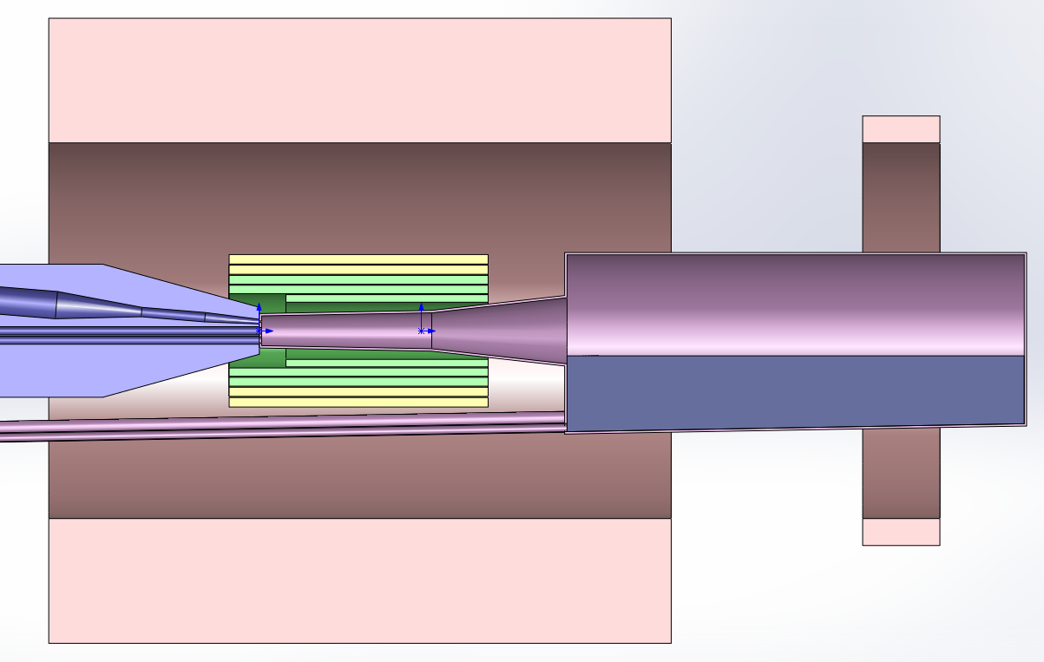
IDS120_20to1.5T7m

Slide 29
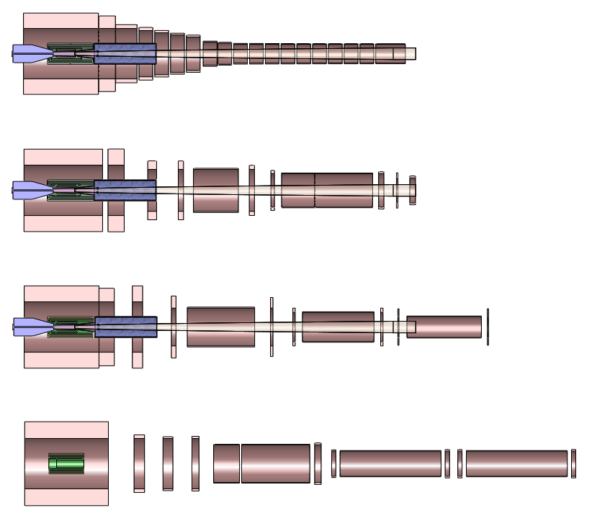

Slide 30
Axial field (T)
Axial distance (m)

