Slide 1
Spallation Neutron Sources Around the World
5th High Power Targetry Workshop
20-23 May 2014 Fermi National Accelerator Laboratory
Bernie Riemer
Thanks to others for the many shamelessly pilfered slides used herein …
Notes:
8:45 AM to 9:30 AM – including Q&A
Roughly 35 slides should do it
Views and opinions expressed herein are my own, un-blessed by SNS, ORNL or DOE management.

Slide 2
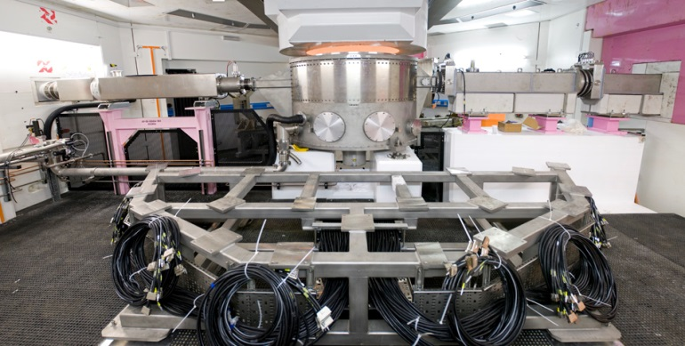
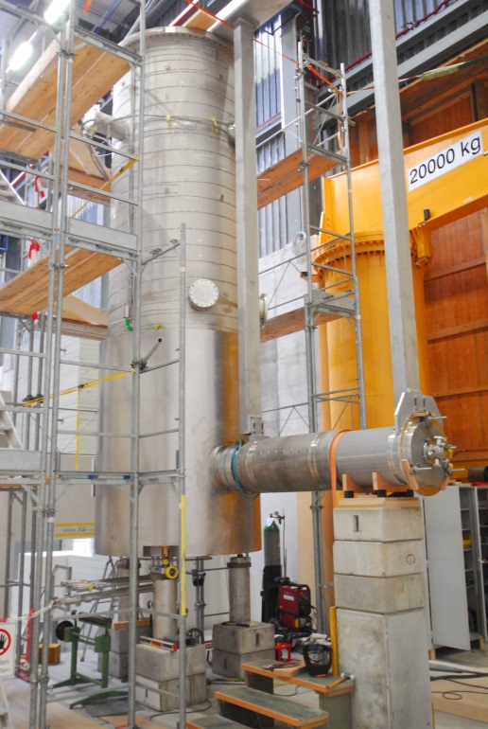
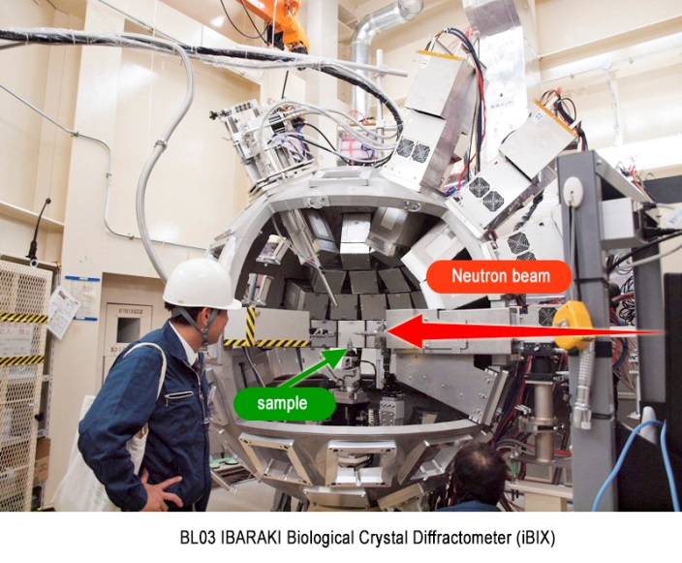
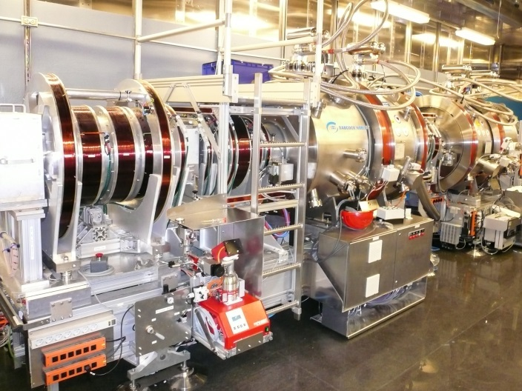
Spallation Neutron Source Facilities Serve Neutron Science Programs
Neutron beams to suites of instruments
  Elastic and inelastic scattering
  Diffractometers and spectrometers
Engineered structures, powders, liquids, crystals, bio-materials, proteins, chemistry …
  Neutron physics, imaging, SEE testing
Wish at ISIS TS-2
iBIX at JPARC MLF
Neutron Spin Echo at SNS
UCN at PSI
Notes:
NSE – SNS http://neutrons.ornl.gov/nse/
iBIX – JPARC http://j-parc.jp/researcher/MatLife/en/instrumentation/ns_spec.html#bl03
Wish – ISIS TS-2 http://www.isis.stfc.ac.uk/instruments/wish/wish-6465.html
UCN – PSI http://ucn.web.psi.ch/index.htm

Slide 3
A few preliminary thoughts
Expectations of funding bodies on neutron source facilities vary
  What defines success?
    Some measure of science productivity
What defines neutron performance?
  Total flux? Intensity? Peak brightness?
  Preferred temporal characteristics?
  Instrument specific metrics have become the norm
Neutron sources: typically 3000 ~ 5000 neutron production hours per year
Budget ups and downs

Slide 4
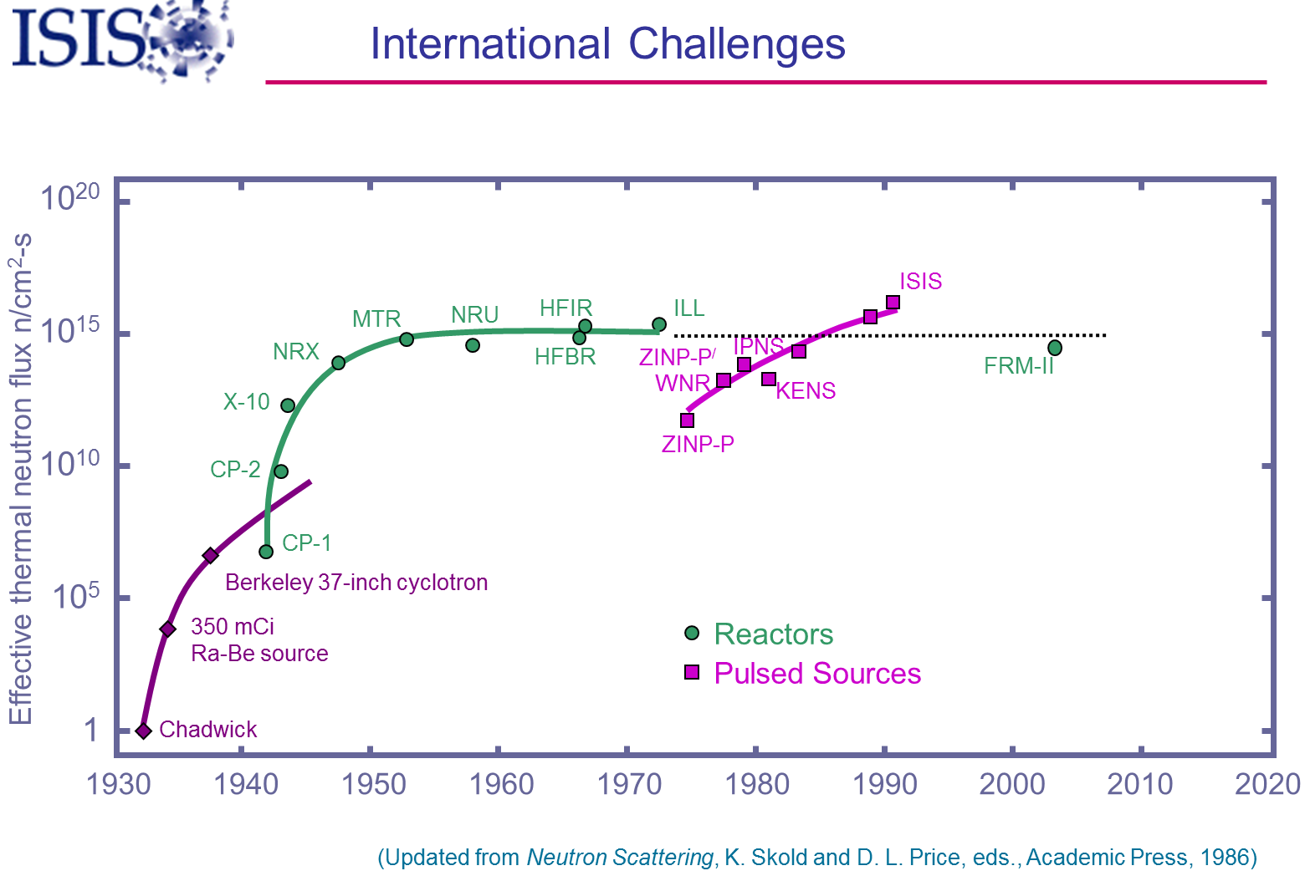
T. Broome
2006
Less and less useful
Notes:
Missing reactor sources: CARR
Missing spallation sources: SINQ, SNS, JSNS, Lujan

Slide 5
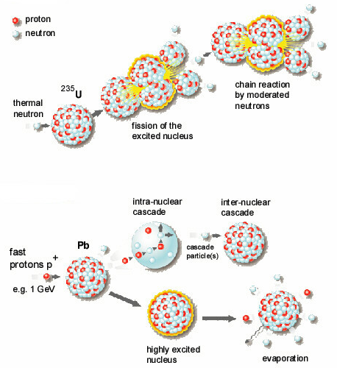
Two popular ways to produce neutrons
Fission
chain reaction
continuous flow
1 neutron/fission
180 MeV/neutron
Spallation
no chain reaction
pulsed or continuous operation
40 neutrons/proton
30 MeV/neutron

Slide 6
Dealing with heating in spallation targets is a still a challenge
Removal of steady state heating
  Total power vs. volume power density
Pulse effects
  Thermal “shock”, fatigue, cavitation damage
Of course, there’s more to target design
Target – source physics performance
Required duty cycle, maintenance strategy, remote handling
Radiation damage effects
Facility safety, waste disposal

Slide 7
Spallation neutron sources
Operating
On the horizon

Slide 8
Low energy neutron sources
Proton knock-out reaction sources – not spallation
  For science, industry, development and education
LENS (Indiana University)
Tsinghua University
Peking University
Bilbao project - in a deep sleep
UCANS
  Union for Compact Accelerator-driven Neutron Sources

Slide 9
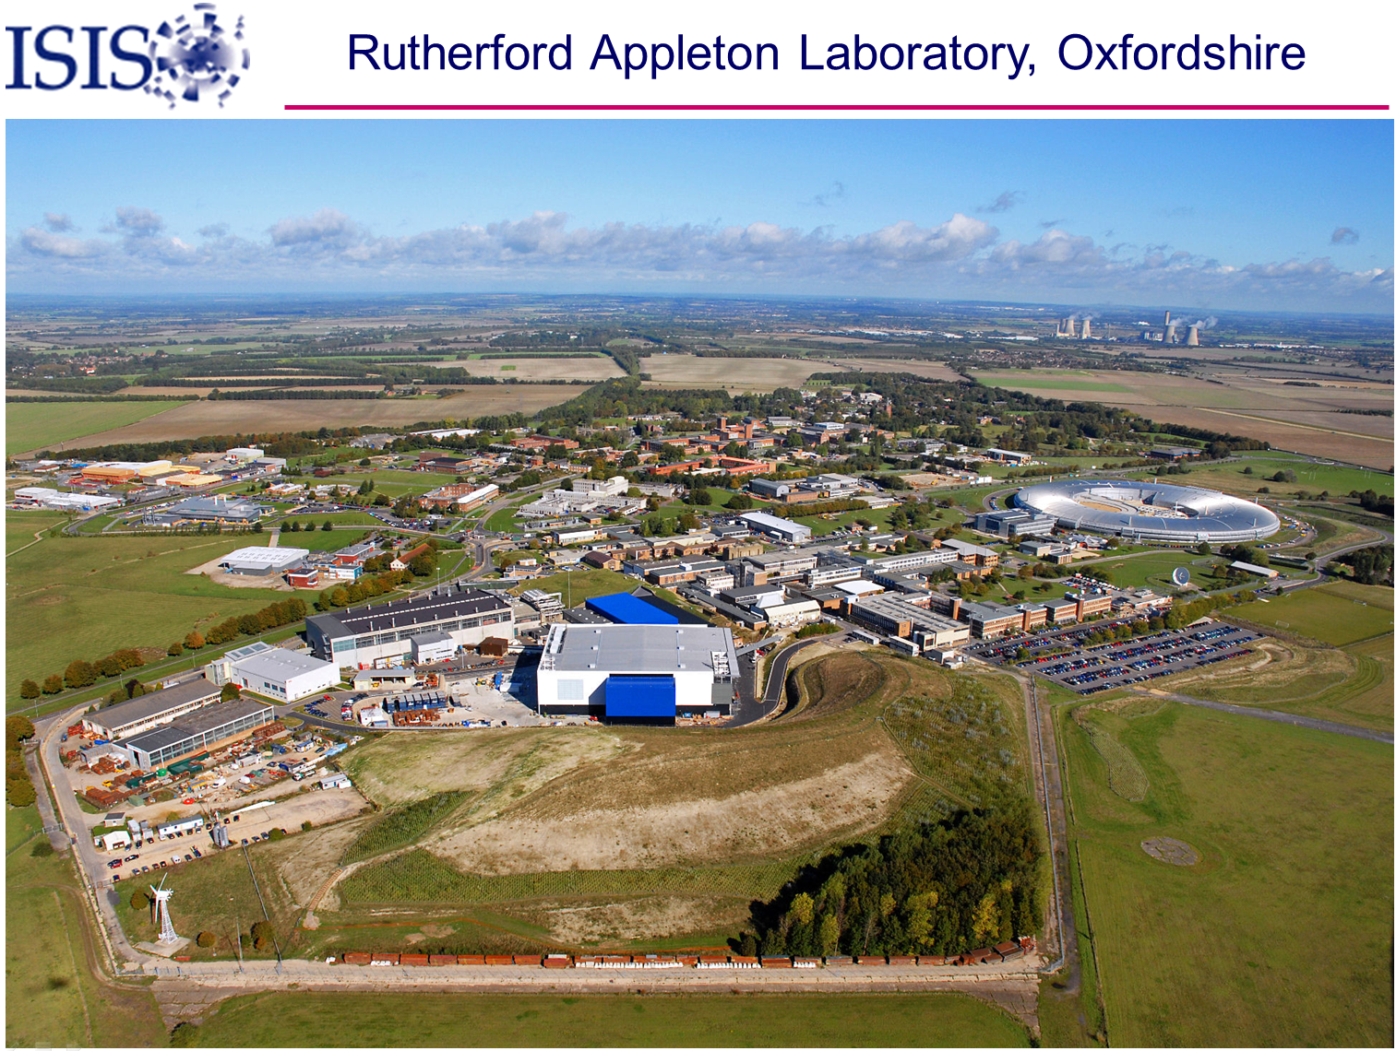
T. Broome
Notes:
Note Diamond Light Source

Slide 10
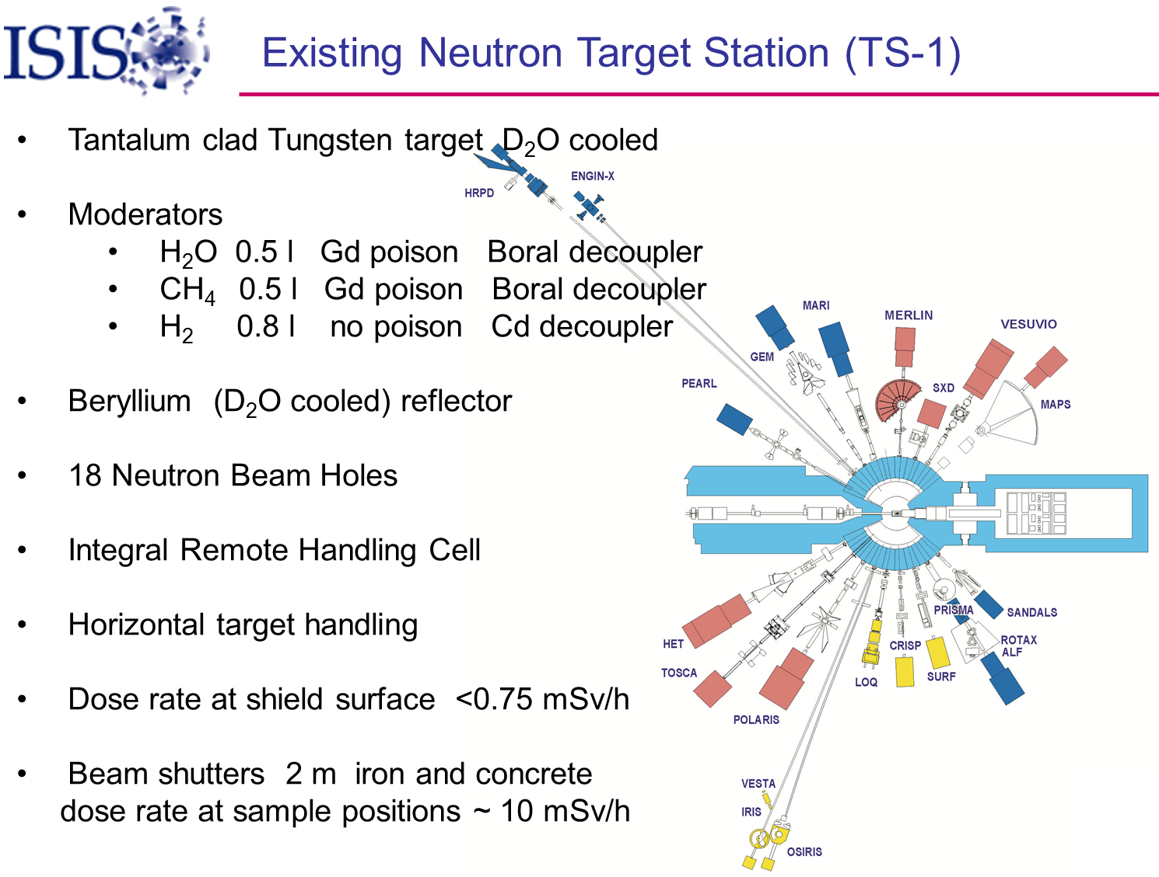
T. Broome
  Running since 1984

Slide 11
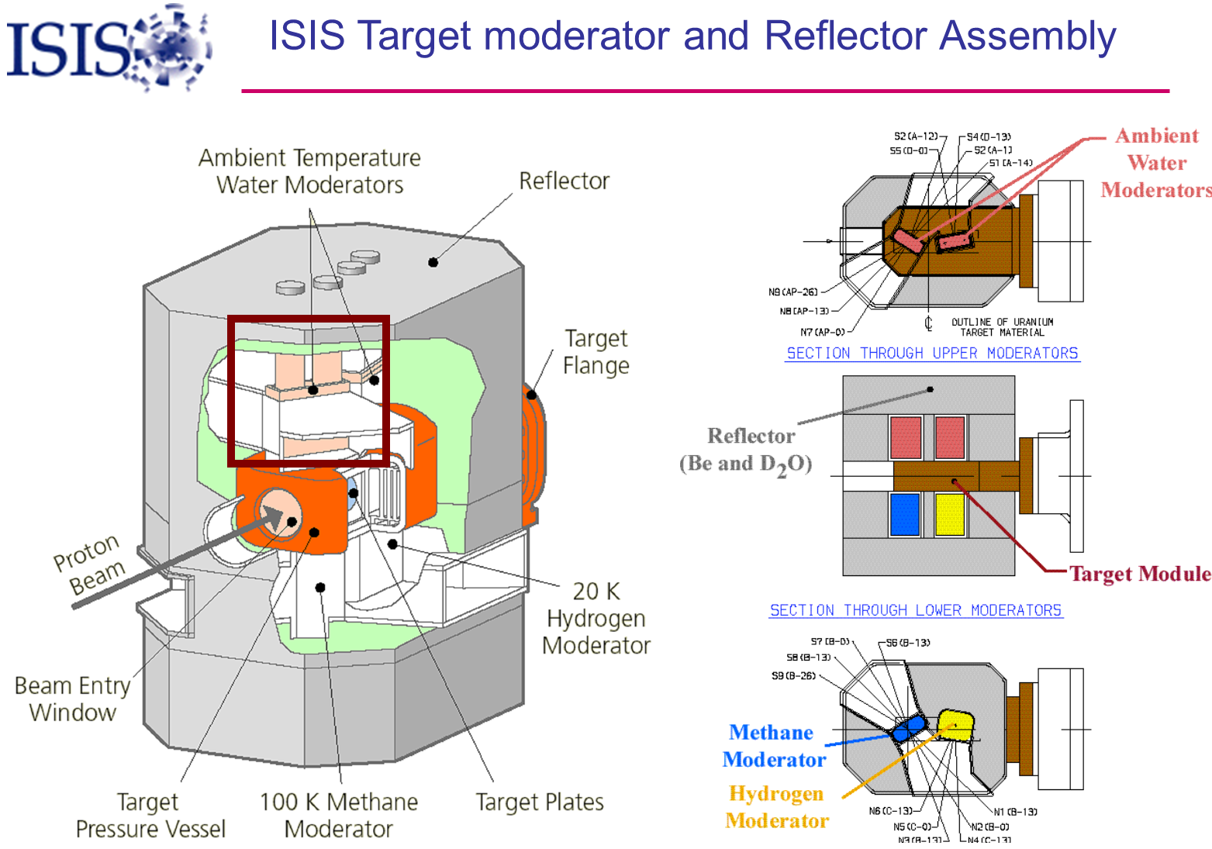
Notes:
Moderators: liquid methane, liquid hydrogen, water
Beryllium reflector (1 inch diameter rods, D2O cooled)

Slide 12
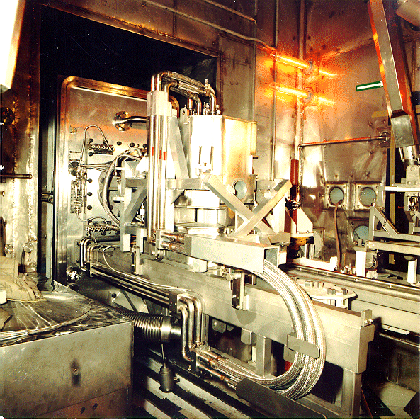
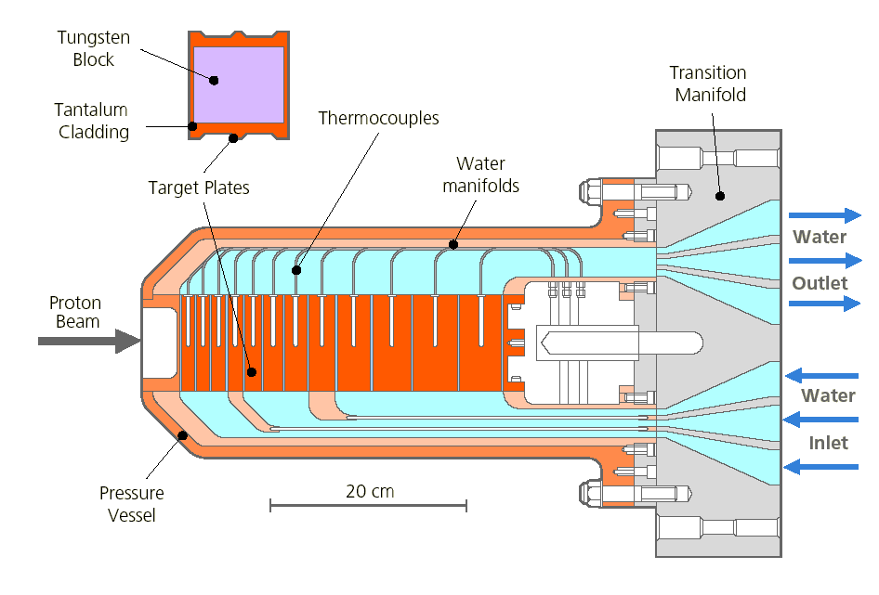
kW class spallation neutron sources
ISIS TS-1 at RAL
  40 / 50 Hz, short-pulse (SP)
  800 MeV H⁺
  160 kW
  W plates target with Ta clad
T. Broome, ISIS
Notes:
Original target was uranium; radiation swelling was a problem.
Next was solid tantalum; afterheat very high
Typical target lifetime: 100 MW⋅d (2400 MW⋅h) ??

Slide 13
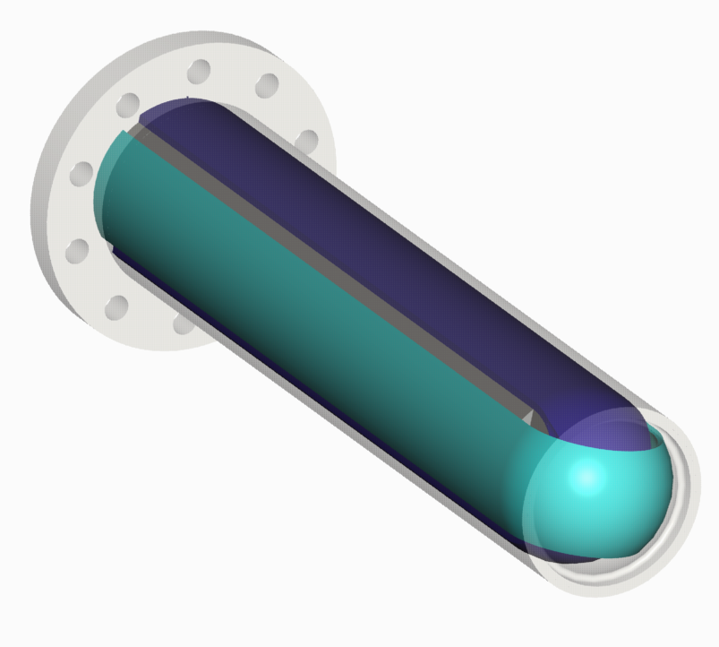
kW class spallation neutron sources
ISIS TS-1 at RAL
  40 / 50 Hz, SP 800 MeV H⁺
  160 kW
  W target with Ta clad
ISIS TS-2 at RAL
  10 Hz, SP 800 MeV H⁺
  32 kW
  Monolithic W rod target
    with Ta clad
L. Jones, ISIS

Slide 14
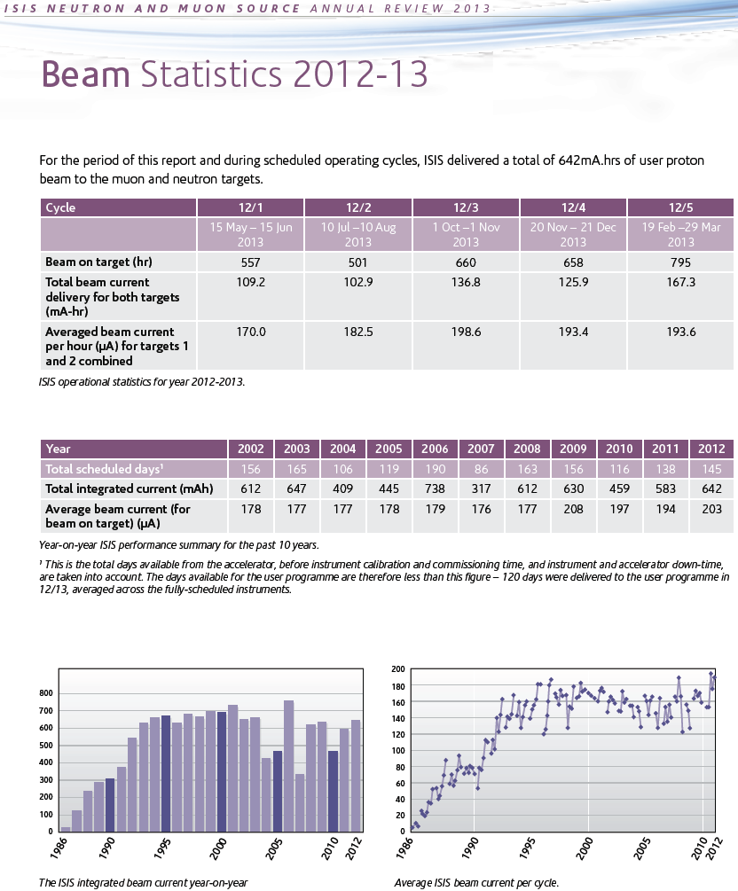
ISIS Operations
Total of 3200 hr of beam on targets in 2012-13 run cycles
642 mAh at 800 MeV
  500+ MW⋅h
> 419 publications
Notes:
Total 3171 hr of beam on target(s) 15May123 – 29Mar13 (?)
642 mAh on target (514 MW⋅h)

Slide 15
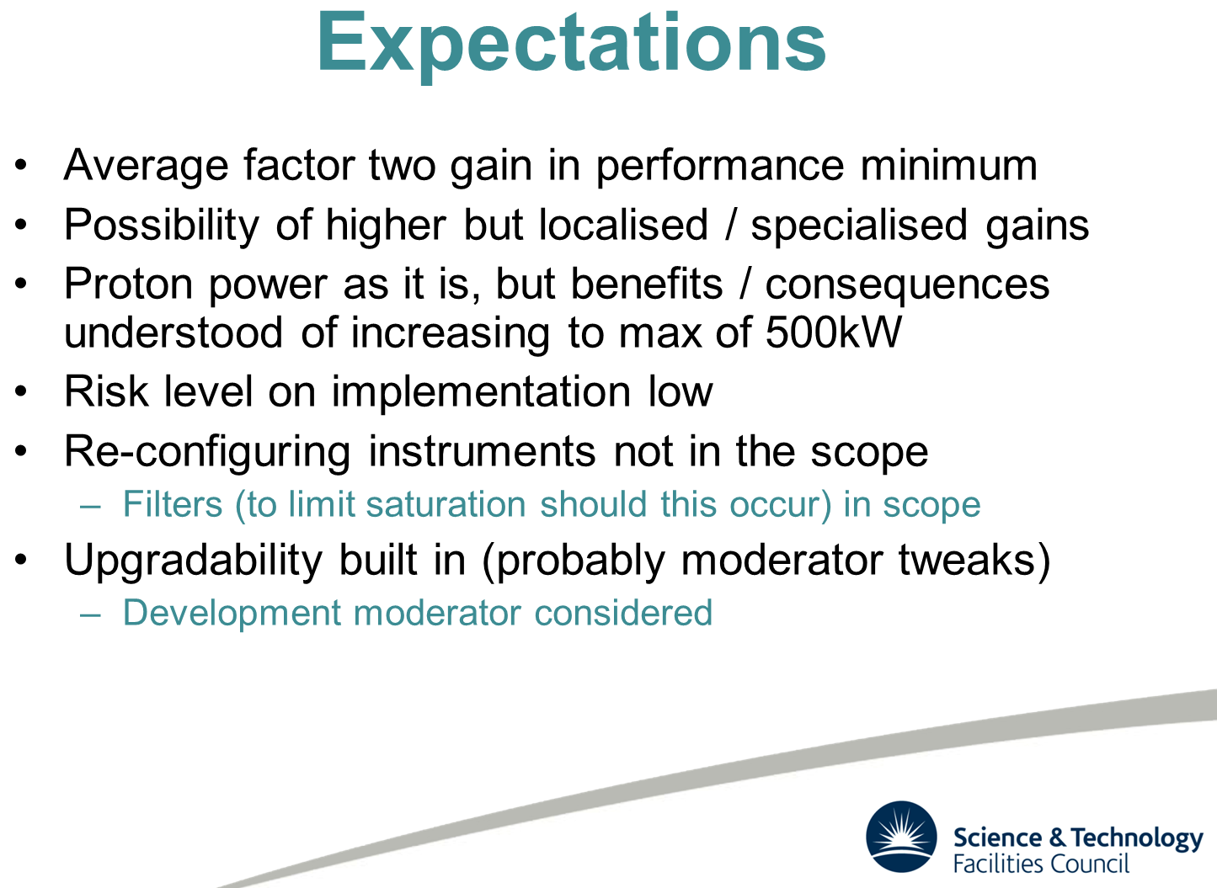
ISIS TS-1 upgrade
In December 2014, TS-1 will have its 30 year anniversary
Upgrades are being contemplated
M. Fletcher

Slide 16
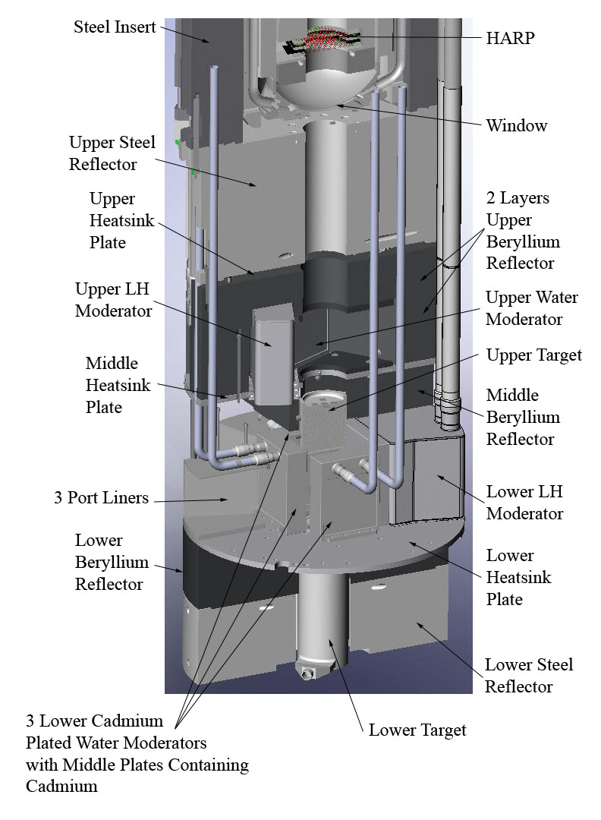
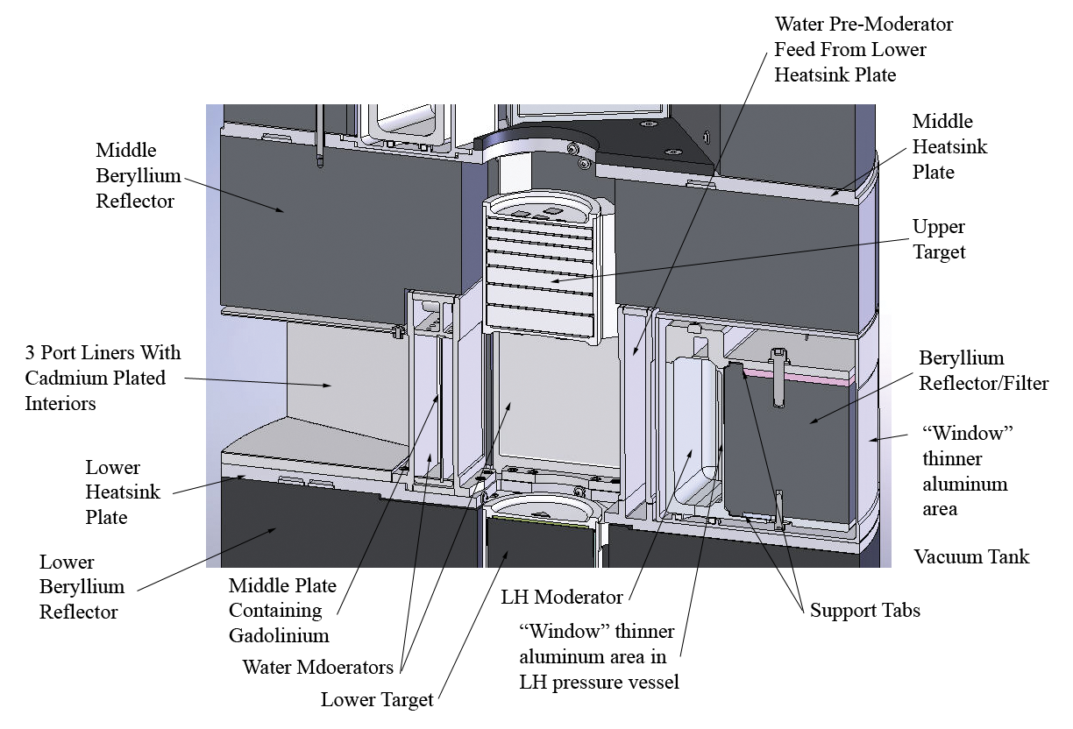
kW class spallation neutron sources
ISIS TS-1 at RAL
  40 / 50 Hz, SP 800 MeV H⁺
  160 kW
  W target with Ta clad
ISIS TS-2 at RAL
  10 Hz, SP 800 MeV H⁺
  32 kW
  W target with Ta clad
Lujan Center at LANSCE
  20 Hz, SP 800 MeV H⁺
  100 kW
  W disks target with Ta clad
  Vertical beam injection
J. O’Toole, LANL

Slide 17
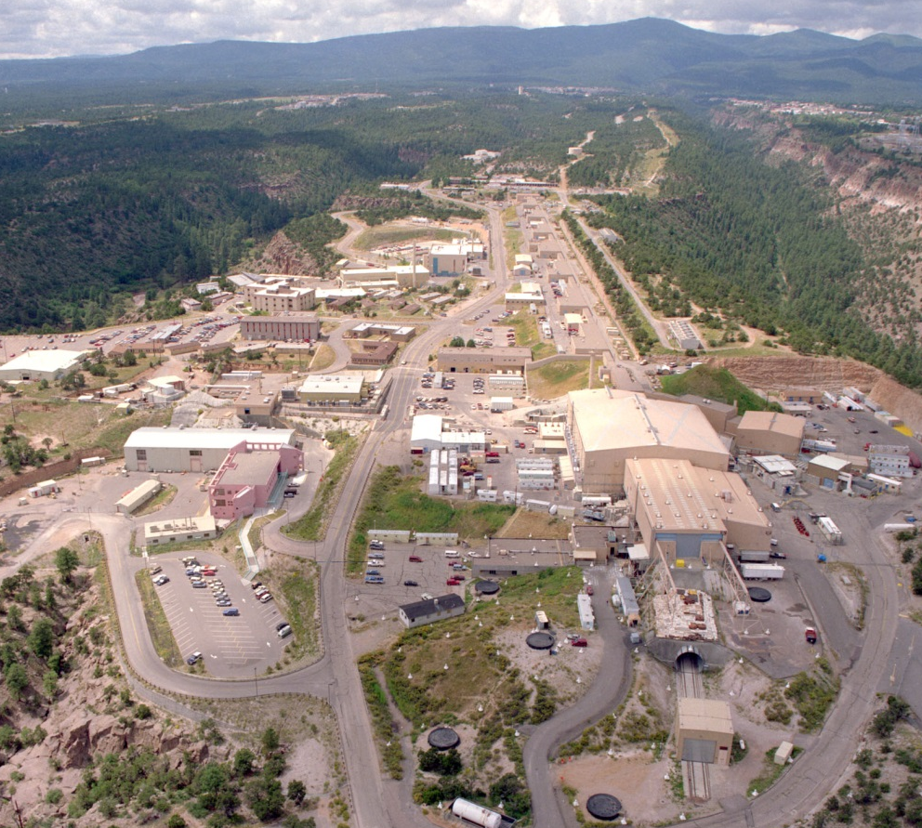
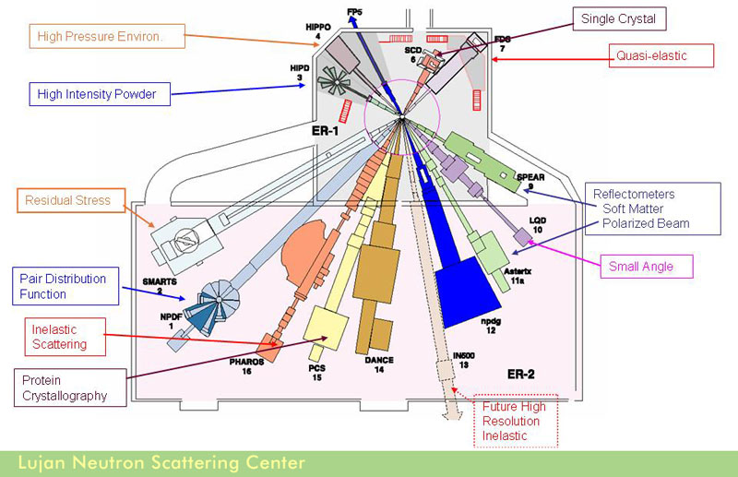
Lujan Neutron Scattering Center at LANSCE
Running since 1985
Operated ~900 hr in 2012
  Beam is shared between several experimental facilities
Proposed cessation of funding for the Lujan Neutron Scattering Center operations from the DOE's Office of Science Basic Energy Sciences – FY15
  NNSA mission continues
Notes:
LANSCE Activity Report 2012
LANSCE has diverse applications / facilities:
IPF, UCN, pRad, WNR
NNSA is the main sponsor

Slide 18
kW class spallation neutron sources
ISIS TS-1 at RAL
  40 / 50 Hz, SP 800 MeV H⁺
  160 kW
  W target with Ta clad
ISIS TS-2 at RAL
  10 Hz, SP 800 MeV H⁺
  32 kW
  W target with Ta clad
Lujan LANSCE at LANL
  20 Hz, SP 800 MeV H⁺
  100 kW
  W target with Ta clad
Notes:
Tungsten targets
Tantalum cladding
Water cooled

Slide 19
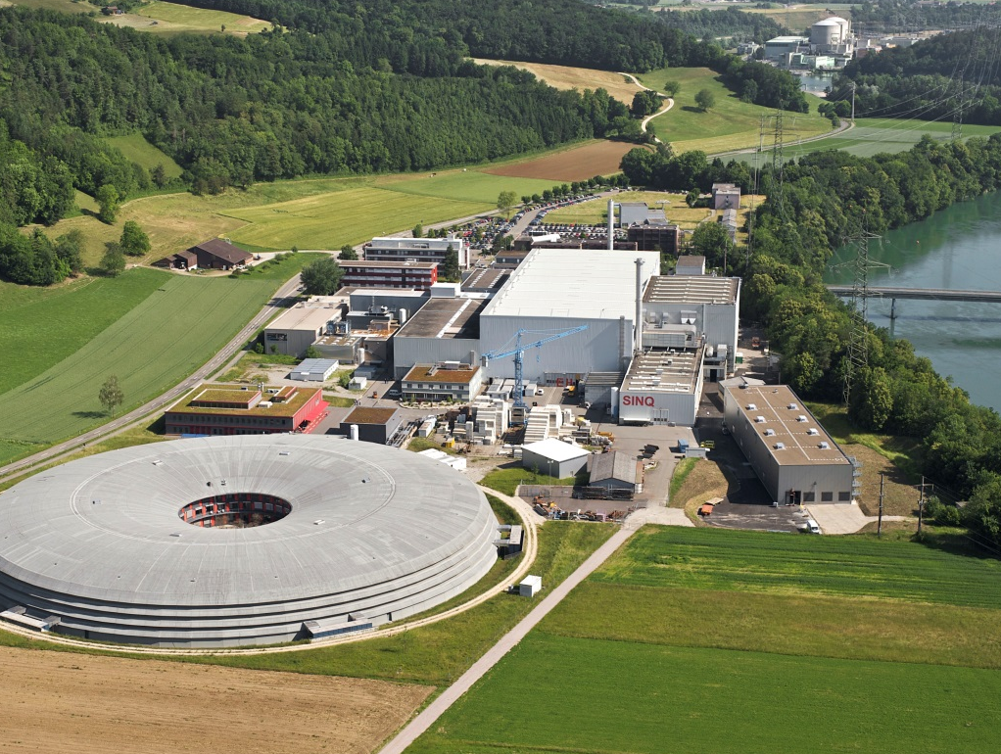
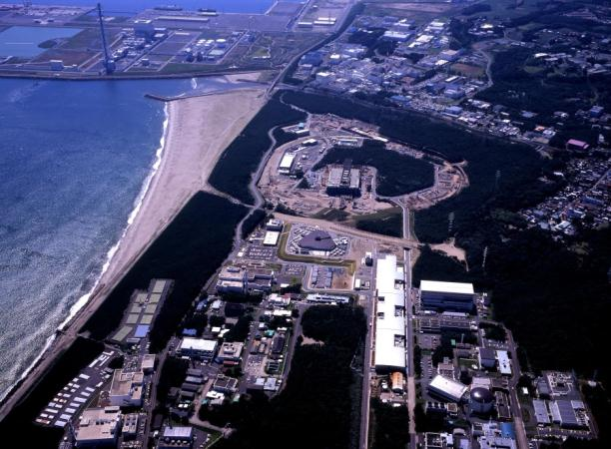
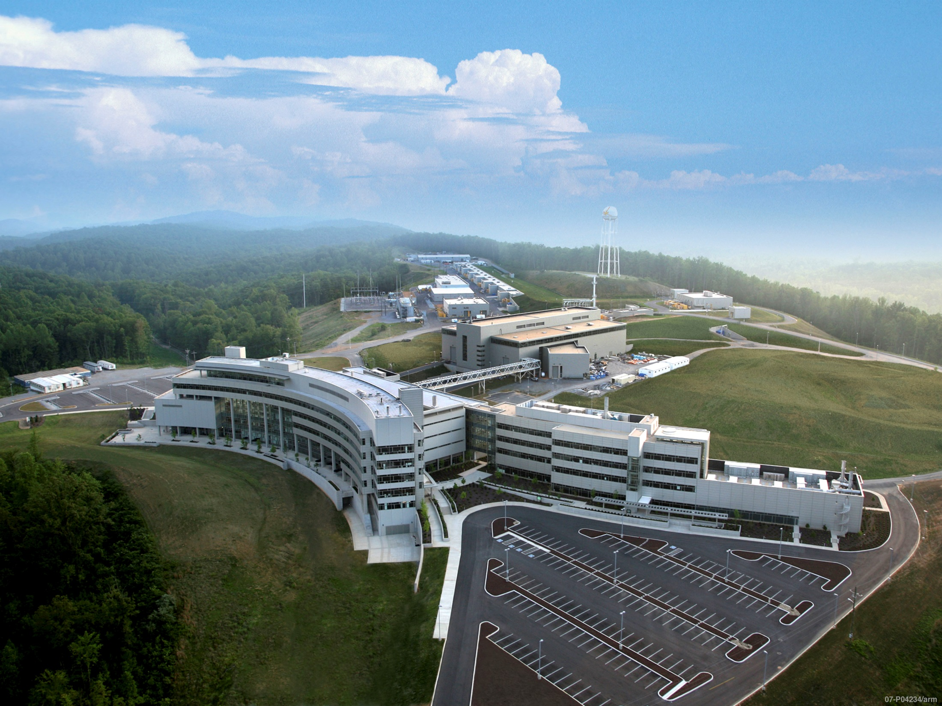
MW class spallation neutron sources
SINQ at PSI
  Continuous beam, 570 MeV H⁺
SNS at the ORNL
  60 Hz, short-pulse, 1 GeV H⁺
JSNS at MLF / JPARC
  25 Hz, short-pulse, 3 GeV H⁺
Notes:
Three MW facilities at different levels of maturity.

Slide 20
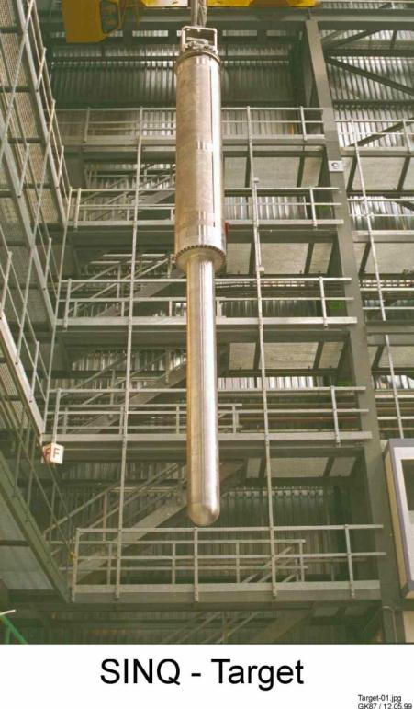
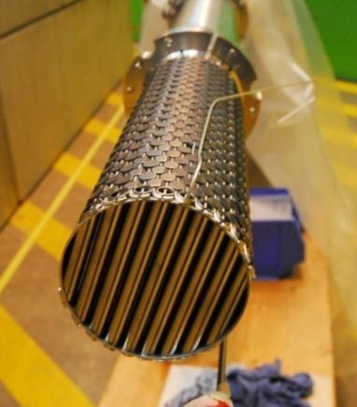
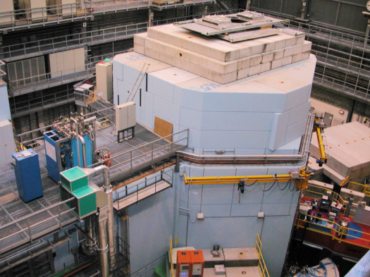
PSI: Swiss Spallation Neutron Source SINQ
Solid lead in Zircaloy tube array target
Water-cooled, stationary SS316L vessel, AlMg3 safety hull
Vertical beam injection, from below
MEGAPIE experiment: molten lead-bismuth
Running since 1997
Target bulk shielding
Pb / Zircaloy target
W. Wagner, PSI
Notes:
The new Zr-Pb cannelloni target for SINQ
Typical operating current on SINQ target now is 1500 µA. At 570 MeV, this is 855 kW
Target 9 lasted 7.0 + 6.3 Ah, or roughly 7500 MW⋅h

Slide 21
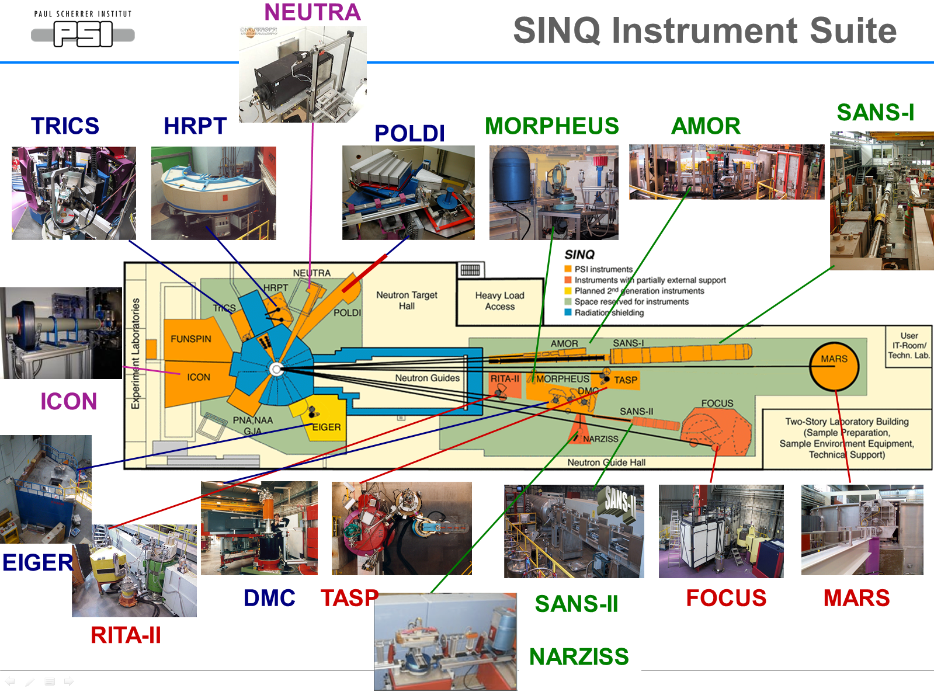
M. Wohlmuther, Feb. 2014
Notes:
Mars is roughly 40 m from source? Check with Michael

Slide 22
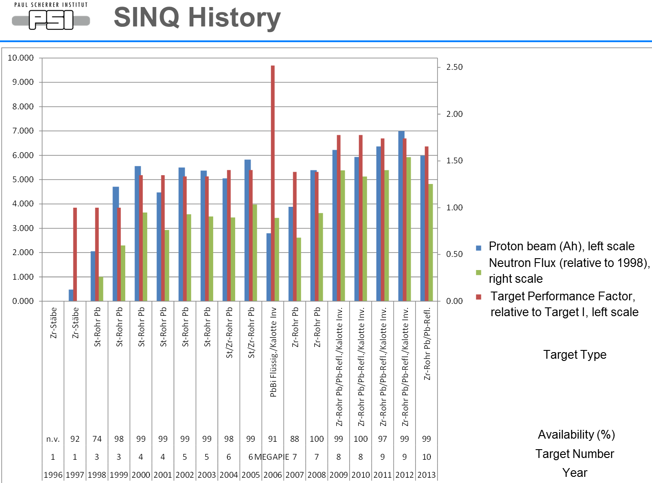
M. Wohlmuther, Feb. 2014
Proton beam (Ah)
Neutron Fluence Factor
Target Performance Factor
Fluence
left
right
Notes:
A few mislabels on this figure
Fluence – not flux; left scale
Target performance: right scale
Some of these are STIP targets – not clear if influence can be seen here
Availability is very high
Key lesson from MEGAPIE was merit in improving the source. Users liked the improved performance.
Calotte and lead reflector have been successful. Increasing power also. Additional improvements under consideration.
Due to fabrication problems (EB-welding) the safety shroud of the spare SINQ target had to be used → hemispherical shroud on T10

Slide 23
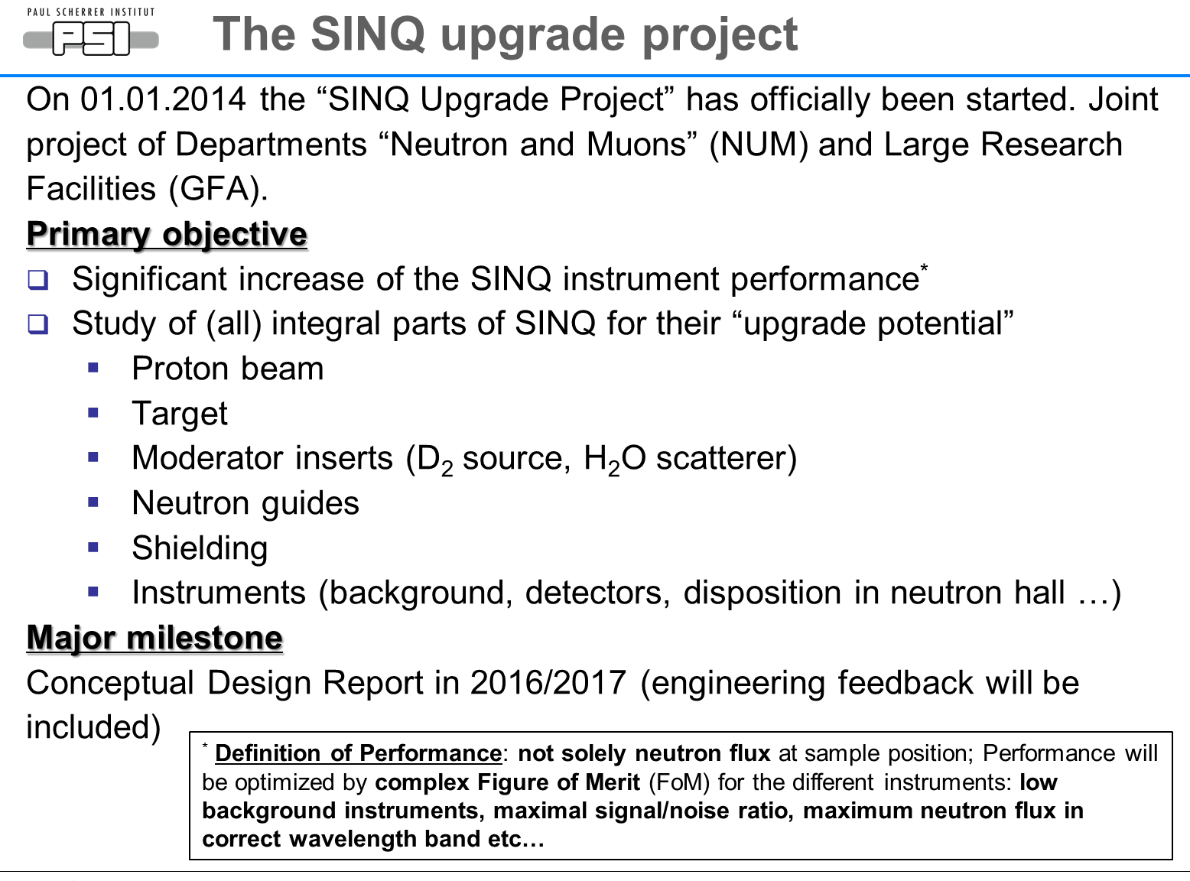
M. Wohlmuther, Feb. 2014

Slide 24
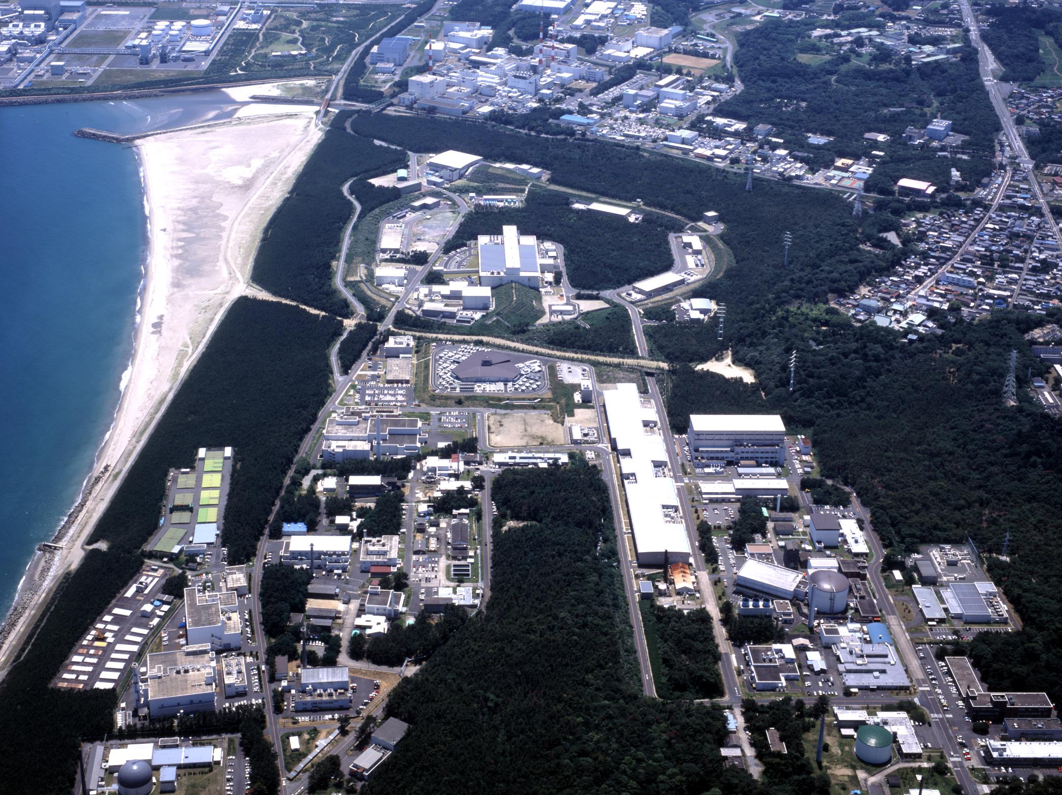
J-PARC serves multiple science missions
MLF: neutrons and muons
Hadrons
Neutrinos
ADS development
Materials & Life sciences Facility

Slide 25
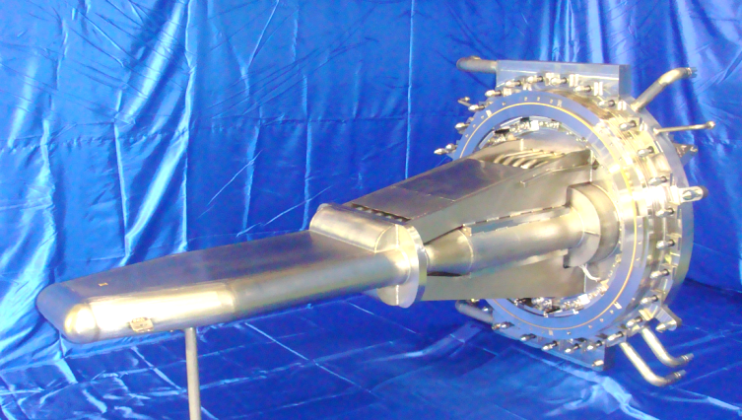
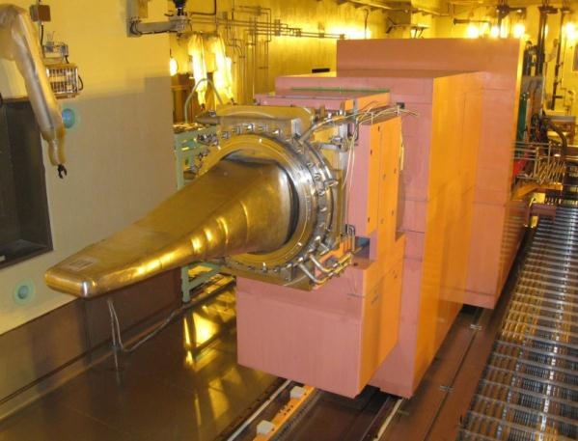
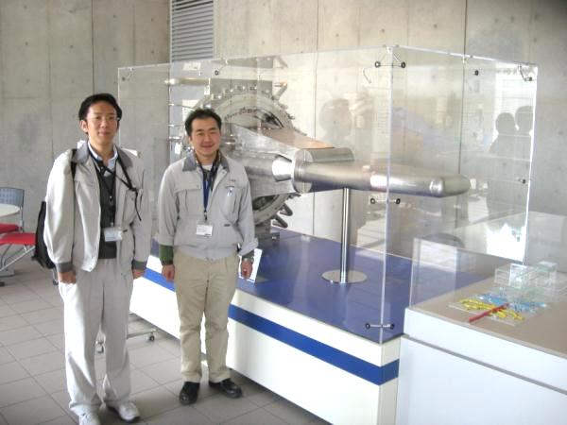
MLF neutron source at J-PARC - JSNS
3 GeV RCS, µs pulses to target at 25 Hz
Mercury, stationary SS316L vessel
Ca. 20 tons of mercury, circulates at 11 liters/sec
Magnetic pump, HX, storage tank all on target trolley

Slide 26
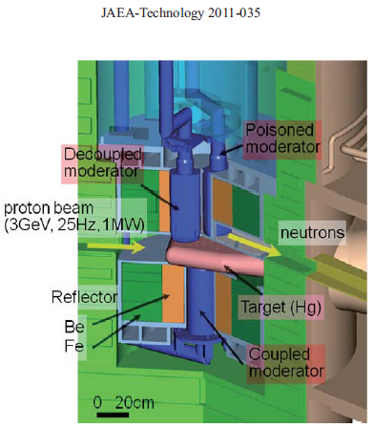
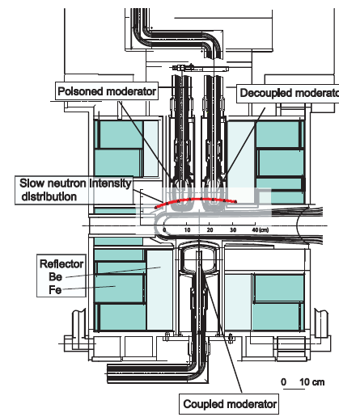
JSNS features 3 liquid hydrogen moderators
Large, coupled
  High time-integrated and pulse-peak intensities
  Requires LH₂ ortho→para catalyst
Decoupled
  Unique Ag-In-Cd de-coupler
    will be replaced by Au-In-Cd
  Sharply cuts neutron pulse tail for improved resolution
Decoupled & poisoned
  Cd poison plate
Moderators can be replaced independently of reflector plug

Slide 27
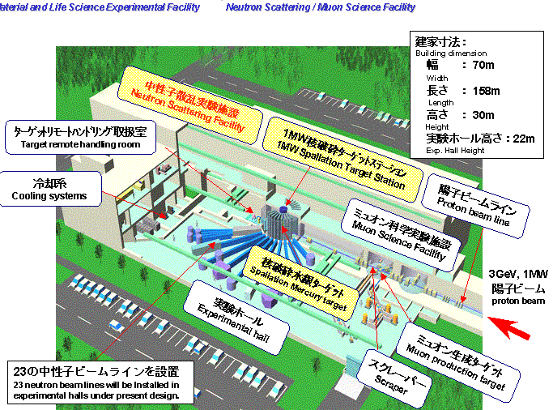
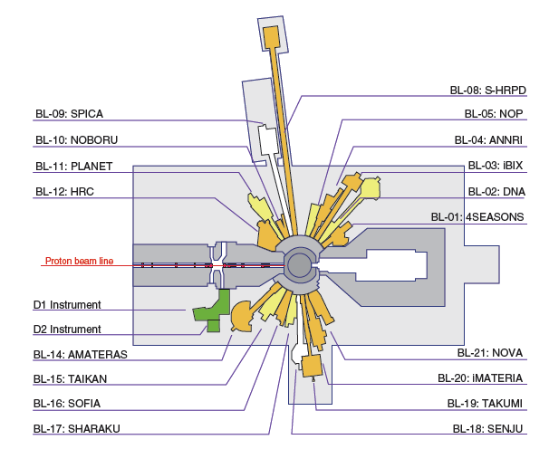
MLF neutron and muon sources
Running since 2008
20 / 23 neutron beam lines occupied or assigned
Time for a second target station!
Notes:
User ops started Dec. 2008

Slide 28
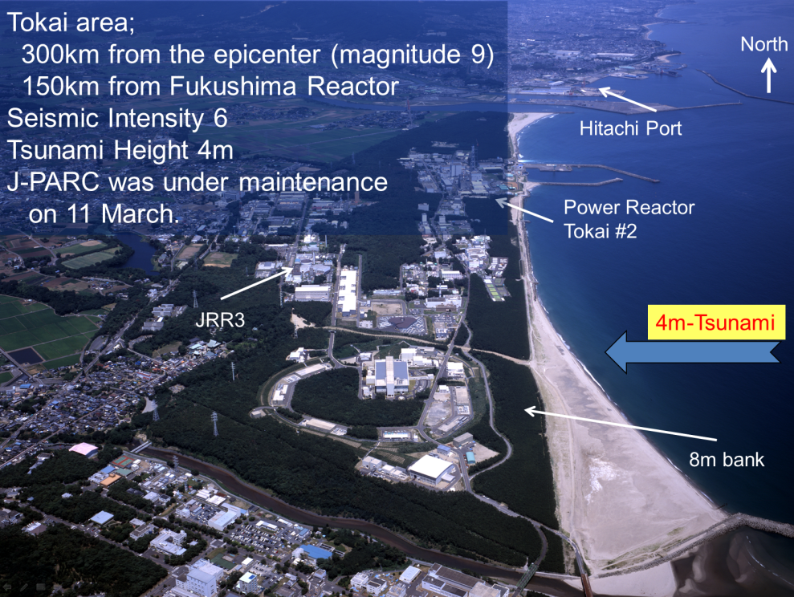
A couple of unfortunate events at J-PARC have held up neutron production
Great East Japan Earthquake, March 2011
  Phenomenal recovery
  Operations resumed in < 1 year
Hadron facility accident May 2013
  Beam extraction malfunction caused 5 ms extraction, vs. intended 2 s
    Gold target partly vaporized
    Spread of contamination
  Safety review of incident and all of operations at J-PARC
  Operations resumed in February 2014
Great East Japan Earthquake, March 11, 2011

Slide 29
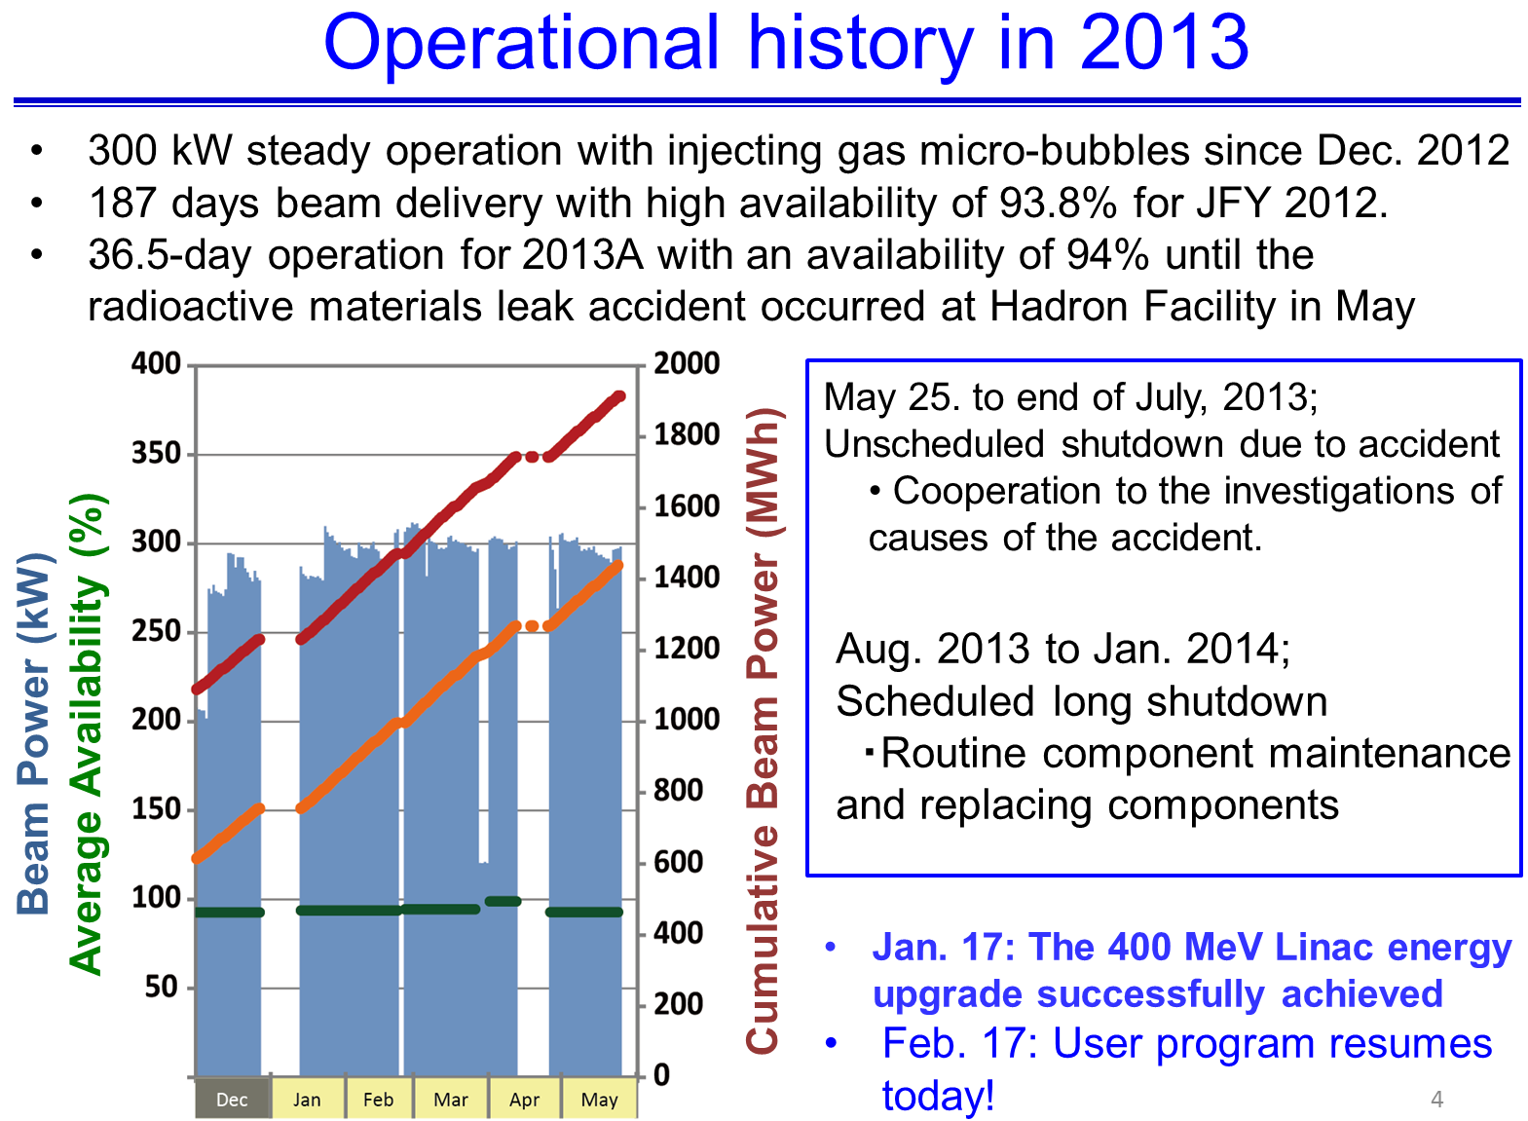
J-PARC
H. Takada, Feb. 2014
Goal: 1 MW before Spring 2016

Slide 30
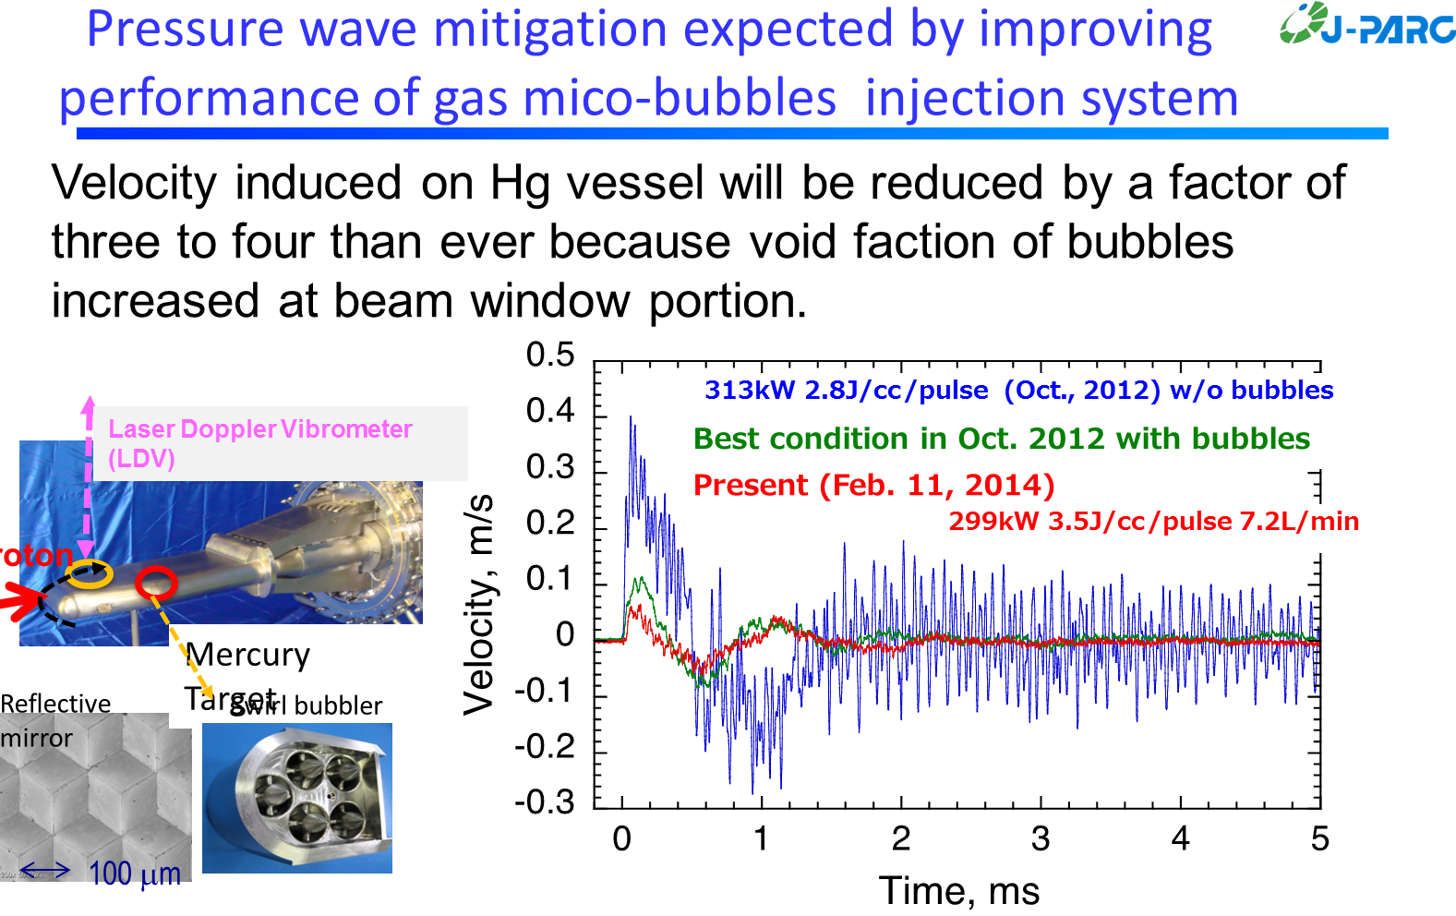
J-PARC is aggressively working mitigation of target pitting damage
Bubbler system operational
  Substantial suppression of target vibration associated with cavitation
New octupole magnet flattens beam on target & reduces energy density in mercury
Target post irradiation examination is pending
Double-wall beam window design in development
H. Takada et al.

Slide 31
SNS – running since 2006
Mission is focused on neutron science
1.4 MW accelerator, 1 GeV, linac & accumulator ring, µs pulses to target at 60 Hz
Notes:
Photo has been modified

Slide 32
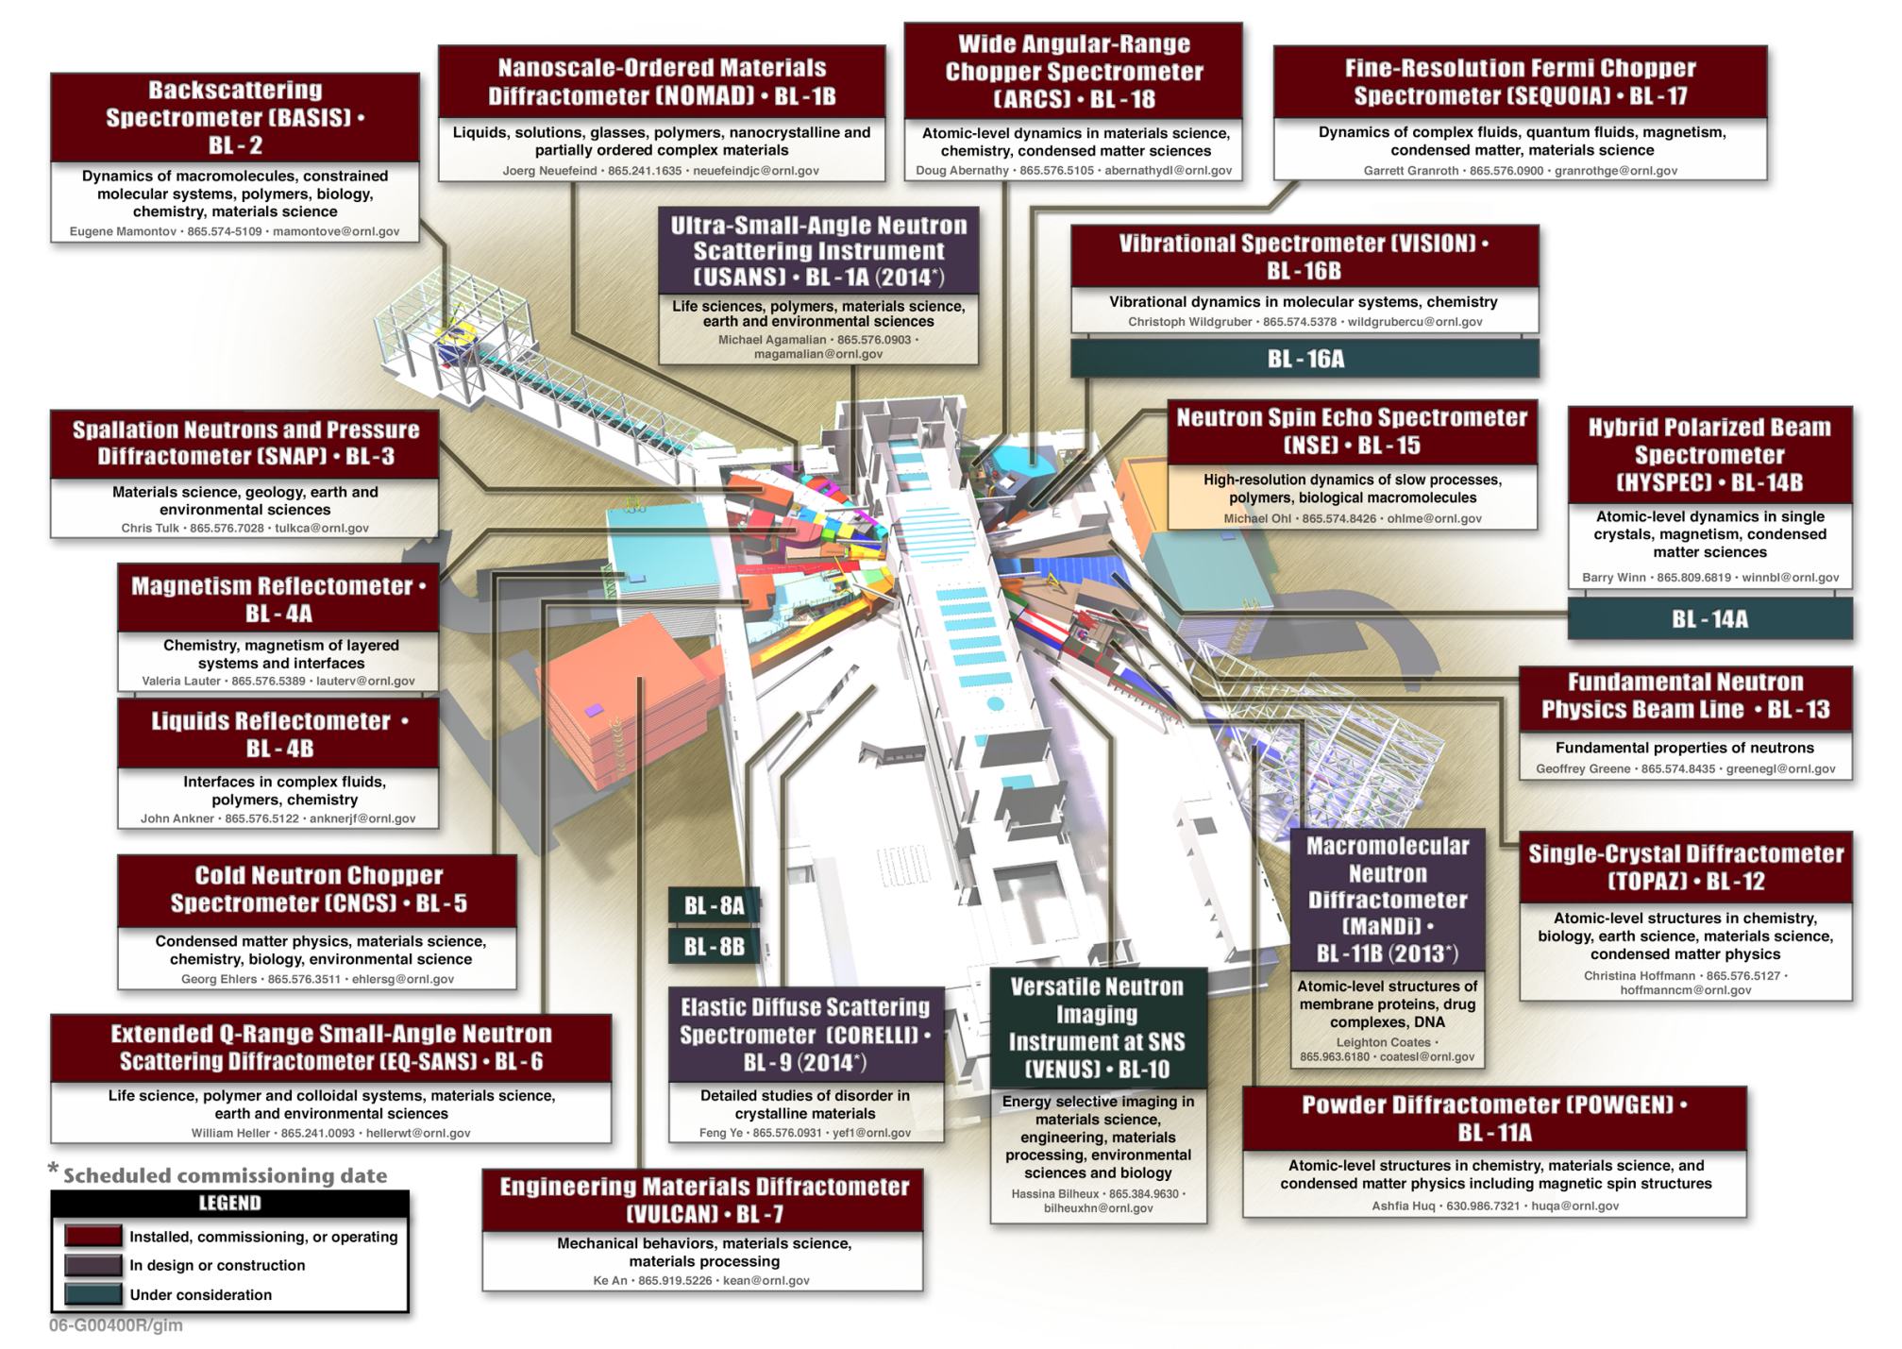
20 out of 24 beam-lines built or assigned
Neutron production schedule ~5000 h/y

Slide 33
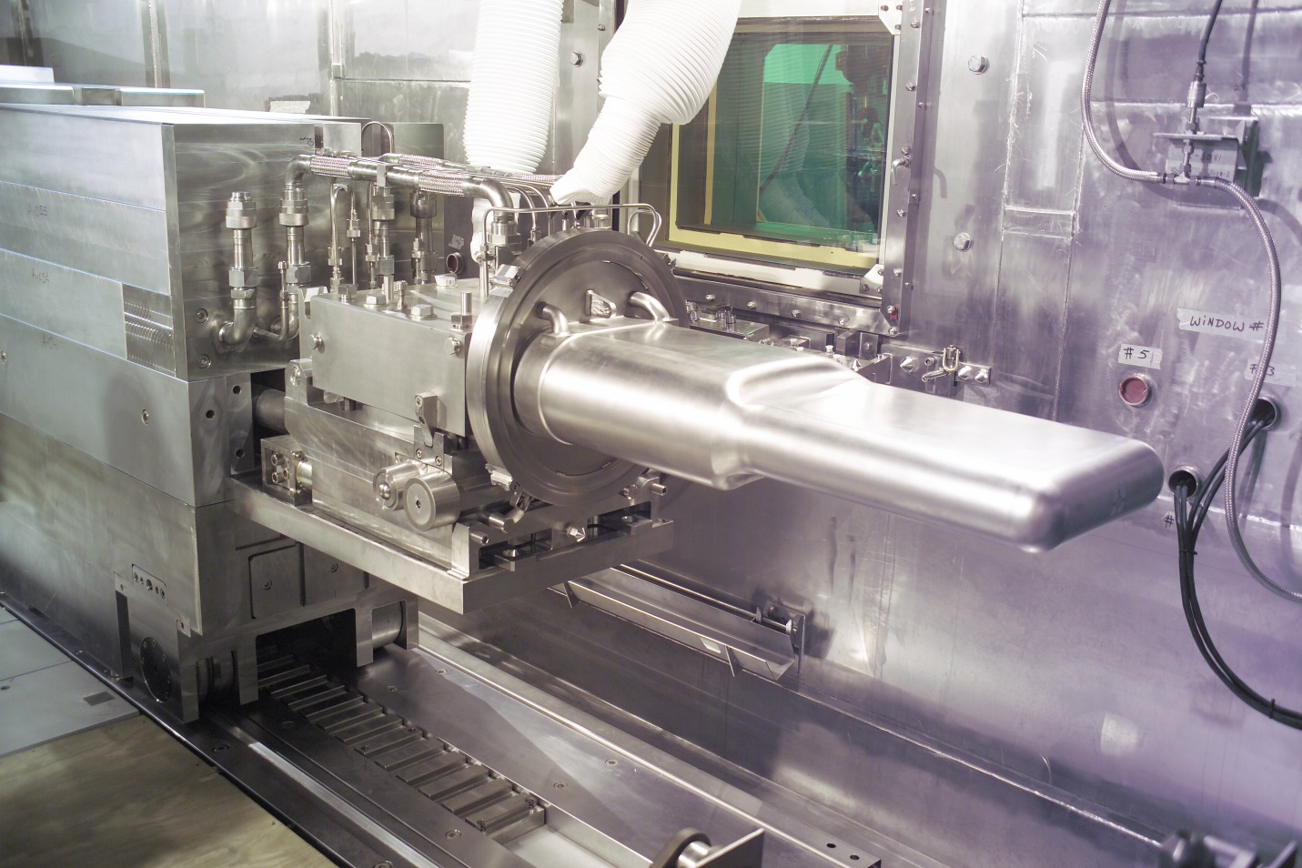
SNS mercury target
More than 20 tons of mercury circulating through a SS 316L target module
The target module is a replaceable component
  Administrative radiation damage limit is 10 dpa
Notes:
Approximate length is 2 m
Empty mass is about 1130 kg

Slide 34
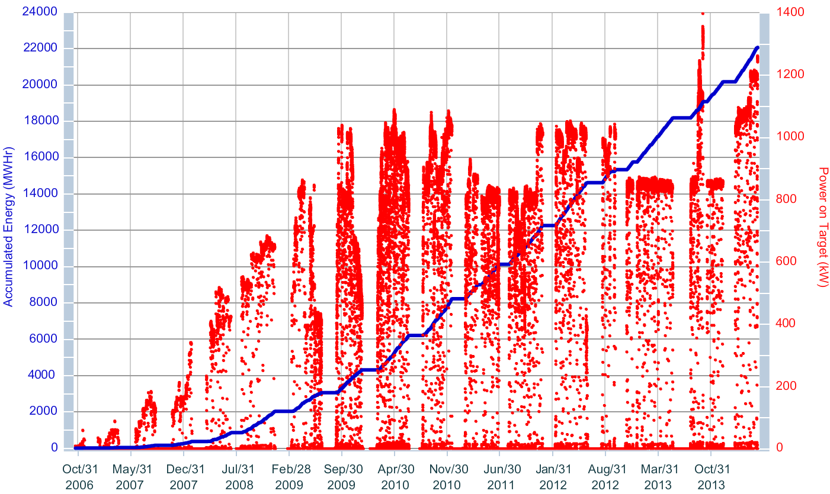
Power on target & accumulated energy
Major Remote Handling Component Replacements
- Target
2
3
4
5
6
7
8
- PBW
- Shutter
1
- CVI
Through
09May14
Notes:
09May14 power history plot
1.4 MW achieved September 2013, albeit briefly
Now running 1.25 MW

Slide 35
Target lifetime and power levels are improving – still room for more
10 dpa is reached at ~5000 MW-hrs
Cavitation / inclusions?
Weld defect
Weld defect

Slide 36
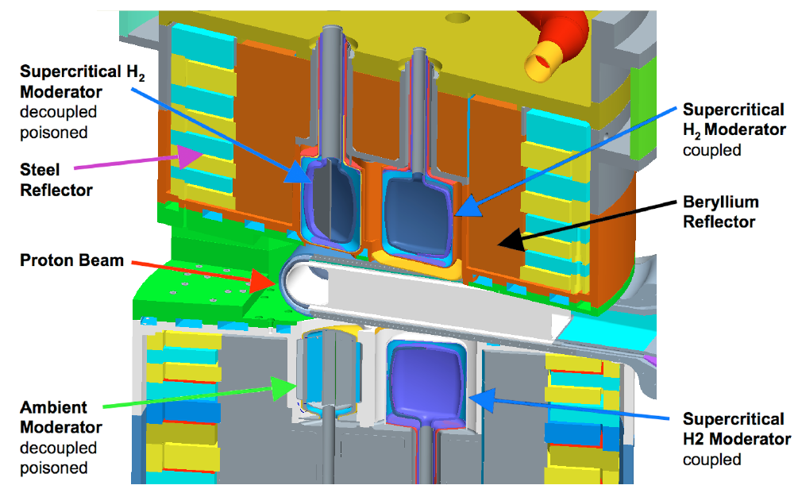
SNS has 3 liquid hydrogen moderators and 1 water moderator
Upstream moderators are decoupled and poisoned
Downstream are coupled, not large; no ortho→para catalyst
  Disadvantage vs. JSNS
  Next generation IRP to improve and enlarge top downstream moderator; catalyst equipment to be added

Slide 37
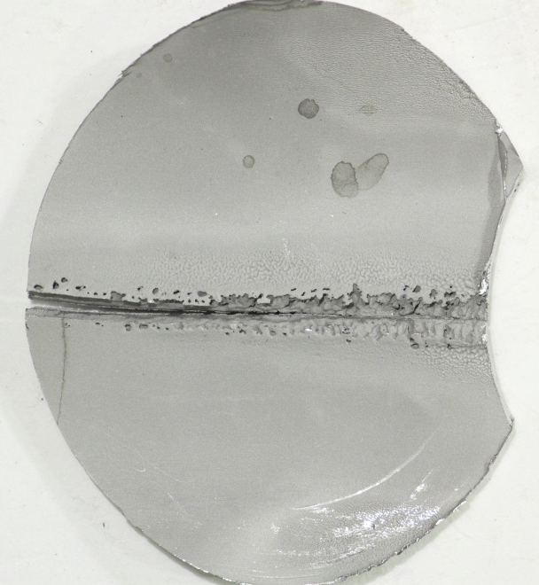
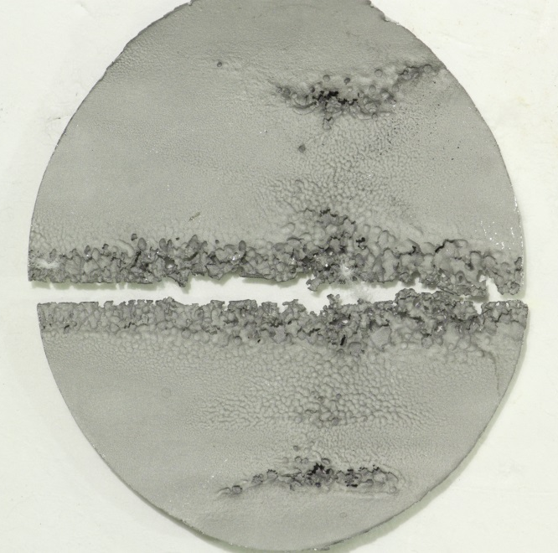
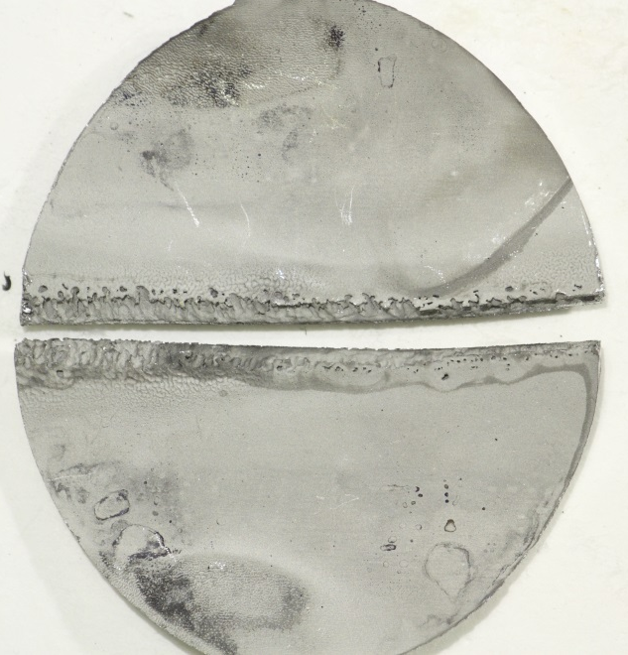
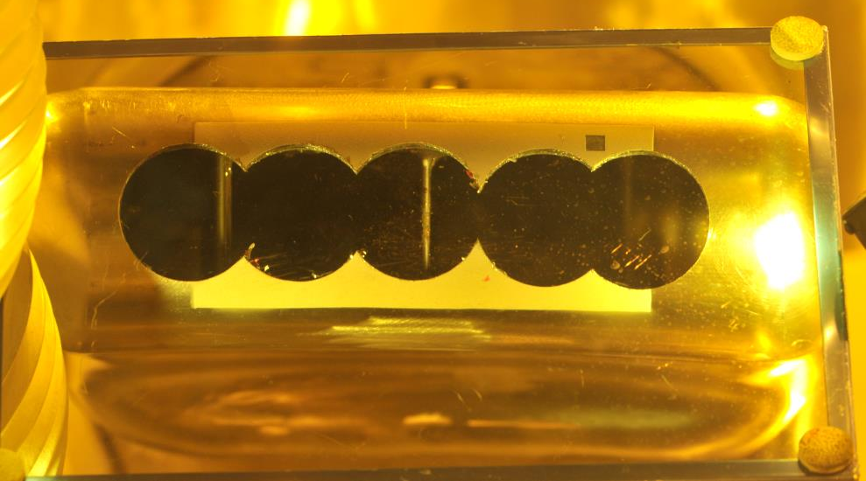
Target pitting damage is being monitored with PIE program
Target 8 mercury vessel beam entrance inner wall
Outer containment wall holds up much better
“Jet-flow” target design should reduce this damage
  Mitigation by flow – no gas injection
  First unit set for installation this summer

Slide 38
Final words on SNS
Upcoming IRP replacement in 2016 will be largest remote handling operation to date
Fusion Materials Irradiation Test Stand (FMITS) about to have 30% design review
Second Target Station Technical Design Study (TDR) is in preparation
  Up to 500 kW, 10 Hz, short-pulse, solid tungsten target – water-cooled
  Related accelerator upgrades will provide 2 MW to FTS

Slide 39
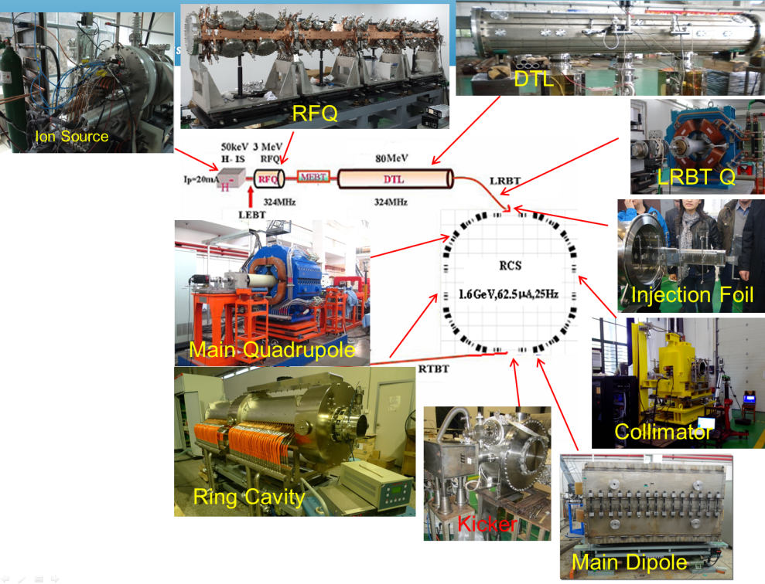
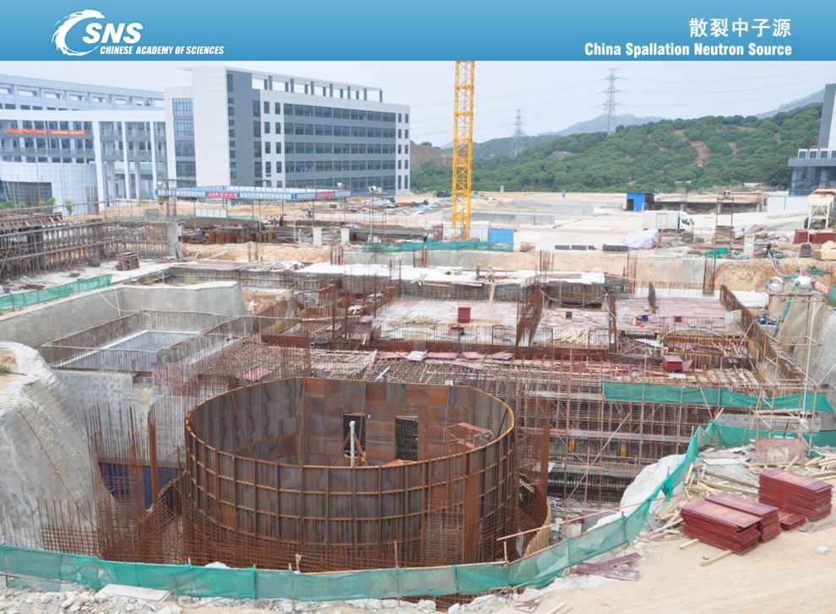
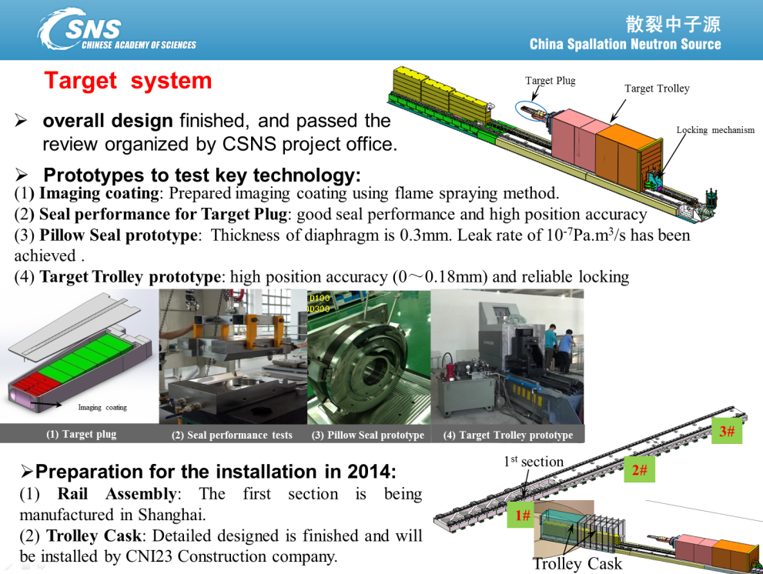
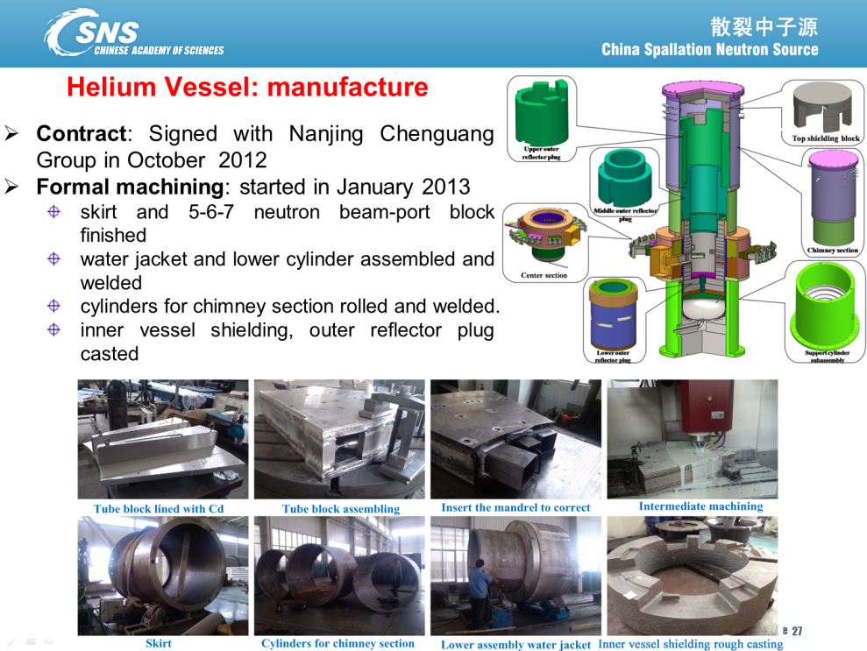
CSNS has taken off
Operational in 2018
25 Hz, SP, 100–200–500 kW, 1.6 GeV
Ta clad W plates target
X. Jia, Jan. 2014

Slide 40


ESS is gaining momentum
5 MW of 2.5 GeV protons
14 Hz, long-pulse (2.86 ms)
Rotating target of tungsten blocks – cooled by helium
More from Yong Joong Lee
R. Linander, ESS
(AccApp13)
2.5 m dia. target wheel

Slide 41
It’s harder to talk only about targets
Overall source performance is what matters
  How well does the source provide the desired beams for science instruments?
Integrated approaches to source design around specific instrument performance metrics, utilizing optimization techniques, can show new paths to high-performance
  TS-2 at ISIS
When isn’t higher target power the right direction for higher performance?
  Spallation sources
  Other high-power target applications

