Slide 1
Radiation damage calculation in PHITS
Radiation Effects in Superconducting Magnet Materials (RESMM'12), 13 Feb. – 15 Feb. 2012
Y. Iwamoto¹, K. Niita², T. Sawai¹,
R.M. Ronningen³, T. Baumann³
¹ JAEA , ²RIST, ³MSU/NSCL

Slide 2
contents
Introduction
Radiation damage model in PHITS
Radiation damage calculation
proton, heavy-ion, neutron incidences
Example of heat calculations
Summary

Slide 3
Introduction
As the power of proton and heavy-ion accelerators is increasing,
the prediction of the structural damage to materials under irradiation is essential.
The average number of displaced atoms per atom of a material DPA :
DPA=φ t σ
σ : the Displacement cross-section.
φt : the irradiation fluence.
For example, 10 dpa means each atom in the material has been displaced from its site within the structural lattice of the material an average of 10 times.
The Monte Carlo particle transport code systems have been developed for the radiation shielding design, radiation damage calculation, and so on.
PHITS, MARS, FLUKA, MCNPX…

Slide 4
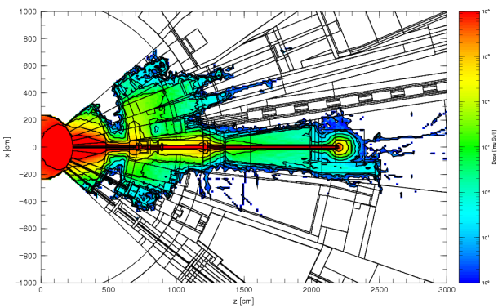
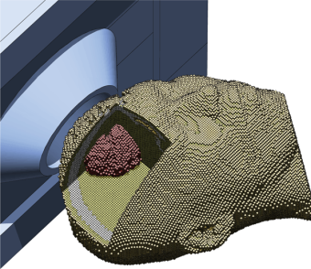
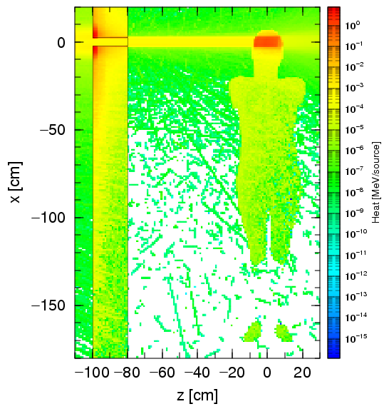
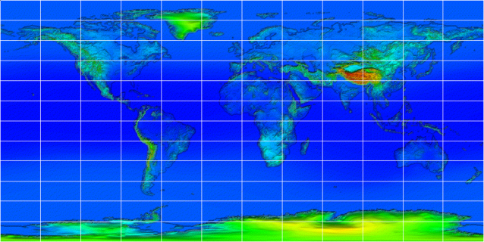
Introduction ~Overview of PHITS~
Particle and Heavy Ion Transport code System
Development
JAEA (Japan), RIST (Japan), KEK (Japan), Chalmers Univ. Tech. (Sweden)
Capability
Transport and collision of various particles over wide energy range
in 3D phase space
with magnetic field & gravity
neutron, proton, meson, baryon electron, photon, heavy ions
up to 100 GeV/n
Application Fields
Accelerator Design
Radiation Therapy
Space Application
http://phits.jaea.go.jp
available from NEA databank

Slide 5
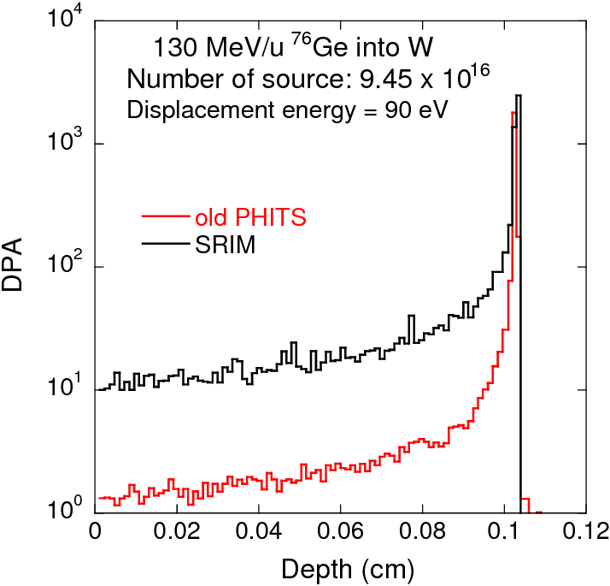
Introduction
Comparison old PHITS with SRIM
SRIM is most famous code in radiation damage study.
Coulomb scattering is implemented.
No nuclear reactions in SRIM.
Coulomb scattering in PHITS was not correct.
Calculated results by old PHITS are much smaller than SRIM one.
Purpose of this study
Improvement of radiation damage model
Radiation damage calculations using improved PHITS
Charged particle incidence
Reactor neutrons and 14 MeV neutrons incidence

Slide 6
contents
Introduction
Radiation damage model in PHITS
Radiation damage calculation
proton, heavy-ion, neutron incidences
Example of heat calculations
Summary

Slide 7
Overview of radiation damage model in PHITS
(2)Energy transfer to target recoil atom by Coulomb scattering
(1) Transport
(3)Cascade damage
approximation
projectile
target atom
Secondary particle
by nuclear reaction
Recoil atom
by Coulomb
target
Recoil atom
Recoil atom
by nuclear elastic scattering
Notes:
Now I would like to talk about overview of radiation damage model in PHITS.
There are three parts for calculations, transport calculation including nuclear reaction, Coulomb scattering by projectile and secondary, and Cascade damage approximation produced by target recoil atom.
The problem in old PHITS was Coulomb scattering was not correct.

Slide 8
Radiation damage model in PHITS(1)
(2) Energy transfer to target recoil atom with
Coulomb scattering
(1)Transport
(3)Cascade damage
approximation
projectile
Secondary particle
by nuclear reaction
Recoil atom
by nuclear elastic scattering
 | Models in PHITS
Collision distance between particles | Total reaction cross section produced by systematic formula
Stopping power dE/dx and ranges | SPAR based on Bethe formula
Nuclear reaction E>20MeV, all particles | Intra-nuclear cascade model
E<20MeV, low energy neutron | Nuclear data, event generator
Notes:
This slide shows the first part of radiation damage model in PHITS, transport including nuclear reaction.
Collision distance is calculated using the total reaction cross section produced by Shen’s formula.
SPAR calculates Stopping power and ranges.
Nuclear reaction produces secondary particles using nuclear physics models JQMD or JAM.
Low energy neutron incident reaction are simulated using event generator mode.
Details are in this paper.
Next slide describes the method of Coulomb scattering.

Slide 9
Radiation damage model in PHITS(2)
Improvement
(2) Energy transfer to target recoil atom with
Coulomb scattering
(3)Cascade damage
approximation
(1)Transport
projectile
E_{p} :kinetic energy, (Z₁, M₁)
Coulomb elastic scattering
secondary
T: transferred energy, (Z₂, M₂)
Recoil atom
by Coulomb scattering
The Coulomb scattering part, which alone leads to the deflection of the projectile and secondary, is described by classical scattering theory using the screening functions f(t^{1/2}).
Thomas-Fermi λ=1.309, m=1/3, q=2/3
Dimensionless collision parameter t=
Dimensionless energy ε=
Transferred energy from projectile
and secondary to target atom
Notes:
The second part is energy transfer to target recoil atom with Coulomb scattering.
The Coulomb scattering part, which alone leads to the deflection of the projectile and secondary, is described by classical scattering theory using the screening functions f(t^{1/2}).
This is the differential Coulomb scattering, screening function, and dimensionless collision parameter.
The important point here is that Dimensionless parameter t include information of energy, emitted angle, and distance between nucleus.
Transferred energy from projectile and secondary to target atom is described as this equation.
Next slide describes the Cascade damage approximation produced by the target PKA .

Slide 10
Radiation damage model in PHITS(3)
Improvement
(2) Energy transfer to target recoil atom with
Coulomb scattering
(3)Cascade damage
approximation
(1)Transport
Damage energy
Number of defects developed by NRT
M.J. Norgett, M.T. Robinson and I.M. Torrens: Nucl. Engineering and Design, 33, 50 (1975).
Integrating using dimensionless collision parameter t
Number of defects developed by NRT
T_{d}: the value of the threshold displacement energy. 30 eV for Cu and 90 eV for W
Notes:
damage cross section produced by the target PKA is expressed by folding with Coulomb scattering cross section and number of defects predicted by NRT.
The important point here is that This function is integrated using dimensionless collision parameter.
Therefore, damage cross section is estimated event by event easily.
Where Td is the value of the threshold displacement energy, and these values are 30 eV for Cu and 90 eV for W in this work.
That’s all I have to say about DPA model in PHITS.
Next, I’d like to move on to results and comparison.

Slide 11
contents
Introduction
Radiation damage model in PHITS
Radiation damage calculation
proton, heavy-ion, neutron incidences
Example of heat calculations
Summary

Slide 12
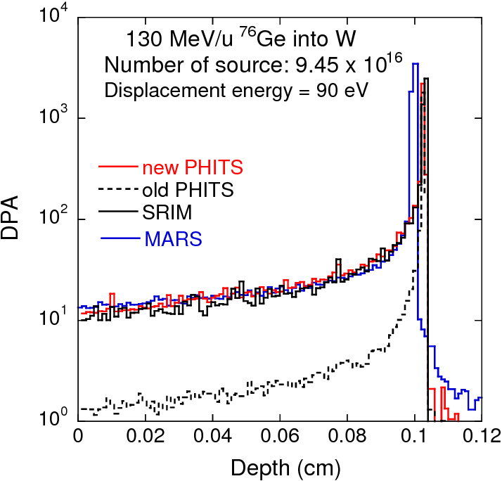
Comparison new PHITS with other code
DPA=φ t σ_{damage}
MARS result:
Courtesy Nikolai Mokhov
MARS also folds with Coulomb scattering and nuclear reaction.
Agreement is very good except for old PHITS.
Notes:
This graph shows the DPA distribution to target depth for the reaction of 130 MeV/u 76Ge incident on W.
Dashed line indicates results by old PHITS and other lines are new PHITS, TRIM and MARS.
Nikolai gave me MARS results. MARS also folds with Coulomb scattering and nuclear reaction.
As you can see, agreements is good except for old PHITS, and Coulomb scattering is important to calculate DPA for this reaction.
.

Slide 13
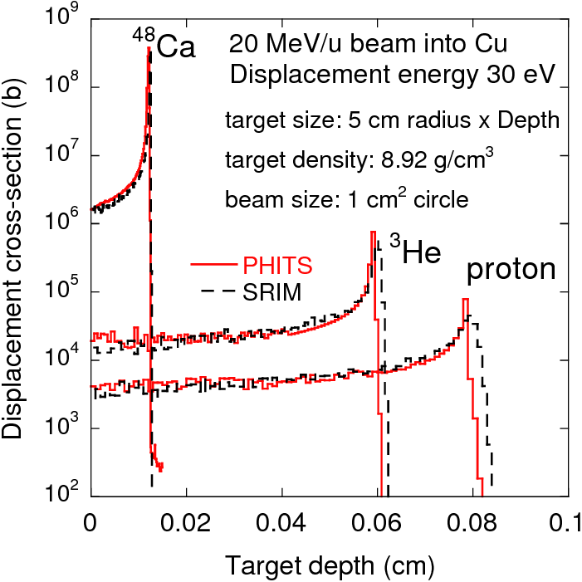
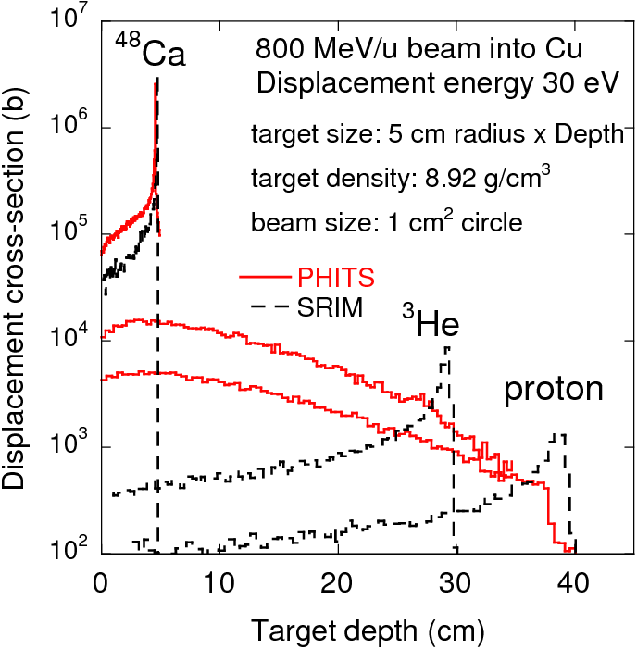
Displacement cross section to target depth
The beam range in materials is less than the mean free path for nuclear reactions.
Nuclear reactions occur before stopping range is reached.
The curves show the characteristics of well-developed hadronic cascades.
Damage calculations without nuclear reaction lead to sever underestimation where projectile energy is high enough to create nuclear reactions.
Notes:
The next slide shows the comparison PHITS with TRIM for 20 MeV/u beam.
The particle is Ca, He and proton. Cu target and W target.
At 20 MeV/u, the beam range in materials is less than the mean free path for nuclear reactions.
For Cu target, new PHITS results gives good agreements with TRIM ones.
For W target, cross-section of new PHITS is smaller than that of TRIM by the factor of about two. It may comes from the defect production efficiency in PHITS.

Slide 14
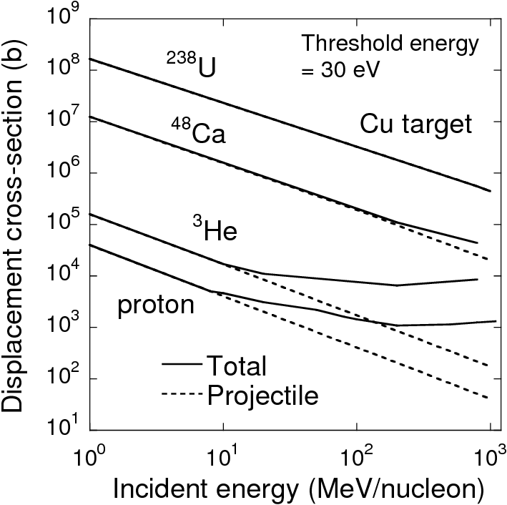
Displacement cross section using PHITS for proton, ³He, ⁴⁸Ca and ²³⁸U
Dash line:
Radiation damage produced by
recoil target atom created by projectile.
For proton and ³He beams, contribution of Coulomb scattering by recoil atom created by the secondary particles increases with energies.
For ⁴⁸Ca and ²³⁸U, the contribution of recoil atom created by the secondary is small.
Displacement cross section of heavy ion is much higher than that of light ion.
Notes:
This is the last slide for the results.
The graph indicates the systematic of incident particles, proton, He, Ca and U for copper target.
For proton and ³He beams, contribution of Coulomb scattering by PKA created by the secondary particles increases with energies.
On the other hands, For ⁴⁸Ca and ²³⁸U, the contribution of PKA’s created by the secondary is small.

Slide 15
Radiation damage for neutron
(1) Transport
(2)Energy transfer to recoil atom with Coulomb scattering
(3)Cascade damage
approximation
(1) Transport
neutron
target atom
Secondary particle
by nuclear reaction
Recoil atom
by Coulomb
neutron
target
Recoil atom
Recoil atom
by nuclear elastic scattering
Notes:
This slide shows neutron incident reactions.
In th transport part, neutron produces secondary particle by nuclear reaction and recoil atom by elastic scattering.
And energy of these particles transfer to recoil atom with Coulomb scattering.
For the neutron incident radiation damage, recoil target atom with Coulomb scattering is dominant.
Therefore it is very important to estimate the production of secondary particles and recoil atom by nuclear reaction and elastic scattering.
These graphs show the cross sections for neutron incident on Al.
We can see that elastic scattering is dominant below 1 MeV, and nuclear reaction is dominant above 10 MeV.

Slide 16
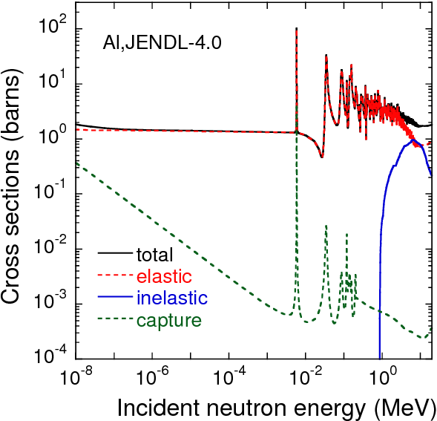
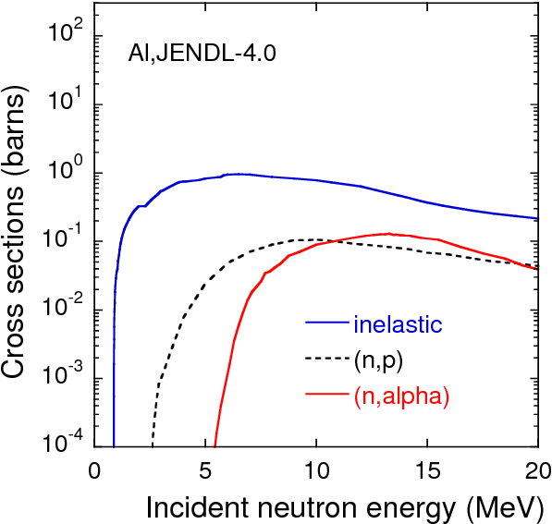
Cross sections for neutron incidence on Al
Elastic scattering is dominant below 1 MeV.
Nuclear reaction is dominant above 10 MeV.
Notes:
This slide shows cross sections for neutron incidence on Al.
This slide shows cross section for the low energy and high energy.

Slide 17
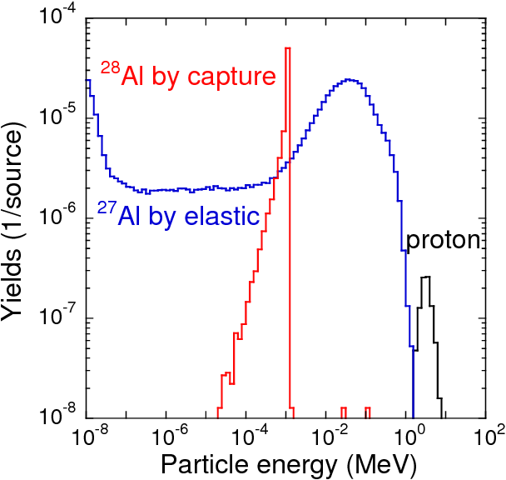
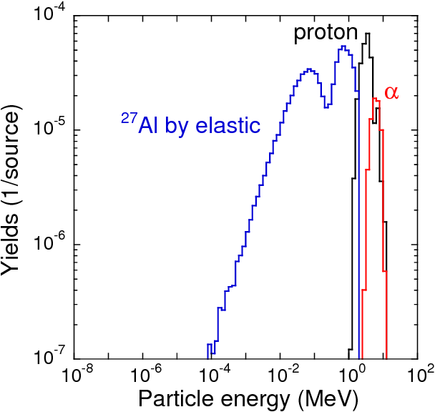
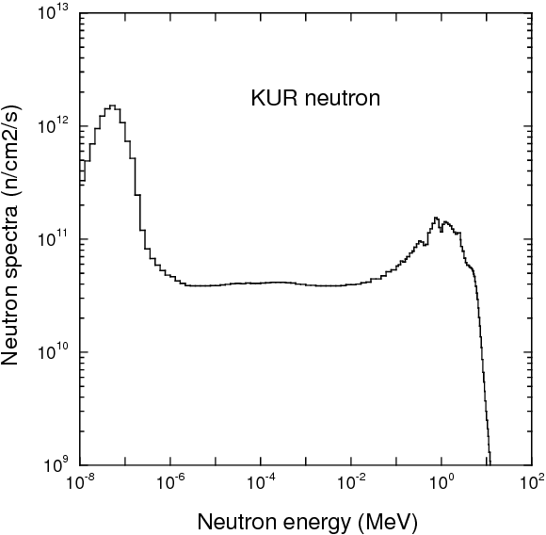
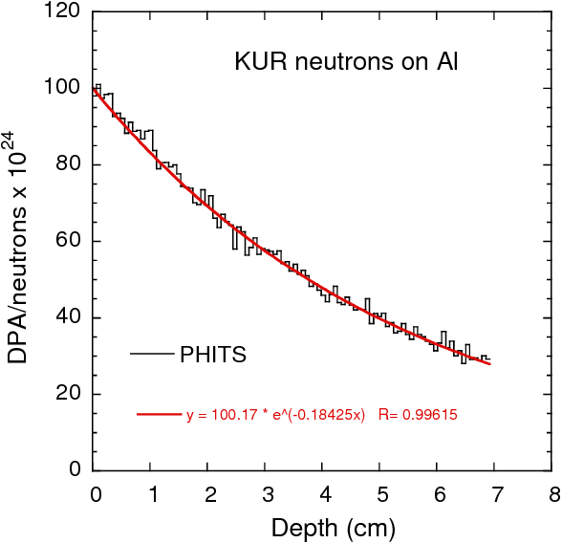
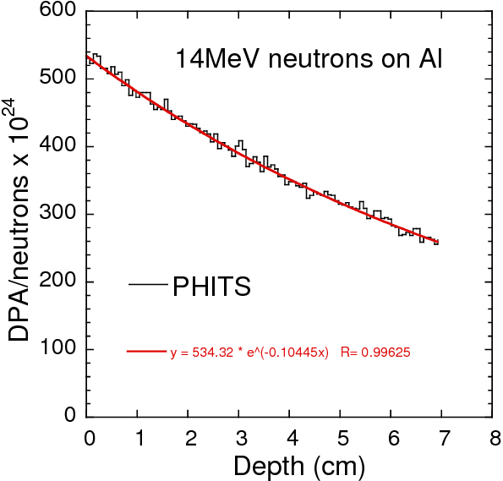
Example of dpa calculation
Particle production in target by PHITS
Calculation condition
Reactor neutrons in Kyoto U.
KUR neutrons
14MeV neutrons
target
Al: 1mmx1mm
x50mm
Al
target
14MeV neutrons
Elastic scattering and capture are dominant.
DPA distribution in target
KUR neutrons
14MeV neutrons
PHITS can calculate detail
dpa distribution in a target.
SRIM code cannot calculate
dpa for neutrons.
DPA value decrease
with depth, exponentially.
PHITS
PHITS
fit
fit
Notes:
This is calculation using KUR neutrons.
This graph shows the energy spectrum of KUR neutrons.
Neutorn hits Al and Cu targets.
These are the energy spectra of particle produced by PHITS.
We can see that elastic scatttering and capture are dominant.
Finally, we obtained the DPA distribution to depth.

Slide 18
contents
Introduction
Radiation damage model in PHITS
Radiation damage calculation
proton, heavy-ion, neutron incidences
Example of heat calculations
Summary

Slide 19
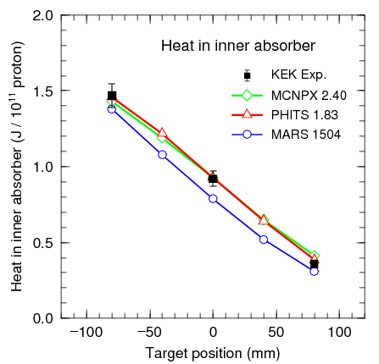
Heat
Benchmark test of HEAT(1) : compared with KEK experiment
Proton beam at 12 GeV
Exp. and Cal. by H. Ohnishi et al.
Nucl. Instr. and Meth. A545 (2005) 88.
12 GeV
MCNPX: calculated by N. Matsuda
PHITS results give good agreement with the experimental data.
Notes:
I show benchmark test of heat load compared with KEK experiments.
12GeV protons produces secondary particles in targets and secondary particle hit the inner absorber.
This graph shows the heat load in inner absorber to target position.
We can see that agreements is good between the codes.

Slide 20
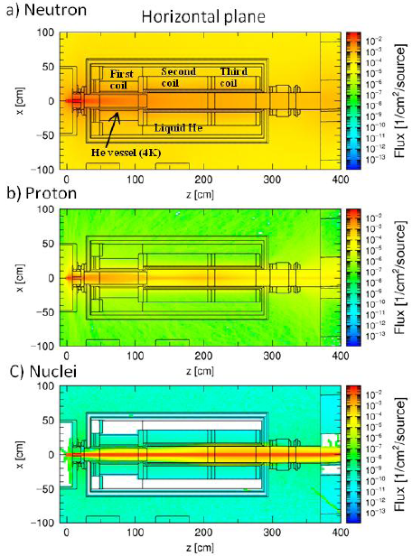
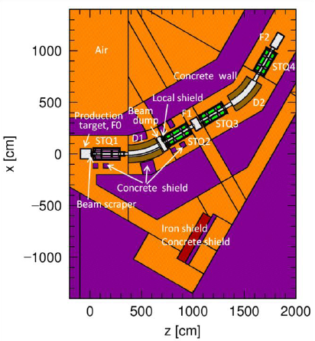
Benchmark test of HEAT(2) : compared with RIKEN experiment
PHITS calculation and experiments for Heat load to the STQ1 cryostat
Calculation model of the BigRIPS separator
Calculated flux intensity of particle around STQ1
⁴⁸Ca beam at 345 MeV/nucleon
STQ1:Superconducting triplet pole
neutron
proton
nuclei
Exp. and Cal. by T. Ohnishi et al.
Progress in Nuclear Science and Technology (2011) 416.
Neutrons are produced at the target,and pass through STQ1.
Notes:
Next is PHITS calculation and experiments for heat load

Slide 21
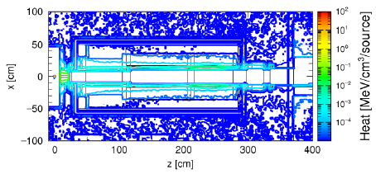
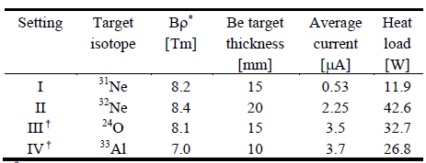
Benchmark test of HEAT(2) : compared with RIKEN experiment
Heat load distribution around STQ1
Heat load mainly distributes at the inner duct.
Experimental condition and measured heat load to the STQ1 cryostat
Heat load(PHITS)
[W]
12.0
63.8
45.9
34.4
Estimated results are about 1.3 - 1.5 times larger than the measured heat loads.

Slide 22
Summary
The radiation damage model using Coulomb scattering in PHITS has been improved.
Damage calculation only by recoil target atom directly created by the projectile lead to sever underestimation where projectile energy is high enough to create nuclear reactions.
Energy distributions of particles produced by elastic scattering and nuclear reactions are important to determine the DPA values.
PHITS is a powerful code to calculate DPA value and heat load to the material.

