Slide 1
Operational Experience for High Power Spallation Targets
John Haines, Bernie Riemer (ORNL),
Masatoshi Futakawa (JAEA),
Werner Wagner and Michael Wohlmuther (PSI)
4th High Power Targetry Workshop
Malmö, Sweden
May 2, 2011

Slide 2
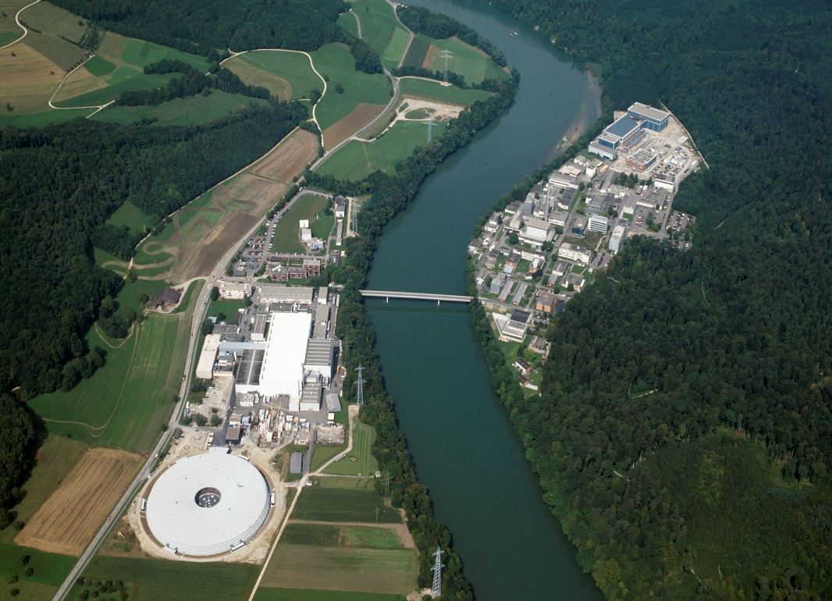
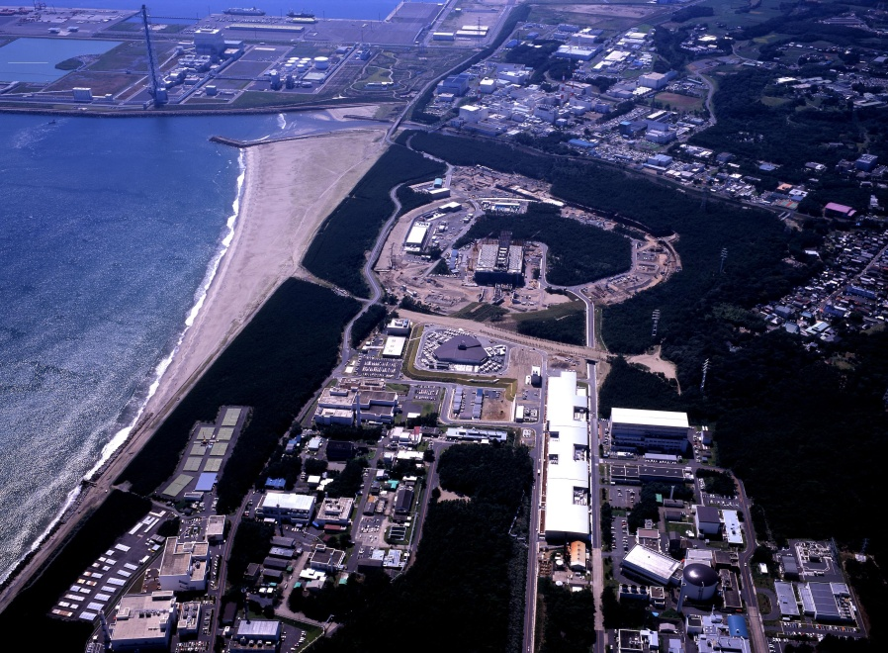
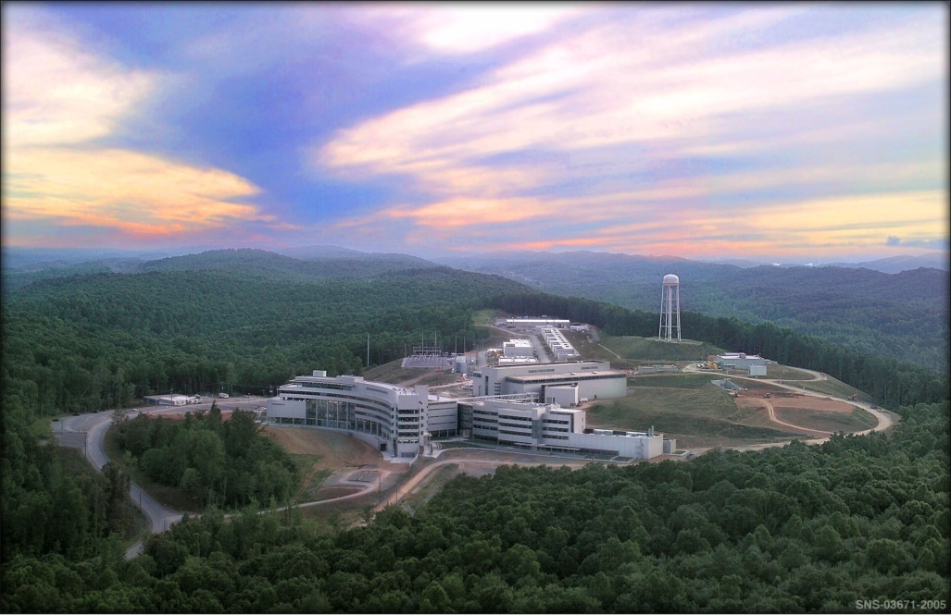
MW-Class Spallation Targets
SINQ at the Paul Scherrer Institut (PSI)
SNS at the Oak Ridge National Laboratory (ORNL)
JSNS at the Japan Atomic Energy Agency (JAEA)

Slide 3
SINQ experience

Slide 4
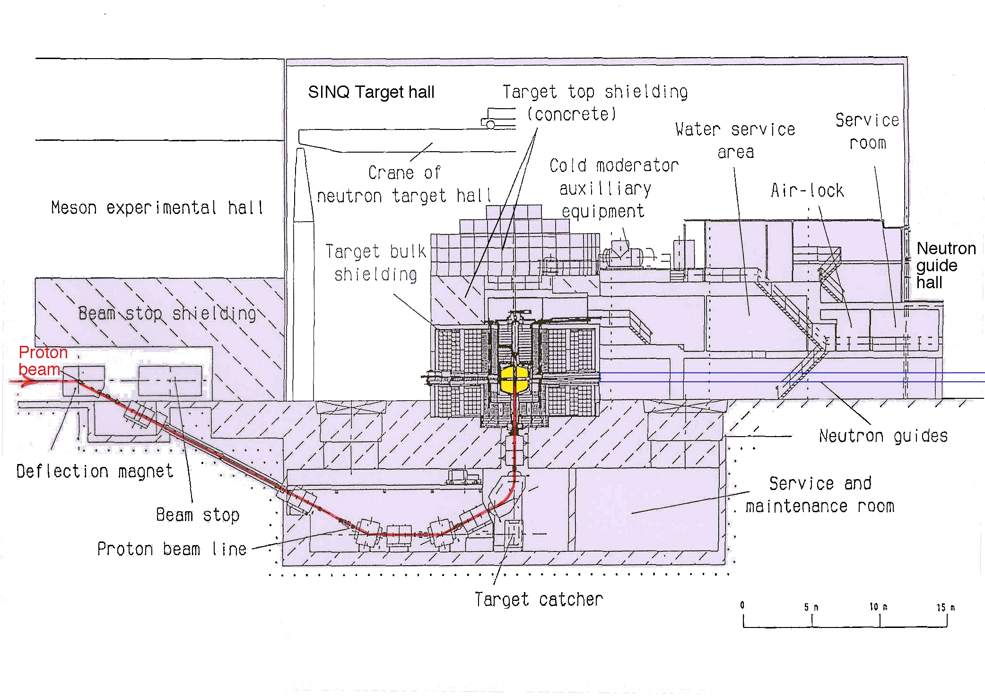
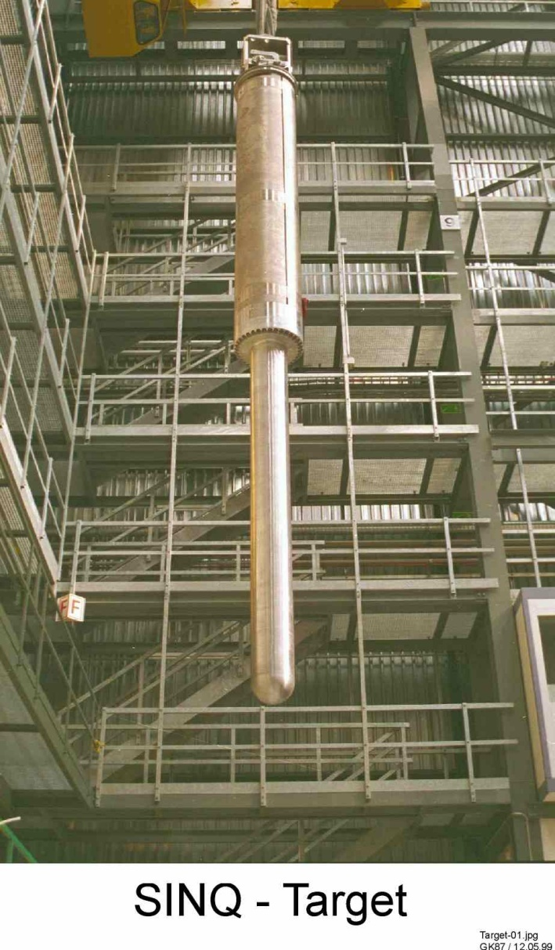
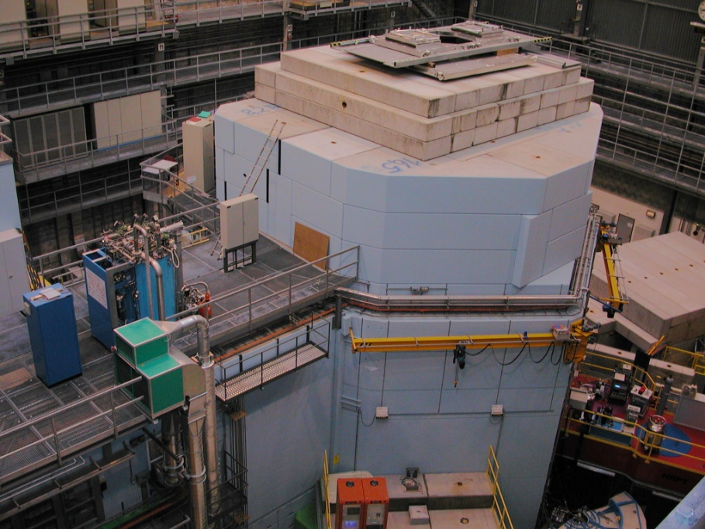
SINQ Facility
SINQ Target Station
Proton beam:
CW
590 MeV
~ 1.5 mA ⇒ 0.9 MW
Target bulk shielding

Slide 5
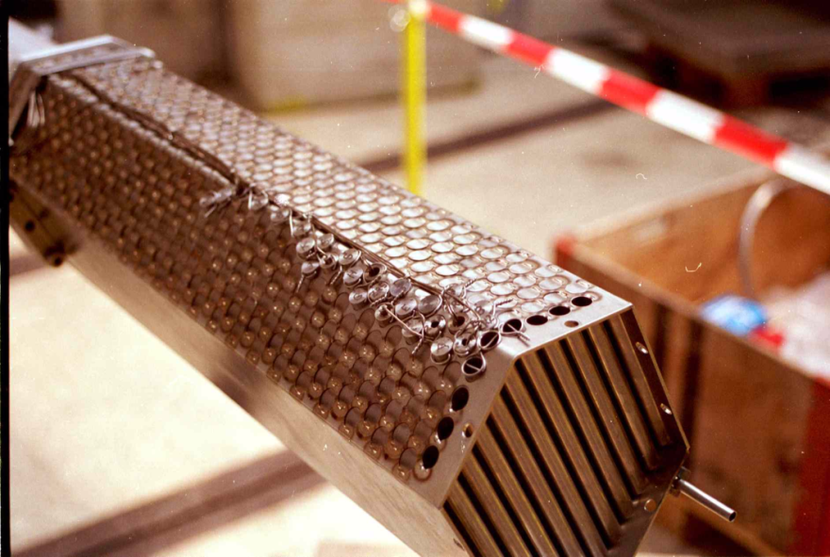
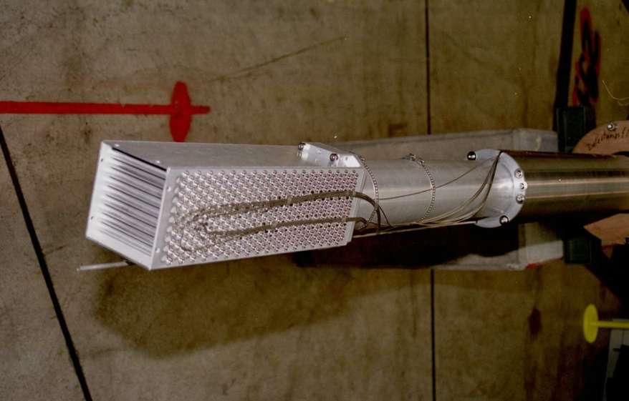
Target Evolution at SINQ
1997-1999: SINQ Target Mark 2
Water-cooled Zircaloy rods
2000 - 2009:SINQ-Target Mark 3:
Lead rods, with steel clad
42% increase in neutron yield
Aug- Dec 2006: MEGAwatt Pilot Experiment:
Joint international initiative to design,
build, licence, operate and explore
a liquid metal spallation target
for 1 MW beam power

Slide 6
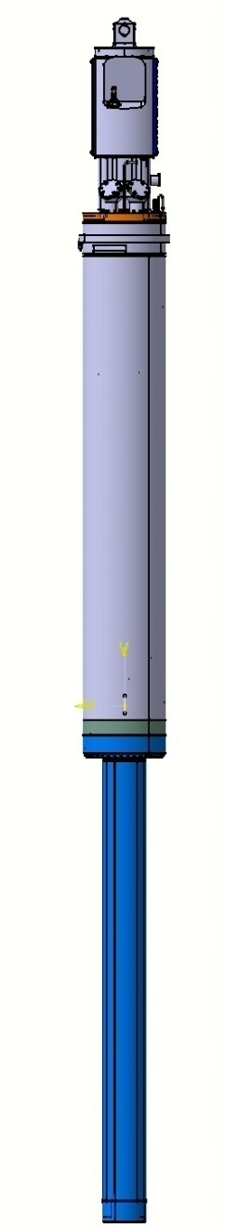
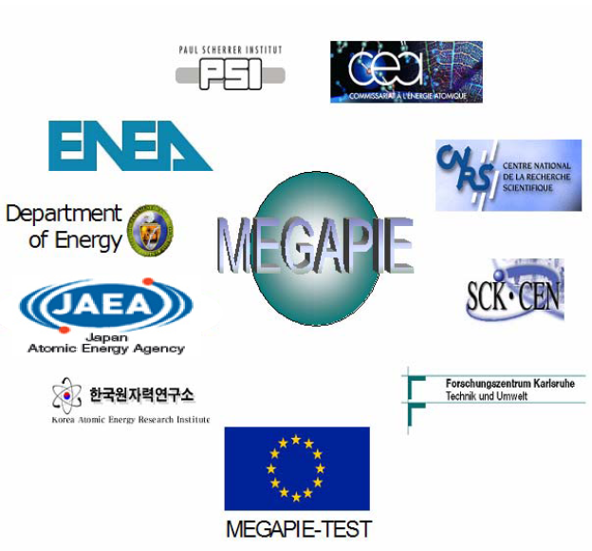
MEGAPIE
A liquid metal target for SINQ
MEGAwatt Pilot Experiment:
Lead-Bismuth-Eutectic (LBE, T_{m}=125ºC)
Increase the neutron flux at SINQ
Demonstrate the feasibility of a liquid metal target for high-power spallation and ADS applications

Slide 7
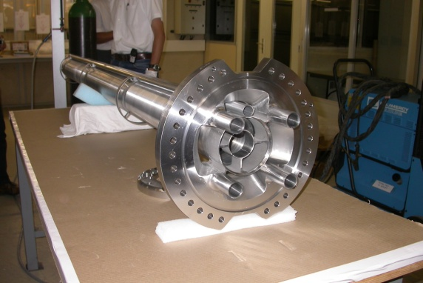
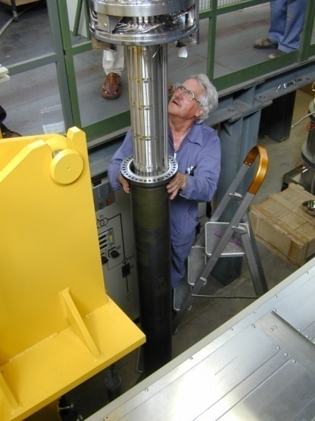
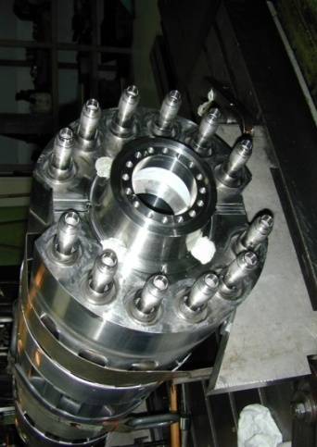
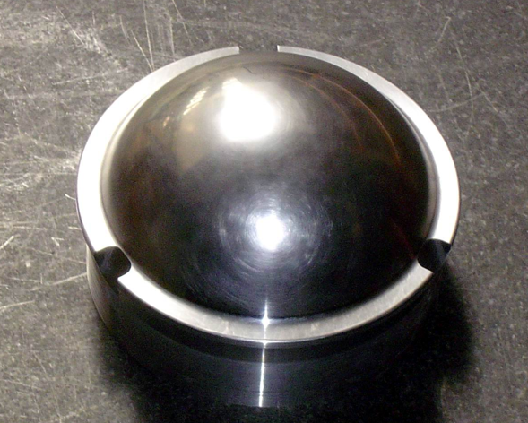
MEGAPIE (Pb-Bi) Target Features
target
head
lower target
assembly
central flow
guide tube
electro-
magnetic
pumps
heat
exchanger
safety
hull
beam
window

Slide 8
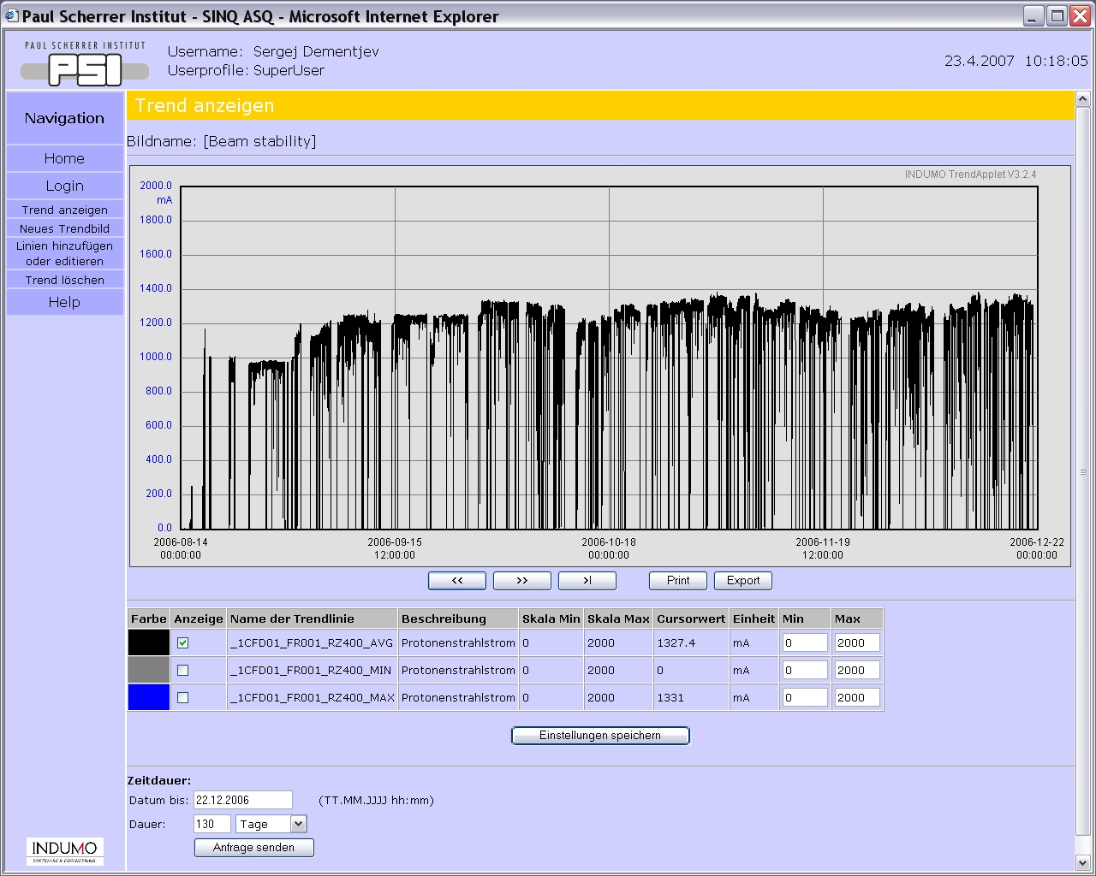
MEGAPIE Target Operated Continuously for Four Months
On beam: August 14 – December 21, 2006
Accumulated charge: 2.8 Ah
Peak Current: 1400 μA
Beam trips (< 1 min): 5500
Interrupts (< 8 h): 570
First protons on target August 14, 2006
PIE will be discussed in Wagner presentation
First protons on target, August 14

Slide 9
MEGAPIE Target Enhanced SINQ Neutron Flux
Fluxes measured by Au foil activation (in neutrons/cm²/s/mA)
 | SINQ 2005 | Err. (%) | MEGAPIE 2006 | Err. (%) | ratio
ICON | 3.80E+8 | ~5 | 6.89E+8 | ~5 | 1.81
NEUTRA | 2.59E+7 | ~5 | 4.80E+7 | ~5 | 1.85
EIGER | 6.46E+8 | ~5 | 1.04E+9 | ~5 | 1.61
NAA | 5.82E+12* | ~5 | 1.04E+13 | ~5 | 1.79

Slide 10
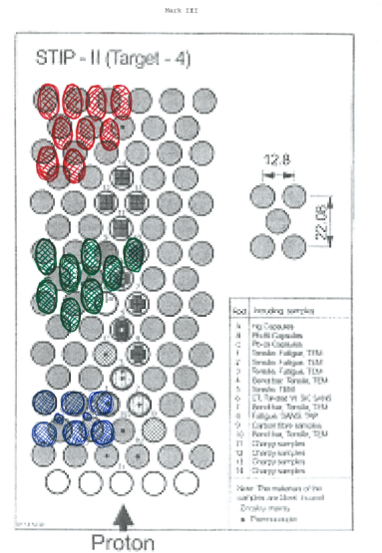
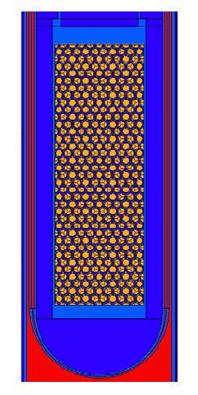
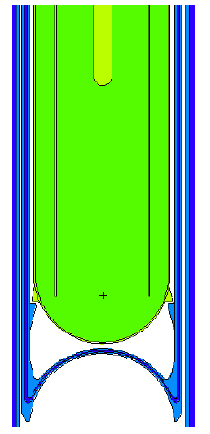
Improvement options for the solid Pb canneloni target
predicted gain
Zr cladding (replacing steel)
compaction: closer rod-packing (2 mm gap ⇨ 1.2 mm)
thinner tube wall (0.75 mm ⇨ 0.5 mm)
Pb-reflectors filling the gap around the canneloni structure
inverted calotte of safety hull
No (or less) STIP samples
→ 10-13%
→ 5%
→ 5%
→ 10%
→ 5%
→ 10%
∼50%
Scetch from Knud Thomsen

Slide 11
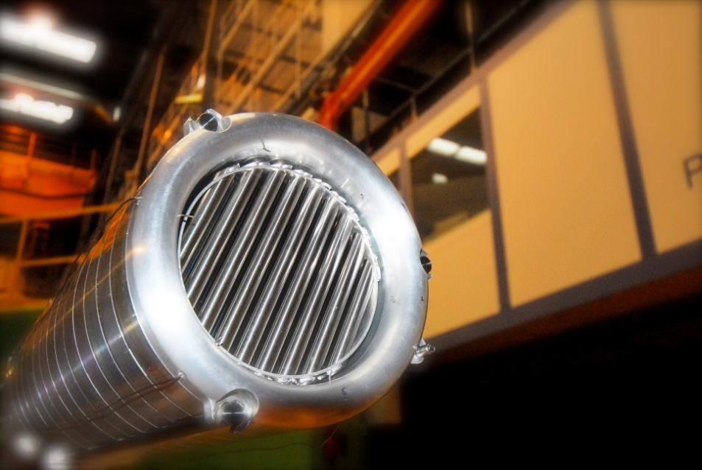
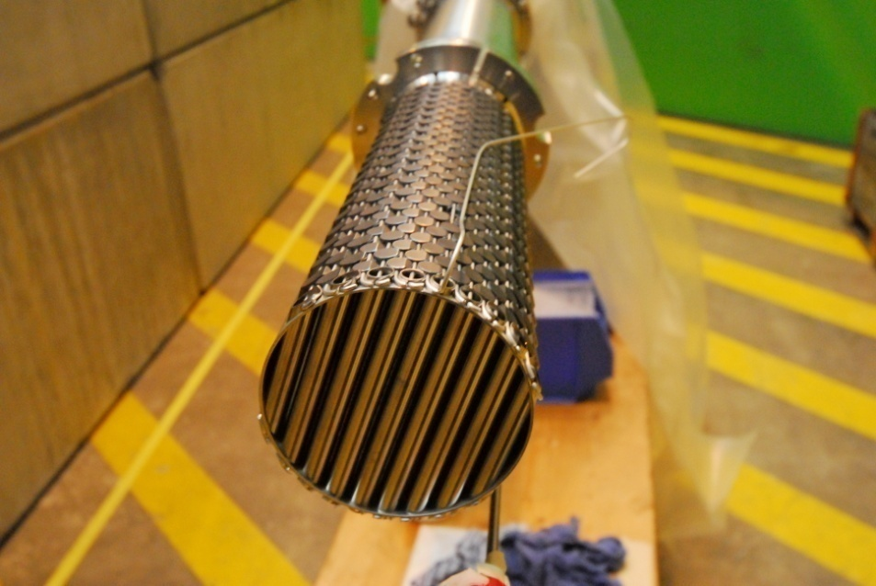
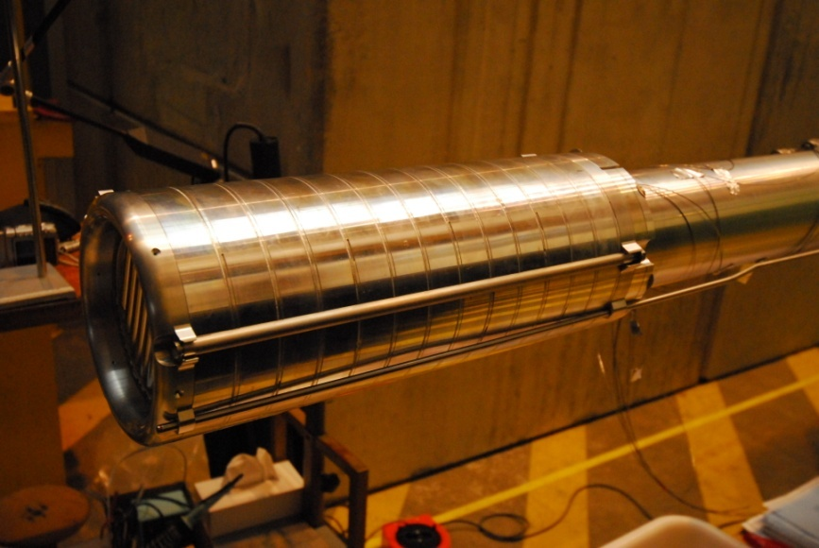
The new Zr-Pb cannellomi target for SINQ
Status:
Operated @ 0.9 MW
April 2009 – Dec. 2010
Neutron flux gain:
54% compared to Target Mark 3 (2004 / 2005)

Slide 12
SINQ neutron production statistics 1997-2010
compact cannelloni
MEGAPIE
Together with 75%
p-beam upgrade
300% more flux
since 1999!!

Slide 13
JSNS mercury target

Slide 14
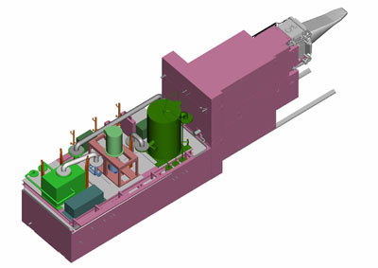
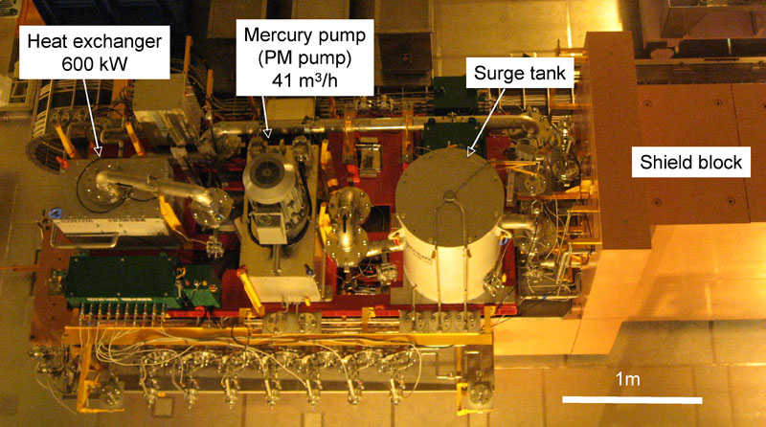
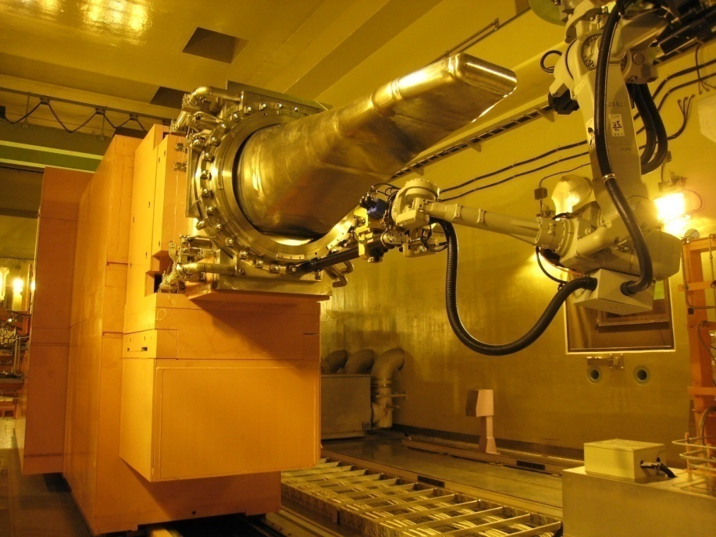
JSNS Hg Target
Proton Beam (design parameters):
  3 GeV, 25 Hz rep rate, 0.33 mA ⇒ 1 MW
Hg Target:
  Cross-flow type, with multi wall vessel
  Hg leak detectors between walls
  All components of circulation system on trolley
  Hot cell : Hands-on maintenance
  Vibration measuring system to diagnose pressure wave effects
Length 12 m
Height 4 m
Width 2.6 m
Weight 315 ton

Slide 15
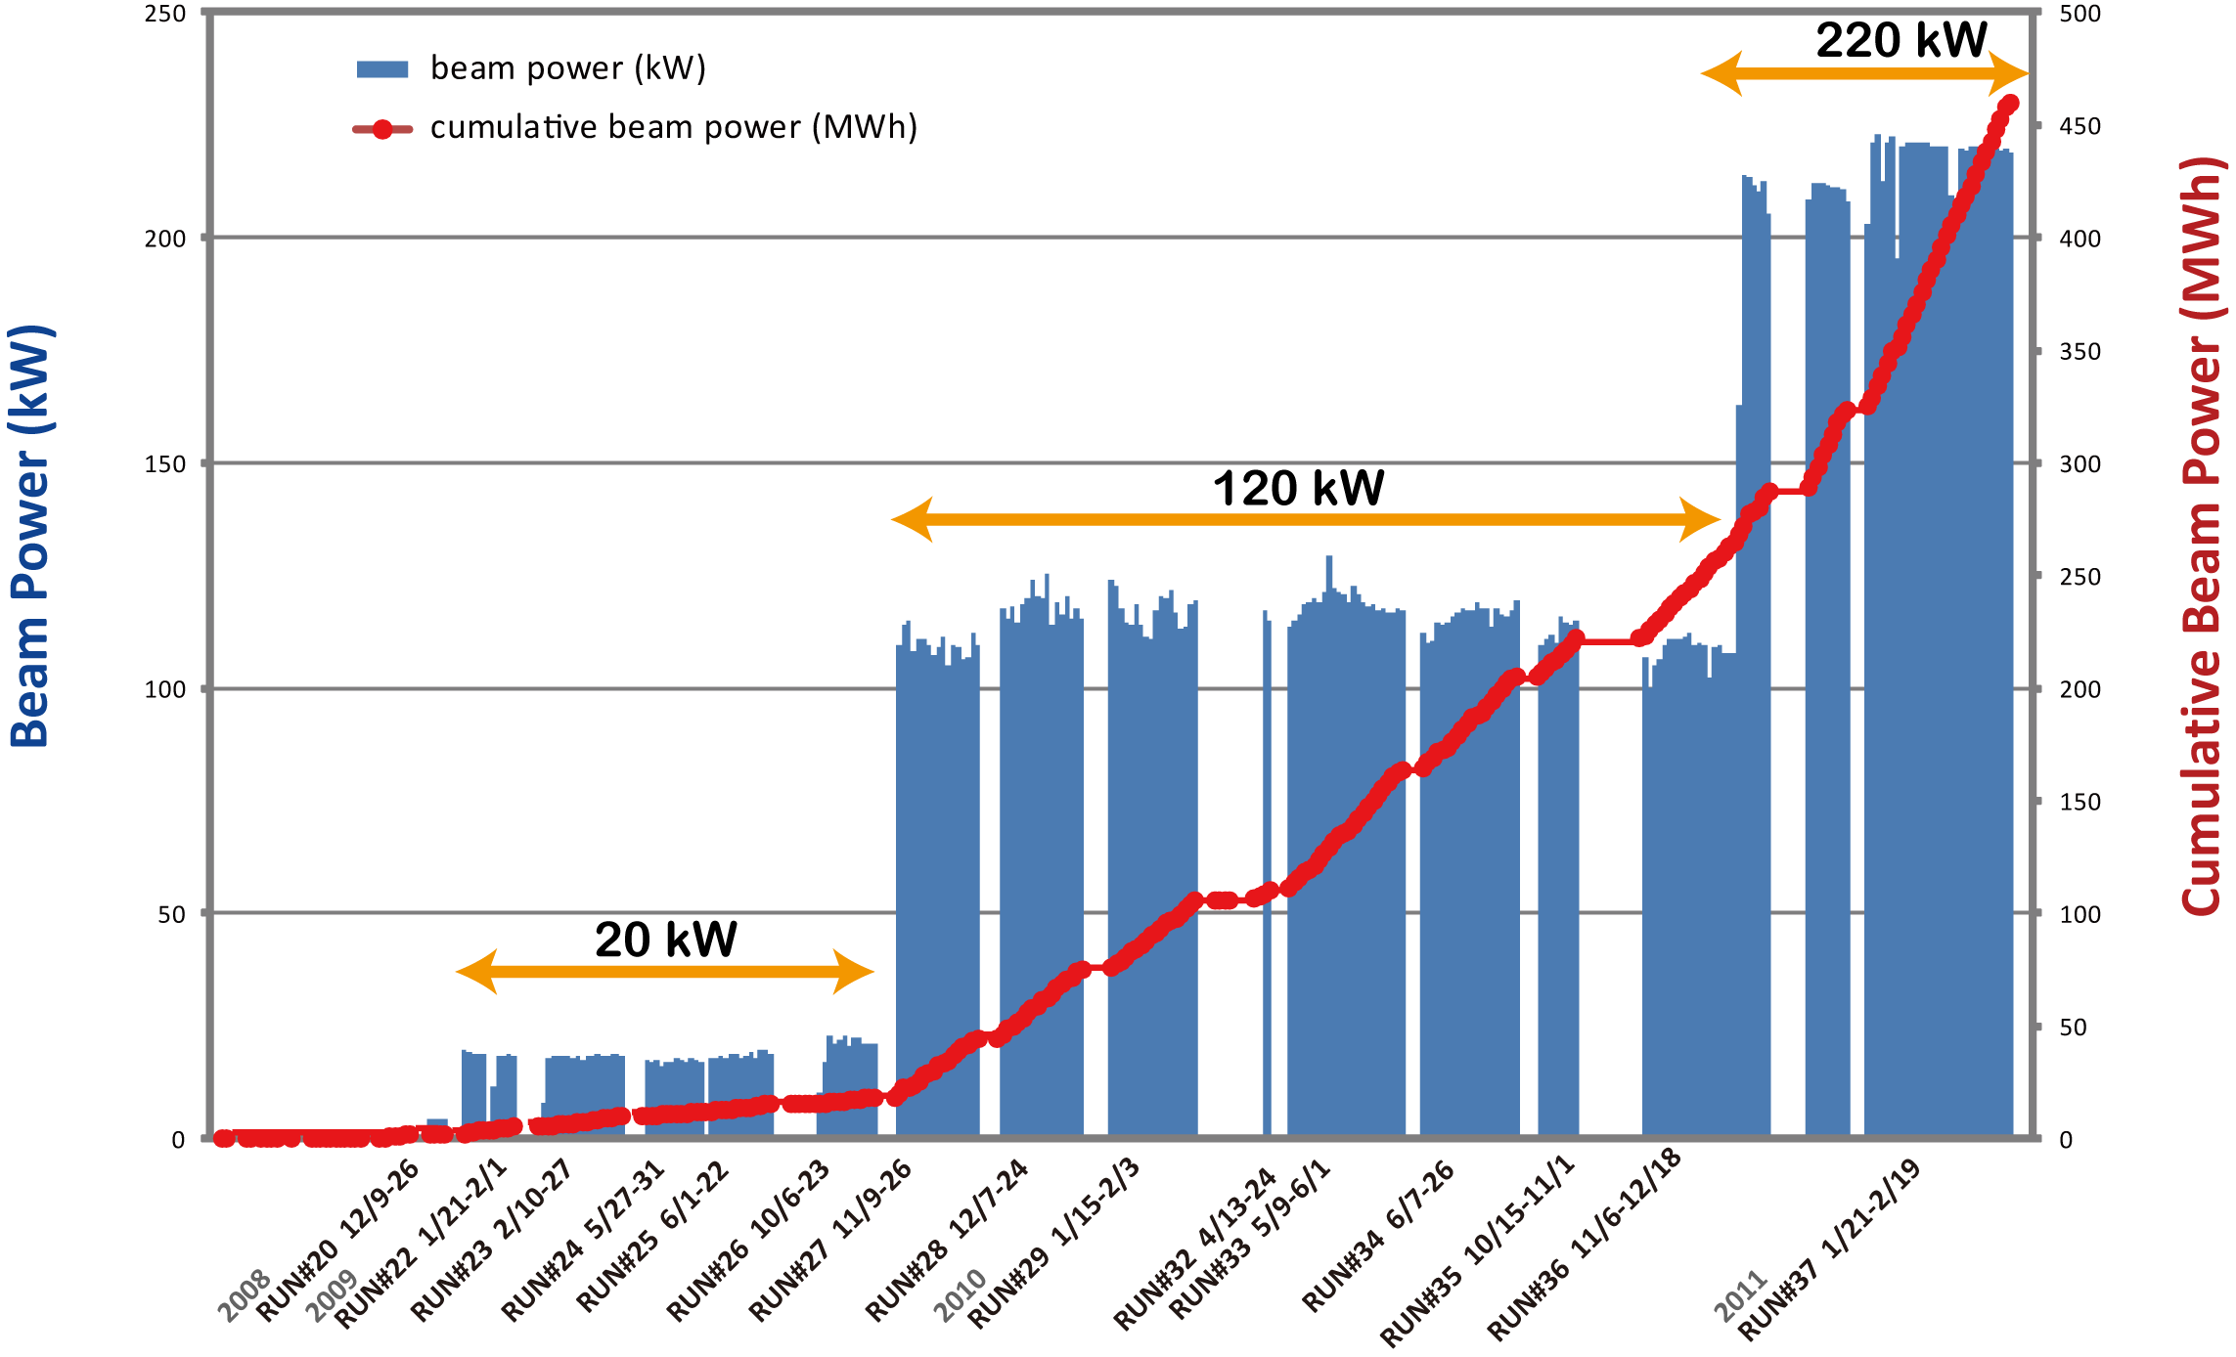
Beam power on JSNS target

Slide 16
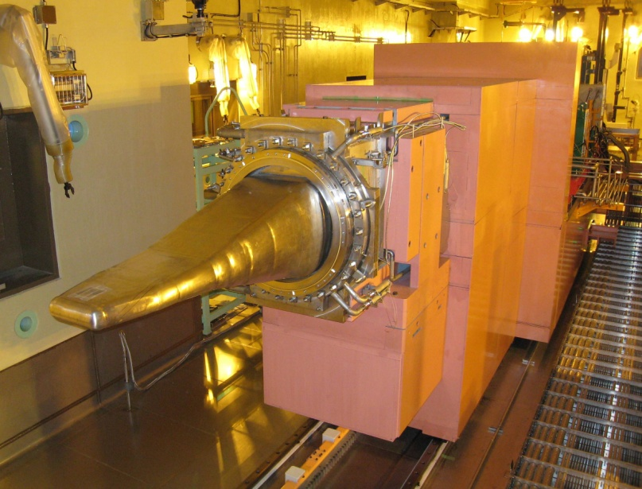
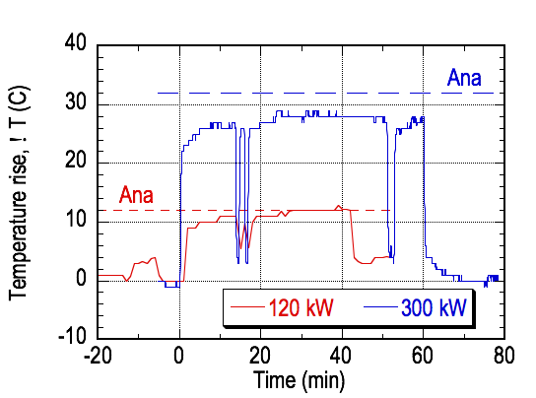
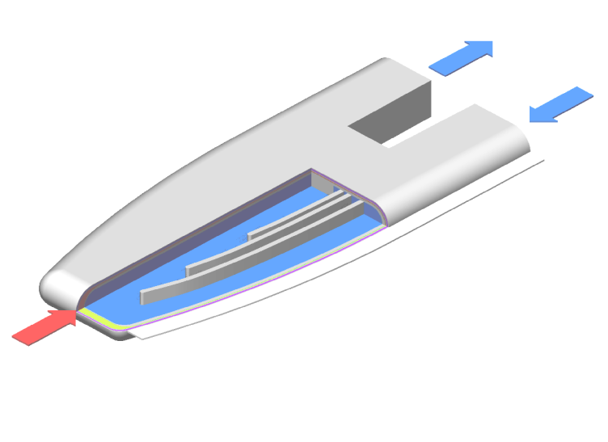
Confirmation of target system design
Temperature rise of mercury vessel for 120 kW & 300 kW beam power agreed with estimates
  Confirmed operation of the mercury circulation system； EM pump, heat exchanger, etc.
Hg
Temp. measuring
point
Proton beam

Slide 17
Bubble Injection Needed to Mitigate Cavitation Damage
3 mechanisms for each region
Center of thermal shock : A
Absorption
Propagation path : B
Attenuation
Negative pressure field : C
Suppression
B
C
A
Bubble<50 μm
A
B
C
Suppression against cavitation bubble by compressive pressure emitted from gas-bubble expansion.
Absorption
Attenuation
Suppression

Slide 18
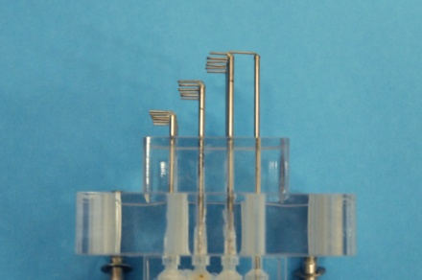
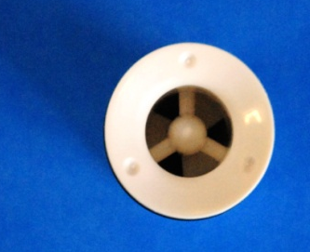
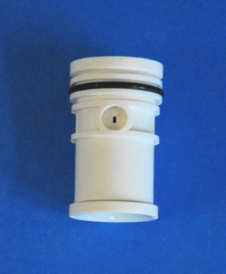
Bubblers applicable to target
What bubbler is the most suitable under mercury target condition ?
Venturi
Difficult to cont., D>50 μm
High erosion risk
High pressure drop
Needle
Controllable, D>500 μm,
Flow induced vibration, Erosion
Swirl
Controllable, D<50 μm,
Acceptable pressure drop
He gas supply

Slide 19
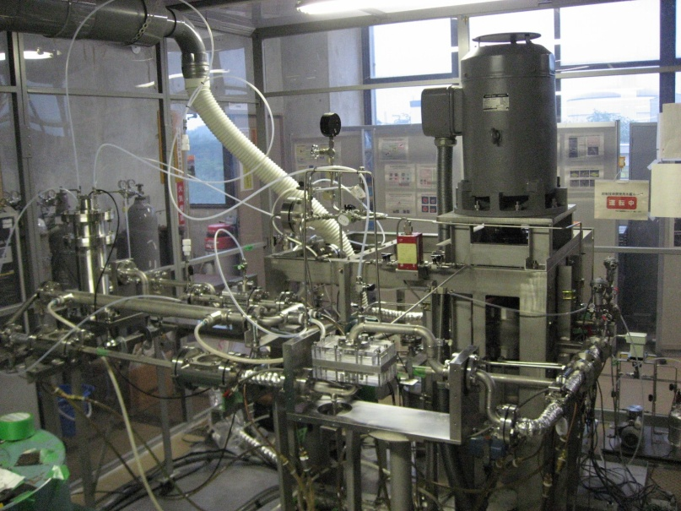
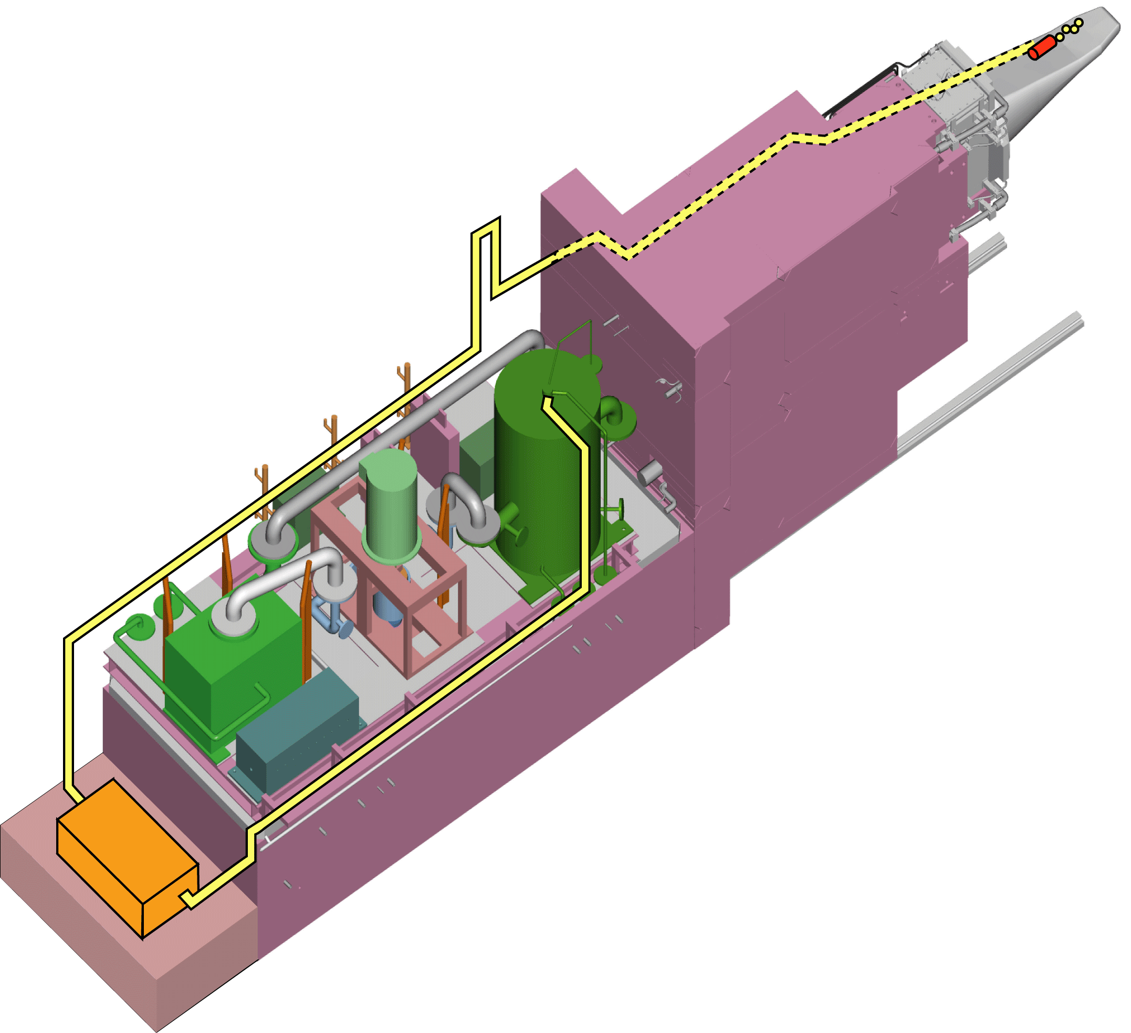
Gas supply system for bubblers
Component tests are being carried out in water and mercury loops
Conceptual design is being made by a company
Bubbler
EM pump
EM Pump
Mercury target
Surge tank
Heat
exchanger
Target trolley
HX
Mercury loop
Surge tank
Remove bubbles > 100 μm
Gas supply system
Control gas pressure and flow rate
Heat exchanger and high points
Evaluate effects of remaining bubbles or gas layers on mercury flow

Slide 20
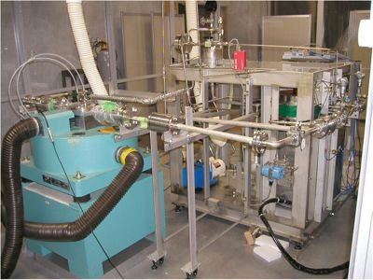
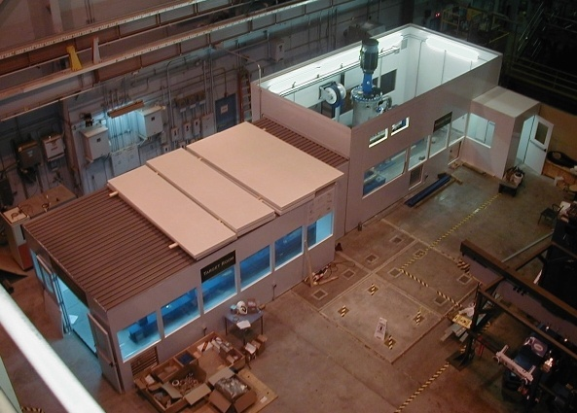
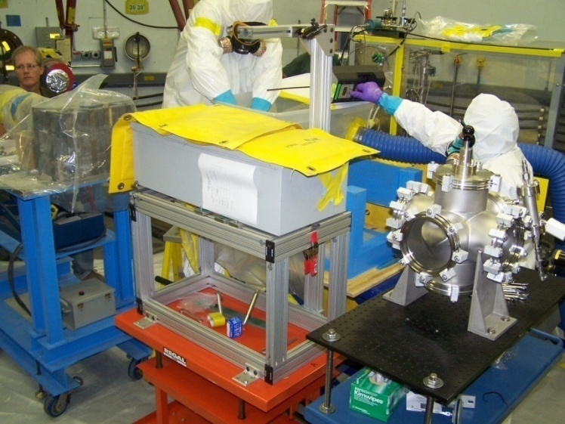
Strong Collaboration Between JSNS and SNS on Hg Target Development
Facilities for cavitation damage characterization and mitigation tests:
  Off-line tests
    JAEAs impact testing apparatus (MIMTM)
    ORNLs full-scale Hg loop (TTF)
  In-Beam Tests at LANLs WNR facility
Characterize bubbles, measure mitigation effects, etc.
MIMTM
WNR
TTF

Slide 21
SNS mercury target

Slide 22
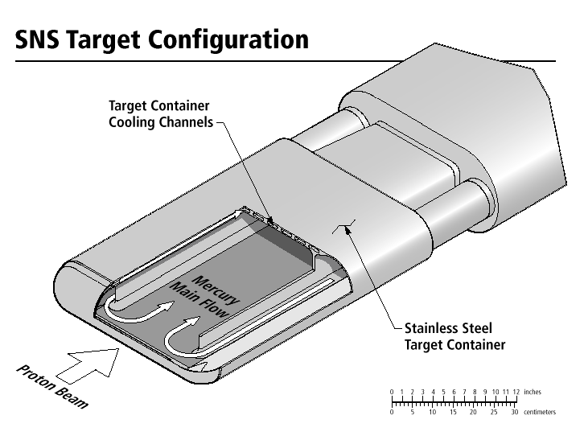
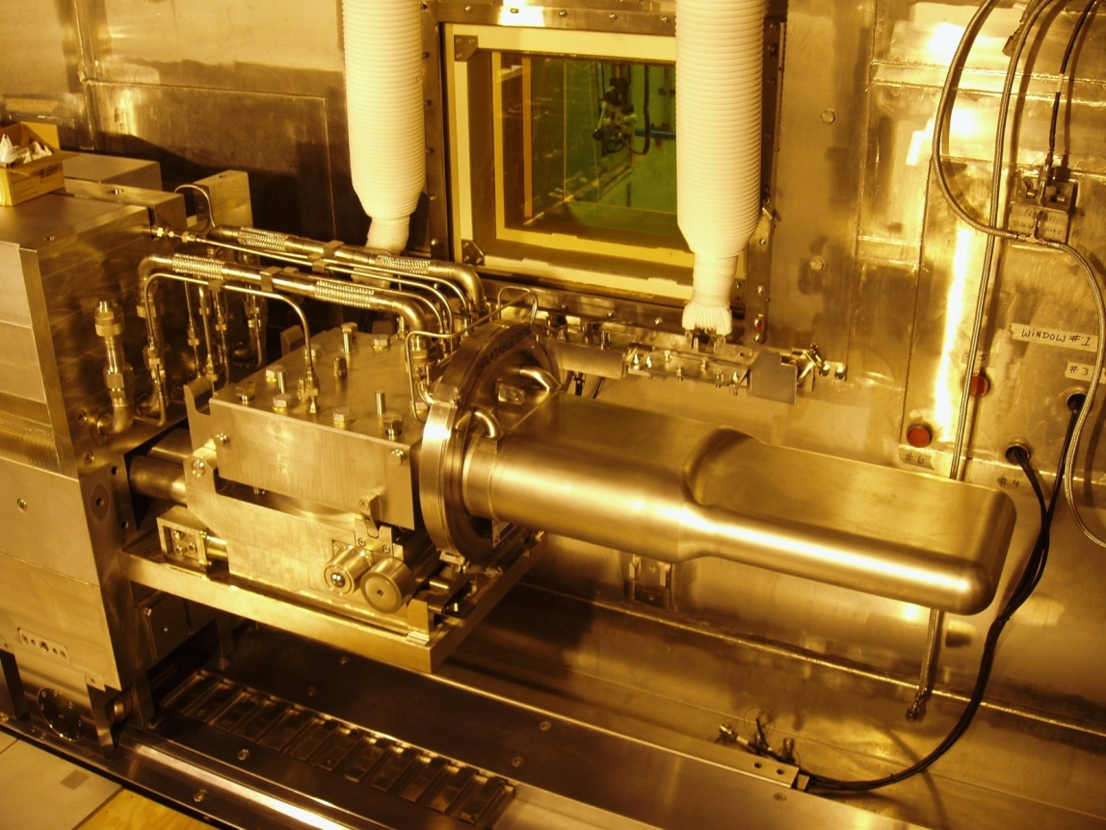
SNS Mercury Target
SNS Ultimate Parameters
1 GeV protons
2 MW average beam power
Pulse duration ~ 0.7 μs
60 Hz rep rate

Slide 23
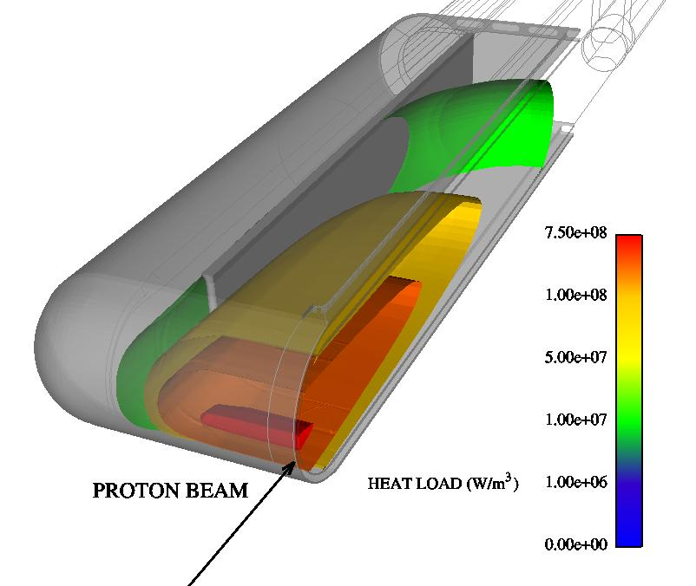
Mercury Loop Parameters @ 2 MW
Power absorbed in Hg 1.2 MW
Nom Op Pressure 0.3 MPa
Flow Rate 340 kg/s
V_{max} (In Window) 3.5 m/s
Temperature
  Inlet to target 60ºC
  Exit from target 90ºC
Total Hg Inventory 1.4 m³
Centrifugal Pump Power 30 kW
SNS Hg Target operates at low temperature and pressure
Peak power density in mercury ~ 800 MW/m³

Slide 24
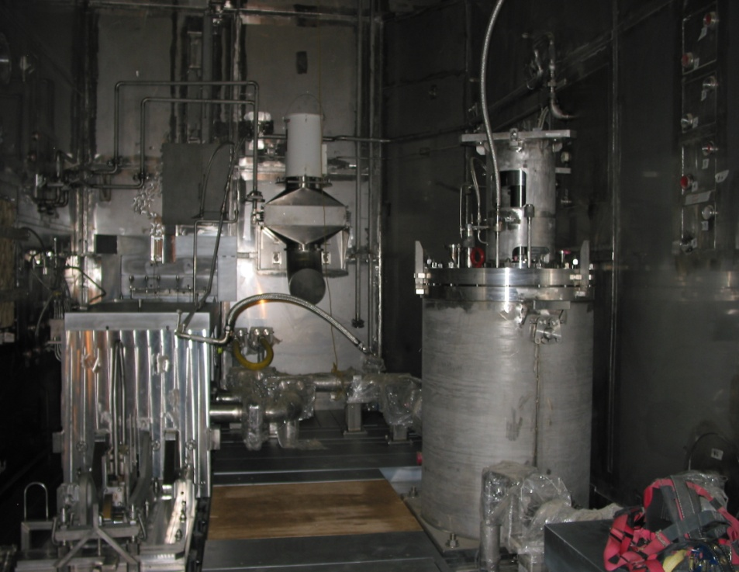
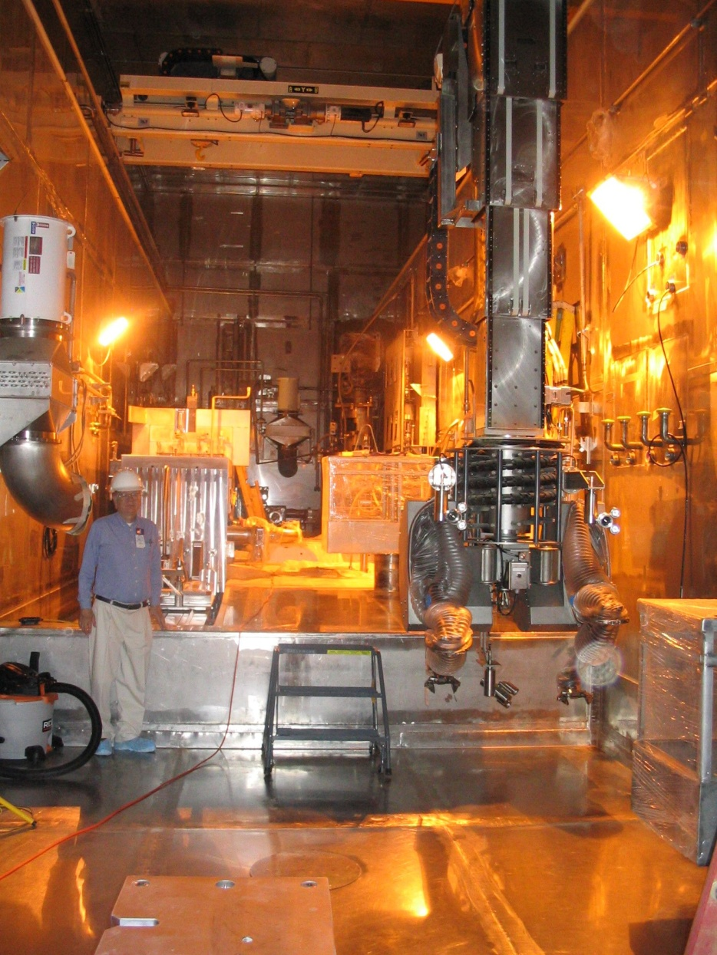
Target Service Bay
7.5 Ton Crane
Hg Pump
Carriage
Target Service Bay
  Stainless-steel lined
  4 window workstations
  8 through-the-wall manipulators
  7.5 ton crane
  Pedestal mounted manipulator
  Shielded transfer bay
Dual Arm Telerob Manipulator on extended pedestal

Slide 25
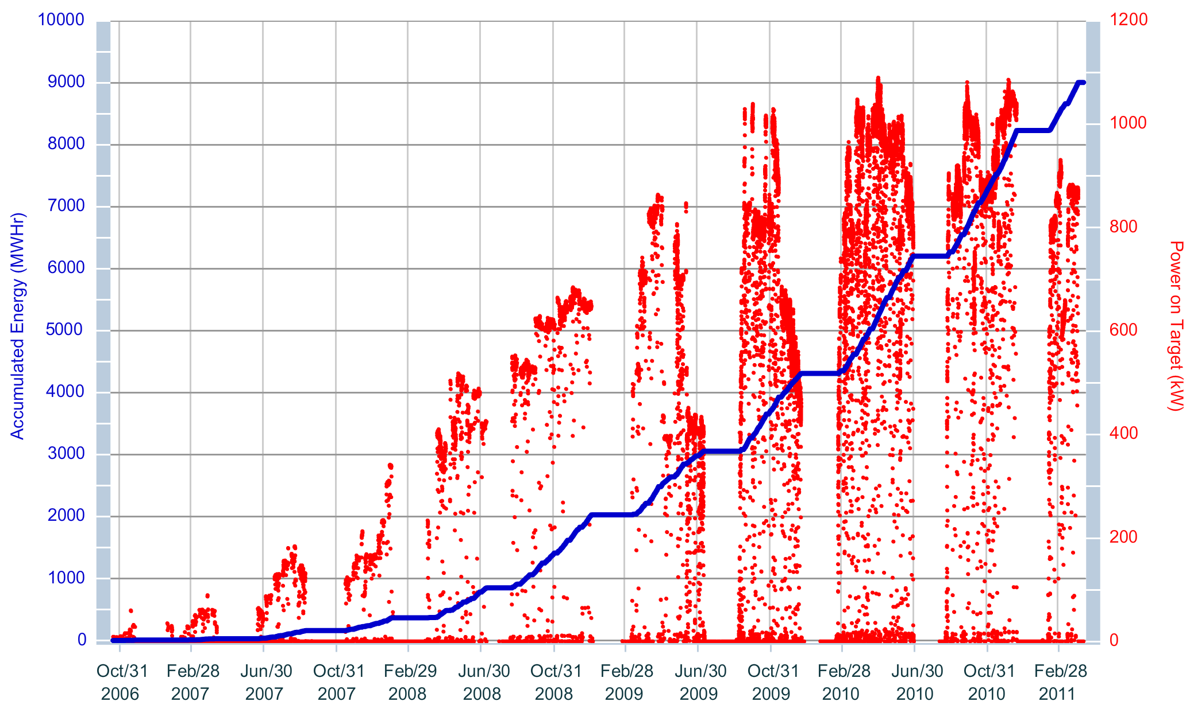
SNS Power Ramp-Up
April 3:
End of life reached!
Currently operating at ~ 1 MW
Target #4
Target #3
Target #2
Target #1

Slide 26
Mercury Target Status
1st target module replaced July 2009; 2nd target replaced July 2010
  Both during planned extended maintenance periods
  Both exceeded original goal of 5 dpa (reaching almost 8 dpa)
Plans are still to run the next few targets to end-of-life, i.e. mercury leaks from primary container to its water-cooled shroud (or 10 dpa)
  If cavitation damage limits lifetime, will operate at a power level consistent with using four targets/year (~ 1250 hour lifetime)
Three spare target modules on-site; five more by 2012

Slide 27
3 April 2011:
Target #3 reached an early end of life
Leak detectors in interstitial space between mercury vessel and shroud gave unanimous indications of a leak
Plan was to replace T3 during summer maintenance period
  It would have reached ca. 10 dpa by that time
Target replacement to be completed by 17 April
Investigation / PIE now under way
  Must locate and characterize the leak
  It is not confirmed that cavitation is the cause

Slide 28
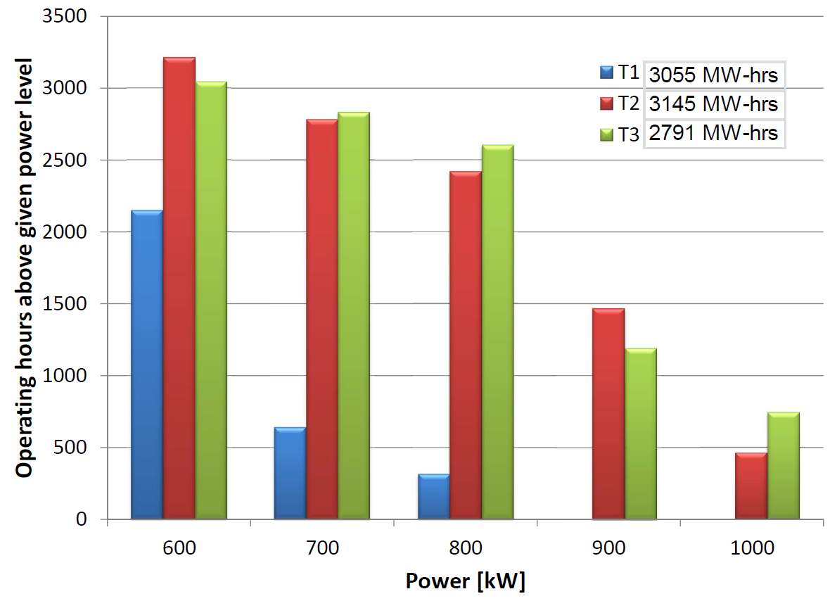
Mercury target module lifetime remains uncertain
1250 hours corresponds to goal of 4 target replacements/year
Demonstrated power limit is now > 900 kW

Slide 29
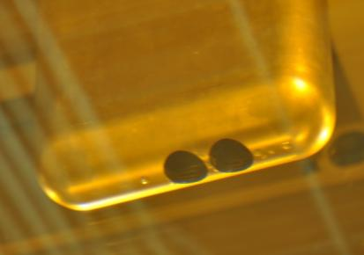
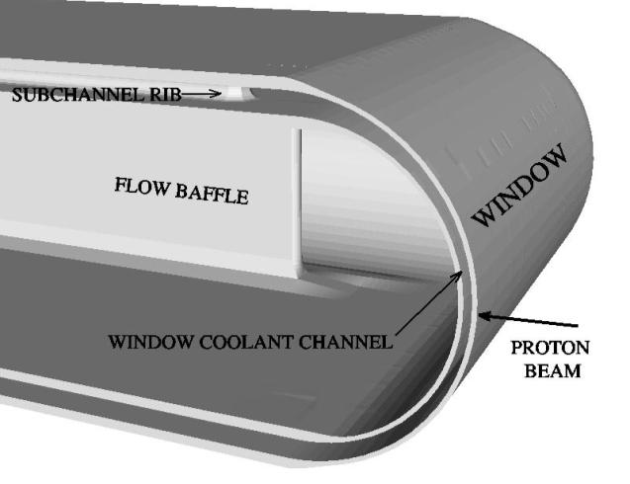
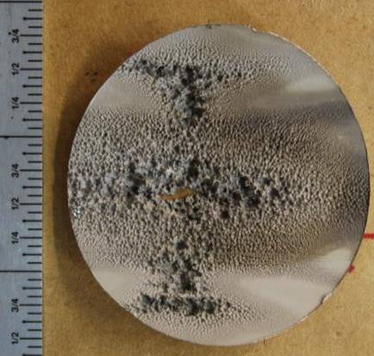
Results of Post-Irradiation Examination of Hg Target Module #1
Target #1:
  Cavitation damage phenomenon confirmed on inner wall at center of target
  Outer wall fully intact; inner wall at off-center location shows little or no damage
  Damage region appears to correlate with regions of low Hg velocity, but not such a clear distinction on Target #2
60 mm
Inner surface of wall between bulk Hg and small channel

Slide 30
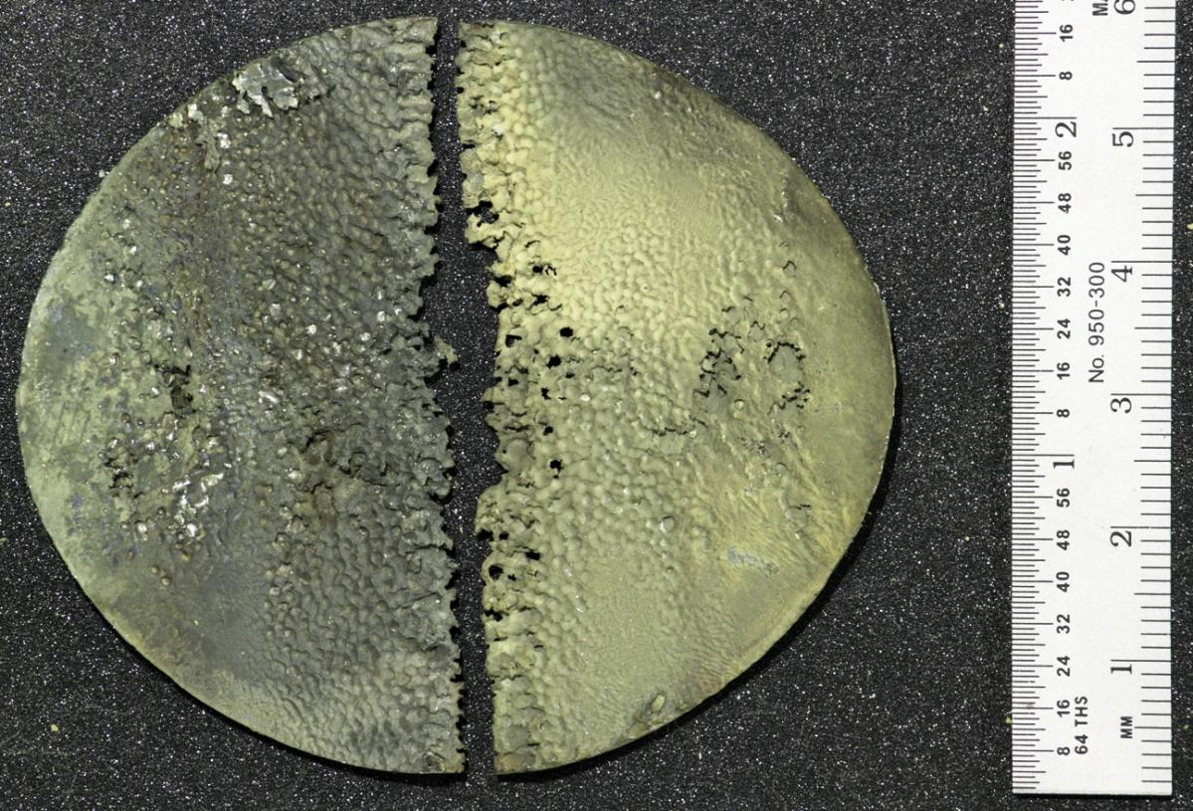
Target #2 survived through planned operating period but inner wall suffered more damage
Horizontal operating orientation
Bulk Hg Flow Surface - UNCLEANED

Slide 31
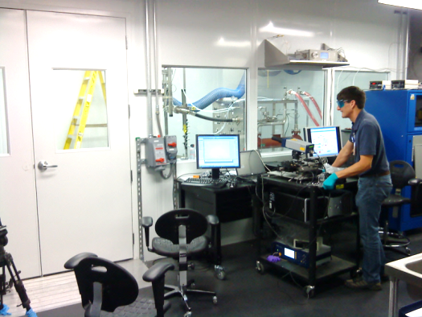
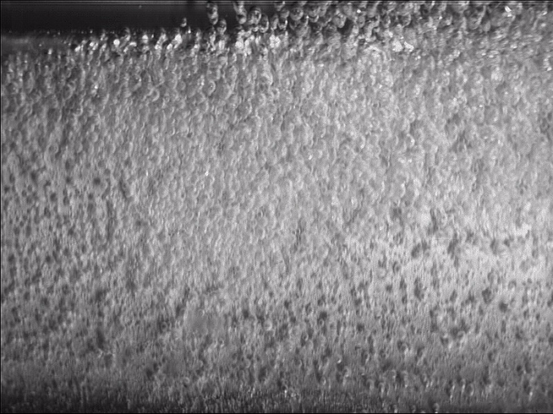
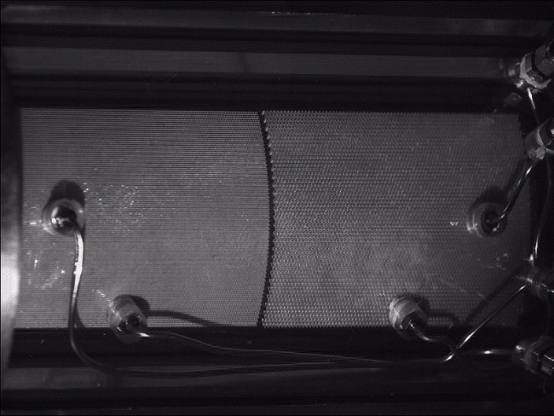

Hg Target Development Plans
New mercury laboratory now operational in SNS Experiment Hall
Continue to pursue gas injection schemes for mitigating cavitation damage
  Gas injection looks promising, but work remains to optimize and implement
    Small gas bubbles and/or gas curtain near wall
    Collaborating with JAEA, RAL, and several university and industrial partners
More detailed PIE of samples from first two three spent target modules will be conducted

Slide 32


Target Imaging System
Implemented Target Imaging System on second target
  System was functional for full life of 2nd target (3200 MW-h)
  3rd target installed with enlarged and improved coating pattern
  Improved resolution system was installed with 3rd Proton Beam Window in December 2010
Flame Sprayed 0.25 mm thick coating (Al₂O₃+ 1.5% CrO)
200mm x 70 mm pattern
Target Imaging System

Slide 33
Concluding Remarks
MEGAPIE, SNS, and JSNS projects successfully implemented liquid metal targets designed for ~ 1 MW
  MEGAPIE experiment completed in 2006; demonstrated ~ 1 MW reliable operation
  SNS operating reliably at 1 MW; 3rd target end of life; ramp-up to 1.4 MW may be impacted
  JSNS was operating reliably at 220 kW; plan to ultimately achieve 1 MW
SINQ is pursuing more optimal solid targets
  Liquid metal target is not being pursued in view of cost and effort, and because the neutron flux of new solid targets is within 15% of MEGAPIE
  Next generation Pb-Bi target (LIMETS) being pursued as an experiment
Cavitation damage remains a concern for pulsed sources with liquid metal targets
  Target lifetime uncertain but reasonably long lifetime established for SNS at 1 MW
    Cause of target 3 end 0f life not yet determined; ultimate power / lifetime limit remains to be discovered
  Strong R&D collaboration between SNS and JSNS
Future projects considering target alternatives
  SINQ upgrades, CSNS, ESS, SNS-STS, MTS
  Both liquid and solid target options under consideration

