Slide 1
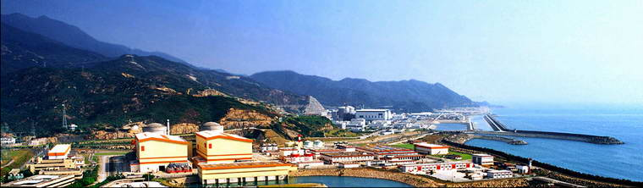
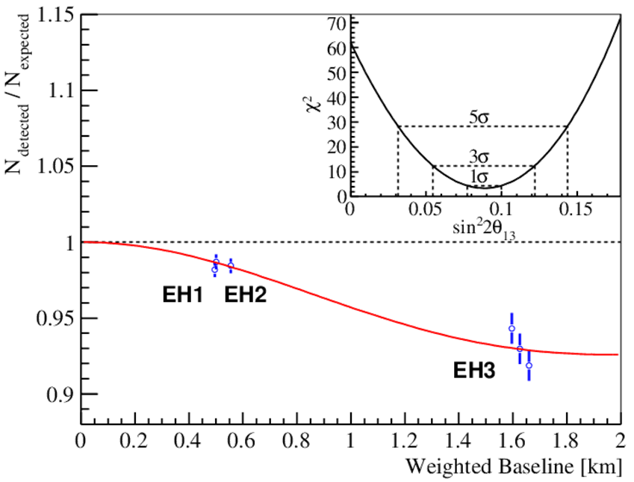
Observation of Mixing Angle θ₁₃
in the Daya Bay Reactor Antineutrino Experiment
Kirk T McDonald
Princeton U
(updated June 1, 2012)
on behalf of the Daya Bay Collaboration
We observe that sin²2θ₁₃ = 0.092 ± 0.016 (stat.) ± 0.005 (syst.) after 55 days of operation with 6 detectors at 3 sites close to 3 pairs of ~ 3 GW reactors.
F.P. Ahn et al., Phys. Rev. Lett. 108, 171803 (2012).
After 110 days of running, sin²2θ₁₃ = 0.089 ± 0.010 (stat.) ± 0.005 (syst.)

Slide 2
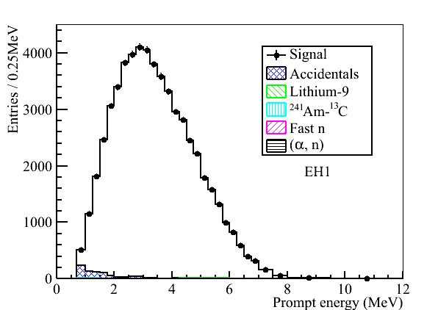
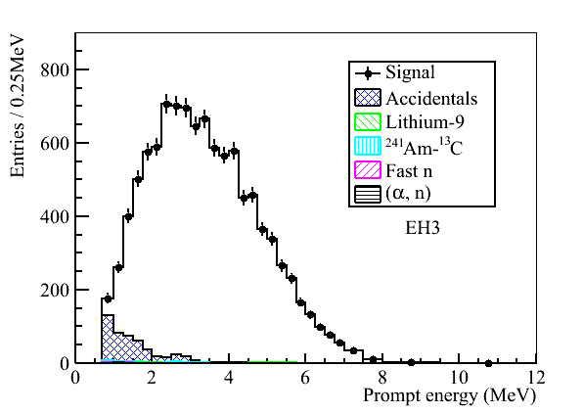
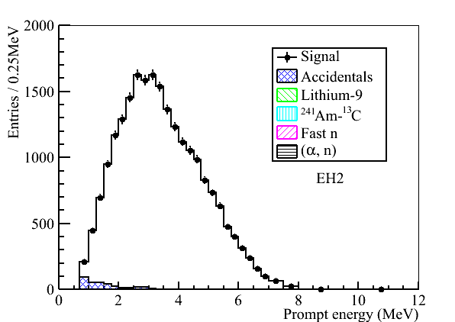
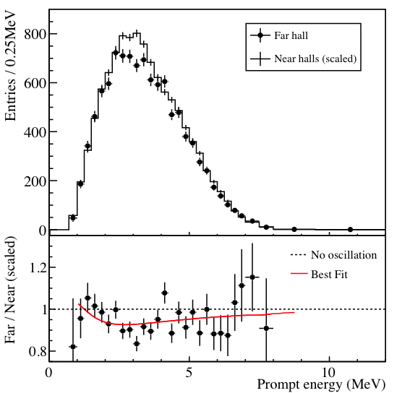
Independent Evidence via Spectral Analysis
Neutrino oscillations at Daya Bay deplete the e⁺ energy spectrum near 3 MeV, ⇒ Far-detector (EH3) spectrum will be “flatter” if oscillations have occurred.
EH1
EH3
57910 signal
candidates
10416 signal
candidates
EH2
In predicting the Far (EH3) spectrum from the Near (EH1 and EH2) detectors, EH2 is weighted 7 times EH1.
22466 signal
candidates
~ 3-σ difference in near-far spectral shapes (preliminary).

Slide 3
Backup Slides

Slide 4
The Neutrino Mixing Matrix
The MNS matrix relates the mass eigenstates (ν₁, ν_{2,} ν₃) to the flavor eigenstates ν_{e}, ν_{μ,} ν_{τ}):
U_{e3} is last unknown
matrix element
sin²θ₁₂ ~ 0.31
sin²θ₂₃ ~ 0.43
MNS = Maki–Nakagawa–Sakata, who (1962) extended Ponetcorvo’s prediction (1957) from 2 to 3 neutrinos.
It can be described by three 2D rotations:
Atmospheric
Majorana Phases
Reactor
Solar
Measurement of the last unknown mixing angle, θ₁₃, is going to have a substantial impact on the future of neutrino physics.

Slide 5
Recent Experimental Results (2011):
θ₁₃ may be large
Accelerator-based appearance expts.
Reactor-based disappearance expt.
T2K
MINOS
Double Chooz
PRL 107, 041801 (2011)
0.03(0.04) < sin²2θ₁₃ < 0.28(0.34) at 90% CL
PRL 107, 181802 (2011)
arXiv:1112.6353v1
sin²2θ₁₃ = 0.086 ± 0.041(stat) ± 0.030(sys)
(0.015 < sin²2θ₁₃ < 0.16 at 90% CL)
T2K has 6 candidate electron-appearance events, all close to the beam-entry side of the Super-K detector.

Slide 6
Combined Analysis
http://arxiv.org/abs/1111.3330 Machado et al.
Combined measurements exclude θ₁₃ = 0 at greater than 3 σ, but no single experiment has this sensitivity.

Slide 7
Reactor-Based θ₁₃ Experiments
ν_{e}
Well understood, isotropic source of electron anti-neutrinos
ν_{e}
Oscillations observed as a deficit of ν_{e}
ν_{e}
ν_{e}
ν_{e}
Near and Far detectors located underground to shield against cosmic rays
“Unoscillated” flux observed here
ν_{e}
1.0
sin²2θ₁₃
Probability ν_{e}
πE_{ν} /2Δm²₁₃
Large for reactor neutrinos at L ~ 2km; Large for L ~ 200 km
Negligible at L ~ 2 km
Distance (L/E)
~ 1800 meters
(at 3 MeV)

Slide 8

The Daya Bay Collaboration
~ 250 collaborators, 38 institutions
Europe (3) (10)
JINR, Dubna, Russia
Kurchatov Institute, Russia
Charles University, Czech Republic
North America (16)(~100)
BNL, Caltech, LBNL, Iowa State Univ., Illinois Inst. Tech., Princeton, RPI, Siena,
UC-Berkeley, UCLA, Univ. of Cincinnati,
Univ. of Houston,
Univ. of Wisconsin-Madison, Virginia Tech.,
William and Mary,
Univ. of Illinois-Urbana-Champaign
Asia (19) (~140)
IHEP, Beijing Normal Univ., Chengdu Univ.
of Sci. and Tech., CGNPG, CIAE, Dongguan
Polytech. Univ., Nanjing Univ., Nankai Univ.,
Shandong Univ., Shanghai Jiao Tong Univ., Shenzhen Univ., Tsinghua Univ., USTC, Zhongshan Univ., Univ. of Hong Kong,
Chinese Univ. of Hong Kong,
National Taiwan Univ., National Chiao Tung Univ., National United Univ.

Slide 9
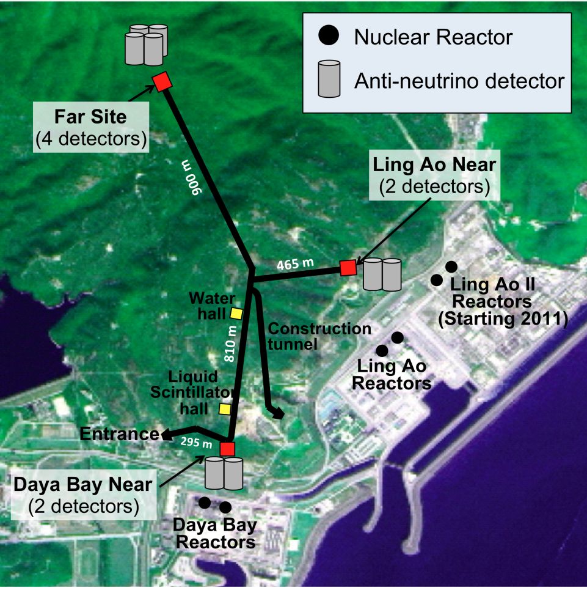
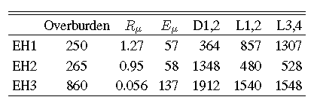
Daya Bay Experiment Design Principles
Identical near and far detectors cancel many systematic errors
Multiple detectors at 3 locations boost statistics while reducing systematic errors with multiple independent measurements
Three-zone detector design eliminates the need for spatial cuts which can introduce systematic uncertainties
Shielding from cosmic rays and natural radioactivity reduces background rates
Movable detectors allow possible cross calibration between near and far detectors to further reduce systematic errors
Experimental Layout
mwe Hz/m² GeV m m m
EH = Experimental Hall
D.B. = Daya Bay reactor cores
L.A. = Ling Ao reactor cores
L.A. II = Ling Ao II reactor cores

Slide 10
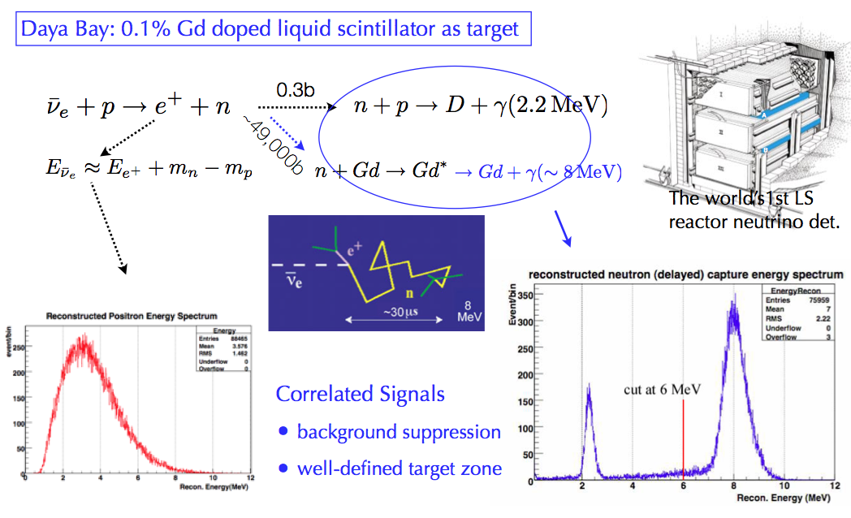
Antineutrino Detection
Inverse beta decay = IBD
Simulation
Simulation

Slide 11
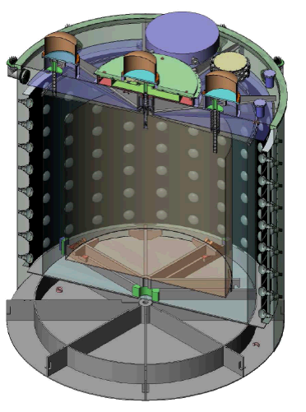
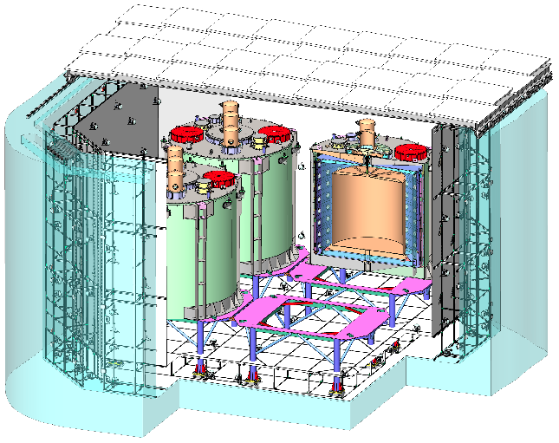
Daya Bay: 8 Identical Antineutrino Detectors
Only 6 detectors installed at present.
Three-zone cylindrical design:
  Target: 20 t (0.1% Gd-based liquid scintillator)
  Gamma catcher: 20-t LS (no Gd, so no 8-MeV neutrons detected here)
  Buffer : 40-t (mineral oil; no scintillator, so no e, n or γ detected here)
Detector mass ~ 110 ton (⇒ need big crane to lift!)
192 low-background 8” photomultiplier tubes
Reflectors at top and bottom
Detectors sit in a pool of water, covered by RPCs
Calibration
system
Steel tank
Far Hall =EH3
RPCs
PMT
20-t Gd-LS “target”
Liquid scintintillator
“gamma catcher”
Mineral oil buffer
5 m
3.1-m acrylic tank
inner and outer water shield
PMT = PhotoMultiplier Tube
AD = Antineutrino Detector
RPC = Resistive Plate Chamber
4.0-m acrylic tank
antineutrino detectors
5 m

Slide 12
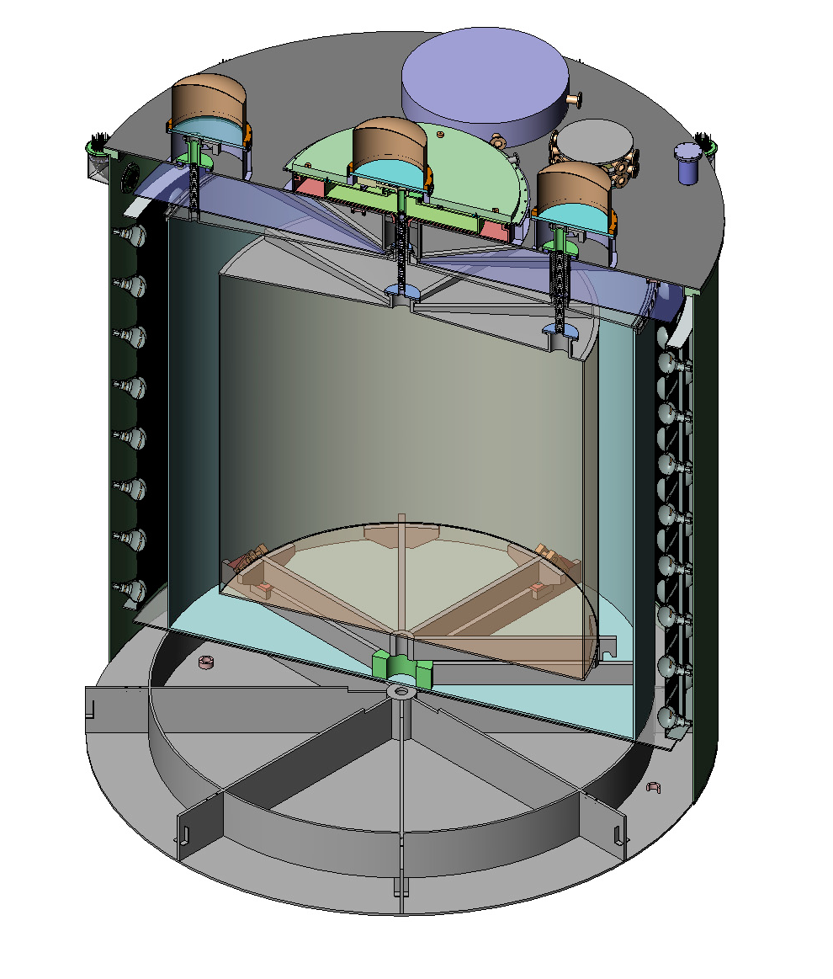
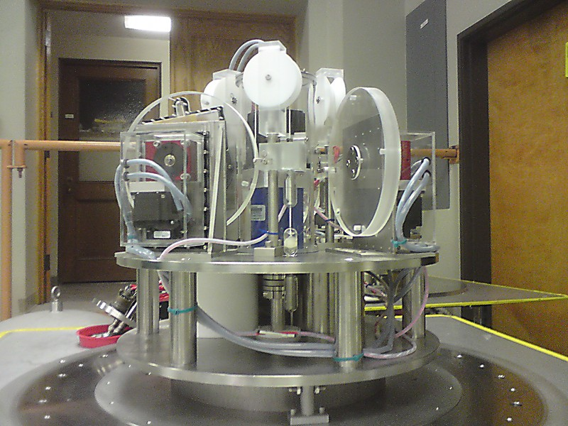
Antineutrino Detector Calibration System
Automated calibration system
→ Routine weekly deployment of sources, lowered into any of the 3 liquid zones.
LED light sources
→ Monitoring optical properties
e⁺ and n radioactive sources (fixed energy)
→ Energy calibration
⁶⁸Ge source
Am-¹³C + ⁶⁰Co source
LED diffuser ball
R=1.7725 m
R=0
R=1.35m
Automated calibration system

Slide 13
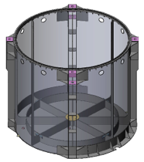
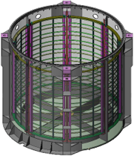
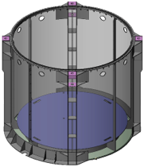
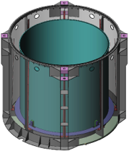
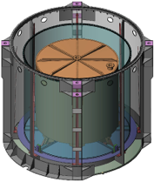
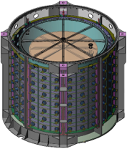
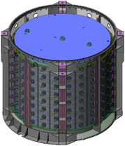
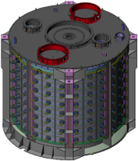
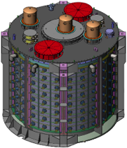
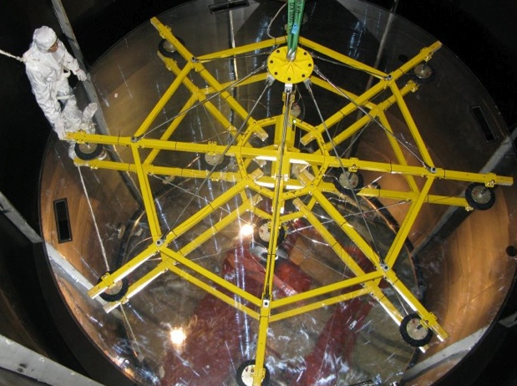
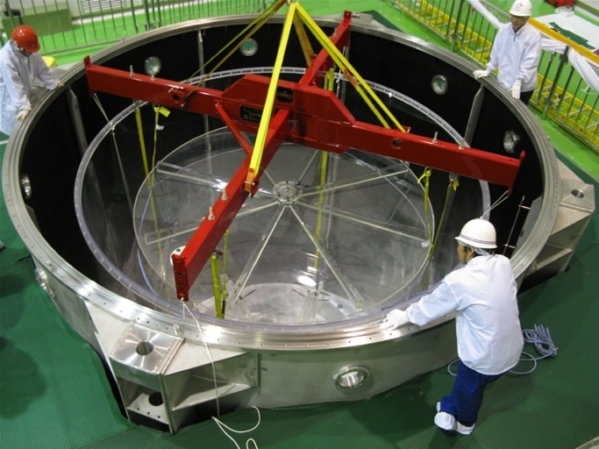
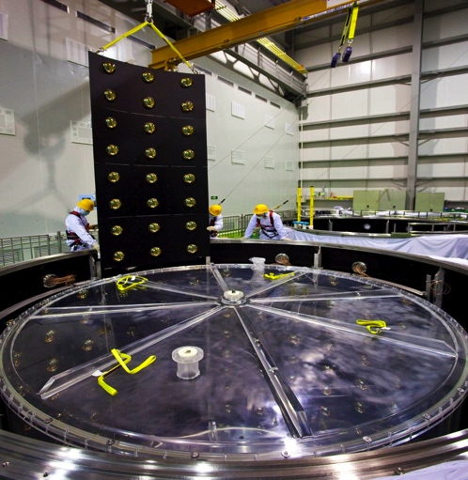
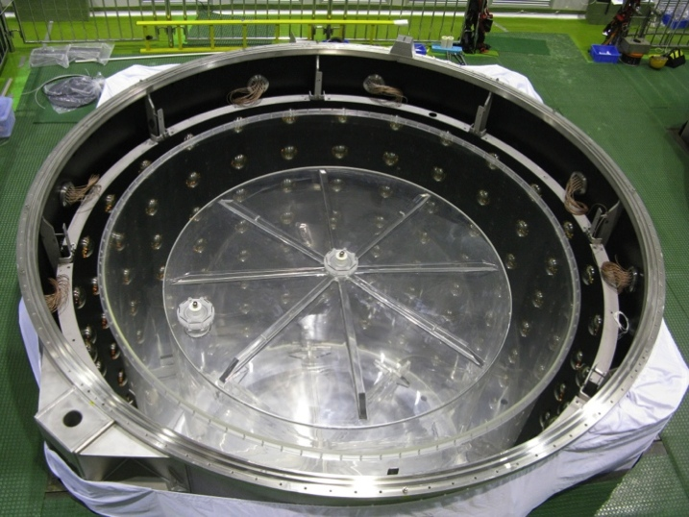
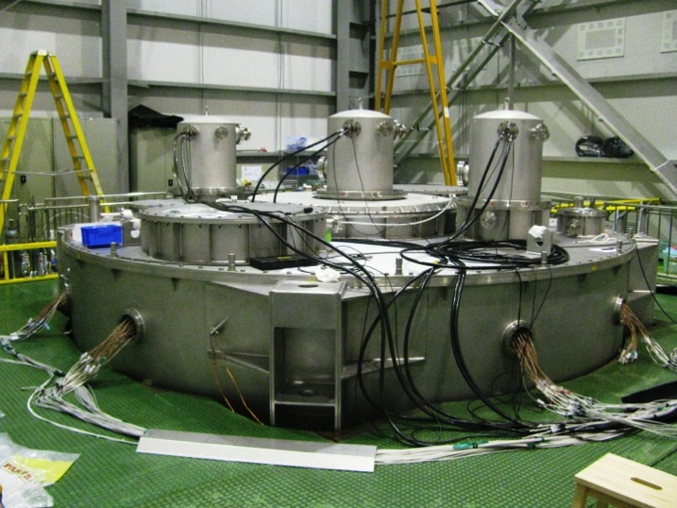
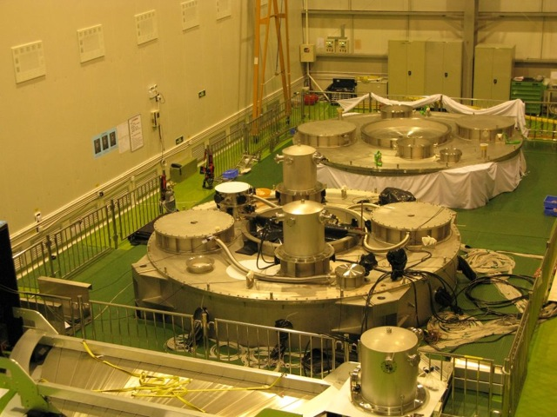
Antineutrino Detector Assembly

Slide 14
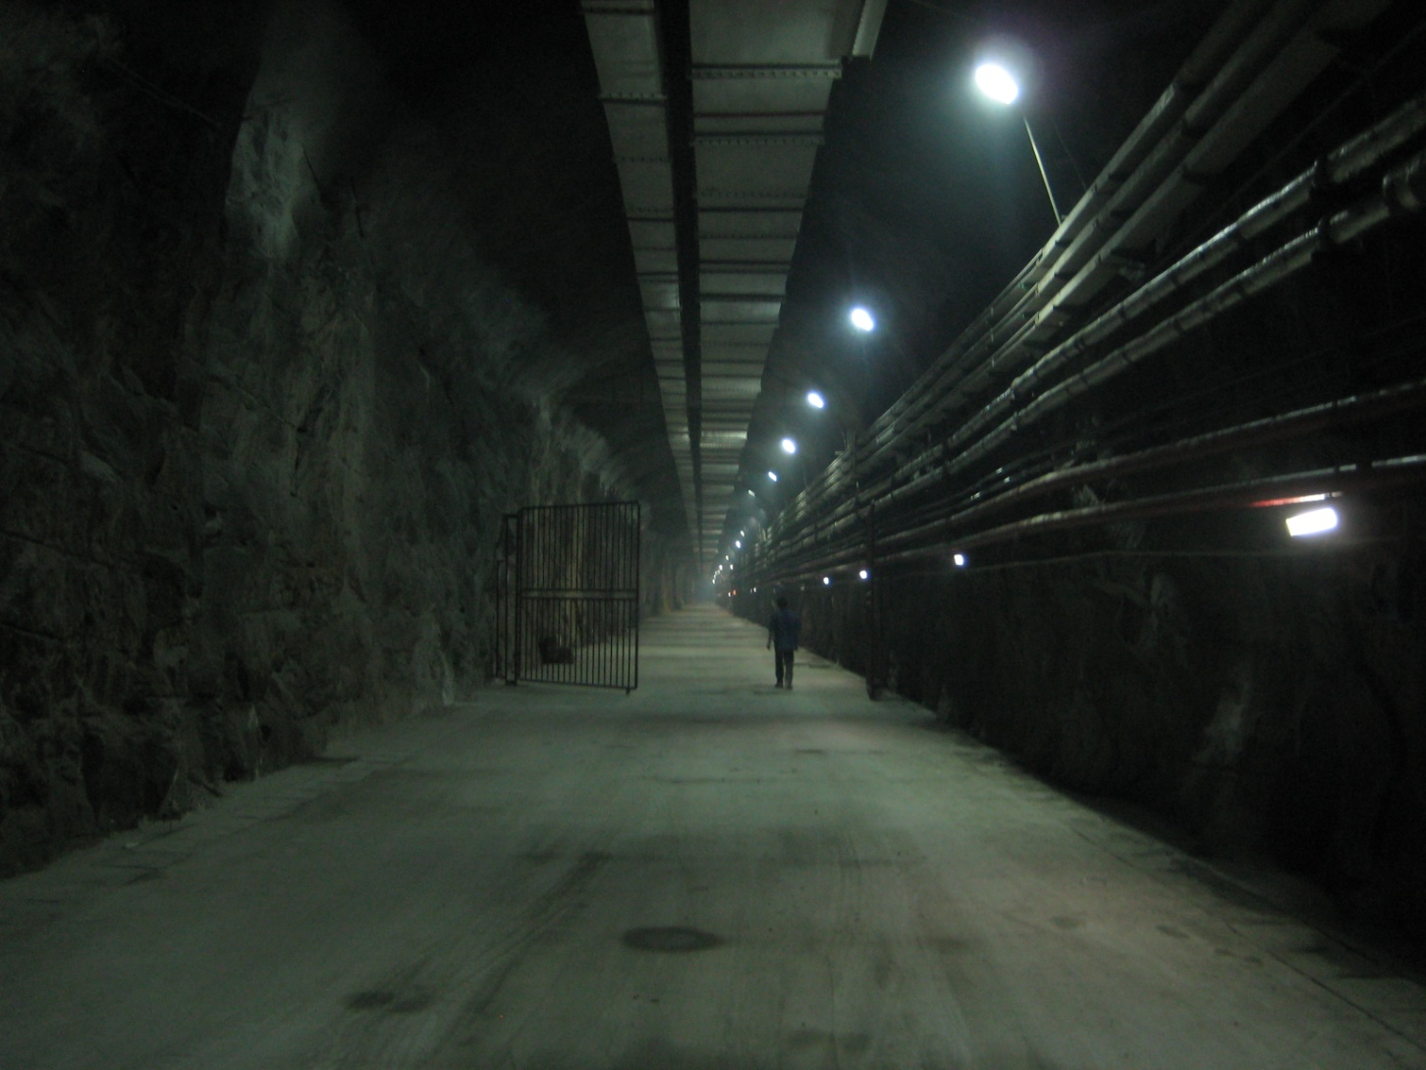
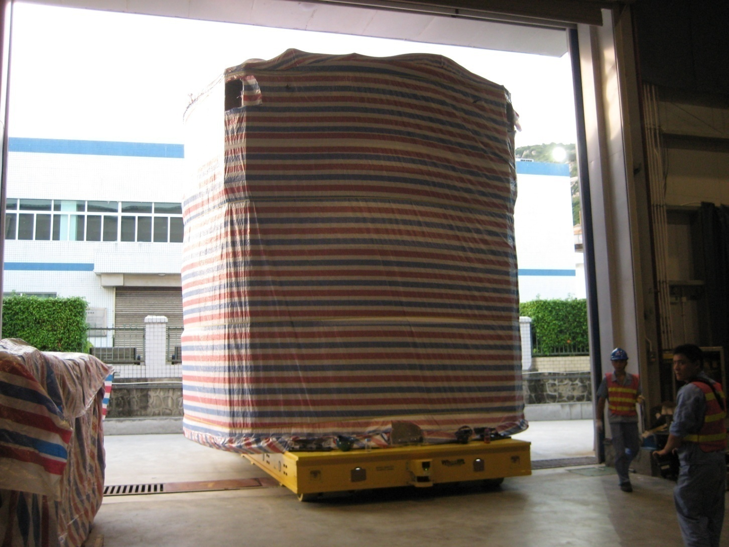
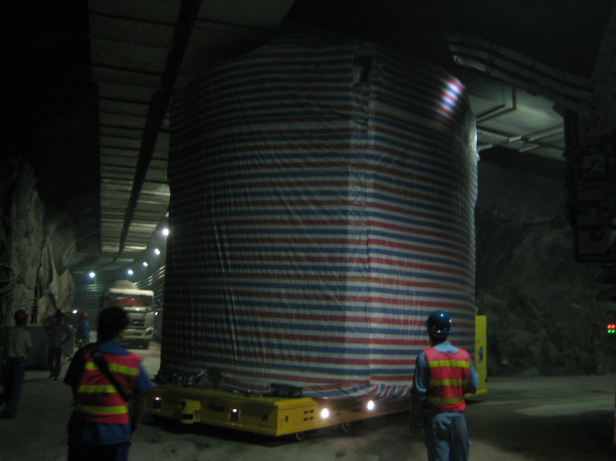
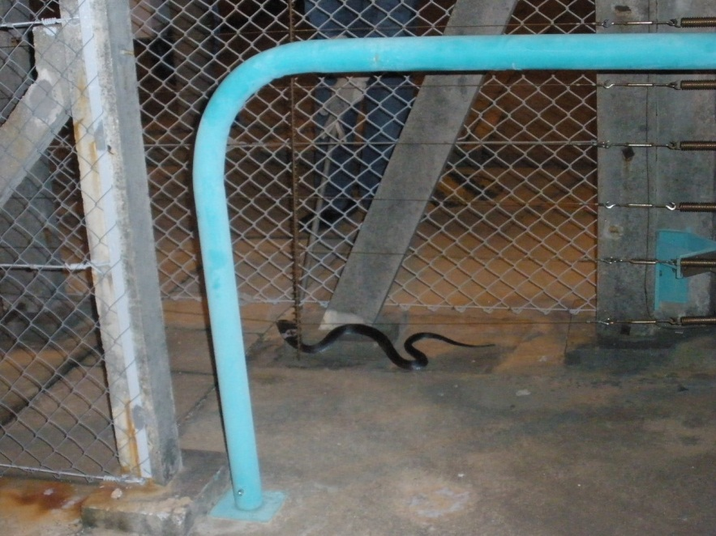
Transporting the Antineutrino Detectors
AGV = automated guided vehicle,
120 ton capacity
Cobra

Slide 15
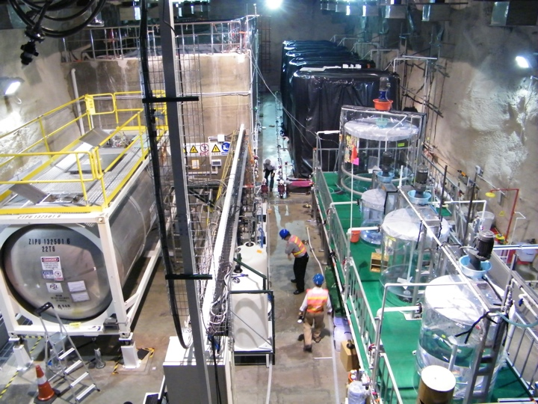
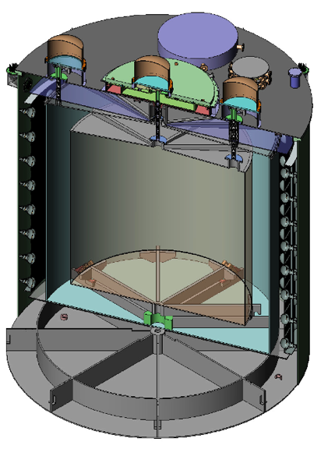
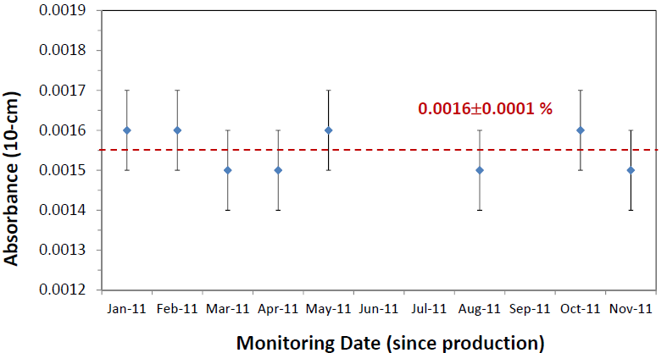
Detector Filling and Target Mass Measurement
Liquid Scintllator production hall, underground
LS
Gd-LS
MO
ISO tank on load cells
detector in scintillator hall
Detectors are filled from same reservoirs “in-pairs” within < 2 weeks.
Target mass determined to ± 3kg
out of 20,000 or < 0.02%.
Gd-loaded scintillator shows good stability with time.

Slide 16
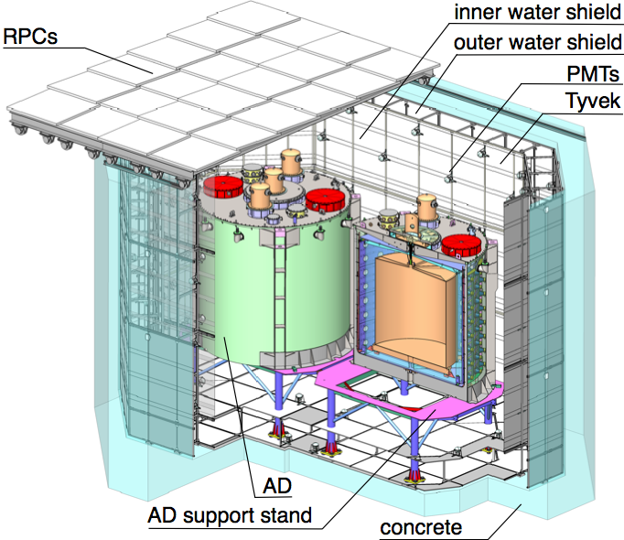
The Muon Tagging System
Dual tagging systems: 2.5-m thick, two-zone water shield, instrumented with PMTs,
+ resistive plate chambers (RPCs) above the water pool.
No online veto, but rather offline tagging/veto of cosmic-ray muon- induced events.
Design tagging efficiency > 99.5% with uncertainty < 0.25%.
Princeton hardware contribution is to the gas system for the RPCs.

Slide 17
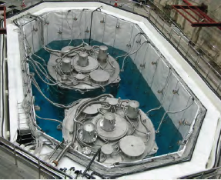
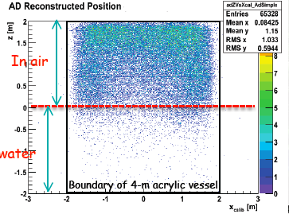
Water Shield Suppresses Background Radioactivity
In water
Singles rates vs. height in the partially filled pool show the suppression of radioactive backgrounds (due to the rock and/or radon) by the water shield.
[PMT coverage in the water pool is poor at the top, where the RPC array augments the muon coverage – but not that for rock radioactivity.]

Slide 18
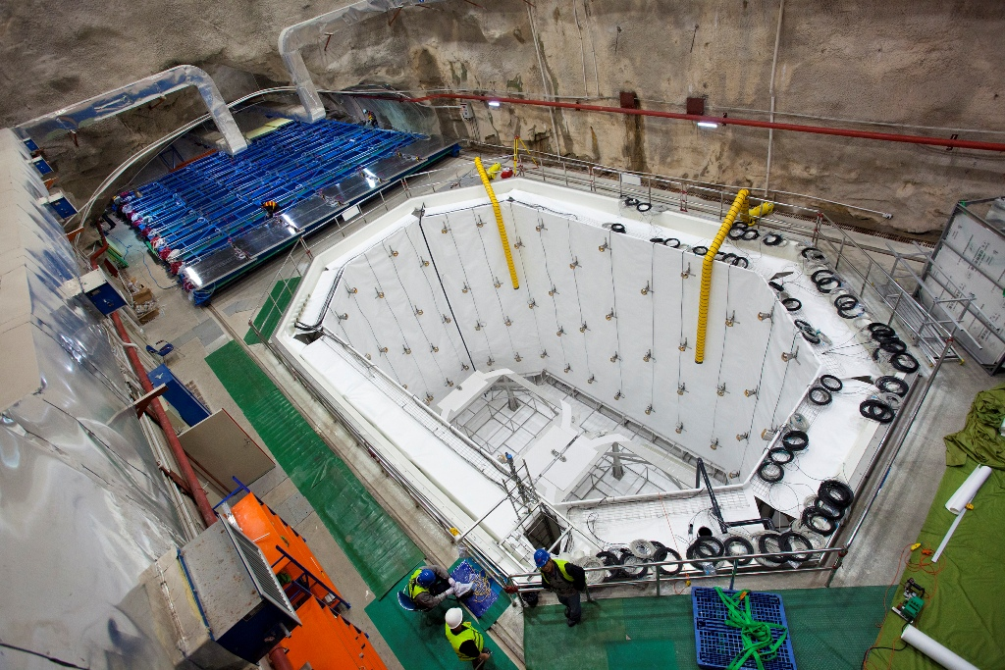
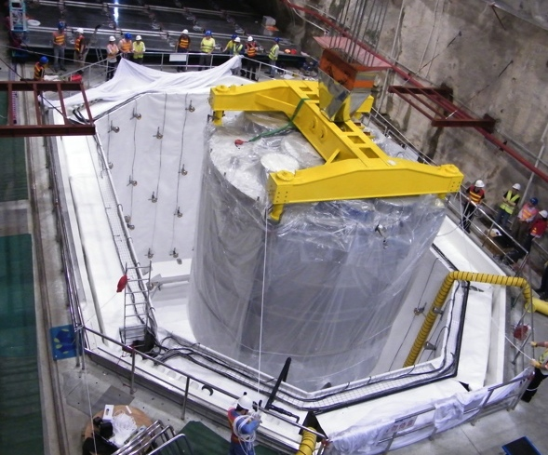
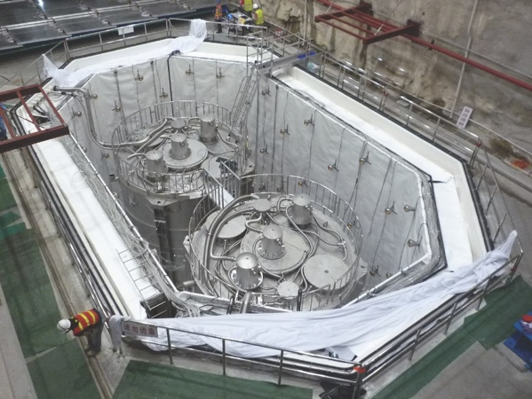
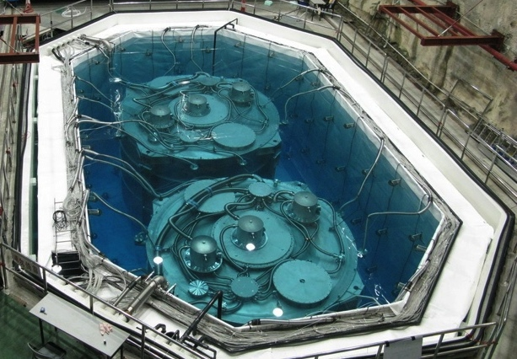
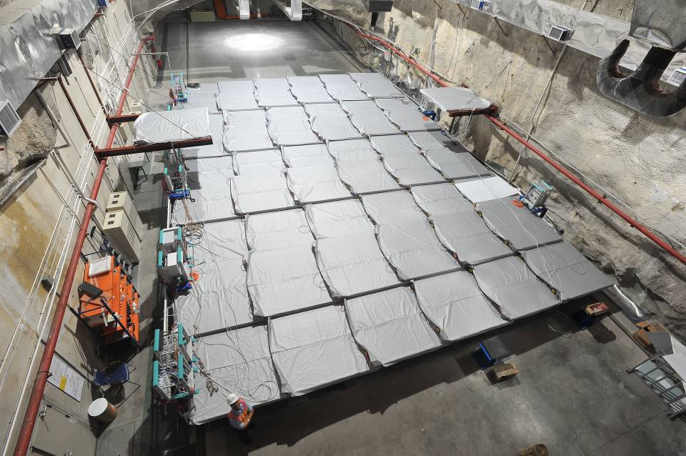
EH1 Data-Taking since August 15, 2011

Slide 19
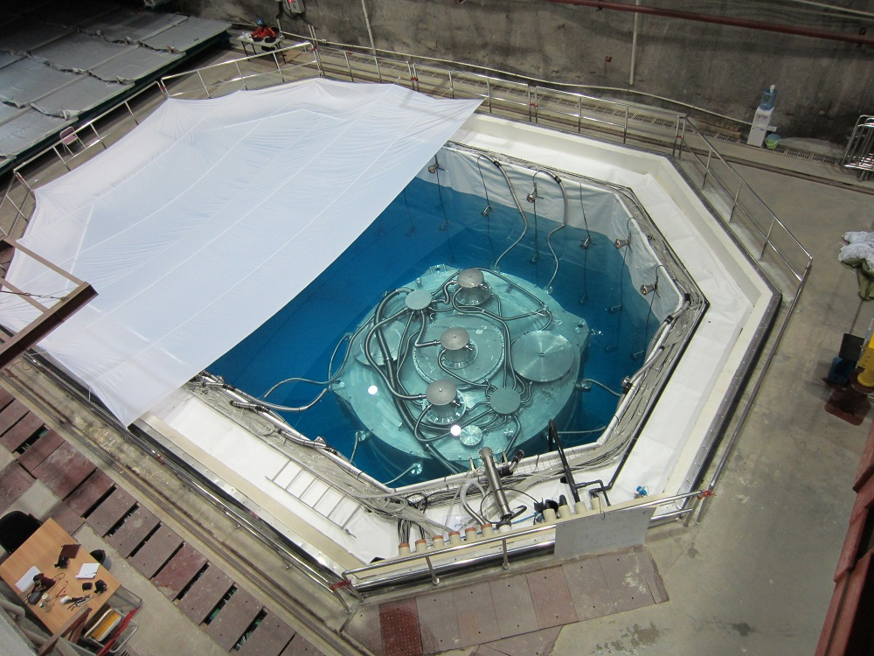
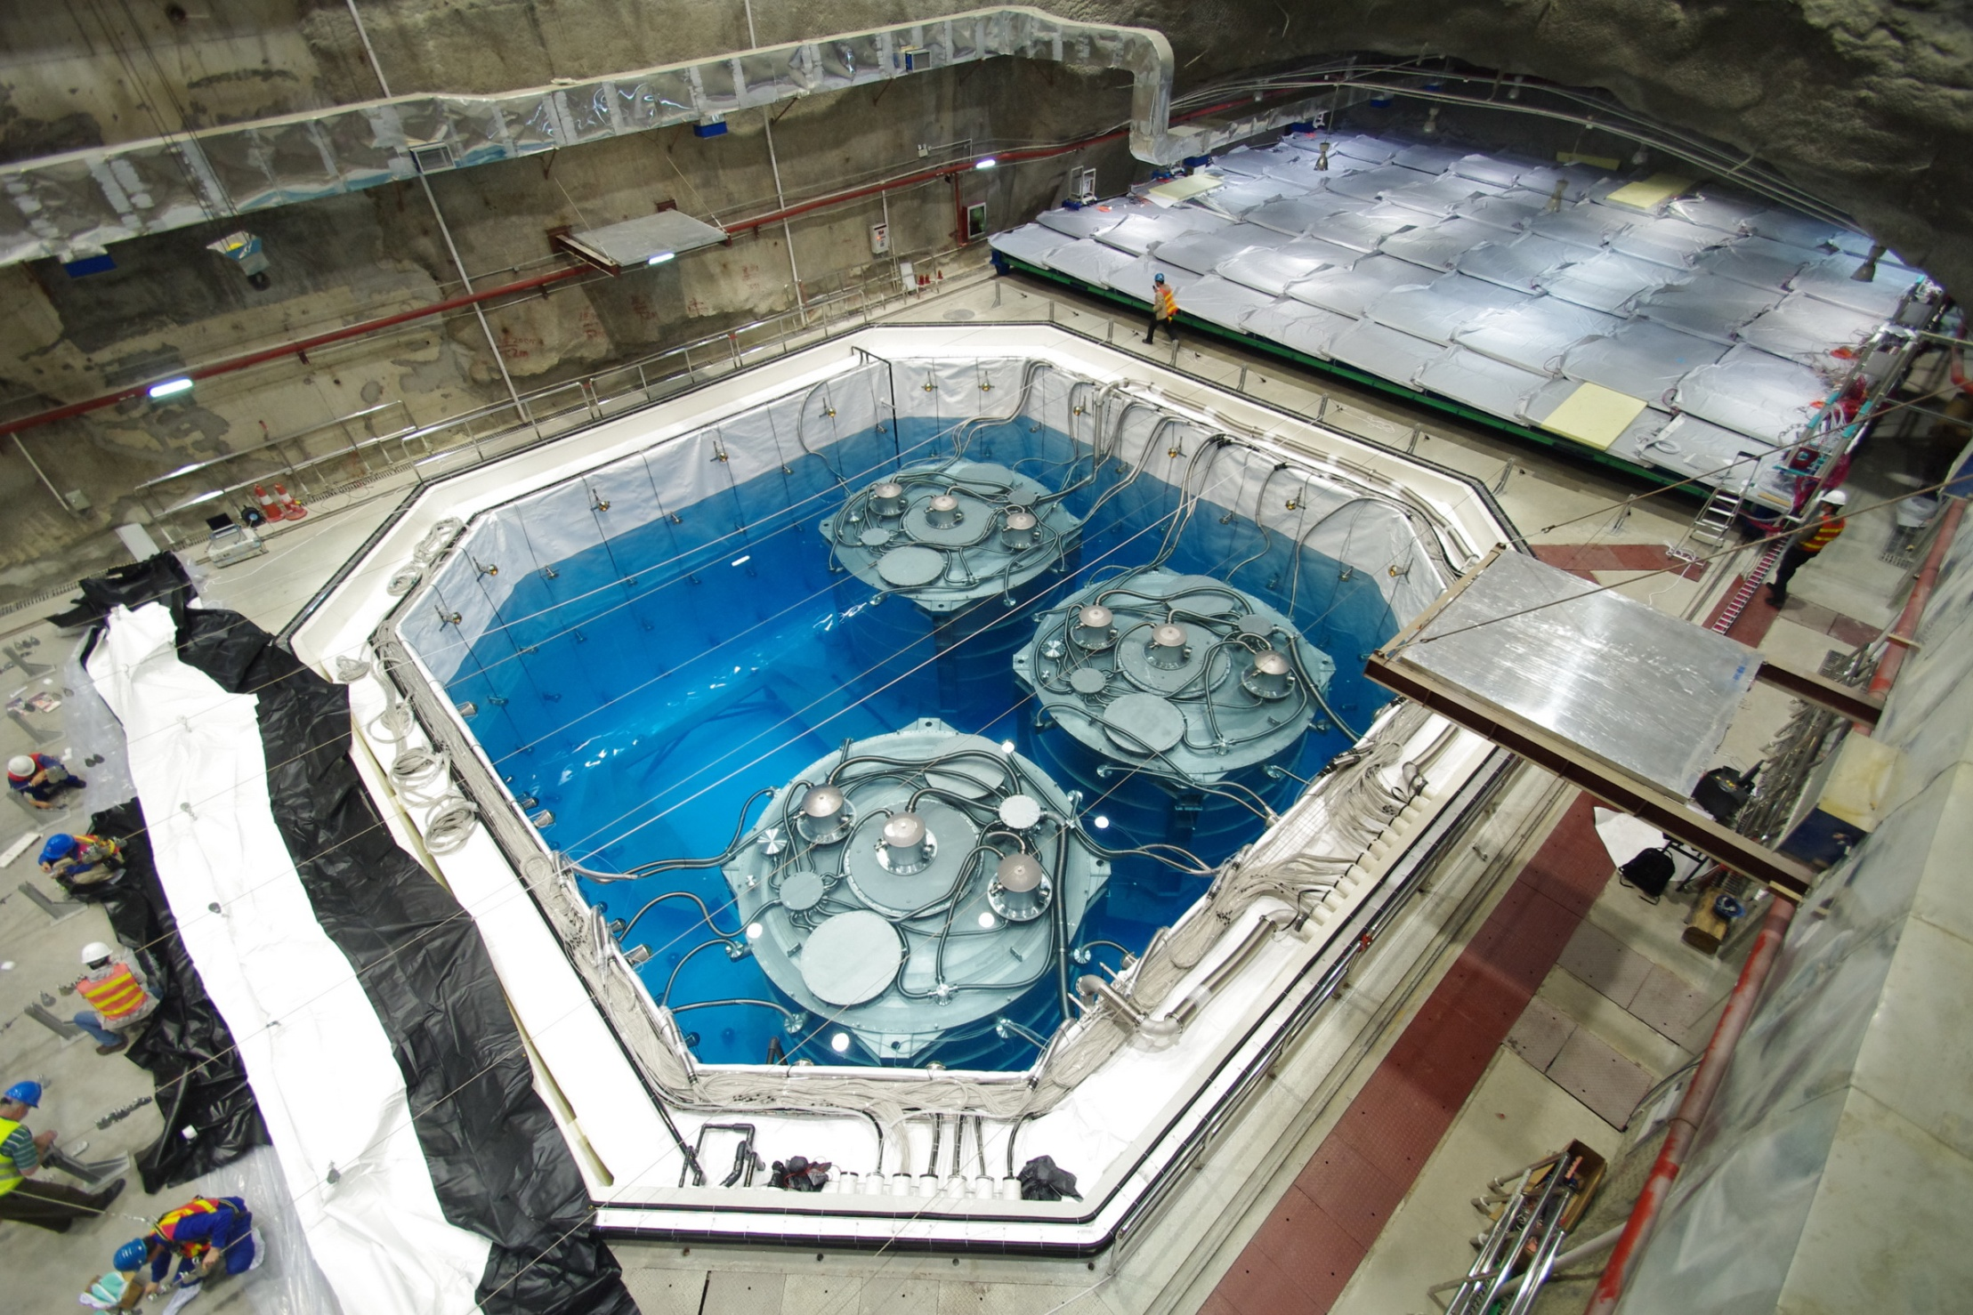
Installation in EH2 and EH3
Hall 2: Began 1 AD operation
on Nov. 5, 2011
Hall 3: Began 3 AD operation on Dec. 24, 2011
2 more ADs still in assembly;
installation planned for
Summer 2012

Slide 20
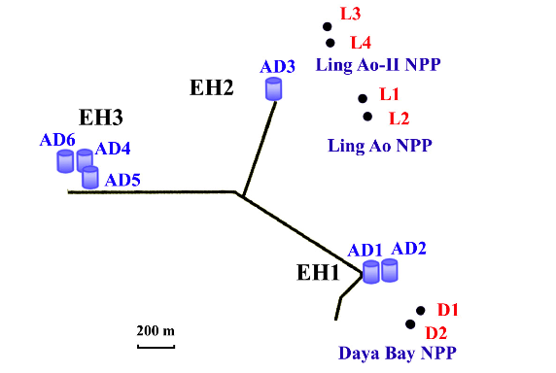
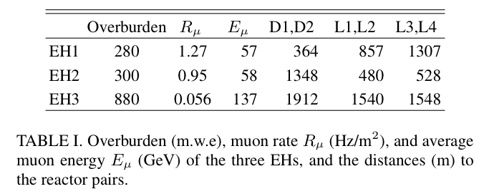
6 Antineutrino Detectors in 3 Halls
EH1 is close to 2 reactors
EH2 is close to 4 reactors
⇒ EH2 much more important in the near/far comparison
6 Reactor Cores

Slide 21
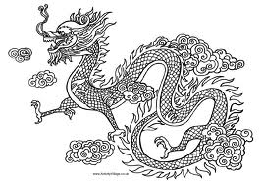
Survey
Detailed Survey:
- GPS above ground
- Total Station underground
- Final precision: 28mm
Validation:
- Three independent calculations
- Cross-check survey
- Consistent with reactor plant
and design plans
2012 = year of the dragon
By Total station (optical)
By GPS

Slide 22
Live Time of First Two Detectors (EH1)
preliminary
We have used the 3 months of data for side-by-side comparison of first two detectors.
Detailed comparison of AD1 and 2: F.P. An et al., http://arxiv.org/abs/1202.6181

Slide 23
Muon Rates at EH1
Measured rates are consistent with expected ~ 20 Hz for each AD at the Daya Bay near site (EH1).

Slide 24
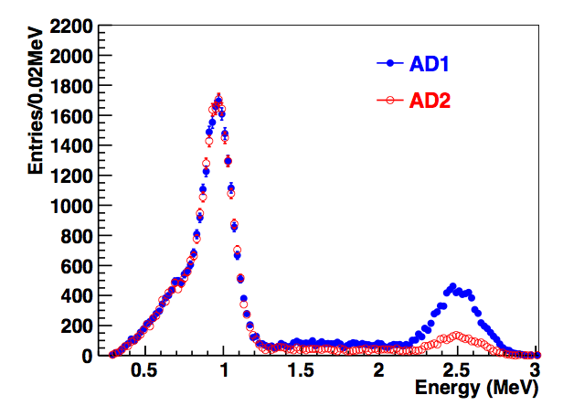
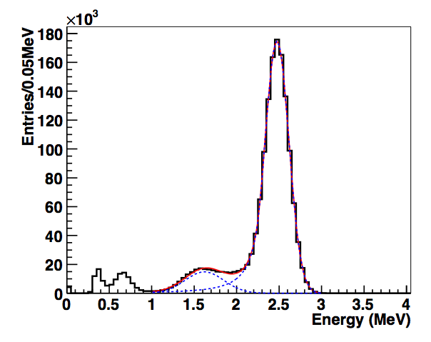
Energy Response with Calibration Sources:
⁶⁸Ge and ⁶⁰Co
⁶⁸Ge Energy Spectrum
⁶⁰Co Energy Spectrum
Preliminary
Preliminary
⁶⁰Co difference
Weekly automatic detector calibration.
Energy responses of the detectors are studied with ⁶⁸Ge, ⁶⁰Co and Am-¹³C.

Slide 25




Energy Spectrum with Am-¹³C/⁶⁰Co Source
Preliminary
2 γ’s from ⁶⁰Co
1 γ from ⁶⁰Co
n from Am-¹³C
N_{AD1,2} is the bin content for AD1 or 2
~ 230 neutrons/day
from Am-C sources
on top of detector,
0.2 accidental
IBD candidates/day
per detector

Slide 26


Calibration with Am-¹³C Source
Prompt signal from proton recoil
Preliminary
Preliminary
Two ADs with similar energy responses (~ 0.5%)
Consistent response in capture time measurements

Slide 27


Spallation-Neutron Energy Spectrum
Preliminary
Flasher PMTs
are turned off
Preliminary
Run-by-run calibration of detectors using spallation neutrons
  ~ 168 p.e./MeV for AD1
  ~ 169 p.e./MeV for AD2
p.e. = photoelectrons detected in a photomultiplier tube.

Slide 28
Singles Energy Spectrum of AD Triggers
After muon veto,
⇒ low-energy events due to radioactivity (mostly in PMTs)
Before muon (offline) veto,
~ 65 kHz with E > 0.7 MeV
Preliminary
Preliminary
The difference in AD1 and AD2 triggers is mostly due to after-pulsing in the PMTs immediately following a muon event (which leads to a relatively large signal).

Slide 29
Selection of Inverse Beta Decay Candidates, 1
Reject “flashers” = emission of light by a PMT, due to secondary emission processes in its dynodes during photoelectron signal amplification.
Prompt “positron”: 0.7 MeV < E_{p} < 12 MeV
Delayed “neutron”: 6.0 MeV < E_{d} < 12 MeV
Neutron capture time: 1 μs < Δt < 200 μs
Muon Veto:
Pool Muon: Reject IBD candidate if < 0.6 ms after pool muon
AD Muon (> 20 MeV): Reject if < 1 ms before IBD candidate
AD Shower Muon (> 2.5GeV): Reject if < 1 s before
Multiplicity cut:
No other AD signal > 0.7 MeV in -200 μs to 200 μs of IBD.
200 μs
200 μs
γ
e⁺
n
γ
t
1 μs < Δe⁺- n < 200 μs

Slide 30

Selection of Inverse Beta Decay Candidates, 2
IBD = Inverse beta decay = ν + p → n + e
Prompt Energy Spectrum
Preliminary
  With Flasher cut, Muon veto, Prompt Energy, Delayed Energy, Time correlation and Multiplicity cuts.

Slide 31



Flasher Cut
A PMT “flash” leads to light collected near that PMT, and on the opposite side of the detector.
Q = charge collected from PMT anode
MaxQ = Q_{max} / Σ Q
Define Quadrant 1 as that which contains the “hottest” PMT
Quadrant = Q_{Quadrant3} / (Q_{Quadrant2} + Q_{Quadrant4})
FID = for IBD candidates, > 0 for “flashers”
Quadrant 3
Quadrant 1 with the flasher PMT

Slide 32

Neutron Capture Time
Consistent IBD capture time measured in all detectors
Relative detector efficiency
estimated within 0.02%
by considering possible
variations in Gd concentration.
Simulation contains no background (deviates from data at > 150 μs)

Slide 33
Inverse-Beta-Decay Candidate Rate
Dashed lines indicate reactor shut down/turn on.
Expected events with all cores ON

Slide 34






Inverse-Beta-Decay Positron Positions in AD1, 3, 6

Slide 35


Background: ²⁴¹Am-¹³C neutrons
Weak (0.5 Hz) neutron calibration source in ACU can mimic IBD via inelastic scattering and capture on iron.
Simulated neutron
capture position
Constrain far site B/S to 0.3 ± 0.3%:
- Measure uncorrelated gamma rays from ACU in data
- Estimate ratio of correlated/uncorrelated rate using simulation
- Assume 100% uncertainty from simulation

Slide 36

Background: Accidentals
Two random single signals can accidentally mimic a prompt-delayed IBD signal
Accidental rate and spectrum
can be accurately predicted
from singles data.
Multiple analyses/methods
estimate consistent rates.
 | EH1-AD1 | EH1-AD2 | EH2-AD1 | EH3-AD1 | EH3-AD2 | EH3-AD3
Accidental rate(/day) | 9.82±0.06 | 9.88±0.06 | 7.67±0.05 | 3.29±0.03 | 3.33±0.03 | 3.12±0.03
B/S | 1.37% | 1.38% | 1.44% | 4.58% | 4.77% | 4.43%
Lower rate of accidentals in EH3 is due to the lower rate of neutrons from cosmic-ray
muons (although rate of neutrons from the retracted Am-C source is the same).

Slide 37


Background: β-n Decay
- Generated by cosmic rays
- Long-lived
- Mimics antineutrino signal
⁹Li
uncorrelated
⁹Li: τ_{½} = 178 ms, Q = 13. 6 MeV
⁸He: τ_{½} = 119 ms, Q = 10.6 MeV
Analysis muon-veto cuts control B/S to ~0.4±0.2%.
Eμ > 4 GeV (visible)
Time since muon (s)

Slide 38


Background: Fast neutrons
Fast Neutrons:
Energetic neutrons produced by cosmic rays (inside and outside of muon-veto system)
Mimics antineutrino (IBD) signal:
- Prompt: Neutron collides/stops in target
- Delayed: Neutron captures on Gd
Constrain fast-n rate using
IBD-like signals in 10-50 MeV
Analysis muon-veto cuts control B/S to 0.06% (0.1%) of far (near) signal.
Validate with fast-n events
tagged by muon veto.

Slide 39

Background: ¹³C(α,n)¹⁶O
Potential alpha sources:
²³⁸U, ²³²Th, ²³⁵U, ²¹⁰Po:
Each of them are measured in-situ:
U & Th: cascading decay of
Bi (or Rn) – Po – Pb
²¹⁰Po: spectrum fitting
Combining (α,n) cross-section, correlated background rate is determined.
Example alpha rate in AD1 | ²³⁸U | ²³²Th | ²³⁵U | ²¹⁰Po
Bq | 0.05 | 1.2 | 1.4 | 10
Near Site: 0.04+-0.02 per day, B/S (0.006±0.004)%
Far Site: 0.03+-0.02 per day, B/S (0.04±0.02)%

Slide 40
Data Set Summary
 | AD1 | AD2 | AD3 | AD4 | AD5 | AD6
Antineutrino candidates | 28935 | 28975 | 22466 | 3528 | 3436 | 3452
DAQ live time (day) | 49.5530 |  | 49.4971 | 48.9473
Veto time (day) | 8.7418 | 8.9109 | 7.0389 | 0.8785 | 0. 8800 | 0.8952
Efficiency | 0.8019 | 0.7989 | 0.8363 | 0.9547 | 0.9543 | 0.9538
Accidentals (/day) | 9.82±0.06 | 9.88±0.06 | 7.67±0.05 | 3.29±0.03 | 3.33±0.03 | 3.12±0.03
Fast neutron (/day) | 0.84±0.28 | 0.84±0.28 | 0.74±0.44 | 0.04±0.04 | 0.04±0.04 | 0.04±0.04
⁸He/⁹Li (/day) | 3.1±1.6 |  | 1.8±1.1 | 0.16±0.11
Am-C corr. (/day) | 0.2±0.2
¹³C(α, n)¹⁶O (/day) | 0.04±0.02 | 0.04±0.02 | 0.035±0.02 | 0.03±0.02 | 0.03±0.02 | 0.03±0.02
Antineutrino rate (/day) | 714.17 ±4.58 | 717.86 ±4.60 | 532.29 ±3.82 | 71.78 ±1.29 | 69.80 ±1.28 | 70.39 ±1.28

Slide 41


Reactor Flux Expectations
Antineutrino flux is estimated for each reactor core
Flux estimated using:
Isotope fission rates vs. reactor burnup
Reactor operators provide:
- Thermal power data: W_{th}
- Relative isotope fission fractions: f_{i}
Energy released per fission: e_{i}
V. Kopekin et al., Phys. Atom. Nucl. 67, 1892 (2004)
Antineutrino spectra per fission: S_{i}(E_{ν})
K. Schreckenbach et al., Phys. Lett. B160, 325 (1985)
A. A. Hahn et al., Phys. Lett. B218, 365 (1989)
P. Vogel et al., Phys. Rev. C24, 1543 (1981)
T. Mueller et al., Phys. Rev. C83, 054615 (2011)
P. Huber, Phys. Rev. C84, 024617 (2011)
Flux model has negligible impact on
far vs. near oscillation measurement

Slide 42

Antineutrino Detection Rate vs. Time
Detected rates strongly
correlated with reactor
flux expectations.
Predicted Rates: (in figure)
- Assumes no oscillation.
- Normalization is determined
by fit to data.
- Absolute normalization is
within a few percent of
expectations.

Slide 43

Uncertainty Summary
For near/far rate analysis , only uncorrelated uncertainties are relevant.
Largest systematics are smaller than far site statistics (~1%)
Influence of uncorrelated reactor systematics reduced (~1/20) by far vs. near measurement.

Slide 44

Far vs. Near Rate Analysis
Compare the far/near measured rates (and spectra)
M_{n} is the measured IBD rate in detector n.
Weights α_{i}, β_{i} are determined from baselines and reactor fluxes.
α ~ 0.014, β ~ 0.10
⇒ EH2 weighted 7 times EH1
0 3 MeV 6 9 12
R = 0.940 ± 0.011 (stat) ± 0.004 (syst)
Clear observation of far-site deficit.
Spectral distortion consistent with
oscillation.*
Caveat: Spectral systematics not fully studied; θ₁₃ value from shape analysis is not recommended.

Slide 45

χ² Rate Analysis
“Pull” χ² analysis.
No constraint on absolute normalization.
Fit on the near-far relative measurement.
Sin²2θ₁₃ = 0.092 ± 0.016(stat) ± 0.005(syst)
χ²/NDF = 4.26/4
5.2 σ for non-zero θ₁₃

Slide 46
Summary
- The Daya Bay reactor neutrino experiment has made
an unambiguous observation of reactor electron-antineutrino
disappearance at ~ 2 km for E_{ν} ~ 3 MeV:
Interpretation of this disappearance as neutrino oscillation in a 3-neutrino context yields, via a χ² analysis:
ruling out zero at 5.2 standard deviations.
θ₁₃ = 8.8° (or 81.2°?), sin²θ₁₃ = 0.024
- Installation of final pair of antineutrino detectors this Summer
R_{far/near} = 0.940 ± 0.011 (stat) ± 0.004 (syst)
sin²2θ₁₃ = 0.092 ± 0.016 (stat) ± 0.005 (syst)

Slide 47

Could θ₁₃ Be Near 90°?
In the 3-ν context, taking Δm²₁₃ ∼ Δm²₂₃, the ν_{e} survival probability is
For large L, the 2nd term averages to (1/2) sin²2θ₁₃ ~ 0.04, such that
If θ₁₃ ~ 81°, then no oscillations could be seen in long baseline experiments with reactor or solar neutrinos.
The clear evidence for oscillations in the KamLAND experiment excludes that θ₁₃ is near 90°.
Phys. Rev. Lett. 100, 221803 (2008)
Using our value for θ₁₃ = 8.8°,
5% increase in sin² θ₁₂ compared to
previous fits.

Slide 48

Asymmetric Confidence Intervals in θ₁₃

Slide 49


Slide 50

RENO Experiment
Yonggwang Nuclear Power Plant
Six ~ 3 GW_{e} reactors along a line.
1 Near and 1 Far detector, each 16 tons.
229 days of data since August 2011.
294.3 m
reactor
detector
~256 m
1383.1 m
sin²2θ₁₃ = 0.113 ± 0.013 (stat) ± 0.019 (syst.)
http://arxiv.org/abs/1204.0626
(Apr. 8 ,2012)

Slide 51

Projected Uncertainty for Future Running of the Daya Bay and RENO Experiments
Next Daya Bay analysis will be based on 140 days of operation.

Slide 52



Update of Daya Bay Analysis through May 17, 2012
χ² fit result: sin²2θ₁₃ =
0.089 ±0.010(stat) ±0.005(syst)
χ²_{min} = 3.4
7.7σ non-zero

Slide 53


