Slide 1
RPC Operation
Jilei, Qingmin, Changguo, Ningzhe
2013/4/3

Slide 2
Outline
EH1 RPC gas and data fluctuate.
EH2,3 data running status
Electronics
HV
Conclusions

Slide 3
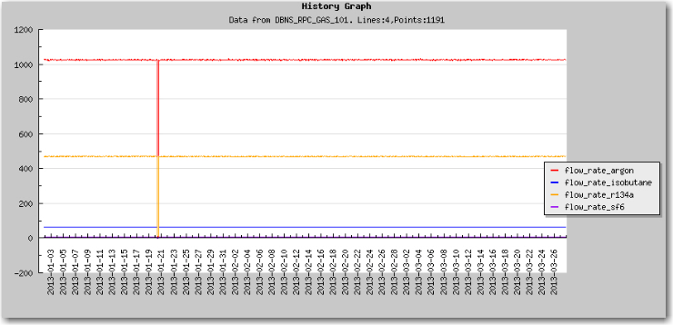
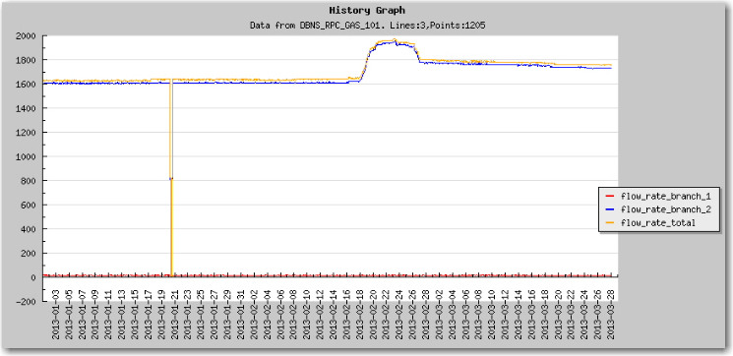
EH1 RPC gas purity
During 2/18 – 2/26/2013 EH#1 RPC gas flow rate showed anomaly, the total gas and branch #2 flow rate displayed a bump, but all four gases showed quite stable rates.
Flow rates of 4 gases show no change in 2/18 – 2/26 period.
But total and branch #2 flow rates show a big bump in 2/18 – 2/26 period.

Slide 4
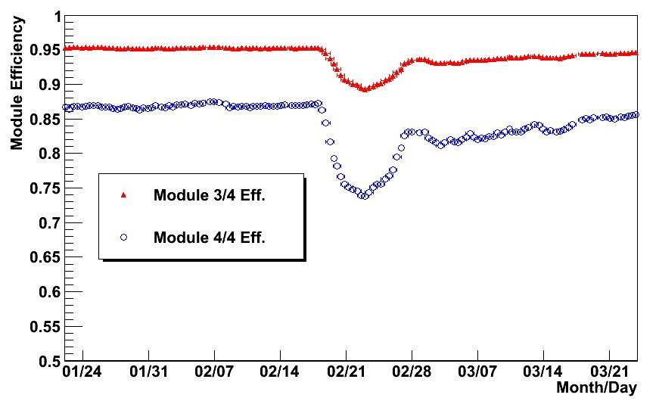
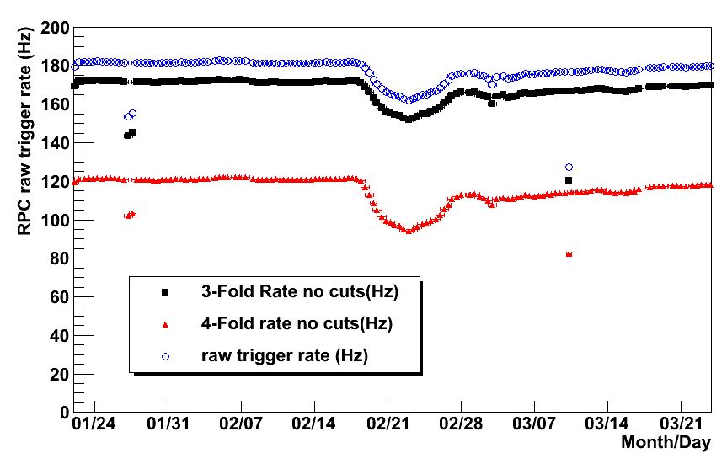
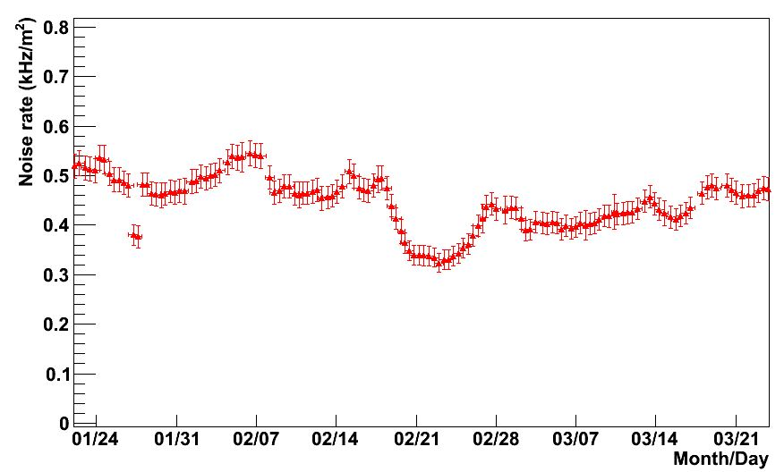
Performance of EH#1 RPC
During that time period the performance of EH#1 RPC system had quite noticeable change. The efficiency was ~7% lower! That is clear indication that gas mixing ratio was changed during that time.

Slide 5
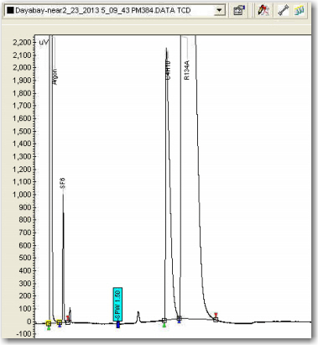
Gas chromatograms (Changguo)
We did find some small peaks stand out during that period.
2/23/2013 EH#1
2 additional peaks showed up

Slide 6
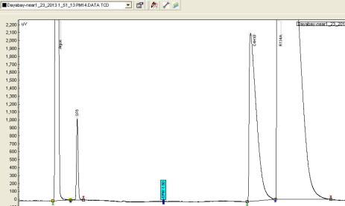
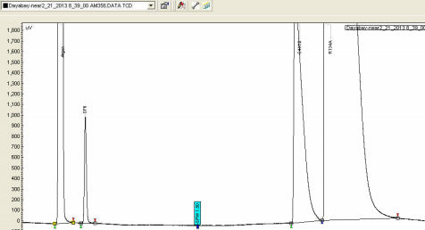
A possible explanation of the performance degradation (Changguo)
As I learned from Jilei and Hansheng, EH#1 changed R134A at 8:35 am, 2/23, changed Isobutane at 22:00, 03/05. We trace down the seen extra small peaks and to see which gas cylinder is responsible to these extra peaks thru the following chromatograms:
1/23/2013 chromatogram showed no extra peaks.
2/21/2013 chromatogram showed no extra peaks, that means before R134A change, there was no extra impurity peak.

Slide 7
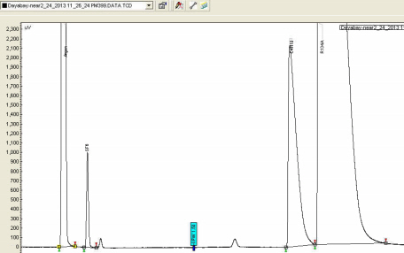
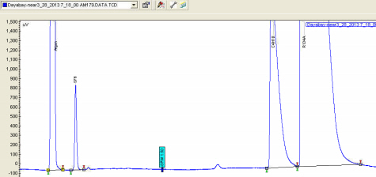
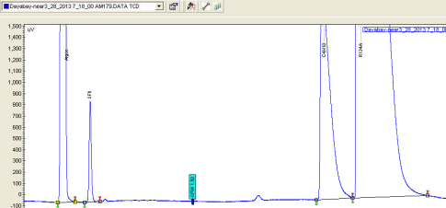
A possible explanation of the performance degradation (cont’d)
3/20/2013
2/25/2013 chromatogram showed profound extra peaks.
3/28/2013
Since 2/25 to now the small peaks remain in the chromatogram, however there is a tendency that the extra peaks are diminishing. This might be a clue that these peaks are produced by lighter impurity of R134A, which is boiling off faster than R134A.
3/20 and 3/28 chromatogram showed smaller peaks.

Slide 8
Puzzling
03/05 isobutane
02/23 R134a
An almost exhaust cylinder, but no extra peak found from GC.
A new cylinder, 2 extra peaks found from GC, but efficiency is going up.
Efficiency valley may not caused by the extra peaks.
But it strongly relate to gas cylinder change.

Slide 9
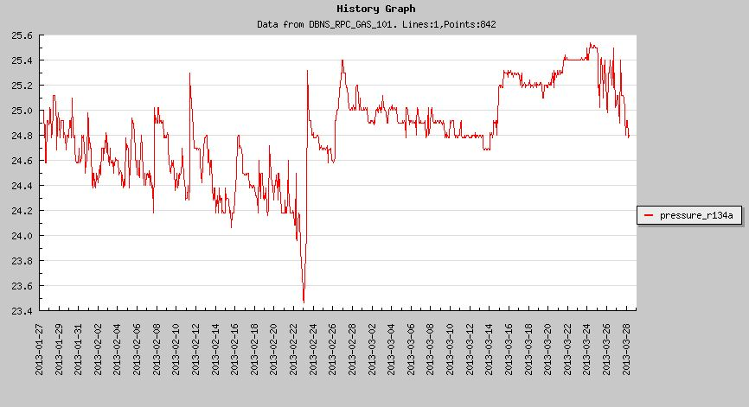
R134a exaust
Pressure of R134a
02/23
To be safe side, I suggest if the rest of R134a gas <5kg in cylider, we’d better not use it. Means we just use about 95% gas of the cylinder.
So gas operator is better to change the bottle a couple of days in advance.

Slide 10
Gas peaks shifting(Changguo)
I also notice that the gas peak’s positions (retaining time) are changing from time to time. We didn’t put the retaining time information into database before. It looks useful to have these retaining times in the database. I have modified the software, beginning from 3/27/2013 the peak retaining times are available. We can monitor the peaks to see if any performance change related to the peak position.

Slide 11
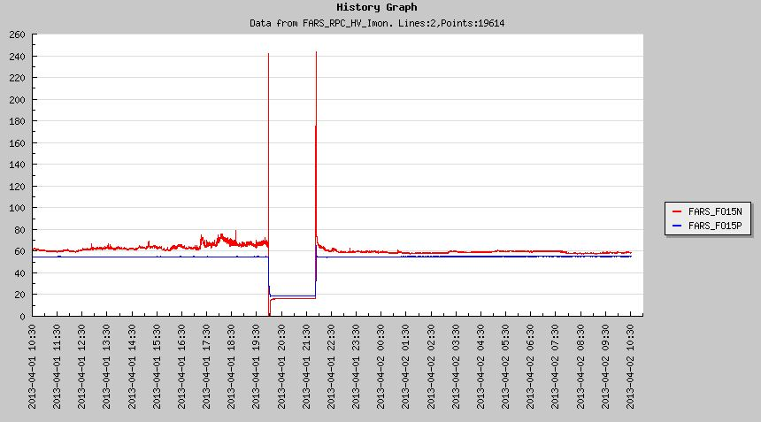
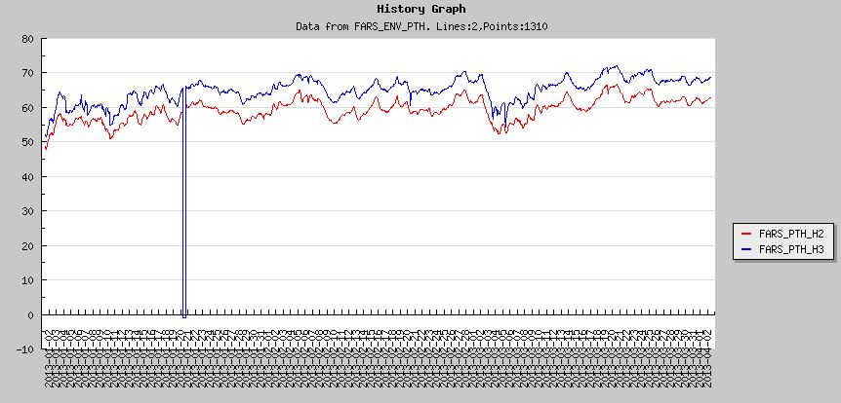
HV
Working stably.
Except one pair of HV channel trip in EH3.
RPC HV 15NP channel trip at Apr 1, 20:00-22:00.
HV 15NP current
24 hour plot
Humidity
Time begin Jan. 1
This is the 1st tripping happened after last commissioning, I think maybe it is because the moist weather in southern of china comes.
I checked the humidity from Jan. to now, the humidity had increased about 10%. so the insulation at some place may become weak.
The accumulated charge sometimes sparks at there.

Slide 12
Electronics
Working stably.
Except one “data check error” happened in EH2, March 31.
Fixed, after reboot RPC VME power.
Maybe too long time power on for VME and caused the time series had some error.

Slide 13
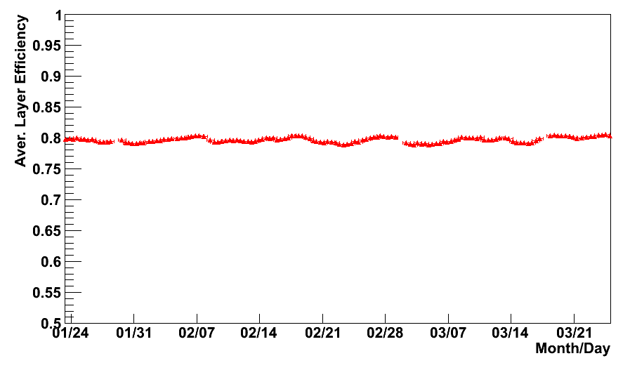
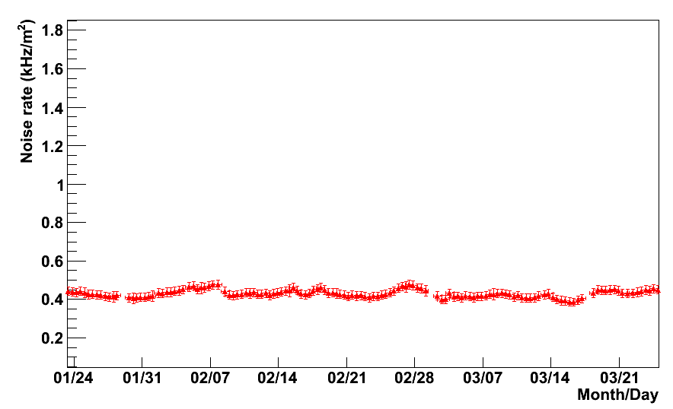
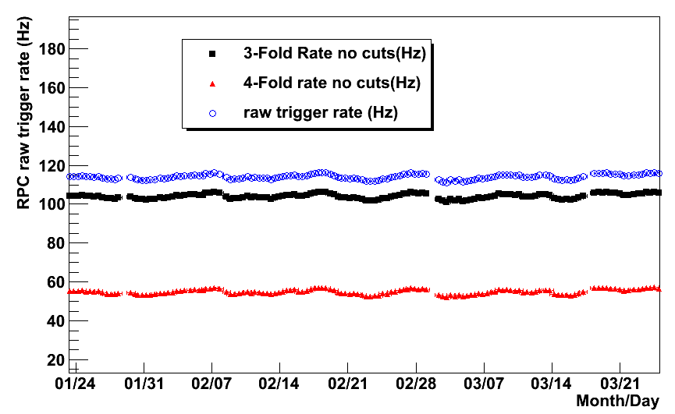
EH2 running status
Aver. Layer Efficiency.
Noise Rate
Running stable
No obvious abnormal.
Trigger Rate

Slide 14
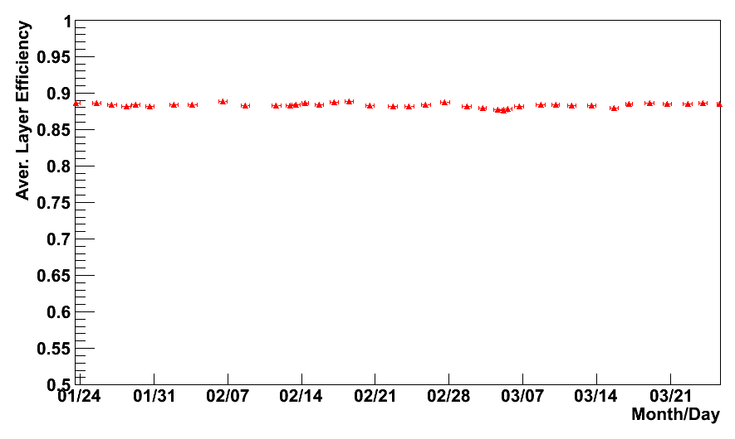
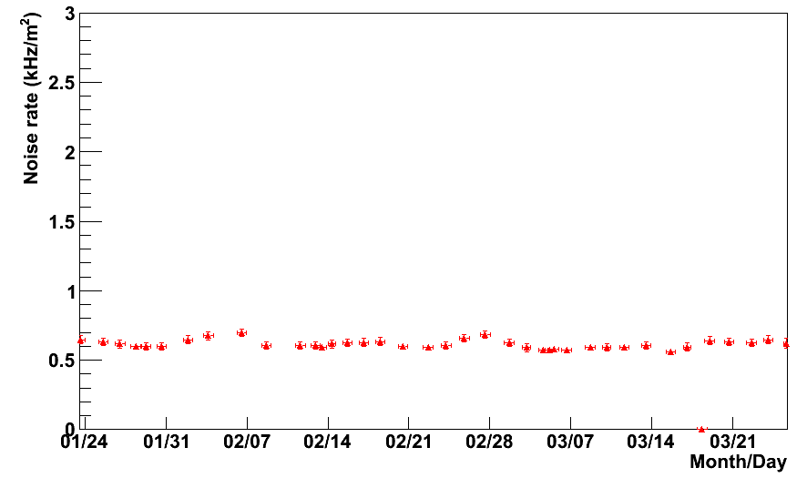
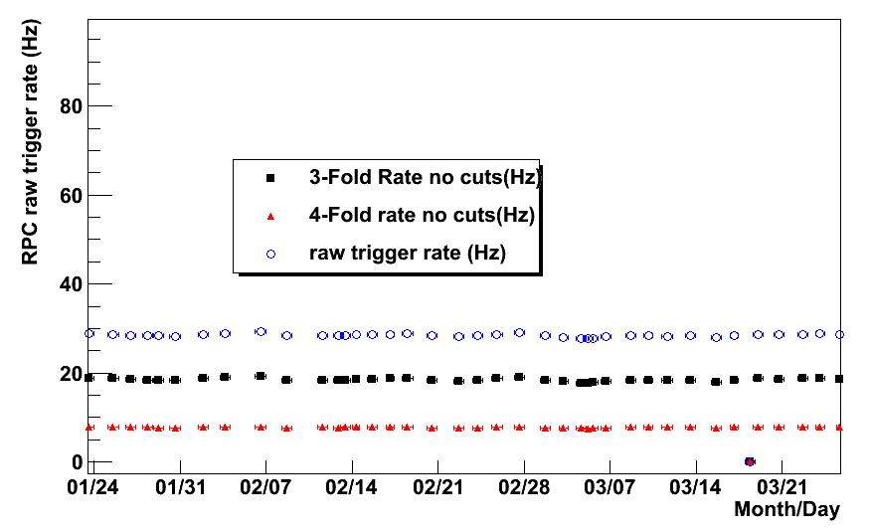
EH3 running status
Aver. Layer Efficiency.
Noise Rate
Running stable
No obvious abnormal.
Trigger Rate

Slide 15
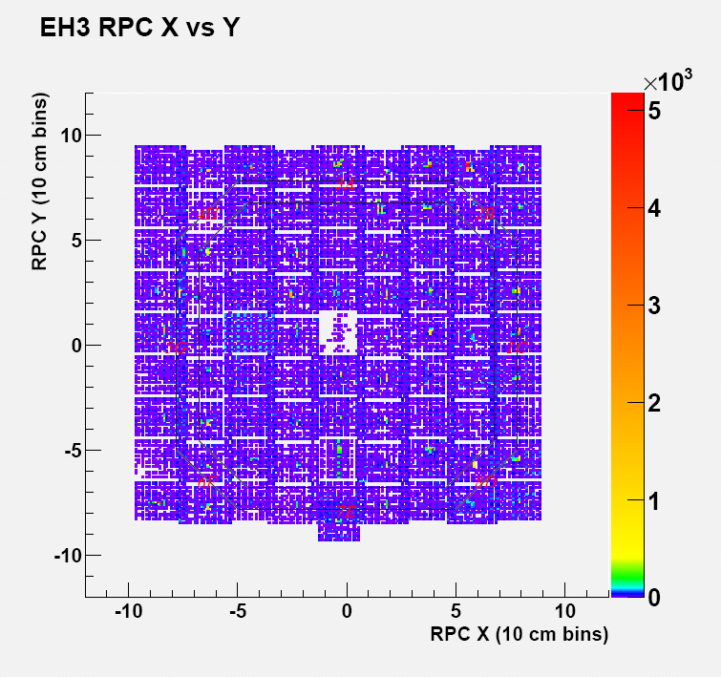
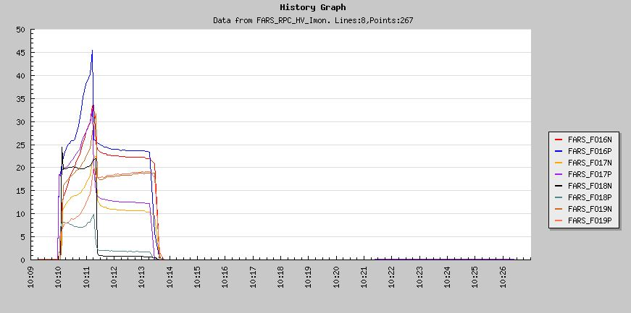
About EH3 5.5 dead module
Charge Current test
1st layer
4th layer
3rd layer
2nd layer
16NP connect 1st layer, 17NP = 3rd layer, 18NP = 2nd layer, 19NP = 4th layer. Tested in 18 March.
Power on HV, there are charge currents for each layer. Means the 4 couple HV channels all have loads(module). Disconnect the load, the charge current is almost zero. Means the HV cable connection is OK.

Slide 16
After HV reach the set value, current is stable, but 2nd layer current is very small, almost 0. That is why we think the 2nd layer disconnected tested by Viktor and Zhimin. http://web.dyb.ihep.ac.cn:8099/RPCs/204
The FEC Electronics self-test no error found.
Gas pipe is bubbling. No gas leakage for this module.
All the connections are OK, however, very little hits. So this module is still puzzling us. One possible reason is the spacers in RPC chambers in the module unglued much.

Slide 17
Conclusions
EH1 RPC data have a valley, may caused by RPC gas. From the data we can see it is slowly going back to normal.
Suggest change the cylinder a couple of days in advance before gas cylinder exhaust.
EH2 and EH3 is running stably.
HV trip appeared once in EH3, fixed.
Electronics error appeared once in EH2, fixed.
The reason of 5.5 module rare triggers is still un-confirm.

