Slide 1
Updated RPC Gas System Installation Plan
Changguo Lu
Princeton University

Slide 2
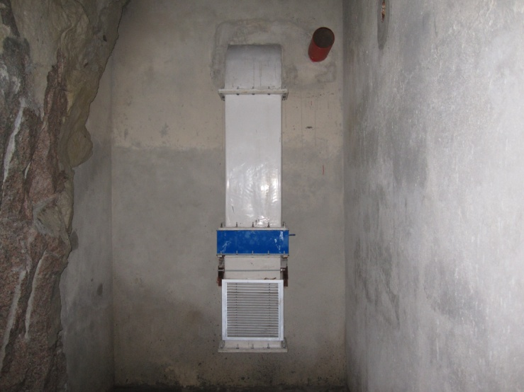
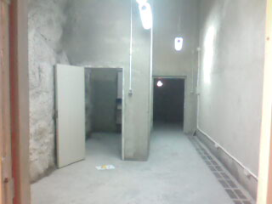
Outline of the installation schedule
The tasks relevant to RPC gas system installation in MuonInstallationRLS.mpp
Gas room
Gas cabinet vent port
Gas room vent port
Gas room
Gas mix room

Slide 3
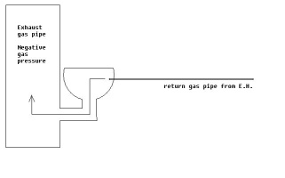
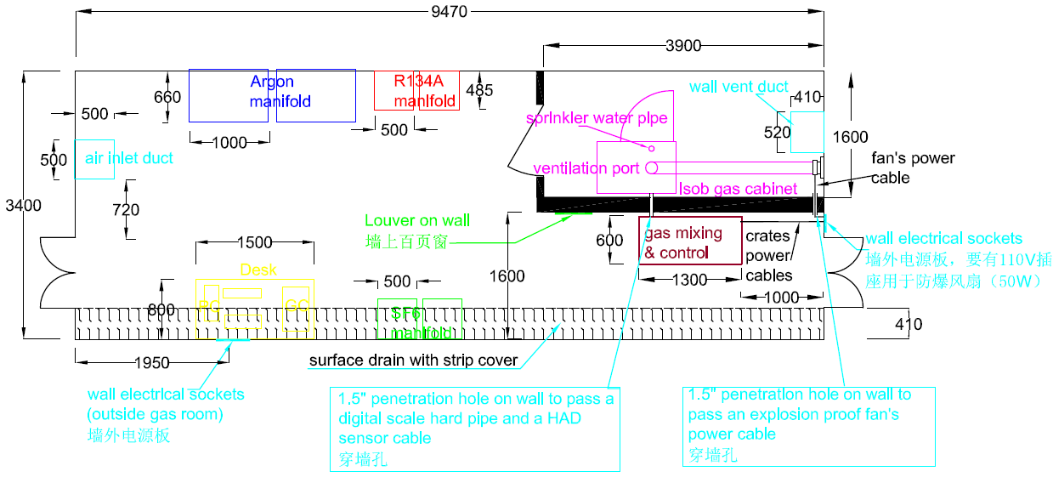
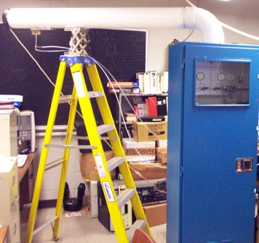
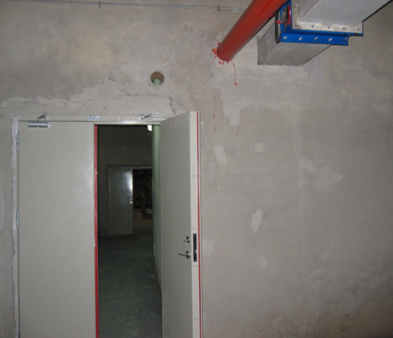
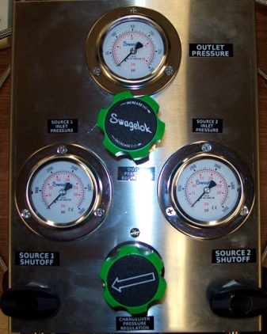
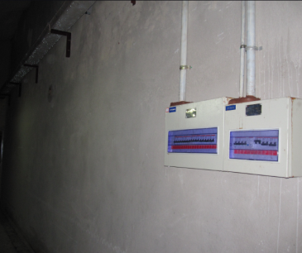
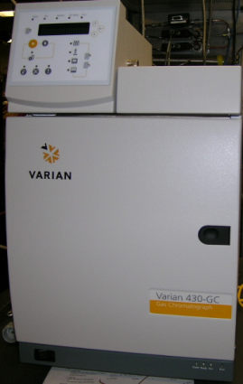
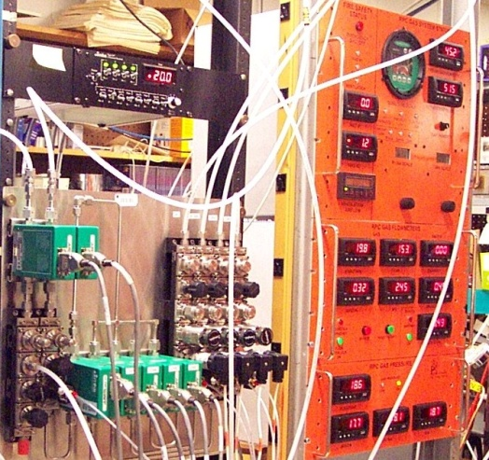
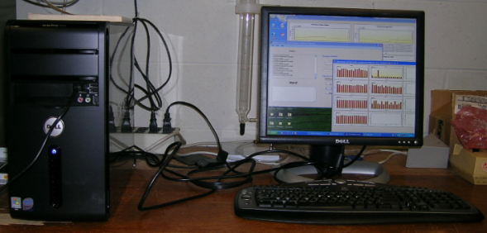
Layout of the gas/gas mixing rooms
View direction
Wall power strip location
Wall power strip location
GC
PC

Slide 4
Detailed plan for WBS items
3.1.12 Daya Bay near hall RPC gas system and three GC systems delivered to Daya Bay by 8/30/2010;
6.4.6 Install gas mixing/control system and 2 GC systems, DCS interface boxes, 10/8 – 11/5/2010 (we may need to start this task earlier due to the warranty deadline for 2 GCs is due on 10/21/2010)
Prerequisites:
Shipping boxes of gas mixing/control system and GCs delivered to gas/gas mixing rooms;
Network wall plugs activated;
DCS interface box cable ready, Desk for PC and GC;
Power line activated;
Water line for sprinkler installed.
Manpower:
C. Lu, (possible S. Chidzik) + Chinese labor contractor.

Slide 5
Detailed plan for WBS items (cont’d)
Chinese labor contractor tasks:
Install gas manifolds for Argon, SF6 and R134A in gas mixing room;
Route copper gas pipe from gas mixing panel to EH1;
Hook up 6” gas ventilation pipe of the gas cabinet to gas room venting port;
Connect water pipe to gas cabinet sprinkler;
Mount emergency shut-off switch on wall and route wires to gas control panel.
Coordination with other Muon installation tasks:
Since this part of gas system installation is within gas/gas mixing rooms, it won’t interfere with any other installation tasks.

Slide 6
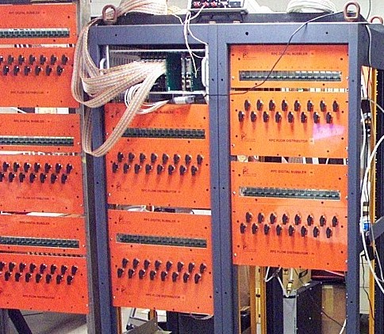
Detailed plan for WBS items (cont’d)
6.4.7 Install gas distribution and digital bubbler system in 10/8 – 11/5/2010
Temporally install it in gas mixing room.
Prerequisites:
Gas racks are available.
Manpower:
Princeton will take care of this installation. Occasionally may need 1 or 2 assistants from labor contractor.
Coordination with other Muon installation tasks:
There is no foreseeable conflict with other installation tasks during this period.

Slide 7
Detailed plan for WBS items (cont’d)
6.8 Connect gas tubing between RPC modules and gas distribution & digital bubbler crates in 12/21 – 1/10/2011.
Prerequisites:
Gas distribution/digital bubbler crates moved onto supporting structure and tested in-situ;
Utility tray on RPC module supporting structure installed.
Manpower:
Princeton supervises the installation, Chinese labor installs.
Coordination with other Muon installation tasks:
We need to coordinate with HV cable installation.
Chinese labor contractor’s tasks:
Cut plastic tubing to length and label two ends of each tube;
Connect each end to its destination connector.
IHEP may want to install support structure earlier, so this task also can be done earlier.

Slide 8
Detailed plan for WBS items (cont’d)
6.9.2 Route Cables & Gas Lines in Flex Tray (1/18/2010 – 2/1/2011)
Prerequisites:
Gas pipe from gas mix room to EH has installed;
Gas distribution/digital bubbler racks have moved to supporting structure.
Manpower:
Princeton supervises, Chinese labor installs.
Coordination with other Muon installation tasks:
Since HV cables also need to be installed into the flex tray, we need to coordinate these two tasks.
Chinese labor contractor’s tasks:
Lay down the hose into the tray and connect each end to its destination connector.

Slide 9
Detailed plan for WBS items (cont’d)
6.9.3 Run and test entire RPC system, 2/2/2011 – 3/30/2011
Princeton will maintain the gas system at this start-up period, locally or remotely. Right now it is still too early to make detailed plan for this task.

