Slide 1
RPC Gas System Operation
Report
for October, 2013
- Changguo Lu, Hansheng Sun

Slide 2
RPC gas system is running smoothly in October.
We have preformed some system maintenance:
Replaced saturated moisture filters for 3 Gas Chromatograph systems;
Readjusted the zero point for all gas flow controllers;
Adjusted the flammable gas sensor’s zero point.

Slide 3
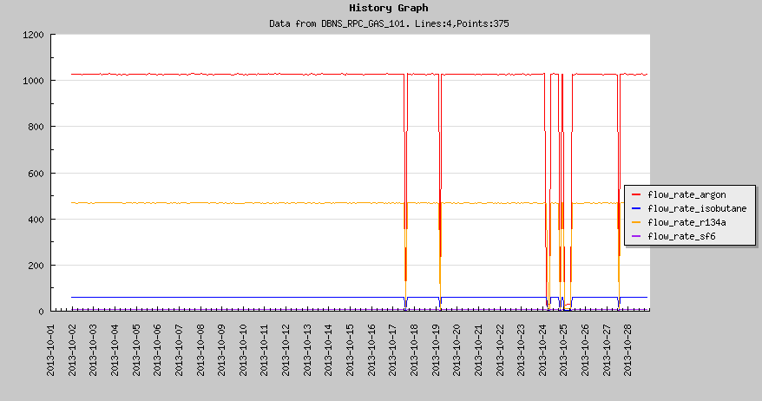
Gas flow rate of EH#1:
1-st and 2-nd drops were due to power shutdown, manually restored the gas flow. The causes for following several drops are not known yet.

Slide 4
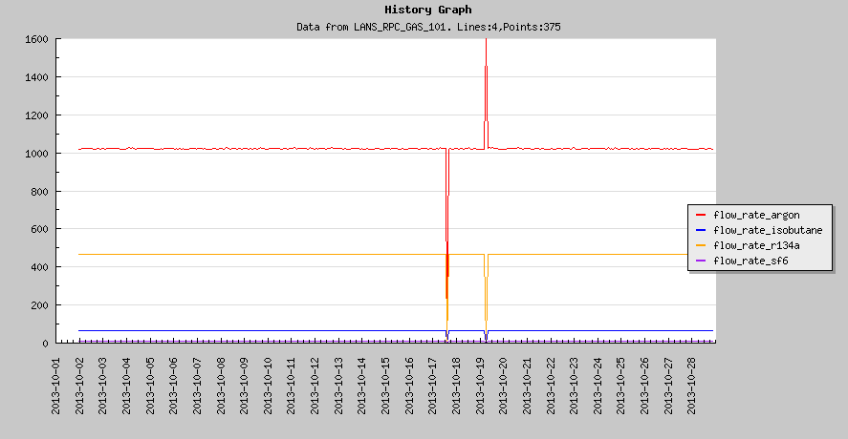
Gas flow rate of EH#2:
Two spike/drops were due to power shutdown.

Slide 5
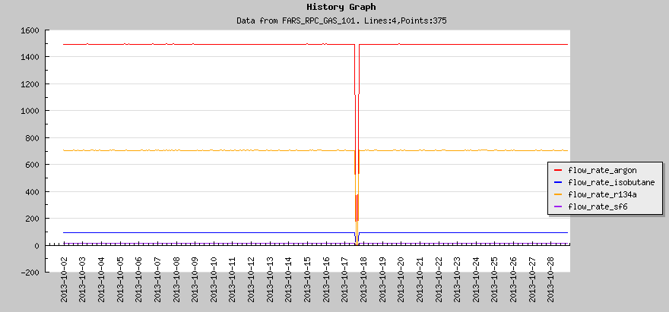
Gas flow rate of EH#3:
One drop was due to power shutdown.

