Slide 1
Completion of DYB near hall RPC gas system installation
Changguo Lu, Princeton University
Sun Hansheng, Guan Mengyun, Xu Jilei, IHEP
Viktor Pec, Charles University

Slide 2
Schedule
Our original gas system installation plan from July 14, 2010 Muon installation workshop:
Done, November 5-th, 2010, as scheduled
Done, March 31, 2011, as scheduled.
Remaining things:
Replace exhausting gas tubing with thicker pipe,
Debugging/Monitoring digital bubbler readout and gas chromatograph system.

Slide 3
What have been done for RPC gas system installation since last November
Installed gas distribution crates on RPC module supporting frame;
Connected gas tubing from modules to distribution crates;
Finished up the cable trays for gas room gas pipe, cables, power cores, etc.
Connected fire water pipe to the gas cabinet and tested;
Posted signs on Isobutane gas room door, gas cabinet, fire water pipes, valves, locked fire water valves to meet safety requirement;
Established the communication between host pc in the gas room and digital bubbler readout crate on the RPC module supporting frame;
Calibrated all four gases with Daya Bay near hall GC. Repaired Linao near hall GC (left over from previous vender’s installation) and found new defect part for this GC;
DGUT group has installed the detector control system interface box.

Slide 4
What have been done for gas system installation(cont’d)
6 gas system procedures and 5 checklists have passed ORR review and translated into Chinese and conducted 2 gas system training sessions on site;
Got approval from LSO to bring Isobutane cylinder into gas room, successfully mixed Daya Bay RPC gas mixture and flow through all 108 channels;
Tested gas system in full flow range (2 volumes/day). Found the original exhausting gas tubing too small that needs to be replaced.

Slide 5
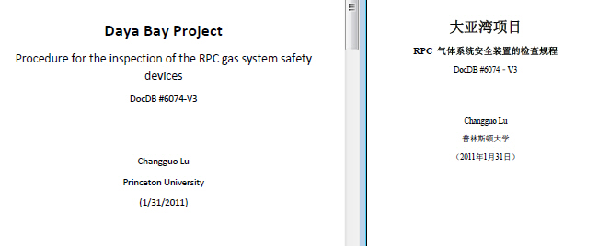
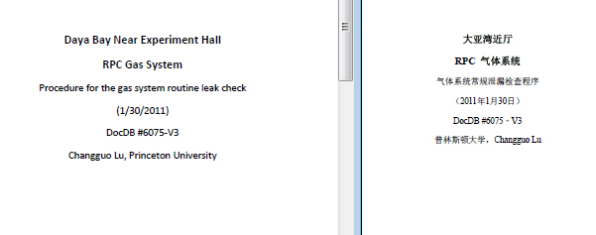
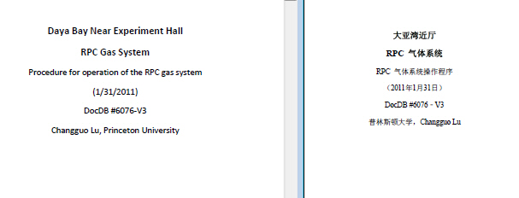
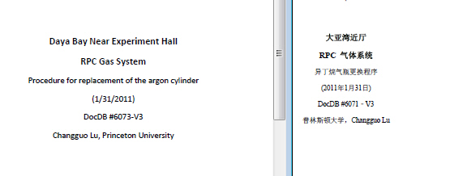
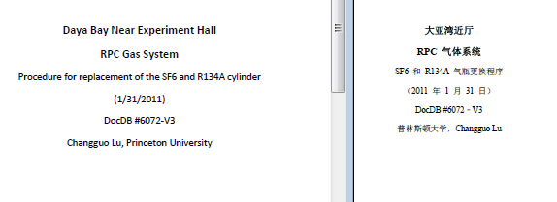
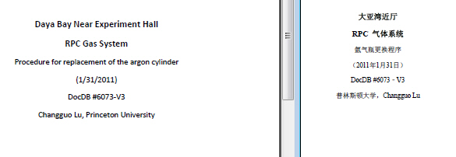
Gas system procedures and checklists
DocDB #6071 - #6076:
DocDB #6071 Procedure for replacement of the Isobutane cylinder w/ checklist;
DocDB #6072 Procedure for replacement of the SF6/R134A cylinder w/ checklist;
DocDB #6073 Procedure for replacement of the argon cylinder w/ checklist;
DocDB #6074 Procedure for the inspection of the RPC gas system safety device w/ 2 checklistss;
DocDB #6075 Procedure for the gas system routine leak check;
DocDB #6076 Procedure for operation of the RPC gas system.

Slide 6
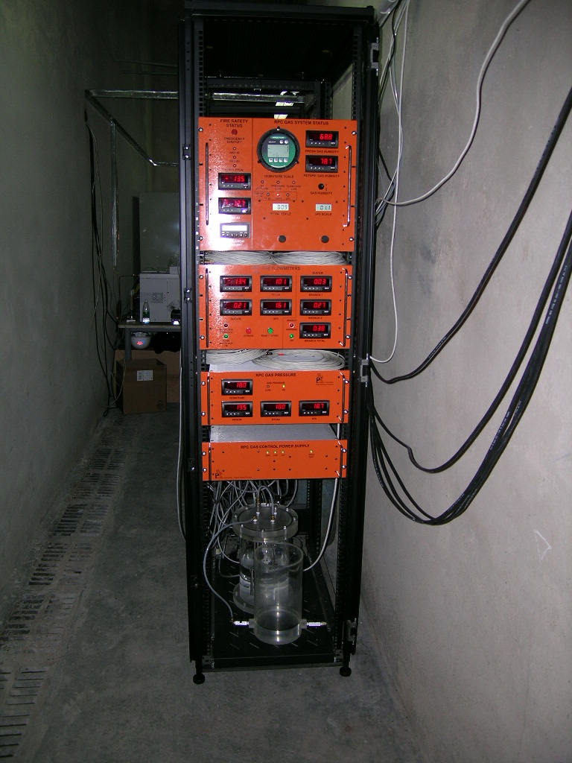
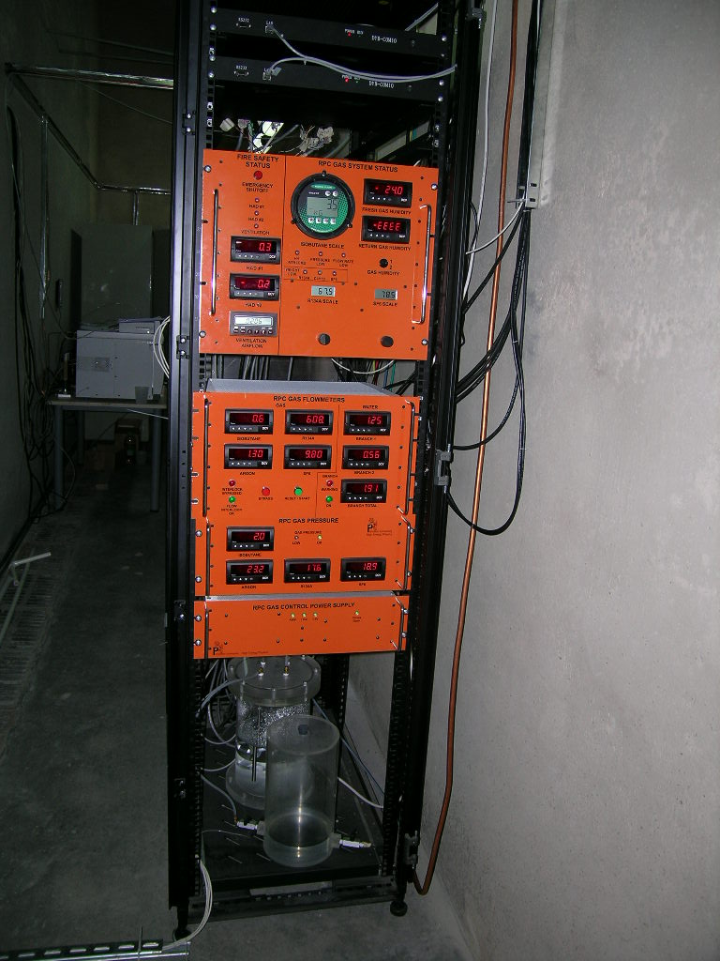
Cable tray in gas room
Was
Now
Cable tray installed

Slide 7
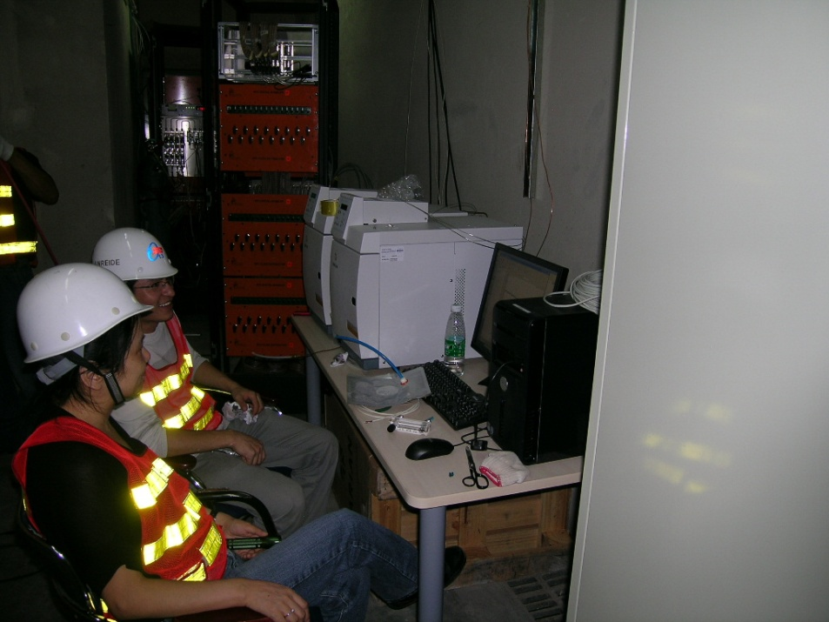
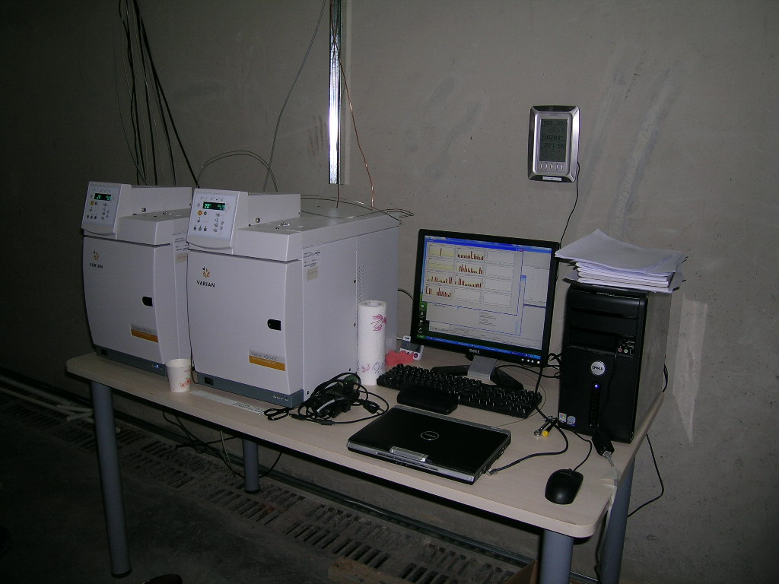
Cable tray (cont’d)
Was
Now

Slide 8
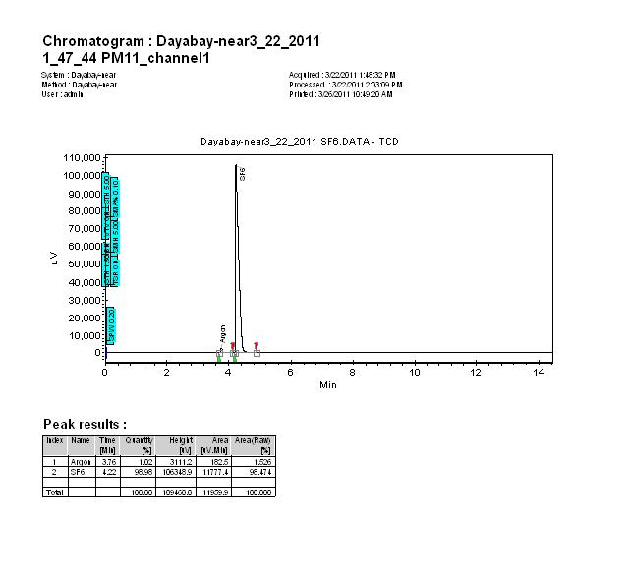
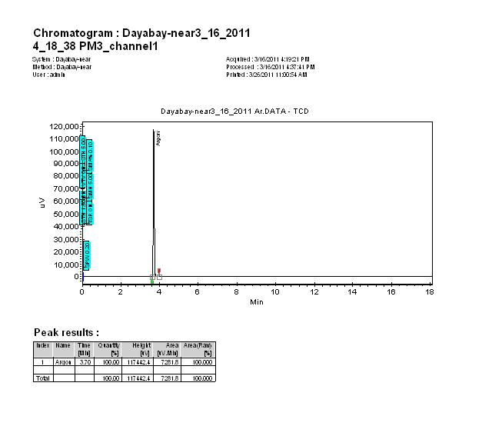
GC calibration chromatograms
SF₆
Ar

Slide 9
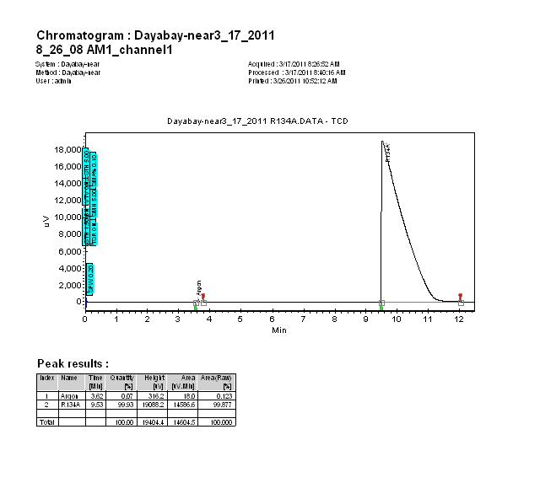
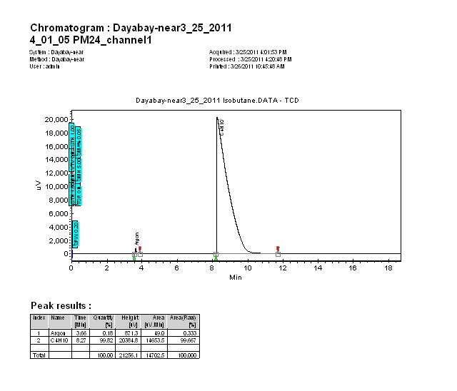
GC calibration chromatograms (cont’d)
R134A
Isobutane

Slide 10
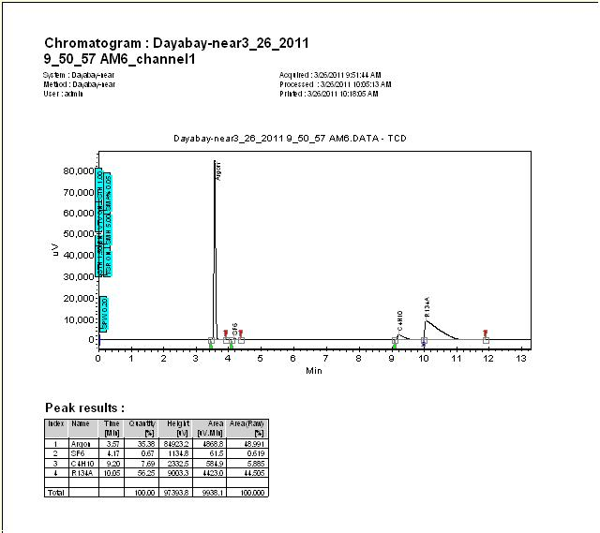
Daya Bay RPC gas mixture
Raw data. Corrected by calibration curves, the mixing ratio is:
65.73: 3.95: 29.81: 0.51
Very close to our nominal ratio: 65.5:4:30:0.5.

Slide 11
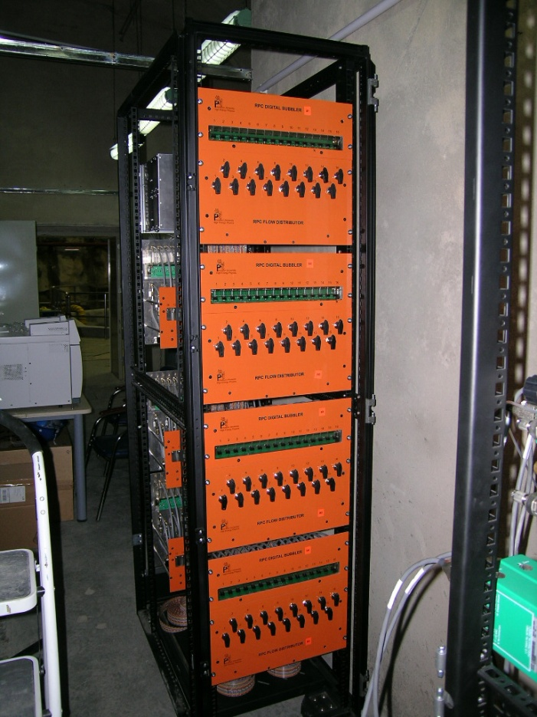
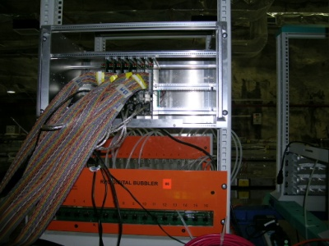
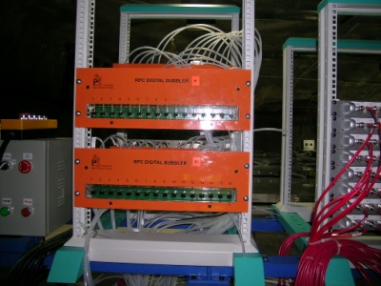
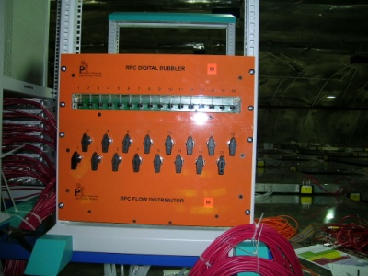
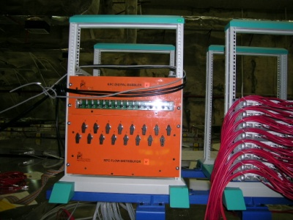
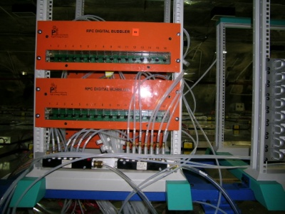
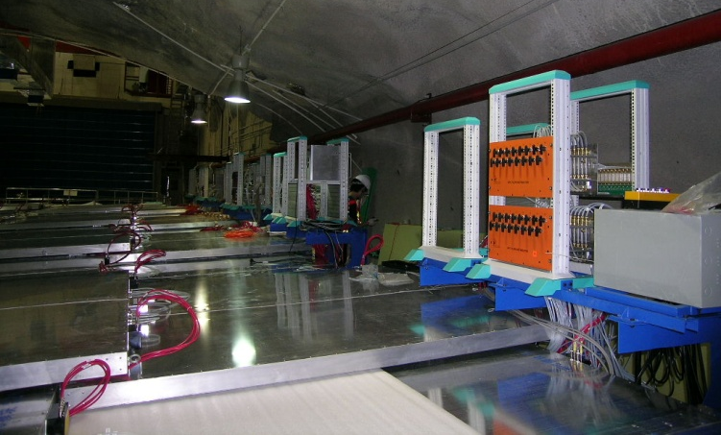
Gas distribution/digital bubblers
Was temporarily mounted on a rack in the gas room:
Now they are mounted on the supporting frames:

Slide 12
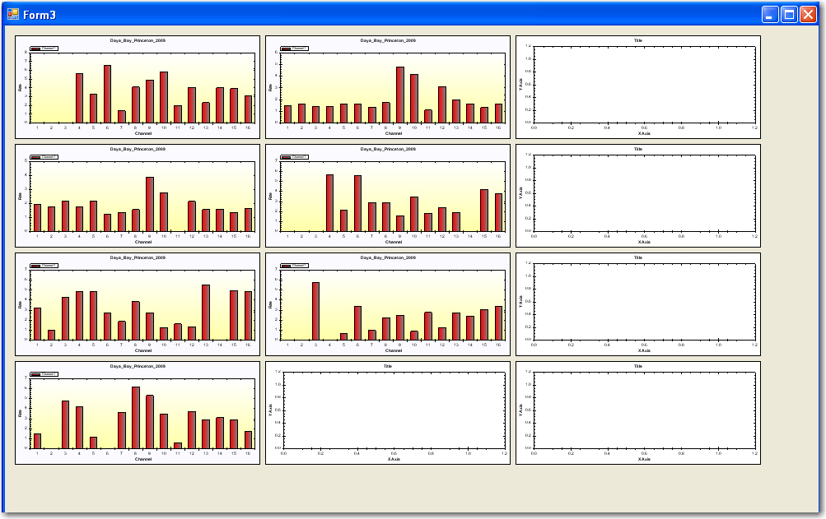
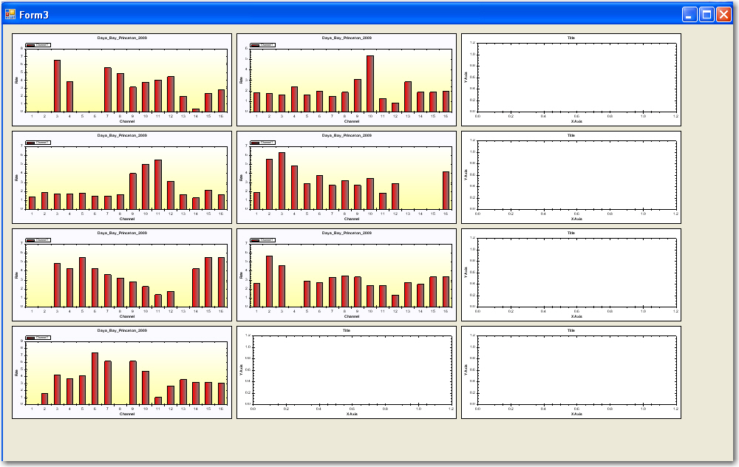
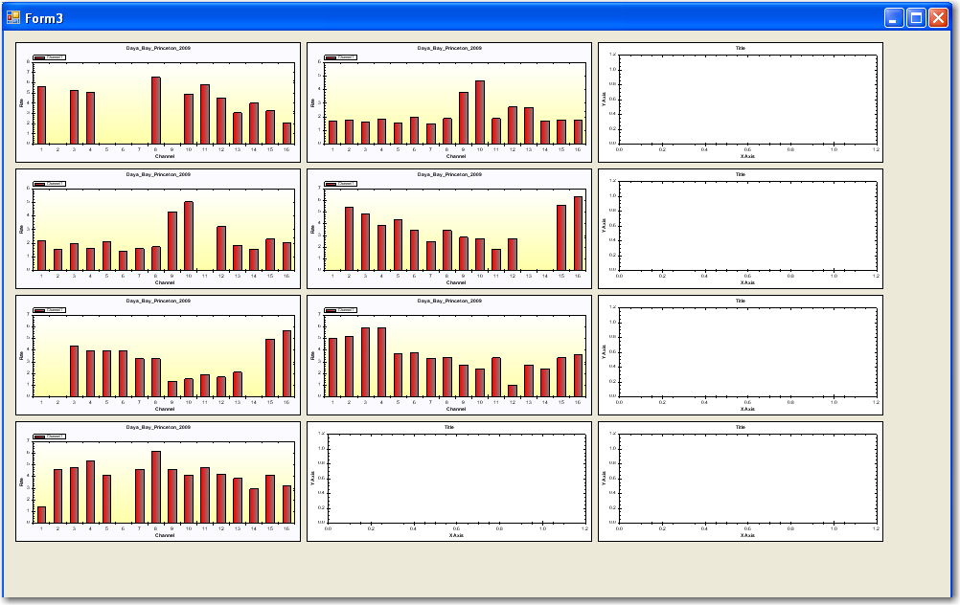
Digital bubbler readout
The screen capture of the digital bubbler readout histograms for all 7 crates (16 channels/crate):
Three screen captures show the RPC “breathing” in the gas flow. If we connect the bubblers w/o RPC chambers we’ll see the bubbling rate histograms w/o “breathing” as shown in next slide.

Slide 13
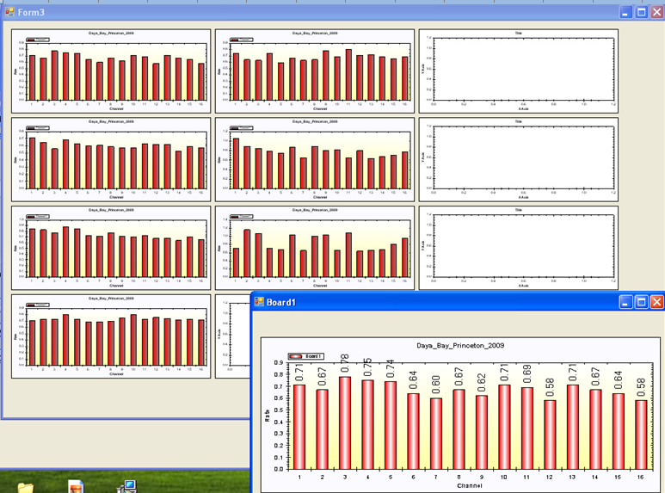
Bubbler histograms w/o “breathing”
Connect the outlet of the gas distribution channels to the digital bubblers directly (w/o RPC chambers), the bubbling rate histograms are quite uniform, no “breathing”.

Slide 14
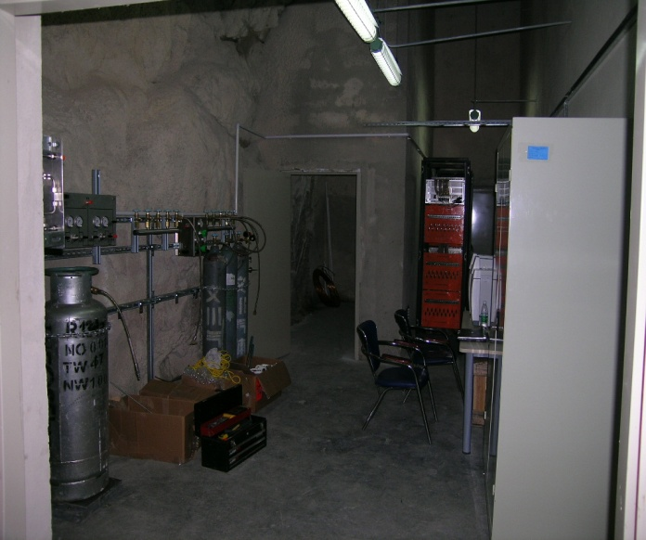
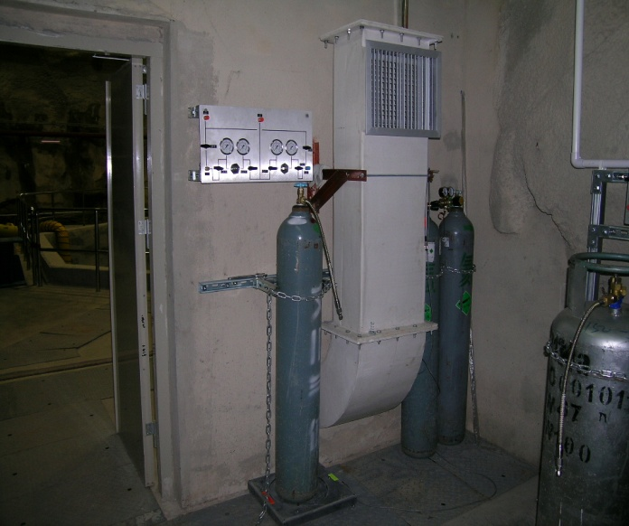
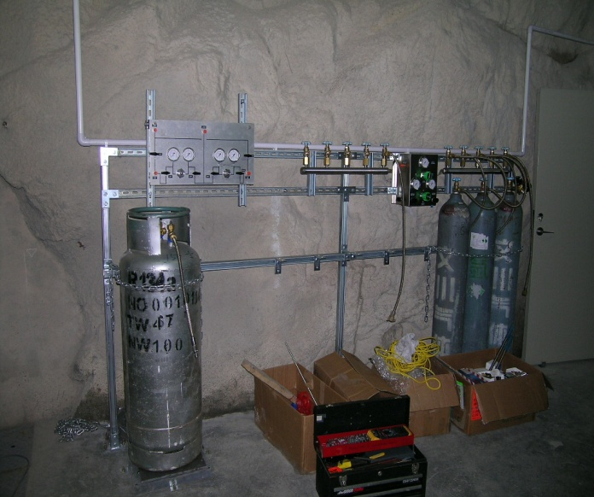
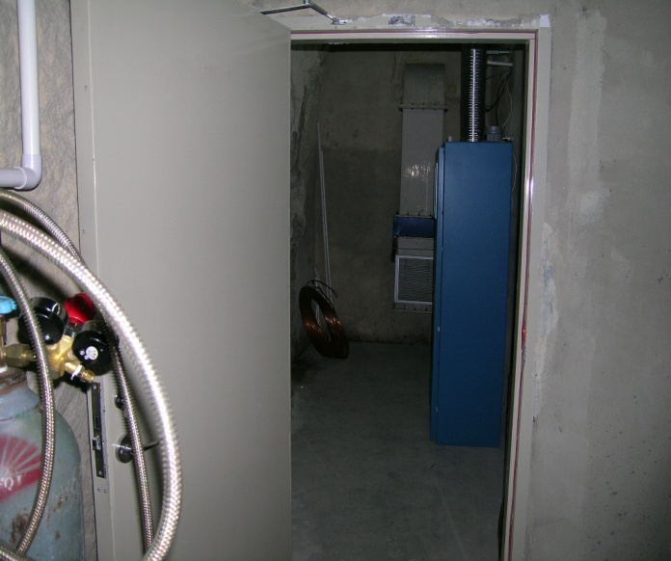
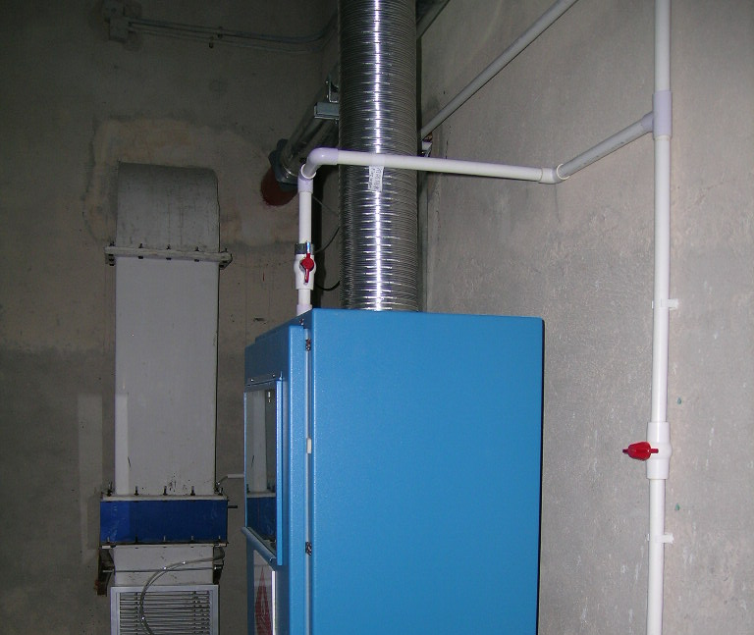
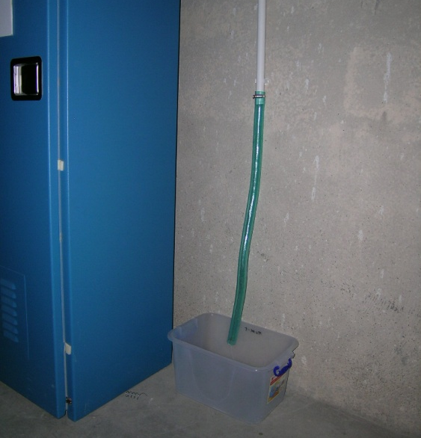
Gas switchover panels, manifolds, pipes & cabinet
Water pipe to drain the fire water once every three months.
Fire water pipe valve has been locked on open position.

Slide 15
Remaining jobs for the first Daya Bay RPC gas system installation
Thoroughly check the leakage of the gas system once more;
Further improving the exhausting gas tubing with 1~2” thick pipe;
Work with DGUT group/DCS group to display gas system status on DCS screen;
Running bubbler readout GUI program, check its stability;
Running GC sequence on a separate PC to check its stability;
Provide Daya Bay RPC gas mixture to RPC modules and commissioning the RPC system.

Slide 16
Special thanks to Strong support from LIM Xiaonan; US/China LSO/SO; IHEP gas installation team; Other collaboration members, who participated in the gas system installation.

