Slide 1
EH#1 RPC Gas System Repair
Report
11/5/2013
- Zhijian Zhang; Y. Lei; Qiang Xiao & Changguo Lu

Slide 2
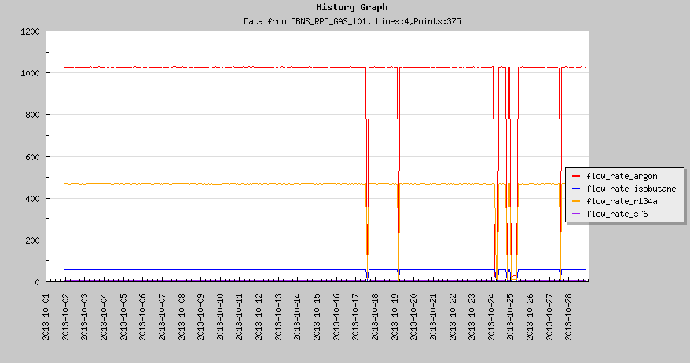
Gas flow rate of EH#1
On October Operation meeting we have reported that EH#1 flow rate is showing irregular drops. The 1-st and 2-nd drops were due to power shutdown, manually restored the gas flow. The causes for the other several drops were not known by that time.

Slide 3
Replacement of the bad Simpson controller
In order to be able to find the cause of this malfunction we have unplugged the cables on “Power Crate” J2 and J3 connectors, and replaced them with jumpers. It temporarily voided the interlock mechanism, so the system can continuously provide the right gas mixture, but won’t be interrupted by the flow rate misbehavior. We have observed that there is no other abnormal warning signs from the rest of EH#1 gas system besides the irregular drops of the R134A flow rate. DGUT group has checked their DCS interface system and found nothing wrong with their interface box. Therefore we reached a conclusion: the Simpson controller used for read and control of R134A gas flow is bad, must be replaced.
After careful plan and preparation, we left the jumper J2 & J3 on Power Crate, the gas system was still providing right gas mixture while we pulled out the Flow Rate Crate, and made the replacement.

Slide 4
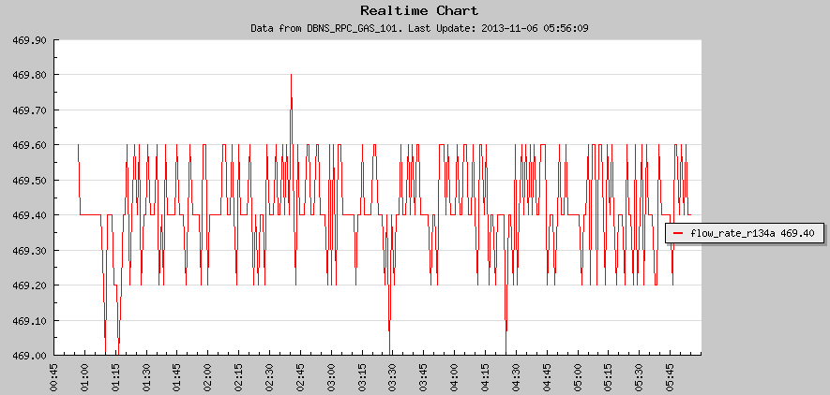
Replacement of the bad Simpson controller
The parameters for this Simpson controller are set as follows:
dCtL | SCtL | oCtL | SP1 | SP2
2345 | Lin 1 Pt 400→1390 | ALoG | -50 Alr1 Lo St-I nE | 9900 Alr2 Hi St-2 nE
After the replacement EH#1 gas system restores its normal function. R134a flow rate is stable.

Slide 5
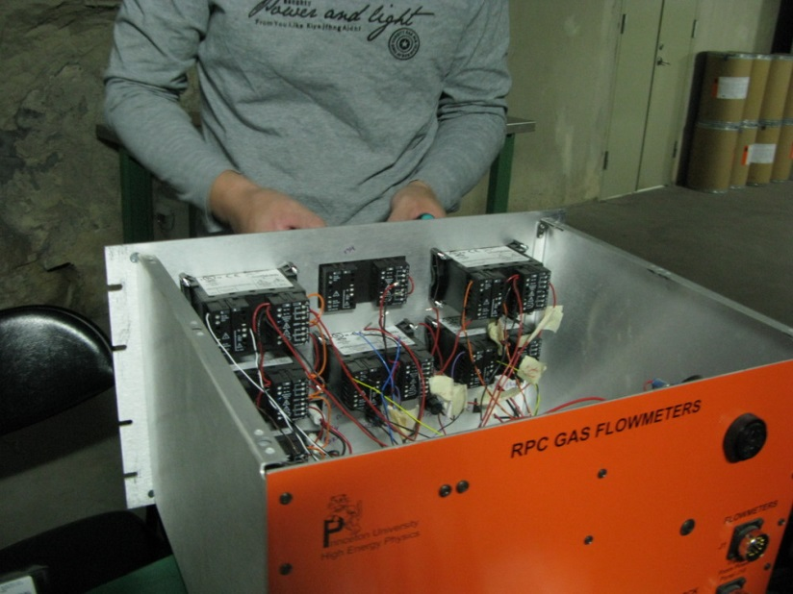
Replacement of the bad Simpson controller
Z. Zhang of DGUT is replacing the bad Simpson.
After the replacement we put J2 cable back on, but still leave J3 jumper on because we suspect some of the Simpsons in gas pressure crate might have been damaged, without J3 jumper it will trigger the gas system interlock. We are ordering more Simpsons, when they arrived we’ll further investigate the trouble related to J3 jumper. J3 jumper won’t cause any safety concern, it is just monitoring the gas pressures, as long as gas flow rates are normal, we don’t care about the gas pressures .

Slide 6
Summary
We have replaced a sick Simpson controller in gas flow rate control crate.
There might be some bad Simpson controller(s) in gas pressure control crate that need to be replaced. When new controllers arrive, we’ll repair the crate.
We put J3 jumper on gas power crate to temporarily disable the interlock mechanism from this crate. This won’t cause any safety concern, we are quite safe at this moment.
The gas flow is normal, RPC modules are getting right gas mixture.

