Slide 1
E.H. #1 RPC Gas System Commissioning ⎯ “Leaky” modules’ study
Changguo Lu, Princeton University
Qingmin Zhang, IHEP
Shih-Kai Lin, University of Houston
(May 18, 2011)

Slide 2
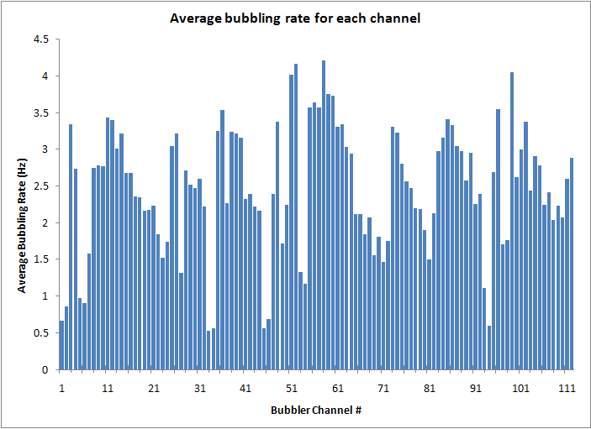
Bubbling rate
No RPC modules connected to these four channels
Averaged bubbling rate in ~ 1 month run (3/28 to 4/28) for all 108 gas channels (last four channels are not connected to RPC modules). It is noticed that some channels the rates are much lower than others, is this an indication of gas leakage for those channels?

Slide 3
RPC gas channel assignment
(Above is an excel spreadsheet, the display is not complete, double click on it to see all)
Gas channel label convention:
H1: E.H. #1; C: Column #, from 1 to 9; R: Row #, from 1 to 6; B: Branch # of module, 1 or 2;
Crate #7 is on the Hall’s gate side;
Short: no RPC module is connected, only a short tube instead;
Purple colored cells indicate possible “leaky” modules: C1R1, C2R1, C3R1, C4R1 and C7R1, all are on Row #1 (see next slide) ?!

Slide 4
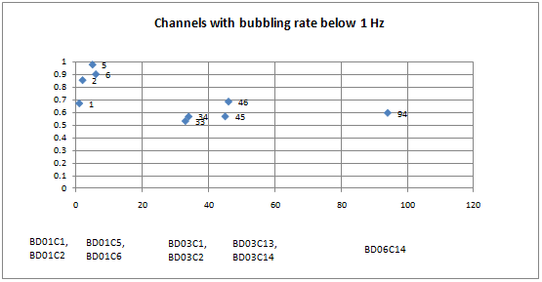
The Possible “leaky” channels
Set the criterion at 1Hz, all “leaky” channels are listed in the plot.
4 pairs and one single channels. Each pair corresponds to one RPC module, thus we total have 4 and one half suspected “leaky” modules.

Slide 5
Breathing rate of the “leaky” channels
We have tightened all the fittings for these suspected modules, also directly measured the gas tightness with a U-tube, we have confirmed that these suspected modules are gas tight, the low bubbling rate must be due to some other reason.
We measured the breathing interval for the gas channels #1 ~ #16, and plot a scatter plot between breathing interval and bubbling rate:
Apparently four suspect channels (Ch. 1, 2, 5 and 6) have longest breathing interval. Watching the bubbler by eye we found that during a burst, the bubbling rate for these channels is much higher than other channels.

Slide 6
Answer to the question
The bubbler program has been set a rate limit 7.5Hz in its algorithm, for higher rate the algorithm won’t be able to count each individual bubble, therefore gives a wrong bubbling rate. 7.5 Hz bubbling rate is corresponding to more than 3 volume change/day, enough for Daya Bay RPC gas system, but due to the RPC module breathing, during the bubble burst the rate could reach 10 Hz, therefore the rate limit of 7.5 Hz should be relaxed. Now we set it to 10.2 Hz. After we lifted the 7.5 Hz upper limit, the algorithm can pick up the burst bubbling rate for those channels, the rates displayed are much higher than before (compare to slide #2 for the circled channels). Only channel #94 is still low.

Slide 7
Modules with various breathing levels
Four gas channels with different breathing behavior. Channel #23 does not show any breathing, the other channel #97 shows most severe breathing. The Y-axis is the bubbling rate in Hz, X-axis is just the order in a measurement sequence. The interval between two measurements is ~10’, each measurement takes ~6.5”.

Slide 8
Conclusion
The lower bubbling rate we reported before is not due to the leak of the RPC module, it is caused by module’s breathing and bubbler’s algorithm. After modified the algorithm the faulty low bubbling rate channels are no longer existing. Various RPC modules show very different breathing behavior, it is an interesting question.

