Slide 1
Report from the NSF
  Elementary Particle Physics
    Marv Goldberg, Saul Gonzalez, Randy Ruchti
  Particle Astrophysics
    Jean Cottam Allen, Jon Kotcher, Jim Whitmore
  EPP/PA/Cosmology Theory Program
    Keith Dienes

Slide 2
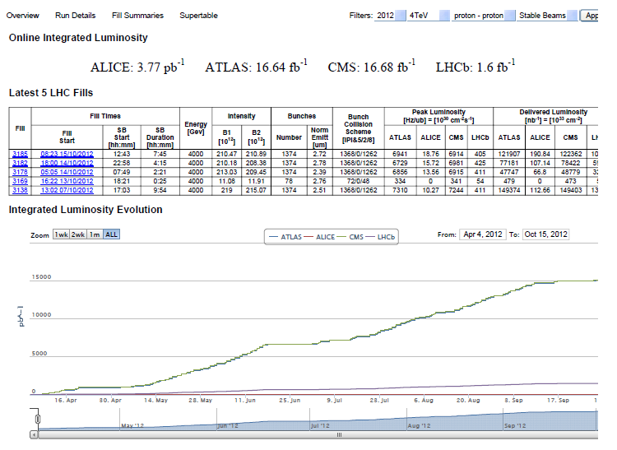
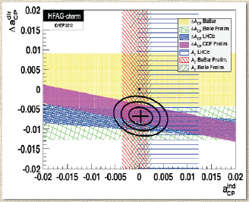
First of all… Congratulations on a Remarkable Year…!
LHC
LHCb - B and C Physics

Slide 3

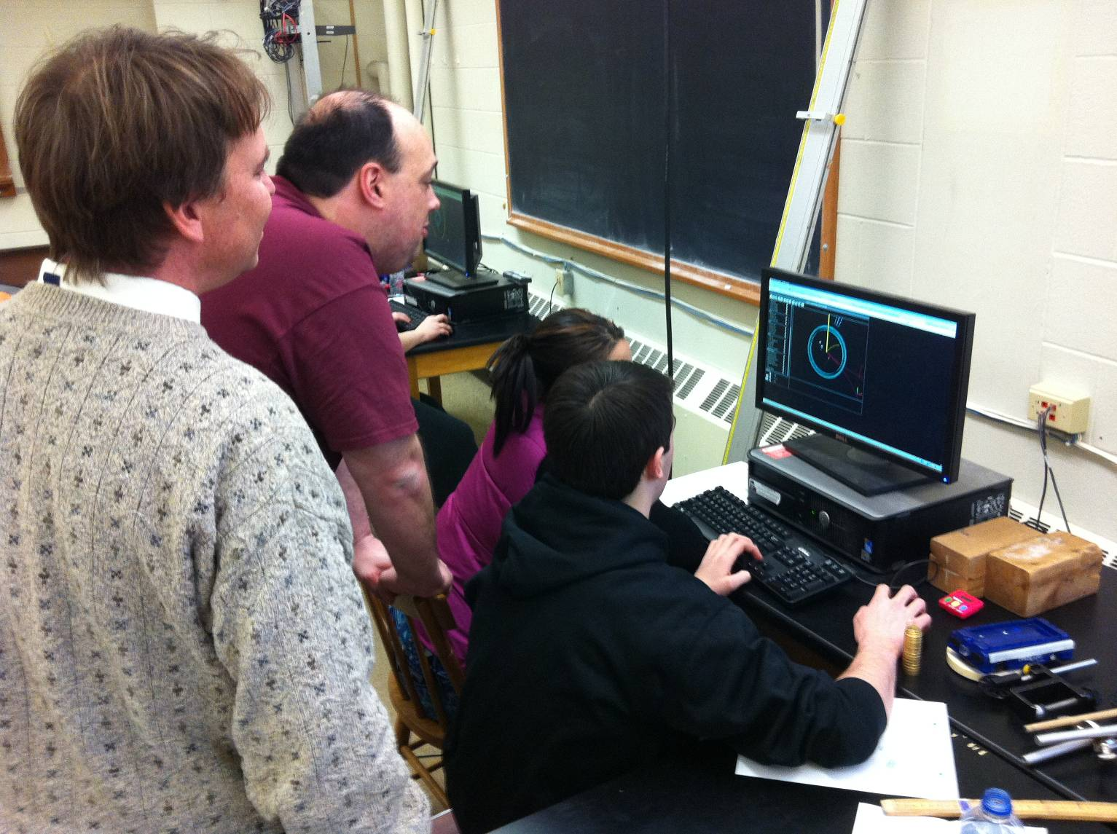
…Congratulations on a remarkable year…
ATLAS and CMS Discovery
LHC Data to Teachers and Students: QuarkNet Masterclasses

Slide 4
NSF Perspective
NSF Mission: “to promote the progress of science; to advance the national health, prosperity, and welfare; to secure the national defense; and for other purposes”
  Empowering university-based investigators
  Educate and train an exceptional and diverse scientific workforce
  Adding value through partnerships and broadening participation
Program Coordination and Execution
  Programs are coordinated with other U.S. and non-U.S. agencies and organizations
  Solicit advice and strategic direction from advisory committees such as HEPAP, P5, AAAC, NSAC and from the National Academy of Sciences
Guiding Principles – NSB review criteria
  What is the Intellectual Merit?
  What are the Broader Impacts?

Slide 5
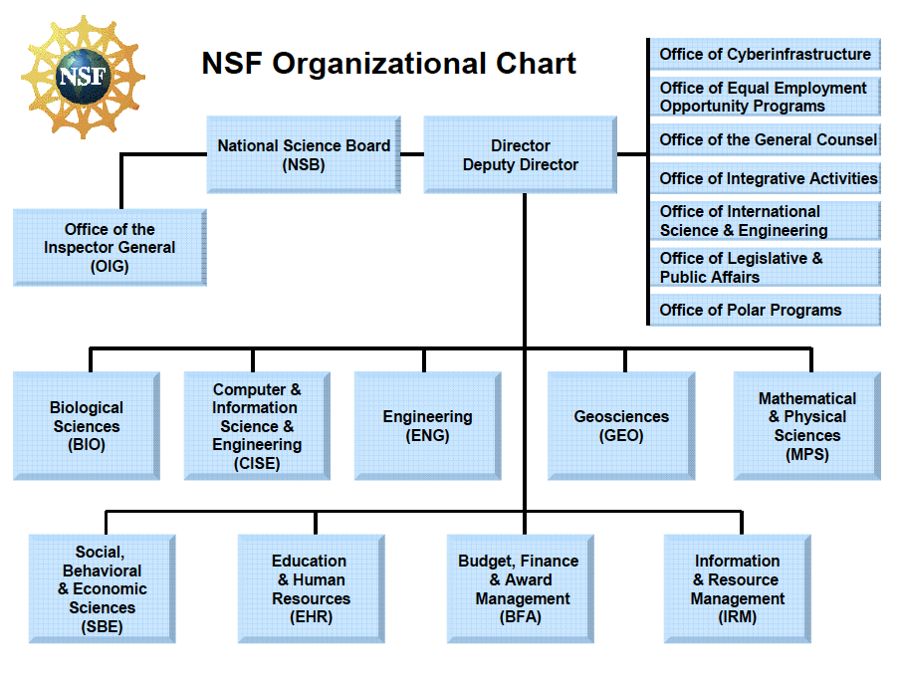
NSF Organization circa FY 2012

Slide 6
NSF Organization circa FY 2012 - midyear reorganization plan

Slide 7
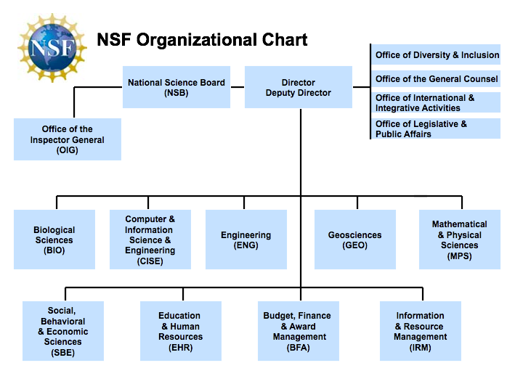
FY2013 Current Structure

Slide 8
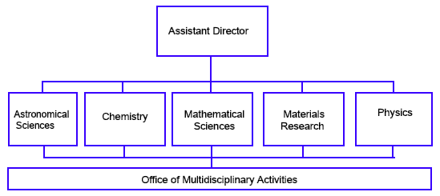
MPS Organization

Slide 9
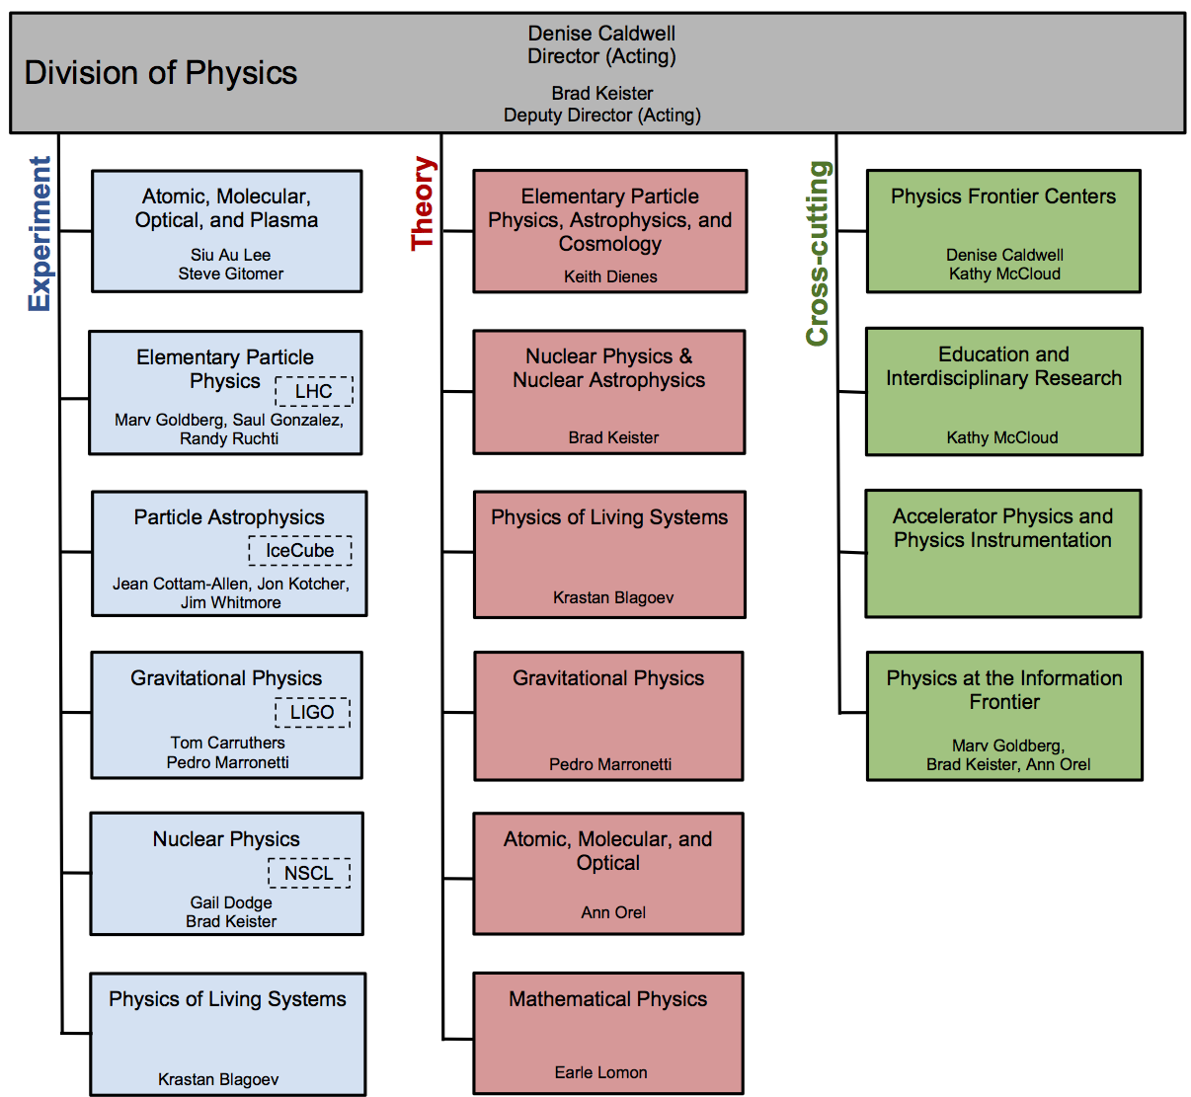

Slide 10
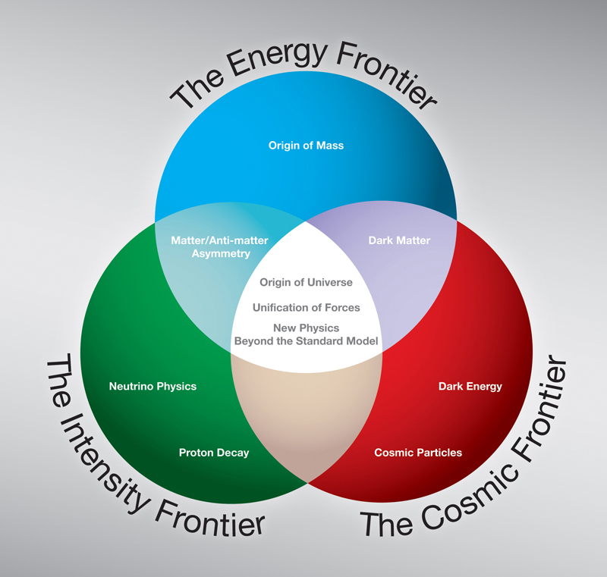
Particle Physics at the NSF
Scientific Frontiers:
  Energy Frontier - Elementary Particle Physics (EPP, THY)
  Intensity Frontier - Elementary Particle Physics, Particle Astrophysics (EPP, PA, THY)
  Cosmic Frontier - Particle Astrophysics (PA, THY)
Applications and Broader Impacts:
  Accelerator Science, R&D
  Detector R&D
  Computing / Data
  Education and Outreach

Slide 11
EPP Program Elements
Energy Frontier
  Hadrons
    LHC
      ATLAS, CMS
    Tevatron
      CDF, DØ
  e+e-
    ILC
      GDE
Intensity Frontier
  Neutrinos
    MINERvA
    Minos/NOvA
    MiniBooNE/MicroBooNE
  Hadrons
    LHCb
  e+e-
    BES-III
    Belle-II
    BaBar
    CLEO-c

Slide 12
Program Elements
Detector R&D
  LHC Upgrades
  Diamond Detectors
  ILC
  LAr TPC (LBNE)
  Large Optical Array
Computing
  OSG
  Tier 2, Tier 3, UltraLight
  Anydata, Anytime, Anywhere
  DASPOS
  ISGTW
Accelerator Science and R&D
  CESR TA
  ILC
  Muon Colliders (MuCOOL, MICE)
  Plasma Acceleration
  Project X (SRF, CESR TA)
  SRF

Slide 13
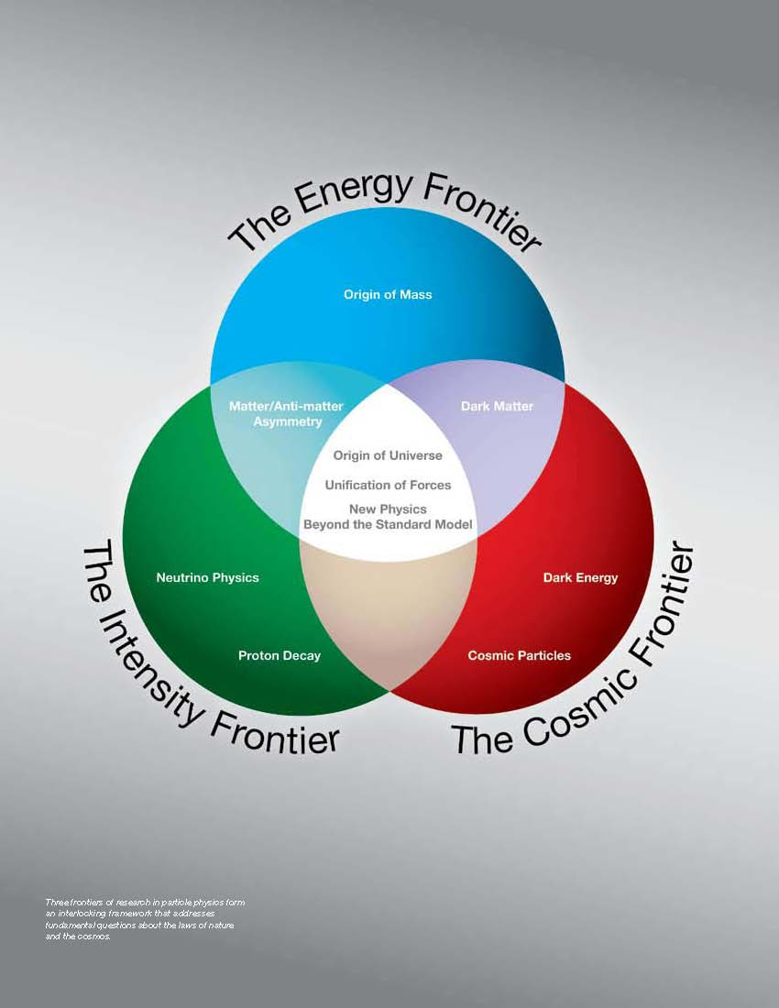
PHY Division PA Program
PHY funds projects in both the Cosmic Frontier and the Intensity Frontier fields
Cosmic Frontier:
Dark Matter, Dark Energy, Cosmology, High Energy Particles (CR, γ-rays, ν)
Intensity Frontier:
Neutrino mass, Neutrinoless Double Beta Decay non-accelerator (and solar) neutrinos

Slide 14
Theory Program in Particle Physics Particle Astrophysics and Cosmology
The NSF Theory Program funds theoretical research in all of the research areas across the three frontiers:
  From string Theory and Grand Unification to neutrinos and proton decay to cosmic rays and dark matter/dark energy.
  The program is completely cross-cutting.

Slide 15
NSF Budget Context
MPS

Slide 16
NSF 2012 Budget ($7,034M)

Slide 17
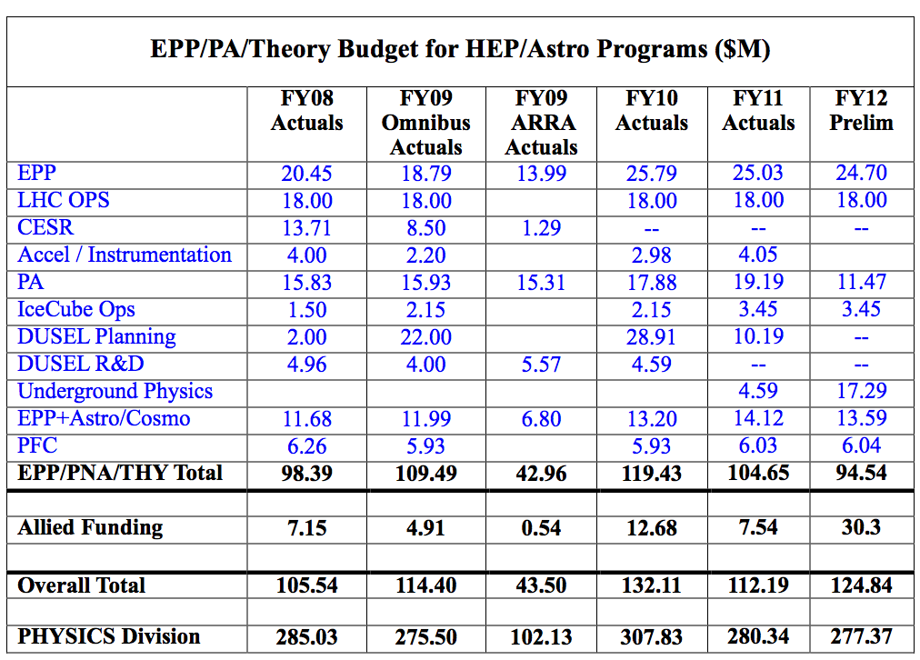
MPS/PHY Budget Context
Physics Division
Particle Physics
EPP/PA/THY

Slide 18
MPS 2012 Budget ($1,309M)

Slide 19
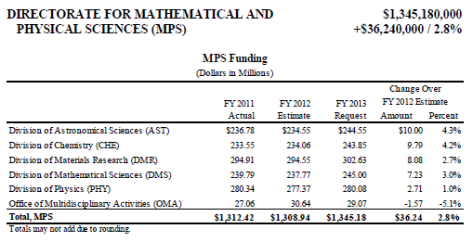
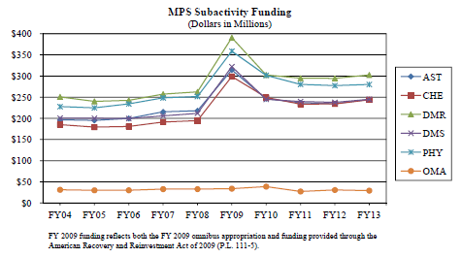
FY2013 Request
PHY
PHY
ARRA

Slide 20
Impact of Adding Value
EPP/PA/THY Program Funding FY 12
EPP Base Program $24.7M
LHC Research Program $18M
PA Base Program $11.47M
Underground Science $17.29M
IceCube Ops $3.45M
THY Base Program $13.59M
Physics Frontier Centers $6.04M
  ________
Subtotal $94.54M
Allied Funding - Added Value (EPP, PA and THY) $30.3M
EPP/PA/THY Total $124.84M

Slide 21
Partnering/Adding Value
From discussion at Snowmass 2013/CPM2012…
  The General Public
  Policy Makers and Opinion Leaders
  The Science Community
  Teachers 5-16
  Students 5-16
At the agencies…
  Physics
    BP - Broadening Participation
    EIR - Education and Interdisciplinary Research
    PIF - Physics at the Information Frontier
  OMA - Multidisciplinary Activities
  OCI – Cyberinfrastructure
  OISE – International
  EHR - Education and Human Resources
  With other agencies

Slide 22
Engagement: Some Examples
Adding Value – Programs/Projects
Interdisciplinary Research and Education
  QuarkNet
  CHEPREO
  Planetarium Show
  Feature-length Video Program
  REU programs
Cyber Infrastructure
  Open Science Grid
  DASPOS
  ISGTW
Multidisciplinary Activity – Broadening Participation
  AGEP Graduate Supplements
International
  Partnerships in International Science and Engineering
  Particle Physics School
  Grid School
  Accelerator School
Partnering with other Agencies
  DOE

Slide 23
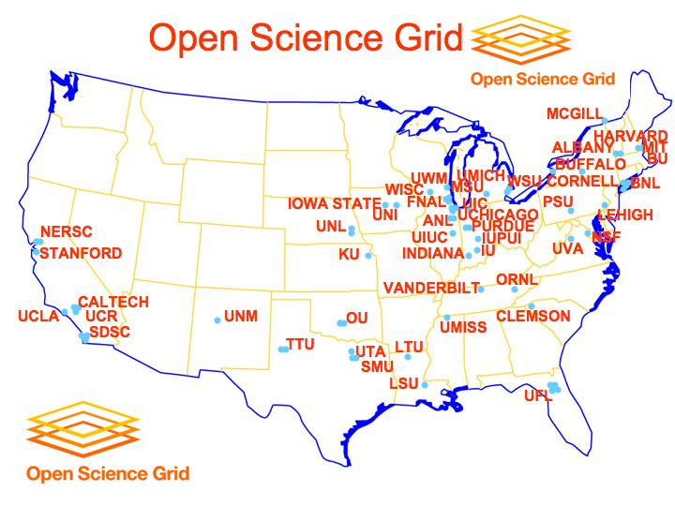
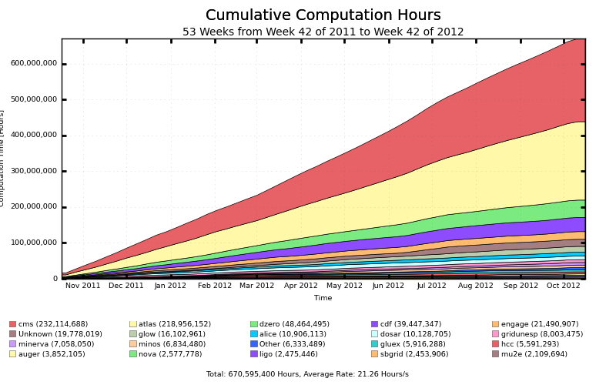
From the OSG Website…
Computation Time (Hours)

Slide 24
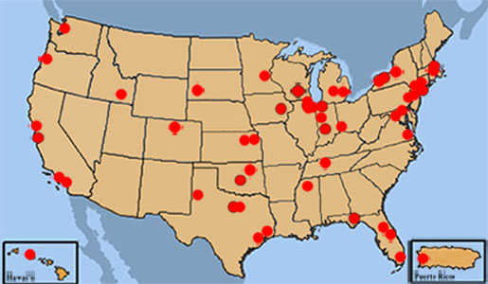
QuarkNet in 2012
LHC Data: to Teachers and Students through e-Labs and Masterclasses
Research Experiences and Professional Development:
  Per year 450 teachers, 100 student researchers, 100 physicists

Slide 25
EPP Calendar
October 31, 2012 – Base Program Target Date
November 2012 – January 2013 - Merit Reviews (submitted by email)
December 2012 time frame– Target Date for Phase-I Upgrade Proposals from USATLAS and USCMS
January 24, 2013 – MRI Deadline
  Note that universities will have their pre-selection much earlier
February 5-8, 2013 – EPP2103 Proposal Panel
March (or later) – NSF/MPS/EPP funding levels determined
March 2013 – USLHC Research Program Review, Location (Site TBD)
April (or later) – Funding actions taken in the Base Program
July 24, 2013 – CAREER 2014 Proposal Deadline (MPS)
July 29 – Aug 7 – Snowmass on the Mississippi

Slide 26
In Summary
Cautionary note…
  We are in for some challenging funding years
Nevertheless…
  LHC research is a centerpiece for NSF/EPP
    It is an extraordinarily exciting time for Particle Physics.
    Congratulations to the LHC Machine and Experiments.
    You have enthusiastic support from those of us at NSF!

