Slide 1
S. E. Tzamarias
Nuclear & Particle Physics Lab
Aristotle University of Thessaloniki
Progress report on the analysis of PICOSECOND-MICROMEGAS test beam and calibration data
techniques and studies
Precise timing workshop
RD51 Mini-Week
21-02-2017

Slide 2
Reminder: Arrival Time Estimation with test beam data
Reminder: SPE Charge Distribution
Comparison of SPE pulses with the muon data
Interpretation of the muon charge distribution in terms of SPE’s
Use the tracking information for the charge distributions
Misalignment, a naïve MC and a nice fit
The laser calibration: some observations
slewing and resolution vs e-peak amplitude
the resolution of the unobserved events
time resolution as jitter of the rise time

Slide 3
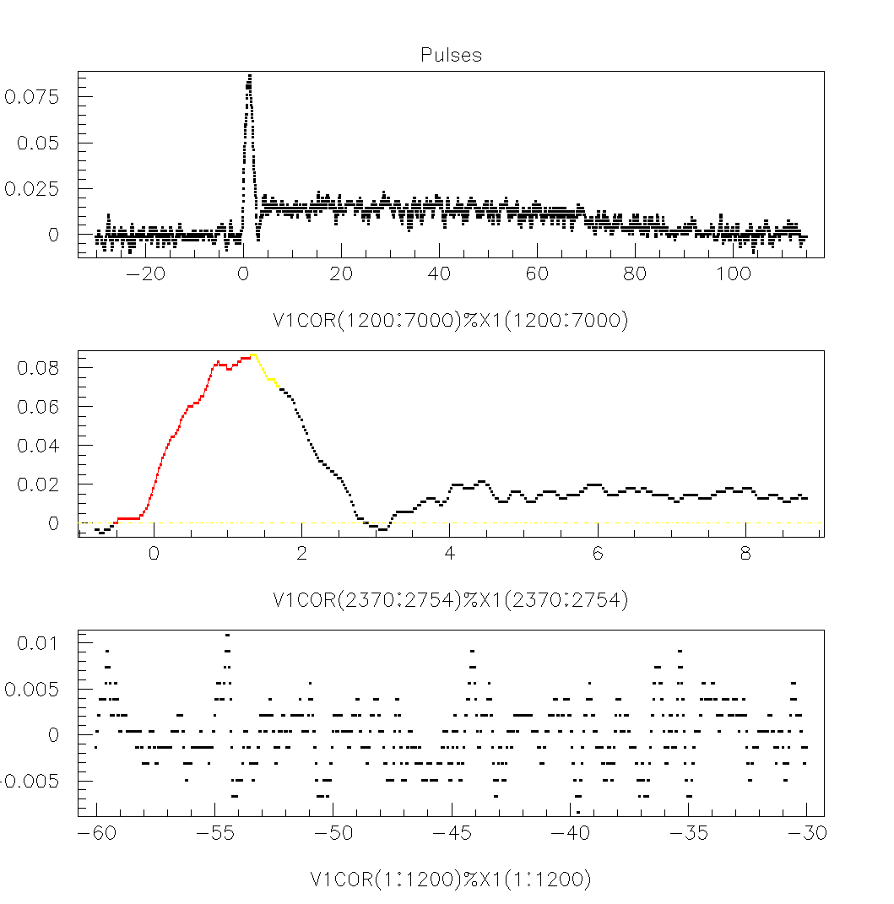
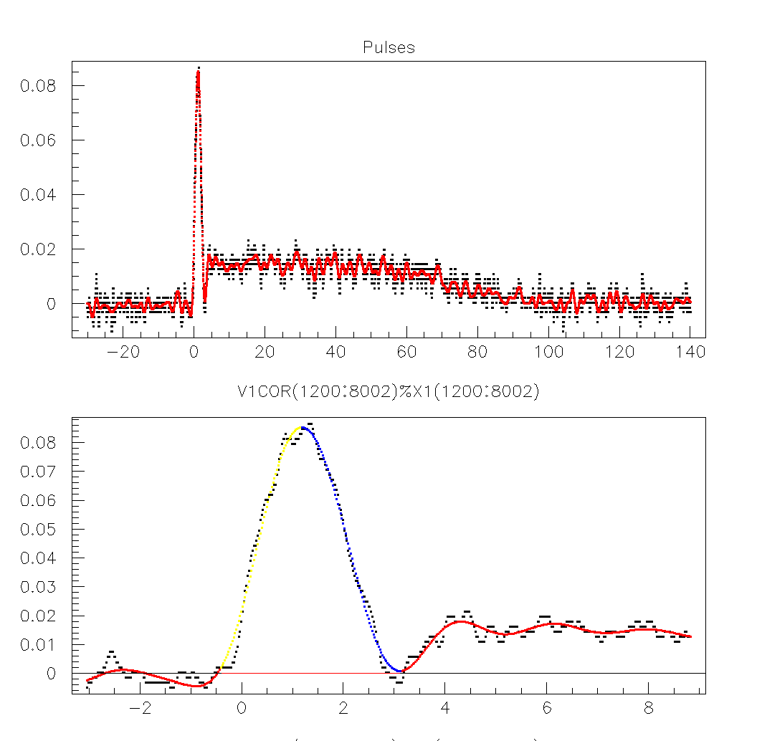
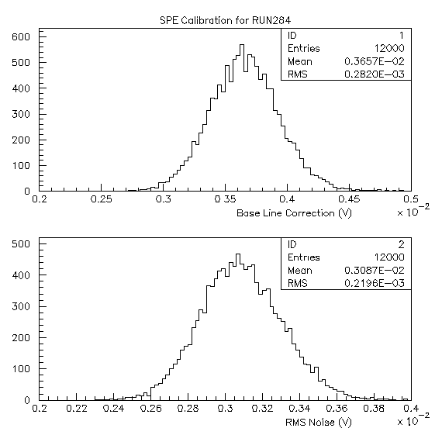
REMINDER: Waveform Analysis
Fourier Filtered signal
Raw signal
Guard Band
T_{s}
T_{e}
T_{p}
Use the Fourier Filtered (F.F.) Waveform to define Ts, Tp, Te
Peak-position=T_{p}-T_{s}, Peak-asymmetry=(T_{p}-T_{s})/(T_{e}-T_{p})
Several estimations of e-Peak Charge
using the raw or the F.F. signal
integrate the waveform from Ts to Tp or from Ts to Te
Integrate the whole waveform, raw or F.F., to estimate the total charge

Slide 4
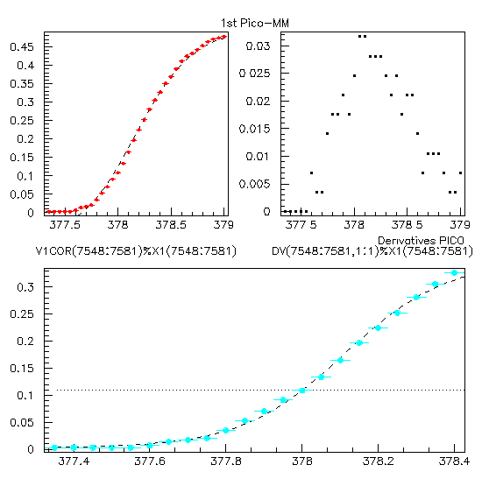
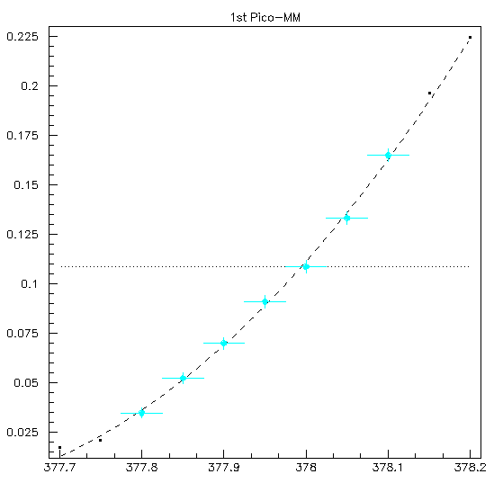
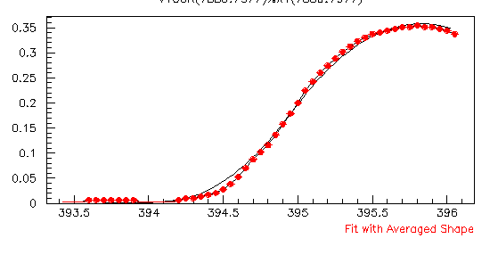
REMINDER: FITS
Four +1 Fitting Strategies give the same results
Timing at C.F. (20% of the Peak)
Global Sigmoid
Earlier Sigmoid
(the inflection point is also a middle point)
Polynomial Fit up to the inflection Point
Linear Interpolation
An extra strategy… Fit based on the average shape
See later….

Slide 5
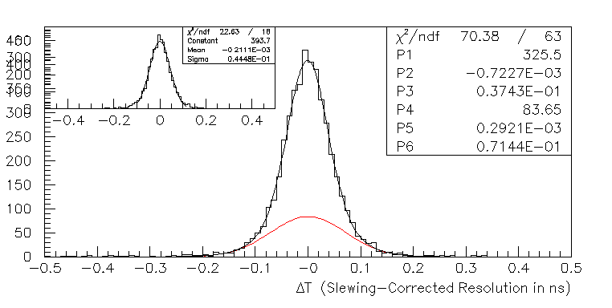
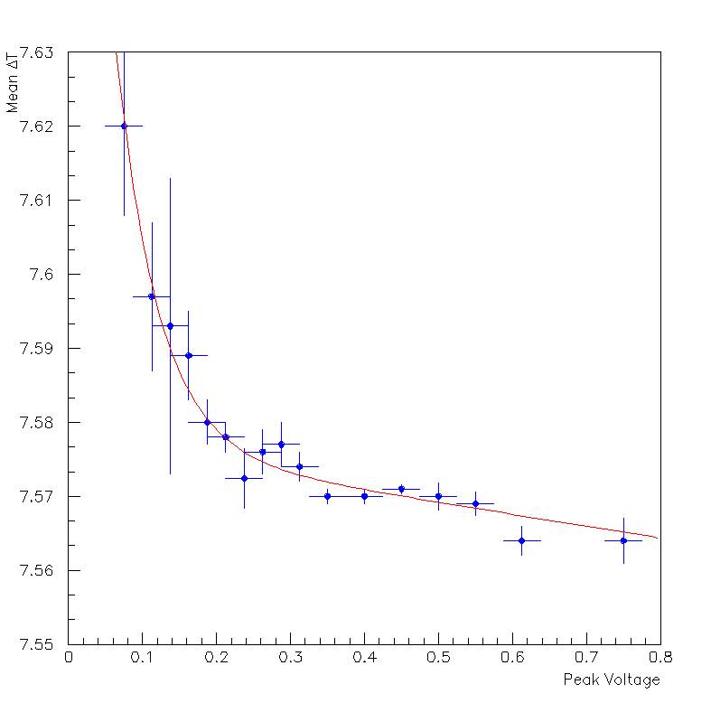
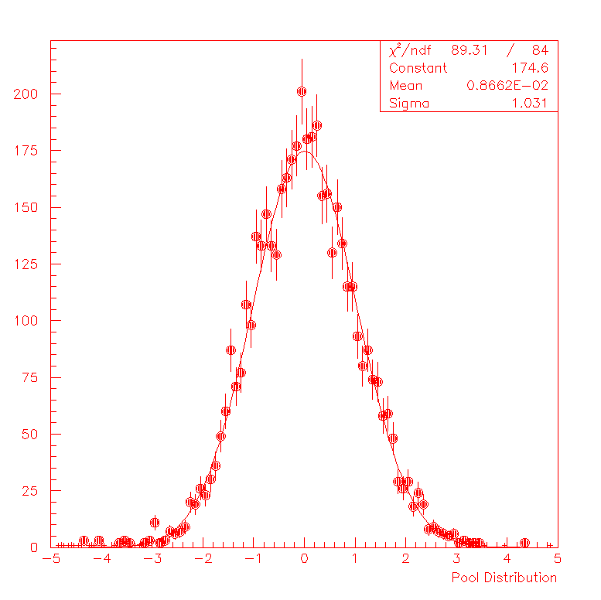
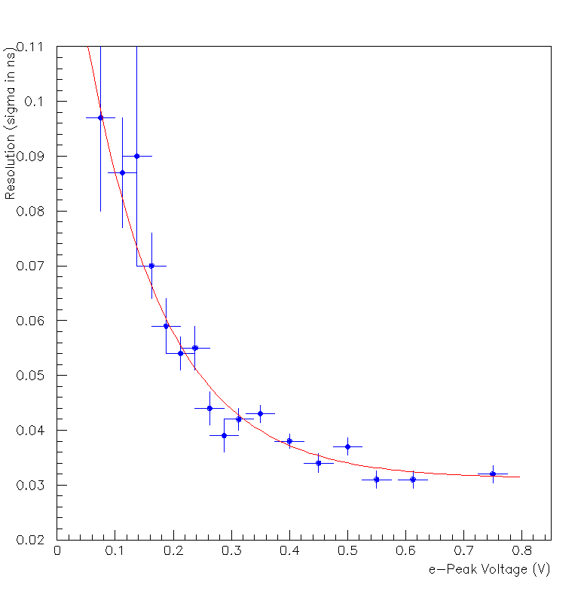
REMINDER: ~44 ps per muon
Measure and parameterize Slewing and Resolution as functions of the e-peak amplitude
Almost a 1/sqrt(N) behavior
ΔT_{corrected}/σ(V_{peak})
The Pull Distribution is Normal with mean and sigma consistent with 0 and 1 respectively

Slide 6
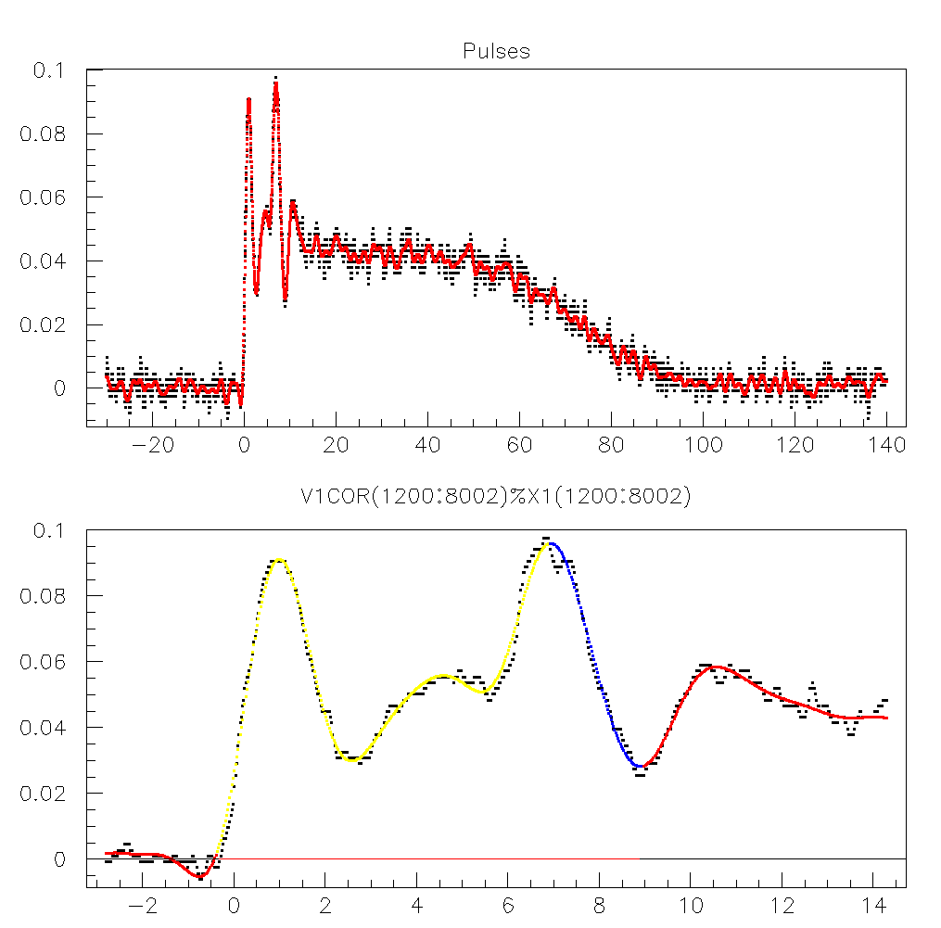
Analyze the “flame” calibration data
Reject calibration events with >1 non-synchronous photons
Fit the SPE charge distribution with Polya (Gamma) Distribution

Slide 7
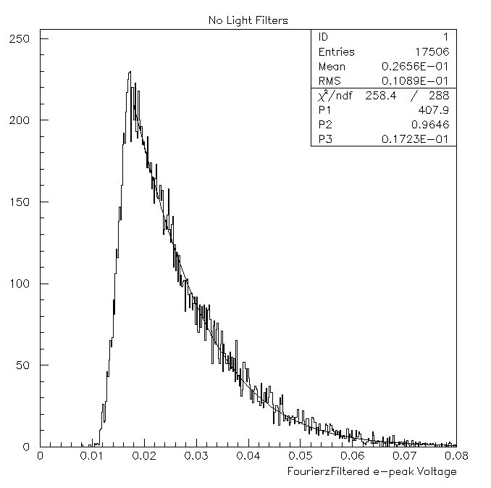
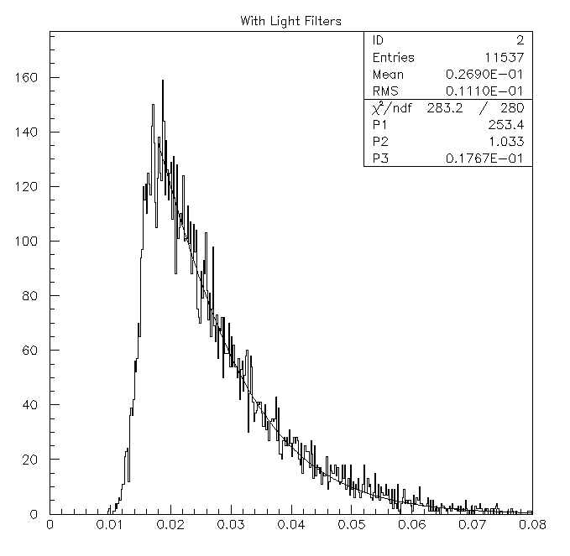
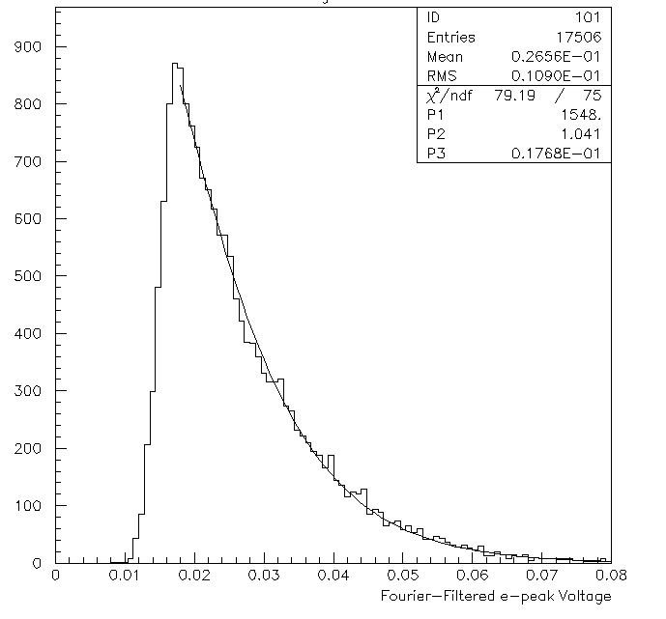
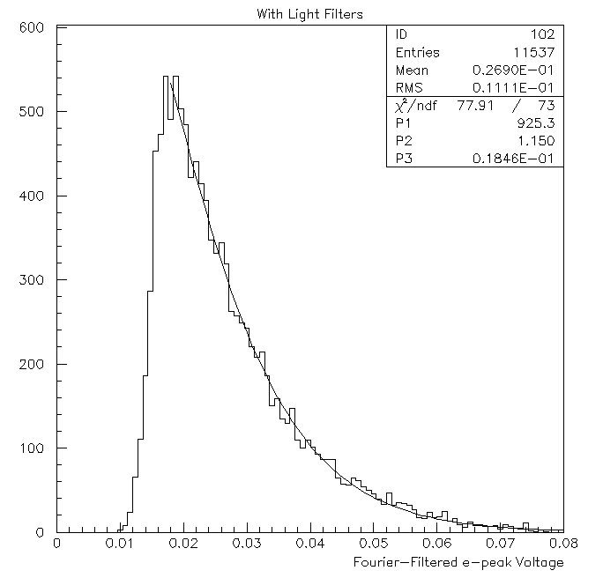
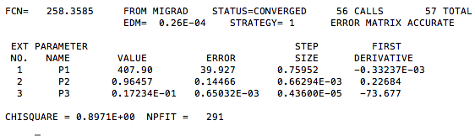
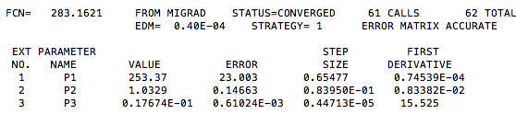
REMINDER:
After rejecting calibration events with >1 non-synchronous photons, the charge distribution is consistent with an SPE spectrum

Slide 8
Calibration and Comparison
at RUN284 Operating Parameters
(V_{mesh} =+450 and V_{drift=}-350)
SPE – Calibration RUN

Slide 9
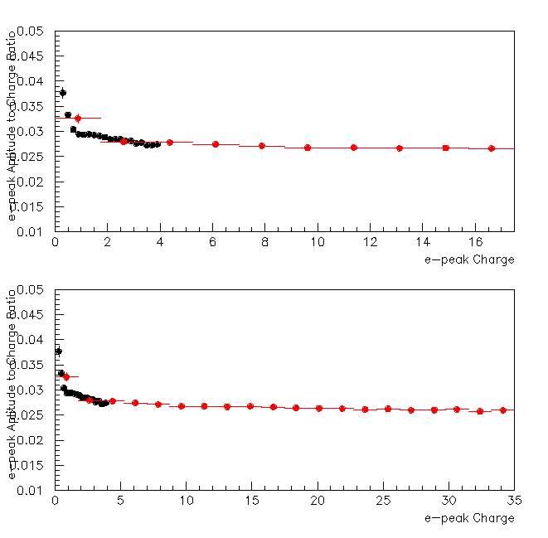
The e-Peak shape in SPE-Calibration and Muon Data

Slide 10
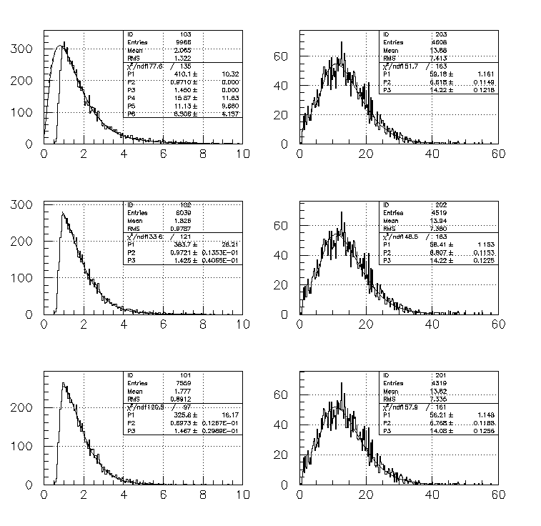
There is NO significant Background Contribution to the Data

Slide 11
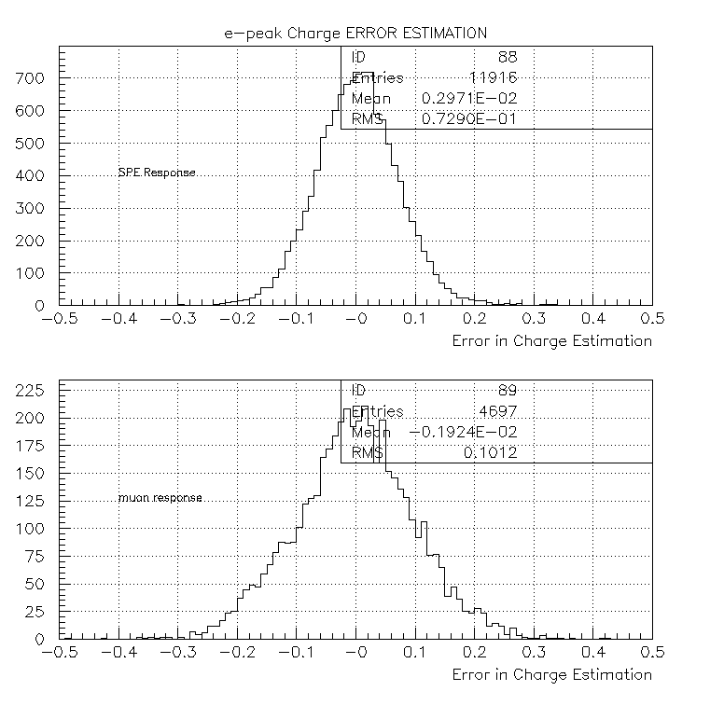
There is not any significant broadening of the e-Peak Charge Distributions
In comparison with SPE_{RMS}~0.9
In comparison with μ_{RMS}~ 7.3

Slide 12
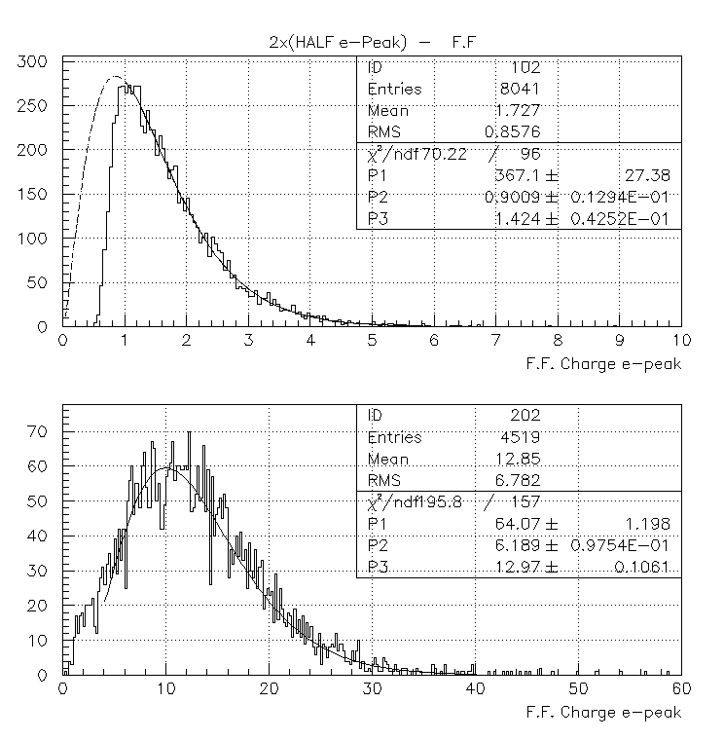
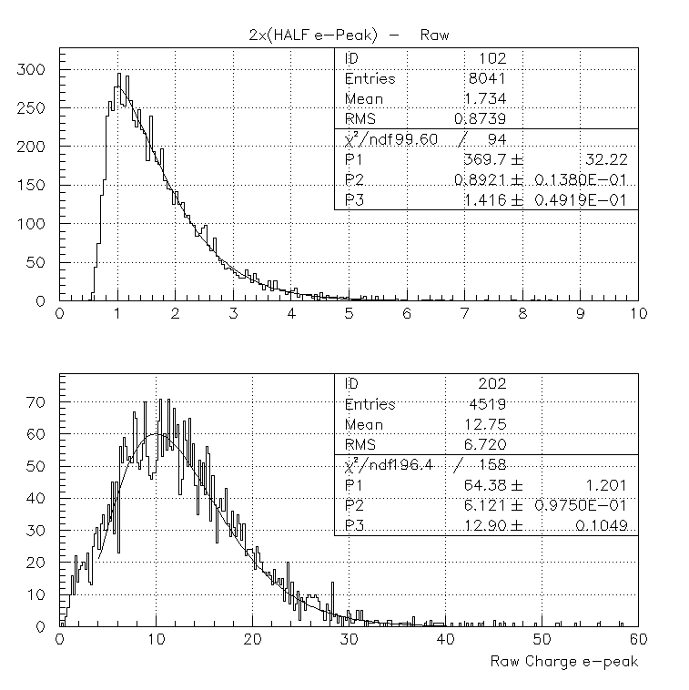
Different e-Peak Charge Estimations result to the same Distribution Parameters in both SPE-Calibration and Muon Data

Slide 13
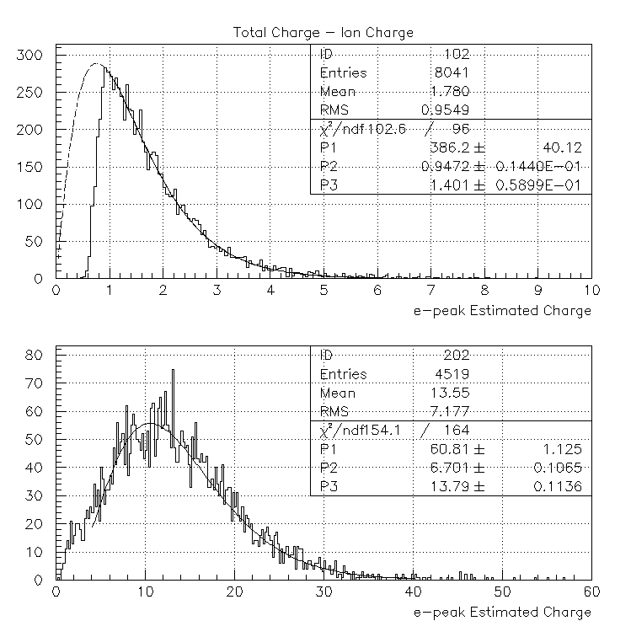
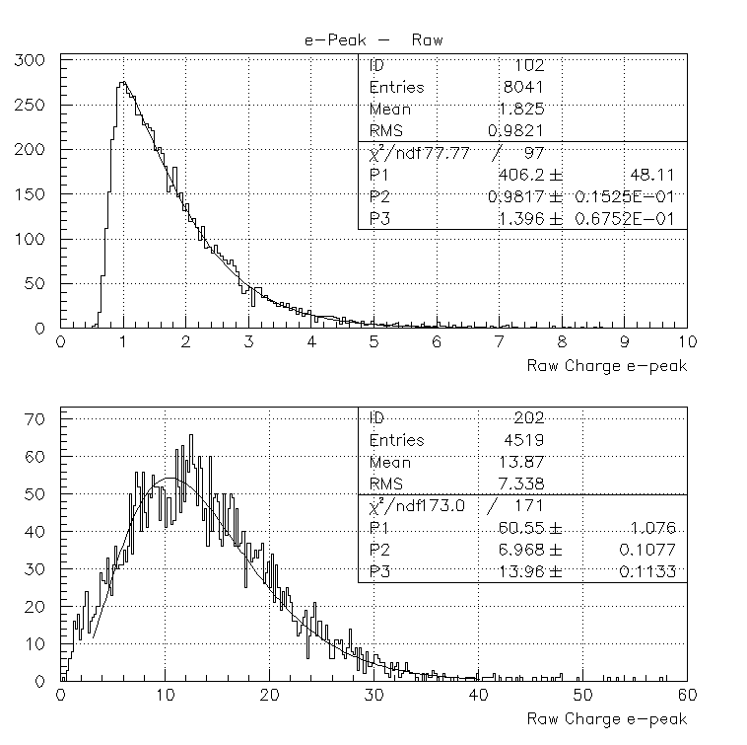
Different e-Peak Charge Estimations result to the same Distribution Parameters in both SPE-Calibration and Muon Data

Slide 14
How can we estimate the mean number of PEs produced by the Muons of the Beam
How we interpret the spread of the e-Peak Charge Distribution in terms of the Detector Response to a Single PE

Slide 15
SPE: mean charge and variance
PE Multiplicity: mean and variance
Mean and variance of the muon charge in terms of the above

Slide 16
E[Q] and V[Q] from the muon data whilst Q_{e} and V_{e} from the Polya Fit to SPE calibration data
We estimate the mean number of observed PEs and the variance of their multiplicity distribution
Example: using F.F. e-peak charge
and the Polya Fit parameters
we estimate depending of the μ parameters used
According to this analysis
the data REJECT the case of a POISSONIAN PE distribution

Slide 17
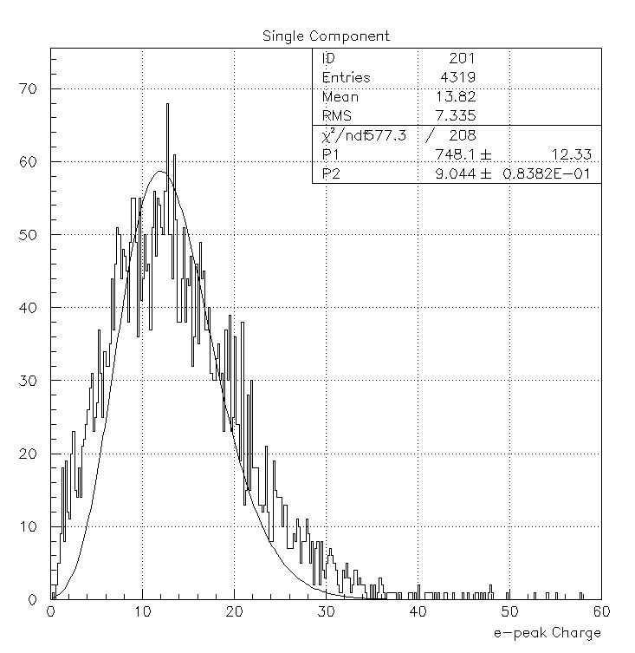
The curve is the result of a fit
Convolution of a Spe- Polya (with parameters defined by the SPE calibration) with a Poissonian for the SPE multiplicity
The mean of the Poissonian is the only free parameter

Slide 18
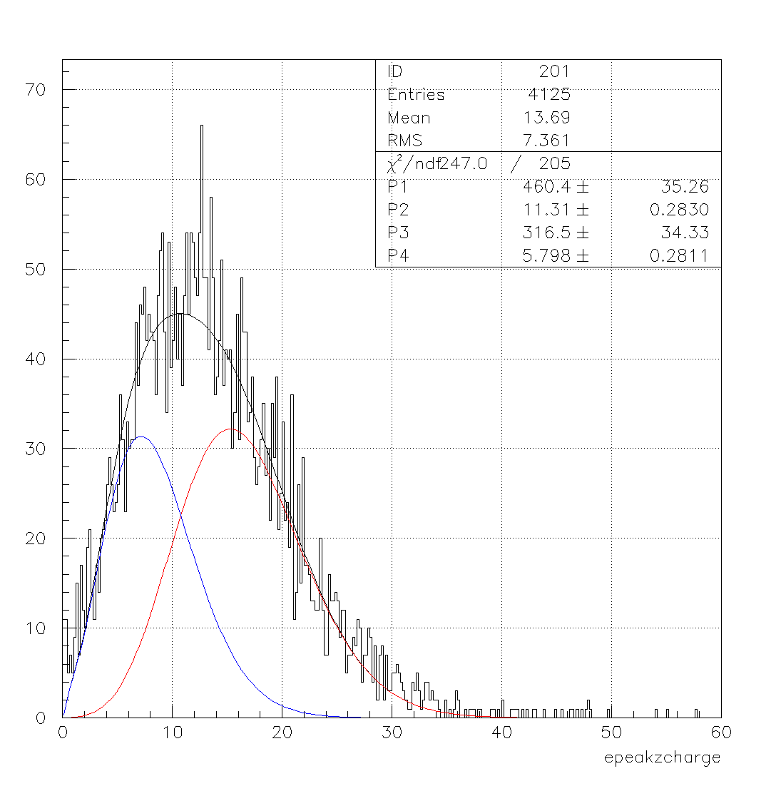
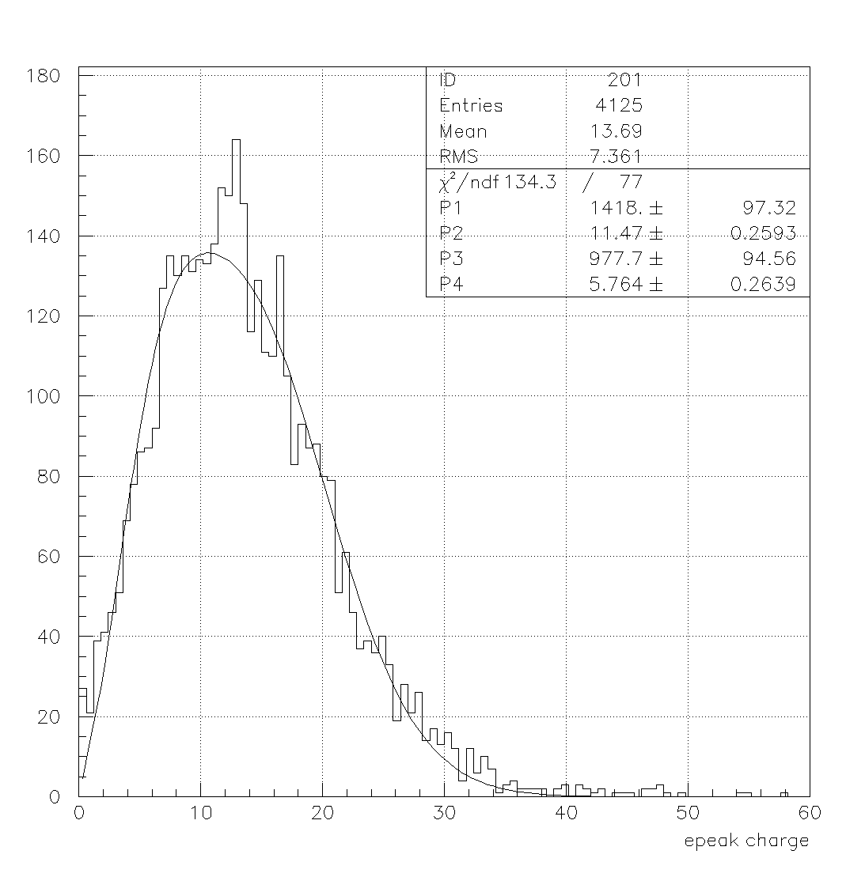
Convolution of a Spe- Polya (with parameters defined by the SPE calibration) with TWO Poissonians for the SPE multiplicity
The mean of the Poissoniana are only free parameter
Two Components Fit
major component: 60%

Slide 19
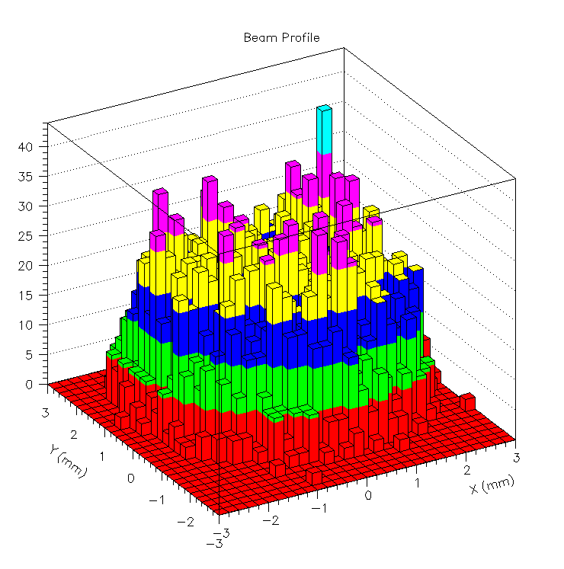
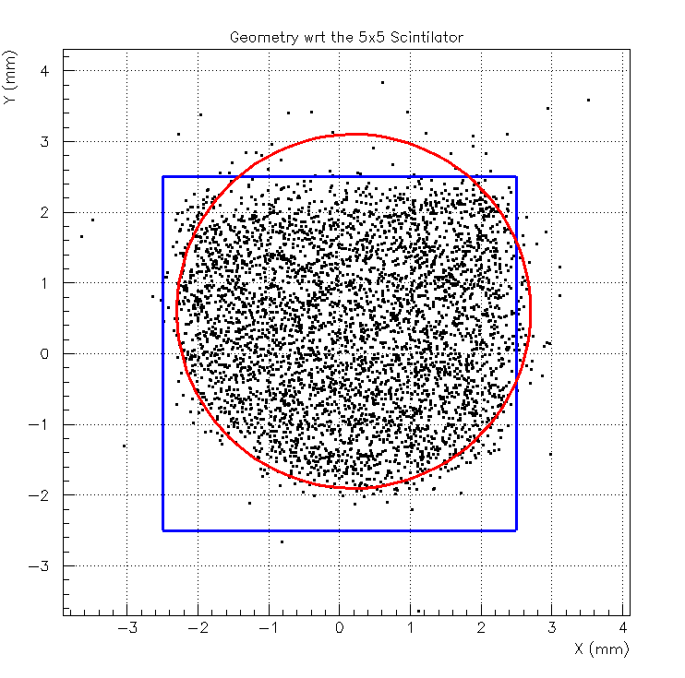
Beam Spatial Distribution wrt the 5x5 mm2 scintillator
Number of Tracks

Slide 20
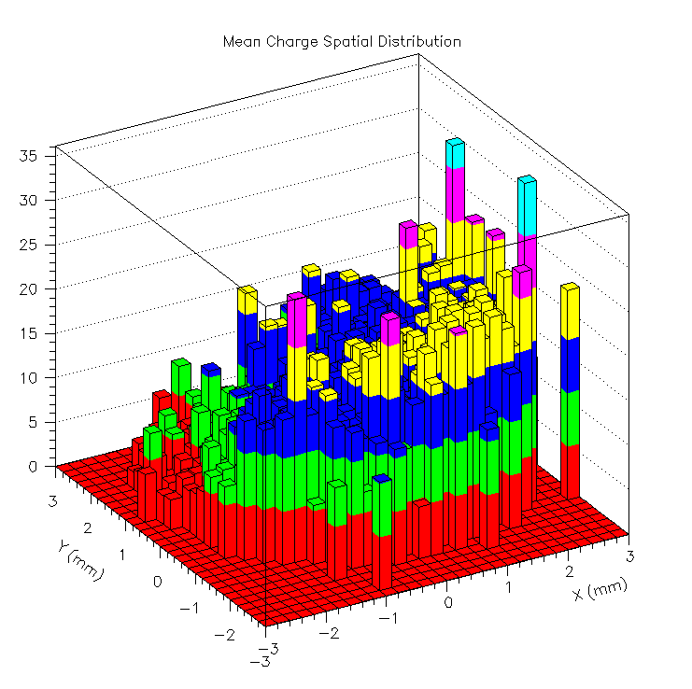
Weighted Beam Spatial Distribution: weight each track by the corresponding e-peak charge
Mean e-Peak Charge Distribution: divide the “Weighted Beam Spatial Distribution” by the “Beam Spatial Distribution’
Calculate the statistical errors
High
LOW
Mean e-Peak Charge per Track
Y Track-Impact Coordinate
X Track-Impact Coordinate

Slide 21
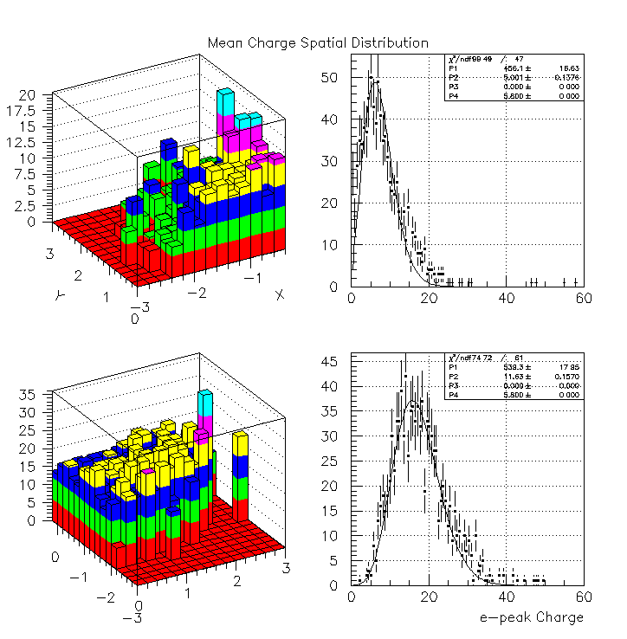
LOW
High

Slide 22
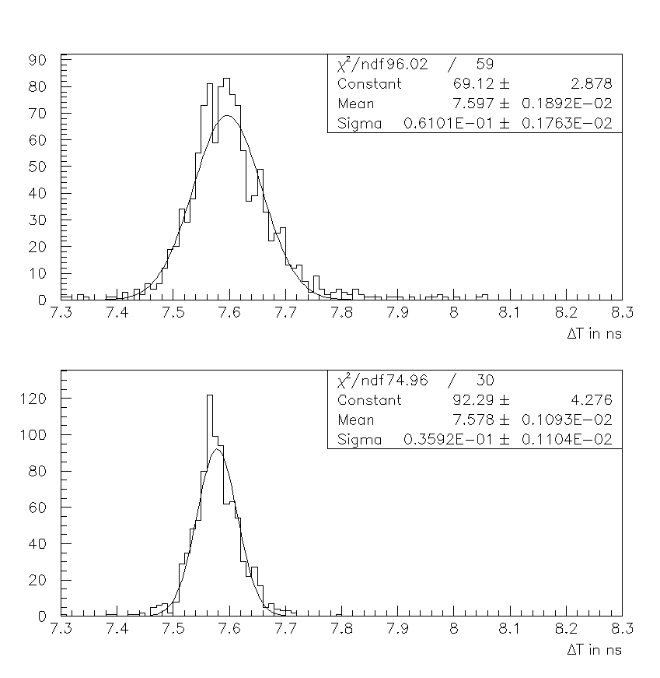
The timing resolution is very different in the two regions
“Low Beam” Region
“High Beam” Region

Slide 23
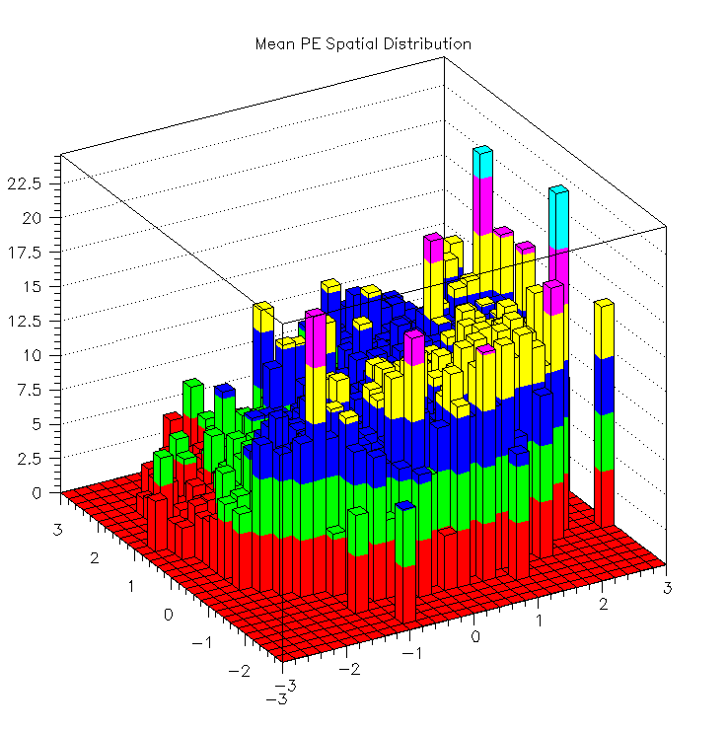
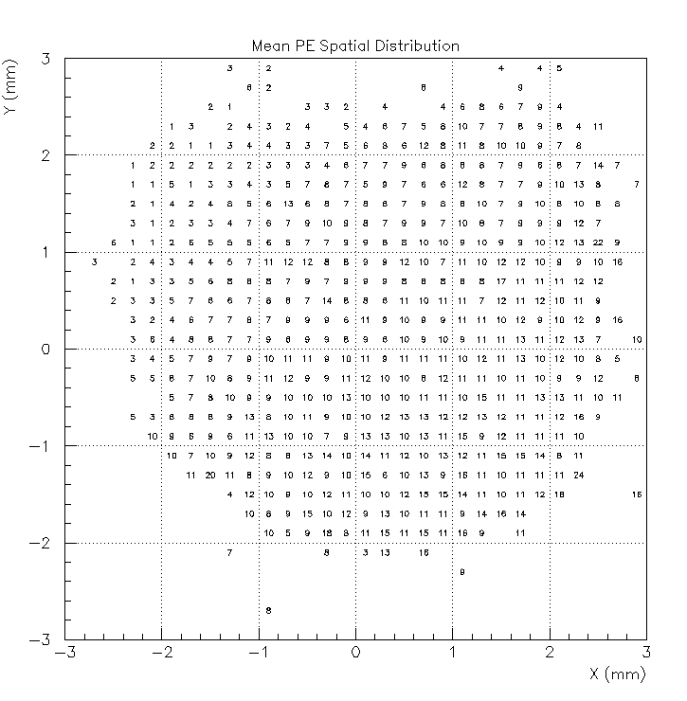
Divide by the mean spe Charge determined by the Polya Fits
High
Mean No of PEs per Track
LOW
X Track-Impact Coordinate
Y Track-Impact Coordinate

Slide 24
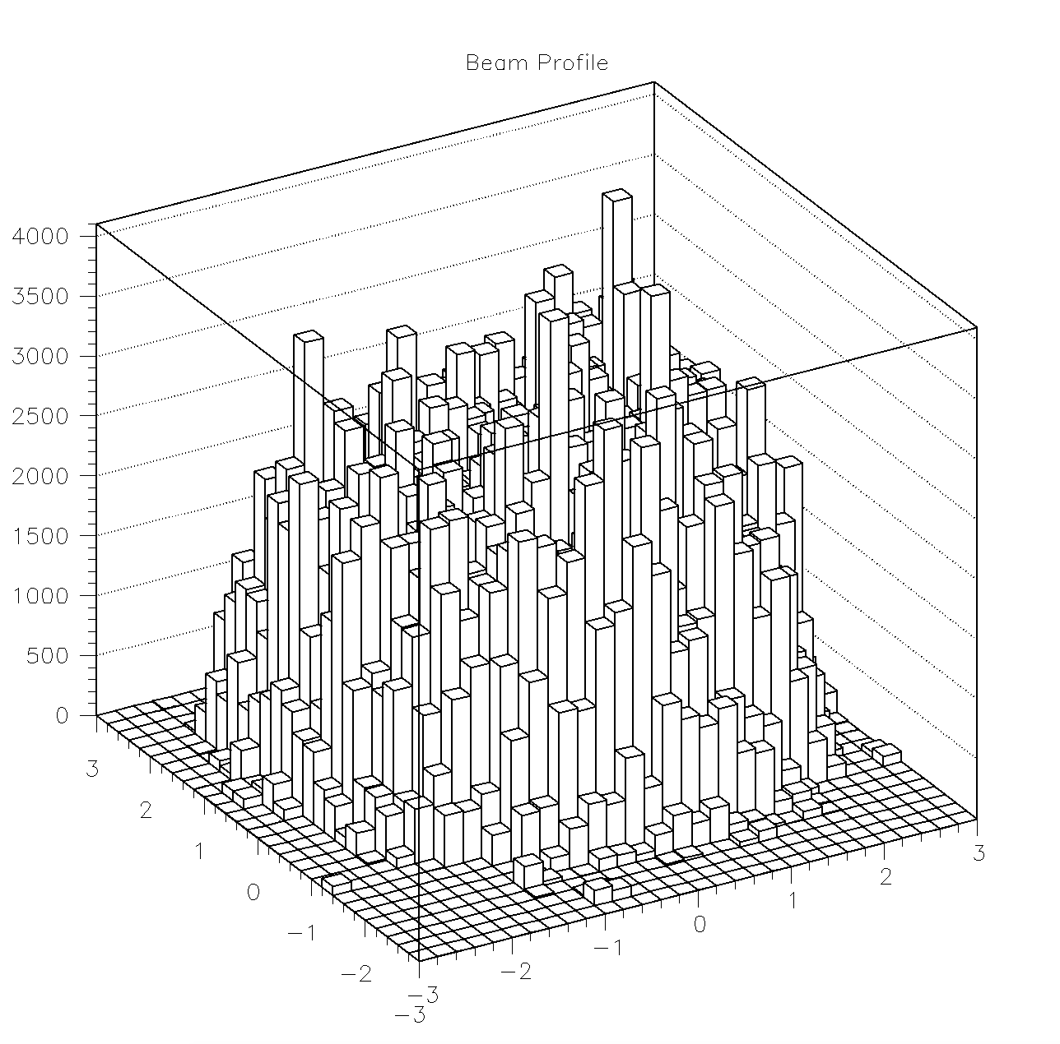
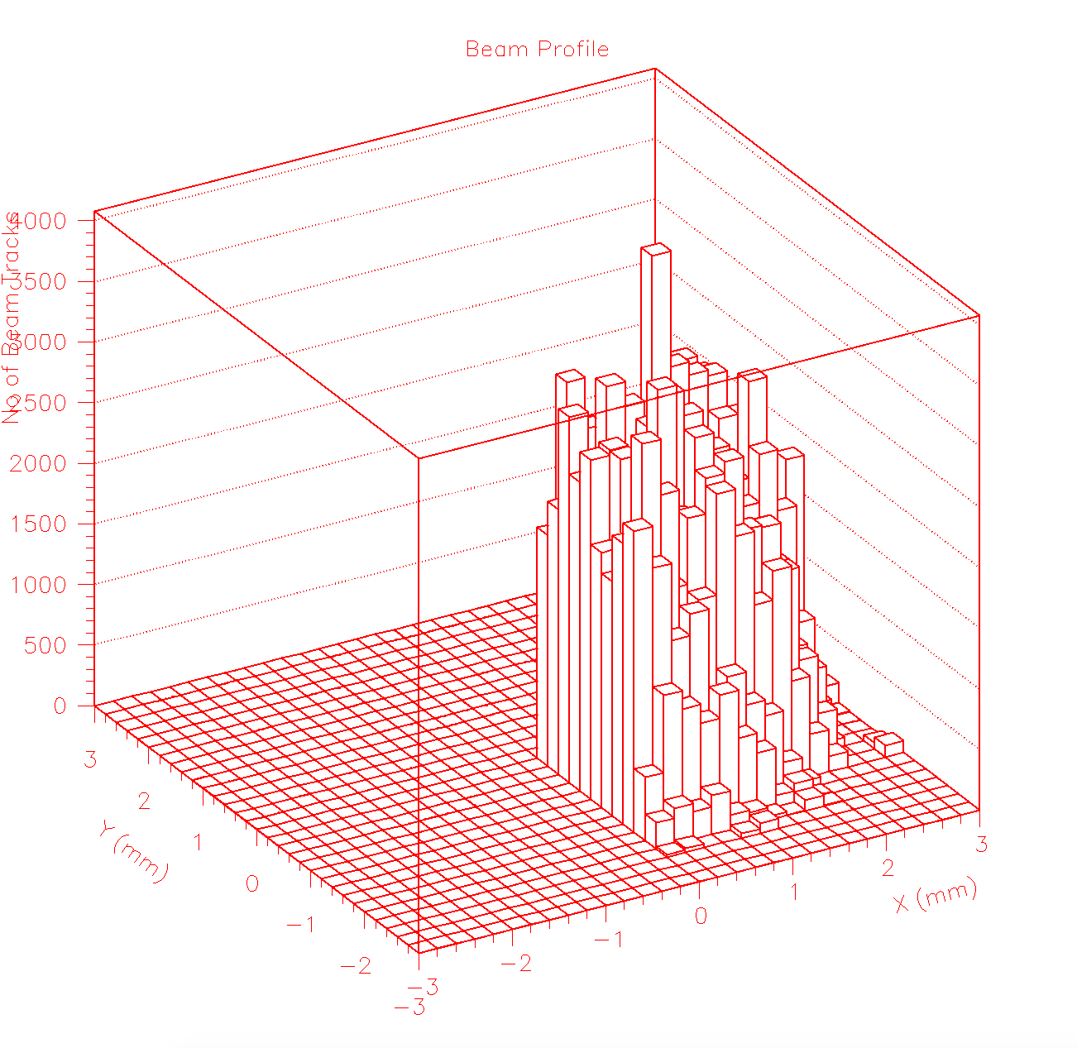
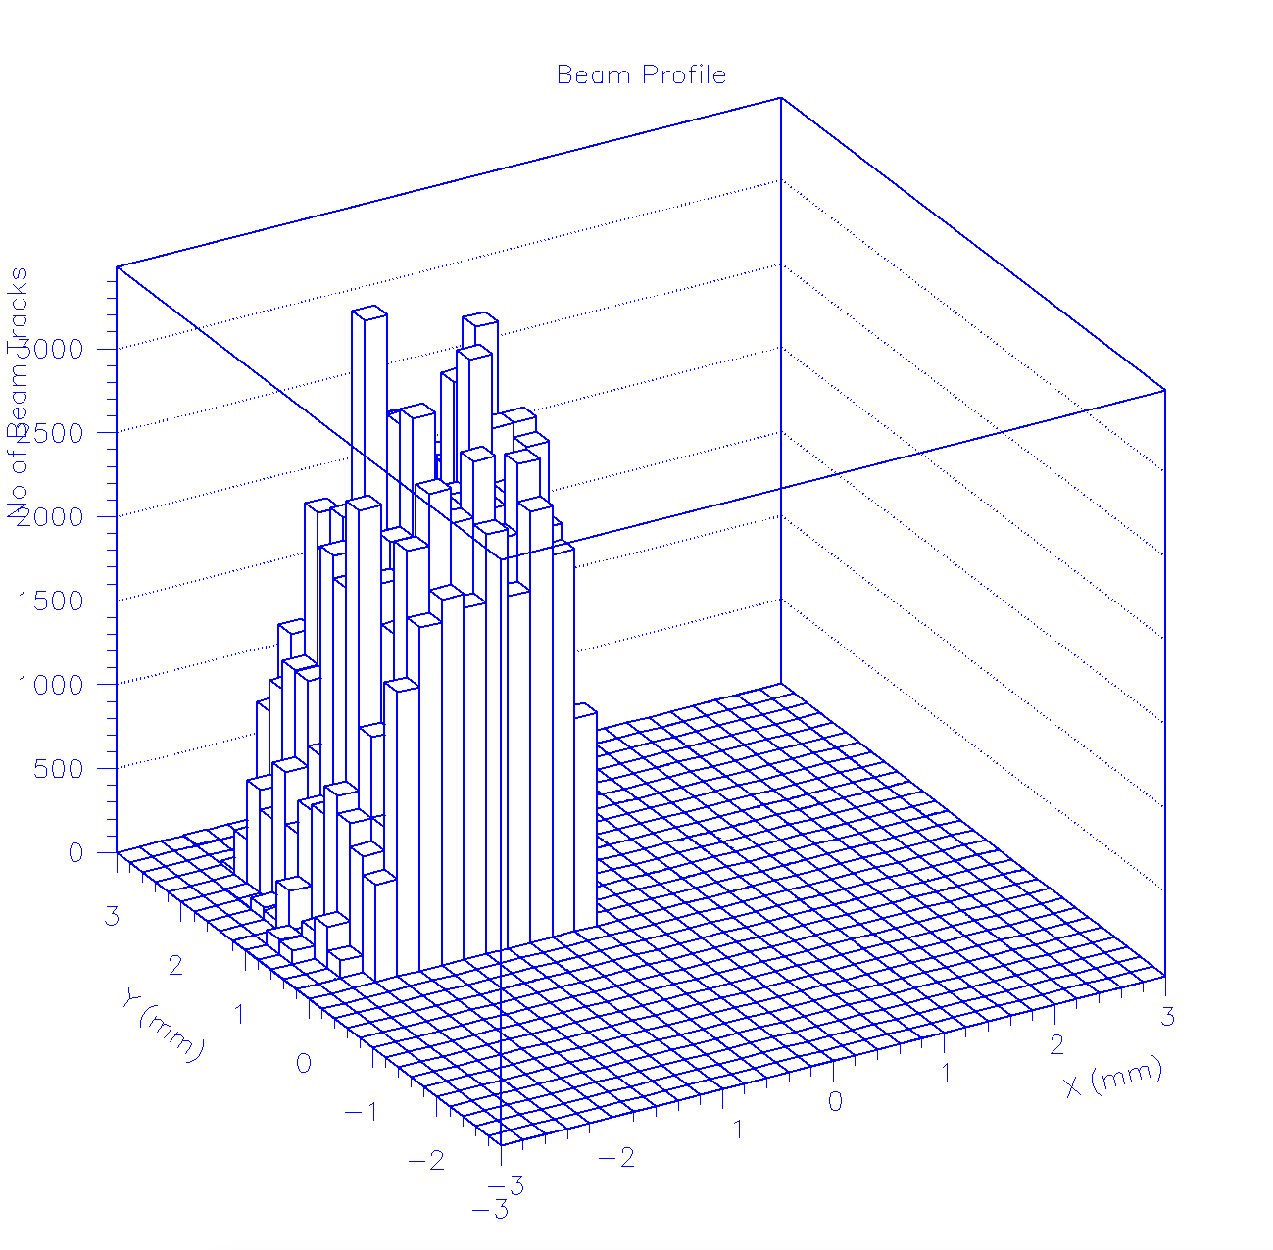
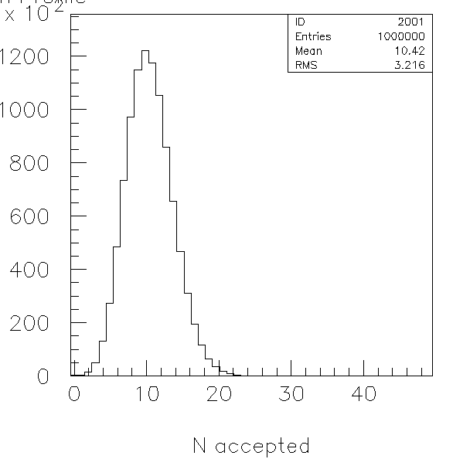
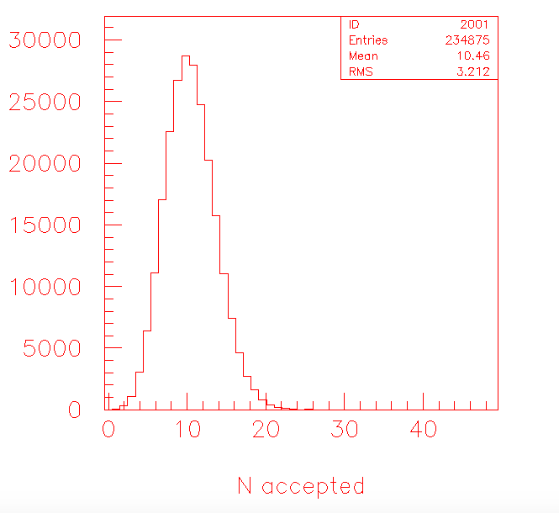
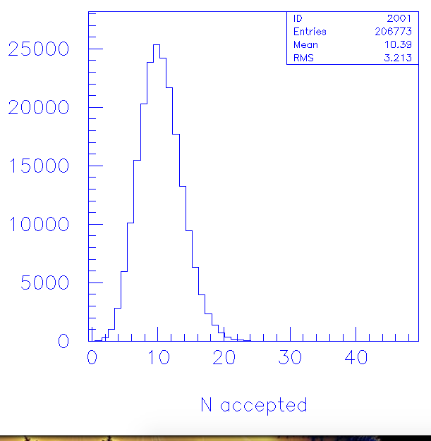
Simulation Studies
simulate the beam by “bootstraping” the RUN284 reconstructed tracks (plus a 0.2 mm jitter)
assume μ_{Cherenkov} =12
perfect alignment, perfect efficiency (except “pillars losses”)
check “ high” and “low” regions
in the demonstration plot the pillars with 0.2 mm radius

Slide 25
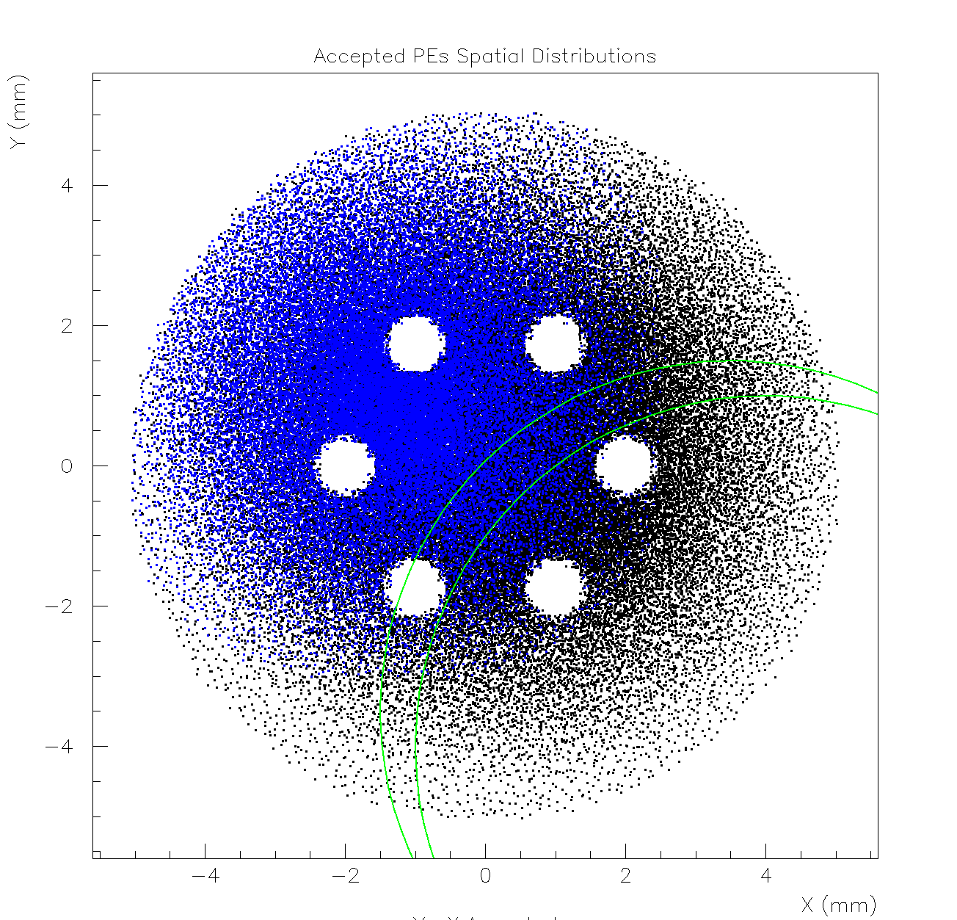
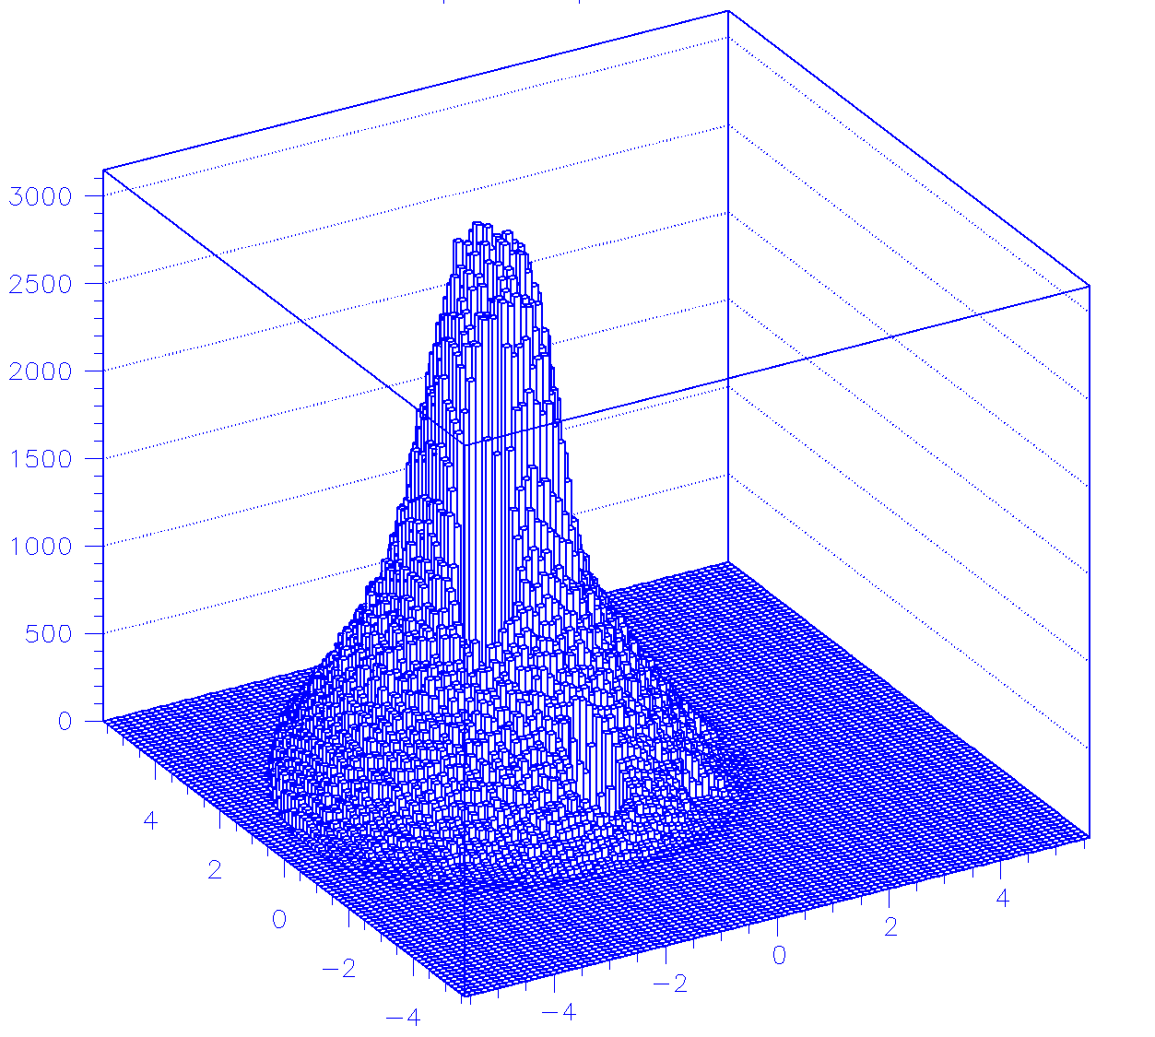
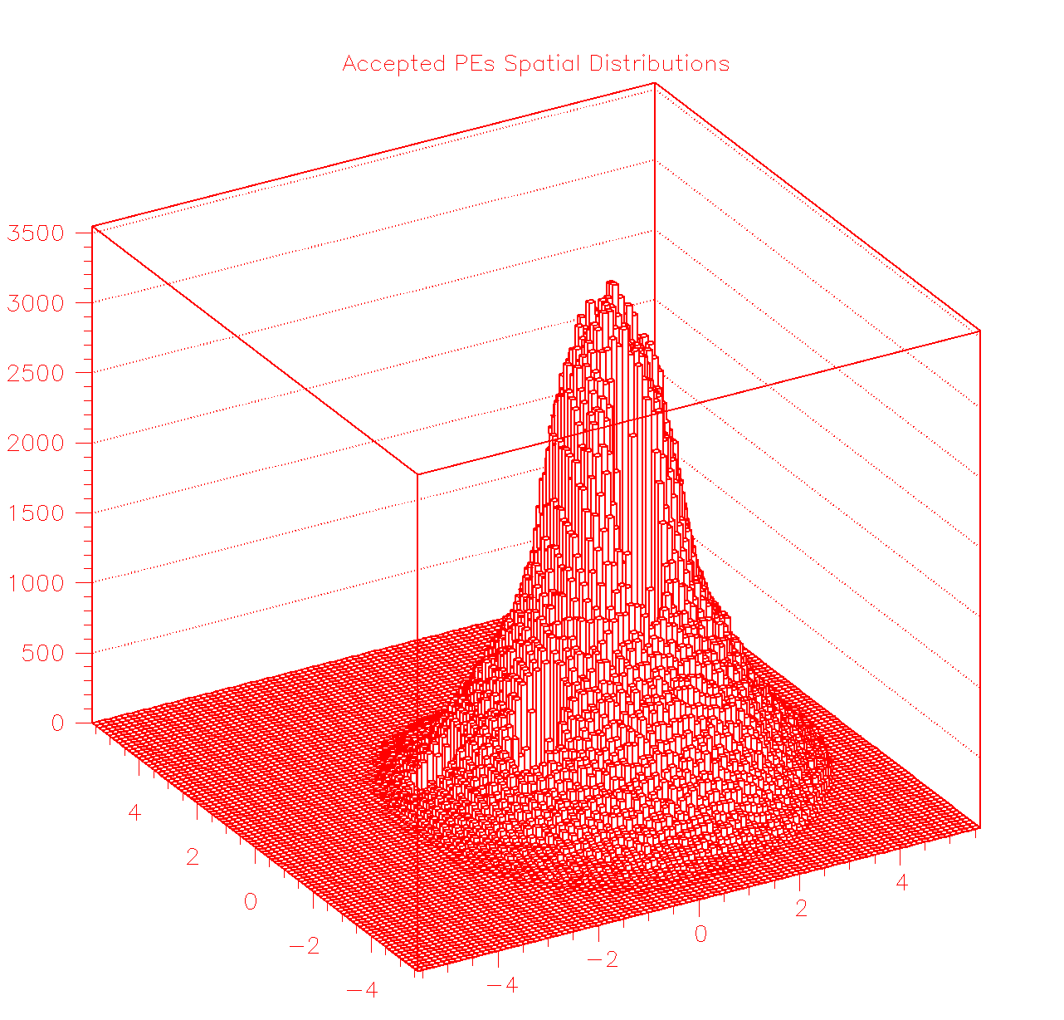
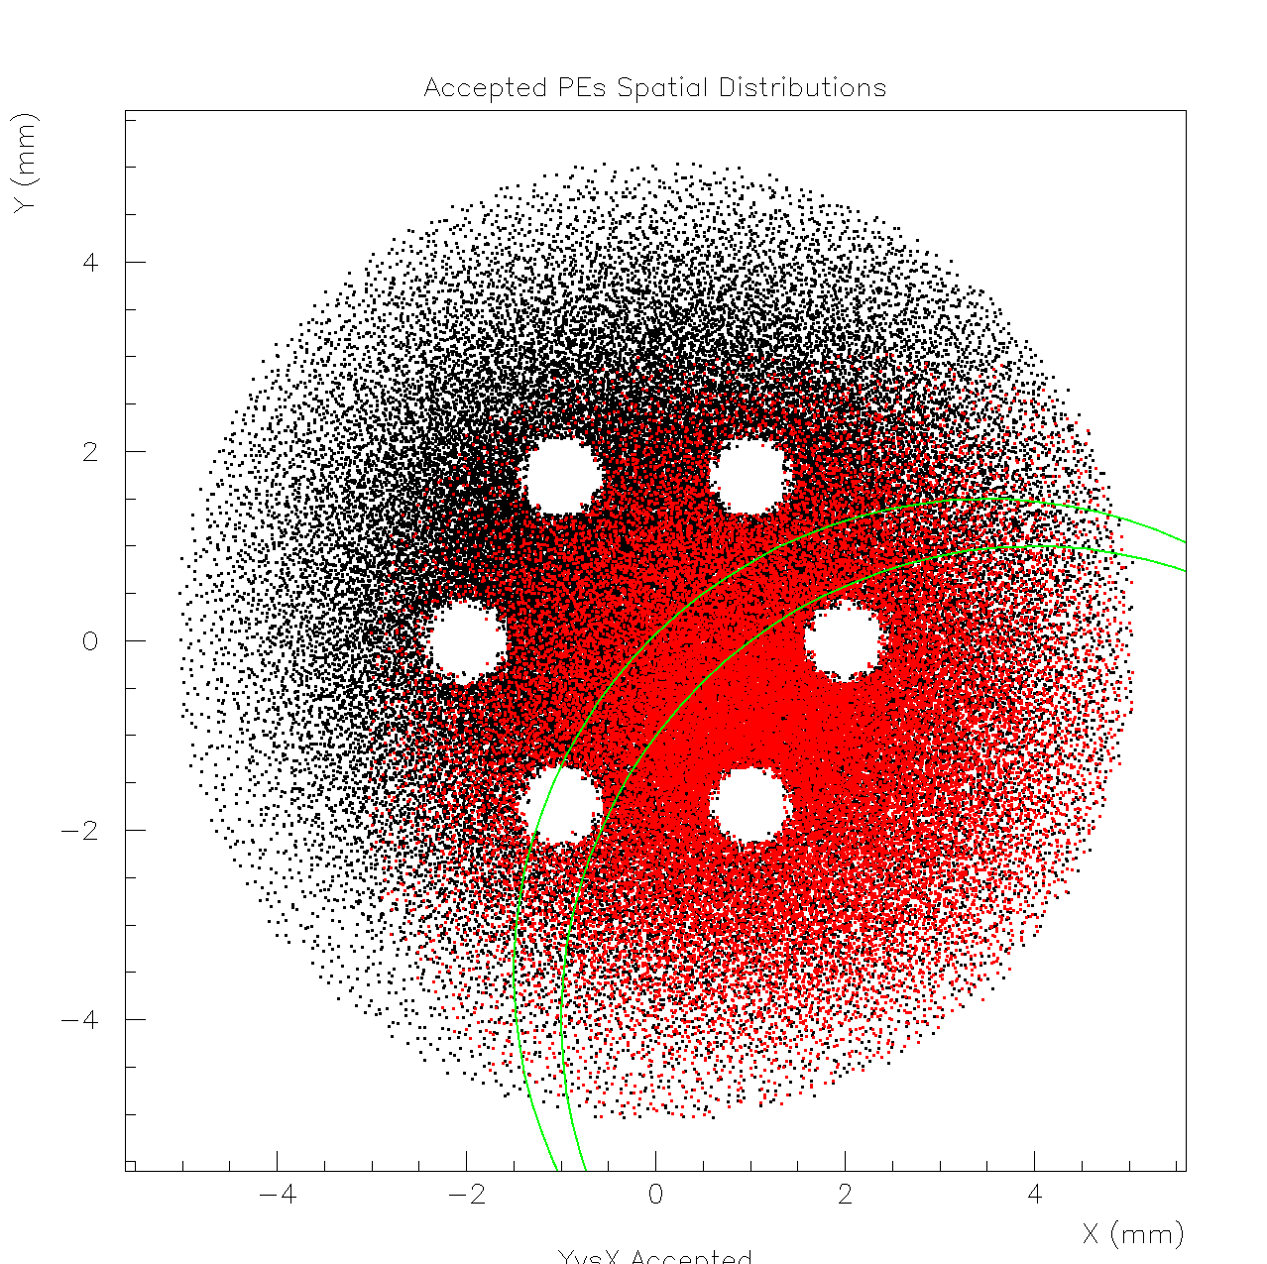
Accepted Pes Spatial Distributions:
all, b) pes from “low” beam region, c) pes from “high” beam region
the arcs represent the detector geometrical limits when displaced by (3.5, -3.5) and (4, -4) mm

Slide 26
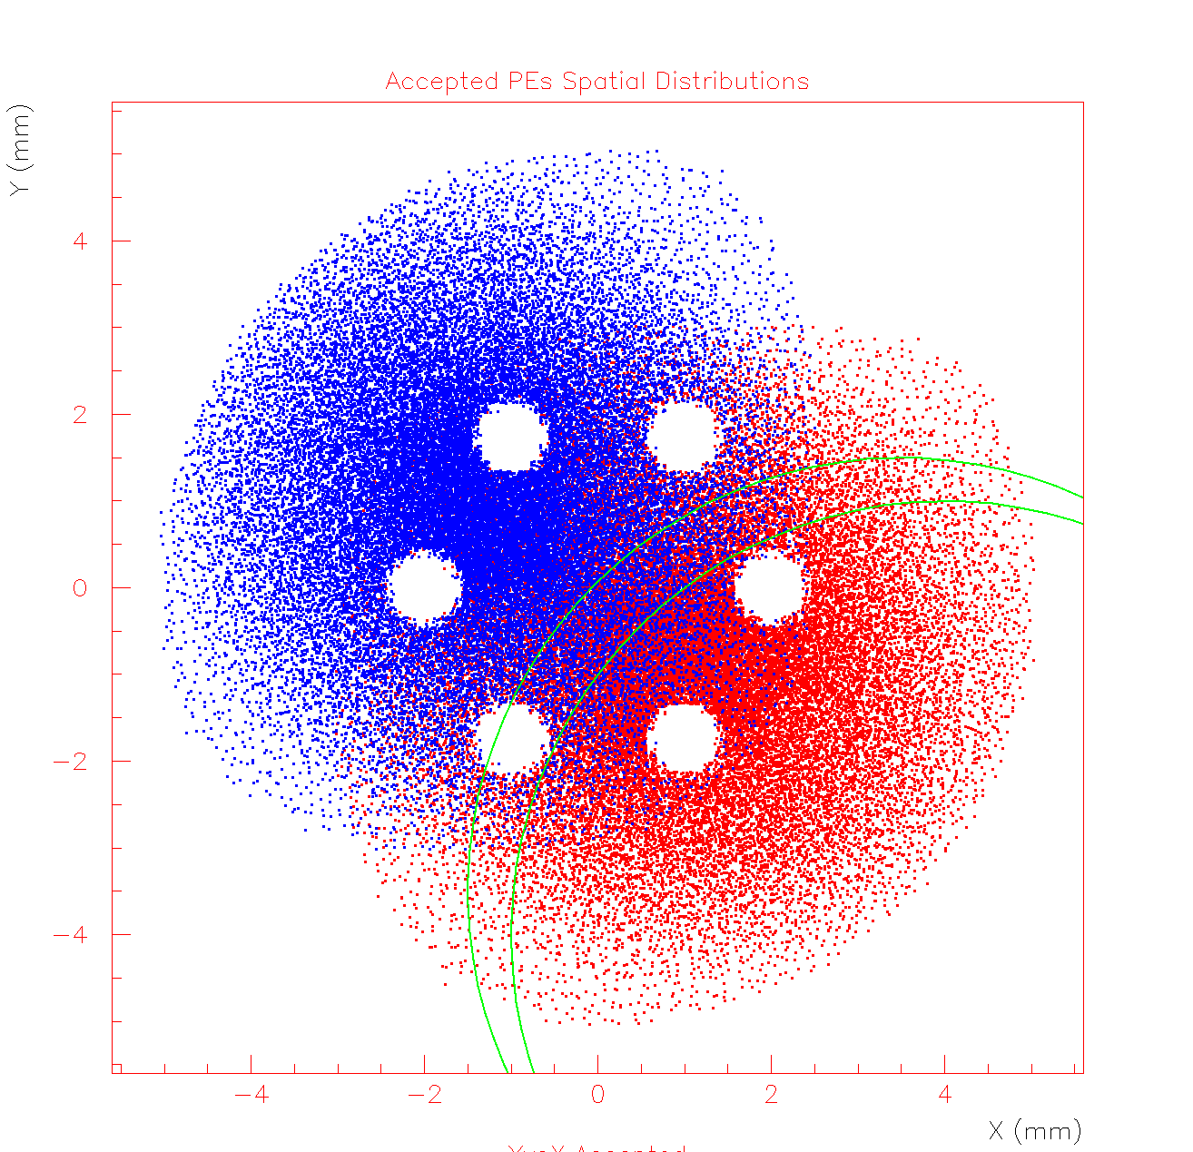
Does a possible misalignment explains the observed spatial dependence of the efficiency ?
pes from “low” beam region, pes from “high” beam region

Slide 27
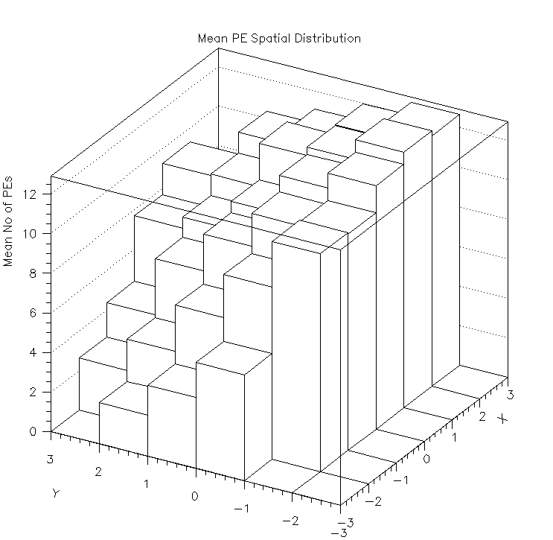
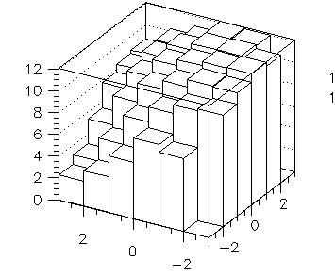
FIT STRATEGY
Simulation is performed with 0.1mm pillars radius, 2.5 mm from the anode periphery
Data
Simulated Pattern
Mean No of PEs per Track
X Track-Impact Coordinate
Data Bins with less than 10 tracks have been put to zero and they do not participate in the fit
Y Track-Impact Coordinate
i and j correspond to X and Y track impact coordinates
D_{ij} are the Data bins, whilst e_{ij} are the corresponding statistical errors.
S_{ij} are the simulated pattern bins which are functions of the mean number of pes produced (μ_{Ch}) and the anode’s displacement (δx , δy).
S_{ij} are produced by different simulation runs, selecting the parameters (δx , δy, μ_{Ch} ) accordingly.
The estimation is performed by minimizing the following χ² estimator, using two different minimization algorithms
where r(δx,δy) is a scale factor that can be a treated as a function of the
displacement or as a constant

Slide 28
χ² MINIMIZATION METHODS
Relative Scaling
Simulated Patterns are generated for several displacement points (δx , δy) using a preselected μ_{Ch} , the same for all the patterns. The “true” displacements are estimated as the values that correspond to the simulated pattern with the minimum “reduced χ²”
The relative scaling corresponds to scaling the number of produced pes, independently, for each simulated pattern. Then, the estimated value of μCh is given by
Iterative Fit
Simulated Patterns are generated for several displacement points (δx , δy) using a preselected μ_{Ch} , the same for all the patterns. The “true” displacements are estimated as the values that correspond to the simulated pattern with the minimum “χ²” :
A scale factor is calculated using the simulated pattern produced at :
If the scale factor is not 1 then update μ’_{Ch}=r_{global} μ_{Ch}, simulate new patterns with μ’_{Ch} and repeat the fit
When r_{global}=1, the procedure have converged

Slide 29
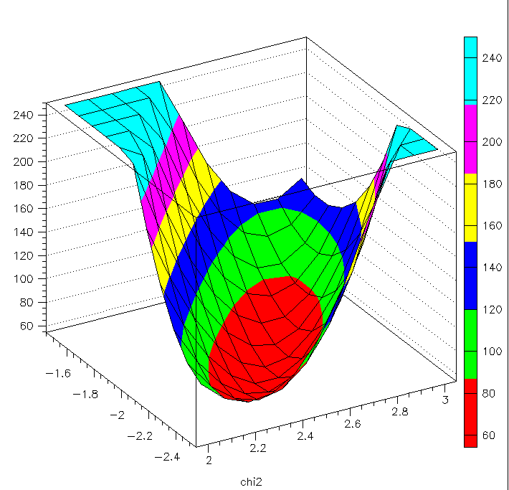
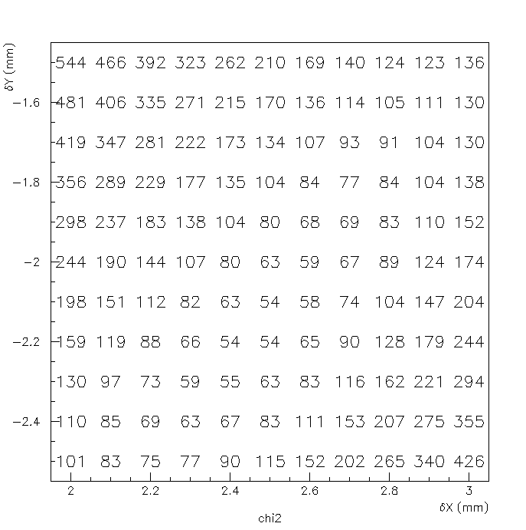
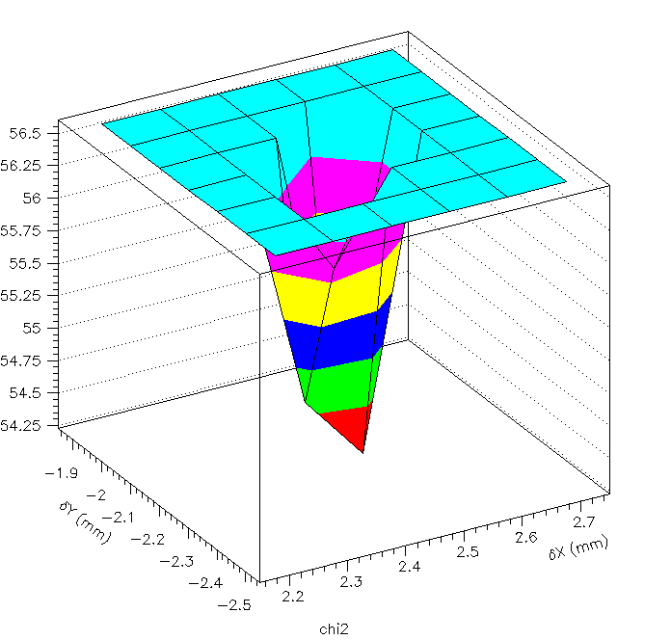
“Relative Scaling” FIT - RESULTS II
Full Scan
χ²
68.3% Level (minimum+2.3)
χ²
Minimum at δx=2.5mm , δy=-2.3mm
Approximate 68.3% limits 2.3mm<δx<2.6mm and -2.4mm<δy<-2.0mm

Slide 30


Iterative FIT - RESULTS III
Full Scan
-2 mm < Y_{b} < -1 mm
-1 mm < Y_{b} < 0 mm
0 mm < Y_{b} < 1 mm
1 mm < Y_{b} < 2 mm
2 mm < Y_{b} < 3 mm
The curve is the convolution of a SPE-Polya with the pe multiplicity distribution evaluated by the MC fit

Slide 31




Systematical Errors:
Anode displaced relative to the beam at δx=2.55mm, δy=-2.1mm
PEs
F=1.7
The underlying model
Beam
F=1.7
Change the pillars orientation
F=1.7
Change the pillars radial coordinate

Slide 32


Systematical Errors:
Anode displaced relative to the beam at δx=2.5mm, δy=-2.1mm
F=2.2
Anode inefficiency
( 0.5mm-wide outer ring)
Fit using a “reduced anode” model: 4.5 mm anode radius
Relative Scaling: χ²_{min}=58.5 δx=2.1 δy=-1.8
Iterative Fit: χ²_{min}=61 δx=2.1 δy=-1.7
Compare with “full anode” results
χ²_{min}=54 , 2.3mm<δx<2.6mm and -2.4mm<δy<-2.0mm @ 68.3% CL
It finds a different minimum with larger Chi2
But …

Slide 33



Fit Results using the “reduced anode” model
F=1.8
Very similar with the “full anode model”
In good agreement with the spe results
The fit is much more sensitive to the “number of pes per track distribution” than to the real misplacement of the anode wrt the beam (i.e. we estimate an effective position !!!)

Slide 34
Calibration @ Other Working Points - PRELIMINARY
 |  |  | Muon Run |  | SPE Run – Polya Fit |  | Parameters
Run Number | PS2 Mesh | PS2 Drift | E[Q] | V[Q] | Q_{e} | V_{e} | <Ν_{pe-obs.}> ± 0.5 | Θ ± 0.3 (??)
277 | +450 | -325
278 | +450 | -300
279 | +425 | -325
280 | +425 | -300
281 | +425 | -350
282 | +450 | -275
284 | +450 | -350 | 13.8 | 53.9 | 1.5 | 0.81 | 9.3 | 1.8
285 | +475 | -250 | 1.94± 0.02 Syst. error 1.75± 0.02 | 1.07 | 0.35± 0.04 | 0.04 | 5. | 2.2
286 | +475 | -275 | 3,4 | 3.24 | 0.51 | 0.1 | 6.7 | 1.6
287 | +475 | -300 | 6.51 | 12.5 | 0.8 | 0.29 | 8.1 | 1.2
288 | +475 | -325 | 13.5 | 53.7 | 1.36 | 0.81 | 9.9 | 1.3
289 | +450 | -325

Slide 35
Studies with the Laser – Calibration Data

Slide 36


Very good agreement between the different timing methods

Slide 37




RUN 25-01-2017_CF4-0.2C2H6 600-500
Single Gaussian Fit
?
0.04V < V_{e-peak} < 0.05V
0.25V < V_{e-peak} < 0.30V

Slide 38



Slide 39

0.04V < V_{e-peak} < 0.05V
0.25V < V_{e-peak} < 0.30V

Slide 40



600-425

Slide 41



Time Resolution dependence on the e-peak amplitude
600-425
600-450
600-475
600-500
CF4/600 V

Slide 42


Slewing dependence on the e-peak amplitude
Corrected for trigger offsets

Slide 43


Global Corrections
All the RUNs-600 treated using the “global” slewing and resolution parameterizations

Slide 44


600-425
We should correct the resolution curves for threshold effects

Slide 45

Data collected with different thresholds
Predicted resolutions for a global 0.018 V pulse acceptance threshold
How we predict?

Slide 46


Slide 47


Slide 48


Slide 49
The errors are from gaussian fits after slewing correction
The “prediction” is the convolution of the Polya parameterization of the PH distribution with the resolution vs PH parameterization
 | 600-425 Cut: 0.018 V | 600-450 Cut: 0.018 V | 600-475 Cut: 0.04 V | 600-500 Cut: 0.05 V
data | 107±1 ps | 94.5±0.7 ps | 70.0± 0.5 | 62.2±0.6
“prediction” | 102 ps | 96.2 ps | 70.6 ps | 61.4 ps

Slide 50

In the following Rise Time =1/R₃

Slide 51

RUN 25-01-2017_cf4-0.2c2h6_600-500
0.05V < V_{p} < 0.06V
0.10V < V_{p} < 0.11V
0.18V < V_{p} < 0.20V
0.25V < V_{p} < 0.35V

Slide 52



Slide 53

Remember that

Slide 54


Slide 55

Comparison of the “Pull” Distributions (with and without slewing corrections) to Standard Gaussians

Slide 56
REMINDER: Estimate the e-Peak Charge Distribution Parameters
Parameterize the PicoMM response to N Pes by Gamma Distribution Functions

Slide 57


REMINDER:
We have developed criteria to reject multi-photon calibration events
Muon Data
SPE Calibration Data

Slide 58
Let us assume that the single pe’s charge distribution is given by:
(1)
where
(2)
The pdf for the charge which is produced by n pe’s (n>0) will be:
(3)
Because , where follow (1) and are mutually independent, then
(4)
Furthermore, the pedestal distribution which corresponds to 0-pes, has

Slide 59
Consider now muons producing n pes, where the variable n follows some pdf , where
(5)
and is a vector of other parameters (this distribution could be Poissonian)
Then the total accumulated charge (that is proportional to the integral of the corresponding waveform) is distributed according to:
(6)
The expectation value of the total charge is given by
(7)

Slide 60
(8)

