Slide 1



New Directions in Robust Photocathodes
Using the tools of materials science to engineer alkali antimonide cathodes for performance and speed
John Smedley
Brookhaven National Laboratory
Feb 21, 2017

Slide 2
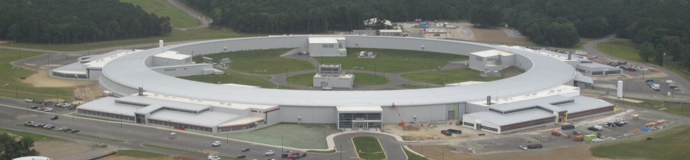
What do we want out of an electron source?
The electron beam properties determine the photon beam properties
  Pulse duration, degree of coherence, flux
In all light sources through 3rd generation, the phase space is determined by the ring
In X-ray free electron lasers (LCLS II, XFEL, MaRIE), this will change – the electron source will determine the beam properties
The highest brightness sources available are photoinjectors, which use a laser on a photocathode to control the spatial and temporal profile of the emitted electron beam

Slide 3
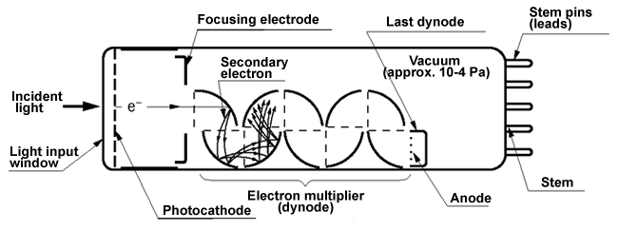
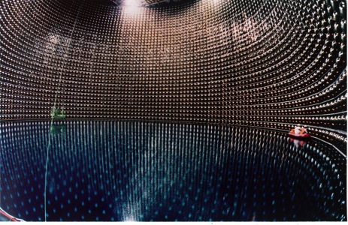
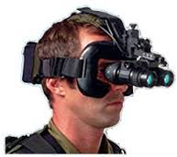
What is a photocathode?
A surface that emits electrons when illuminated (Go Einstein!)
What are they used for?
Traditionally, in image intensifiers and photodetectors/PMT
Super-Kamiokande
Neutrino Detector
11,200 20”
K₂CsSb PMTs

Slide 4
What is a photocathode?
A surface that emits electrons when illuminated (Go Einstein!)
What are they used for?
Traditionally, in image intensifiers and photodetectors/PMT
More recently also as electron sources for accelerators
Allow control of the spatial and temporal profile of the beam
Produce a “Brighter” electron beam than can be achieved from other sources
What makes a good photocathode?
Quantum Efficiency, lifetime, fast temporal response
Correlation of emitted electrons (low beam “temperature”, or emittance), high current, low dark current, spin polarization
Important applications to other fields – Photovoltaics, PET imaging

Slide 5
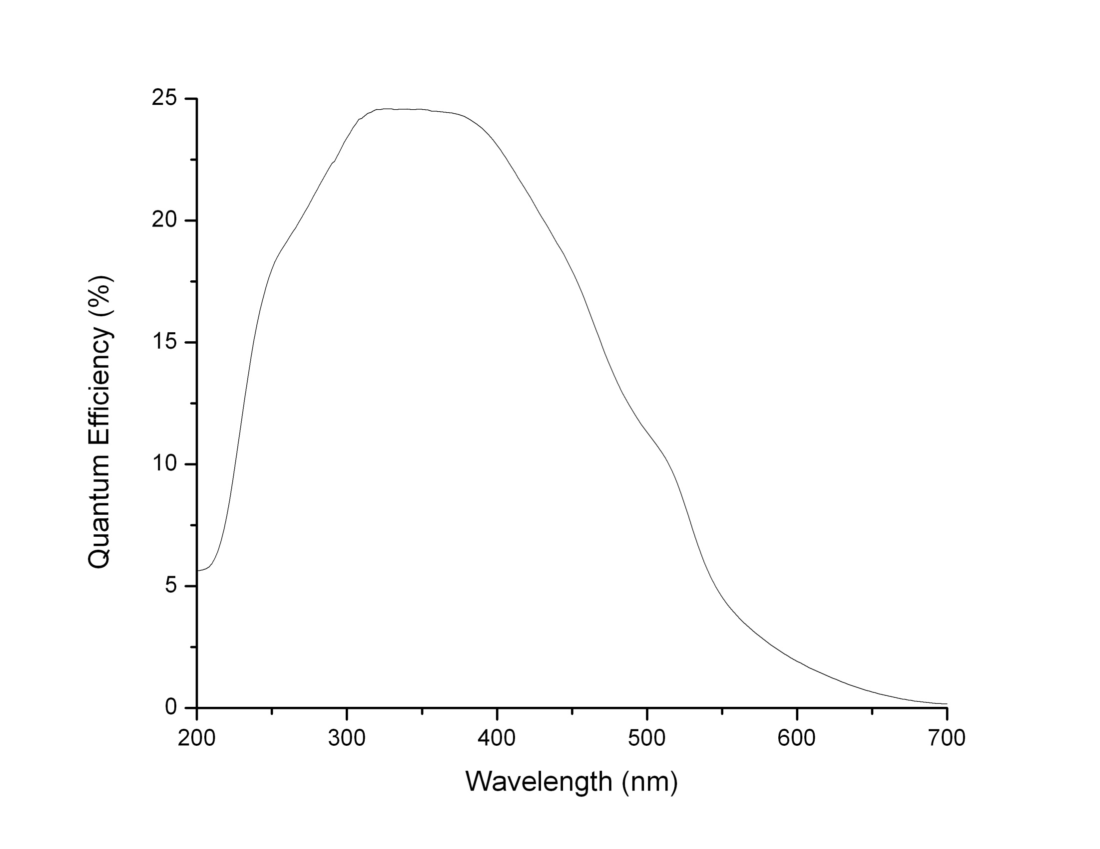
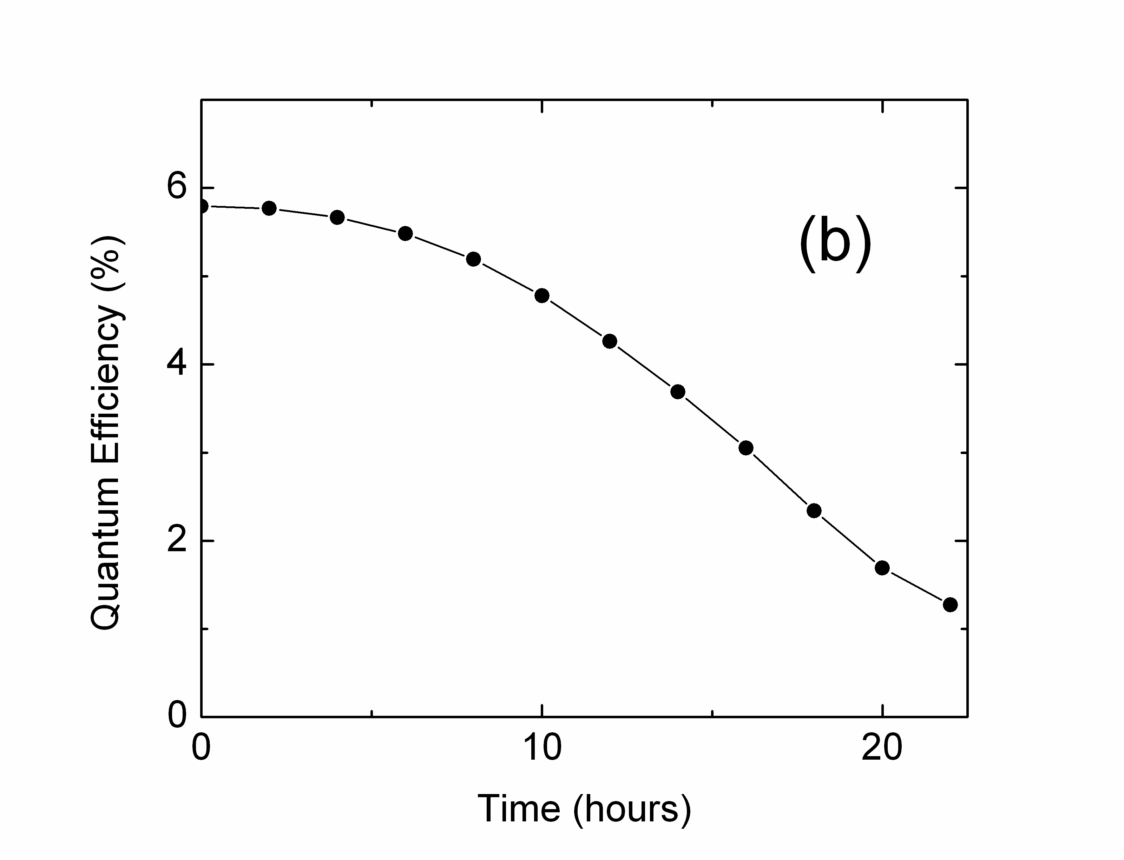
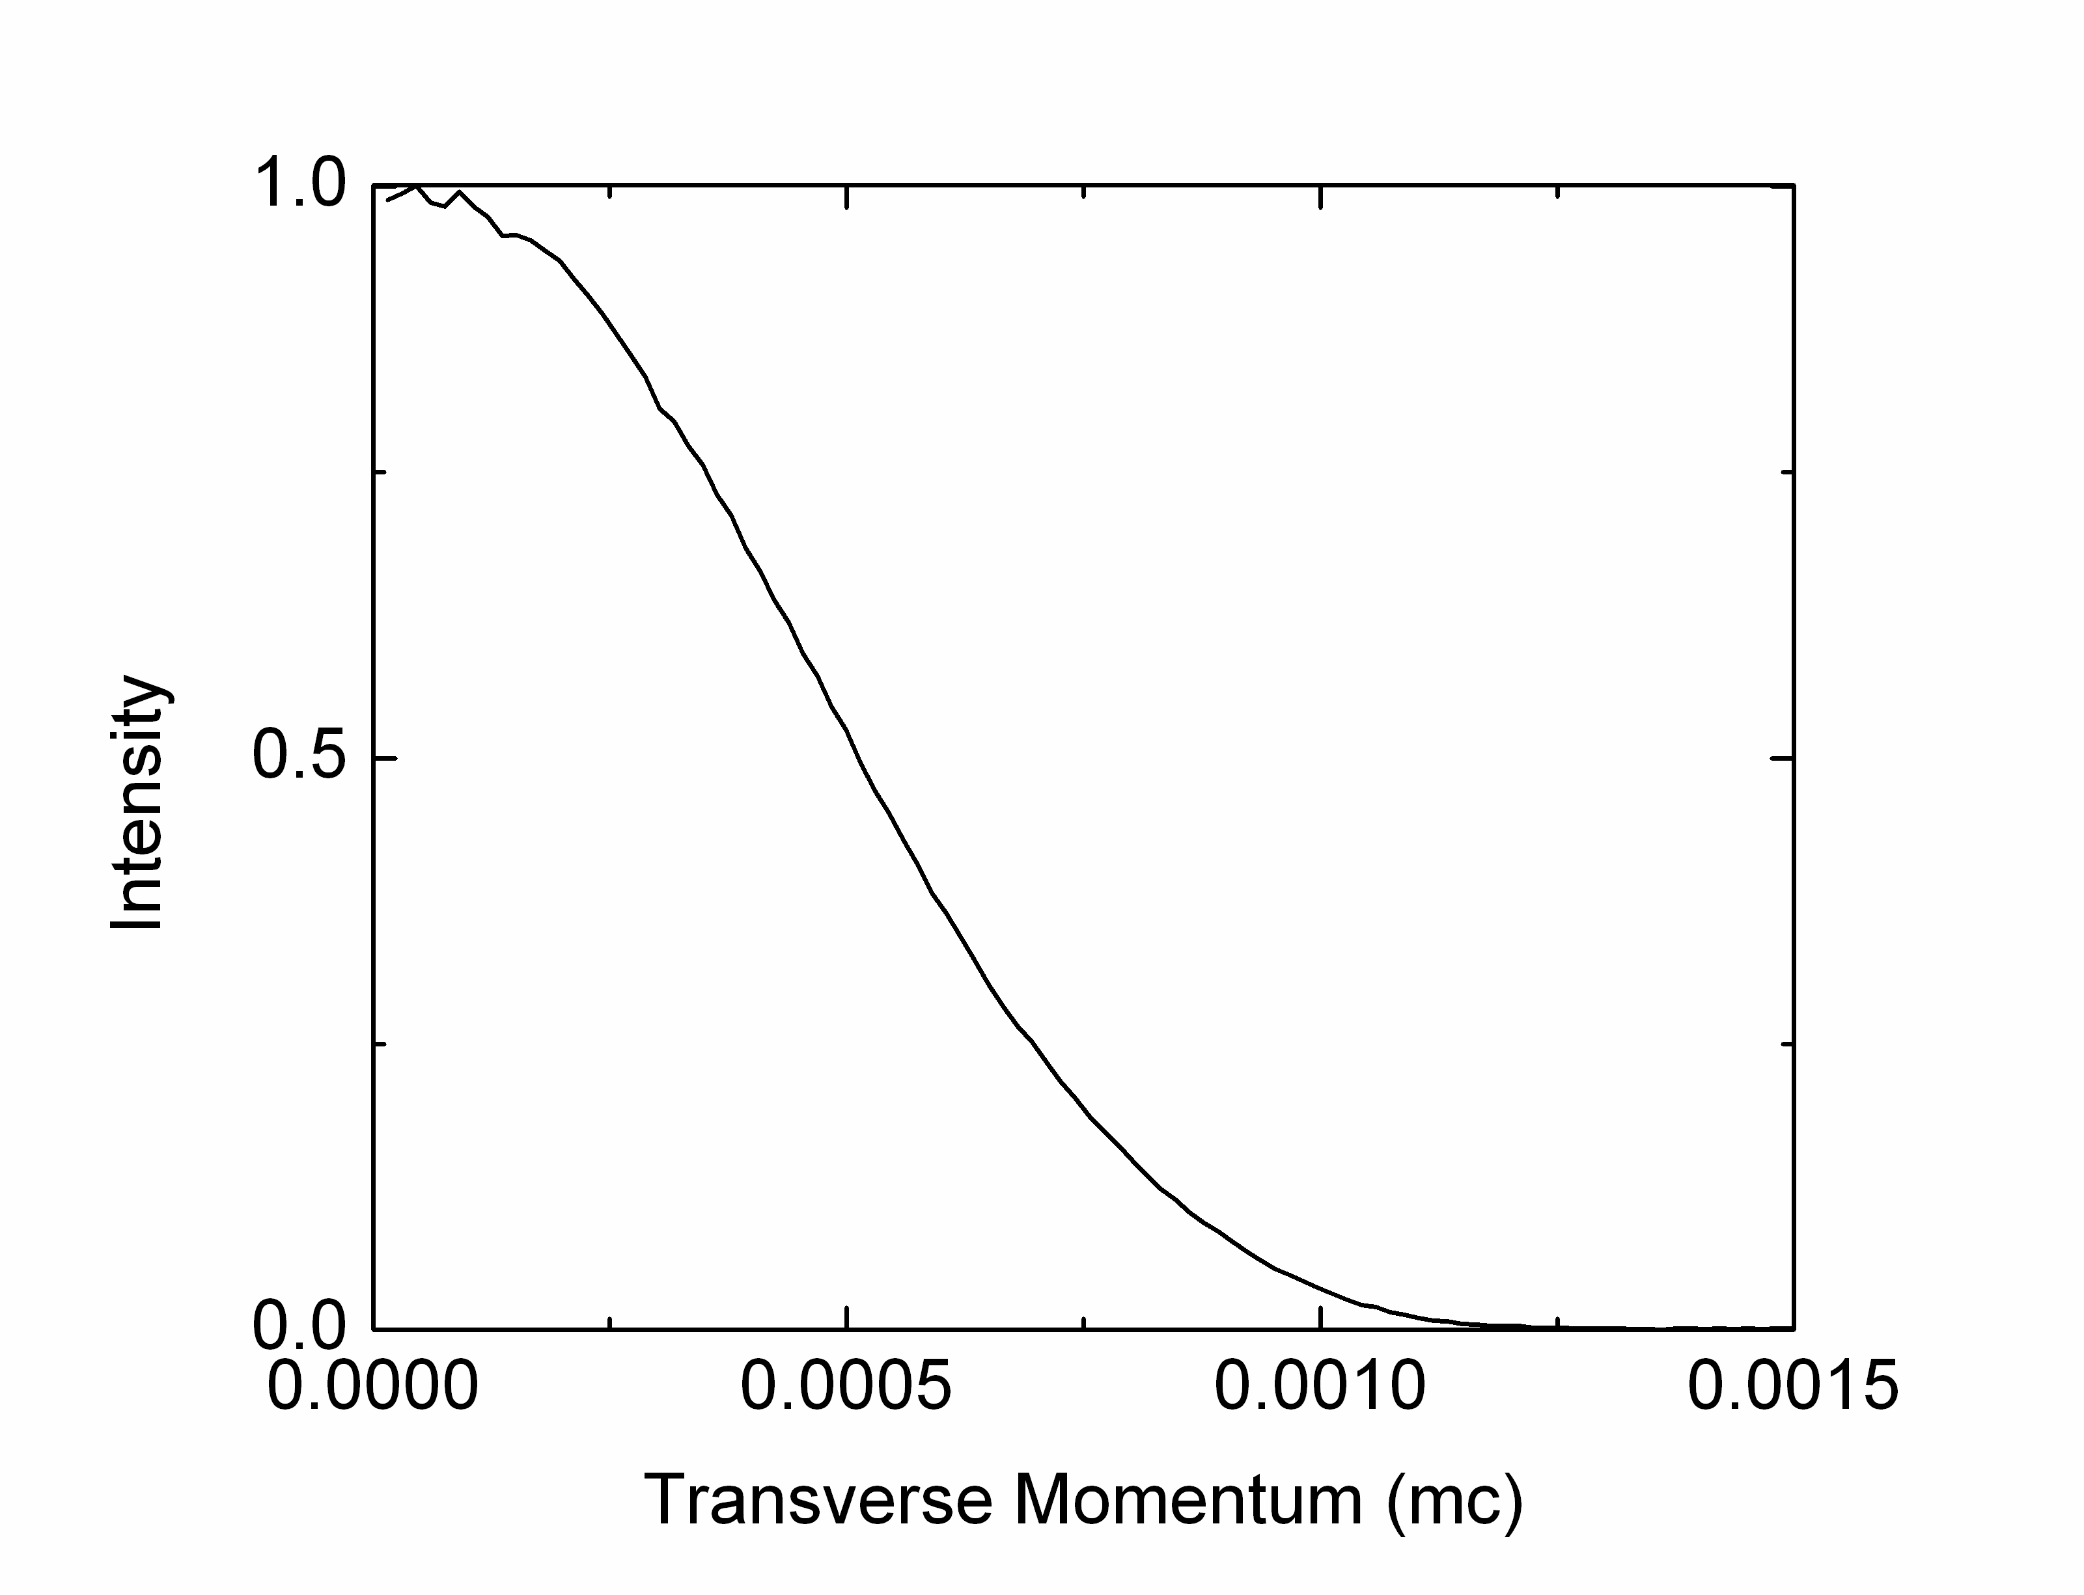
K₂CsSb: A Good Candidate
Good
Lifetime
1e-9 mBar
In “magic window”
Low transverse
Momentum (543 nm)
0.36 µm/mm
Onset of e-e
scattering
Unproductive absorption
T. Vecchione et al., Appl. Phys. Lett. 99, 034103 (2011)

Slide 6
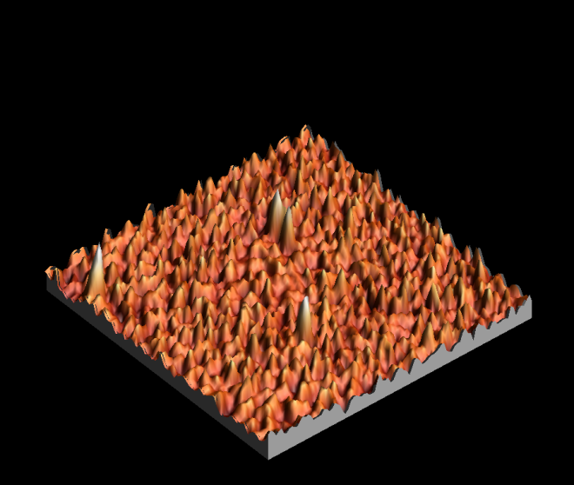
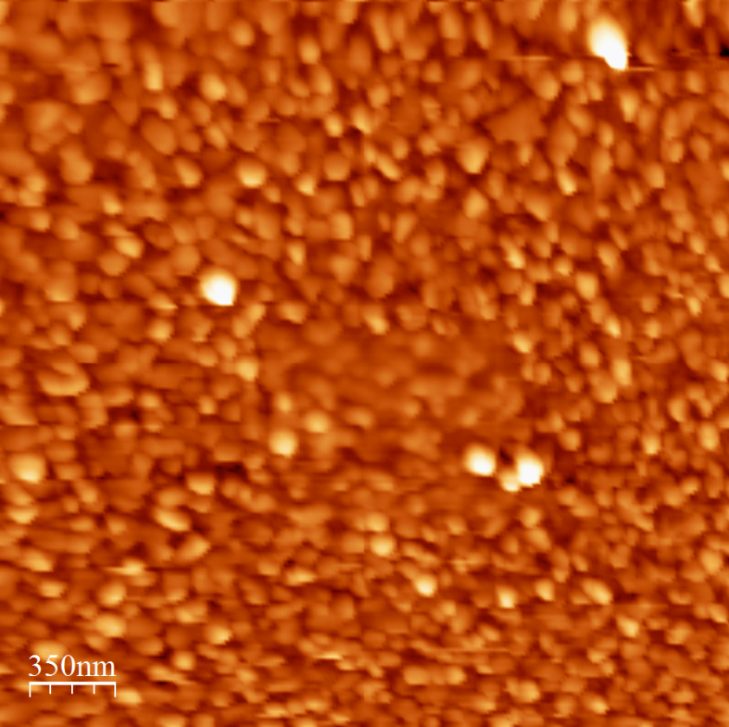
Traditional Sequential Deposition of K₂CsSb
High QE and Rough Surface
  25 nm roughness, 100 nm spatial period
  S. Schubert et al., APL Materials 1, 032119 (2013)
  Emittance vs field measured with Momentatron, 532 nm light
  T. Vecchione, et al, Proc. of IPAC12, 655 (2012)

Slide 7
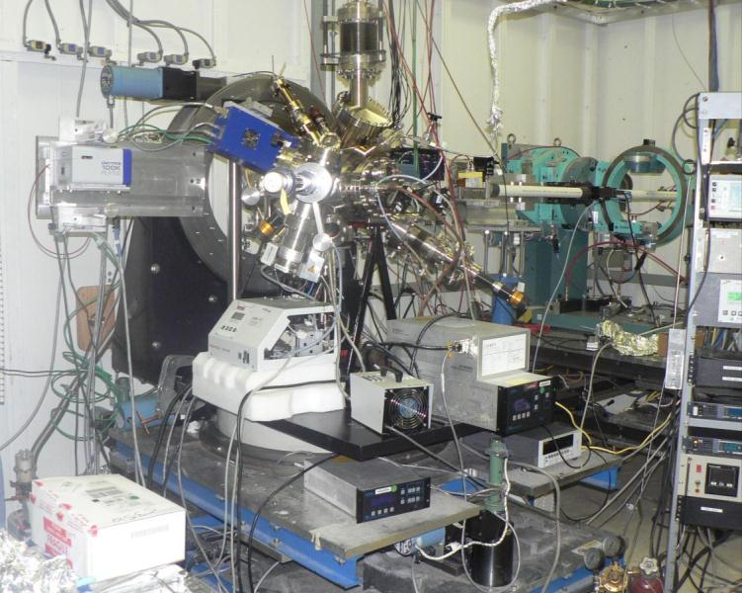
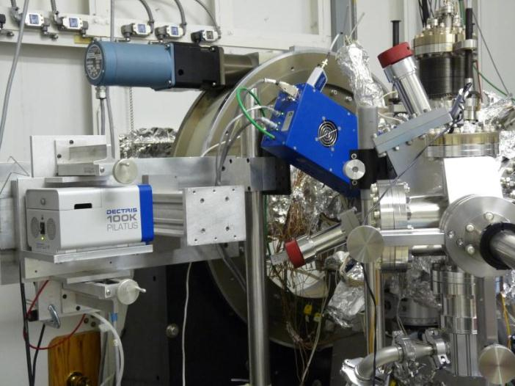
In operando analysis during growth
(setup at NSLS/X21 & CHESS G3 – ISR soon)
UHV system ( 0.2 nTorr base pressure)
Residual Gas Analyzer (RGA)
Heating/cooling substrate/cathode
Load lock
  fast exchange of substrates
  gun transfer
Horizontal deposition of Sb, K and Cs.
Sputter Deposition!
Camera 2
Camera 1
Two 2D detectors (Pilatus 100K)
XRF, XRD, XRR, GISAXS, QE

Slide 8
Experimental set up: K₂CsSb cathode growth
Horizontal evaporation of three sources:
P=1x10-10 mbar
FTM
Cs
K
X-rays
Sb
Recipe:
QE during growth (532 nm laser)
Cs
T(C)
QE(%)
140
K
K
Cs
100
Sb
25
t
t

Slide 9
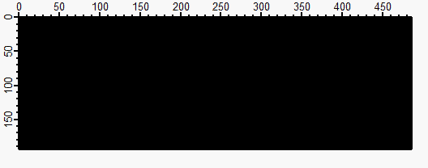

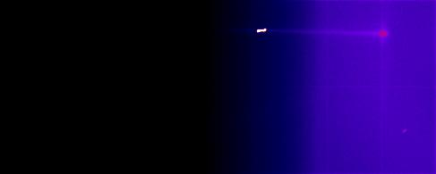
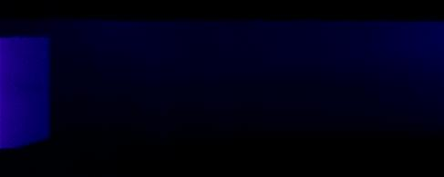
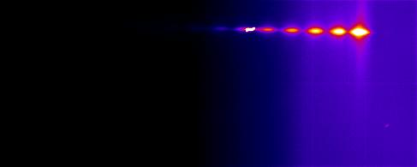
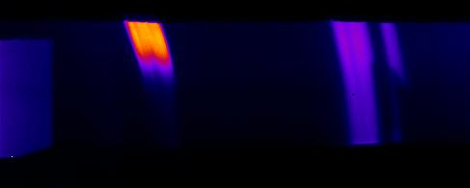
165Å Sb at RT on Si(100)
Simultaneously Acquire XRD and GISAXS
Understanding reaction dynamics through crystalline phase evolution
Map the thickness and roughness evolution of the cathode
Is there a correlation between reactivity, QE and roughness?
Camera 1: GISAXS & XRR
Camera 2: WAXS
14.9˚
39.3˚
0Å
time
165Å
(003)
(012)
(104)
(110)
Sb peaks

Slide 10
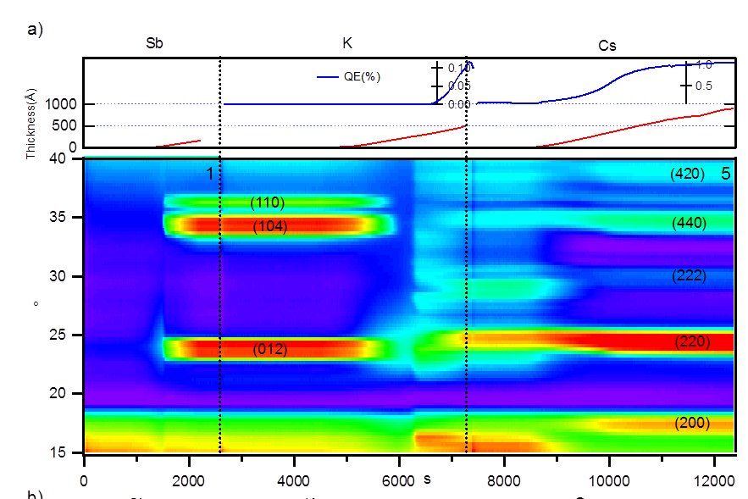
Reaction Dynamics
Antimony evaporated on Si, 0.2 Å/s; crystallize at 4nm
K deposition dissolves Sb layer - This is where roughening occurs!
QE increase corresponds with K_{x}Sb crystallization
Cs increases lattice constant and reduces defects
M. Ruiz-Osés et al., APL Mat. 2, 121101 (2014)

Slide 11
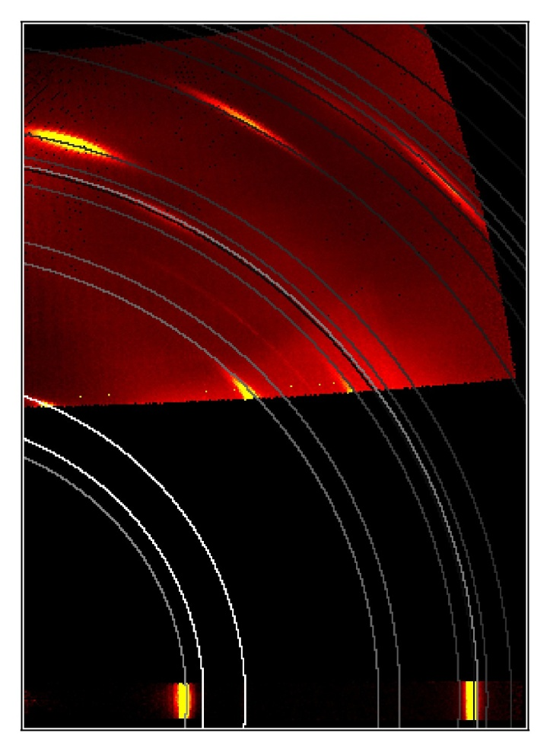
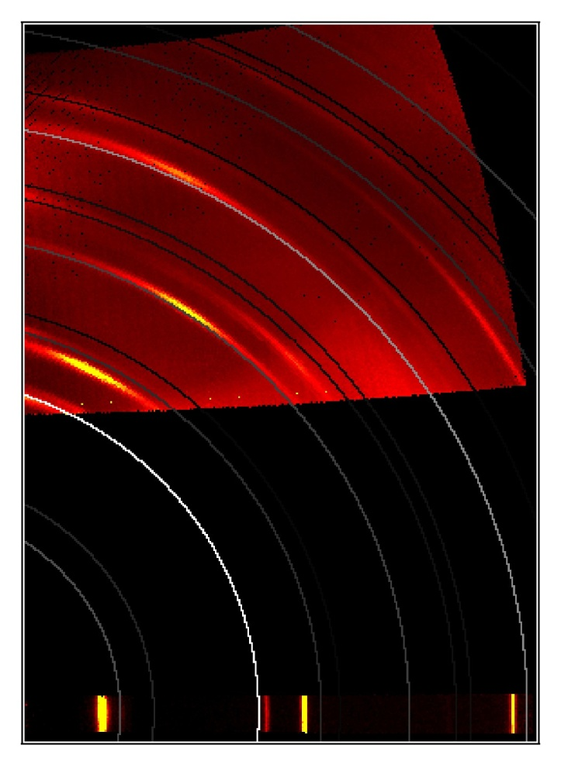
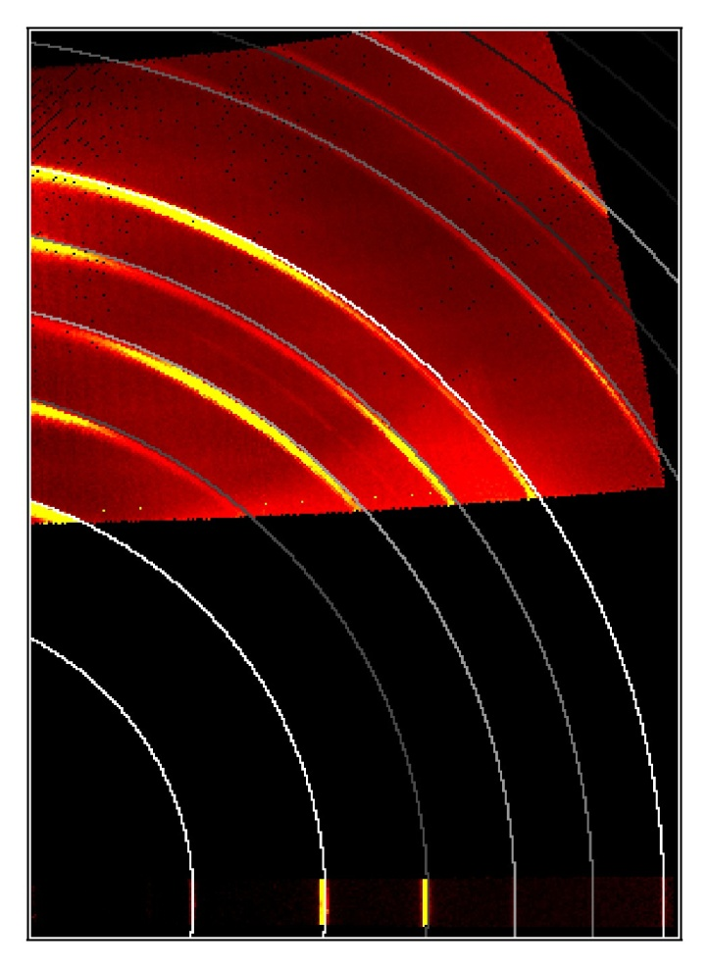
Cathode Texture
Sb evaporated at RT
Clear [003] texture
Add Potassium at 140C
Textured final film
But not K₃Sb
Add Cesium at 140C
Textured final film
Both [220] & [222]
(domains?)
Final QE 7.5% @ 532nm

Slide 12
Engineering a Smoother Cathode
Idea: Never let Sb crystalize
100 C
125 ̊C
125 ̊C
Substrate: Si (100)
Sb
K_{x}Sb
CsK₂Sb
+3nm Sb
+K until photocurrent peaks
+Cs until photocurrent peaks
2nd layer: +5nm Sb
M. Ruiz-Osés et al., APL Mat. 2, 121101 (2014)

Slide 13
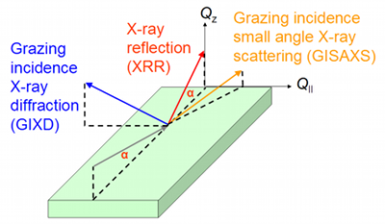
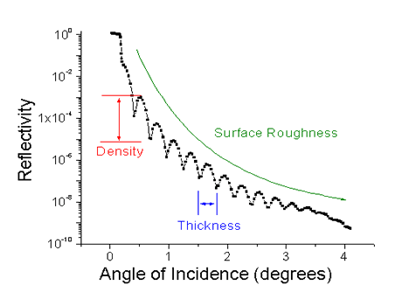
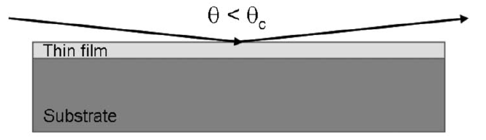
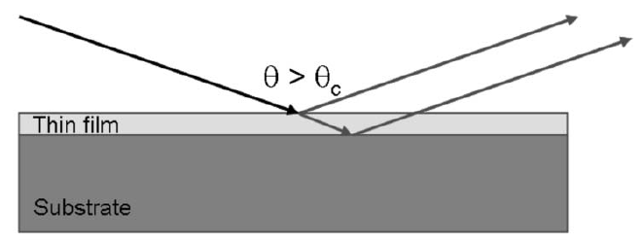
X-ray reflectometry (XRR) provides in-situ thickness monitoring
Understand ‘sticking’ coefficient of materials to substrates at various temperatures
Observe the intermixing vs layering of materials
Observe the onset of roughness
Notes:
This when we have fixed layer…
For In-situ growth -> fringes disappears… there are two reasons: either it is too thick or surface becomes rough
We get interference pattern when we have constructive interference.

Slide 14
XRR shows roughness evolution
Deposited Layers | Total Thickness (Å) | Roughness (Å)
Cs-K-Sb-Cs-K-Sb/Si | 469 | 32
K-Sb-Cs-K-Sb/Si | 449 | 36
Sb-Cs-K-Sb/Si | 200 | 21.3
Cs-K-Sb/Si | 174 | 13.2
K-Sb/Si | 141 | 10.5
Sb/Si | 35 | 2.9
Si Substrate | - | 3.1
The substrate fit includes 1.5 nm of SiO₂
Multi-layer subcrystalline film is smoother,
At slight loss of QE

Slide 15
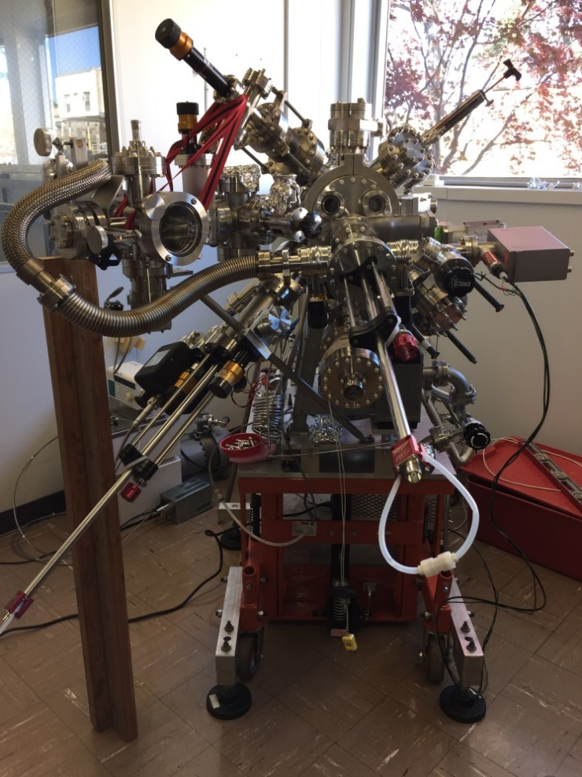
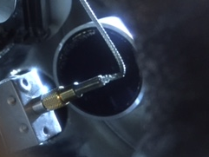
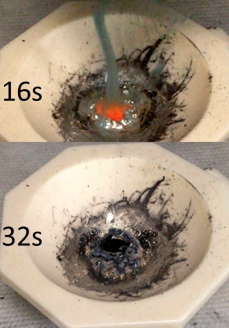
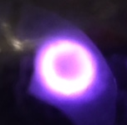
Sputter growth of Bi-alkali photocathode
Before
Sputter target and sputter gun was product of RMD. Inc. Photos of sputter target prep are contributed by H. Bhandari
Sputtering
K₂CsSb
sputter gun

Slide 16
Sputter Growth
25 nm K₂CsSb + layers of (total 30 nm) Cs evap.
Silicon substrate at 90 C, layer barely crystalline
25 nm sputtered layer + Cs
50 nm sputtered layer + Cs
layer | K (±0.1) | Sb (±0.05) | Cs (±0.05) | K/Cs
K₂CsSb sputter | 0.85 | 1.00 | 0.41 | 2.08
Cs | 0.84 | 1.00 | 1.75 | 0.48
Notes:
Examples of typical data set

Slide 17
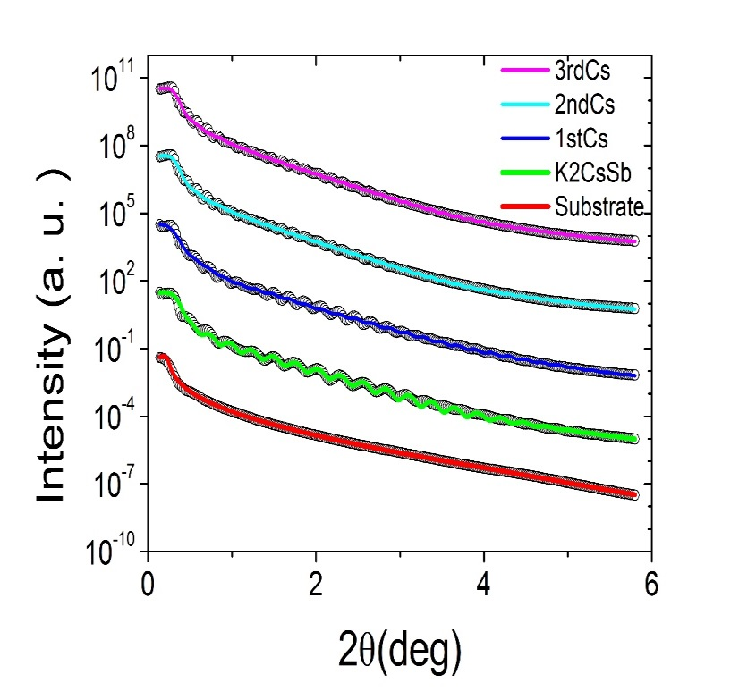
Surface roughness & QE of Sputtered Photocathodes
 | Thickness (Å) | Roughness (Å)
3rd Cs | 416.0 | 5.67
2nd Cs | 341.3 | 4.94
1st Cs | 249.5 | 4.91
sputter K₂CsSb | 234.2 | 5.17
SiO₂ | 10.24 | 3.27
Substrate (Si) | --- | 3.75
Peak QE > 20%
Green QE: 4.3%

Slide 18
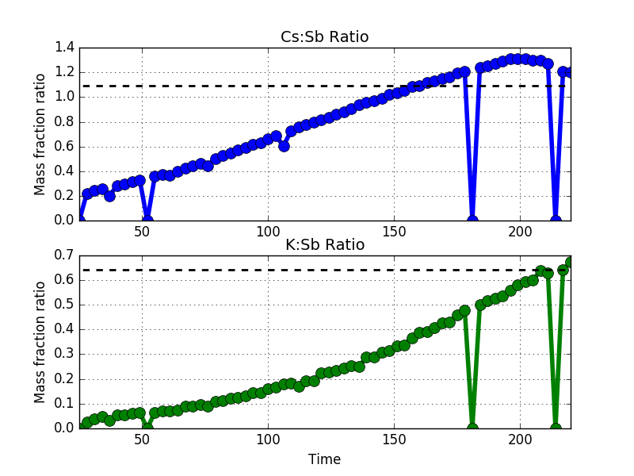
Software Upgrades - Real Time XRF during growth
Currently using to regulate ternary co-evap

Slide 19
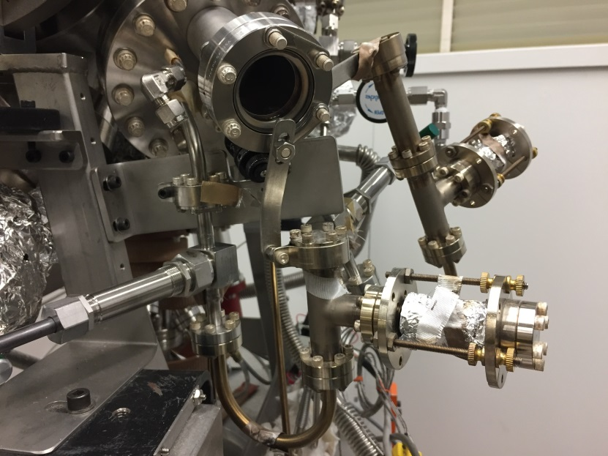
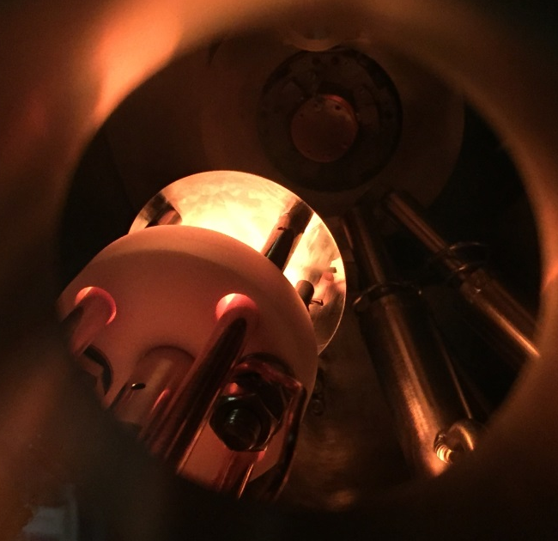
Ternary Co-evaporation
Simultaneously evaporate from Sb evaporator and K,Cs effusion cells
In situ, In operado XRR, XRF, XRD & Quantum efficiency (QE) measurement
Cs Cell
Growth rate are controlled by J tube temperature, valve and shutter
J tube
K capsule

Slide 20
Thickness
~10nm
(440)
Real time
XRD
(422)
(420)
(222)
Real time
Fluorescence
QE

Slide 21
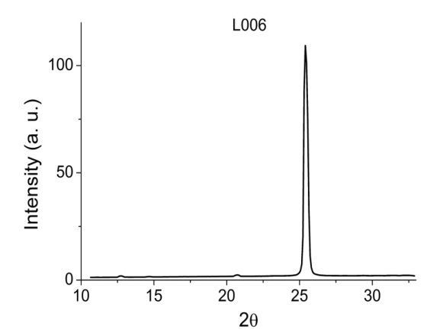
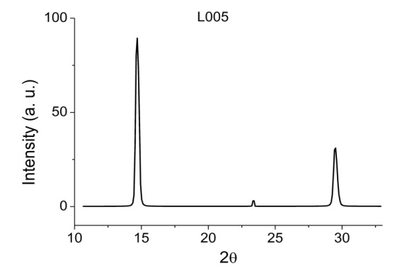
Stoichiometry & Structural Analysis
Camera 1
(200)
Grain size 27.7nm
Grain size 20.2nm
(222)
(400)
(111)
(220)
Camera 2
 | K | Sb | Cs
L004 Si | 2.50 | 1.00 | 1.16
L005 Si | 2.37 | 1.00 | 0.91
L006 Si | 2.21 | 1.00 | 0.95
L011 Si | 2.07 | 1.00 | 0.94
L012 MgO | 1.98 | 1.00 | 0.88
Highly textured
K₂CsSb phase!
Good K/Cs/Sb ratio!

Slide 22
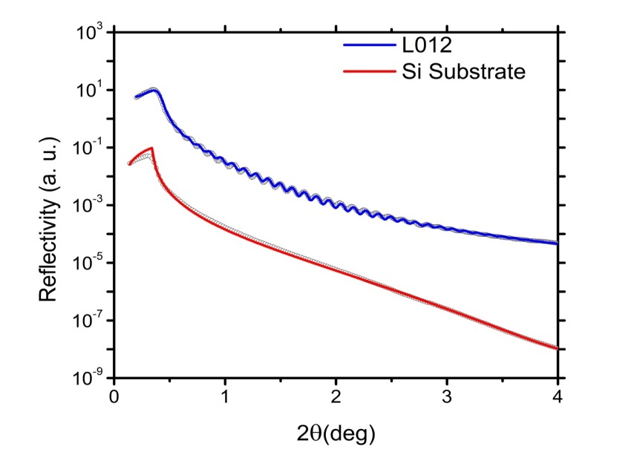
Surface Roughness & QE
 | QE@532nm(%) | Roughness(A) | Thickness (A) | Grain size (A)
L004 Si | 4.9 | 3.5 | 234 | 155
L005 Si | 5.8 | 11.5 | 815.3 | 277
L006 Si | 5.4 | 13.8 | 757.5 | 202
L011 Si (HT Si) | 6.4 | 79.0 | 905.2 | 208
L012 MgO | 5.7 | 8.6 | 566.4 | 193

Slide 23
Alkali Antimonide Cathodes
What we’ve learned
We now have a tool which is capable of optimizing growth parameters for figures of merit other than Quantum Efficiency
We understand the formation chemistry of these materials, and why traditional deposition results in rough cathodes
RMS roughness down almost 2 orders of magnitude, to ~atomic scale
Avoiding crystalline Sb helps, as does co-evaporating alkali
Sputter deposition is good – easy to do, covers large area, almost atomically smooth even for thick films – but alkali poor
Real time XRF feedback provides option of ternary coevaporation, producing best cathode
Can now consider heterojunctions and doping of alkali antimonides (following a similar development path to the III-V materials)
Can consider ultra thin (under 10 nm) cathodes to improve response time
Large grain, smooth surfaces should be more resistant to ion bombardment and chemical poisoning than conventional cathodes

Slide 24


Thanks for your attention!
Thanks to K. Attenkofer, S. Schubert, M. Ruiz Oses, J. Xie, J. Wang, H. Padmore, E. M. Muller, M. Gaowei, J. Walsh, T. Vecchione, X. Liang, J. Sinshiemer, Z. Ding
DOE Office of Science – Basic Energy Science

Slide 25
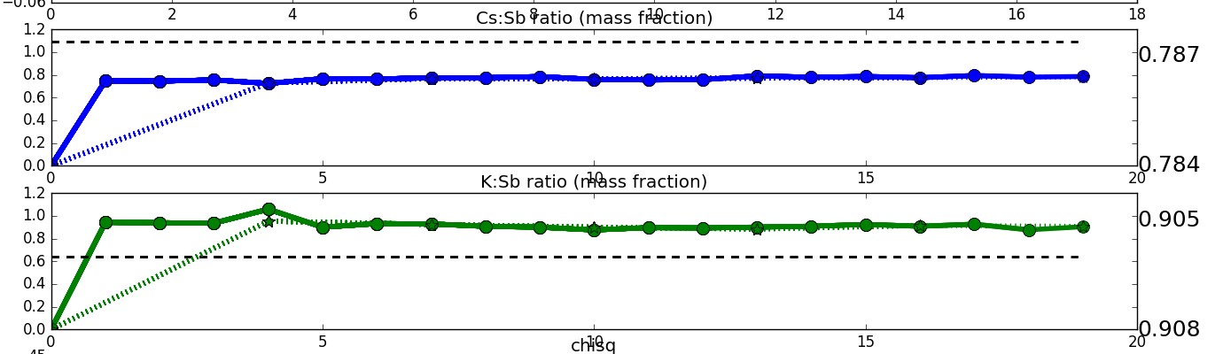
Hot off the presses – Co-evaporation
Effusion Cell (K & Cs)
Pure metals
Antimony Crucible with cooled mask
Rates balanced with real-time XRF
QE over 30% (8% Green)
XRR oscillations

Slide 26
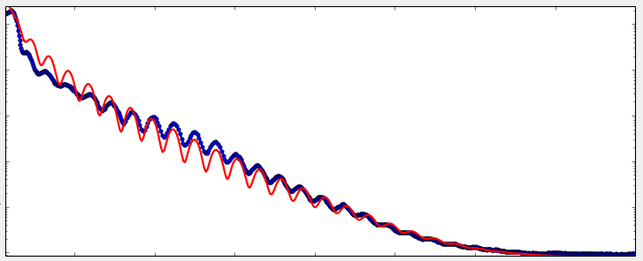
Hot off the presses – Co-evaporation
Effusion Cell (K & Cs)
Pure metals
Antimony Crucible with cooled mask
Rates balanced with real-time XRF
QE over 30% (8% Green)
XRR oscillations
23 nm thick, 0.5 nm roughness

Slide 27
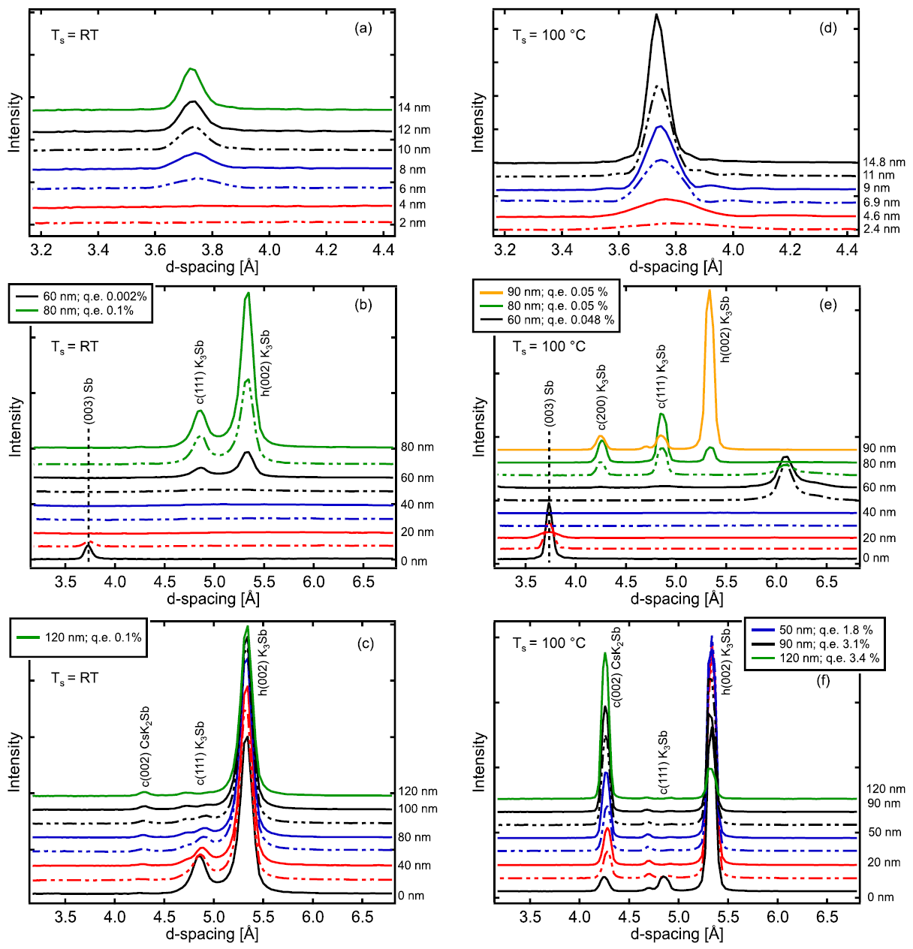
Stepwise High Resolution XRD
A little bit of Potassium goes a long way…
Sb
Sb
K
K
S. Schubert et al., J. Appl. Phys. 120, 035303 (2016)

Slide 28
Stepwise High Resolution XRD
A little bit of Potassium goes a long way…
Room Temperature
Recrystallization to K₃Sb
Better QE of K₃Sb
Principally Hexagonal
100C Substrate
Recrystallization to K_{x}Sb
Cubic K₃Sb first
Eventually Hex appears (oops!)
K
K
S. Schubert et al., J. Appl. Phys. 120, 035303 (2016)

Slide 29
Stepwise High Resolution XRD
Cs
Cs
Room Temperature
K₃Sb resists Cs incorporation
QE never improves
100C Substrate
Cubic K₃Sb converts quickly
Hex K₃Sb mostly converts
S. Schubert et al., J. Appl. Phys. 120, 035303 (2016)

Slide 30
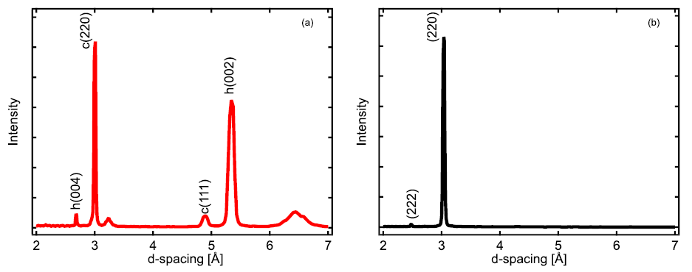
Stepwise High Resolution XRD
100C without “too much” K
15 nm Sb, 70 nm K
Stop at “mixed phase” K_{x}Sb
lower QE of K₃Sb
90 nm Cs sufficient
Full conversion to CsK₂Sb
QE = 6.7% at 532 nm
S. Schubert et al., J. Appl. Phys. 120, 035303 (2016)

Slide 31
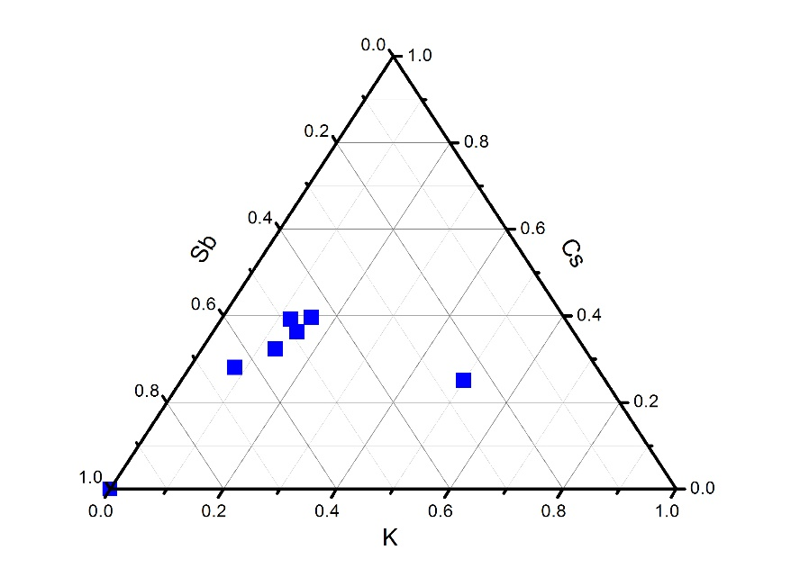
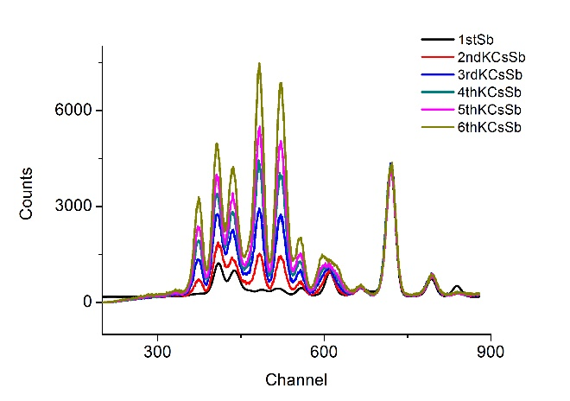
Yo-yo deposition
~120 C
~120 C
Substrate: MgO
Sb
Cs_{x}K_{y}Sb
+1.5 nm Sb
+K, Cs
Repeat growth (6 layers)
5th
6th
4th
3rd
2nd (K,Cs)+Sb
1st Sb
XRF analysis results of co-dep sample.
→ Calculated stoichiometry shows Sb, Cs - excess, K-deficient

Slide 32
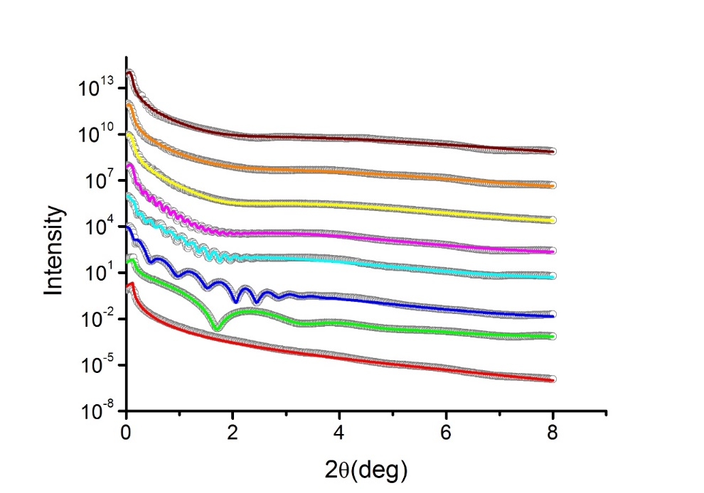
Yo-yo deposition
layer | Roughness (Å) | Thickness(Å) | QE
6th (K,Cs)+Sb | 23.6 (-3.9, 1.4) | 806.7 (-25.3, 98.9) | 4.5%
5th (K,Cs)+Sb | 24.9 (-17.2, 1.0) | 725.5 (-46.5, 24.6) | 4.9%
4th (K,Cs)+Sb | 14.5 (-2.1, 0.40) | 609.3 (-70.5, 9.5) | 3.7%
3rd (K,Cs)+Sb | 9.92 (-1.5, 1.5) | 489.09 (-6.8, 18.7) | 4.2%
2nd (K,Cs)+Sb | 9.73 (-0.30, 0.86) | 334.3 (-1.8, 2.1) | 1.7%
1st (K,Cs)+Sb | 9.22 (-2.9, 0.78) | 159.3 (-1.6, 0.9) | 1.2%
Sb | 5.2 (-0.11, 0.35) | 36.74 (-0.26, 0.13)
Substrate (MgO) | 1.5 (-, -)
XRR simulation result of K/Cs co-dep sample.
Colored solid lines: simulation; Open circle: measured data. Error noted is 5% of change in logarithm FOM function

