Slide 1




Electron Emissive Devices
A materials science approach to photocathodes and secondary emitters (with a bit of diamond thrown in at the end for fun)
John Smedley
Brookhaven National Laboratory
Feb. 24, 2016

Slide 2
Overview
Brief intro to 3-step model as it applies to semiconductors
In situ materials analysis during cathode formation
How better diagnostics might lead to better cathodes
How to grow smoother cathodes (and why you might want to)
Secondary electron emission: Diamond, SiN and Tipsy
Diamond as a sensing material for detectors and beam diagnostics
Reference Material
Some of this talk comes from a course on Cathode Physics Matt Poelker and I taught at the US Particle Accelerator School
http://uspas.fnal.gov/materials/12UTA/UTA_Cathode.shtml
Modern Theory and Applications of Photocathodes
W.E. Spicer & A. Herrera-Gómez
SAC-PUB-6306 (1993)
Great Surface Science Resource:
http://www.philiphofmann.net/surflec3/index.html

Slide 3
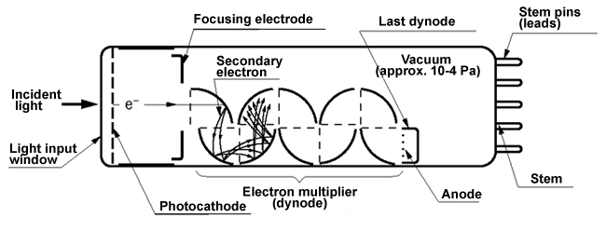
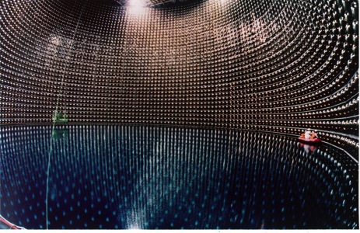
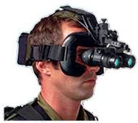
What is a photocathode?
A surface that emits electrons when illuminated (Go Einstein!)
What are they used for?
Traditionally, in image intensifiers and photodetectors/PMT
Super-Kamiokande
Neutrino Detector
11,200 20”
K₂CsSb PMTs

Slide 4
What is a photocathode?
A surface that emits electrons when illuminated (Go Einstein!)
What are they used for?
Traditionally, in image intensifiers and photodetectors/PMT
More recently also as electron sources for accelerators
Allow control of the spatial and temporal profile of the beam
Produce a “Brighter” electron beam than can be achieved from other sources
What makes a good photocathode?
Quantum Efficiency, lifetime, fast temporal response
Correlation of emitted electrons (low beam “temperature”, or emittance), high current, low dark current, spin polarization
Important applications to other fields – Photovoltaics, PET imaging

Slide 5
Three Step Model of Photoemission - Semiconductors
Excitation of e⁻
  Reflection, Transmission
  Energy distribution of excited e⁻
2) Transit to the Surface
  e⁻-phonon scattering
  e⁻-defect scattering
  e⁻-e⁻ scattering
  Random Walk
3) Escape surface
Overcome Workfunction
Multiple tries
Need to account for Random Walk in cathode suggests Monte Carlo modeling
Empty States
Vacuum level
hν
Φ
No States
Energy
Filled States
Laser
Medium
Vacuum

Slide 6
A.R.H.F. Ettema and R.A. de Groot, Phys. Rev. B 66, 115102 (2002)

Slide 7
Parameters, and how to affect them
Increasing the electron MFP will improve the QE. Phonon scattering cannot be removed, but a more perfect crystal can reduce defect and impurity scattering:
Control of surface roughness is critical to minimizing the intrinsic emittance – epitaxial growth?
A question to consider: Why can CsI (another ionic crystal, PEA cathode) achieve QE>80%?
Large band gap and small electron affinity play a role, but, so does crystal quality.
T.H. Di Stefano and W.E. Spicer, Phys. Rev. B 7, 1554 (1973)

Slide 8
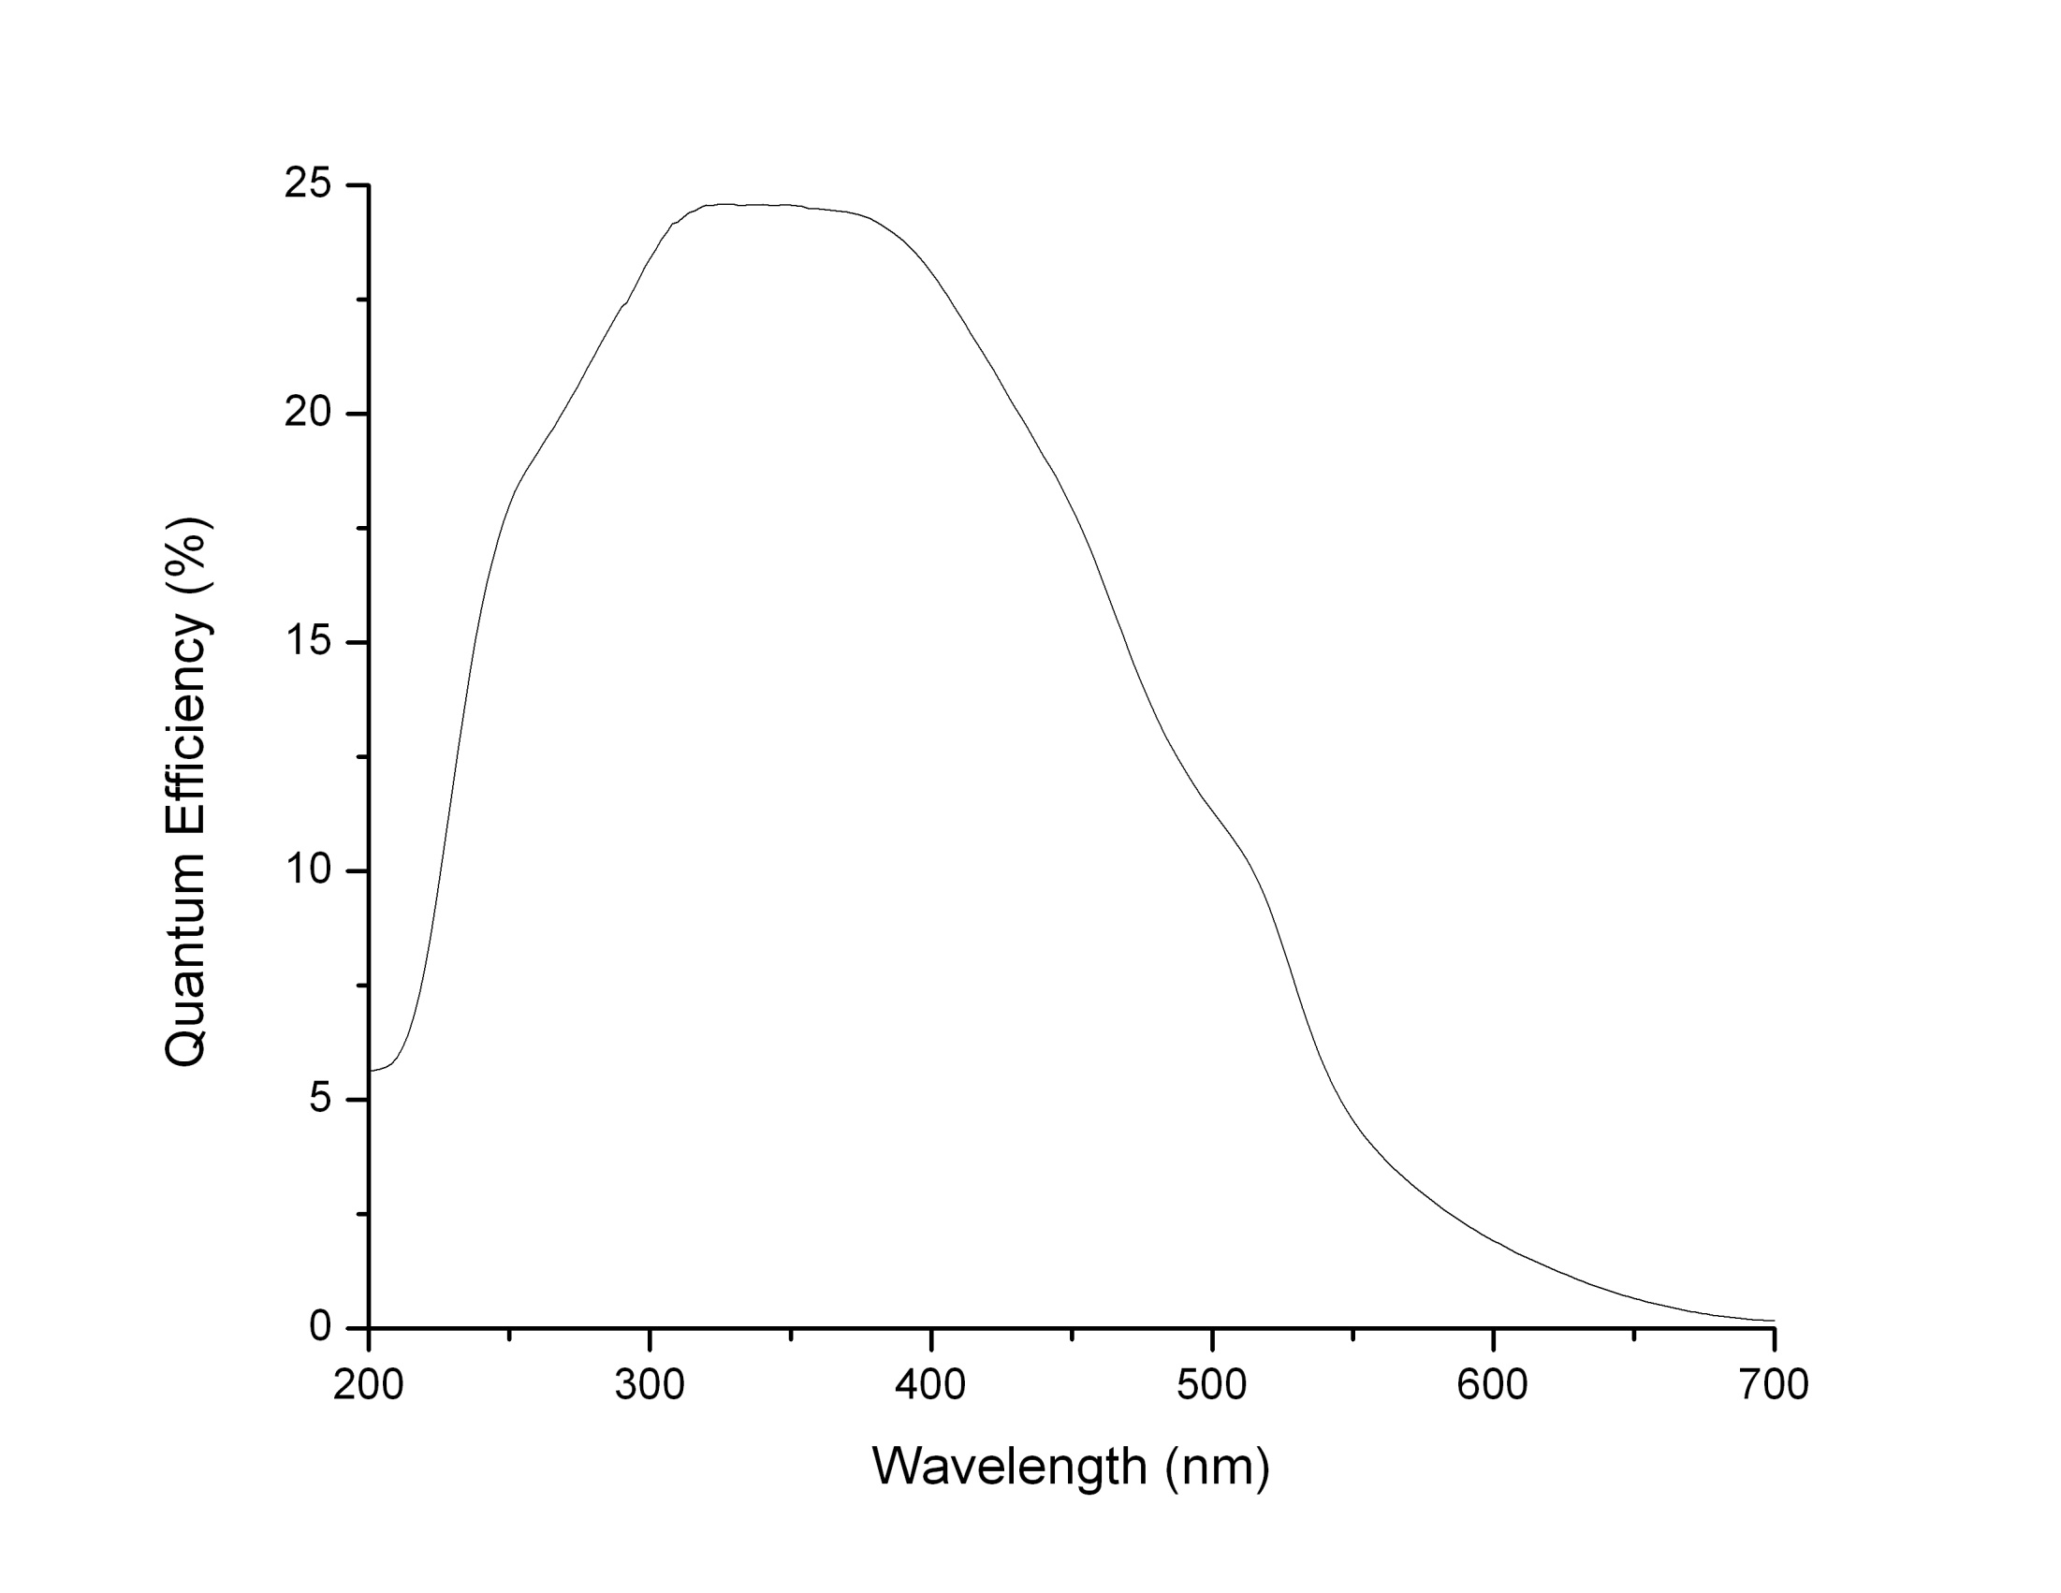
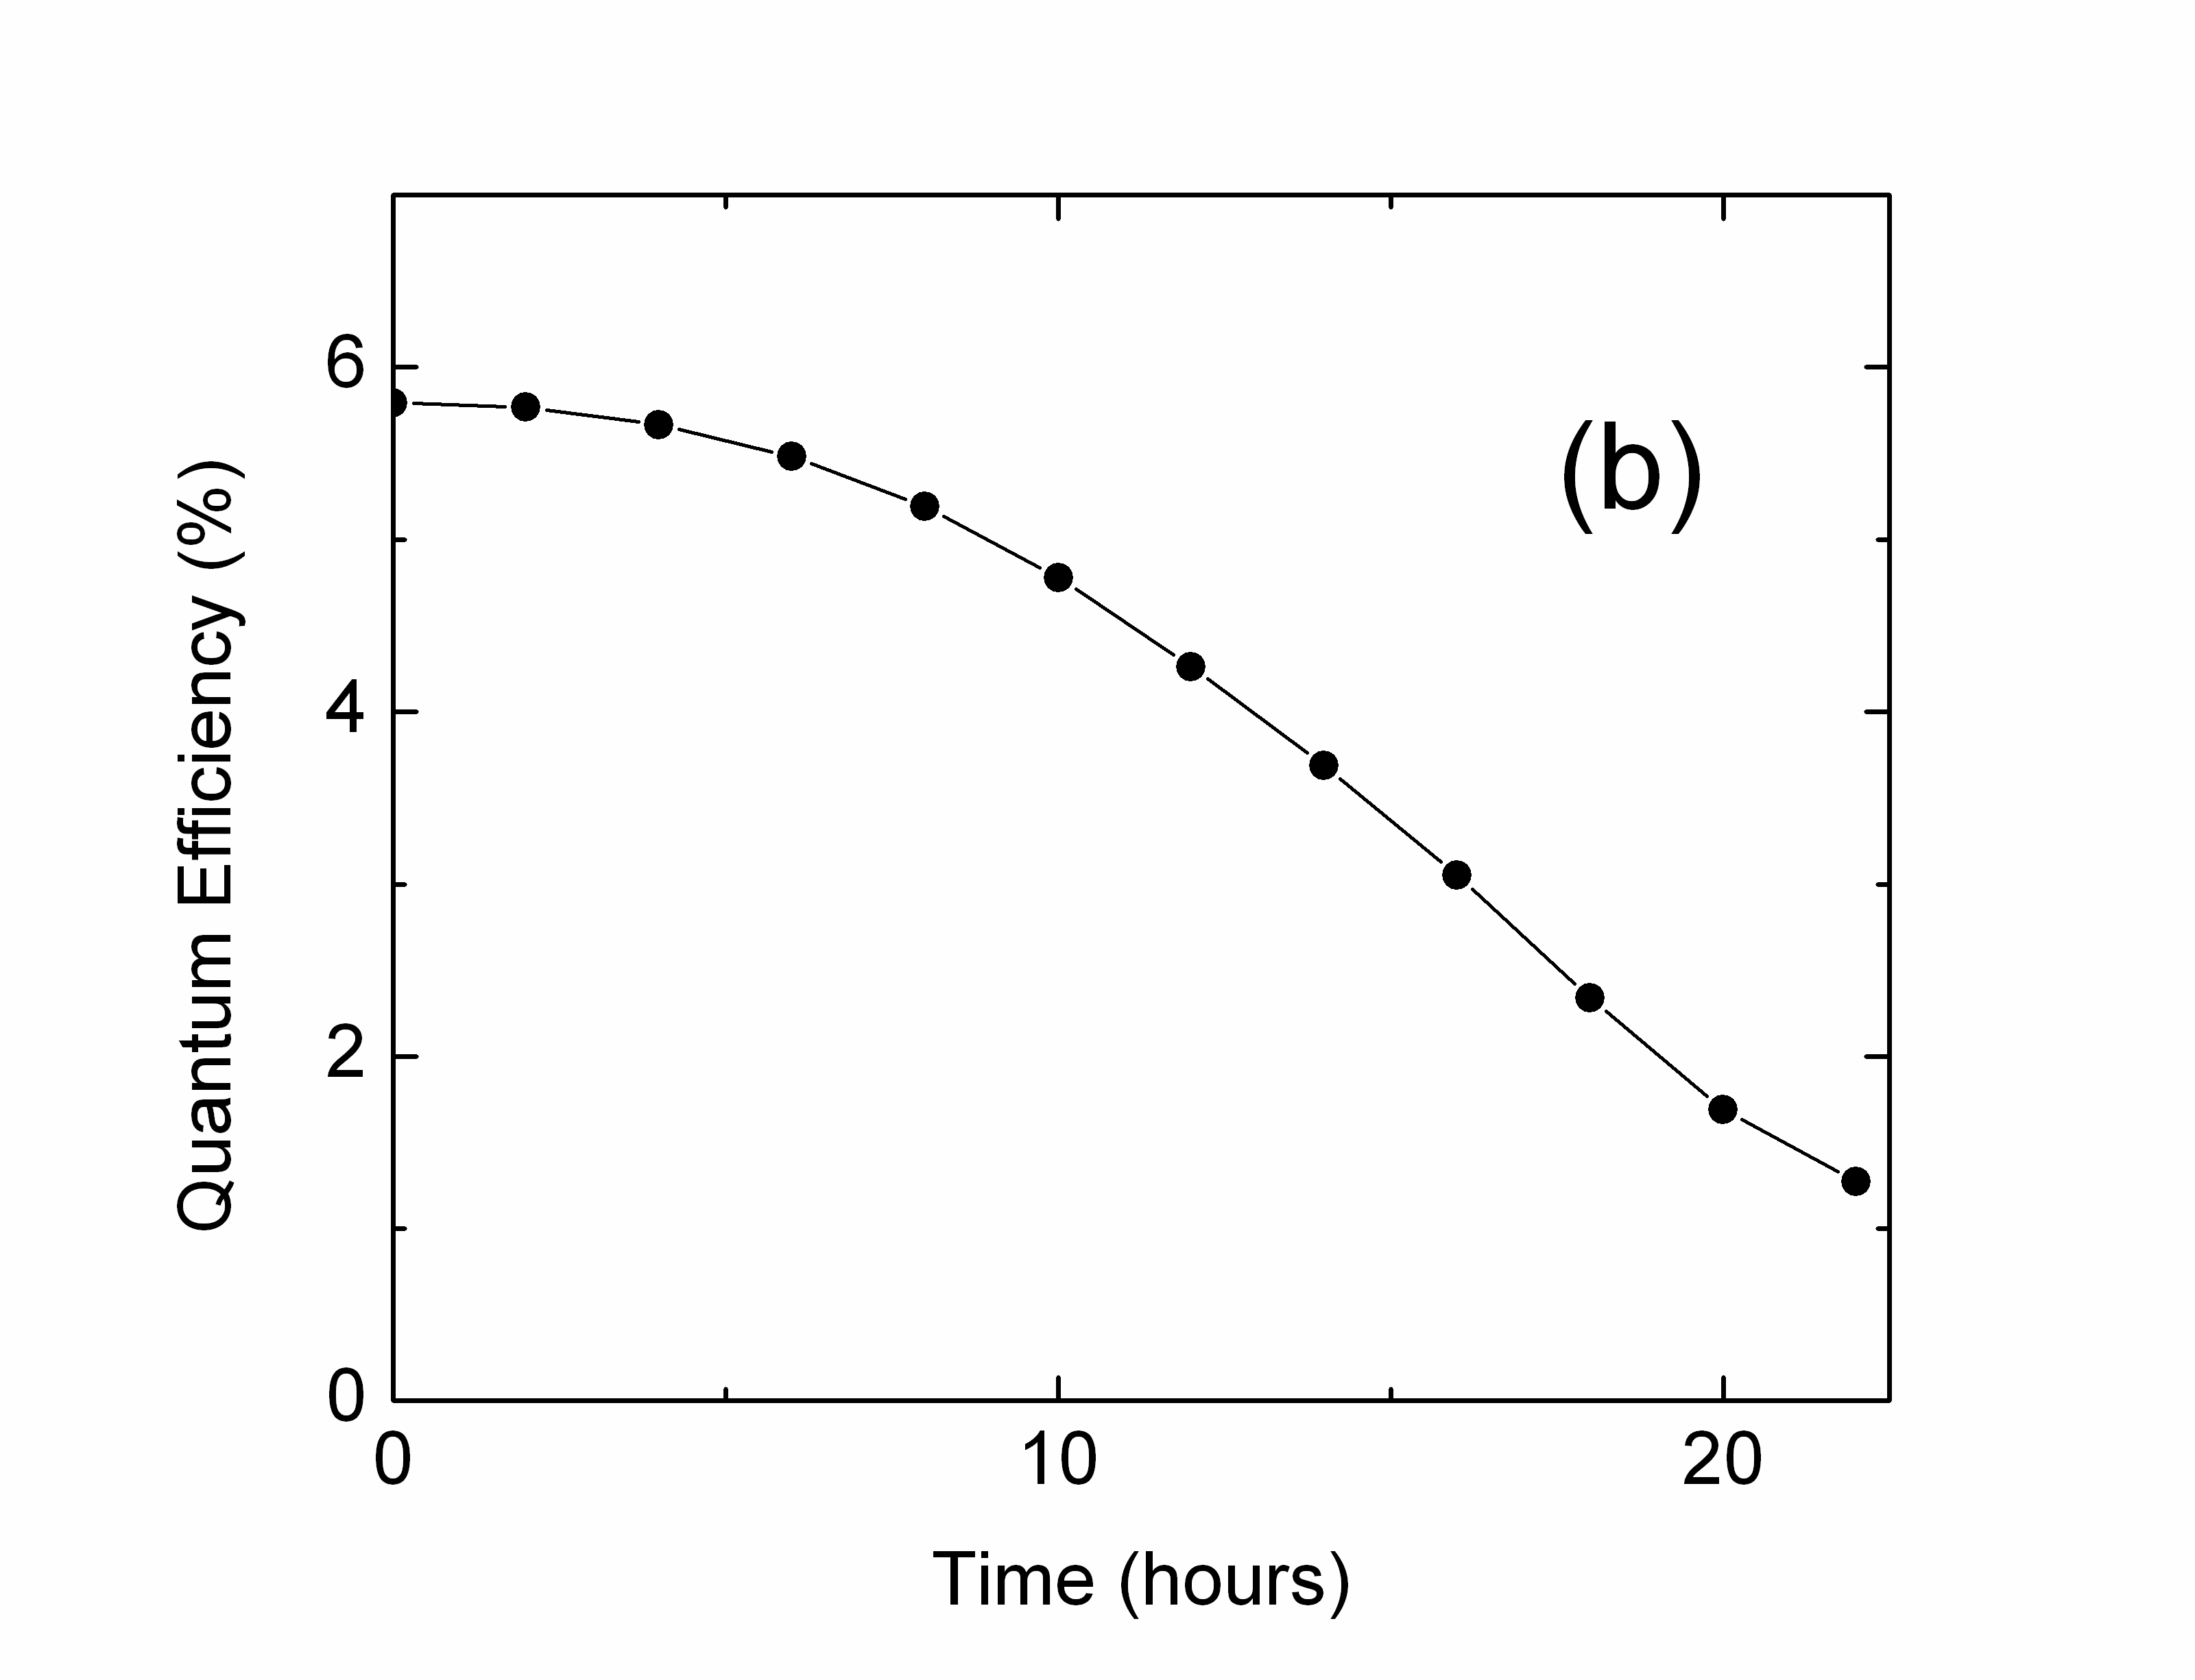
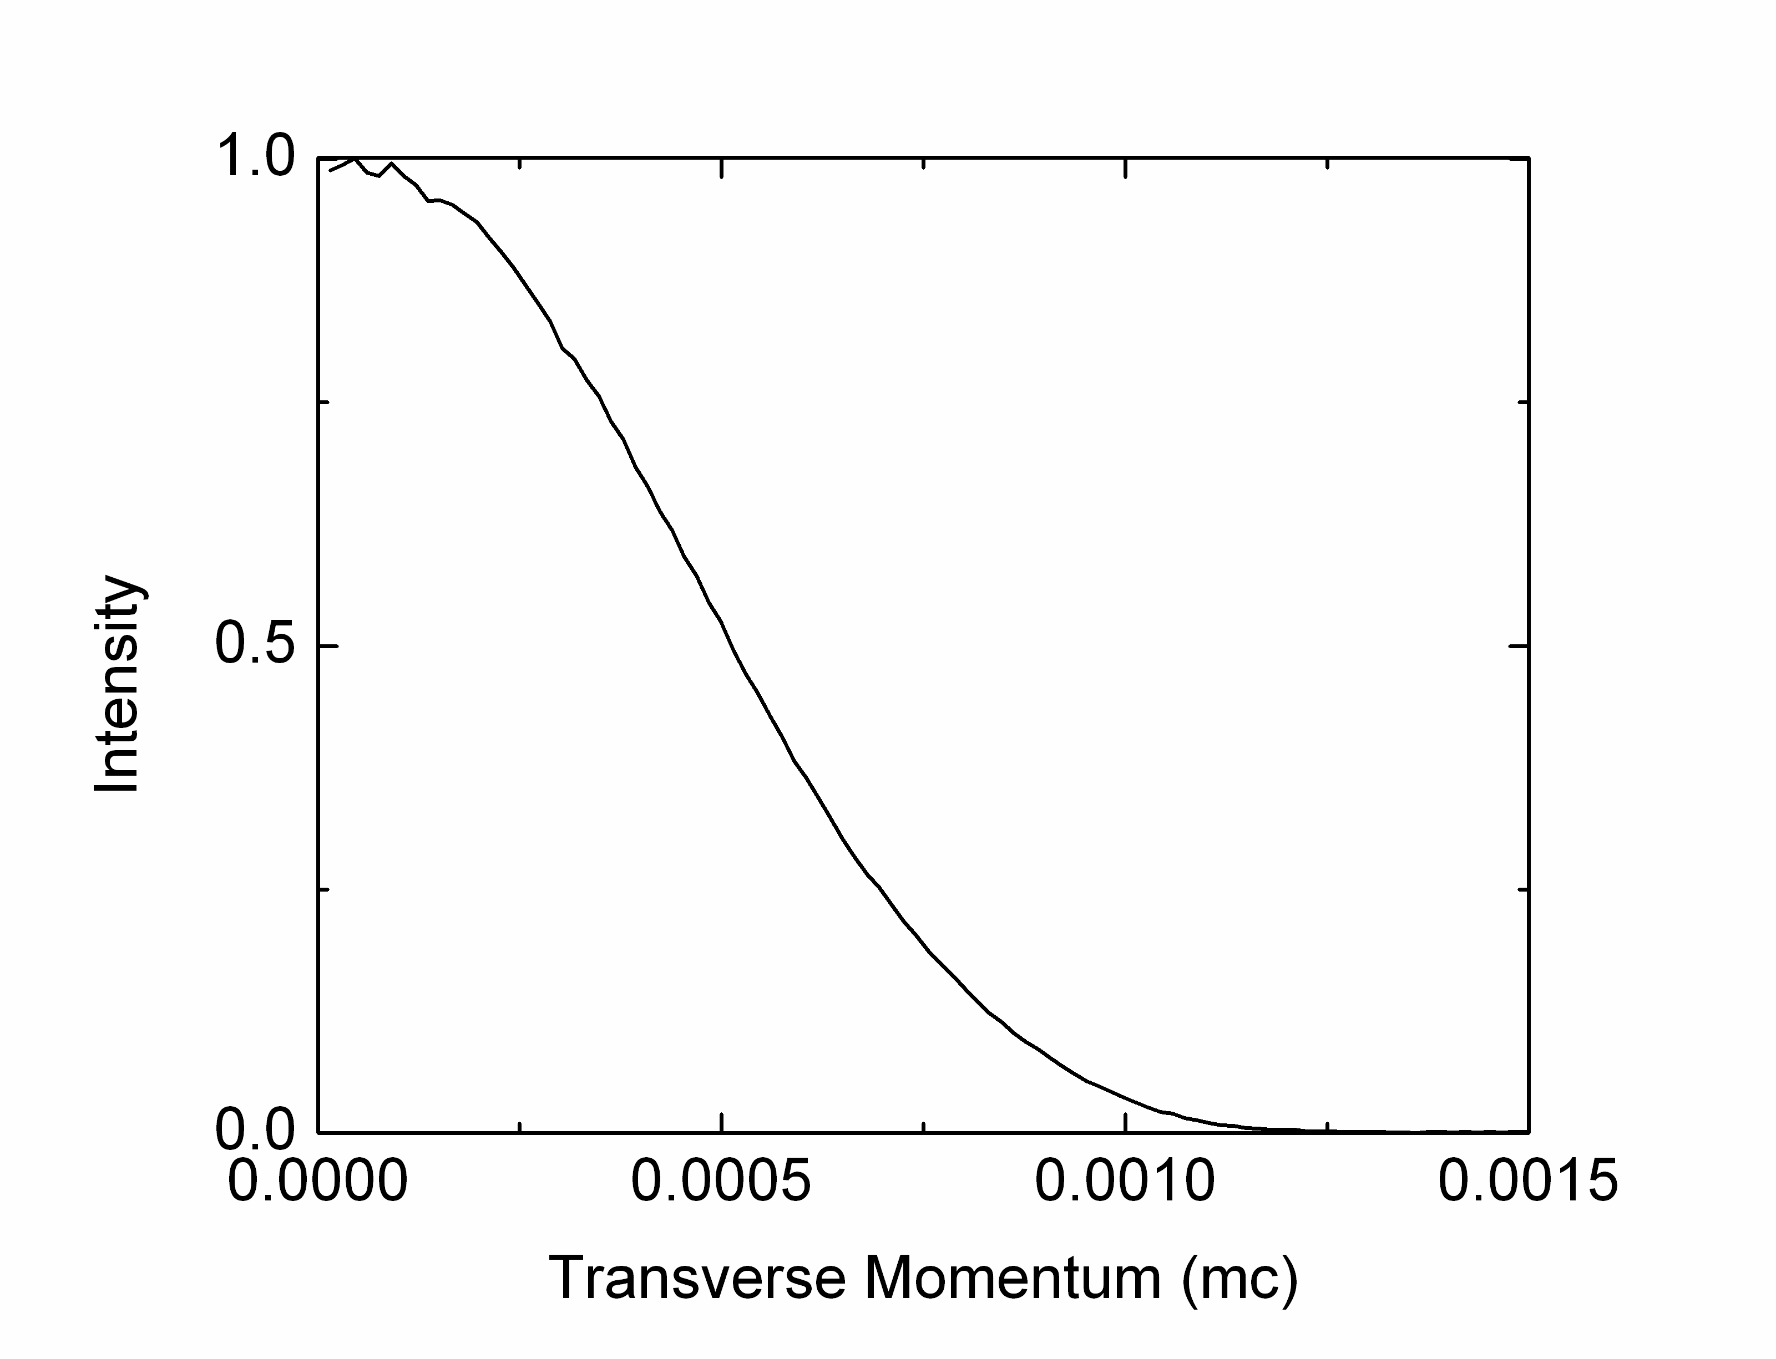
K₂CsSb: A cathode with excellent characteristics for accelerators
Good
Lifetime
1e-9 mBar
In “magic window”
Low transverse
Momentum (543 nm)
0.36 µm/mm
Onset of e-e
scattering
Unproductive absorption
T. Vecchione et al., Appl. Phys. Lett. 99, 034103 (2011)

Slide 9
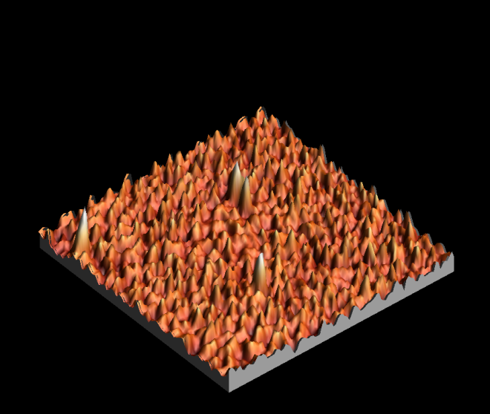
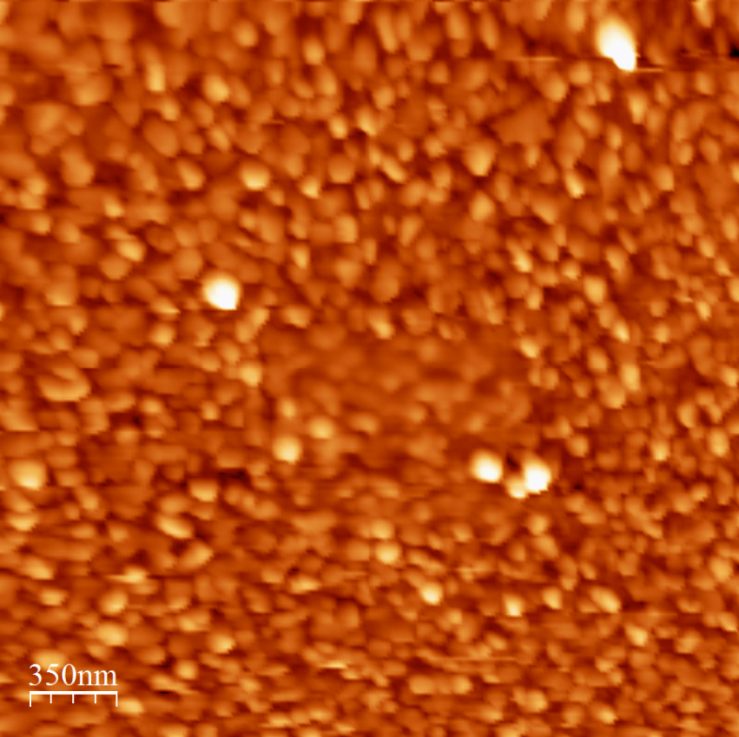
Traditional Sequential Deposition of K₂CsSb
High QE and Rough Surface
  25 nm roughness, 100 nm spatial period
  S. Schubert et al., APL Materials 1, 032119 (2013)
  Emittance vs field measured with Momentatron, 532 nm light
  T. Vecchione, et al, Proc. of IPAC12, 655 (2012)

Slide 10
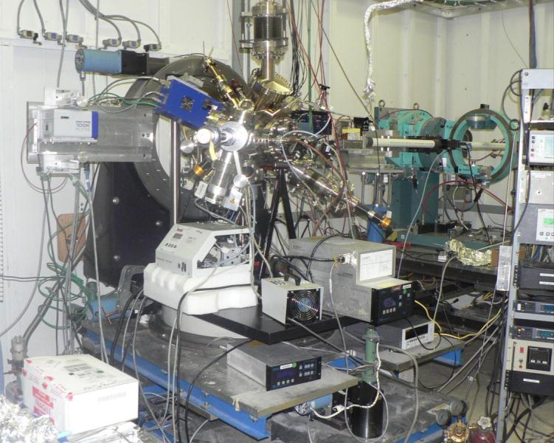
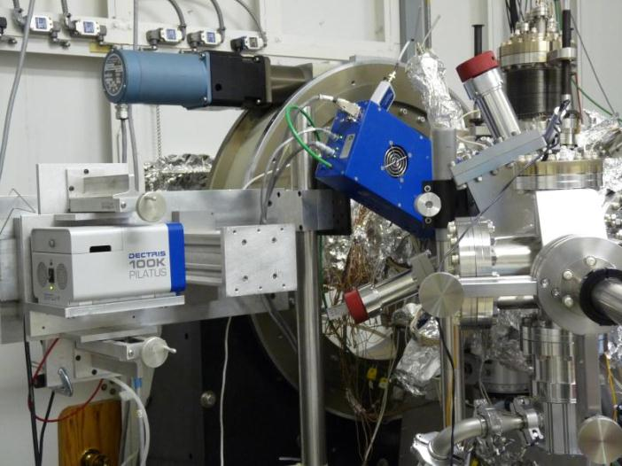
In operando analysis during growth
(setup at NSLS/X21 & CHESS G3)
UHV system ( 0.2 nTorr base pressure)
Residual Gas Analyzer (RGA)
Heating/cooling substrate/cathode
Load lock
  fast exchange of substrates
  gun transfer
Horizontal deposition of Sb, K and Cs.
Sputter Deposition!
Camera 2
Camera 1
Two 2D detectors (Pilatus 100K)
XRF, XRD, XRR, GISAXS, QE

Slide 11
Experimental set up: K₂CsSb cathode growth
Horizontal evaporation of three sources:
P=1x10-10 mbar
FTM
Cs
K
X-rays
Sb
Recipe:
QE during growth (532 nm laser)
Cs
T(C)
QE(%)
140
K
K
Cs
100
Sb
25
t
t

Slide 12
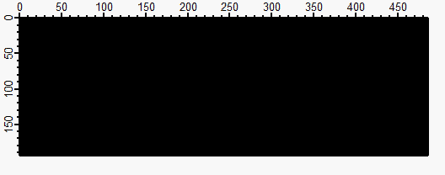



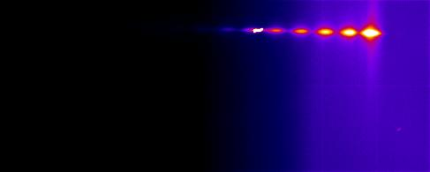
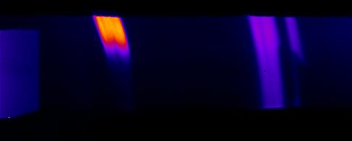
165Å Sb at RT on Si(100)
Simultaneously Acquire XRD and GISAXS
Understanding reaction dynamics through crystalline phase evolution
Map the thichness and roughness evolution of the cathode
Is there a correlation between reactivity, QE and roughness?
Camera 1: GISAXS & XRR
Camera 2: WAXS
14.9˚
39.3˚
0Å
time
165Å
(003)
(012)
(104)
(110)
Sb peaks

Slide 13
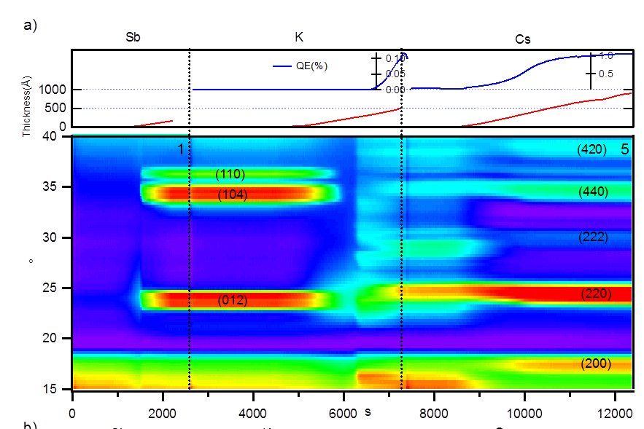
Reaction Dynamics
Antimony evaporated on Si, 0.2 Å/s; crystallize at 4nm
K deposition dissolves Sb layer - This is where roughening occurs!
QE increase corresponds with K_{x}Sb crystallization
Cs increases lattice constant and reduces defects
M. Ruiz-Osés et al., APL Mat. 2, 121101 (2014)

Slide 14
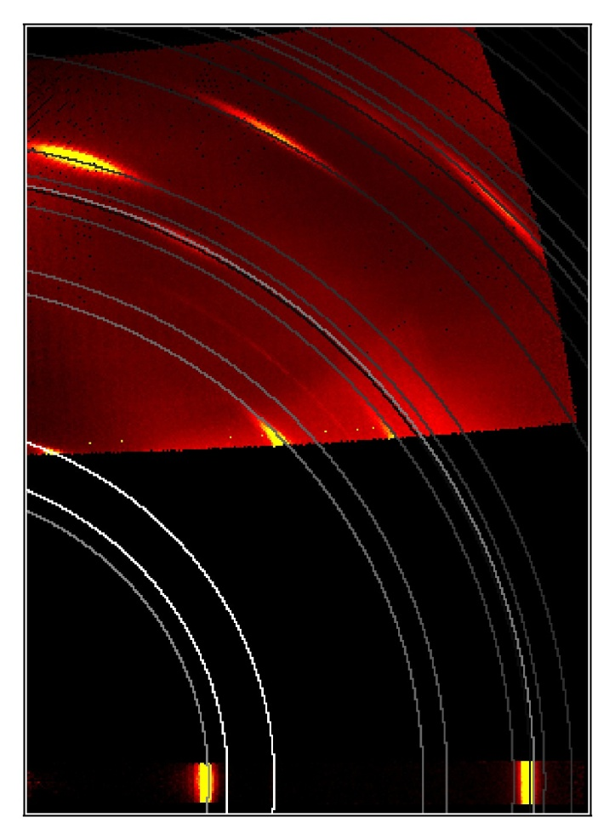
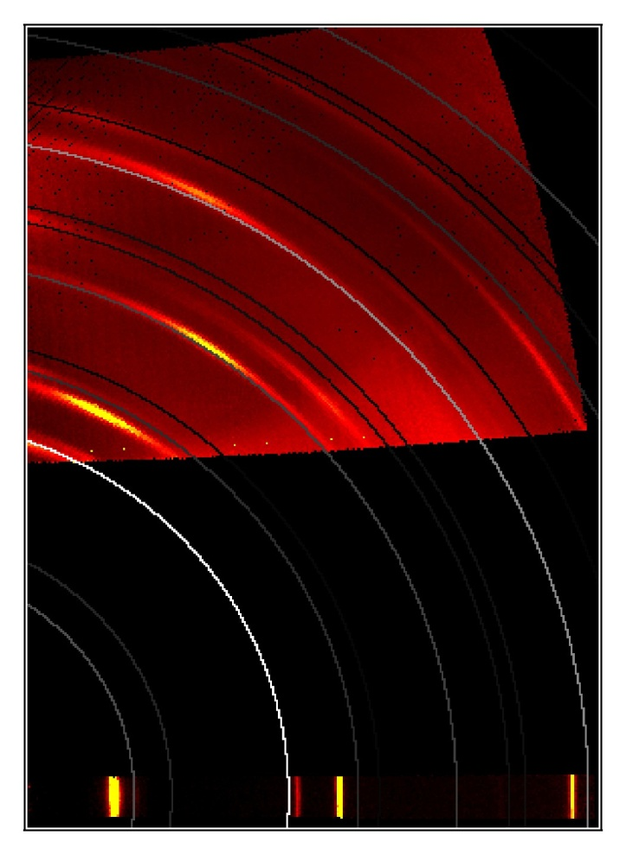
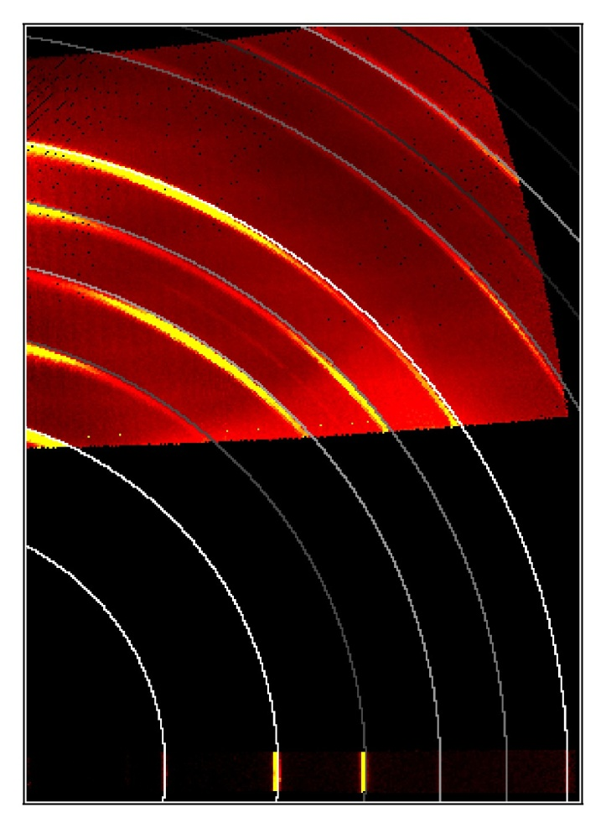
Cathode Texture
Sb evaporated at RT
Clear [003] texture
Add Potassium at 140C
Textured final film
But not K₃Sb
Add Cesium at 140C
Textured final film
Both [220] & [222]
(domains?)
Final QE 7.5% @ 532nm

Slide 15
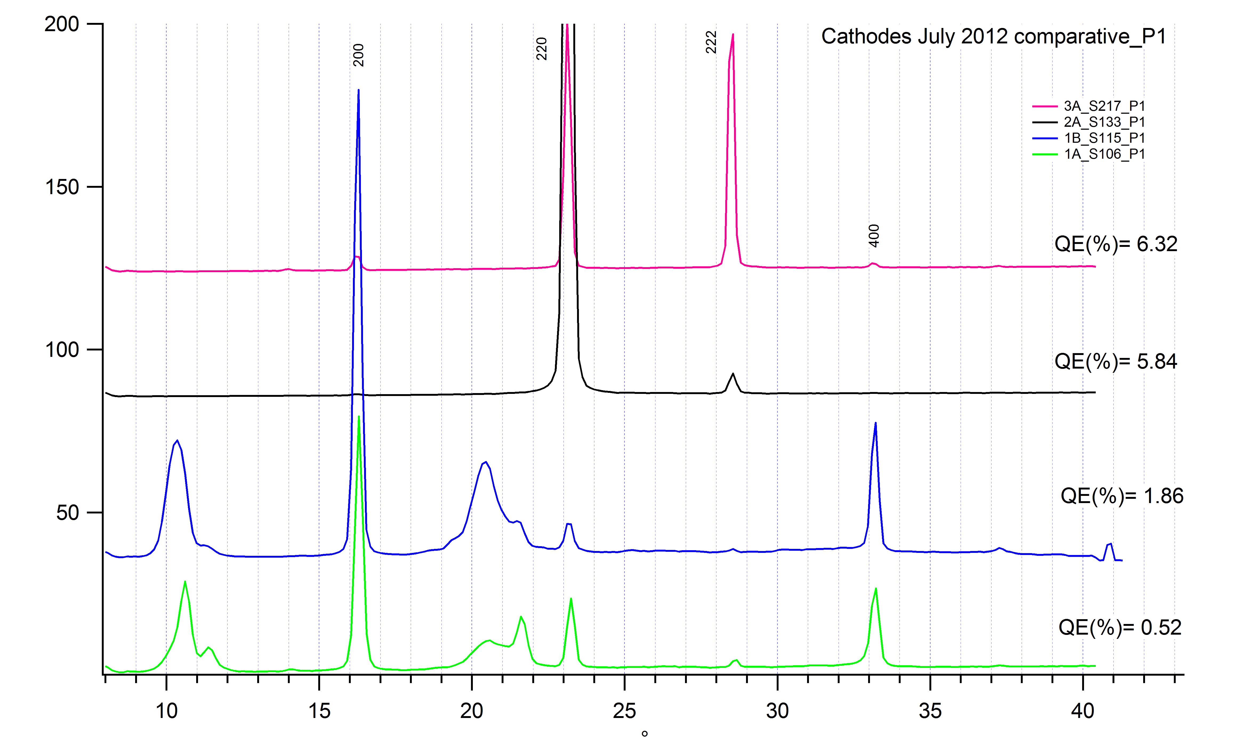
Comparison of Crystal structure and Final QE
K₂CsSb
QE = 7.5%
QE = 7.0%
QE = 2.2%
QE = 0.6%

Slide 16
Engineering a Smoother Cathode
Idea: Never let Sb crystalize
100 C
125 ̊C
125 ̊C
Substrate: Si (100)
Sb
K_{x}Sb
CsK₂Sb
+3nm Sb
+K until photocurrent peaks
+Cs until photocurrent peaks
2nd layer: +5nm Sb
M. Ruiz-Osés et al., APL Mat. 2, 121101 (2014)

Slide 17
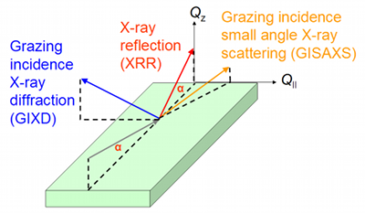
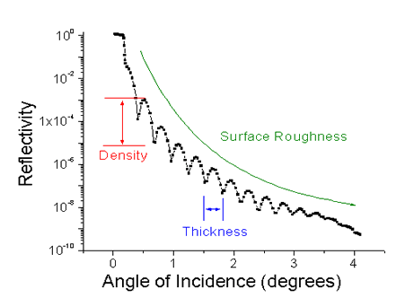
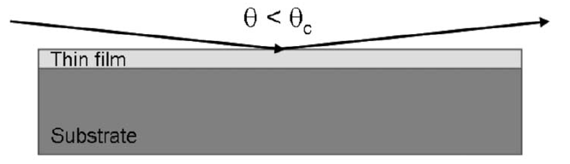
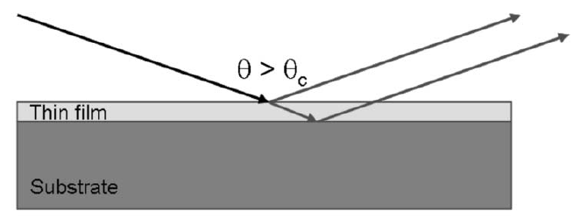
X-ray reflectometry (XRR) provides in-situ thickness monitoring
Understand ‘sticking’ coefficient of materials to substrates at various temperatures
Observe the intermixing vs layering of materials
Observe the onset of roughness
Notes:
This when we have fixed layer…
For In-situ growth -> fringes disappears… there are two reasons: either it is too thick or surface becomes rough
We get interference pattern when we have constructive interference.

Slide 18
XRR shows roughness evolution
Deposited Layers | Total Thickness (Å) | Roughness (Å)
Cs-K-Sb-Cs-K-Sb/Si | 469 | 32
K-Sb-Cs-K-Sb/Si | 449 | 36
Sb-Cs-K-Sb/Si | 200 | 21.3
Cs-K-Sb/Si | 174 | 13.2
K-Sb/Si | 141 | 10.5
Sb/Si | 35 | 2.9
Si Substrate | - | 3.1
The substrate fit includes 1.5 nm of SiO₂
Multi-layer subcrystalline film is smoother,
At slight loss of QE
What if we co-deposit the alkalis?

Slide 19
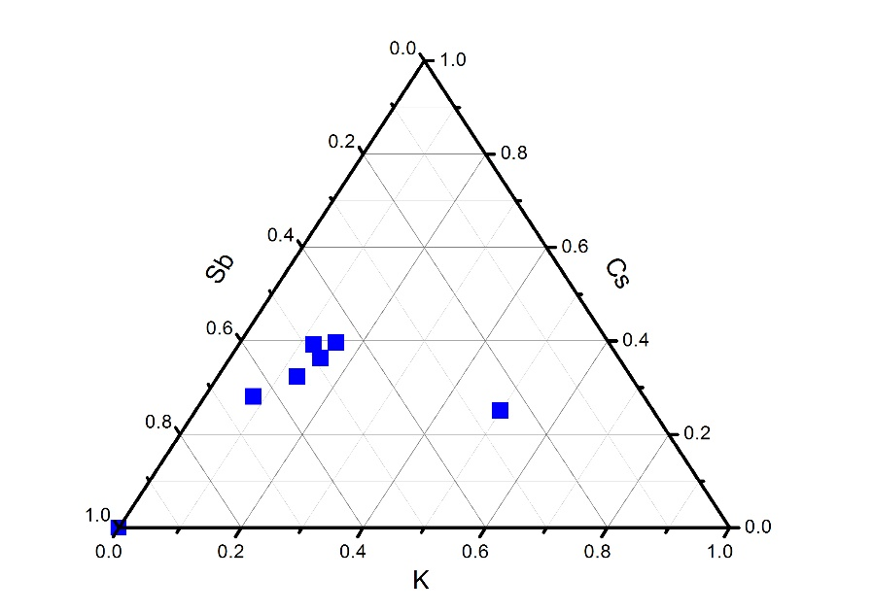
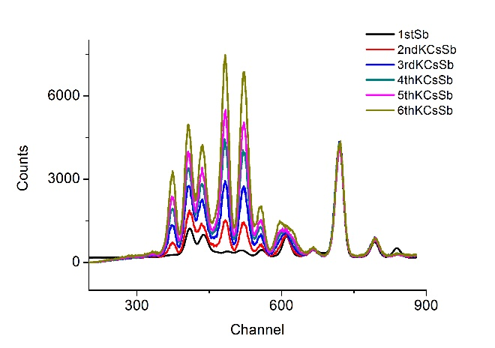
Yo-yo deposition
~120 C
~120 C
Substrate: MgO
Sb
Cs_{x}K_{y}Sb
+1.5 nm Sb
+K, Cs
Repeat growth (6 layers)
5th
6th
4th
3rd
2nd (K,Cs)+Sb
1st Sb
XRF analysis results of co-dep sample.
→ Calculated stoichiometry shows Sb, Cs - excess, K-deficient

Slide 20
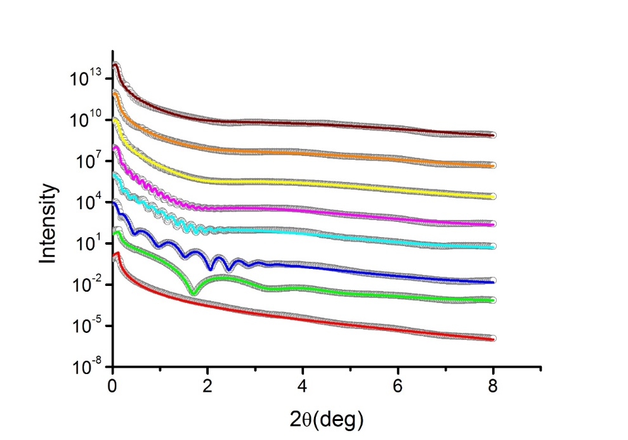
Yo-yo deposition
layer | Roughness (Å) | Thickness(Å) | QE
6th (K,Cs)+Sb | 23.6 (-3.9, 1.4) | 806.7 (-25.3, 98.9) | 4.5%
5th (K,Cs)+Sb | 24.9 (-17.2, 1.0) | 725.5 (-46.5, 24.6) | 4.9%
4th (K,Cs)+Sb | 14.5 (-2.1, 0.40) | 609.3 (-70.5, 9.5) | 3.7%
3rd (K,Cs)+Sb | 9.92 (-1.5, 1.5) | 489.09 (-6.8, 18.7) | 4.2%
2nd (K,Cs)+Sb | 9.73 (-0.30, 0.86) | 334.3 (-1.8, 2.1) | 1.7%
1st (K,Cs)+Sb | 9.22 (-2.9, 0.78) | 159.3 (-1.6, 0.9) | 1.2%
Sb | 5.2 (-0.11, 0.35) | 36.74 (-0.26, 0.13)
Substrate (MgO) | 1.5 (-, -)
XRR simulation result of K/Cs co-dep sample.
Colored solid lines: simulation; Open circle: measured data. Error noted is 5% of change in logarithm FOM function

Slide 21
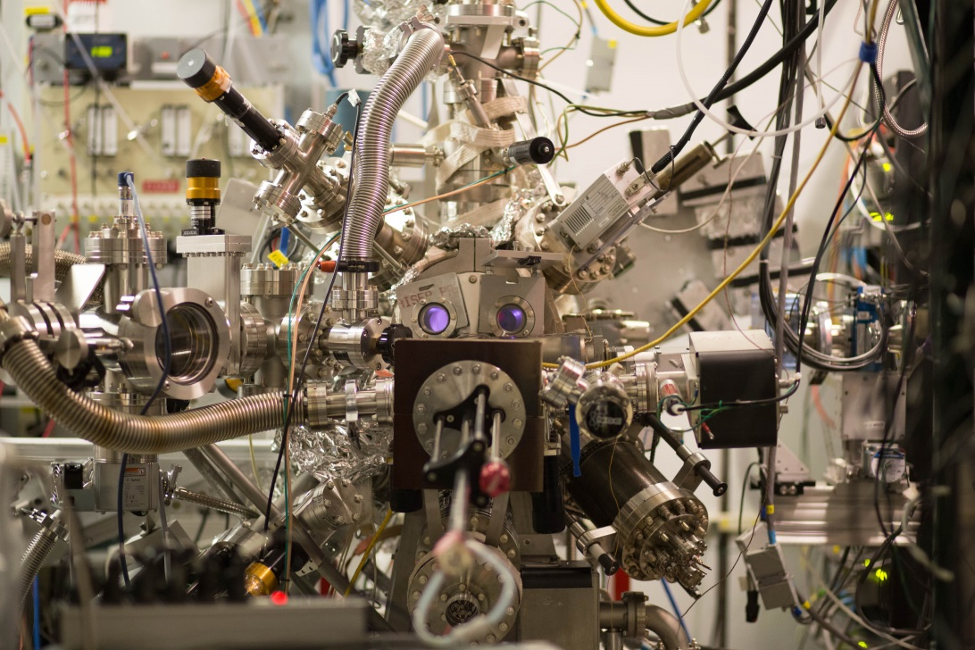
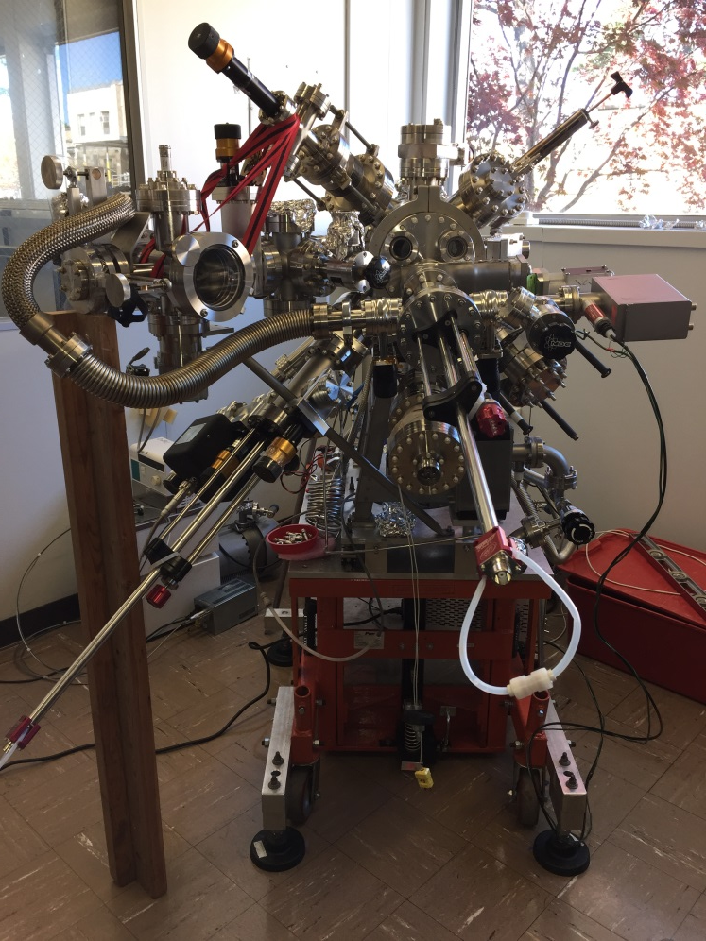
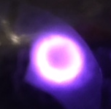
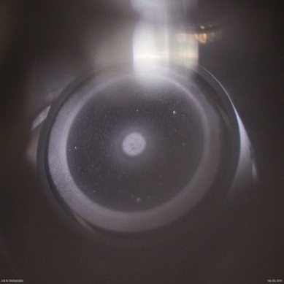
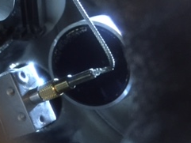
Sputter Growth
In situ, In operado XRR, XRF, XRD & Quantum efficiency (QE) measurement
Cs₃Sb
sputter gun
K₂CsSb
sputter gun
Sputter targets grown by RMD, Inc

Slide 22
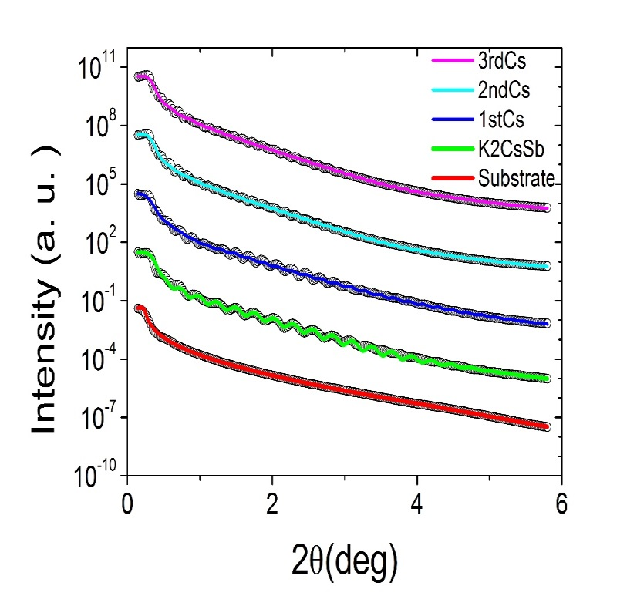
Sputter Growth
25 nm K2CsSb + layers of (total 30 nm) Cs evap.
Silicon substrate at 90 C, layer barely crystalline
 | Thickness (Å) | Roughness (Å)
3rd Cs | 416.0 | 5.67
2nd Cs | 341.3 | 4.94
1st Cs | 249.5 | 4.91
sputter K₂CsSb | 234.2 | 5.17
SiO₂ | 10.24 | 3.27
Substrate (Si) | --- | 3.75
layer | K (±0.1) | Sb (±0.05) | Cs (±0.05) | K/Cs
K₂CsSb sputter | 0.85 | 1.00 | 0.41 | 2.08
Cs | 0.84 | 1.00 | 1.75 | 0.48
Notes:
Examples of typical data set

Slide 23
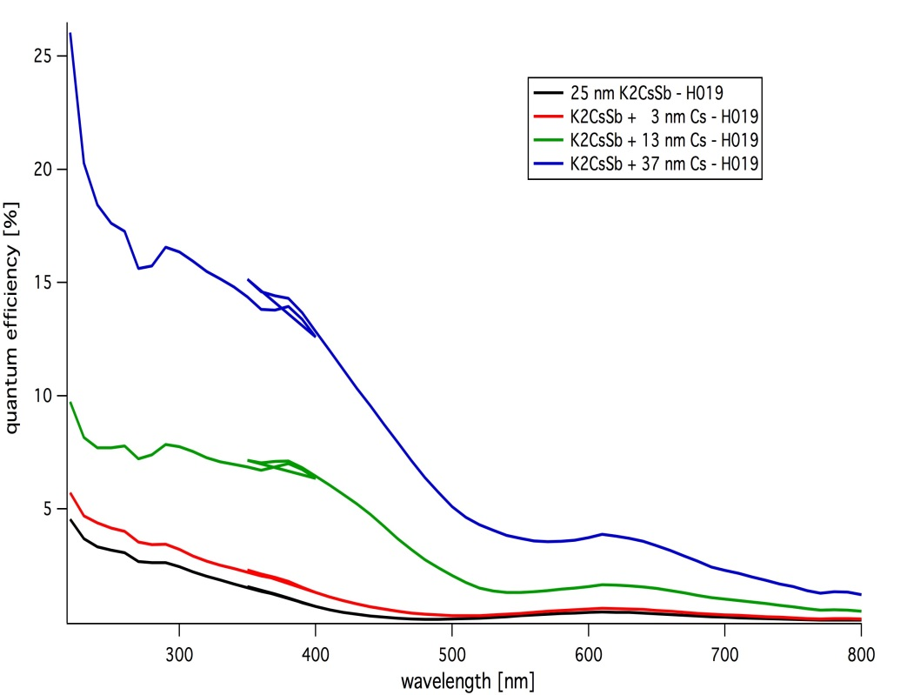
Sputter Growth

Slide 24
Alkali Antimonide Cathodes
What we’ve learned
We now have a tool which is capable of optimizing growth parameters for figures of merit other than Quantum Efficiency
We understand the formation chemistry of these materials, and why traditional deposition results in rough cathodes
Avoiding crystalline Sb helps, as does co-evaporating alkali
Sputter deposition is best – easy to do, covers large area, almost atomically smooth even for thick films
Can now consider heterojunctions and doping of alkali antimonides (following a similar development path to the III-V materials)

Slide 25
Diamond Amplifier
Advantages
Secondary current can be >300x primary current
Diamond acts as vacuum barrier
e⁻ thermalize to near conduction-band minimum

Slide 26
Diamond Amplifier Setup
Hydrogenated surface
Phosphor Screen
Diamond
Focusing Channel
Pt metal coating
CCD camera
0- to 10-keV Electron beam
Anode with holes
A
H.V. pulse generator

Slide 27
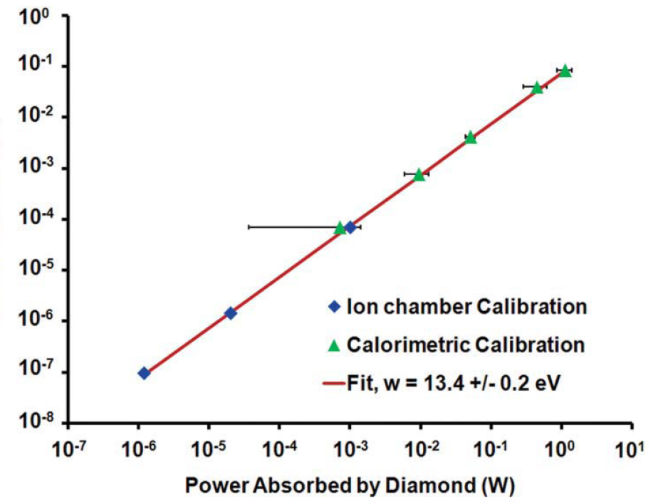
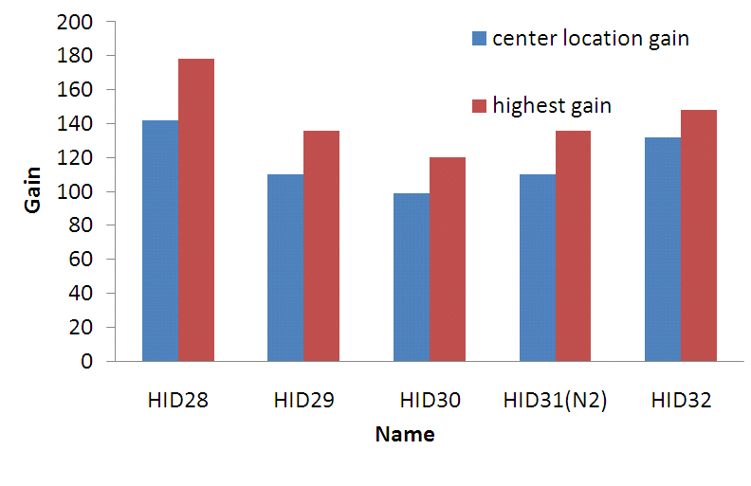
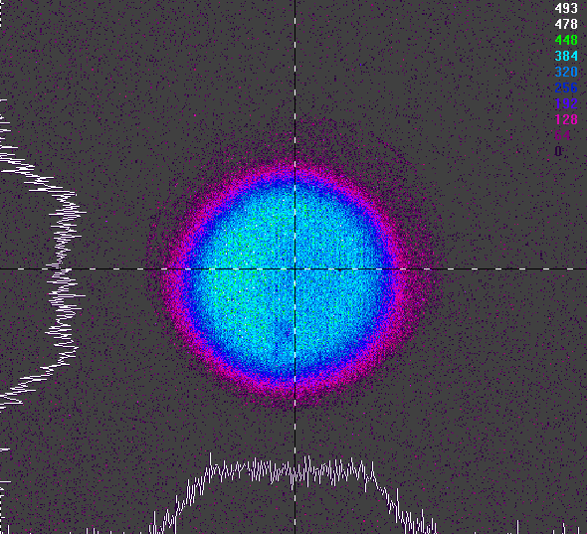
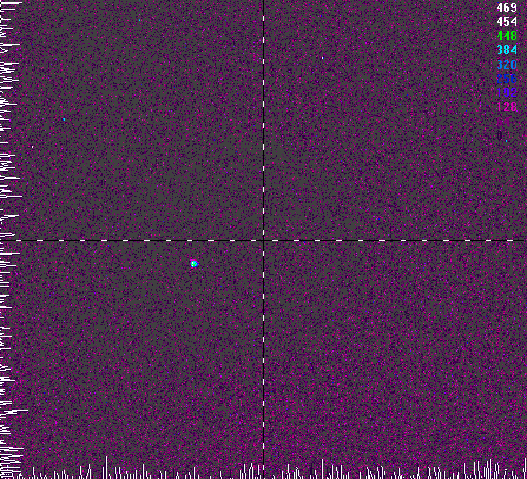
Diamond Amplifier Results
White / pink beam at up to 20 W/mm²
NSLS-X28C
Current through diamond (A)
Demonstrated emission and gain of >100 for 7 keV primaries
Emitting ~60% of secondaries
X-ray photons have been used to generate current densities in excess of 20A/cm² with no deviation from response linearity
With focusing
X. Chang et al., Phys. Rev. Lett. 105, 164801 (2010)
J. Bohon, E. Muller and J. Smedley, J. Synchrotron Rad. 17, 711-718 (2010)

Slide 28
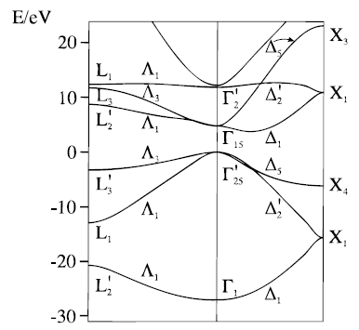
Why Does Diamond Emit?
Projection of k-space onto [100] Surface
Hydrogen termination causes diamond to have a work function ~1 eV lower than it’s band gap but the band gap is indirect
Thus even electrons with energy 1 eV above the conduction band minimum are not in a momentum state capable of emission
This is the crux of the problem for Negative Electron Affinity Diamond

Slide 29
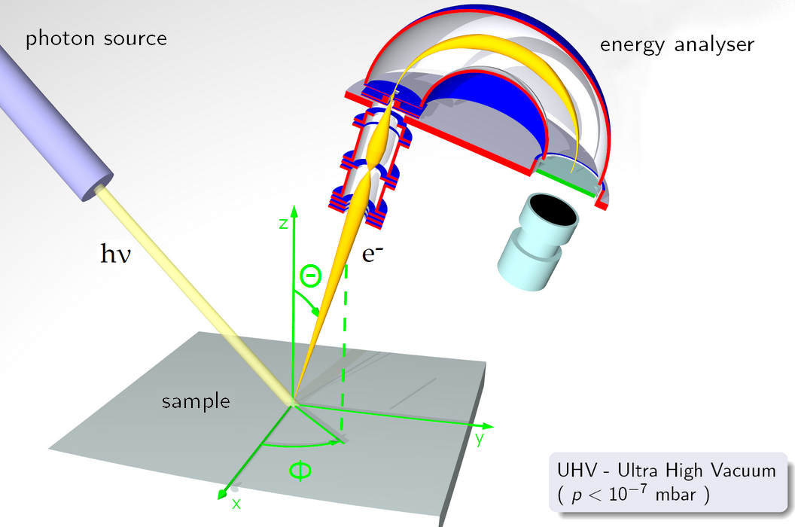
Angle-Resolved Photoemission Spectroscopy

Slide 30
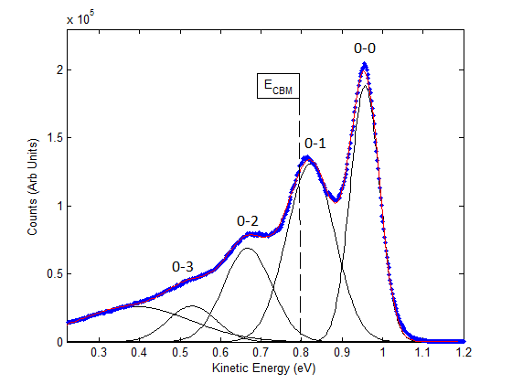
6 eV Laser ARPES
Conduction
Band
ħΩ{
χ_{eff}
μ
E_{F} located at 1.662 eV according to Au reference
KE scale referenced to E_{vac} for NEA material; NEA = -0.955 eV
Peak spacing 142±5 meV, consistant with the 145 meV energy of optical phonon which connects Γ to Δ
Valence
Band
J. D. Rameau, et al., Phys. Rev. Lett. 106, 137602 (2011)

Slide 31
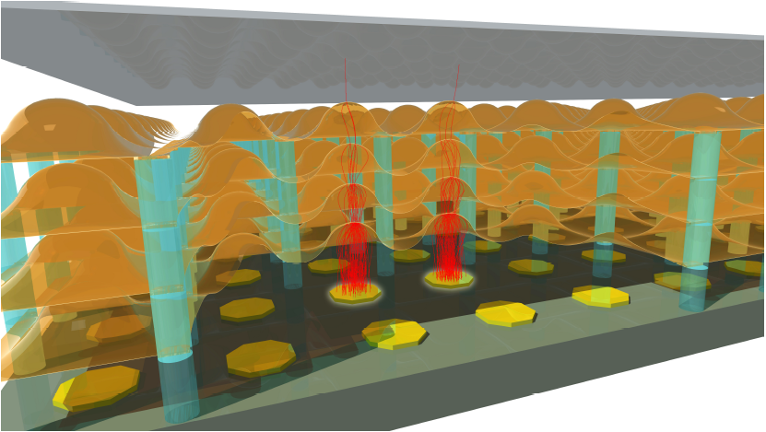
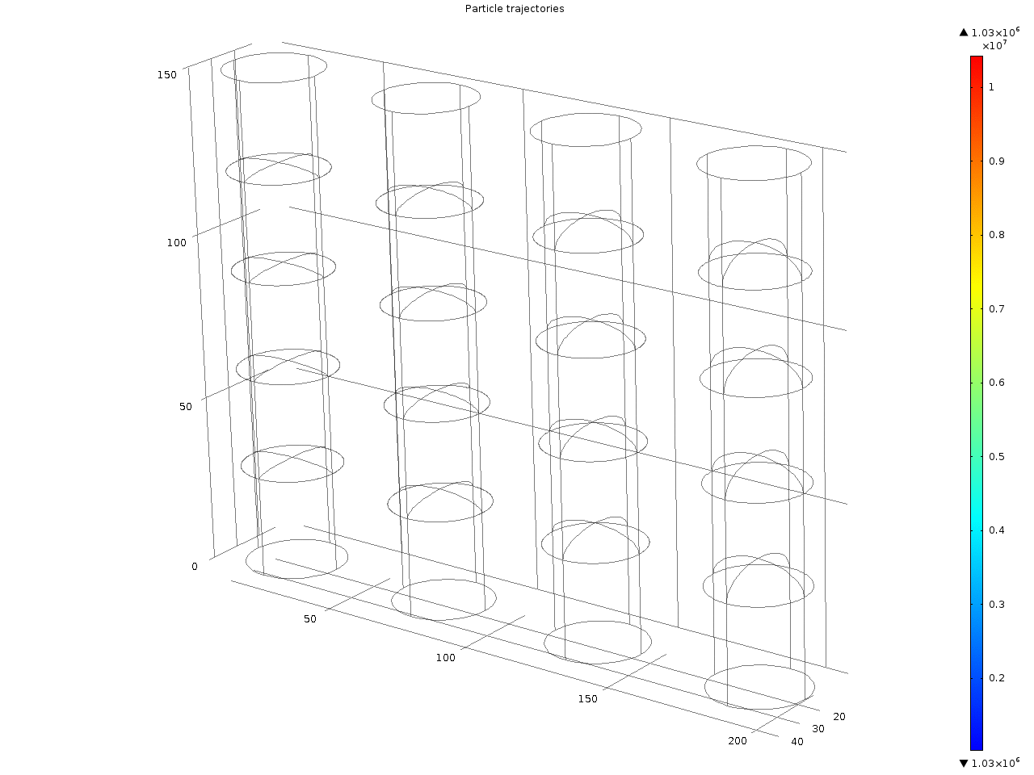
Functional Aspects of Tipsy
“Timed Photon Counter”=>TiPC=>Tipsy
Photocathode:
High QE important
but
Must tolerate 3-7 V/µm
with minimal dark cts
Dynodes:
SEY will determine viability of device and number of dynodes
Surface treatment and processing optimization required

Slide 32
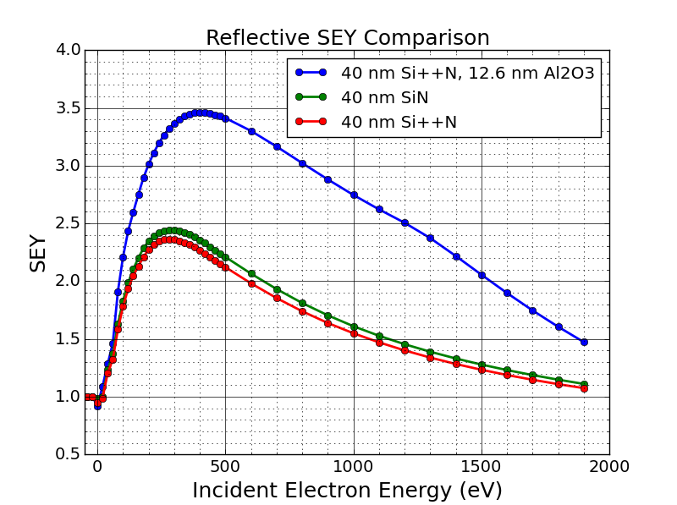
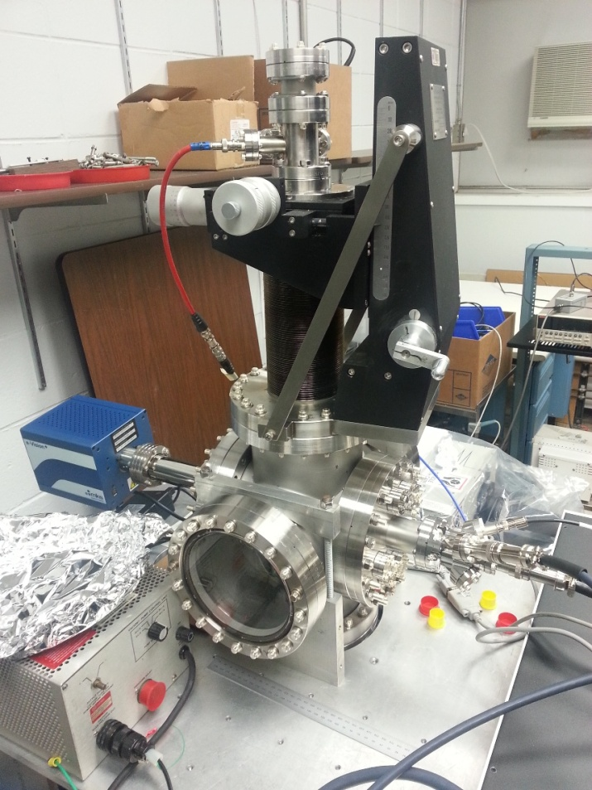
Dynode Testing for Tispy (DyTest)
UHV system, with electron gun and optical port for QE/workfunction measurement
Load multiple samples and measure secondary elecron yield in reflection and transmission mode
In-situ heating and surface treatment (Cs evaporation)

Slide 33
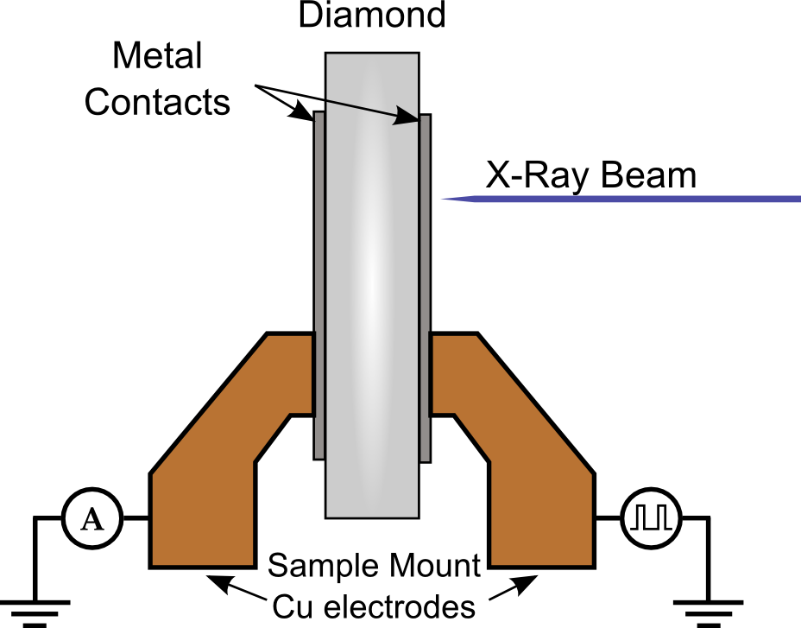
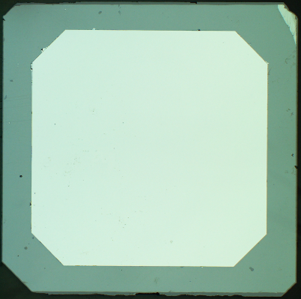
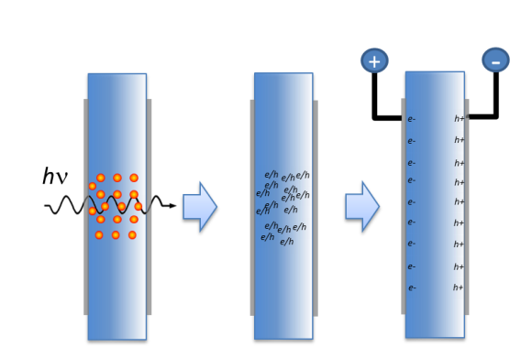
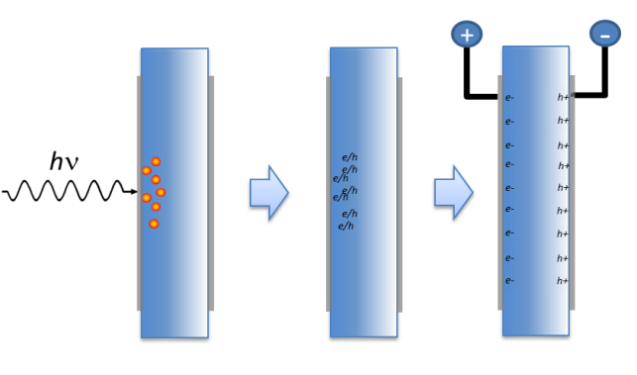
Diamond as a X-ray sensor
Diamond Advantages:
Low X-ray Absorption
High Thermal Conductivity
Mechanical Strength
Radiation Hardness
Indirect bandgap
Sample Information:
Electrical grade CVD single crystal diamond
  (100) surface orientation
  ~1 ppb nitrogen impurity
Typical size: 4mm x 4mm x 50µm
X-ray generated charge carriers
Low energy x-ray
High energy x-ray
Electron hole pairs created near incident electrode: must move entire thickness of the diamond
Electron hole pairs created throughout the thickness creating a column of electron-hole pairs

Slide 34
Responsivity vs Photon Energy
Platinum M edge feature due to loss of photons absorbed by incident contact
not field dependent
Maximum S of 0.07 A/W
=> w = 13.3±0.2 eV
Loss of photons through
diamond reduces S for
hv >5 keV
0.4 MV/m, 95% Duty Cycle for hv<1 keV, 100% for hv>1 keV
The calibration matches theory over 3 beamlines and 5 orders of magnitude in flux
C K edge feature is field dependent, caused by incomplete carrier collection
for carriers produced near incident electrode – electrons diffuse into incident contact
and are lost
J. Keister and J. Smedley, NIM A 606, (2009), 774

Slide 35
Response vs Bias
300 µm thick plate
Under 0.1 V/µm required for full collection
40 mA from less than 1 mm²

Slide 36
High Flux Response
Response to incident flux linear over 11 orders of magnitude

Slide 37
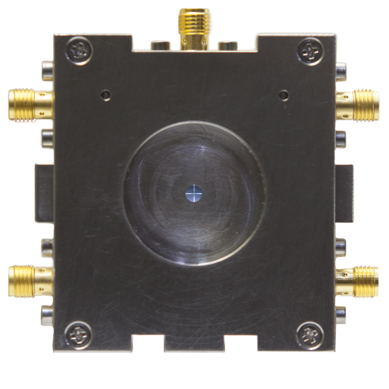
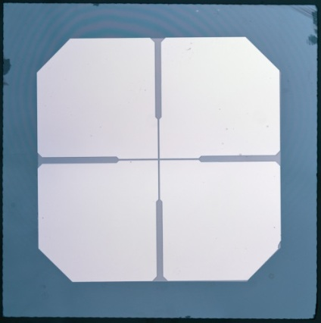
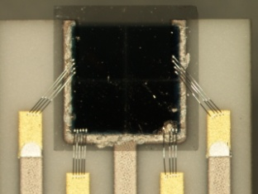


Diamond Beam Position Monitors
Circuit Board Mounted
  Pt metallization
  wire-bonded electrodes
  SMA/LEMO connectors
Application specific –
X-Ray fluorescence (X27)
  Ag diamond metallization
  Ceramic board
  1 cm wide (compact)
  Ag traces
White BPM (X25)
  Mini-gap undulator
  ~100W incident power
  Large beam

Slide 38





Fabrication
Lithography @ CFN
Wire Bonding - Instrumentation
75µm
20µm
25 µm aluminum wirebonds
5 bonds per pad
Conductive epoxy for backside/bias contacts
3.1mm
4.0mm
Topography – NSLS/CHESS
Electronic grade single crystal (100) diamond
30-50 µm thick
20 µm street over a 1mm center region
Metalization: 25 nm Pt
White beam topography
Prior to slicing

Slide 39

Beam Position Monitors
4mm
A
B
50 µm
C
D
3.5mm
RMS ~ 38 nm

Slide 40
Pulse Mode Beam Position 11-ID-D, APS
Ring mode “hybrid fill, top up”.
102mA total, 16mA in first bunch, 86mA in remaining pulse train.
Separated by 1.594 µs
Ratio of ring currents matches very closely to measured charge ratio
Current Ratio: 86mA/16mA = 5.38
Measured Q Ratio: 0.91nC/0.17nC = 5.35

Slide 41

Pixelated Diamond Window
readout animation
Pixels are created by metalizing one side of the diamond with horizontal stripes and the other with vertical stripes. As the x-rays pass through the diamond, the induced current is collected in each vertical stripe, while the bias is applied to individual stripes on the other side. This bias is cycled, allowing readout of one line of “pixels” at a time.
Image Readout
32 x 32 stripes, yielding 1024 pixels
Only one row is active at a time minimizing ohmic heat generation.
Project goal of real time imaging at 1 Hz, currently at 32 Hz
Up to ~10mA per pixel
Window Fabrication
The diamond sensor will be brazed to a stainless steel vacuum flange.
The diamond and electronic interconnects will be protected by a metal mask.
Heat dissipation provided by water cooling.

Slide 42



Beam Imaging
CHESS G3 Beam
NSLS X28C Beam

Slide 43

Beam Imaging
CHESS G3 Beam
Zhou et al. (2015) JSR 22 :1396 (cover article)

Slide 44

Brazing the Way to the Instrumented Window
Single Crystal Diamond
Laser cut an polished by Applied Diamond
4.7x4.7x0.054 mm³
Lithographically patterned
60 µm pixels, 2x2 mm² active area
Platinum metallization
Brazed by Applied Diamond
13 mm diameter polycrystalline diamond
Laser cut 3.3 mm square
Brazed w/o compromising metalization
Custom boards
  Wirebonded front and back to individual circuit boards as in final device

Slide 45

Brazed Detector Test at CHESS

Slide 46
Conclusions
From Photocahtodes to X-ray diagnostics, we can use our tools to build better ones
Alkali Antimonide cathodes
  Peak QE of 35% and a green QE of 7.5% have been achieved
  We can optimize cathodes for structure as well as QE
  Traditional cathodes are very rough… but we are learning to make them smoother
  Sputter growth may open new opportunities for this material
Secondary yield
  Diamond, when operated as an active drift device with NEA, has a SEY of >100
  SiN with ALD Alumina coating can achieve SEY of 3.5 in “diffusion” mode
DiamondDetectors
  Flux linearity demonstrated over 11 orders of magnitude
  Position resolution of better than 50nm, and single bunch flux and position have been achieved
  50 devices delivered or on order world wide (APS, CHESS, Diamond, NSLS-II)
  1k Pixel beam imaging system demonstrated for both white and monochromatic beams
Thank you!

Slide 47






Slide 48
Thanks for your attention!
Thanks to K. Attenkofer, J. Mead, W. Ding, T. Zhou, M. Maggipinto, A. Della Penna, T. Rao, S. Schubert, M. Ruiz Oses, J. Xie, J. Wang, H. Padmore, E. M. Muller, J. Bohon, J. Mead, M. Gaowei, A. Héroux, L. Berman, M. Sullivan, R. Beuttenmuller, J. Jordan-Sweet, J. Keister, A. Sumant, E. DiMasi, J. Walsh, B. Raghothamachar, J. Distel, K. Vetter, G. DeGeronimo, B. Dong, D. Dimitrov, D. Pinelli, J. Skinner, M. Cowan, S. Ross, R. Tappero, B. Ravel, C. Jaye, D. Fischer, M. Lu, F. Camino, D. Abel, I. Ben-Zvi, T. Vecchione, X. Liang, J. Rameau, P. Johnson, J. Sinshiemer, H. van der Graff and the MEMBrane collaboration
Beamlines (and staff): U2A, U2B, U3C, U7A, U13, X3B, X6B, X8A, X15A, X16C, X19C, X20A&C, X21, X23, X24, X25, X28C & APS ID 11D & CHESS G3
DOE Office of Science – Basic Energy Science and High-Energy Physics, NSF IDBR Program

Slide 49




Quad detectors for NYSBC
2 quad detectors (65µm and 80µm thick)
3.6mm x 3.6mm x 30nm Pt contacts, 20µm streets
High thermal conductivity ceramic circuit board (Beryllia)
Integrated vacuum seal
Operating voltage 10V.
Self-aligning defractometer

Slide 50


Sealed Capsule Photocathodes
Photonis USA, using detector growth process
Shelf life of months at least
NaK₂Sb available
QE drops during heating to remove cap, but recovers

Slide 51

Sealed Capsule Photocathodes
Comparison to Photonis commercial PMT cathode
Similar texture (222 surface normal preferred)
Broader peaks imply smaller grain size
(50 nm for BNL cathode, 39 nm for Photonis cathode)

Slide 52


layer | Roughness(Å) | Thickness(Å)
3rd layer | 6.87 (-0.17, 0.19) | 512 (-1.17, 1.30)
2nd layer | 6.20 (-0.19, 0.33) | 336 (-1.35, 1.04)
1st layer | 6.05 (-0.23, 0.18) | 178 (-0.54, 0.47)
Substrate (MgO) | 2.43 (-, -)
layer | Roughness(Å) | Thickness(Å)
After Cs | 7.56 (-0.20, 0.13) | 776.0 (-75.7, 71.0)
1st layer | 8.21 (-0.068, 0.13) | 555.4 (-2.6, 3.3)
Substrate (MgO) | 3.93 (-0.03, 0.03)

Slide 53
Temporal Response, Hard X-rays
J. Bohon, E. Muller and J. Smedley, J. Synchrotron Rad. 17, 711-718 (2010)

Slide 54
Temporal Response, Soft X-rays

Slide 55

What do we want out of an electron source?
The electron beam properties determine the photon beam properties
  Pulse duration, degree of coherence, flux
In all light sources through 3rd generation, the phase space is determined by the ring
In 4th generation sources (LCLS, XFEL, NGLS), this will change – the electron source will determine the beam properties
The highest brightness sources available are photoinjectors, which use a laser on a photocathode to control the spatial and temporal profile of the emitted electron beam

Slide 56
What do we want out of photocathode?
High Brightness:
  large number of electrons in a small volume of phase space
Low Emittance:
  Determines the electron energy required for an X-FEL at a given wavelength
High Quantum Efficiency
  High Average Current
Long Operational Lifetime
  Chemical Contamination
  Ion back bombardment
Sub-ps response time
The optimal cathode is still
a work in progress
It is becoming increasingly
clear that material parameters
such as texture and surface
roughness may play an
important role

Slide 57

Effects of roughness seen in the emittance of thick multilayer K₂CsSb
Emittance (µm/ mm rms)
Field (MV/m)
Thin films grown at high rate give ~ expected emittance (very low field dependence)
Films grown in a multilayered manner were shown to give higher QE but
showed marked emittance growth with field
Can be explained by invoking a simple roughness model.
Fitting gave reasonable roughness parameters, confirmed by in vacuum AFM
Roughness in high gradient guns looks to be an issue based on current in-situ measurements of cathode surfaces
T. Vecchione et al., Proceedings of FEL2011, Shanghai, China 179 (2011)

Slide 58
in-situ AFM on cathode at CFN
QE~0!!!!%
QE~1%
10 nm Antimony film evaporated at room temperature
Potassium and Cs added by monitoring QE
Should result in a 50 nm thick final film
Observed 25 nm RMS roughness, with a 100 nm spatial period
Nano-pillars of uniform height – consistent with XRR and GISAXS
Likely the source of the Field dependence of the intrinsic emittance
S. G. Schubert, et al, APL Mater. 1, 032119 (2013)

Slide 59

Experimental Setup
Monochromatic beam tests demonstrate flux linearity from 100 pW to 10 µW
Reach >10 W (>3kW/cm²) with focused white beam
Calorimeter, Diode and Ion Chamber
Nitrogen Enclosure or Vacuum
E
D
C
A
B
X-ray port (A)
Beam defining aperture (B)
Diamond Detector (C)
Ion Chamber or Diode (D)
Calorimeter (E)

Slide 60



X28C – motion and focusing tests
Detector Bias: 8V
Circular aperture 1.6 mm in diameter.
Scanned horizontally and vertically in 200 µm steps

Slide 61


Imaging Testing at X28C
Test Setup
Detector mounted on x-z stage.
Pinhole to define beam size
Filters to change X-ray flux
Nitrogen enclosure to avoid ozone depletion of contacts
http://www.bnl.gov/newsroom/news.php?a=25299

Slide 62


Pixelated Diamond X-ray Detectors
Early Prototypes
16 Pixels – 4 strips each side, 1mm wide
Standard Pt metallization, Al wirebonds
Circuit board design, device assembly and wire bonding done at the Instrumentation Division
Validated concept measuring both position, morphology and flux
Current Prototypes
Two devices – one using an Element Six diamond and one a IIA Technologies’
1024 Pixels – 32 strips each side, pitch: 60 µm and 100 µm
Diamond thickness: 50 µm
Full image readout at video rate (limited by USB 2.0 transfer speeds).
Fully calibrated position, flux and beam shape monitor

Slide 63



Diamond Instrumented Window
Development of a diamond window which will provide position, flux and morphology of high flux x-ray beams while simultaneously acting as the vacuum-air interface
X-ray Footprinting (XFP) at NSLS-II
Structural biology: X-ray Footprinting for In Vitro and In Vivo Structural Studies of Biological Macromolecules
Focused white beam (Expected incident x-ray power: ~100W )
Variety of beam sizes/shapes needed
Feedback and control systems for optical elements (toroidal focusing mirror) or sample positioning stages
Target Morphologies for the current target application (x-ray footprinting: NSLS X28C and NSLS-II XFP)
Multiple Sample Holder (PCR tubes)
Capillary Flow Cell
Quench-Flow
Major Challenges for high flux beamlines
Heat load management in optics (including Be windows)
Real-time volumetric measurement of beam properties such as flux, position, and morphology
400 µm
2.5 mm
Flow cell (capillary and quench-flow)
PCR tube (5µL volume)
The beam optimization capabilities of this device will be useful for almost every synchrotron technique!

Slide 64
Pixelated Diamond Window
readout animation
Pixels are created by metalizing one side of the diamond with horizontal stripes and the other with vertical stripes. As the x-rays pass through the diamond, the induced current is collected in each vertical stripe, while the bias is applied to individual stripes on the other side. This bias is cycled, allowing readout of one line of “pixels” at a time.
Image Readout
32 x 32 stripes, yielding 1024 pixels
Only one row is active at a time minimizing ohmic heat generation.
Project goal of real time imaging at 1 Hz, currently at 32 Hz
Up to ~10mA per pixel
Window Fabrication
The diamond sensor will be brazed to a stainless steel vacuum flange.
The diamond and electronic interconnects will be protected by a metal mask.
Heat dissipation provided by water cooling.

