Slide 1
Carrier Board Design
Eduardo Sevilla
10-11-2017

Slide 2
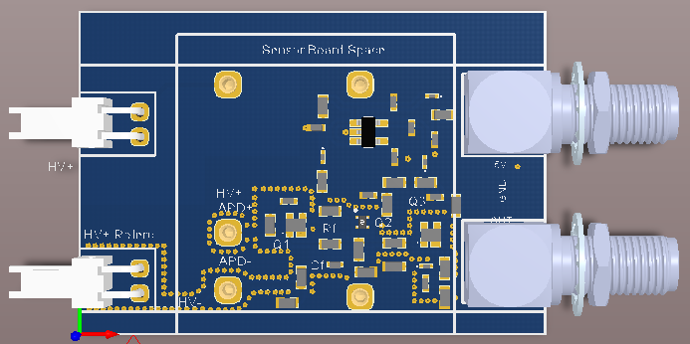
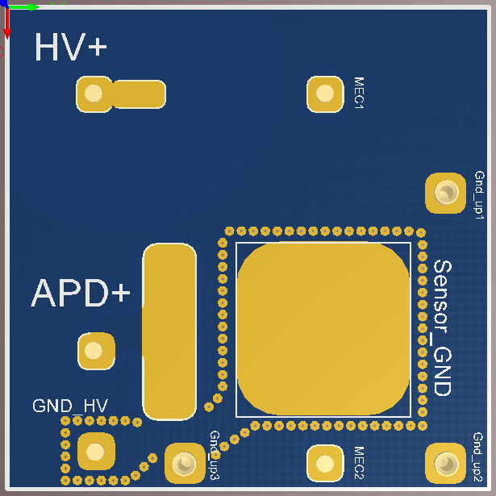
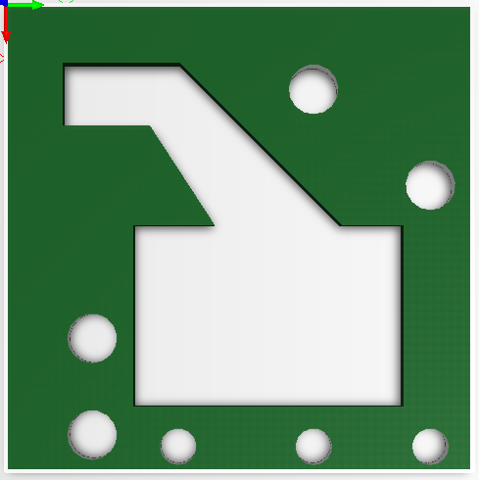
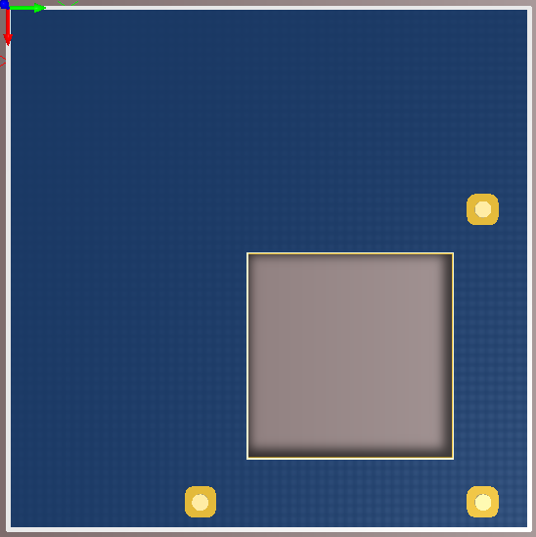
Previous Designs

Slide 3
Update
Mother Board (v9)
  Delete Quenching Resistor
  Include Input Protection
  Include Holes (current design of Sensor Board)
  Update Size (35 x 47.3 mm²)
Sensor Board (v6)
  Include two sensor polarizations
  Include PT100/1000 space&connector
  Include Hole for irradiation
Filling Board(v3)
  Modify structure to fill epoxy and house PT1000

Slide 4
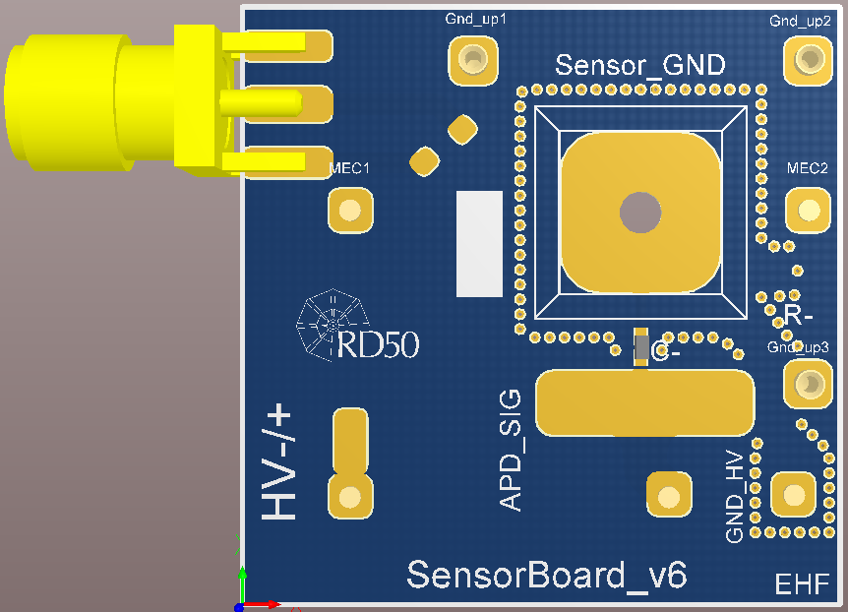
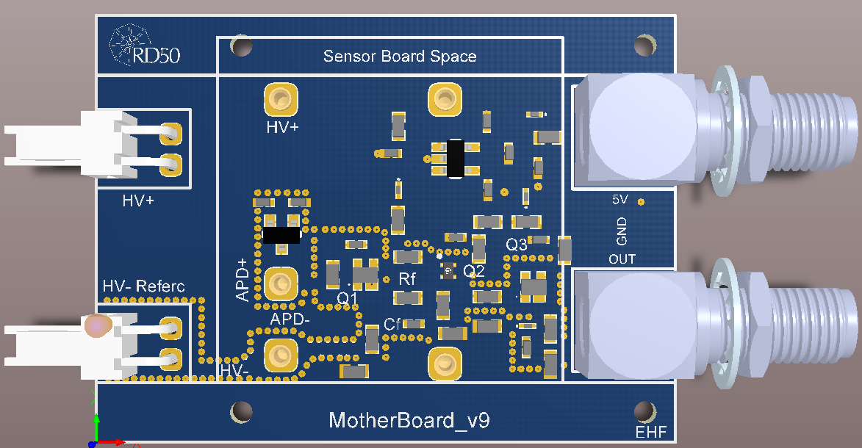
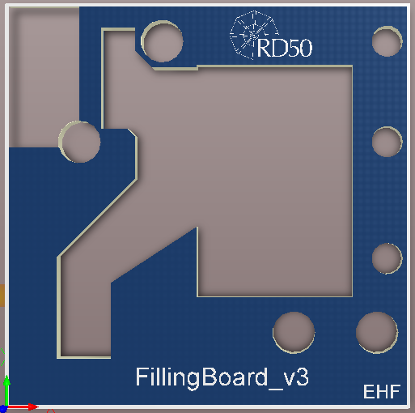
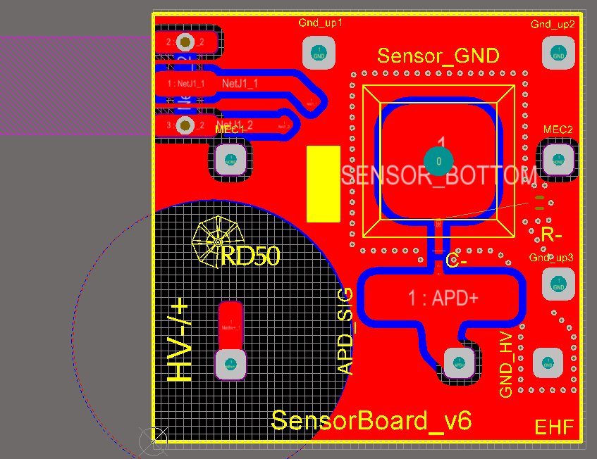
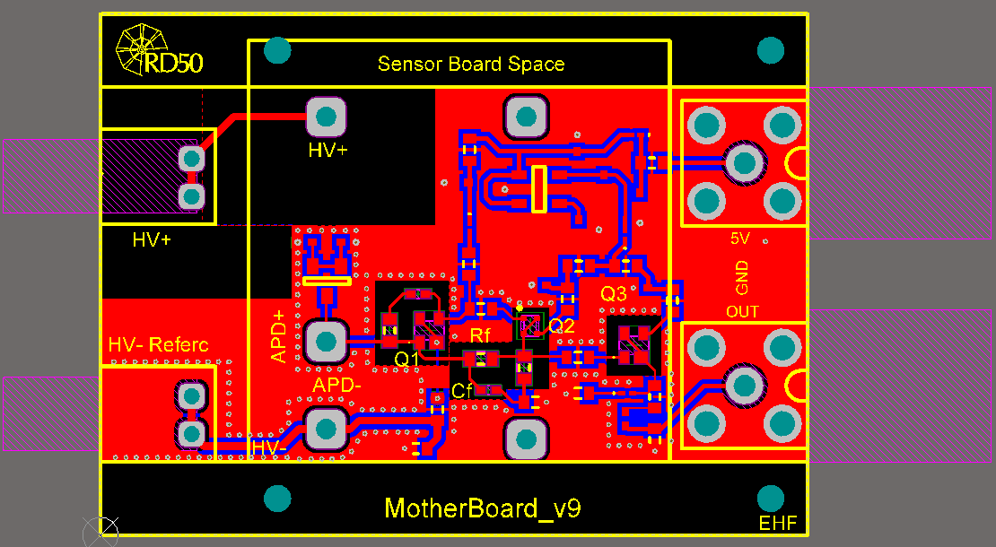
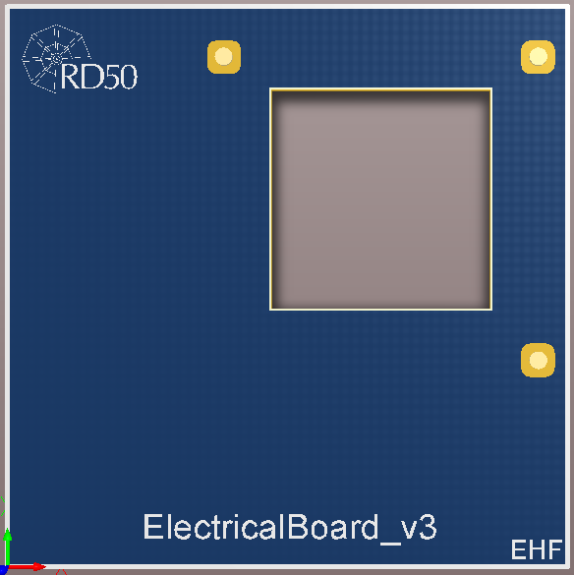
Update

Slide 5
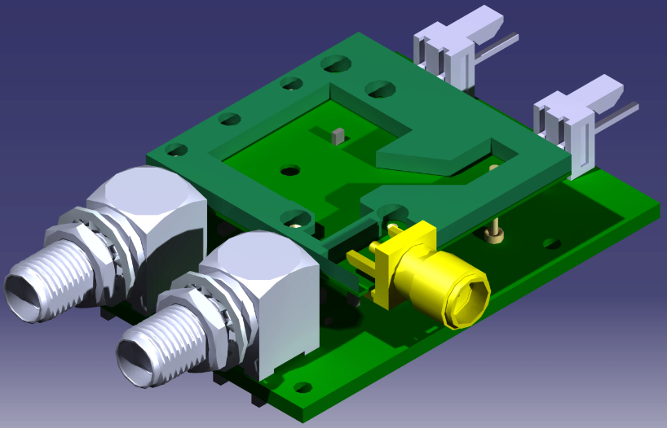
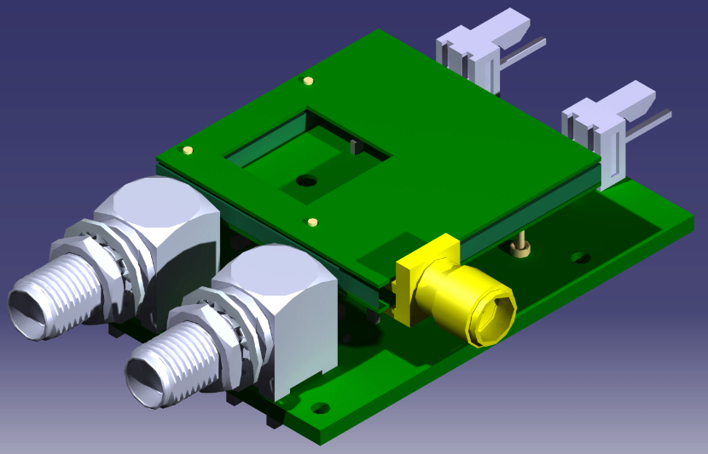
Update

Slide 6
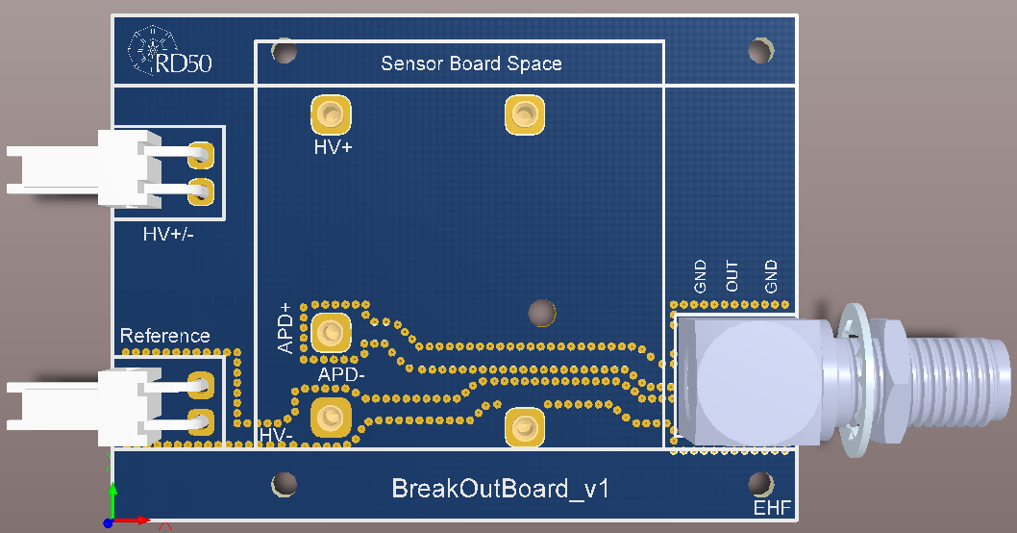
BreakOut Board

Slide 7
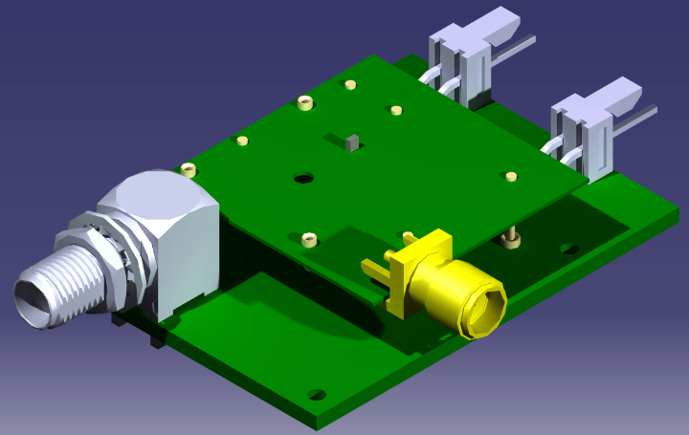
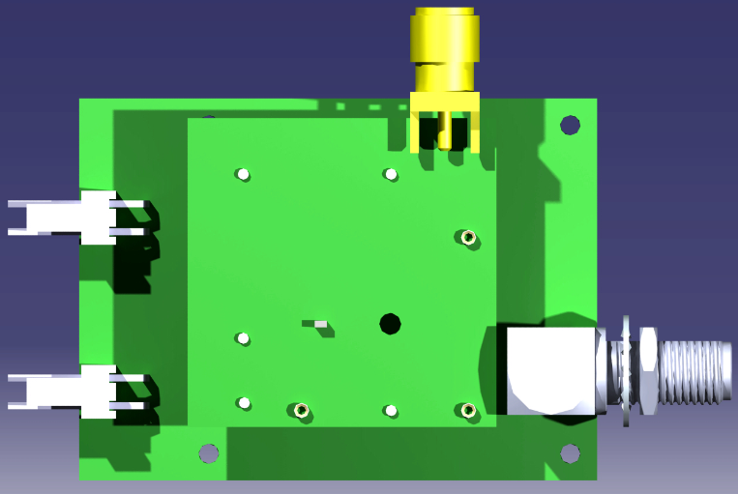
BreakOut Board

Slide 8
To Do
Manufacture the Boards
Buy Discrete Components
Laboratory Tests

Slide 9
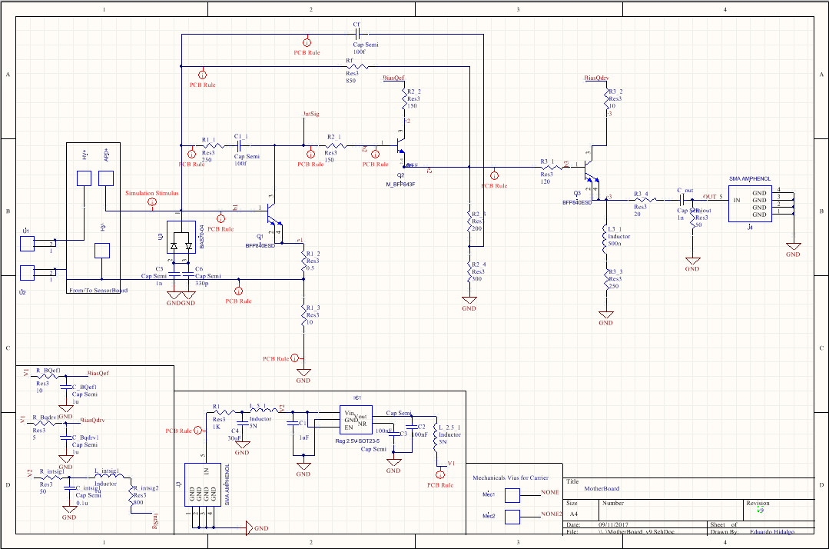
Schematics

Slide 10
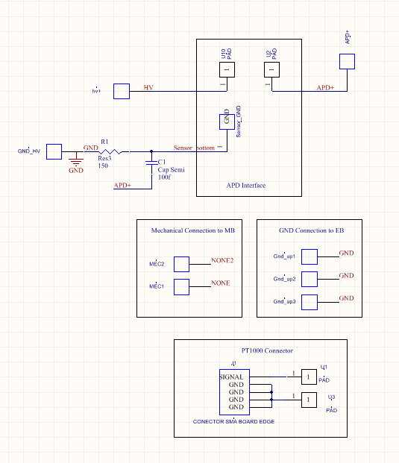
Schematics

