Slide 1
Carrier Board Design
Eduardo Sevilla
3-11-2017

Slide 2
From Previous Design
3 Updates from previous versions
Clearance for 1800V was wrong in previous Boards. >5mm

Slide 3
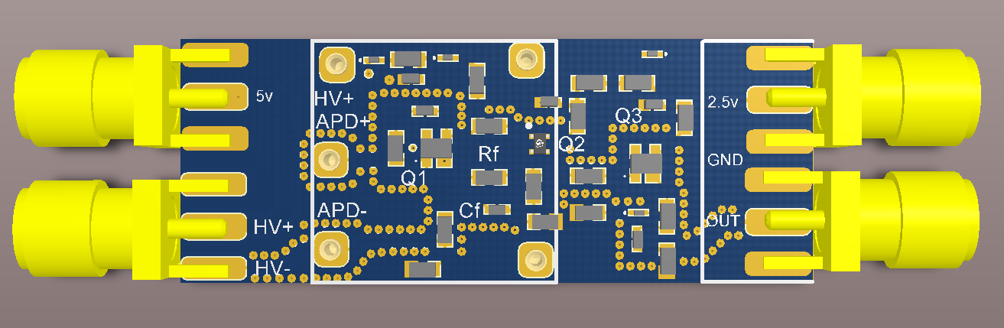
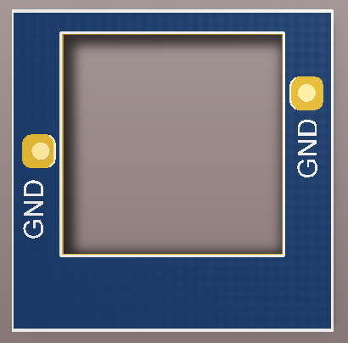
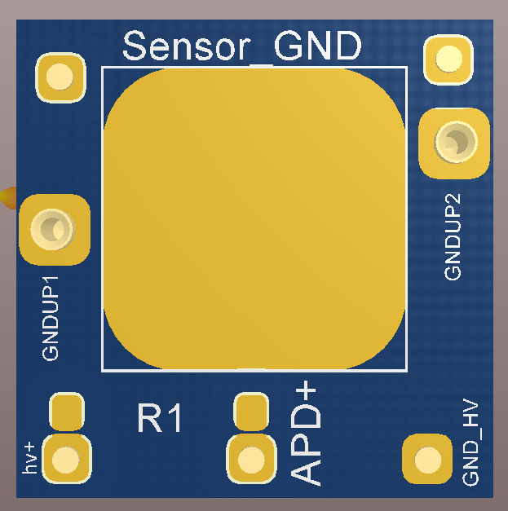
Previous Design

Slide 4
Update 1
Update of HV+ Clearance (6mm)
Sensor Board (v3)
  Include two TH (SMD is not possible for the Clearance ) Quenching Resistor
  Multiple Bounding for APD signal (Reduce resistor)
  Longer vias for connect with MotherBoard (Vertical Clearance)
  Update the Board Size (32.8x34.6mm²)
Electrical Board (v2)
  Update the Size (32.8x34.6mm²)
  Remove Copper of Bottom Layer
Mother Board (v6)
  Update Carrier Board Vias distribution
  Include internal Regulator (5Vdc →2.5Vdc). Remove 2.5V connector
  Include RC LP filter (5Hz)
  Update pins sockets
  Holes for Screws or fixings
  Update the Board Size (52.6x44.3mm²)

Slide 5
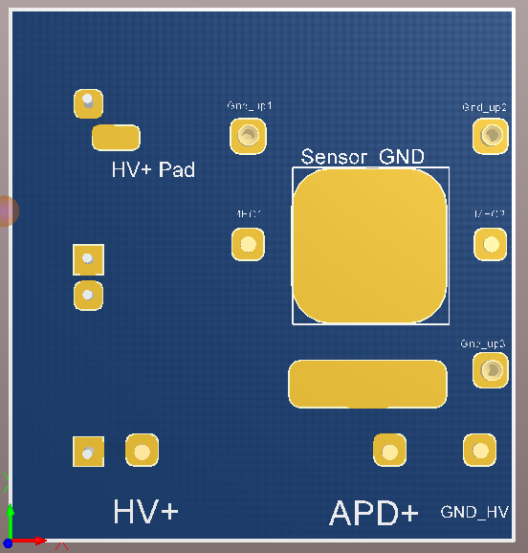
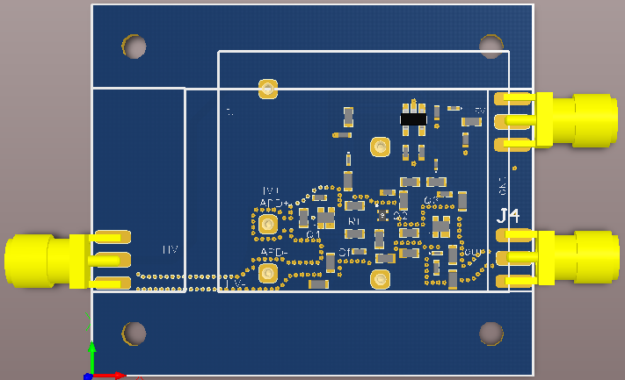
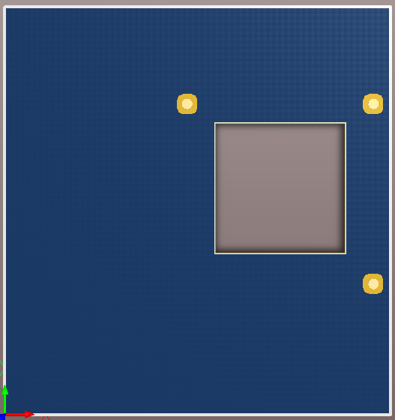
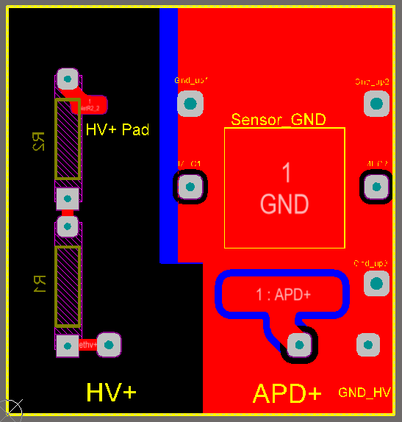
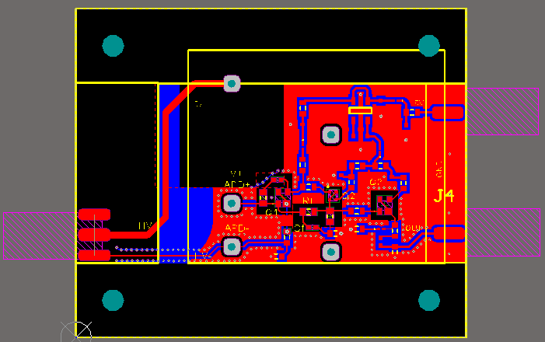
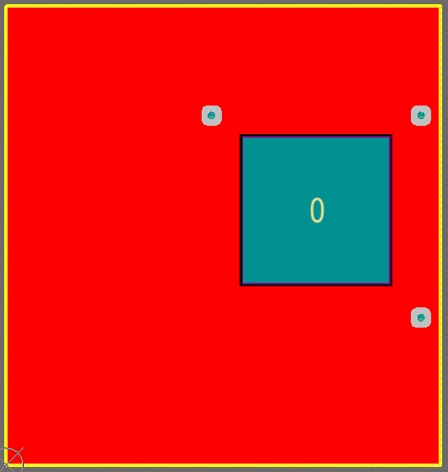
Update 1

Slide 6
Update 2
Sensor Board (v4)
  Delete Quenching Resistor (to MotherBoard)
  Update the Board Size (28.2x28.2mm²)
  Include GND vías to drive the Reference Signal
  Update the Pins Layout
Electrical Board (v3)
  Update Board Size (28.2x28.2mm²)
Mother Board (v7)
  Include 1 Quenching Resistor (2 Bigger Board Size)
  Modify HV Connector → 2 Connectors (HV+ / Ref) with 2 pins each one (possible 1 per connector)
  Update Transsitors Bias and Output Connector (with threath)
  Update the Sockets for the Carrier Board
  Update the Size (53.2x44.3mm²)

Slide 7
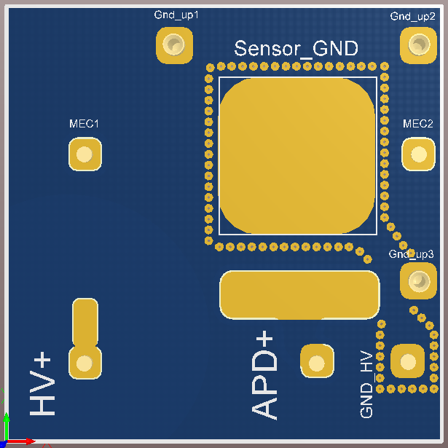
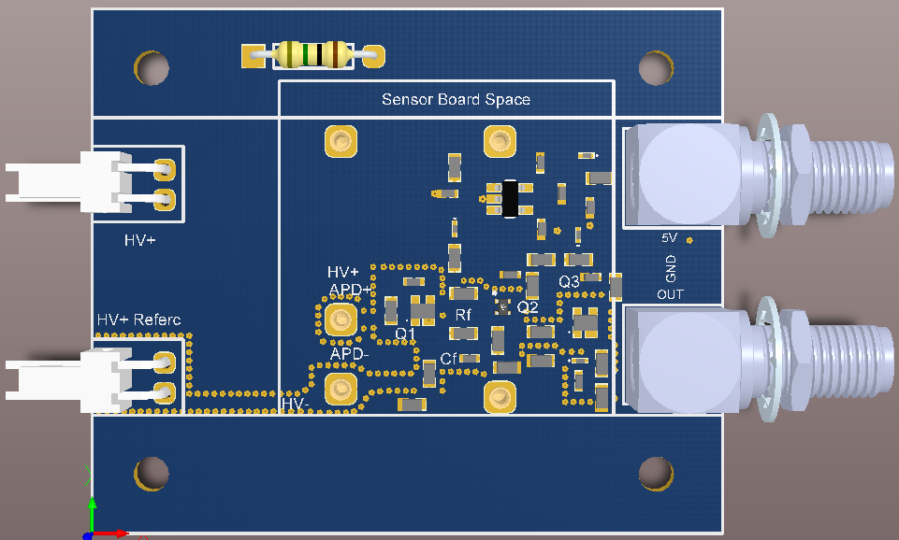
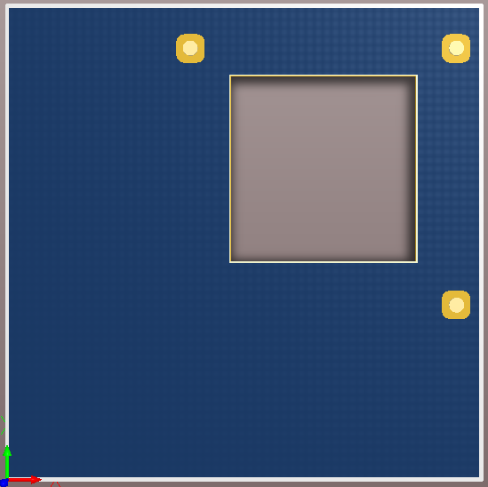
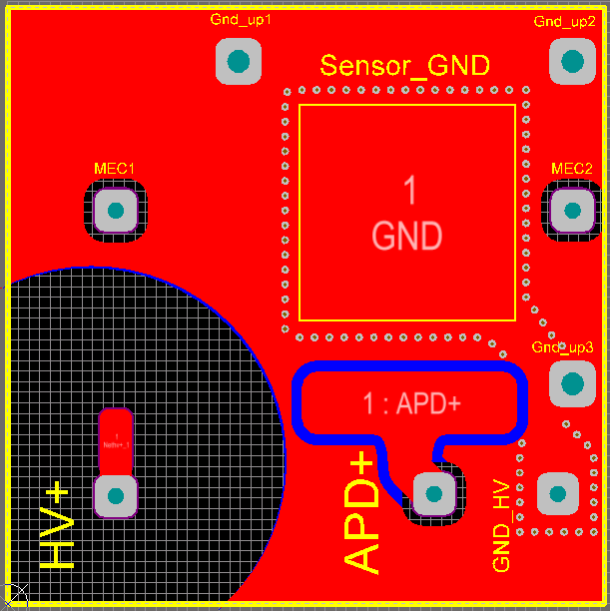
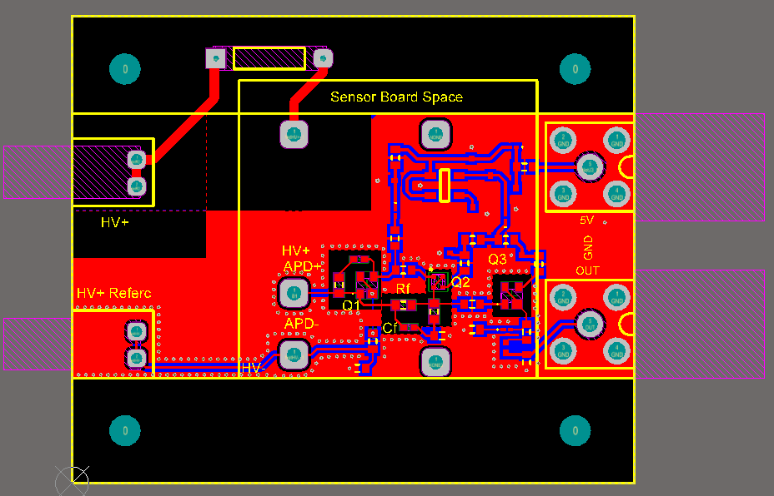
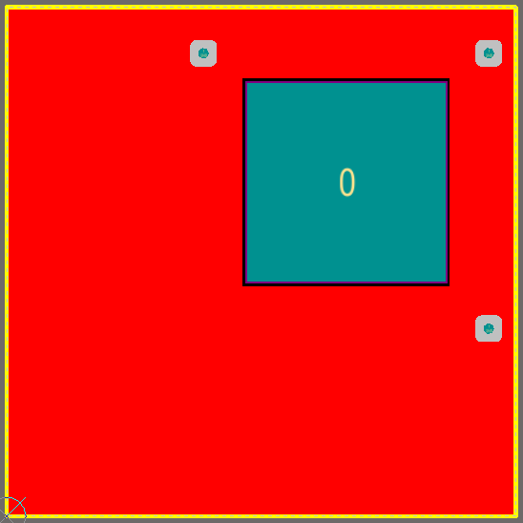
Update 2

Slide 8
Update 3
Mother Board (v8)
  Remove the Quenching Resistor
  Remove Fixing Holes
  Reduce the Board Size (47.3x32.8mm²)

Slide 9
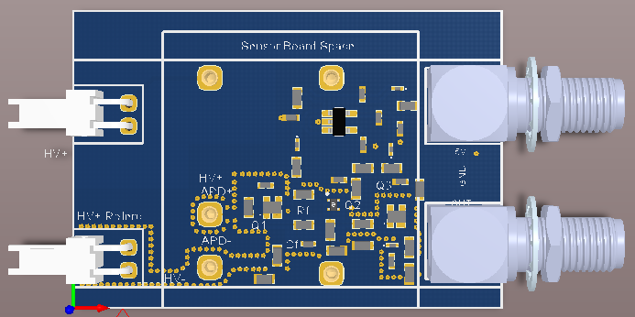
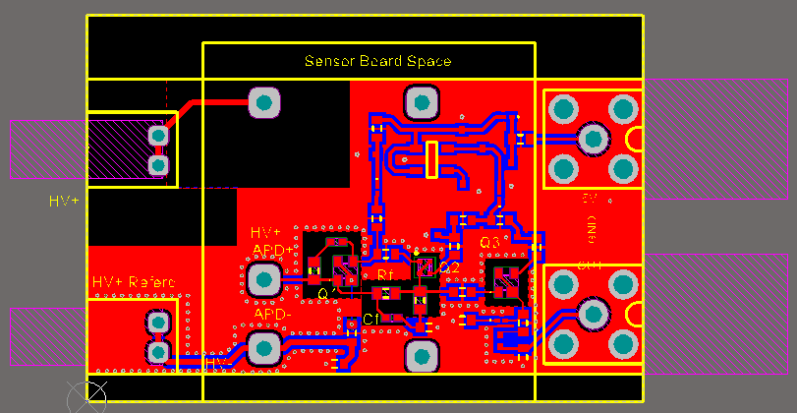
Update 3

Slide 10
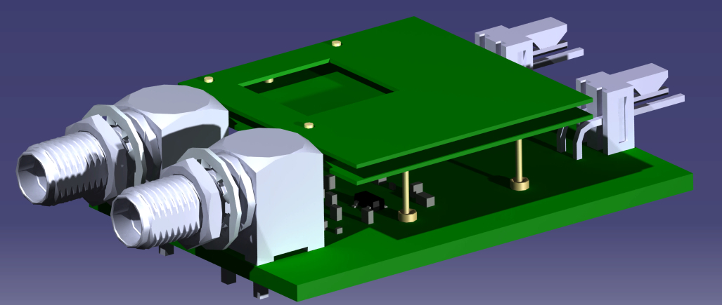
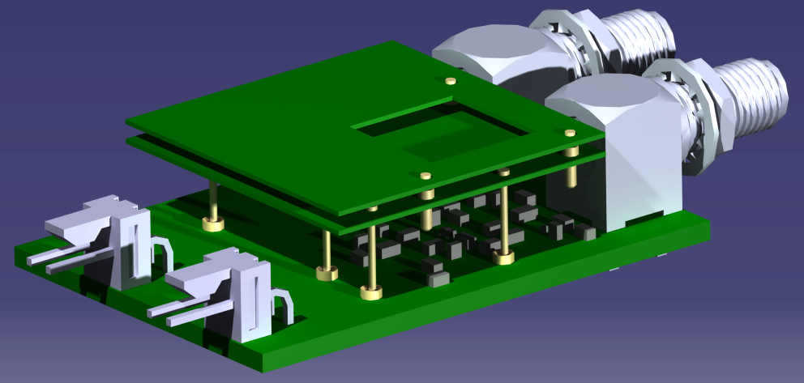
System

Slide 11
Filling Intermediate Space
Select the Epoxy for filling the “sandwich”
  Intermediate Board instead of Epoxy to separate SensorBoard and ElectricalBoard. Design Intermediate Board
  Epoxy to protect the bounding and the area below sensor top layer.
    Select and buy the epoxy
Select the Process to apply to the Epoxy
  Put it, vacuum and oven

Slide 12
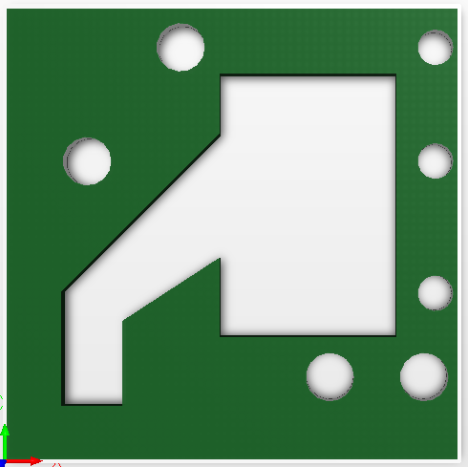
Filling Intermediate Space

Slide 13
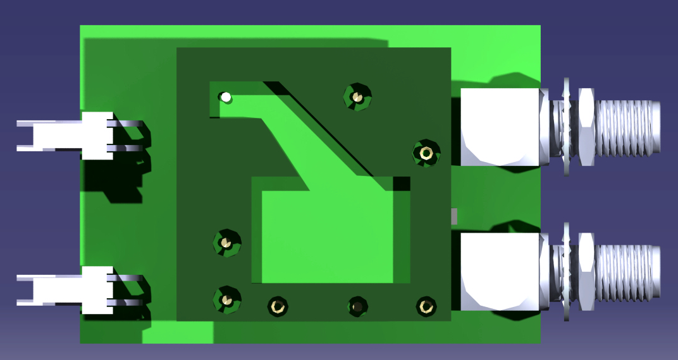
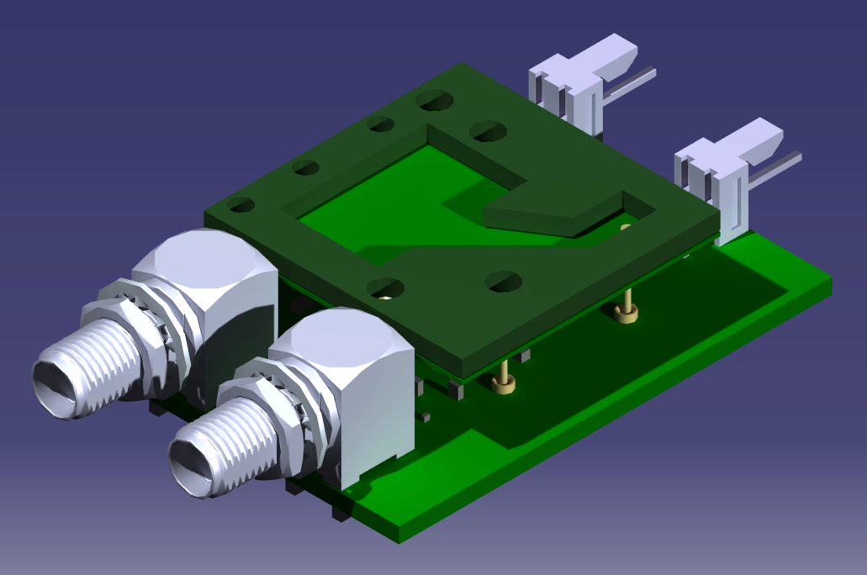
Filling Intermediate Space

Slide 14
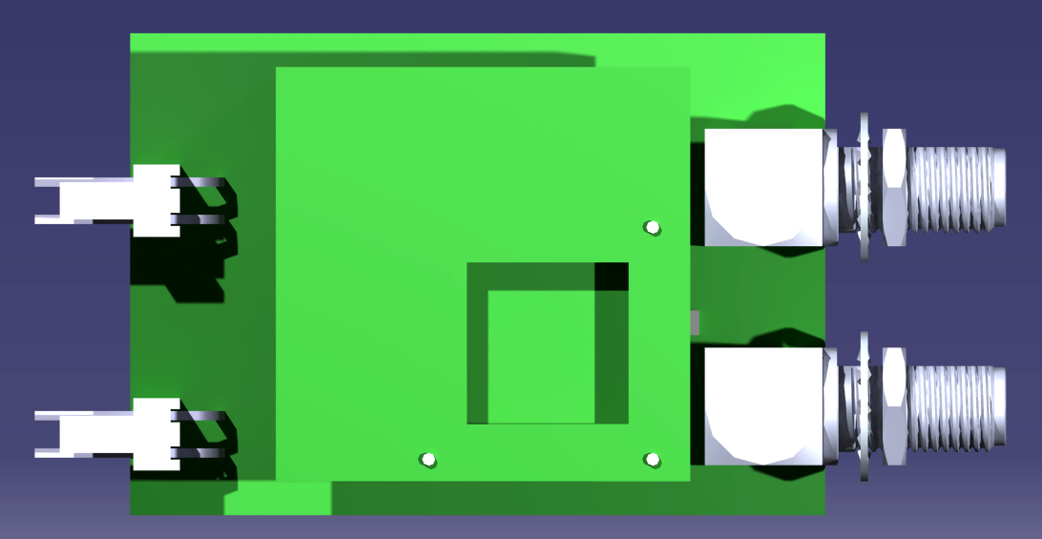
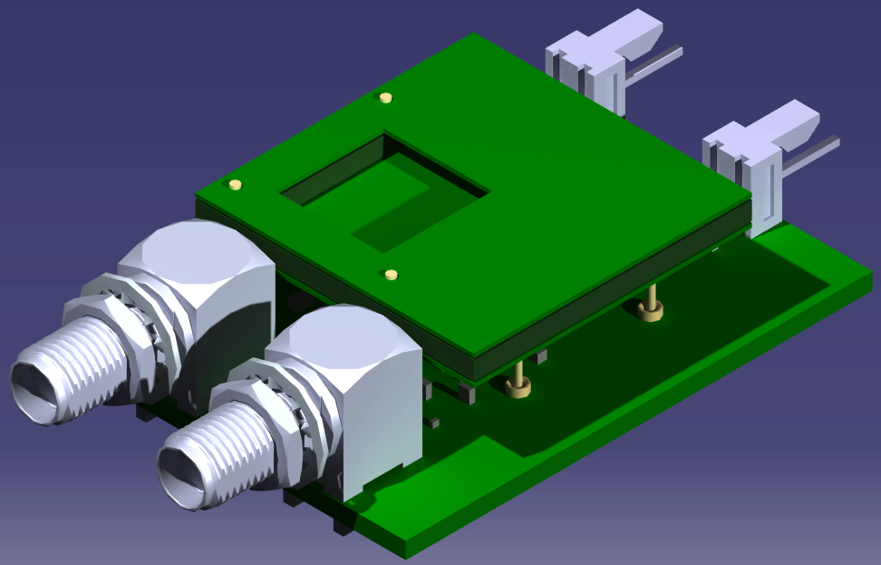
Filling Intermediate Space

Slide 15
To Do
Redesign Carrier Board for use with “Negative” Polarity
  Adaptation of AC Coupling Scheme
Manufacture the Boards
Buy Discrete Components
Laboratory Tests

Slide 16
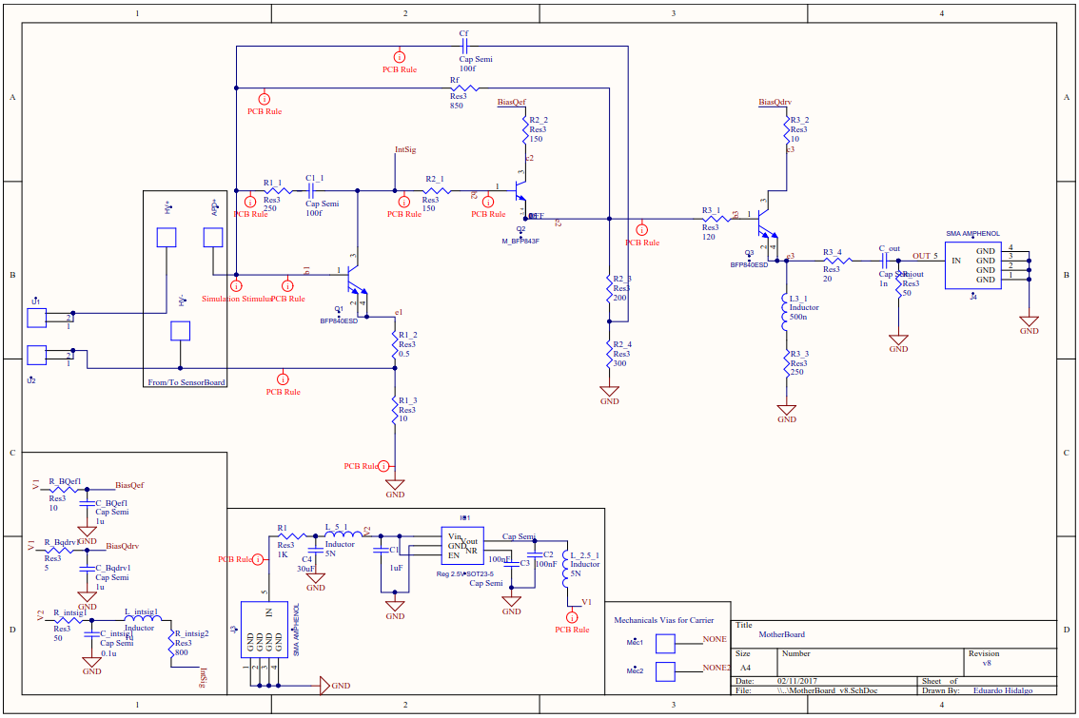
Schematics

Slide 17
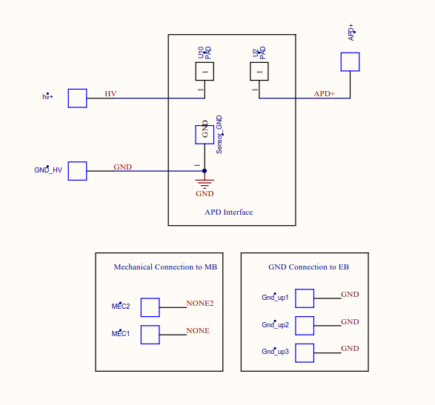
Schematics

