Slide 1
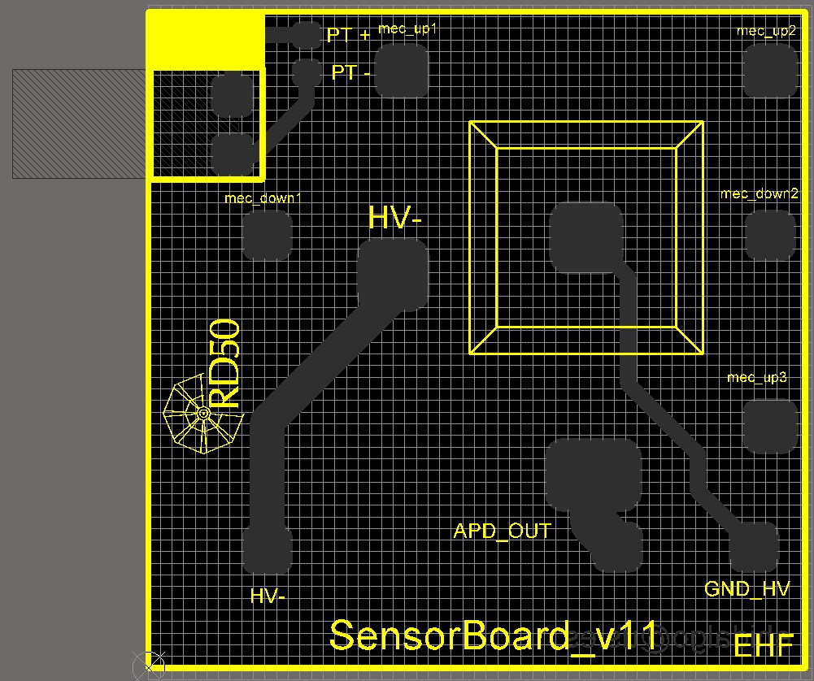
K. McDonald, 12 Dec, 2018
For good fast-timing performance, the “pad” for the mesh-readout wire bonds should be 8 mm wide close to the APD, then tapering down towards the pin that connects to the test board.

Slide 2
K. McDonald, 12 Dec. 2018
Move the HV wire-bond pad up a bit (on the top side).
The APD ground-connection pad on the top side of the carrier board could be only ~ 1x8 mm² (tho a bigger pad would also be OK).
It should be connected by ~ 5 vias to a similar pad on the bottom side of the carrier board.
Then, this bottom-side pad should be connected to the ground pin by a triangular trace (on the bottom side).

