Slide 1
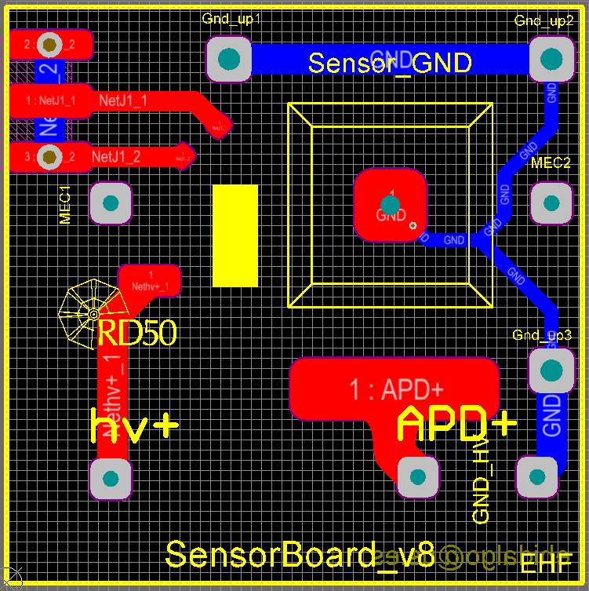
K. McDonald, 6 Dec, 2018
Move the temperature-sensor pad from under the HV wire bonds to the upper part of the PCB (assuming that the blue Sensor trace is on the bottom of the PCB).
Move the HV wire bond pad closer to the APD (and make its end more rounded than in my sketch.
Why are these traces located here, close to where the HV bond pad should be?
Move the mesh wire bond pad closer to the APD.

