Slide 1
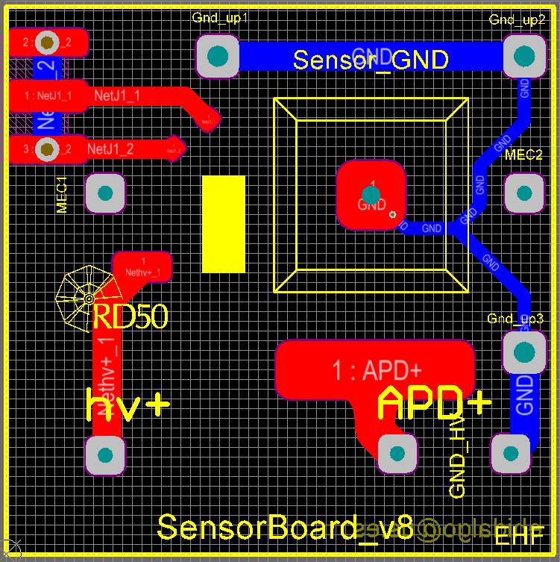
K. McDonald, 5 Dec, 2018
This HV pad is unnecessarily large, and unnecessarily close to the ground trace.
All that is needed for HV pad is the solder pad for the HV wire and a ~ 1 mm diameter pad for the will bond.
Bert should comment whether this circular pad for the wire bond should be closer to the APD, so that the bond wires are not too long.

Slide 2
If this ground trace is on the “top” side of the PCB, there will be trouble
where it goes under the “trench” around the edge of the APD

