Slide 1
Measurements
on Ultra-Fast Silicon Detectors (UFSD)
Hartmut F.-W. Sadrozinski
SCIPP, UC Santa Cruz
Timing
Beam test results
Effect of doping profile on time resolution
Landau fluctuations

Slide 2
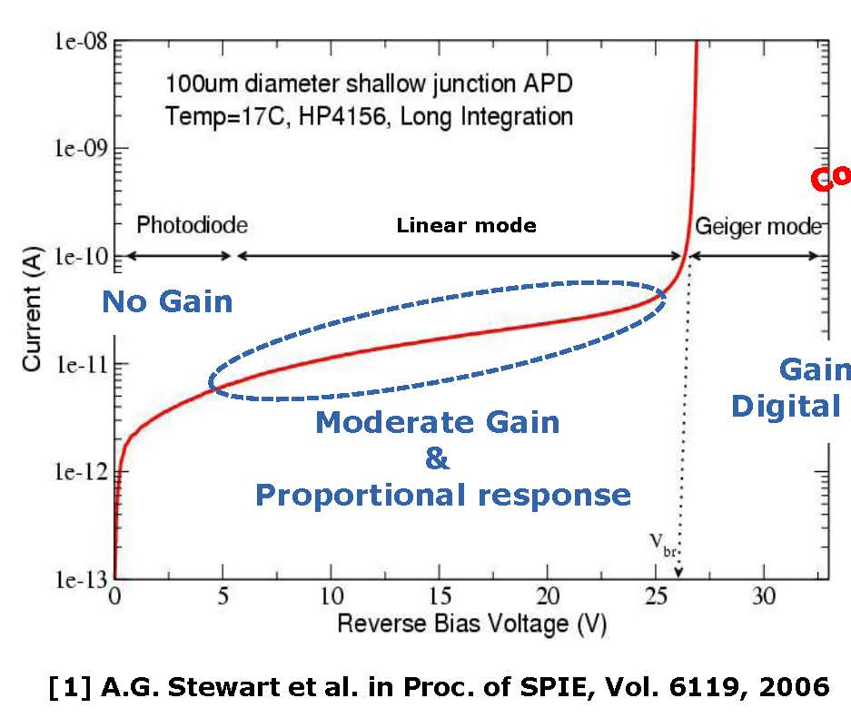
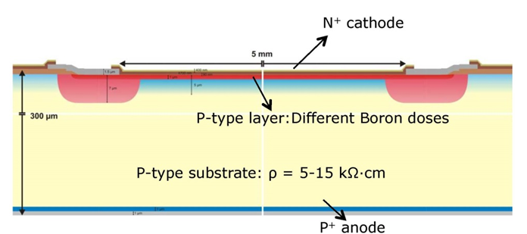
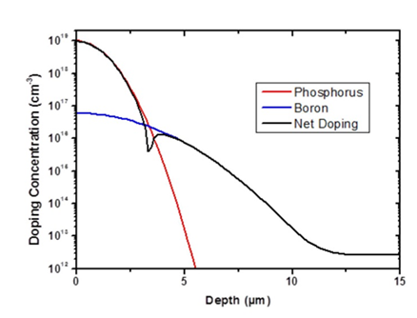
UFSD = thin Low-Gain Avalanche Detectors (LGAD)
Principle:
An extra p-layer increases the E-field so that charge multiplication with moderate gain of 10-20 occurs without breakdown.
Gain > 10⁴
Digital response
High Doping Concentration: High Field
As part of a RD50 Common Project, CNM Barcelona fabricated about 10 runs of LGAD, with thickness 300µm -> 50 µm.
The INFN project at FBK Trento has produced 300µm LGAD,
will deliver soon 50µm devices.
HPK will deliver thin LGAD to UCSC in the beginning of December 2016.
The beam tests were performed with 45 µm LGAD from CNM

Slide 3
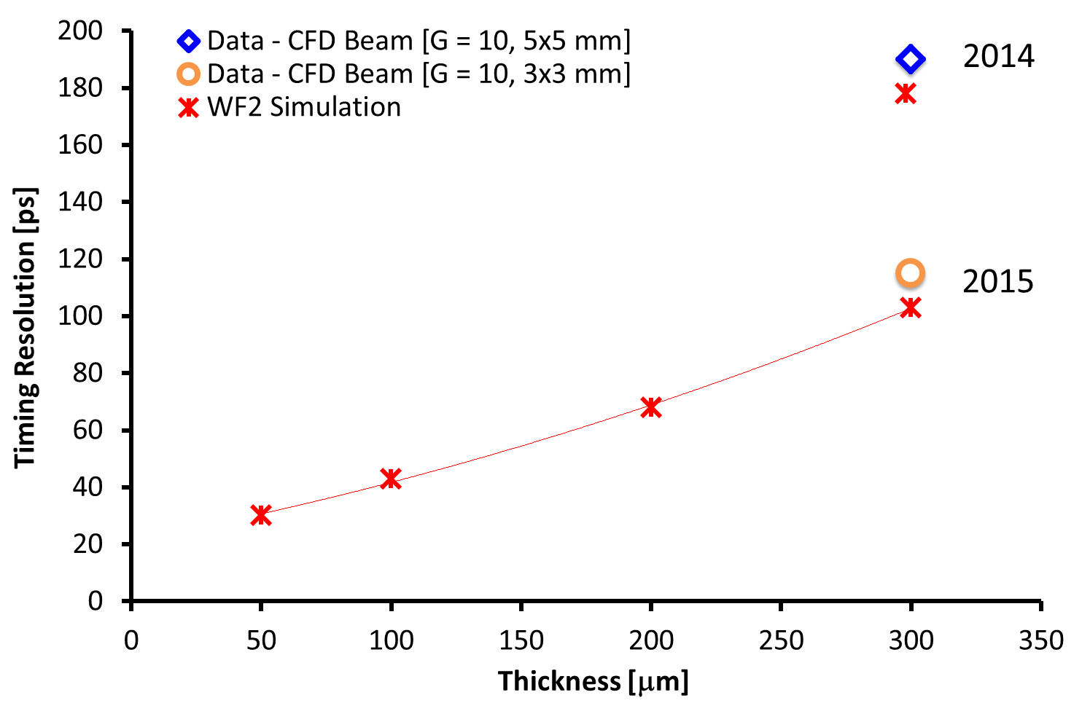
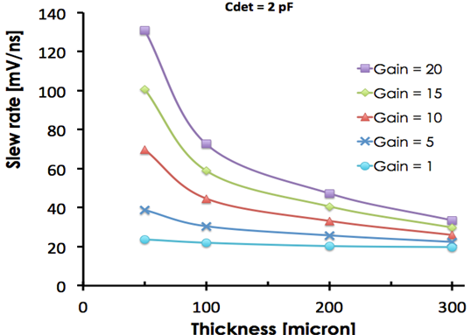
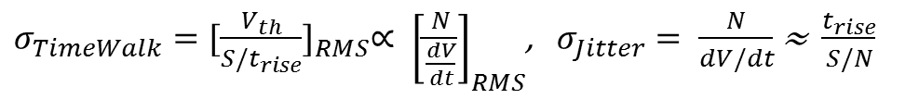
Prediction of Timing Resolution
$$σ_{t}^{2}=σ_{TimeWalk}^{2}+σ_{LandauNoise}^{2}+σ_{Distortion}^{2}+σ_{Jitter}^{2}+σ_{TDC}^{2}$$
$σ_{TimeWalk}={[\frac{V_{th}}{S/t_{rise}}]}_{RMS}∝ {\left[\frac{N}{\frac{dV}{dt}}\right]}_{RMS}$, $σ_{Jitter}= \frac{N}{dV/dt}$ ≈ $\frac{t_{rise}}{S/N}$
Maximize slope dV/dt (i.e. large and fast signals)
Correct time walk with constant-fraction discriminator (CFD)
Minimize noise N
WF2 Prediction of slope dV/dt:
use thin sensors with internal gain
Beam test results extrapolated to 50µm UFSD
Small C
Low noise

Slide 4
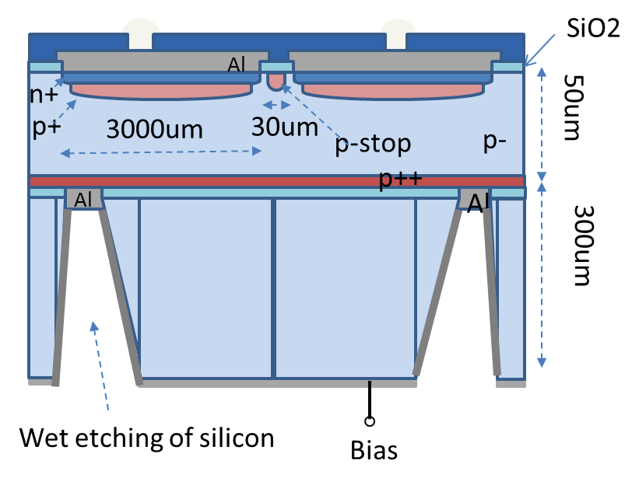
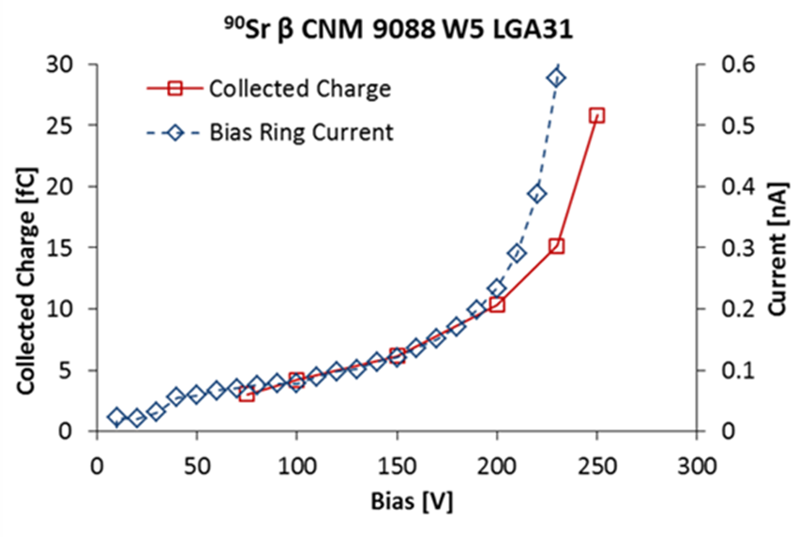
45µm LGAD detectors on SoI (CNM)
N-on-p FZ on 300 handle wafer
Wet-etched contacts on the backside to permit bias contact.
1.3x1.3 mm² single pad LGAD
Measurement of current and gain in the UCSC 90Sr β-source
Very low currents
Stable guard ring > 300V
Break-down at ~ 250V
Bias [V] Gain
150 10
200 20
240 40

Slide 5
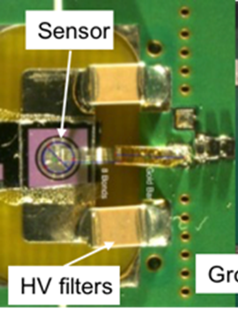
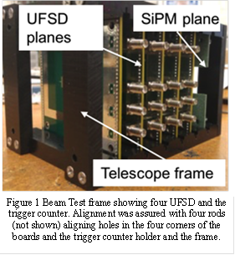
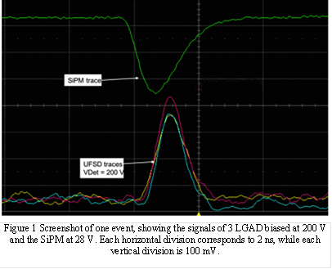
Beam Test of a UFSD timing system
Beam Test CERN H8 Aug 17-25 2016, 180GeV π
Results from 3 stacked UFSD & Č trigger counter
UFSD
1.3x1.3mm² 45µm thick SoI LGAD, from the RD50 Common Project Run 9088 at CNM.
Amplifier board developed at UCSC (2 GHz BW)
Analog readout into 4 GHz – LeCroy WaveRunner Zi digital scope, at a sampling rate of 20 GS, (time discretization of 50 ps)
Č Trigger (M. Albrow et al.)
10mm long, 3x3mm² quartz radiator + 3x3mm² SensL SiPM on evaluation board (σ ≈ 15ps)
Connections between the UFSD
and the read-out board

Slide 6
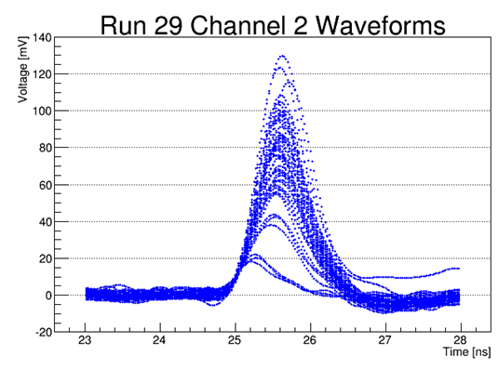
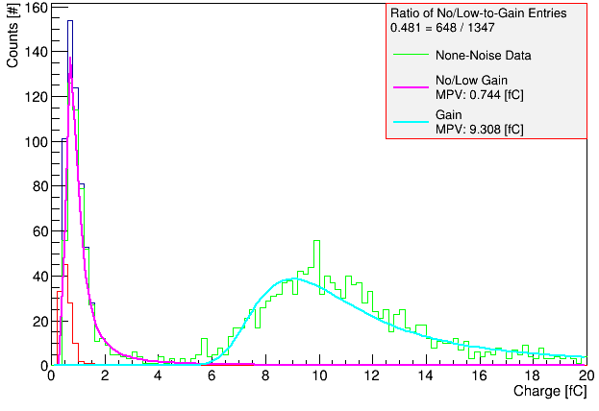
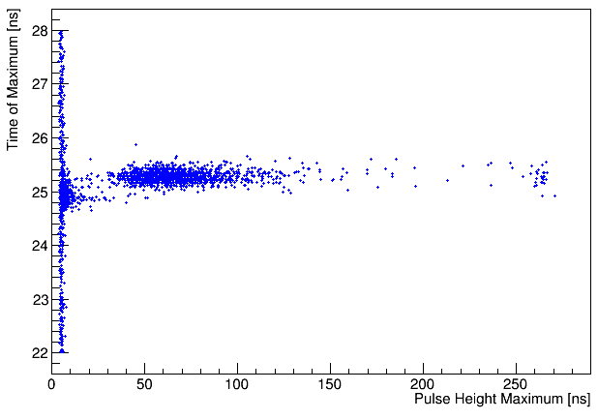
Beam Test Signals 45μm UFSD (1.3x1.3 mm² )
Pulse shapes have two distinct populations:
“Gaussian”, large = gain
Triangular, small = no/lo –gain
Gain
No/Lo Gain
Gain
Clear separation gain vs. no/lo gain
Excellent S/N
No-Lo Gain
Time of the pulse maximum
Pulse maximum
Background
Tmax vs. Pmax

Slide 7
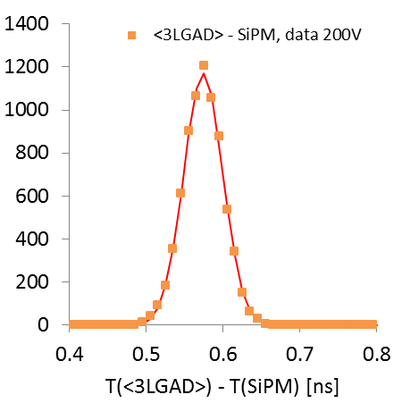
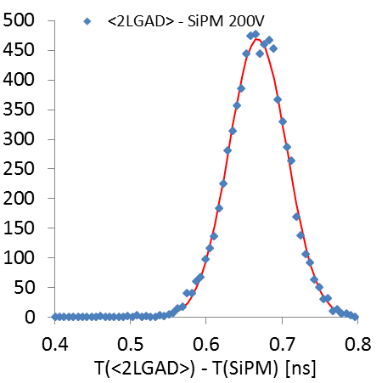
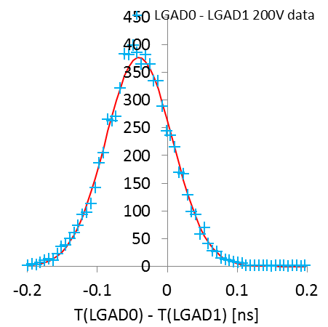
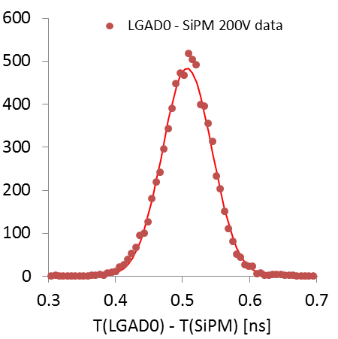
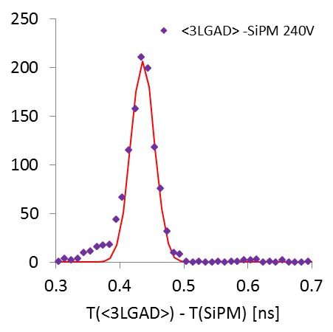
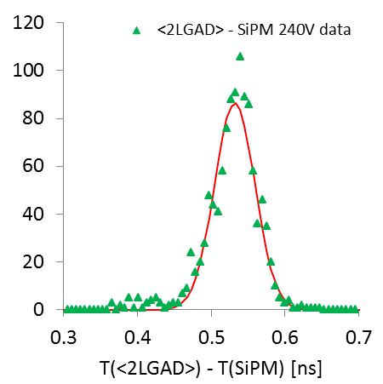
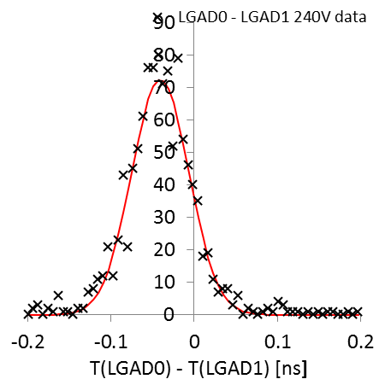
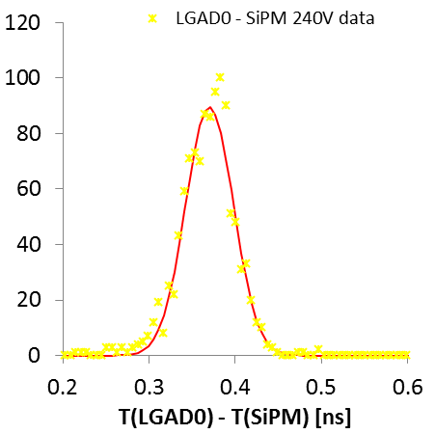
Time Differences with 3 UFSD and 1 SiPM (examples)
subtract SiPM resolution in quadrature
(T₀+T₁+T₂)/3-T_{SiPM}
( 1 measurement)
(T_{i}+T_{k})/2-T_{SiPM}
( 3 measurements)
T_{i}-T_{k}
( 3 measurements)
T_{i}-T_{SiPM}
( 3 measurements)
200V
( Gain ≈ 20)
σ = 25.6 ps
σ = 29.1 ps
σ = 48.1 ps
σ = 37.0 ps
240V
( Gain ≈ 40)
σ = 19.8 ps
σ = 22.0 ps
σ = 35.6 ps
σ = 27.7 ps

Slide 8
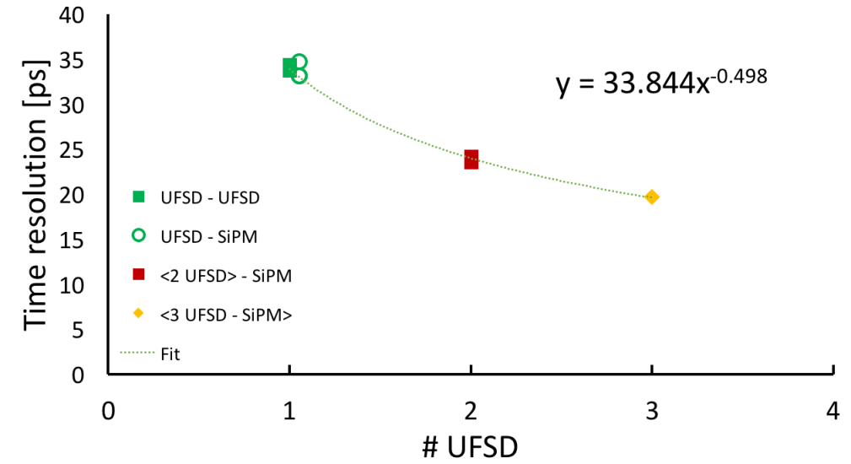
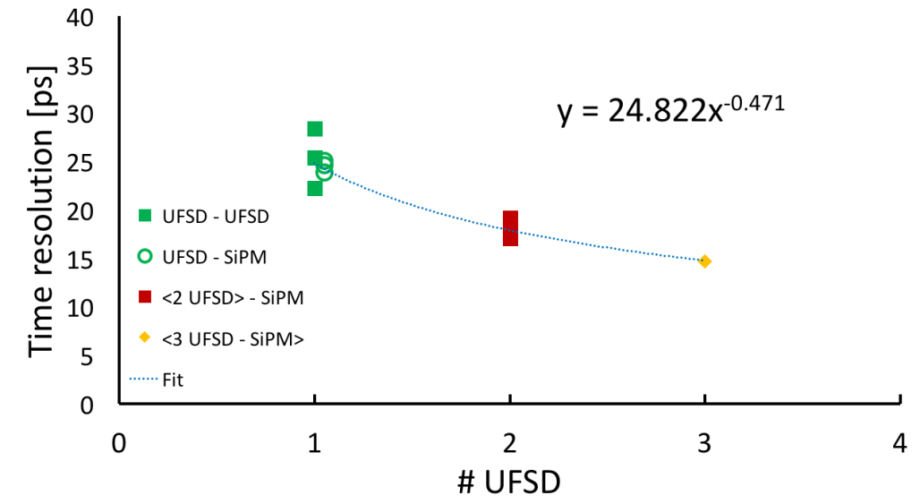
Beam test results of a UFSD timing system
Evaluate timing resolution (CFD ≈ 20%) for bias voltages 200V and 240V for different combinations of sensors and SiPM and fit for resolution of single UFSD and averages of double and triple UFSD. Singles: UFSD-SiPM & UFSD-UFSD (6 measurements)
Doubles: <2 UFSD>/2 – SiPM (3 measurements)
Triplet: <3 UFSD>/3 – SiPM (1 measurement)
Timing resolution as a function of
number N of UFSD averaged
200V
Good matching of 3 UFSD sensors
UFSD time resolution 26 ps - 35 ps
Time resolution of average of 3 UFSD:
20 ps (200V) & 15 ps (240V)
Timing resolution agrees
with expectation σ(N) = σ(1)/N^{0.5}
Improvement expected from 130nm ASIC
240V
N. Cartiglia et al, (INFN Torino, UC Santa Cruz, CNM Barcelona, IJS Ljubljana) https://arxiv.org/abs/1608.08681v2

Slide 9
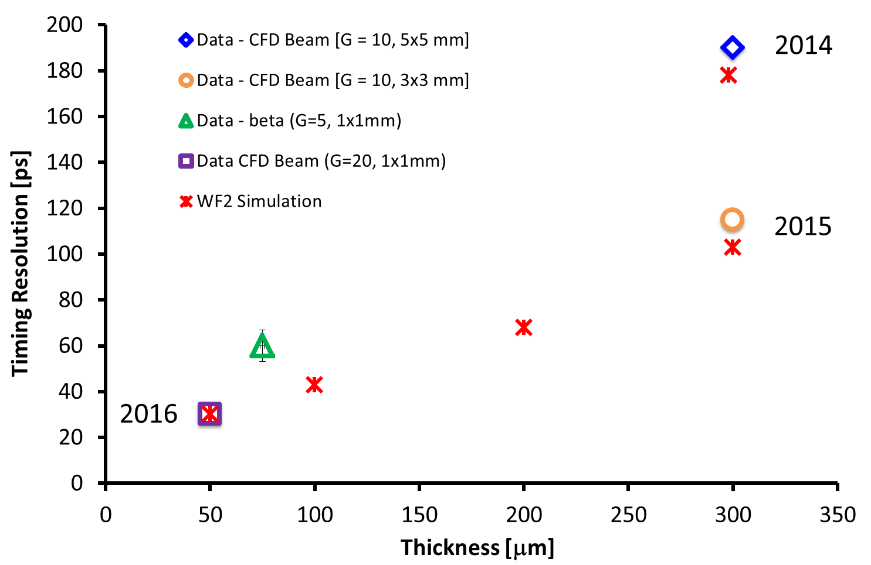
Updated UFSD Timing Resolution from Beam Tests
Improvement due to
Thin sensors
Small capacitance
Low noise
Good agreement with WF2 prediction

Slide 10
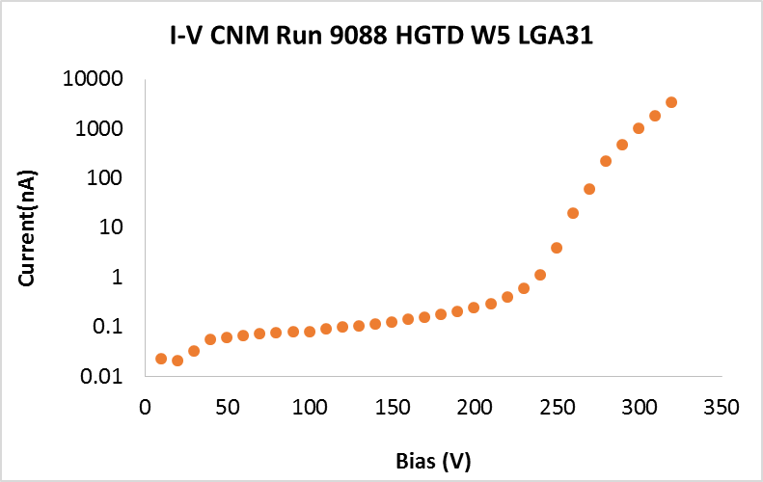
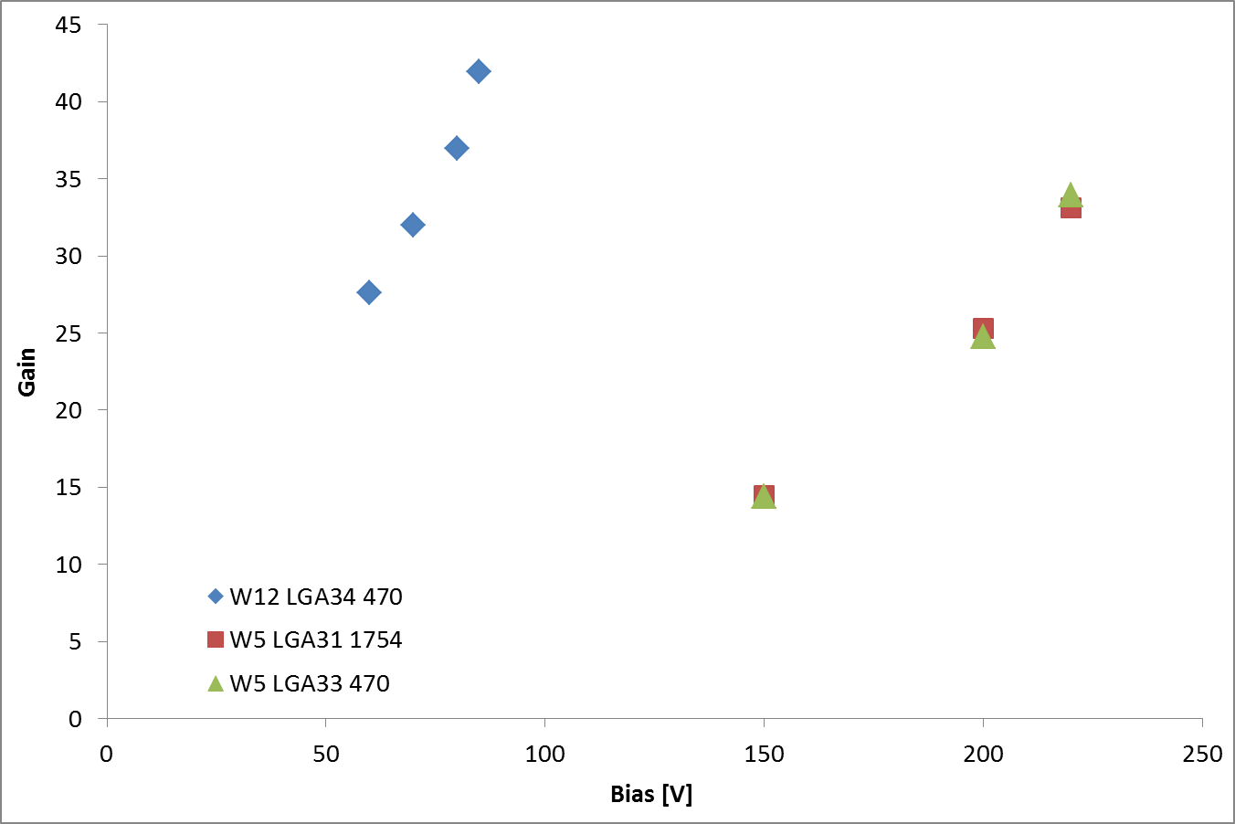
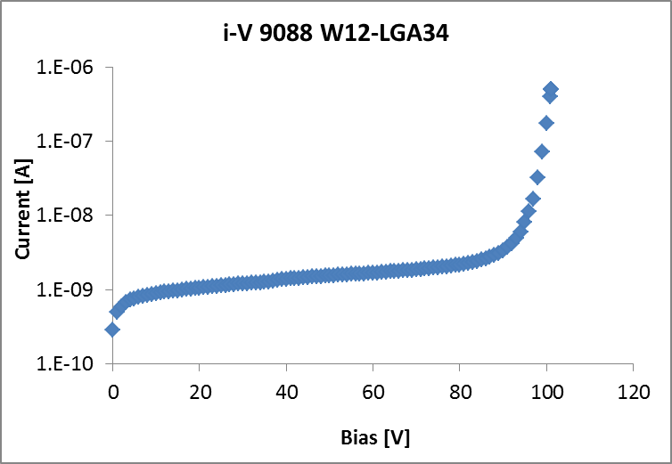
P+ dose dependence of Breakdown and Gain
Breakdown behavior is determined by the p⁺ dose
250V for 1.9*10¹³ cm⁻² ,
100V for 2.0*10¹³ cm⁻² ,
45 μm 1.3x1.3 mm² LGAD from CNM Run 9088
1.9*10¹³ cm⁻²
Gain is determined by the p⁺ dose
is about the same at breakdown
2.0*10¹³ cm⁻²
Setting the collected charge the same for the two preamps
yields 2 kΩ feedback resistor → 1754 Ω Trans-impedance

Slide 11
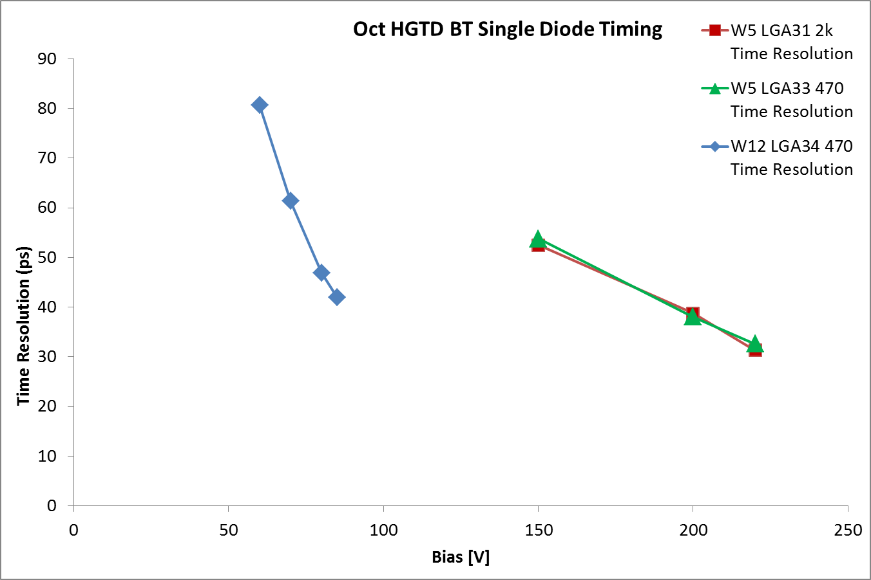
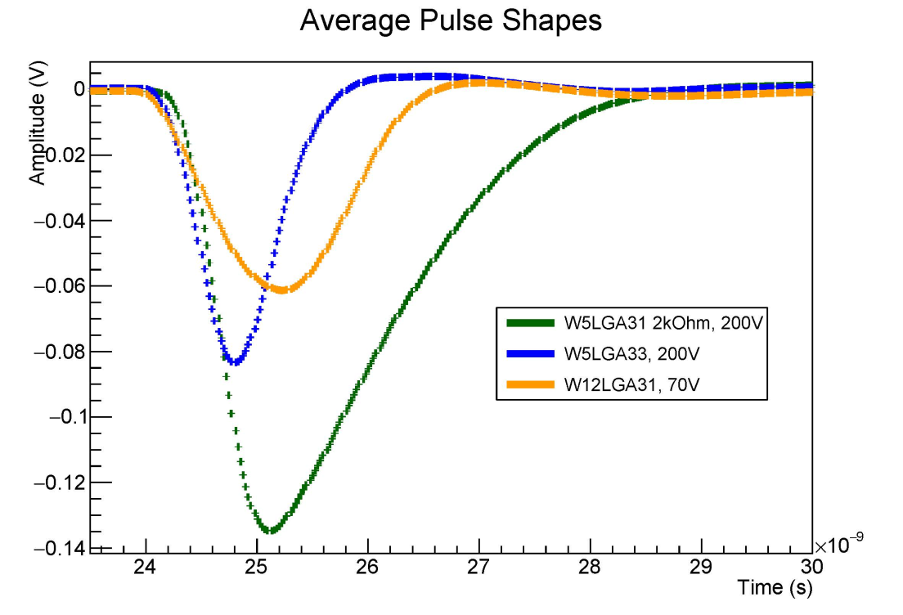
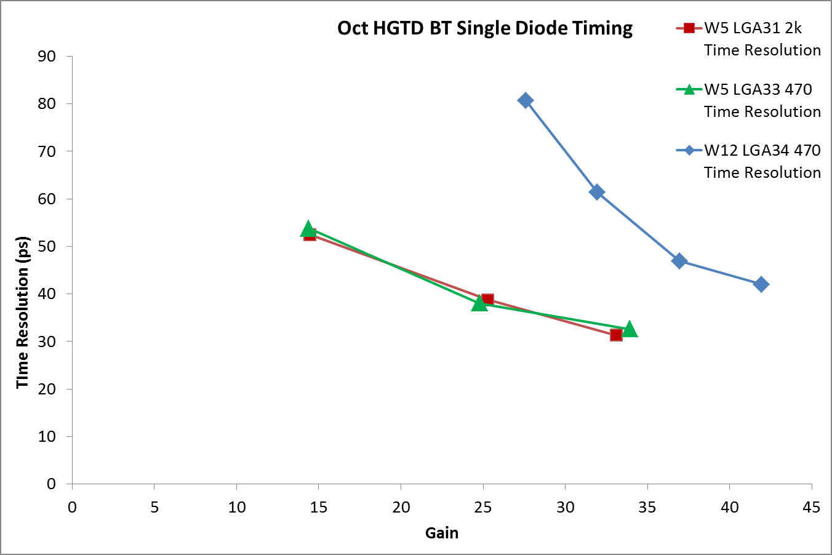
Time Resolution vs. Bias and Gain
Pulse shapes governed by charge collection
and by frontend electronics
W 12: Breakdown below 100V limits the drift field
Time resolution limited by collection time!.
W 12: Slower electron drift leads to slower pulse. Higher input impedance amplifier leads to slower and longer pulse, but also less noise.
Slower amplifier has lower noise, leads in the end to almost identical jitter.

Slide 12
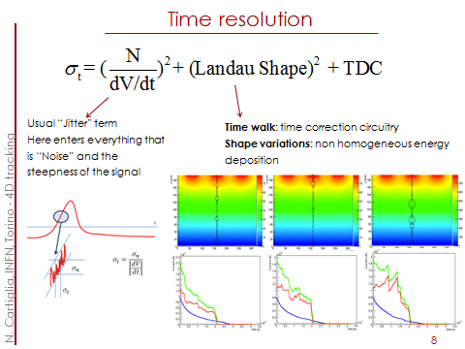
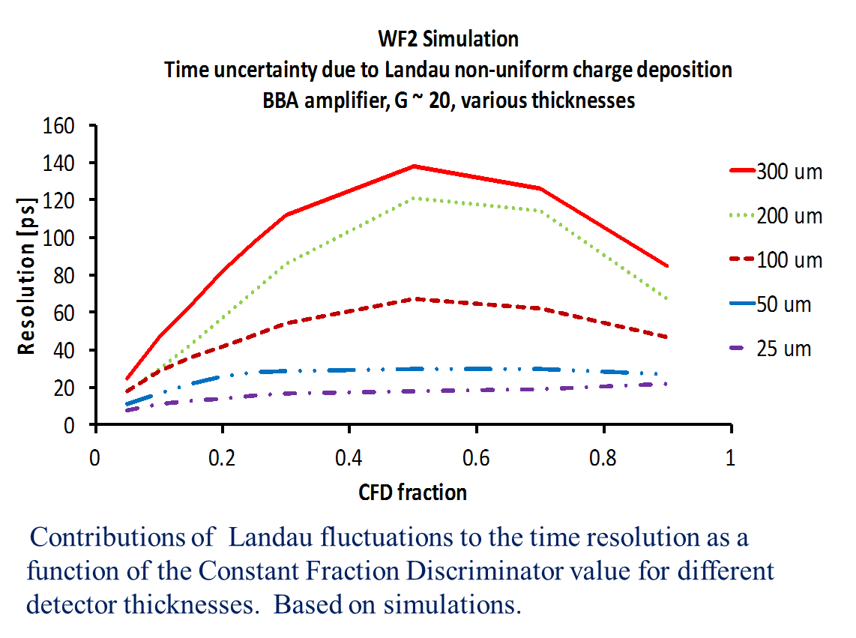
What is missing?: Landau Fluctuations
Beam Tests show that we can correct for time walk.
So assuming we can beat the time jitter with lower noise and higher gain, Landau fluctuations become the time resolution floor which we can’t go below.
They depend on the sensors thickness, independent of the gain.
Both thin sensors, and low noise (for low threshold) are required for good timing resolution.

Slide 13
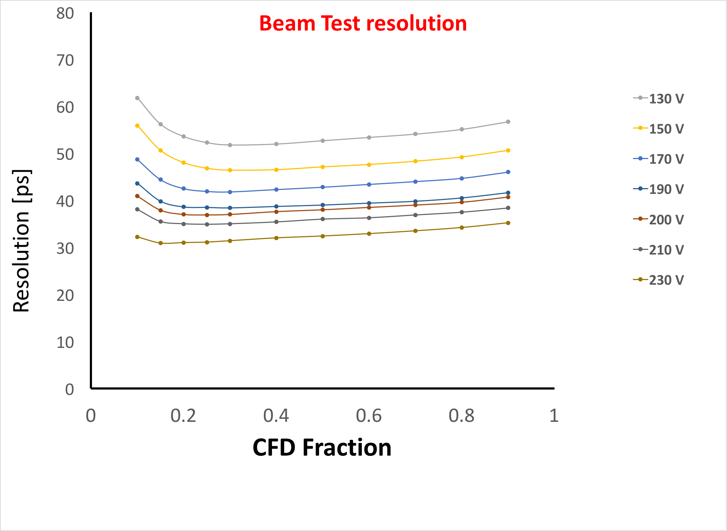
Beam Test Resolution vs. CFD Fraction and Bias

Slide 14
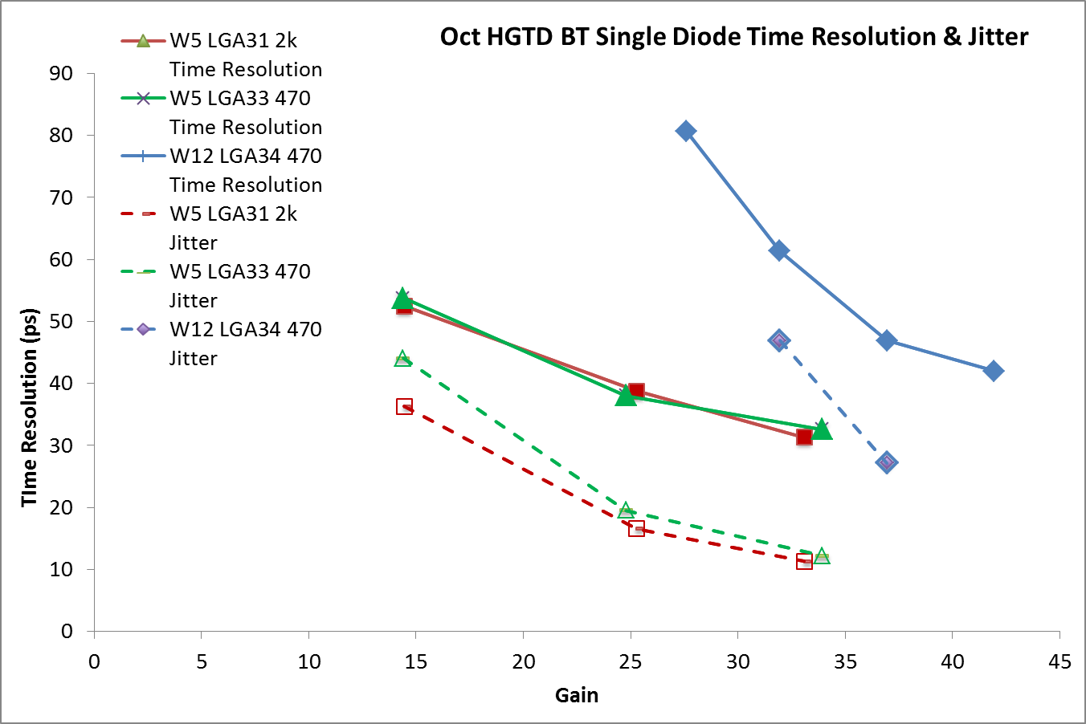
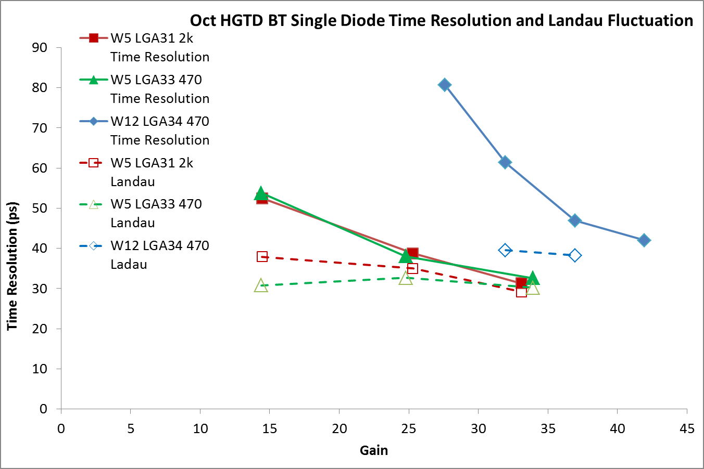

Time Resolution, Jitter, Landau Fluctuations vs. Gain
Resolution
Time resolution σ_{t} governed
by Jitter σ_{J} and Landau Fluctuation σ_{L:}
σ_{t}² = σ_{J}² + σ_{L}²
Time resolution > Jitter
Jitter
The Jitter can be determined
from global parameters
$σ_{J}= \frac{N}{dV/dt}$≈ $\frac{t_{rise}}{(\frac{S}{N})}$
Landau Fluctuations σ_{L}² = σ_{t}² - σ_{J}²
are approximately constant as expected
(independent of gain since due to
fluctuations of the initial ionization)
Resolution
Evidence is mounting that Landau Fluctuations are the limiting effect to the time resolution of UFSD.
Landau

Slide 15
Conclusions
Since inception of 4D sensors in 2012,
we made giant steps forward:
Fabrication of UFSD (= thin LGAD) by 3 manufacturers
Development of fast current amplifiers with SiGe frontend
Beam test results (both UFSD and HGTD) in agreement with WF2,
~35 ps for single 1.3x1.3 mm² UFSD, 20 ps for stack of three at gain = 20.
Closing in on the time resolution limit in Landau fluctuations.
For excessive gain (low breakdown voltage) time resolution is worsened by the slow charge collection.
This work was supported by the United States Department of Energy, grant DE-FG02-04ER41286.
Part of this work has been financed by the European Union’s Horizon 2020 Research and Innovation funding program, under Grant Agreement no. 654168 (AIDA-2020) and Grant Agreement no. 669529 (ERC UFSD669529), and by the Italian Ministero degli Affari Esteri and INFN Gruppo V.
This work was partially performed within the CERN RD50 collaboration.

Slide 16
Contributors
A. Anker, J. Chen, V. Fadeyev, P. Freeman, Z. Galloway, B. Gruey, H. Grabas,
L. Hibbard, C. Labitan, Z. Liang, R. Losakul, Z. Luce, N. Maher, S. N. Mak,
C. W. Ng, H. F.-W. Sadrozinski, A. Seiden, E. Spencer, M. Wilder, N. Woods, A. Zatserklyaniy
SCIPP, Univ. of California Santa Cruz, CA 95064, USA
R. Arcidiacono, B. Baldassarri, N. Cartiglia, F. Cenna, M. Ferrero, A. Staiano, V. Sola
Univ. of Torino and INFN, Torino, Italy
G. Pellegrini, S. Hidalgo, M. Baselga, M. Carulla,
P. Fernandez-Martinez, D. Flores, A. Merlos, D. Quirion
Centro Nacional de Microelectrónica (CNM-CSIC), Barcelona, Spain
V. Cindro, G.Kramberger, I. Mandić, M. Mikuž, M. Zavrtanik
Jožef Stefan Inst. and Dept. of Physics, University of Ljubljana, Ljubljana, Slovenia
Students in bold

Slide 17
Backup

Slide 18
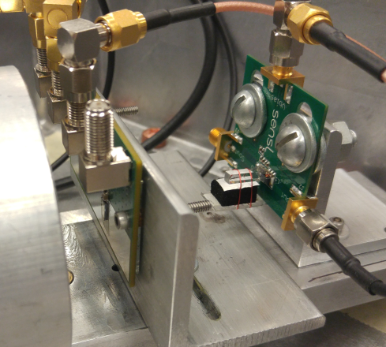
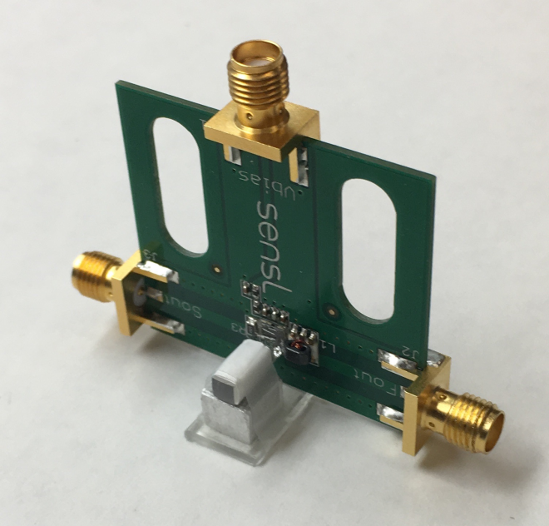
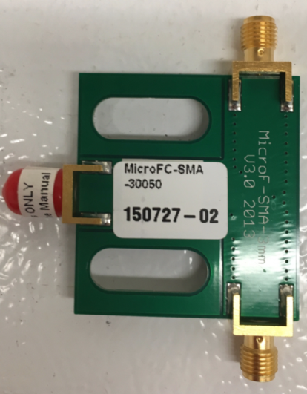
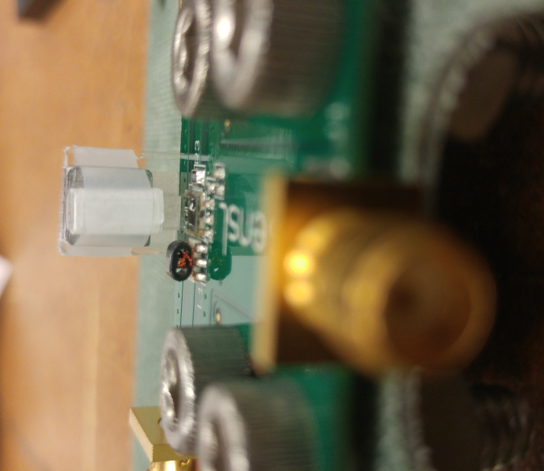

Ultra-Fast Trigger counter
3mmx3mmx10mm
quartz bar
read out by fast SiPM
Sensl S-MicroC series evaluation board
http://sensl.com/downloads/ds/DS-MicroCseries.pdf
Trigger: 3x3x10 mm Quartz & SiPM
sensl MicroFC-SMA-30050r
M. Albrow et al.NIM . A 623 (2010) 931

