Slide 1
Ultra-Fast Silicon Detectors
Hartmut F.-W. Sadrozinski
SCIPP, Univ. of California Santa Cruz, CA 95064, USA
22 Feb, 2016
for the
UFSD Group
UCSC – Torino – CNM Barcelona – IJS Ljubljana- LPNHE
First measurements on 75 μm LGAD
Contributions to UFSD time resolution
R&D for ATLAS HGTD by CSM

Slide 2
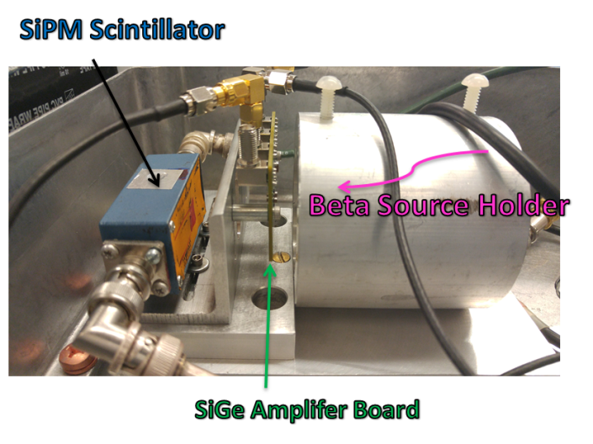
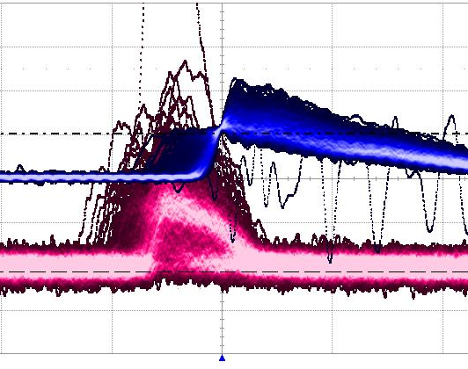
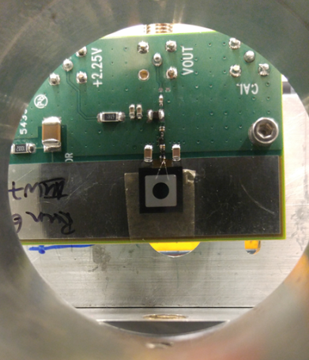
LGAD Testing with β source
For the first beam tests we used commercial amplifiers with bias-T.
For the next tests with ⁹⁰Sr sources and beams, we developed a broadband amplifier
(BW > 2 GHz, discrete SiGe frontend, analog readout into digital scope)
Signals in:
LGAD, power, sensor bias
Signals out:
single-ended analog signals into 50 Ω
Important: development of shielding
Use β source as test bed for signal and noise performance:
tune the details of the circuit with LGAD data!.
Precision measurements will be done in beam tests.
Scintillator + SiPM (Trigger)
LGAD Signal

Slide 3
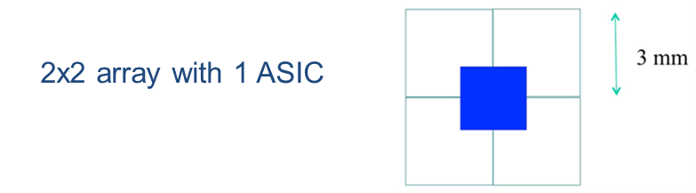
LGAD detectors for HGTD Beam Test
Expect by May 2016:
2x2 arrays of 3-mm and 2-mm side length
various thickness and doping concentration (see later slides)
Amplification and time digitization is required locally for trigger
ASIC development just starting
For the first beam tests plan to use
broadband amplifier developed by UCSC
4 amplifier channels (~ 1-mm width)
wire-bonded to 2x2 array
2 mm

Slide 4
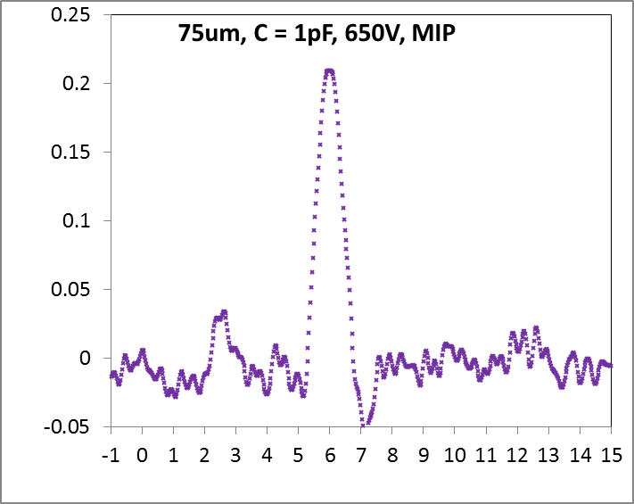
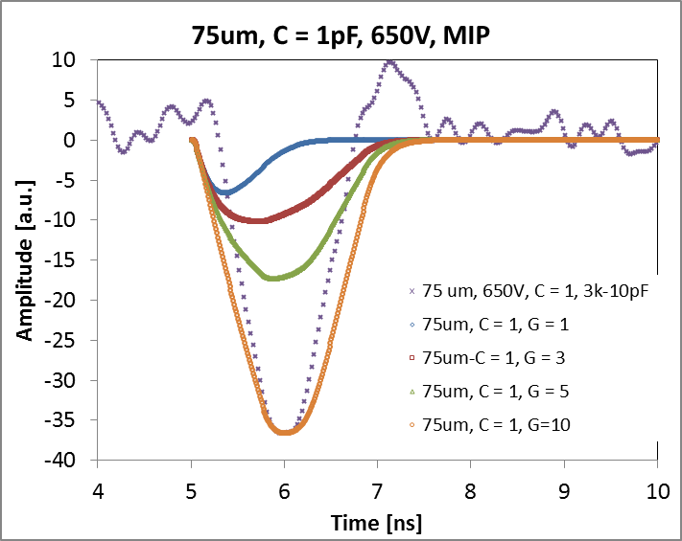
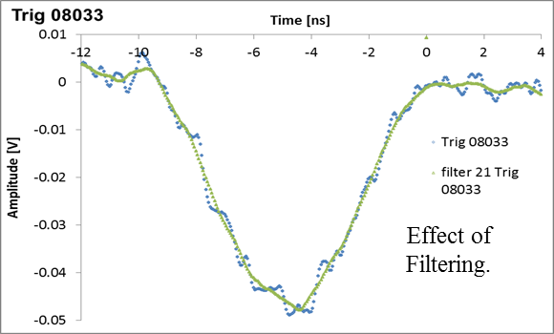
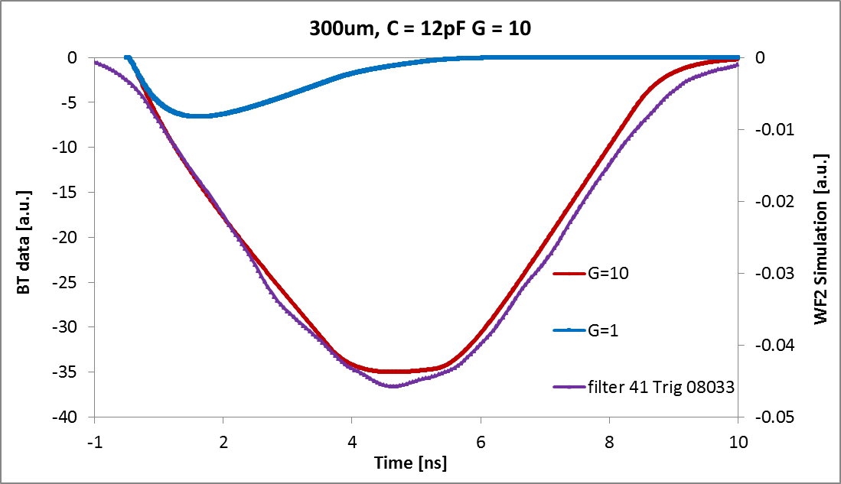
β Beam data with 75 μm LGAD (G = ?)
75 μm,
β‘s
Pulses
shorter
than
simulation!?
Ave. Time
Jitter < 40 ps
Time Jitter: 11 ps
Pulse shape suggests gain G ≈ 10!
300 μm,
CERN BT
Filtered time
resolution ~100 ps
Time Jitter: ~ 200 ps

Slide 5
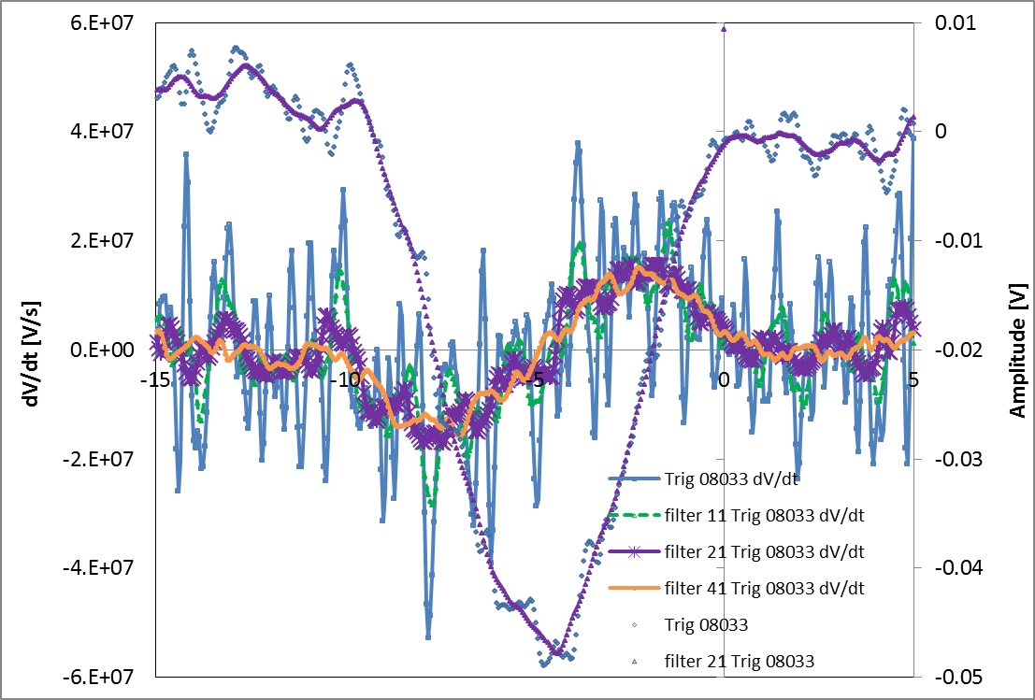
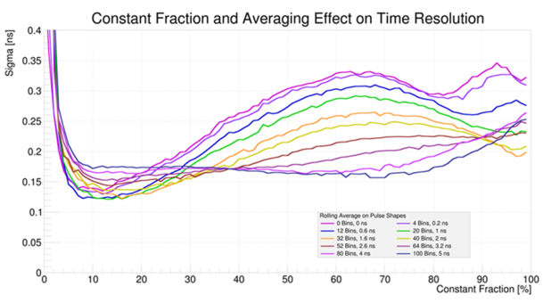
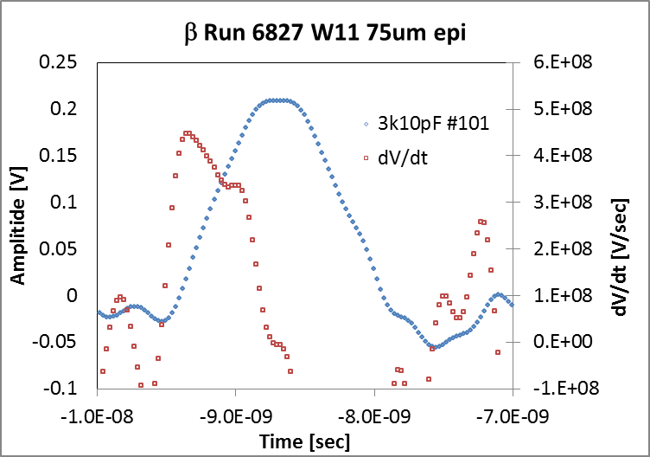
dV/dt Comparison of 75 μm – 300 μm LGAD
Amplitude
300 μm:
21 average used to reduce noise
1 ns shaping ≈ 1/3 of rise time
dV/dt
High frequencies not important for 300 μm
(Need to adjust the CFD threshold)
High frequencies very important for 75 μm
(only for BB)
dV/dt
Amplitude
75 μm:
21 averages reduces dV/dt by ½
500 ps shaping ≈ rise time
Fast, low-noise amplifier a requirement

Slide 6
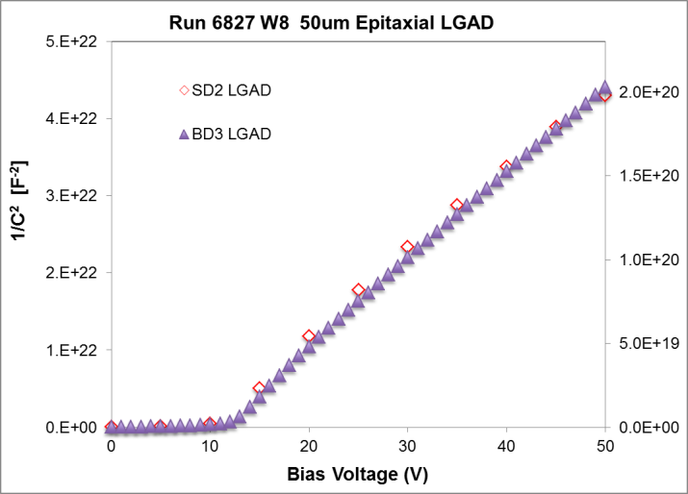
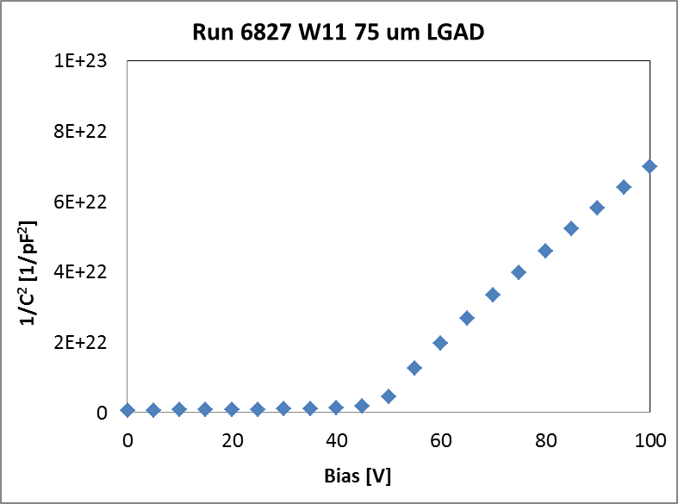
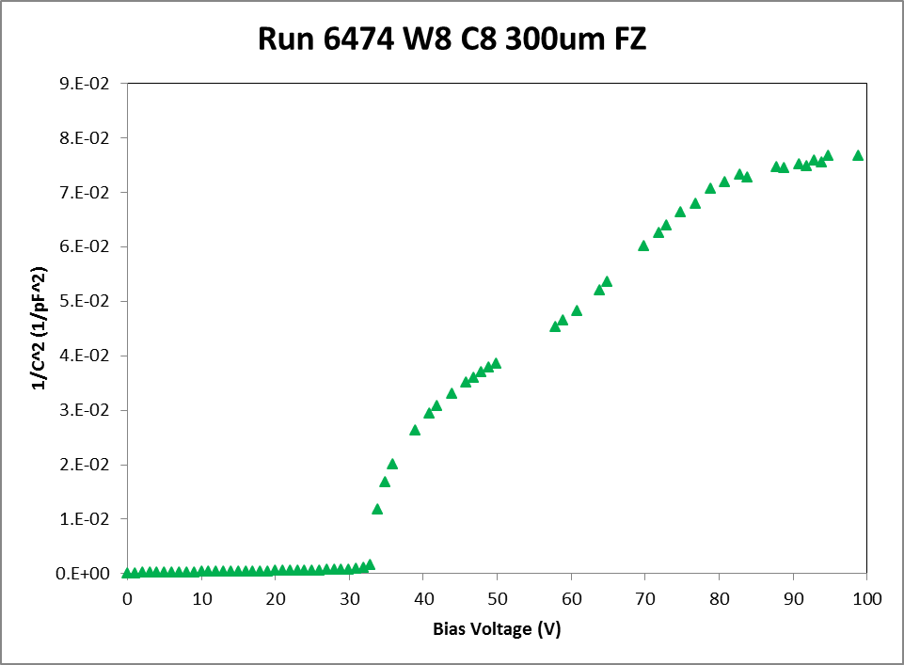
C-V 50 μm (W8) & 75 μm (W11) epi LGAD Run 6827
50 μm: C-V suggests gain G < 3!
also measured
75 μm: C-V suggests gain G > 10!
300 μm:
measured gain G > 10!

Slide 7
Toward LGAD Specifications for HGTD
Larger cell size, higher gain, lower resistivity (?) ==> increased shot noise,
Larger cell size ==> increased electronic noise (CSA), lower dV/dt (BB)
Thicker sensors ==> increased Landau Noise
Lower input impedance ==> lower trans-impedance
Electronics and sensors are closely coupled.
Both LGAD and no-gain n-in-p are being considered
To get to 10 ps jitter:
dV/dt at threshold > 0.5 μV/ps ?
Noise (into 50 Ω) < 5 μV ?
LGAD details (all numbers TBD):
Gain 10 - 20
Thickness <100 μm
Resistivity 0.1 - 10 kΩ-cm
Cell size dimension 2-5 mm
Impedance at amplifier input 20 – 50 Ω
Radiation Hardness (Leakage current, Noise, dV/dt)
Power per cell
Power per cm²

Slide 8
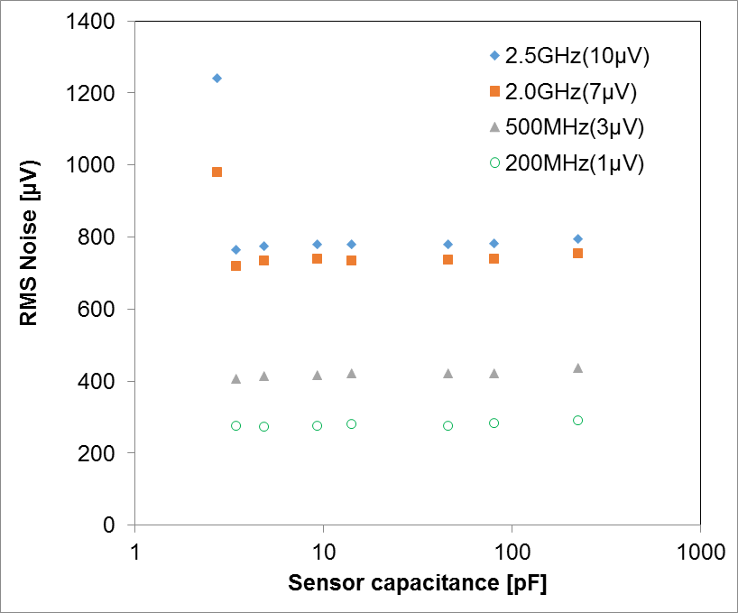
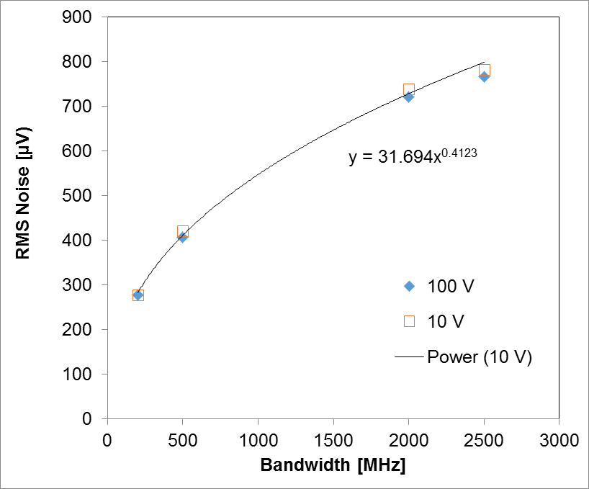
Jitter
Time Jitter = Noise/slope = Noise / (dV/dt)
Hard to predict the noise in the moment.
At least we know that for BB it is constant vs. capacitance.
Need to know what it is as a function of the input impedance.
(Data taken with amplifier with gain = 130 shows 4 μV at 1 GHz.)

Slide 9
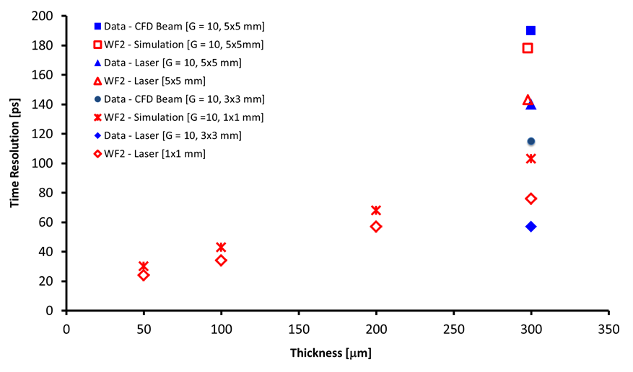
Slew-rate (Slope) dV/dt
Assume that the resolution scales with slope dV/dt.
For 50 μm LGAD (G=10), required dV/dt = 0.7 μV/ps (correcting for gain = 100 in WF2).
Slope dV/dt = 0.5 μV/ps would give 40 ps

Slide 10
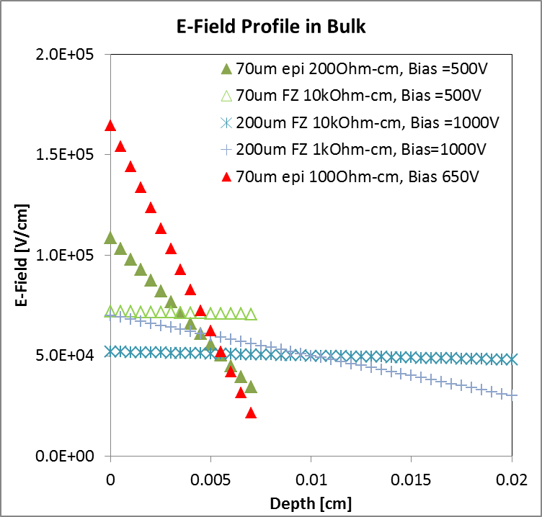
Bulk Resistivity
  Resistivity 0.1 - 10 kΩ-cm
Low-resistivity bulk (100 Ω-cm) generates high field at the junction
(about ½ what is needed for LGAD).
Only half needs to be supplied by p+ multiplication layer
Observe remarkable bias reach in low-resistivity LGAD
We are operating
50 μm & 70 μm epi sensors
with 100 Ω-cm bulk
at 650 V bias.

Slide 11
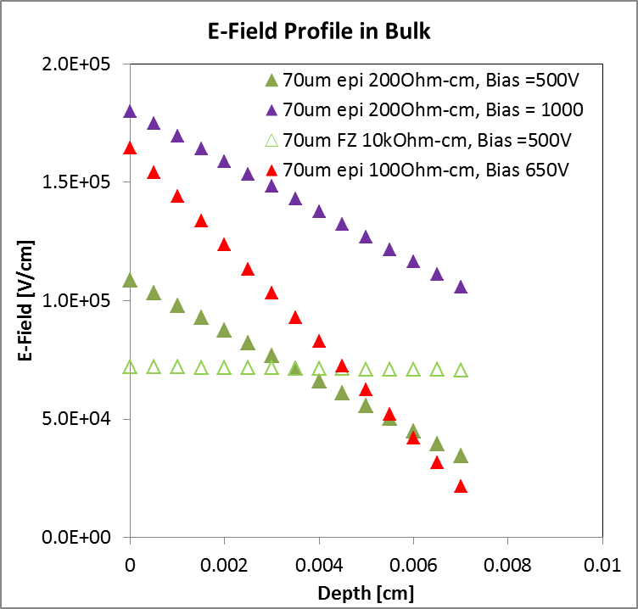
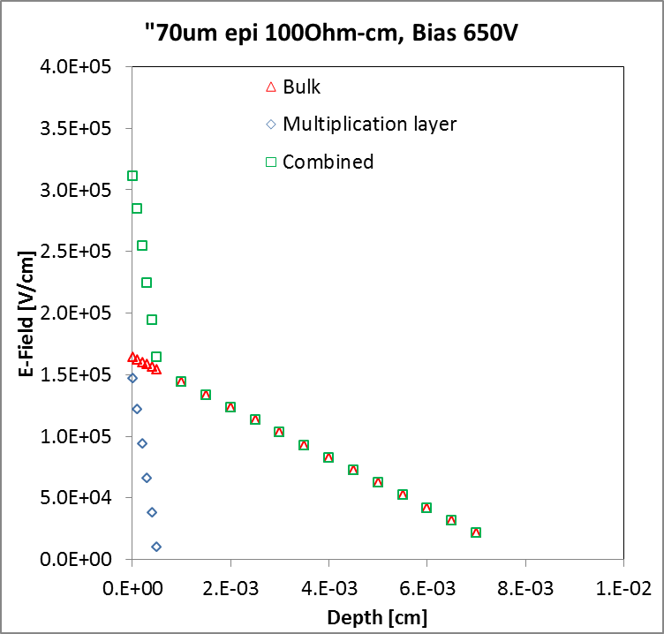
E-field in LGAD bulk adds to the “gain field”
Low-resistivity bulk (100 Ω-cm) generates high field at the junction
(about ½ what is needed for LGAD).
Only 1/2 is supplied by p+ multiplication layer
Near-term: thin 4” wafers at CNM
SOI 100 μm & 150 μm > 5 kΩ-cm
Epi 50 μm 100 Ω-cm; 75μm, 100 Ω-cm; 110 μm, 600 Ω-cm

Slide 12
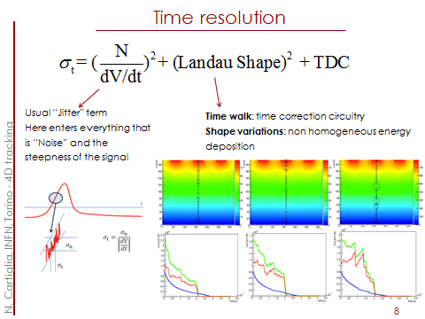
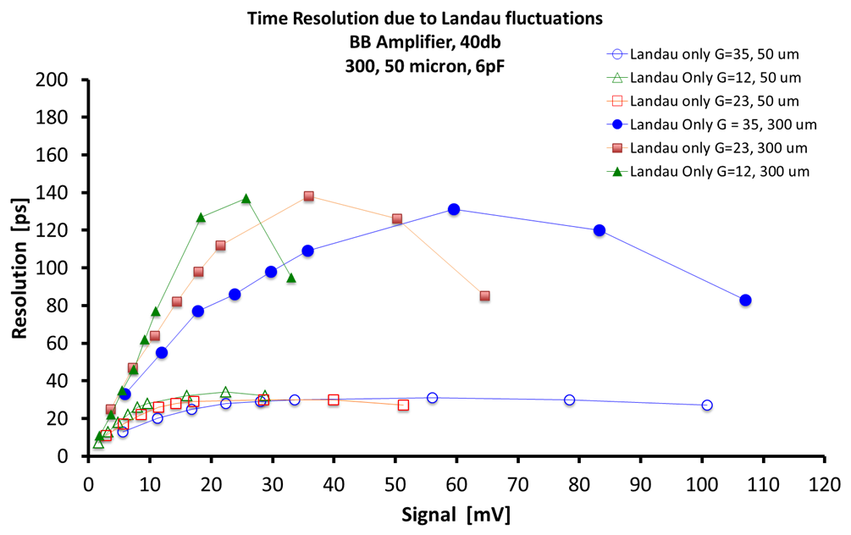
Landau Fluctuations
Beam Tests show that we can correct for time walk.
So assuming we can beat the time jitter with lower noise and higher gain, Landau fluctuations become the time resolution floor which we can’t go below.
They depend on the sensors thickness, independent of the gain.
Both thin sensors, and low threshold are required for good timing resolution:
Another reason to develop low- noise amplifiers

Slide 13
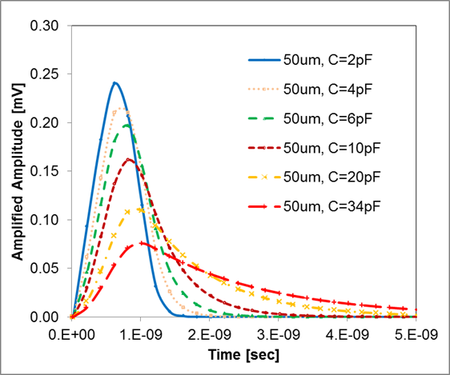
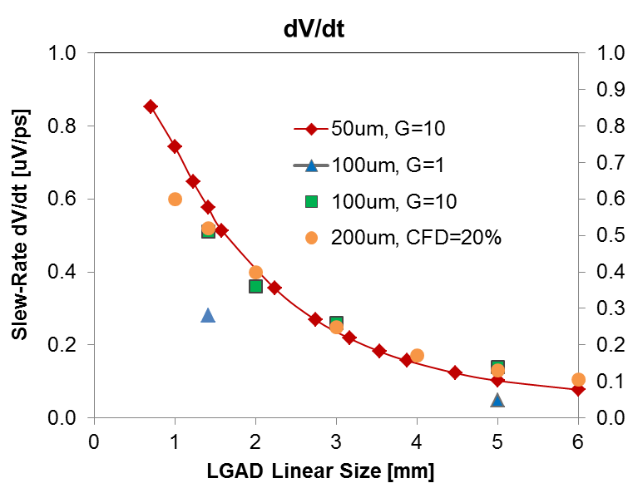
Cell Size
  Cell size dimension 2-5 mm
Need gain, need small detector sizes to get to sufficient dV/dt Into 50 Ω

Slide 14
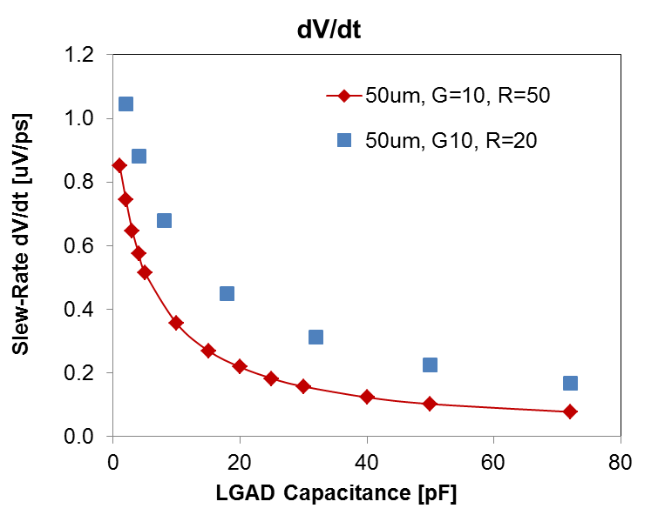
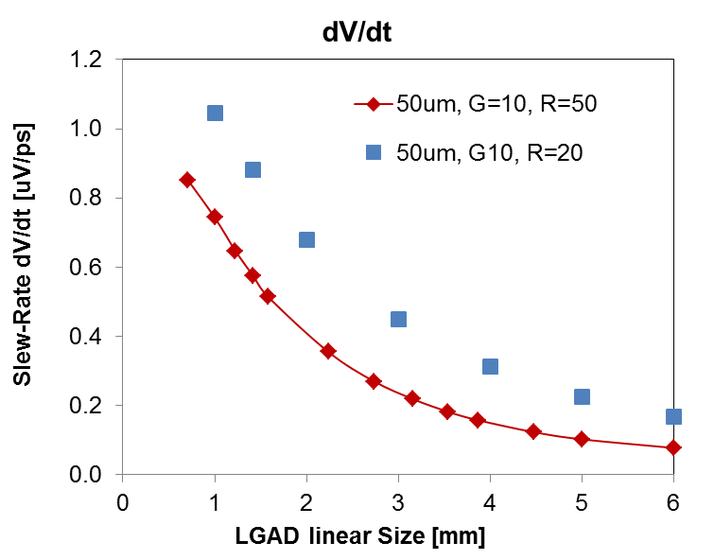
Impedance at Amplifier Input 20 – 50 Ω
Lowering the amplifier input impedance allows higher slope dV/dt.
We need to ascertain that the noise scales exactly, too.

Slide 15
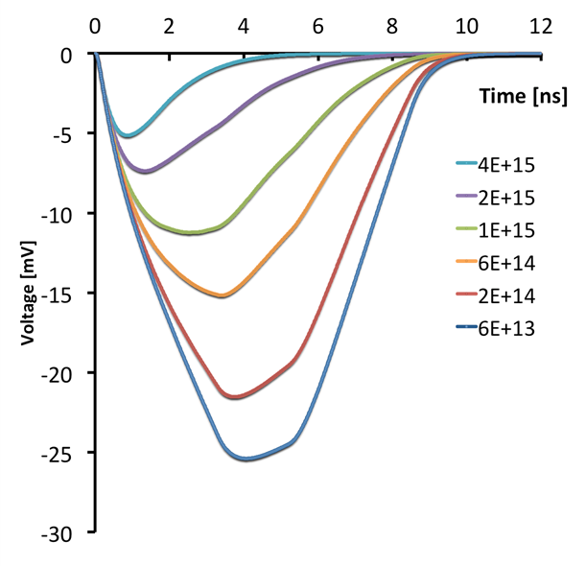
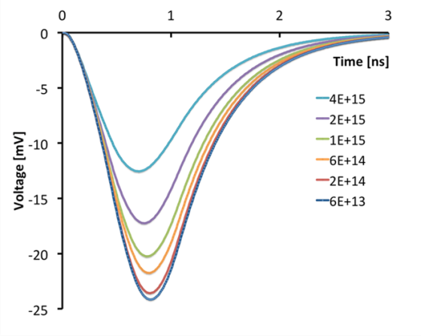
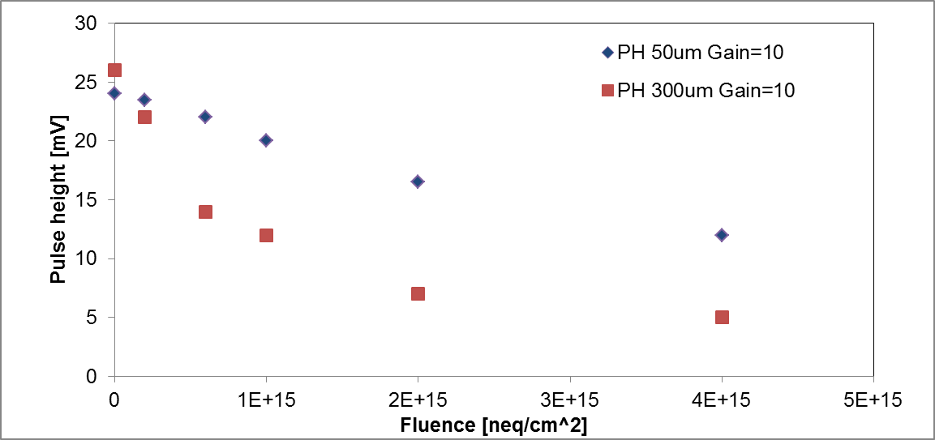
WF2 Simulation: Radiation Damage (Trapping)
Effect of trapping in thick and thin detectors at large fluences is different since the trapping distance is ~ 50 µm.
Effect of trapping:
gain holes disappear,
looks like a change in gain
300 µm,
Gain = 10
50µm,
Gain=10
The rising edge of thin sensors is essentially insensitive to trapping: good for timing!
Trapping:
Degradation of pulse height in 4*10¹⁵ neq/cm²
down to ~ 20% for 300 µm LGAD
down to ~ 50% for 50 µm LGAD
An additional effect resulting in a decrease in gain beyond trapping has been reported in 300 µm LGADs and is being investigated on 50 µm LGAD.
Investigate restoring gain loss after irradiation with increasing the bias voltage.
Pursue program to improve radiation tolerance by replacing Boron with Gallium.
Weightfield 2 (WF2) Implementation and Simulation: Bianca Baldassari

Slide 16
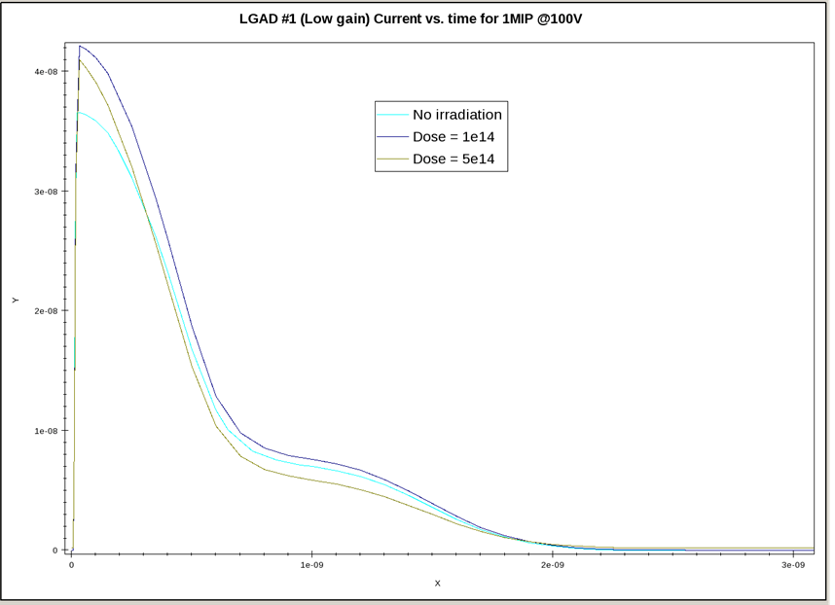
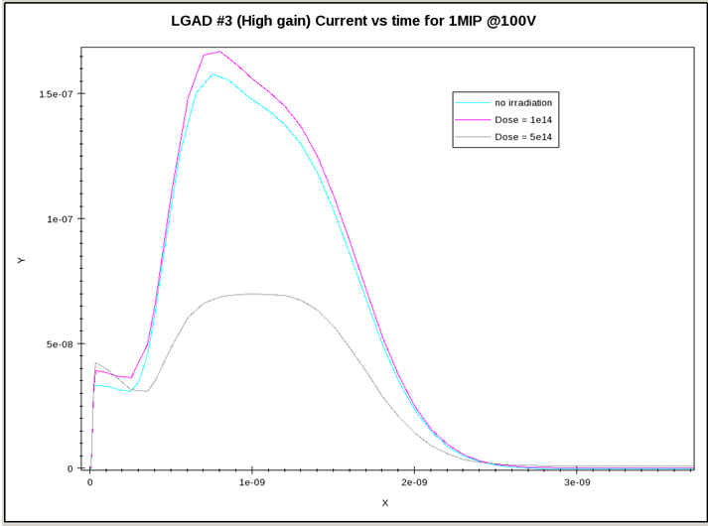
Sentaurus Simulations (Julie Segal, SLAC)
LGAD #1 (low gain) 50 μm thick
Current vs. Time for 1 MIP @ 100 V Bias
No radiation, 1e14, 5e14
LGAD #3 (high gain) 50 μm thick
Current vs. Time for 1 MIP @ 100 V Bias
no radiation, 1e14, 5e14
N.B. “1 MIP” relates to the amount of charge is injected into the backside of the LGAD: maximum .
Similar results are reported by many groups: TCAD works “right out of the box”
We are now measuring LGAD which were irradiated with protons at Los Alamos and neutrons at Llubljana.

Slide 17
HGTD Simulation, Design and fabrication.
G. Pellegrini, M. Carulla, S. Hidalgo, D. Flores, D. Quirion

Slide 18
Design of HGTD ATLAS LGAD
3x3 mm² and 2x2mm² pads separated by 33 μm (optimized by simulation).
P-stop isolation.
50 μm thick active area. Support wafer can be etched away leaving a mechanical structure for mounting the read out chip and wire bonding.
Each chip reads out 4 channels.
Gain is set by the thickness of the substrate (max bias expected 200 V due to the planar junction breakdown), a complete (technological and electrical) simulation has been performed using Sentaurus and Silvaco to find the parameter necessary for the fabrication. Expected gain 6-10
Fabrication steps are the same than standards LGAD (with the thermal steps and implant energy and dose to be optimized by simulation).
First fabrication in 4” SOI wafers. Fabrication started in February 2016, wafers should be ready by May 2016.
Then fabrication should be optimized in 6” wafers. At the moment CNM is already doing a run of LGAD detectors in 6” wafers, 200 μm thick. The run is due in 2016.
Open question: are they radiation hard? Fluences expected up to 5E15n_{eq}/cm².

Slide 19
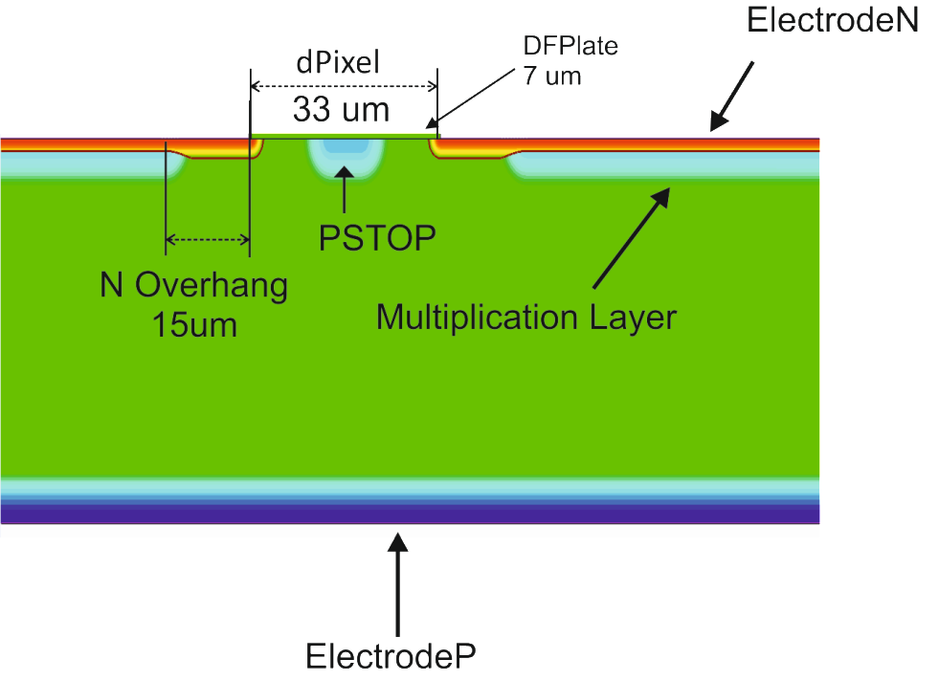
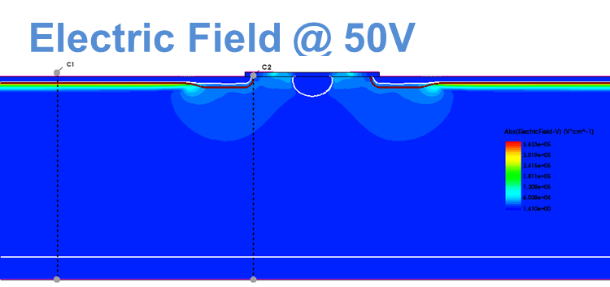
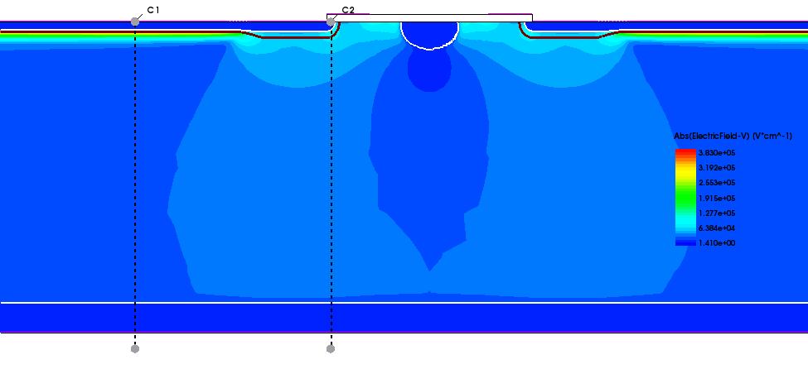
Core Structure
Multiplication dopant implant as measured by SIMS. The fabrication process is the same as for the standard 300 μm thick wafers.
passivation
FE
SiO2
n+
30um
p+
3000um
p-stop
p-
50um
p++
50um
Al
Al
300um
Wet etching of silicon
Electric Field @ 140V

Slide 20
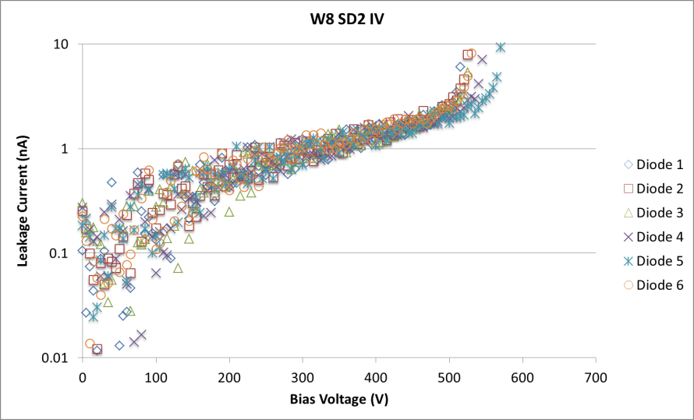
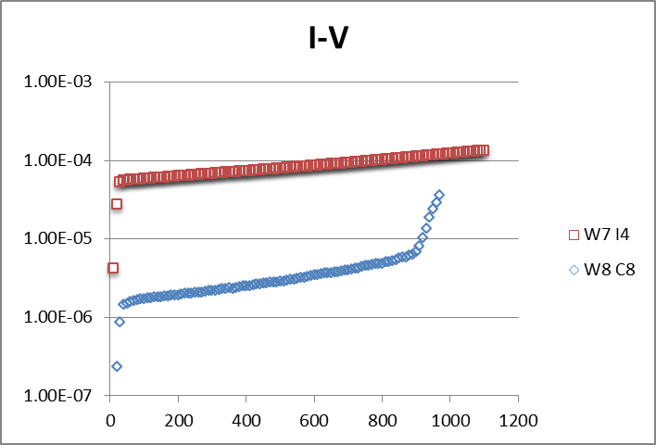
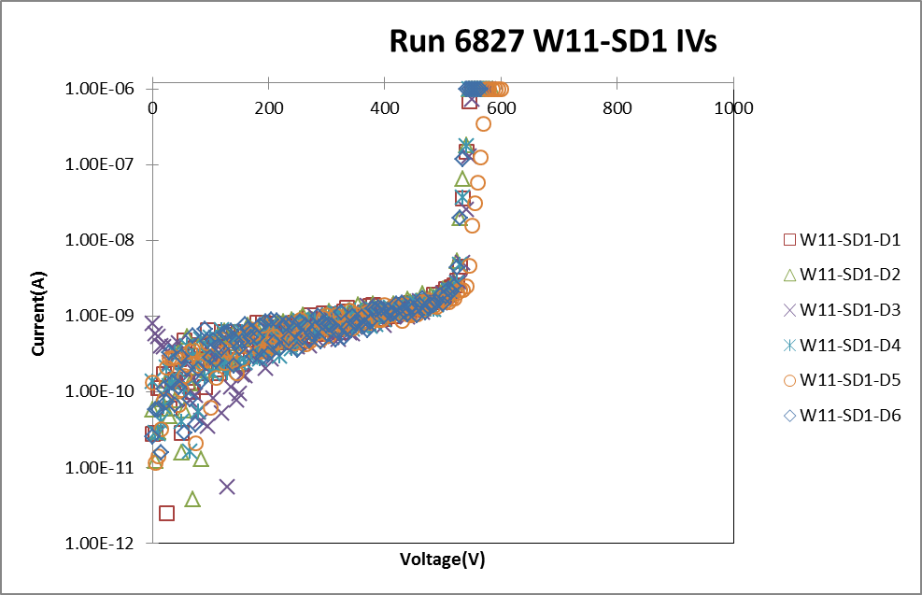
I-V Characteristics of thin detectors
Beware of the dimensions of the active volume
50um epi
Run 6474
300um FZ
75um epi
20

Slide 21
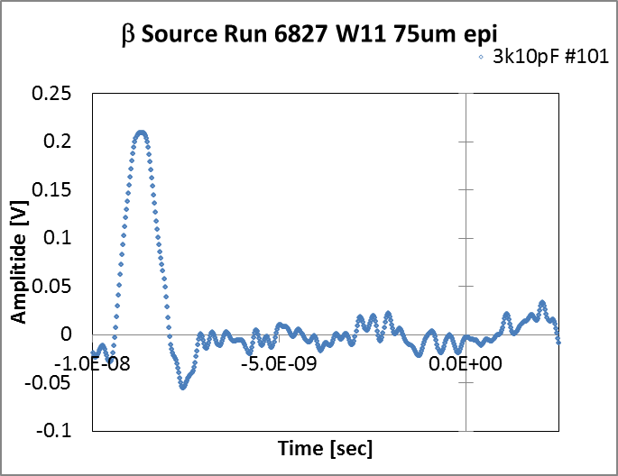
Transient Simulations and Measurements

Slide 22
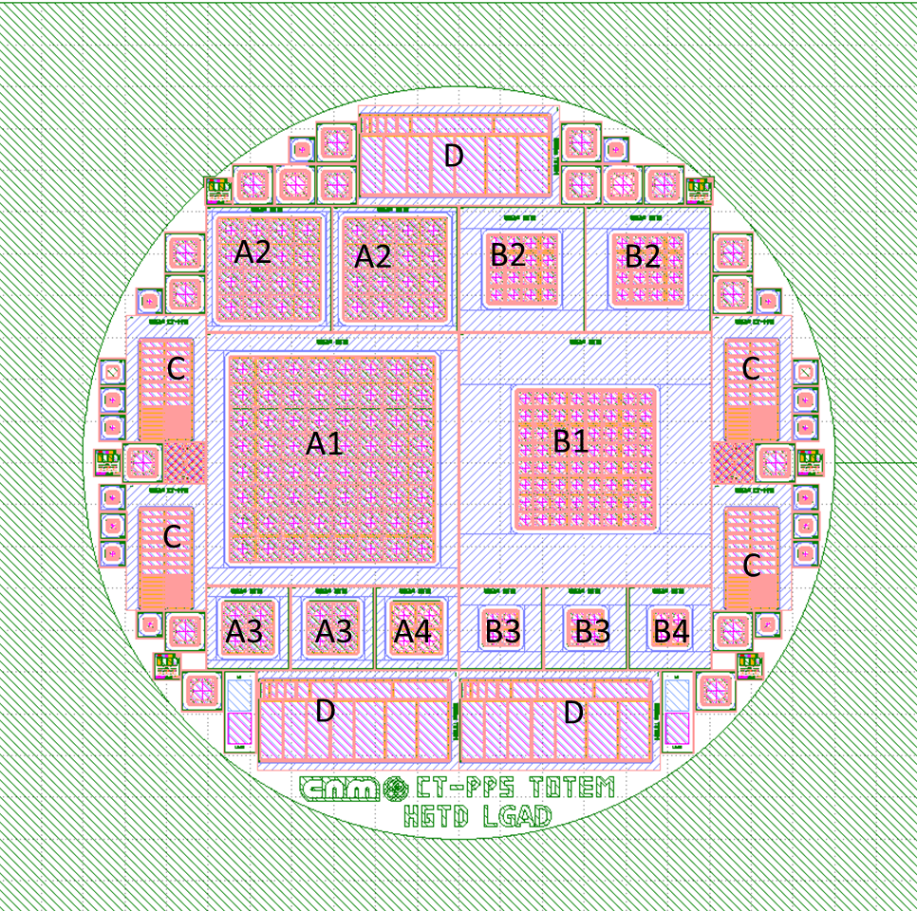
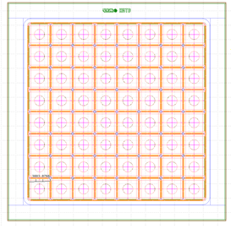
CNM Wafer Layout
A1=8x8 matrix, 3mm pad
B1=8x8 matrix, 2mm pad
A2=4x4 matrix, 3mm pad
B2=4x4 matrix, 2mm pad
A3=2x2 matrix, 3mm pad
B3=2x2 matrix, 2mm pad
A4=2x2 matrix, 3mm pad, PIN
B4=2x2 matrix, 2mm pad, PIN
C=CT-PPS
D=TOTEM detector
Different diodes and test structures.
3x3 mm² pixels.
Hole in the metallization
JTE only in the guard ring.
P-stop isolation.

Slide 23
Contributors
A. Anker, J. Chen, V. Fadeyev, P. Freeman, Z. Galloway, B. Gruey, H. Grabas, L.Hibbard, C. Labitan, Z. Liang, R. Losakul, S. N. Mak, C. W. Ng,
Hartmut F.-W. Sadrozinski, A. Seiden, N. Woods, A. Zatserklyaniy
SCIPP, Univ. of California Santa Cruz, CA 95064, USA
B. Baldassarri, N. Cartiglia, F. Cenna, M. Ferrero
Univ. of Torino and INFN, Torino, Italy
G. Pellegrini, S. Hidalgo, M. Baselga, M. Carulla,
P. Fernandez-Martinez, D. Flores, A. Merlos, D. Quirion
Centro Nacional de Microelectrónica (CNM-CSIC), Barcelona, Spain

Slide 24
Conclusions
We took data in a triggered β source with 75 μm thick epi LGAD with gain G ≈ 10 and measured a jitter of less than 40 ps.
The timing resolution in beam and laser tests are confirmed by the Weightfield 2 simulations.
We are developing specifications for LGAD to be used in the ATLAS HGTD.
We are looking forward to the next production run of UFSD at CNM available in May 2016.
Thanks to the organizers for arranging this year’s “Trento” meeting in Paris!

