Slide 1
Hartmut F.W. Sadrozinski with
Marta Baselga, Scott Ely, Vitaliy Fadeyev, Zachary Galloway, Jeffrey Ngo, Colin Parker, Davi Schumacher, Abe Seiden,
Andriy Zatserklyaniy
SCIPP, Univ. of California Santa Cruz see also Colin Parker’s Poster
4D Sensors:
Unifying the Space and Time Domain with
Ultra-Fast Silicon Detectors UFSD

Slide 2
“4D”
Ultra-Fast Silicon Detectors (UFSD) incorporate the time-domain into the excellent position resolution of semiconductor sensors
They provide in the same detector and readout chain
      ultra-fast timing resolution [10’s of ps]
      precision location information [10’s of μm]
A crucial element for UFSD is the charge multiplication in silicon sensors investigated by RD50, which permits the use of very thin detectors without loss of signal-to-noise.
Hartmut Sadrozinski, “Exploring charge multiplication for fast timing with silicon sensors”,
20th RD50 Workshop, May 30 to June 2, 2012, Bari, Italy
https://indico.cern.ch/getFile.py/access?contribId=18&sessionId=8&resId=1&materialId=slides&confId=175330

Slide 3
“4D”
We “just” need 3 items:
    Charge Multiplication
    Thin segmented sensors
    Fast readout
2 questions need to be addressed for UFSD:
can they work: signal, capacitance, collection time vs. thickness
will they work: required gain and E-field, fast readout
In this talk:
        Motivation
        Charge collection in thin sensors
        Low-Gain Avalanche Detectors (LGAD)
        Charge multiplication data on pad detectors
        R&D Program

Slide 4
Motivation for 4D Detectors
Up to now, semiconductor sensors have supplied precision data only for the 3 space dimensions (diodes, strips, pixels, even “3D”), while the time dimension has had limited accuracy (e.g. to match the beam structure in the accelerator).
We believe that being able to resolve the time dimension with ps accuracy would open up completely new applications not limited to HEP
An example in HEP are forward physics projects at the LHC, like the AFP. Scattered protons are tracked from stations 100’s of meters downstream back to the interaction region and the z-vertex is determined from the timing information. A time resolution of 10ps results in a resolution in the vertex resolution of 3 mm. 4D sensors can give the required good resolution both in position resolution and timing in one sensor, while at the moment two different detector technologies are required (e.g. pixels and Micro-channel plates).
Proposal: Combined-function pixel detector will collect electrons from thin n-on-p pixel sensors read out with short shaping time electronics.
4D sensors rely on internal charge multiplication to increase the collected signal

Slide 5
Benefits of Ultra-Fast Silicon Detectors
- Tracking: Identifying with high precision the temporal signature of different events allows for their association and it reduces random coincidences. Traditional tracking is often overwhelmed by combinatorial backgrounds, which can be dramatically reduced by adding a 4th dimension (time) per point.
- Vertex Locator: Forward physics in AFP (ATLAS) and HRS (CMS)
- Time of Flight (ToF): ToF is already used in many commercial applications such as ToF-enhanced PET and Mass Spectroscopy ToF, however with precision one order of magnitude higher than the goal of UFSD (~500 ps vs. ~50 ps). ToF is also used in particle physics as a tool for particle identification.
- ToF can also be used in 3D and Robotic Vision: the ability to accurately measure the travel time of light pulses reflected by an object at unknown distance is of paramount importance to reconstruct 3D images, fundamental in imaging and robotic vision. UFSD will offer a spatial precision of a few mm at low illumination power, allowing for battery operated, portable systems.
- Particle counting: UFSD performance would allow developing new tools in single particle counting applications with unprecedented rate capabilities. For example, in the treatment of cancer using hadron beams, such a tool would measure the delivered dose to patients by directly counting the number of hadrons.
Material science experiments using soft x-rays will benefit from the combination of high rate and precision location that UFSD offers.

Slide 6
Internal Gain in Detectors
Charge multiplication (CM) in silicon sensors (investigated by RD50 institutions) can have much wider applications then off-setting charge lost due to trapping during the drift of electrons or holes in irradiated sensors.
Charge multiplication makes silicon sensors similar to drift chambers (DC) or Gas Micro-strip Detectors (GMSD), where a modest number of created charges drift to the sense wire, are amplified there (by factors of > 10⁴) and are then used for fast timing.
Recall our experience with DC:
Need to balance the need of high E-field around a wire to have charge multiplication with the need to keep the E-field low to prevent breakdown (wire diameter, field shaping wires,.) and give proper drift field.
The drifting electrons contribute mainly to the collected charge after they have undergone charge multiplication, which means that the pulse develops (in principle) in a short time.
The very large charge density in the “plasma cloud” prevents the electron to move until the ions have drifted away! So electron signal is given by hole dynamics!?
Basic question for use of CM
What field strength do we need?
Can the sensor geometry and doping profile engineered so that the amplification field can be kept high, but just below the breakdown field?

Slide 7
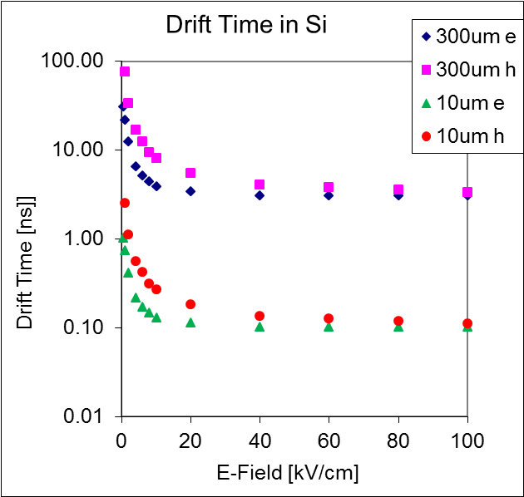
Collection of Charges in Silicon Sensors
Drift velocity saturates for both electrons and holes!
-> need thin sensors for fast charge collection
Collection time is close to minimum when
E-Field ≥ 20 kV/cm
For 300um Si
Collection time ~ 5 ns (h), ~ 3 ns (e)
For 10um Si
Collection time ~ 0.3 ns (h), ~ 0.1 ns (e)

Slide 8
Can 4D-UFSD work? Collected Charge & Capacitance
Signal = thickness*EPM (EPM = 73 e⁻/μm)
Collection time = thickness/v_{sat} (v_{sat} (e) = 100 μm/ns)
WRONG

Slide 9
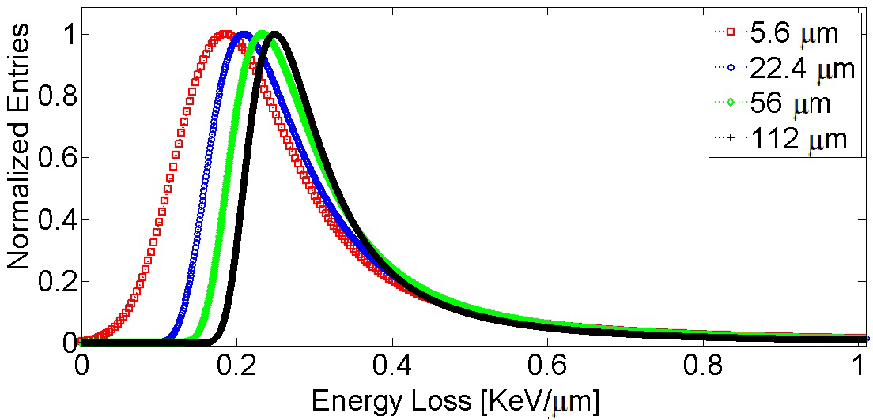
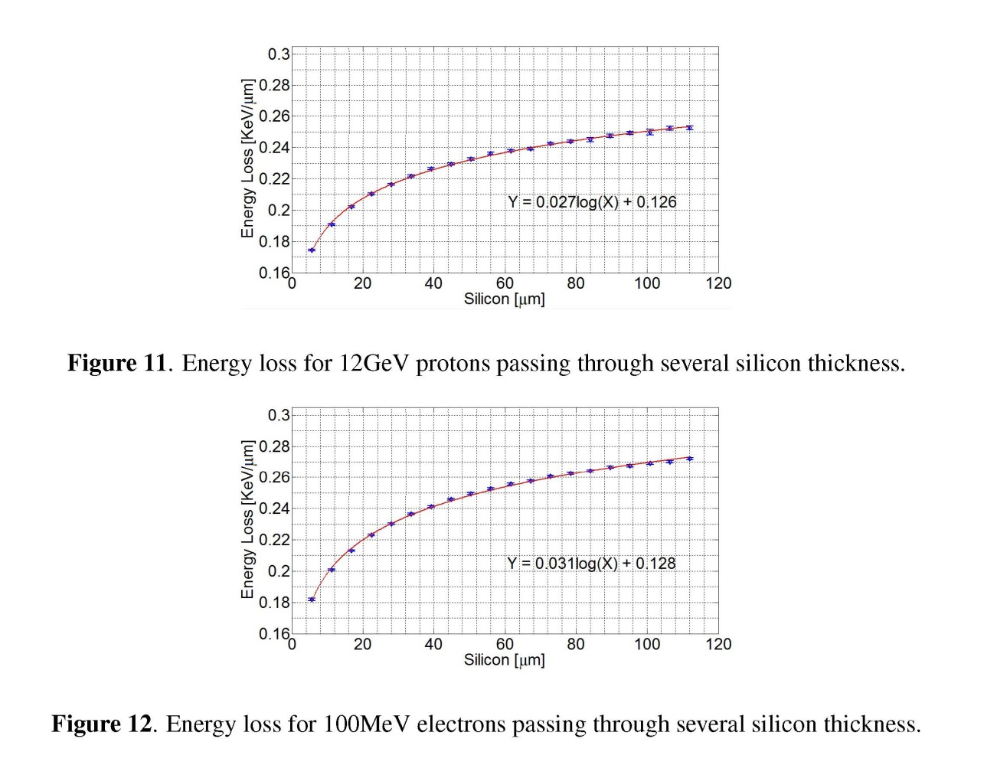
Details of Collected Charge in Thin Sensors
Energy loss measurement for charged particles in very thin silicon layers
S. Meroli, D. Passeri and L. Servoli
11 JINST 6 P06013
Reduced measured energy loss
in very thin silicon layers

Slide 10
Can 4D-UFSD work? Correct Collected Charge
Collection time = thickness/v_{sat} (v_{sat} = 80 μm/ns) (holes)
Realistic
gain & cap
Good time
resolution
For pixel thickness > 5 um, Capacitance to the backplane Cb < Cint (200 fF)
For pixel thickness = 2 um, Cb ~ ½ of Cint, and we might need bipolar (SiGe)?
Viable sensor thickness 2 µm – 10 µm (i.e. 20-100ps)
Needed Gain: Pixels 4 – 25, Strips (1 mm) 20- 150
(much less than APD’s or SiPM)
Note: CNM (Barcelona) is routinely producing 10 µm thick sensors.

Slide 11
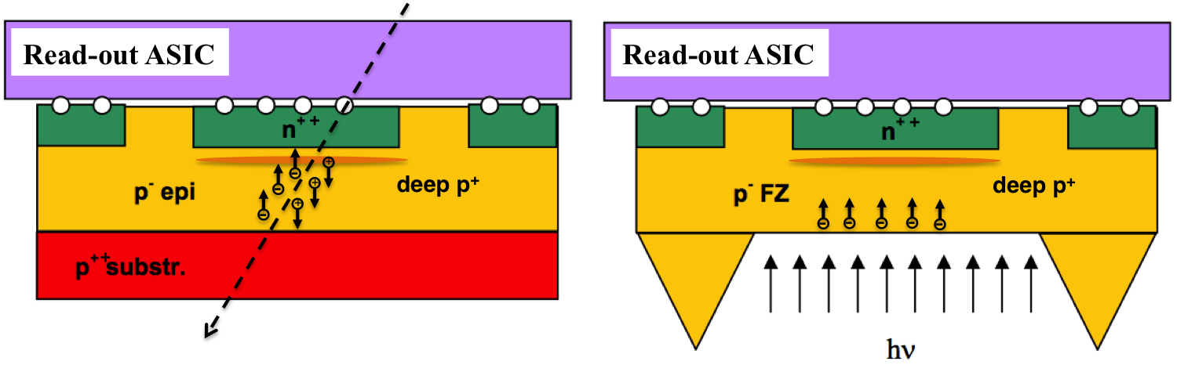
Thin 4D Sensors
Sensor
ASIC
Thinned FZ
sensors
with “ribs”
for strength
(HLL-MPI,
CNM):
even photons
Position and Energy
Position and Time
Counter Chip
Epitaxial
sensors
Ideal for
prototyping

Slide 12
Charge Multiplication
A. Macchiolo,16th RD50 Workshop Barcelona, Spain, May 2010
Charge multiplication in path length ℓ :
At the breakdown field in Si of 270kV/cm:
α_{e} ≈ 0.7 pair/µm
α_{h} ≈ 0.1 pair/µm
→ gain g = 33 possible in l = 5 µm.
→ In the linear mode (gain ~10), consider electrons only
Need to raise E-field as close to breakdown field as possible for high gain
but not too much to prevent breakdown!

Slide 13
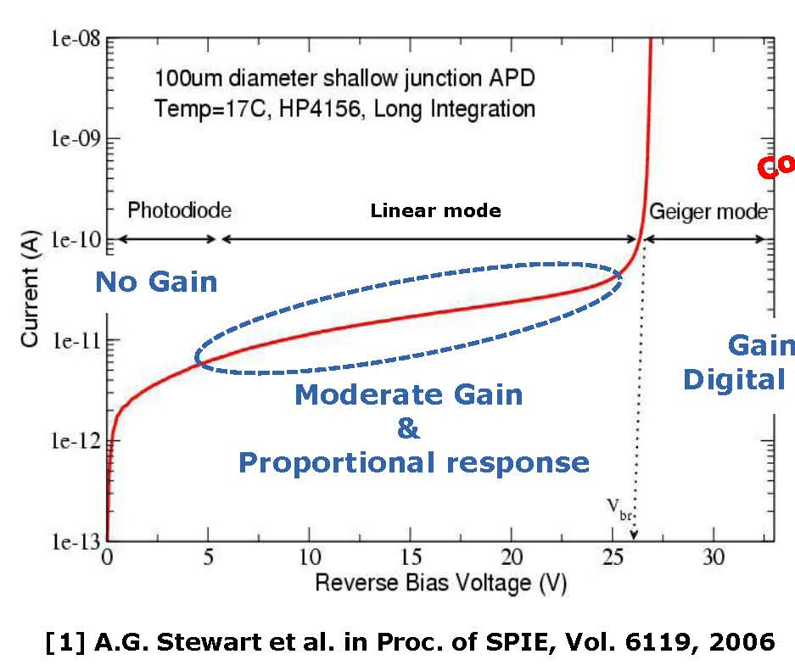
Development of Si sensors with gain (RD50)
RD50 Groups have been investigating charge multiplication (CM) in heavily irradiated silicon sensors.
Un-irradiated sensors manufactured without drastic changes to the doping profile exhibit very little gain before breakdown.
Started RD50 Common Project to manufacture Low-Gain Avalanche Detectors (LGAD) based on the prinicple of SiPM or APD, but with moderate gain.
Principle:
Deep n-implants and
extra p-layer increase the E-field
so that moderate charge multiplication
occurs without breakdown.
CNM Barcelona
First step: Pad detectors/simple diodes
verify gain,
optimize parameters
radiation hardness
Second step: strip/pixel sensors
Gain > 10⁴
Digital response

Slide 14
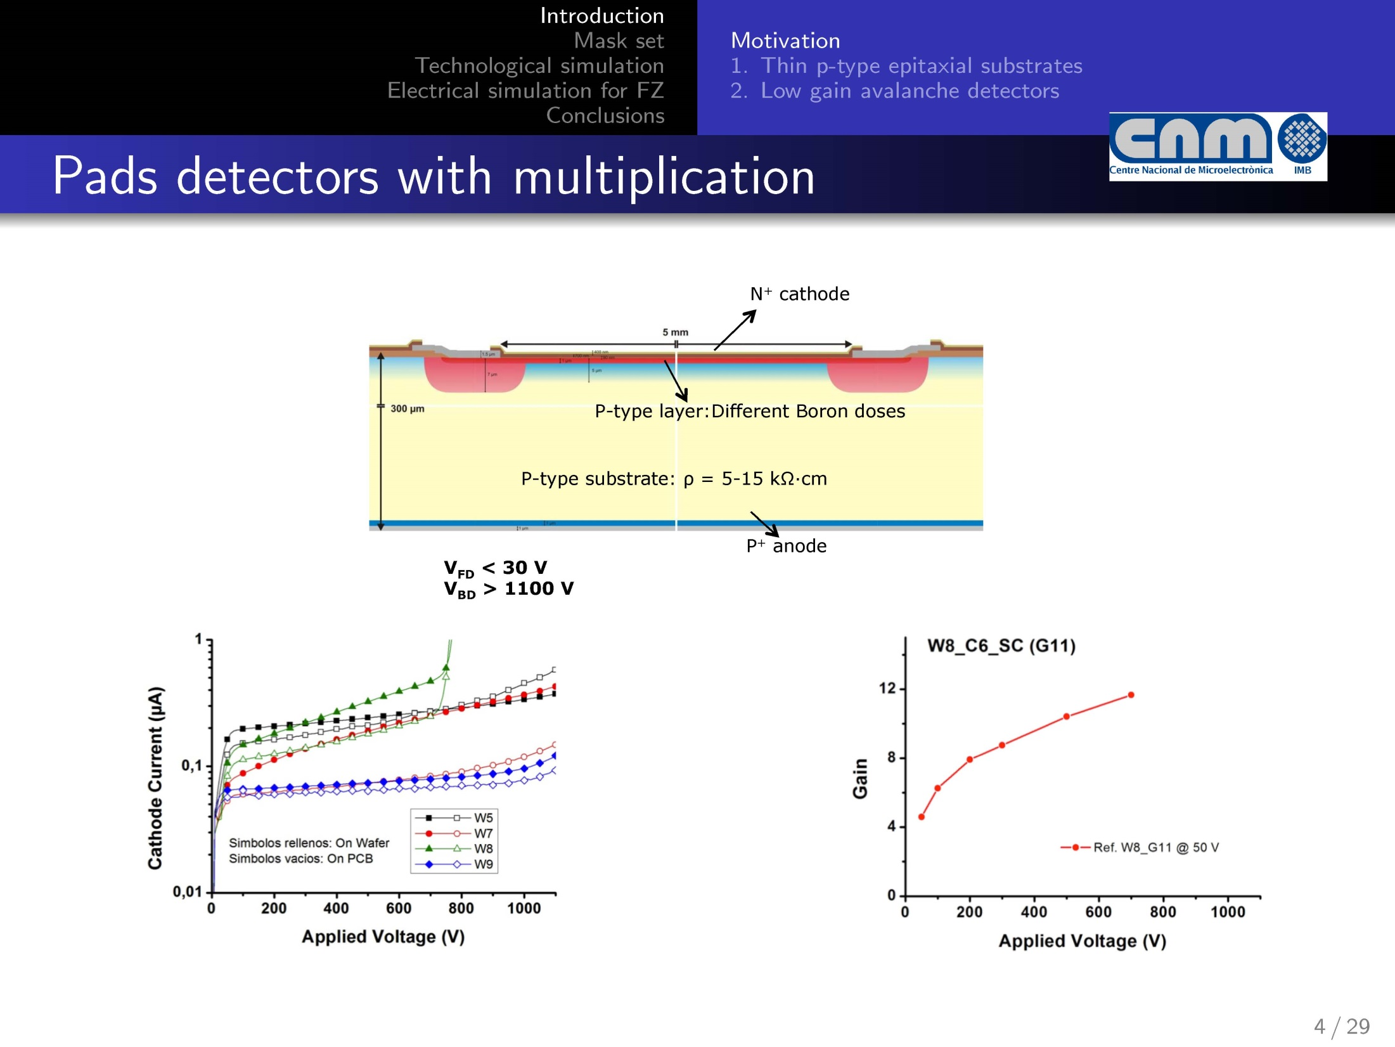
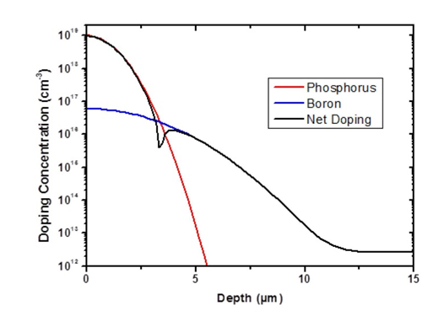
Low-Gain Avalanche Detector (LGAD)
High-Field: Gain
Marta Baselga,
Trento Workshop
Feb. 2013

Slide 15
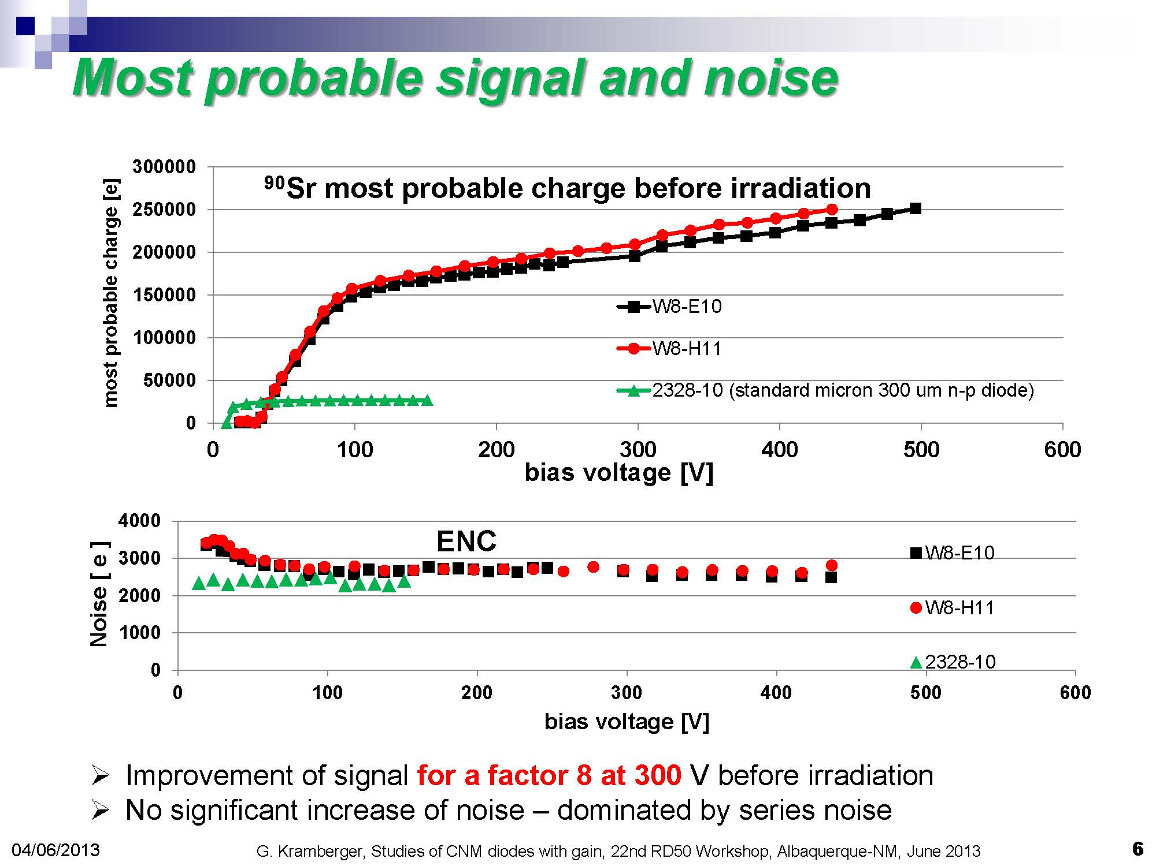
Gain with MIP’s

Slide 16
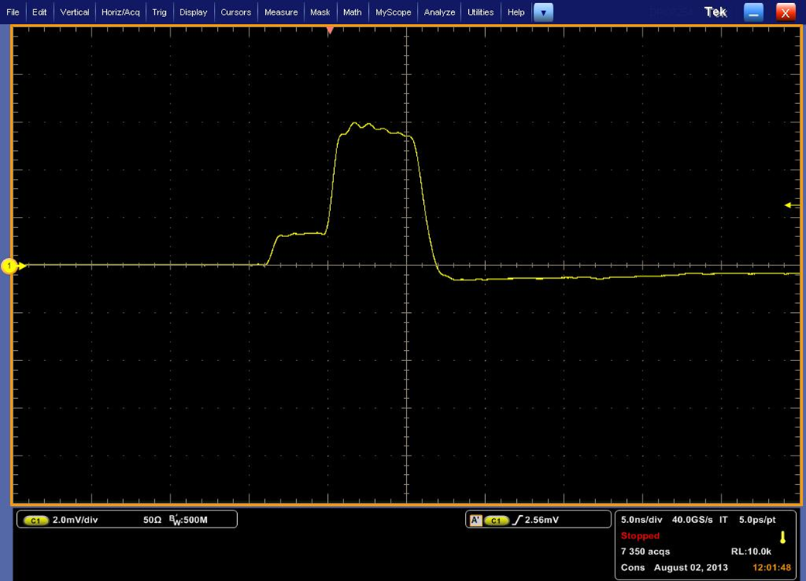
Charge Collection with α’s from Am(241)
α’s
Am(241)
illuminating the back, range ~few um
“electron injection”
signal drifts and is then amplified in high field
Colin Parker
Fast signals!
Observed rise times ≈ 400 ps
allowing time-resolved current transient (TCT) analysis .
Don’t know yet where the
lower limit is.

Slide 17
Observed TCT shapes from α’s

Slide 18
Estimation of Gain with α TCT
Total Gain = I_{M}(a) / I(a)*ΔT_{M}/ΔT~5*2=10
(N.B.: For thin sensors, both ΔT_{M} and ΔT are shortened)

Slide 19
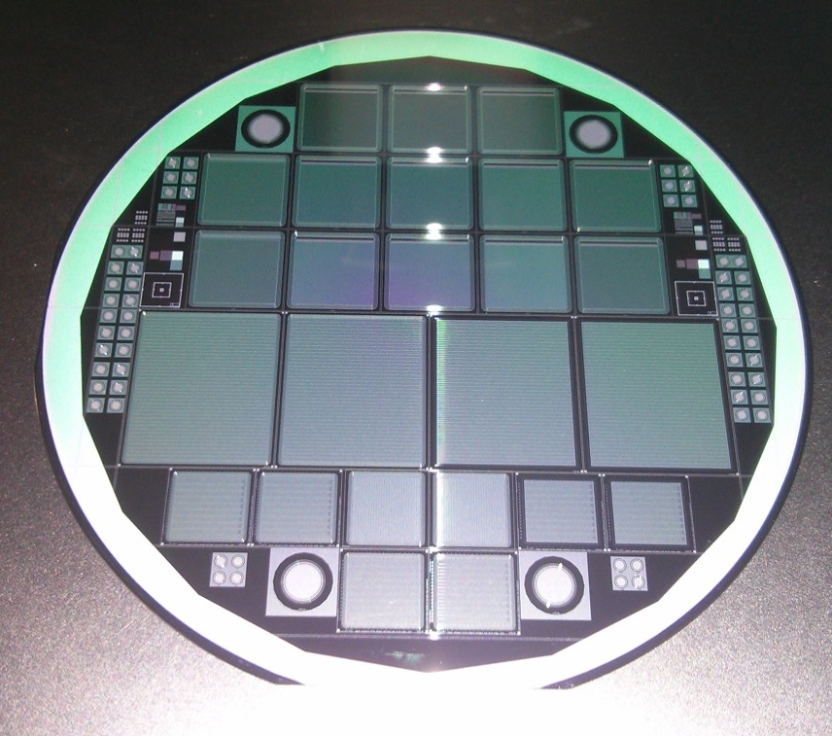
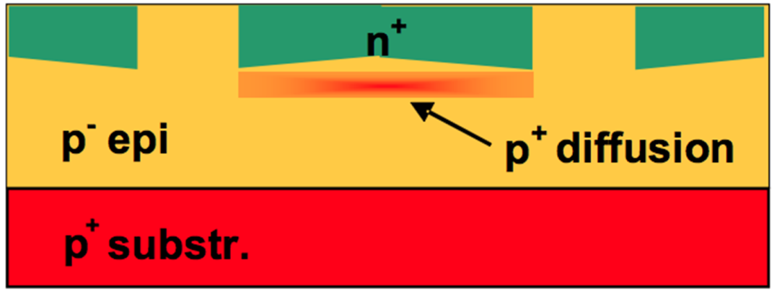
From pads to strips and pixels
New CNM production (RD50)
14 p-type wafers
Thick Resistivity Substrate Substrate
(µm) (Ωcm) resistivity (Ωcm) thickness (µm)
9.8 110.5 0.006 525
50.4 96.7 0.006 525
75.2 104.6 0.006 525
285 (FZ) 12000 ± 7000
Width/Pitch varies from 0.3 to 0.8

Slide 20
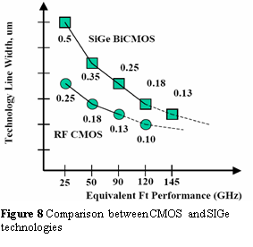
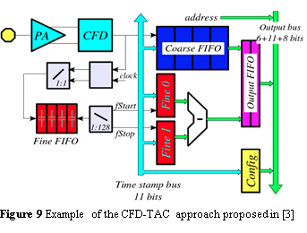
What about fast readout?
CERN fixed-target experiment (NA62) needs very fast pixel sensors: Gigatracker (GTK)
Prototype CFD system (INFN Torino) has ~ 100 ps resolution, predicted to be 30 ps in next iteration.
Optimized for 200μm sensors and hole collection (?), could it be re-designed for electron collection from 2 – 10μm sensors?

Slide 21
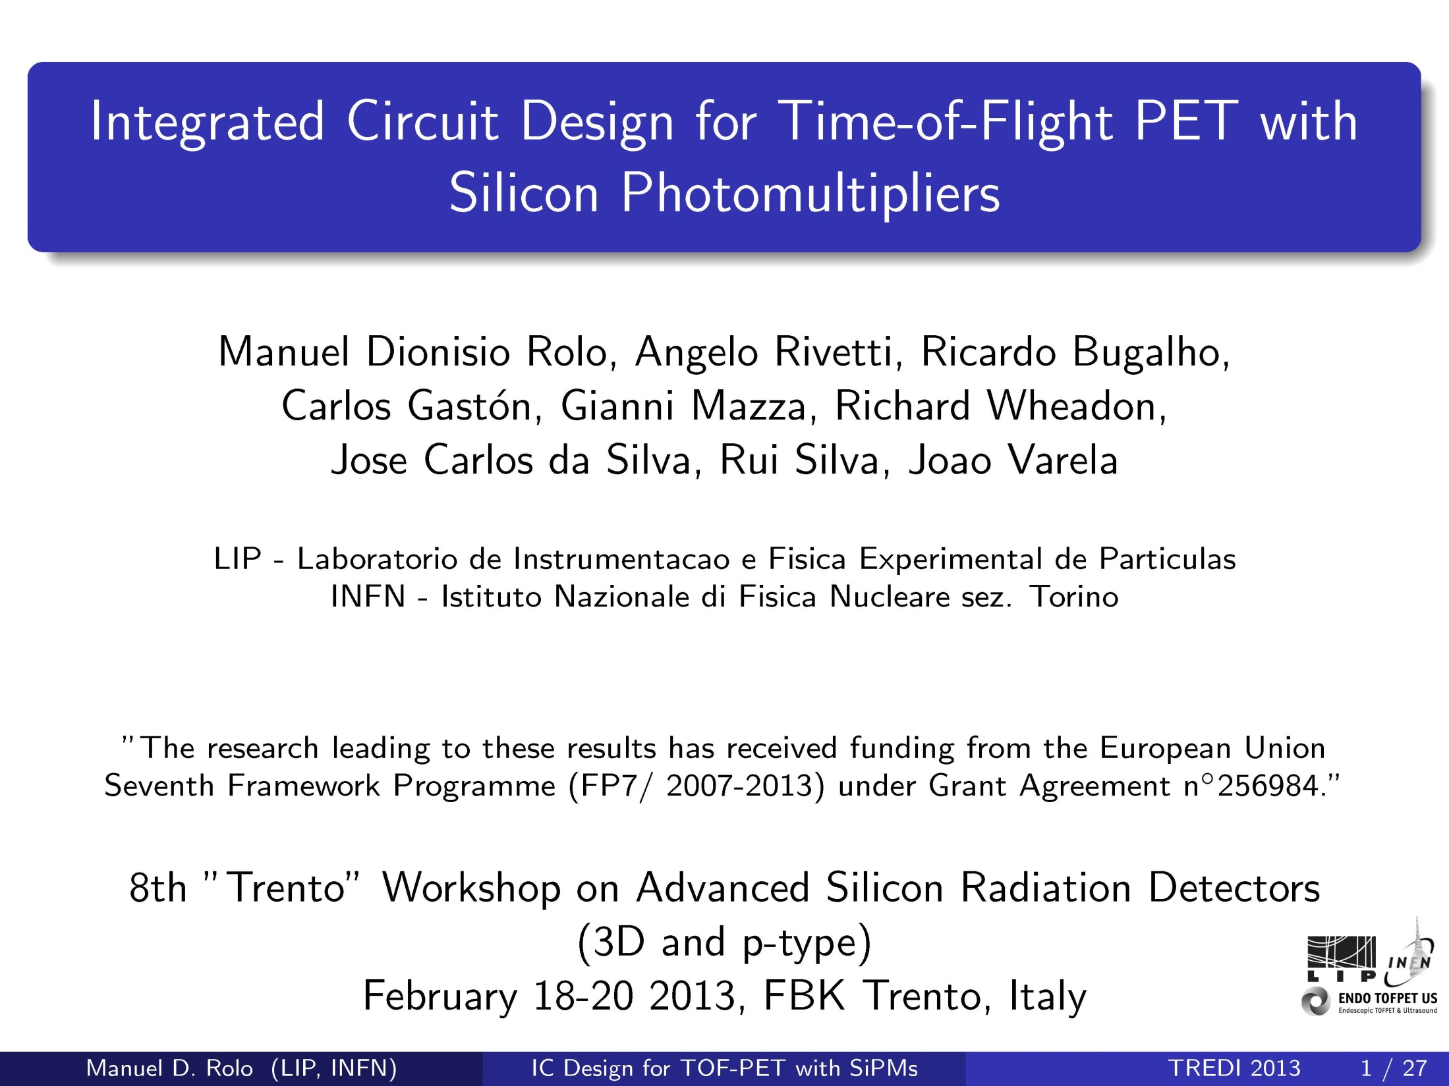
Example of ASIC development for fast signal processing:
Here much larger dynamic range

Slide 22







4D Sensors:
Unifying the Space and Time Domain with
Ultra-Fast Silicon Detectors UFSD
Sensor Production: CNM Barcelona
Sensor Testing: UC Santa Cruz, Freiburg U., Florence U., SJI Ljublejana, Trento U.
Readout ASIC: INFN Torino, UC Santa Cruz,
Data Acquisition DAQ: HEPHY Vienna

Slide 23
Conclusions
Timing precision in silicon sensors
has been the young Cinderella of instrumentation,
in contrast to photon detectors.
(Sherwood Parker has been the only voice in the wilderness).
With Ultra-Fast Silicon Detectors
we want to reach the same happy ending as the fairy tale.
We made quite a lot of progress in one year:
Charge Multiplication Achieved gain 10 -15 with pad detectors
Thin segmented sensors Received 10 um – 75 um epi strips/pixels
Fast readout Area of next big push

Slide 24
More Applications for 4D UFSD

Slide 25
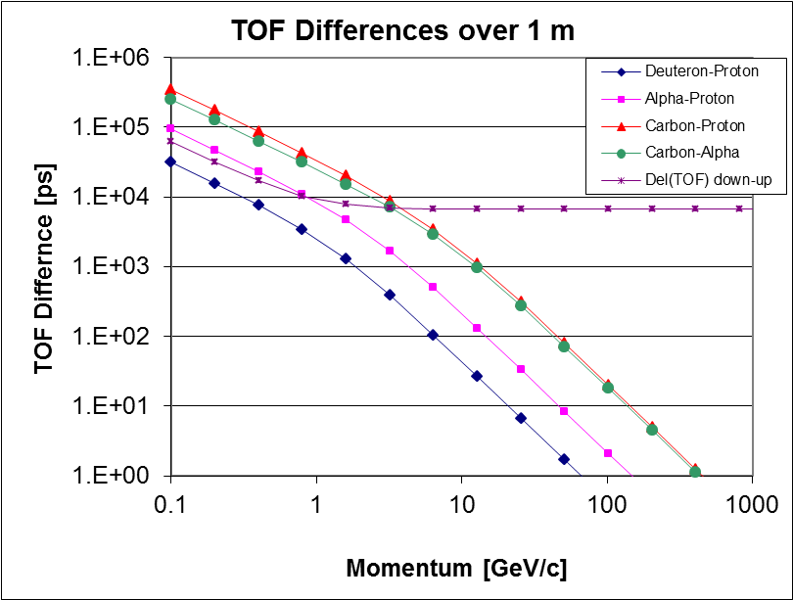
Time of Flight for Particle Identification in Space.
The Alpha Magnetic Spectrometer (AMS) detector, operating in the International Space Station since 2011, performs precision measurements of cosmic ray composition and flux.
The momentum of the particles is measured with high-resolution silicon sensors inside a magnetic field of about 1 m length.
A time resolution
of 10 picoseconds,
the “Holy Grail” of
Cosmic Ray Physics:
the distinction between
anti-carbon ions and
anti-protons can be achieved
up to a momentum of 200 GeV/c.

Slide 26
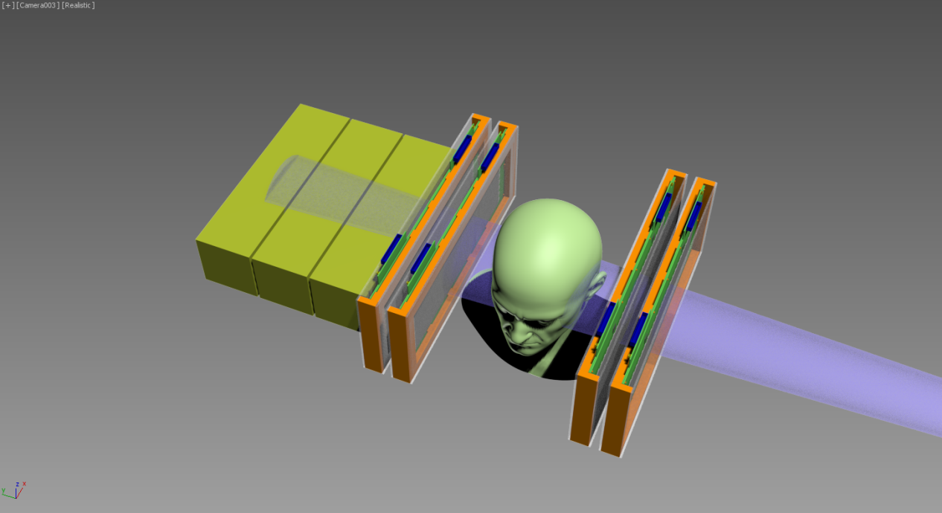
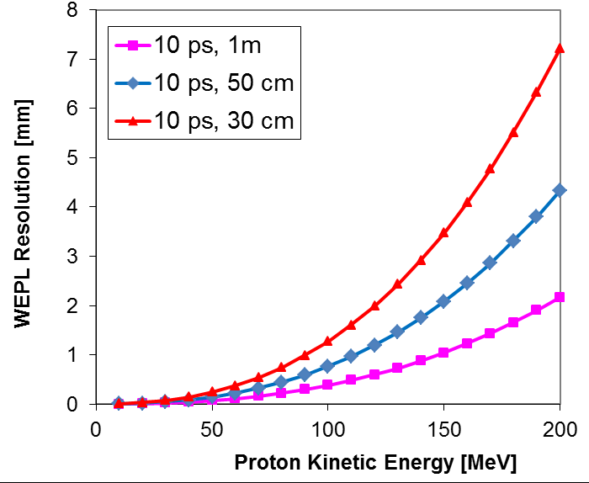
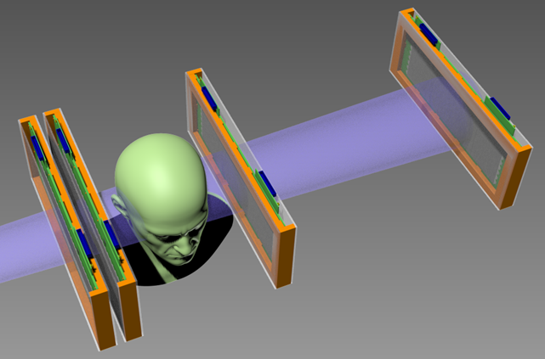
Future: 4-D Ultra-Fast Si Detectors in pCT
Protons of 200 MeV have a range of ~ 30 cm in plastic scintillator. The straggling limits the WEPL resolution.
Replace calorimeter/range counter by TOF:
Light-weight, combine tracking with WEPL determination
Range straggling limit for 200 MeV p

Slide 27
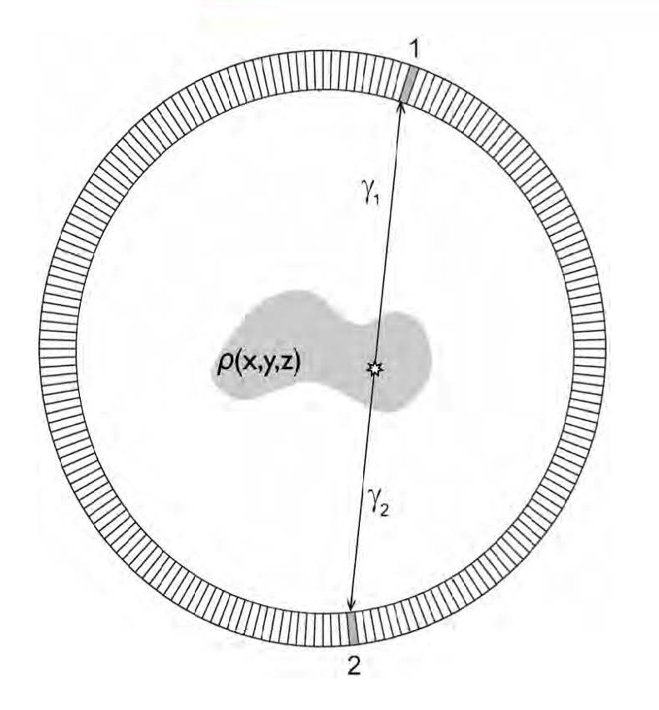
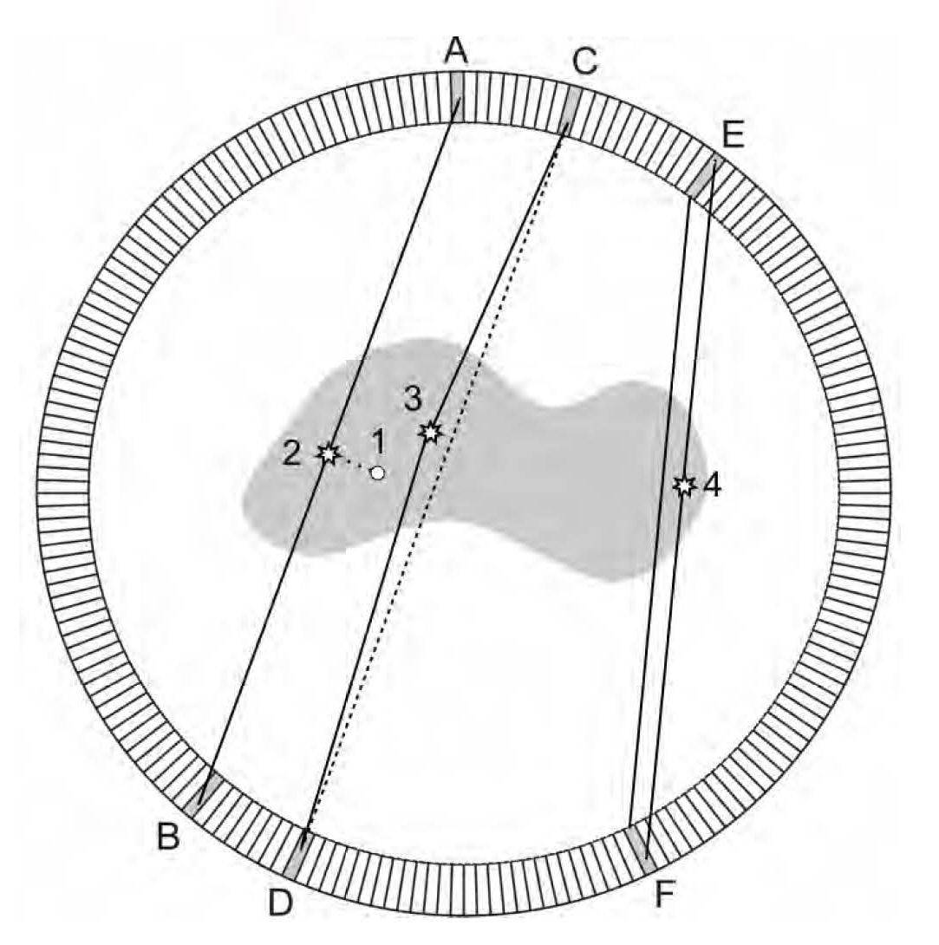
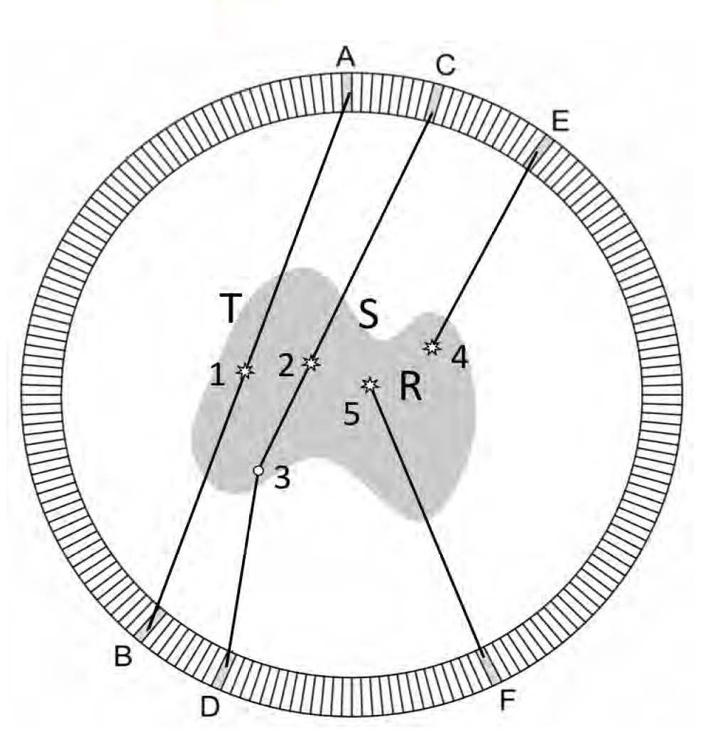
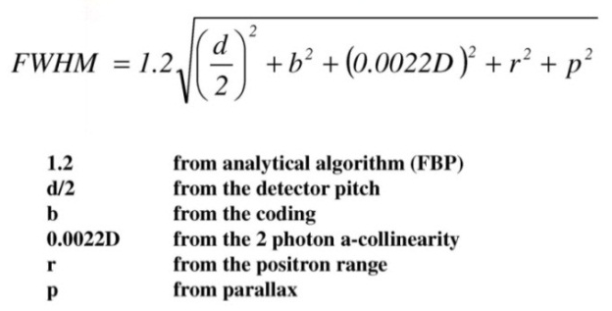
Positron Emission Tomography PET
Study accumulation of radioactive tracers in specific organs.
The tracer has radioactive positron decay, and the positron annihilates within a short
Distance with emission of 511 keV γ pair, which are observed in coincidence.
Perfect Picture:
Resolution and S/N Effects:
Resolution of detector (pitch)
Positron range
A-collinearity
Parallax (depth)
T: true event
S: Compton Scatter
R: Random Coincidence
A. Del Guerra, RESMDD12

Slide 28
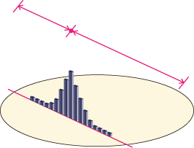
Reduce Accidentals & Improve Image: TOF-PET
PET
t1
t2
TOF-PET
Localization uncertainty:
Δd = c x Δt /2
When Δt = 200 ps
➔ Δd = 3 cm
@ VCI
K. Yamamoto 2012 IEEE NSS-MIC
Notes:
As you know, in Time-Of-Flight Positron Emission Tomography, TOF information provides better localization of the annihilation event and improves the signal-to-noise ratio of the reconstructed image.
For example, when timing resolution is 300ps, position resolution is 4.5cm along the line of response.
In fact, timing resolution depends on the scintillation light yield, detector performance and read out noise.
Multi-Pixel Photon Counter, MPPC is a silicon photomultiplier and expected for use in PET-MR.
Timing resolution required for the MPPC is less than 200ps.

Slide 29
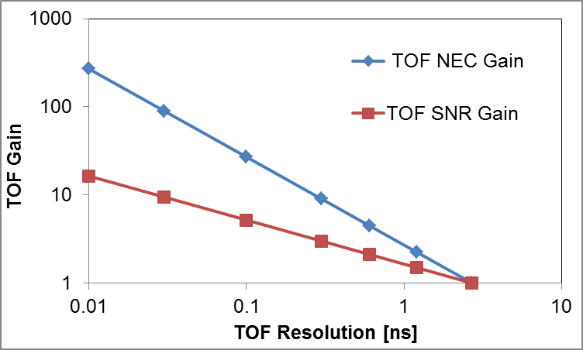
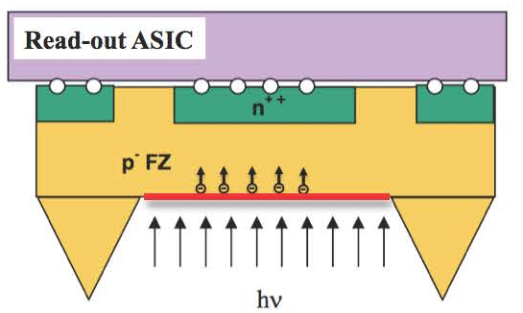
ToF – PET SNR Improvement
The improved source localization due to timing
leads to an improvement in signal-to-noise
and an increase in Noise Equivalent Count NEC
For a given acquisition time and dose to the patient, TOF can provide better image quality and improved lesion detection.
OR
with TOF the scan time and dose can be reduced while keeping the same image quality ( better clinical workflow and added comfort for the patient).
600 ps -> 30 ps
20x
Dose reduction
M. Conti, Eur. J. Nucl. Med. MoI Imaging (2011) 38:1147-1157
Photon Timing improvement is a major R&D Field

