Slide 1
T-979: SiPM Time Resolution with DRS4 Readout
Anatoly Ronzhin,
Fermilab, AEM
March 12, 2012
Team: Mike Albrow, Sergey Los, Pasha Murat, Erik Ramberg, Fermilab
Heejong Kim, University of Chicago
Andriy Zatserklyaniy, University of Puerto Rico
Sarah Malik, Rockefeller University

Slide 2
TB goals with new SiPms and DRS4 readout
measure electronic time resolution (ETR) to find limit with 200 ps/bin? (to compare bench test and beam data results)
ETR dependence on delay between “start” and “stop” signals when “TOF dynamic range” needed.
repeat our previous measurements, but with the DRS4 instead of ORTEC readout (200ps/bin instead of 3.1ps/bin).
measure time resolution with new SiPms.
Influence of signal clipping on time resolution.
study strip line parameters with the DRS4 readout (to compare with PiLas laser data).
test different algorithms for timing analysis (Heejong and Andriy).
noise floor (Sipms, DRS4) at test beam condition.
To make measurements for future HPS (LHC) experiment with new SiPms and new readout options (Mike Albrow next report for more details).
noise floor (Sipms, DRS4) at test beam condition.

Slide 3
Why SiPms and DRS4 for the fast TOF application?
the avalanche spread is very fast. Single photoelectron time resolution (SPTR) is at the level of 100 ps, our SPTR measurements approved it.
perfect single photoelectrons spectra which allows easy calibration.
PDE for the blue light is at the level of 50%. For TOF we don’t care too much about optical crosstalk. But we also studied SiPm with tranches.
non sensitivity to magnetic field, what extend SiPm TOF application.
low amount of material introduced into the particle’s path to get few tens picosecond time resolution.
“high” voltage bias applied to SiPms is only 30-70 Volts.
the industrial sensitive size of SiPms is 5x5mm2 is currently available
SiPms produced with almost edgeless design, which allows produce different geometry, like matrix, cells in line, etc.
temperature and bias voltage stability requirements defined to keep few ps level. It is not a problem now for TOF application.
we involved in STM study and have perfect feedback with producers.
DRS4, waveform digitizer, 5Gs/s (200 ps/sample), 500 MHz BW, 10 bits depth/ch.; allows to measure time interval with few ps accuracy and pulse height (PH) simultaneously at low cost (wrt. Ortec). Last version #4 with ~1 mV/50 Ohm noise floor.
3

Slide 4
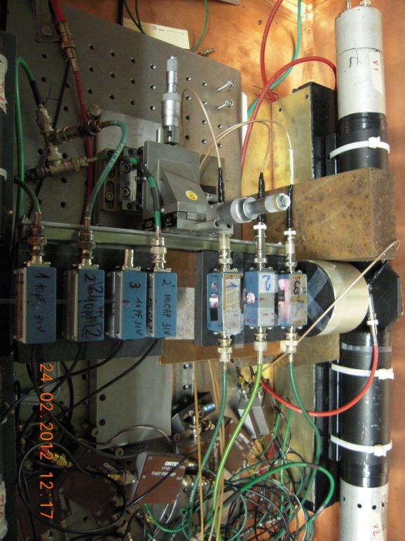
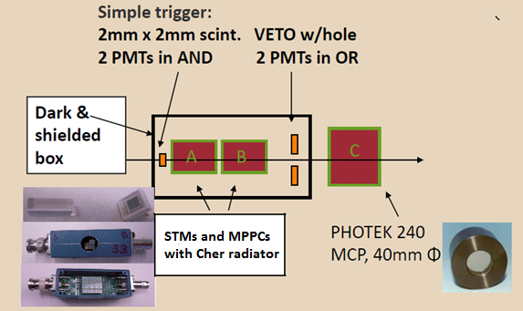
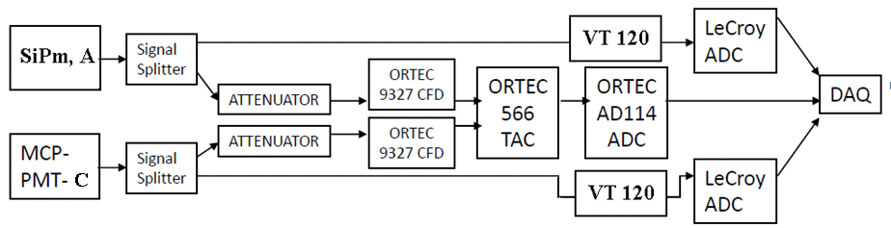
T-979 Setup in Fermilab Test Beam Facility (FTBF)
Time interval between “start” (SiPm) and “stop” (SiPm or Photek 240) signals is measured value. Beam: 120 GeV protons. Light is generated in fused silica radiator for the SiPms and in the Photek 240 input window at normal particle incidence.
ORTEC readout:
CFD – constant fraction discriminator,
TAC – time amplitude converter,
ADC – analog to digital converter, ~16,000 channels, 3.1 ps/ch
“Electronic” time resolution (ETR) is 2 ps.
7

Slide 5
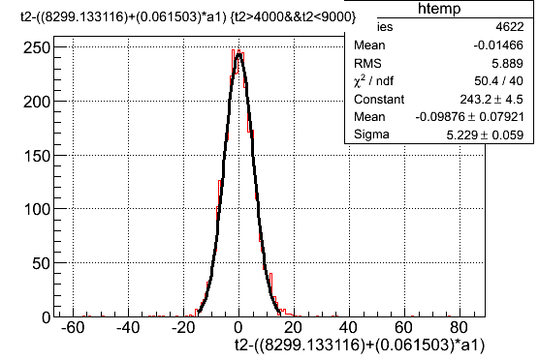
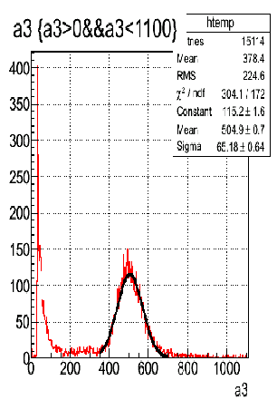
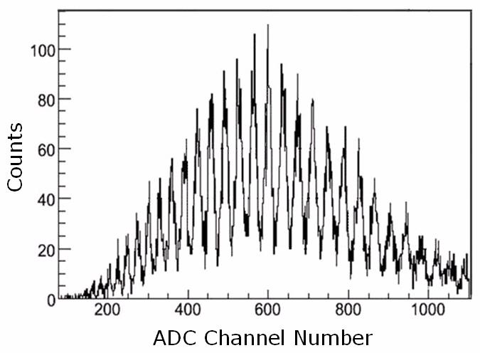
STM signal must be clipped to fit Ortec 9327 CFD (<5 ns, FWHM), previous best tb result – 14.5 ps, sigma
Sigma = 16.3 ps
MPPC-Photek240
inline
Schematic of STM biasing and readout
Timing difference spectrum for signals coming from MPPC (radiator is fused silica, 3x3x30 mm3) and Photek 240 (radiator is input window, 9.6 mm thick). 120 GeV protons. Normal incidence. The MPPC time resolution is 14.5 ps. Soft pulse height cuts and slewing correction applied. Both “start” and “stop” counters located next to each other.
The MPPC pulse height spectrum, 120 GeV protons.
Quartz radiator, 3x3x30 mm3
N of photoelectrons ~ 60 phes
STM pulse height spectrum, mean number of photoelectrons = 17 phes. STM is 3.5x3.5mm2, 4900 pixels, 48x48um2 pixel size, 3.5V of OV.
STM signals with (top) and w/o (b) clipping capacitance, 40 ns scale
STM signal with clip cap, 2 ns scale
9

Slide 6
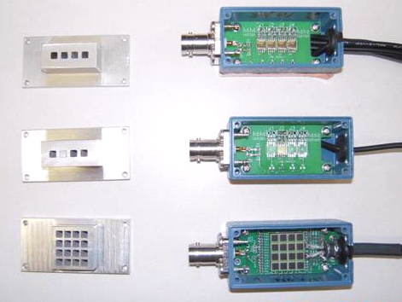
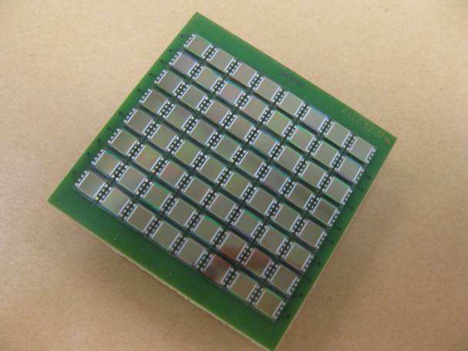
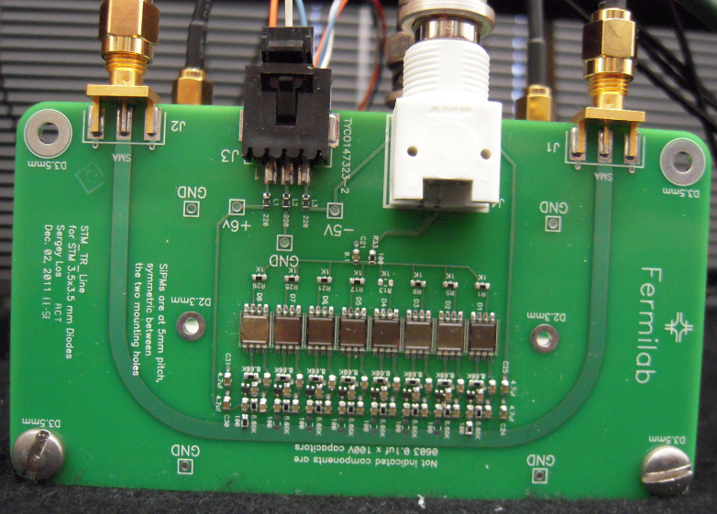
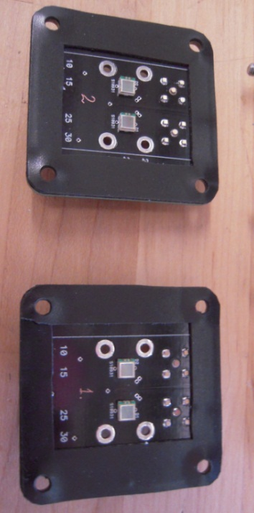
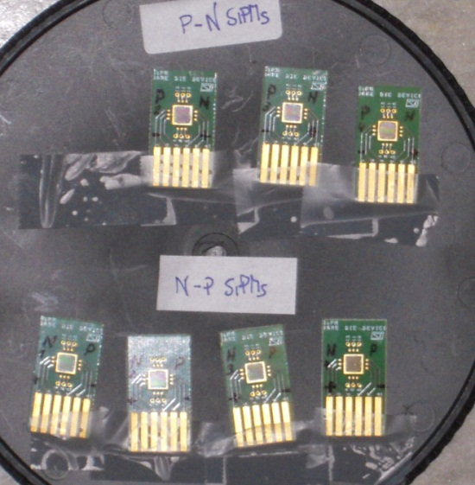
Some STMs news
STM, started with N on P structure. P on N structure - result of cooperation. Sergey Los is working on matrix based on single STMs.
The photo is taken from STM
.
Left – radiator’s mechanical support,
Right from the top – 4 STM in line,
single STM, bottom - 4x4 MPPC, Sergey Los PC design
STMs, N on P and P on N
MPPCs for Quartics
8 STMs hooked up to the strip line. S.L. design.

Slide 7
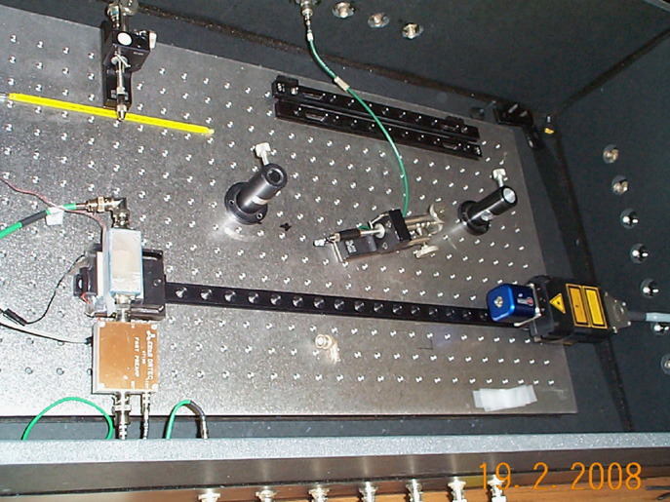
N on P SPM30 and SPM42 – Layout Characteristics
Parameters | Unit | SPM30-60 | SPM30-75 | SPM30-100
Diode active area | mm² | 9.0 | 9.0 | 9.0
Number of pixels per diode |  | 2500 | 1600 | 900
Fill factor | % | 45.4 | 55 | 66
Pixel size | µm² | 60 x 60 | 75 x 75 | 100 x 100
Last STM delivery for FNAL evaluation. SPTR, rise time, linearity, BV, temperature dependences, noise floor (~1mV/1phe).
Always preliminary test of STMs before test beam on the bench at SiDet setups. PiLas laser (17 ps light pulse, sigma, 405nm, 635 nm heads) and equipped dark boxes used.
Parameters | Unit | SPM42-60 | SPM42-75 | SPM42-100
Diode active area | mm² | 17.6 | 17.6 | 17.6
Number of pixels |  | 4866 | 3342 | 1742
Fill factor | % | 45.4 | 54.2 | 66.1
Pixel size | µm² | 60 x 60 | 71 x 75 | 100 x 100
PiLas dark box at SiDet. Shown: optical bench with laser head on the rail, STM with VT120 preamp. The VORTEX cooling system and optical filters are not shown. Noise floor of the detectors placed in the box ~ 0.5 mV . Good for SPTR.

Slide 8
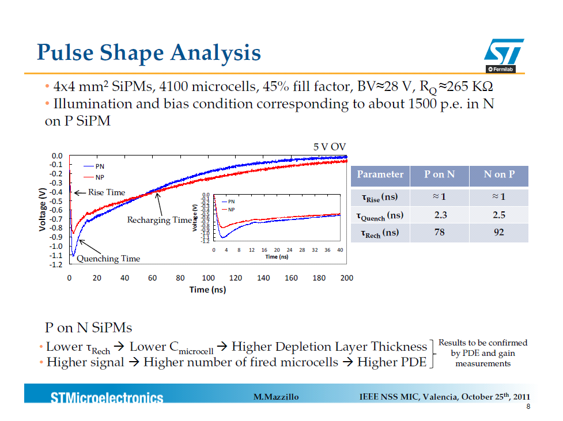
Tau rise – avalanche propagation, collection of carriers in drift region and at the contact across the bulk region. Tau quench - time for avalanche current to decrease from max to zero due to discharge of capacitance of the quenching resistor . Tau recharge - time to recharge all caps thru quenching resistors
The SiPms signal shape play crucial role for SiPm timing. The influence of main parameters on the shape is understood now. STM can technologically change shaping according to requirements. SPICE analysis. Noise counted.

Slide 9
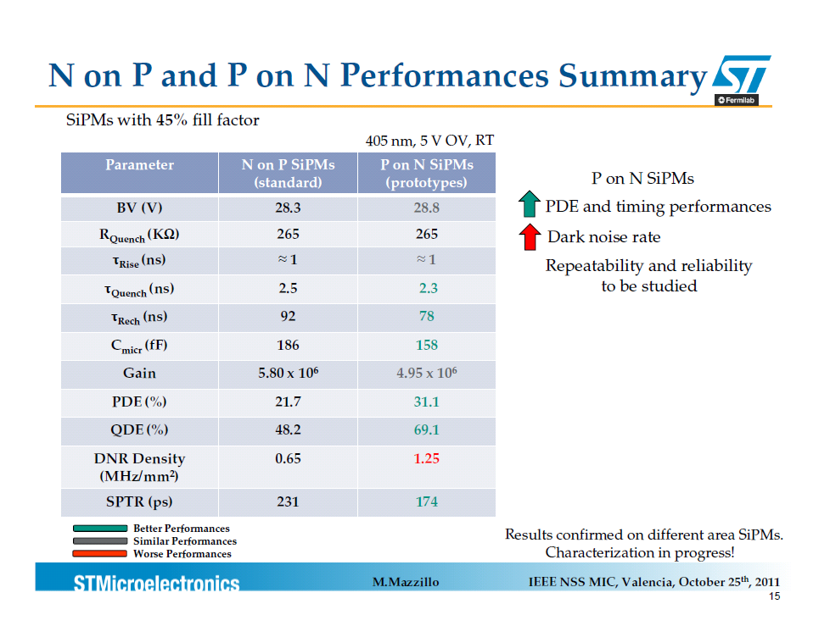
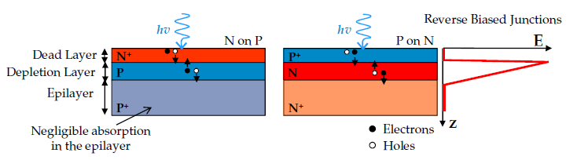
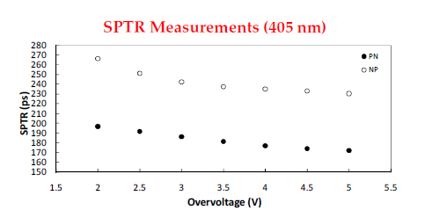
420 nm ~ 50% of the photons absorbs in 150 nm of Si
The P on N structure tested only with PiLas at Fermilab and shows better SPTR timing than N on P. The presented test beam results refer only to N on P. P on N test will be next. Noise amplitude <1 mV/50 Ohm.

Slide 10
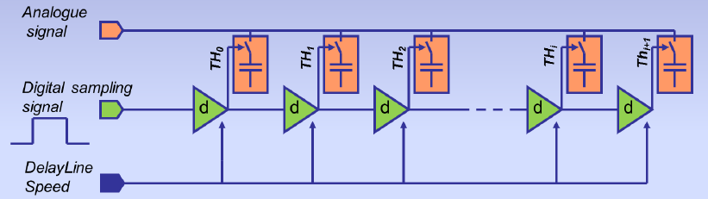
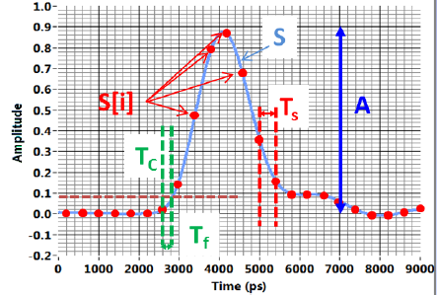
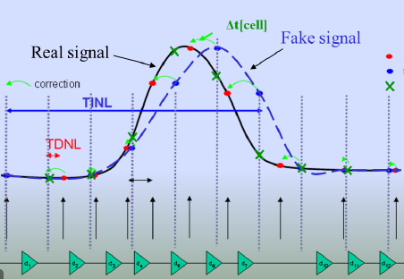
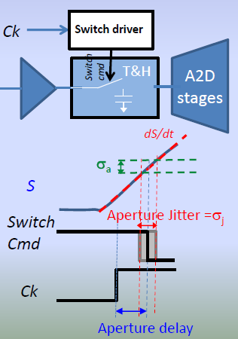
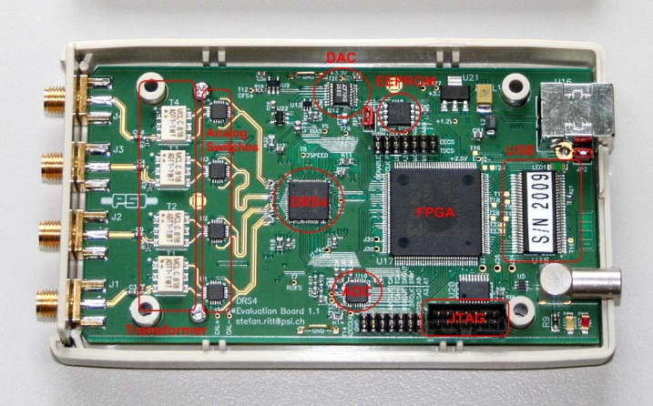
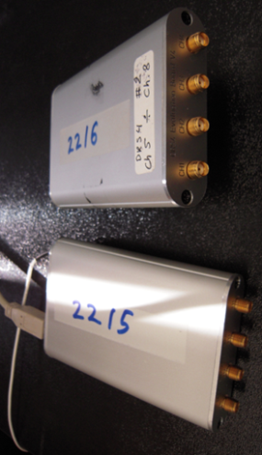
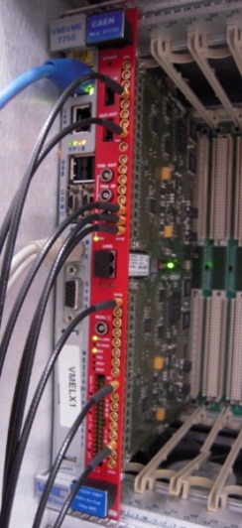
DRS4, (Domino Ring Sampler), introduced by Stefan Ritt, PSI
Principle: Sample & Store an incoming signal in an array of capacitors, waiting for (selective) readout and digitization= bank of Track & Holds. DRS4 can replace old classic TDC, ADC traditional readout. PH and TR measured by the same unit. Used one is capable to digitize 4 input channels at sampling rates 5 Giga-samples per second (GSPS, 200ps/cell). Individual channel depth of 1024 bins and effective range of 12 bits. BW is up to 850 MHz. DRS4 is based on Switch Capacitor Array (SCA). “Aperture” and “random” time jitter. Correction of “aperture” jitter. Noise floor ~1 mV/50 Ohm (Slides below taken from Stefan Ritt (DRS4) and Eric Delagnes (LAPPD).
Switch Capacitor Array (SCA).
Signal sampling
Correction of “aperture” jitter
Key parameters of DRS4
DRS4 unit open, (old) version
DRS4, last version
CAEN V1742

Slide 11
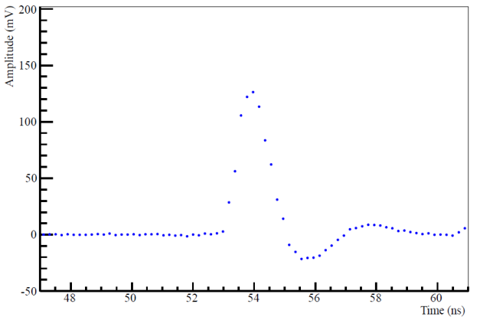
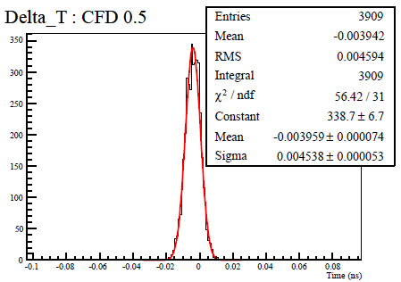

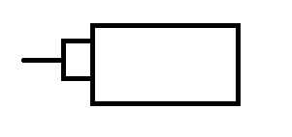

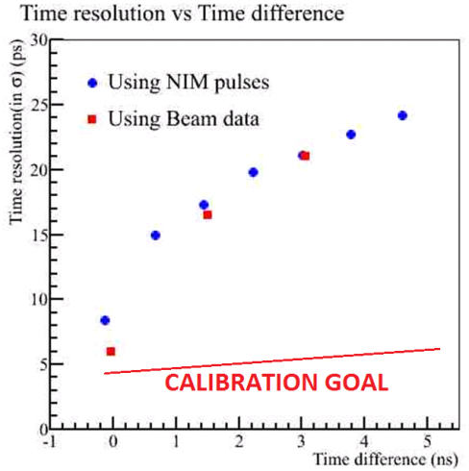
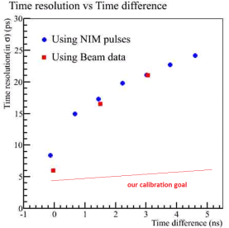
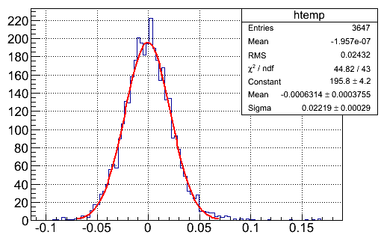
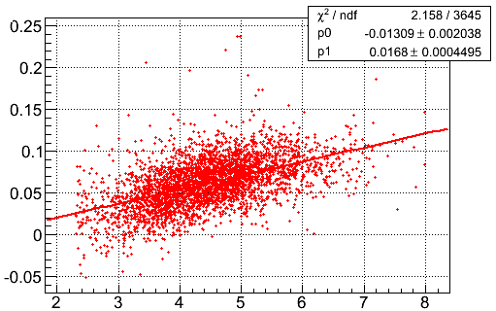
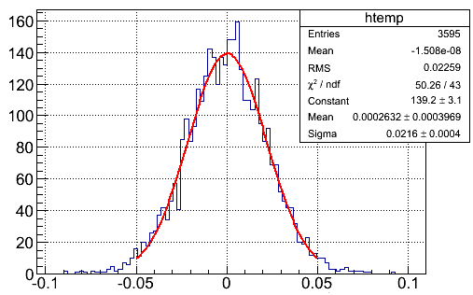
.
Last TB results. ETR. New STMs. DRS4 readout
Photek240, 3 dots on leading edge, 200ps between the dots
ETR=4.5ps
CFD
Same signal split by half and half
DRS4
Electronic Time Resolution (ETR) of the DRS4 depends on delay between “start” and “stop” signals. Start and stop signals are halves of the same signal (Photek240 on the beam or NIM pulse”. DRS4 should be calibrated for the time resolution. For the result shown above the delay was ~ 0ps. Noise floor is still deposit into the DRS4 ETR. TR is the same for both “clipped” and “non clipped” STM signals (also as with PiLas). This allow to get the same high TR without clipping capacitance and amplifier for STM
Example of TB data are below. Conditions: 2 STMs with 30mm long quartz radiator, both along the beam line, (second behind first), 120 GeV protons, normal incidence, TR at the level of 14-15 ps.
14.7ps/STM
Time resolution (TR), 2 STMs
TR (ns) vs. amplitude, skew
TR after skew correction

Slide 12
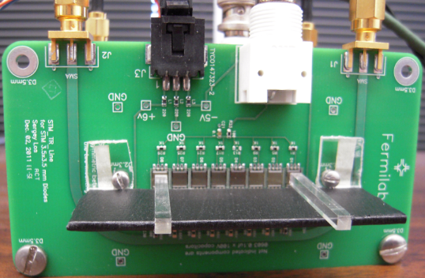
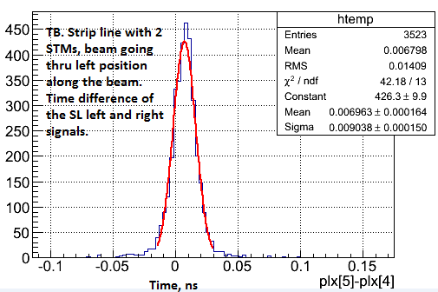
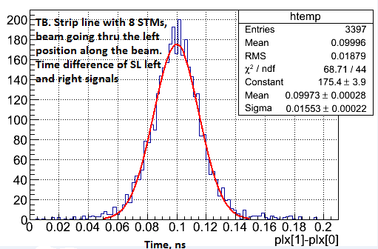
Test beam strip line (SL) results.
9ps
.
15.5ps
Strip line (SL) readout, STMs, DRS4. DRS4 calibrated. SL has signals out left (L) and right (R). Time difference measured between L and R out (SMA connectors shown) for the same STM. STMs along the SL placed with 5 mm step. Distance between STM #1 and #8 is 35 mm. 35 mm corresponds 185.5 ps (PiLas) Strip Line Speed (SLS)=0.63c (c is speed of light in vacuum). 3x3x30mm3 quartz radiator on STMs, normal particle incidence.TR is 15.5 and 9.0 ps (number of photoelectrons ~ 40). The SL dynamic range corresponds ~ two DRS4 cells (each cell is 200ps at 5Gs/s). 3x3x30mm3 quartz on STMs (only one STM irradiated each time, 30mm along the beam, normal incidence).

Slide 13
Summary
Continue Fermilab TOF systems development. Our area: silicon photomultipliers and new readout, based on fast wave forms digitizers (e.g. DRS4).
The best time resolution obtained with STM in beam conditions is at level of 14 ps (new STMs, new readout, DRS4, FTBF).
The readout with the strip line is about 10 ps on the beam.
Work together (including direct contacts) with STM producers (Massimo Mazzillo) and DRS4 inventor (Stephen Ritt). We benefit also from direct contact with PSEC4 producers in frame of LAPPD project.
Setup for new SiPm study with DRS4 readout arranged at SiDet. We have studied timing properties (Single Photoelectron Time Resolution (SPTR), signal shape dependence on SiPm structure, SiPms noise floor of several SiPms producers (STM, MPPC, IRST (FBK), SensL, Kotura, MePhy, CPTA, etc.).
Our choice is limited with two types of SiPms by now - STM, Catania, Italy and MPPC. We study now STMs mostly by using MPPC as reference. Why? Because of very good last results with STMs (including last P on N structure), perfect feedback and free of charge STMs delivery to FNAL.
Continue to investigate the influence of SiPm structure on SPTR by illuminating SiPms with blue (405nm) and red (635nm) light of the PiLas laser head. We understand this effect.
Continue to study of SiPm’s time resolution (at picosecond level) in dependence on temperature and bias voltage. We defined the requirements.
The TOF based on the SiPms used in FTBF (FNAL), HFS (LHC), Tauwer , etc.
The obtained TB results will be useful for our PET-TOF application.
12

