Slide 1
Development of a new fast shower maximum (SM) detector based on micro channel plates photomultipliers (MCP-PMT) as an active element.
Anatoly Ronzhin,
Fermilab
March 25, 2014
Team: Sergey Los, Erik Ramberg, Fermilab
Artur Apresyan, Si Xie, Maria Spiropulu, Caltech
Andriy Zatserklyaniy, University of Puerto Rico

Slide 2
Outline
A bit history of using Secondary Emitters in SM.
Large Area Picosecond Photo Detector (LAPPD).
Micro Channel Plates properties.
Proposal to use Micro Channel Plates in Sampling Calorimeters with Timing.
Digital Sampling Readout. DRS4. PSEC4.
First test beam results. SM time resolution.
Plans. Summary

Slide 3
Our goal
One of possibility to make fast and radiation resistant shower maximum (SM) detector (or calorimeter) is to use secondary emitter as an active element. We proposed to use secondary emitter materials (micro channel plates, MCPs) as an active element in sandwich type calorimeter. This work initiated another type research based on PMT dynode system as secondary emitter. The main limits to introduce the technique into practice was high cost of MCPs. Now the cost can go significantly down due to the Large Area Picosecond Photodetector (LAPPD) progress. We present below test beam results, obtained with different type of the detectors based on the MCP-PMT. The time resolution obtained for this new type of detector is at the level of 20-30 ps. The work could be considered as first step in building new type of calorimeter based on the same principle.

Slide 4
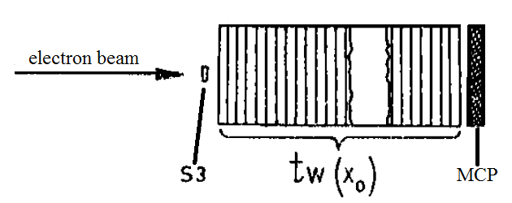
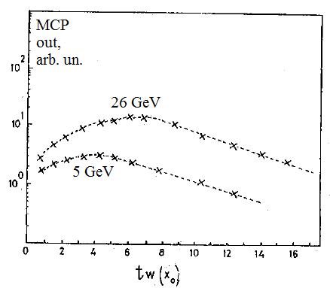
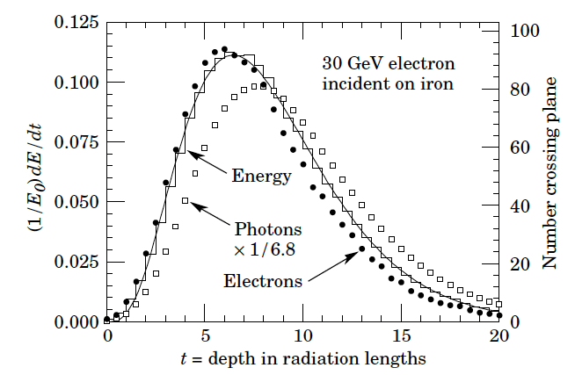
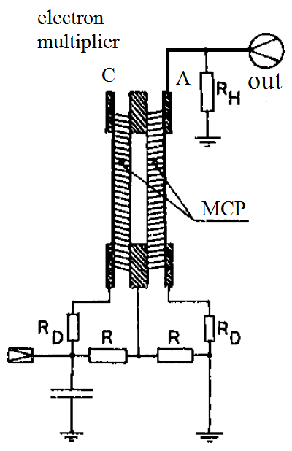
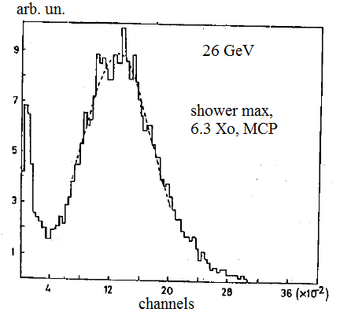
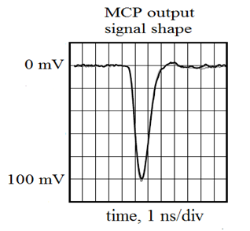
Proposal of new type calorimeter, radiation resistant and fast, 1990.
MCP amplitude in dependence of the tungsten thickness
Test beam, tungsten absorber thickness changed
MCP schematics
Pulse height
Sandwich calorimeter with electron multipliers as an active elements was first proposed.

Slide 5
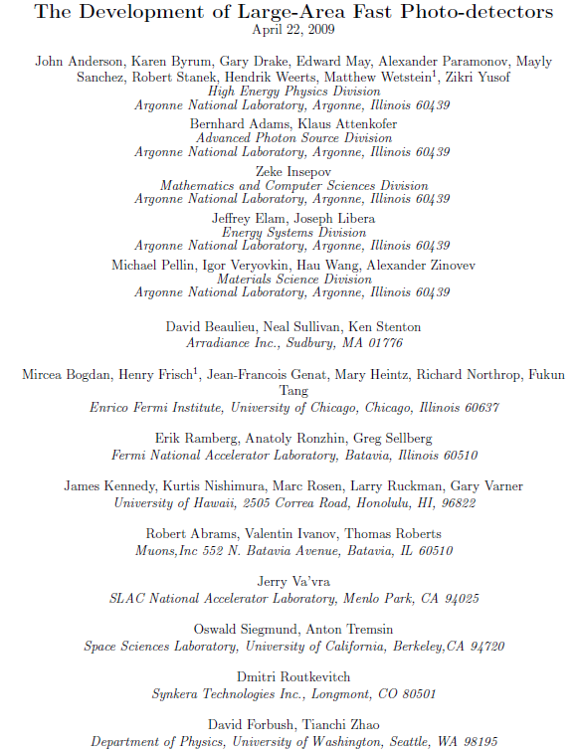
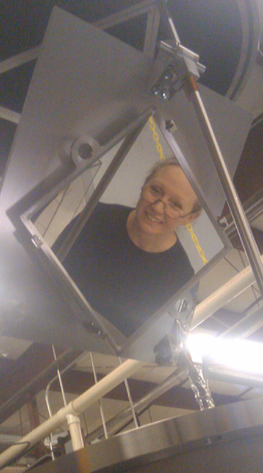
LAPPD, Large Area Picosecond Photodetector

Slide 6
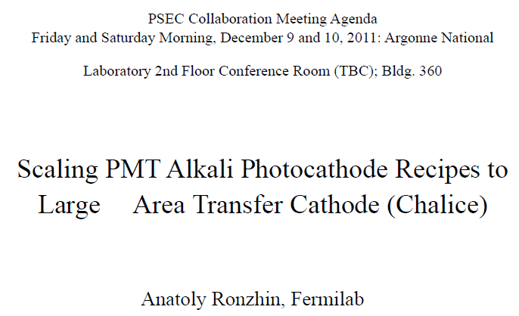
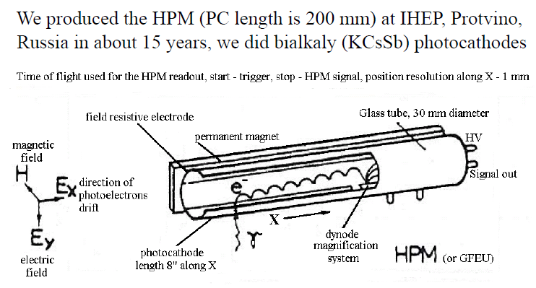
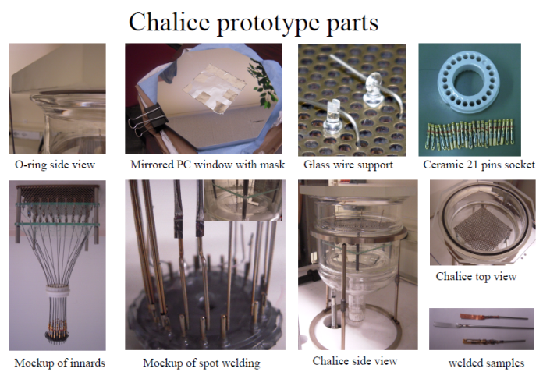
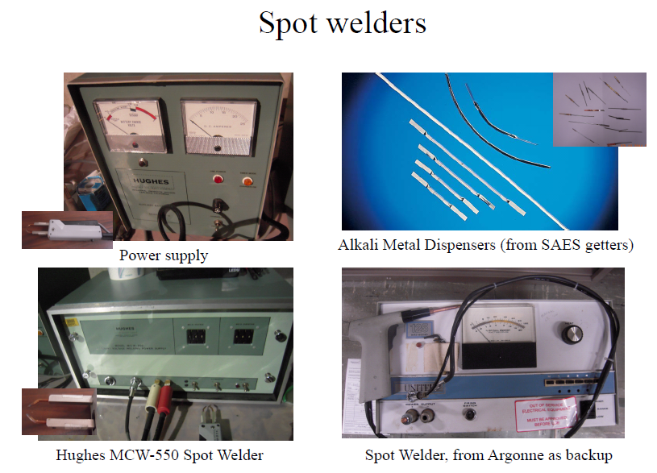
We transferred our PC production technology to Argonne
.

Slide 7
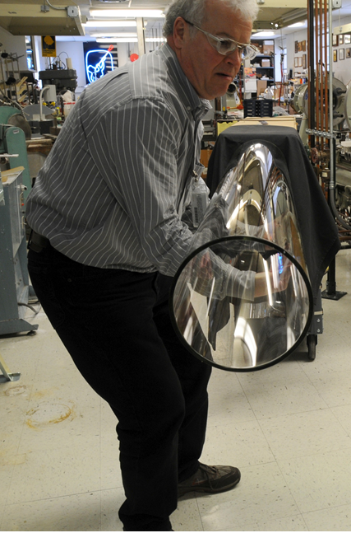
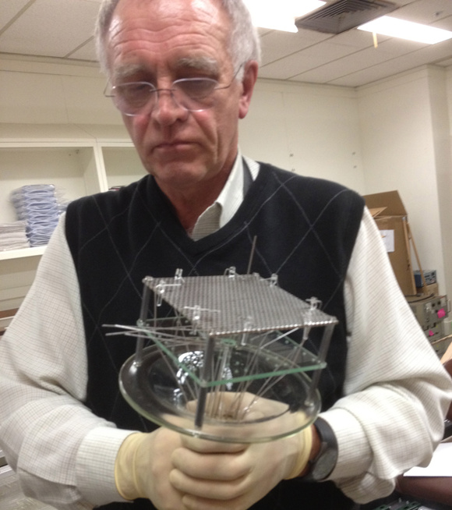
Joe Gregar and Anatoly at Argonne glass shop, making chalice
.

Slide 8
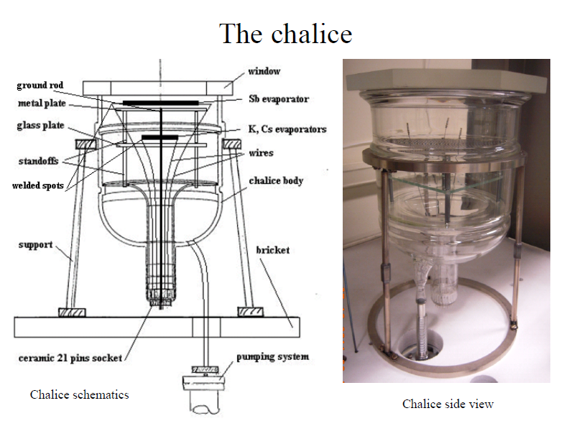
Chalice structure

Slide 9
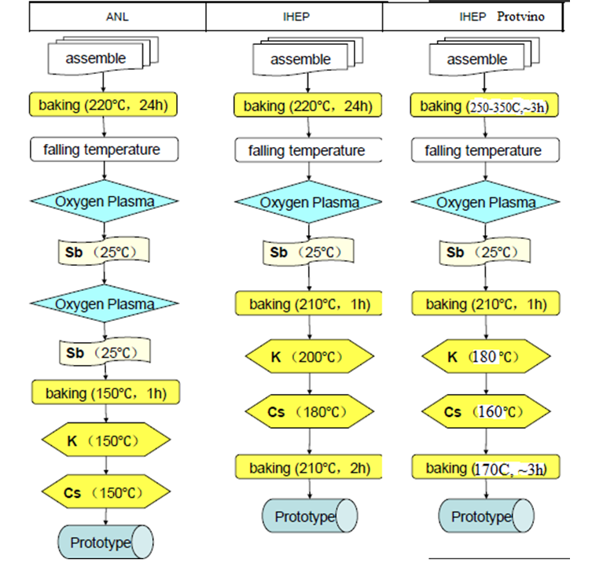
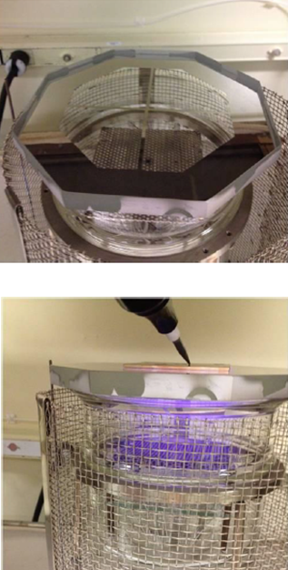
The different technology to make PC, chalice
.

Slide 10
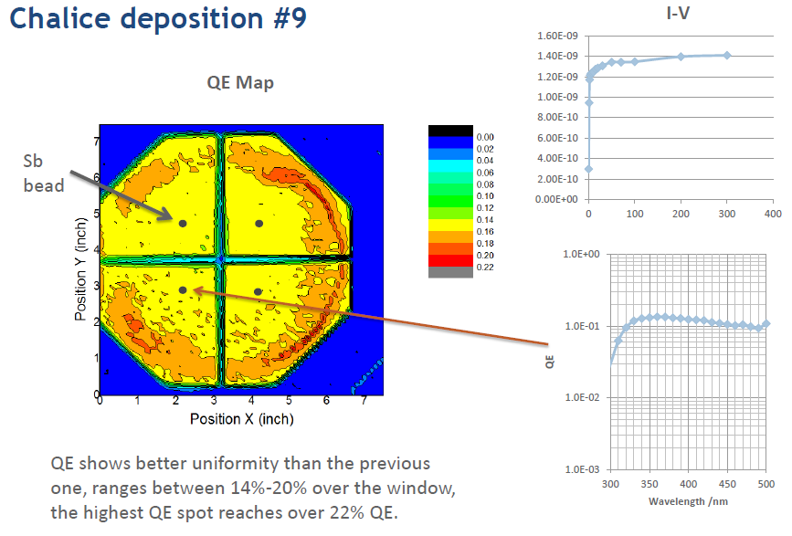
v
.

Slide 11
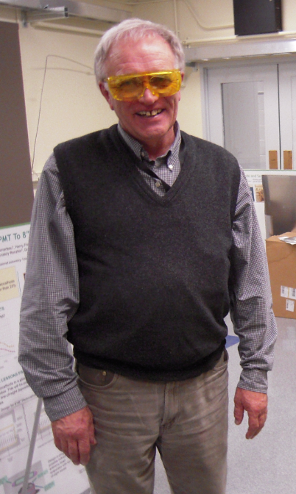
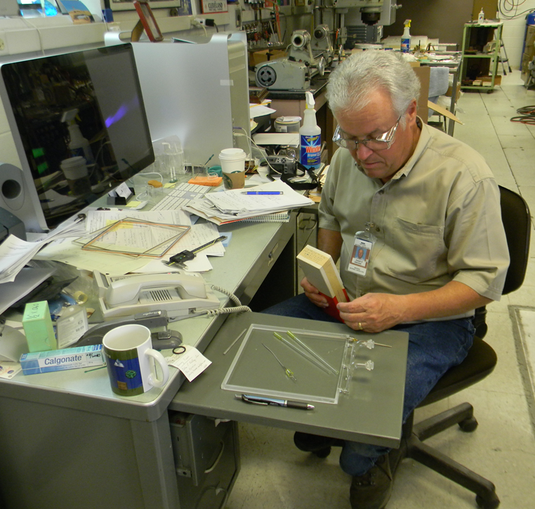
Joe Gregar and Anatoly at Argonne glass shop, making chalice
.

Slide 12
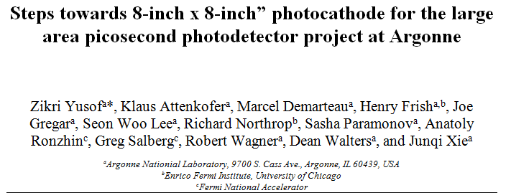
PC papers
`
The Timing Properties of a Picosecond MCP-PMT measured at the Fermilab MTEST Test Beam
John Anderson, Karen Byrum, Gary Drake, Camden Ertley, Henry Frisch,
Jean-Francois Genat, Edward May, Richard Northrup, Anatoly Ronzhin,
Erik Ramberg, Fukun Tang
Argonne National Laboratorya, University of Chicagob
,Fermi National Accelerator Laboratoryc

Slide 13
Hermetic Packaging Godparent Committee
The charge to the Godparent committees is: “To monitor progress, identify problems, provide wise advice and support to those working in the sub-area.
A design for a detector that uses thin cheap transmission-line readout MCP’s to solve the depth-of-interaction problem, and that has excellent energy, position, and time resolution. The electronics consists of cheap, low power, wave-form sampling that locally converts hits into energy, time, and provides a Level-1 trigger for readout.
Packaging is probably our most complex area at present - today is a chance to think, decide, and help…
Hermetic Packaging Godparent Review – taking place every year starting 2010.
Committee Members: Katsushi Arisaka (UCLA-HEP), Karen Byrum (Argonne-HEP), Henry Frisch (UC), Scott Moulzolf (U.Maine – HEP), Michael Minot (MinoTech Eng), Anatoly Ronzhin (Fermilab-HEP), Jeff Elam (Argonne-ES), Jean-Farncois Genat (LPNHE, Paris), Daniel Ferenc (UC-Davis-HEP), Paul Hink (Photonis)

Slide 14
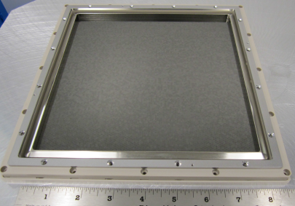
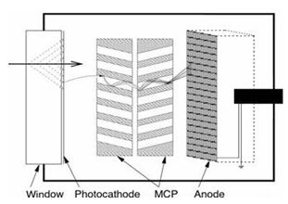
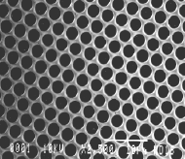
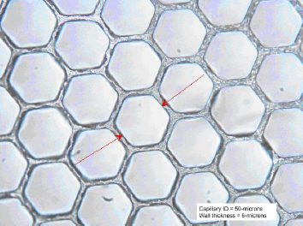
What is micro channel plate (MCP)?
A micro-channel plate (MCP) is a slab made from highly resistive material of typically 2 mm thickness with a regular array of tiny tubes (micro channels) leading from one face to the opposite, densely distributed over the whole surface.
MCP materials: lead glass,
borosilicate glass, aluminum oxide…
Different technology developed.
Metallization process is covering MCP by NiCr, to make electrical contact for HV leads.
.
LAPPD
MCP
A standard MCP is produced by chemical etching of a fused fiber optic that is produced using specialized (and expensive) core and clad glass. The core glass is etched away from the plate and the cladding is hydrogen fired to produce a thin layer of semi- conducting reduced lead oxide on the surface of the MCP pores. INCOM’s MCP is fabricated using a unique hollow draw process that eliminates the need for a specialized core glass that needs to be removed

Slide 15
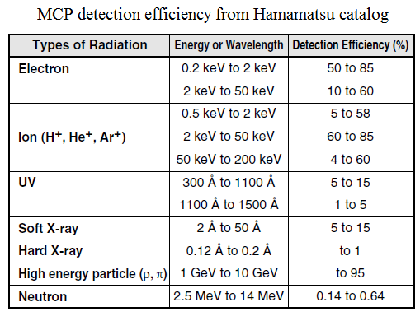
`

Slide 16
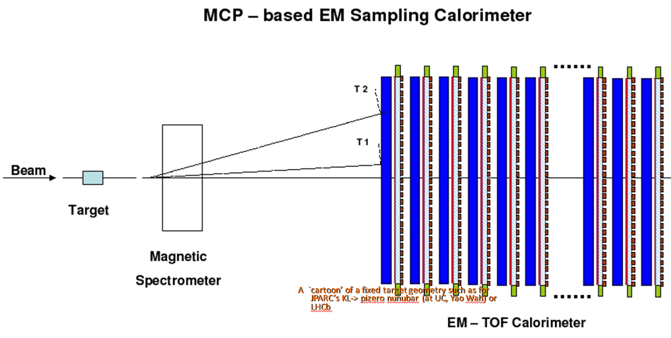
Use of Flat Panel Microchannel Plates in Sampling Calorimeters with Timing
Anatoly Ronzhin (Fermilab) and Henry Frisch (EFI, Univ. of Chicago)
Here we propose using large-area MCPs (produced in frame of the LAPPD project) assembled without the usual bialkali photocathodes as the active element in sampling calorimeters. LAPPD modules without photocathodes can be economically assembled in a glove box and then pumped and sealed using the process to construct photomultipliers, bypassing the slow and expensive vacuum-transfer process required by bialkali photocathodes.

Slide 17
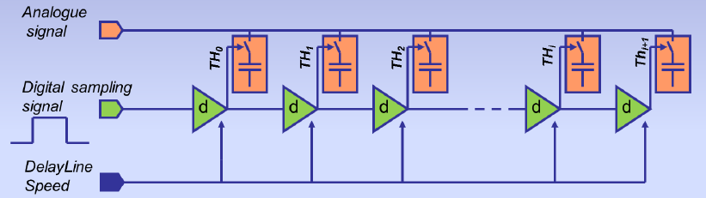
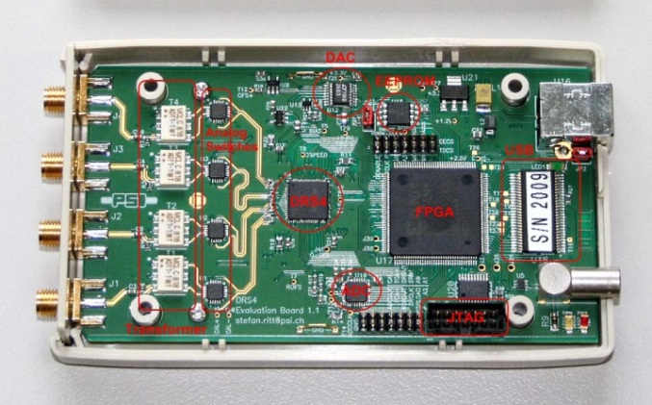
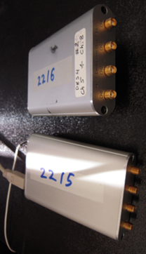
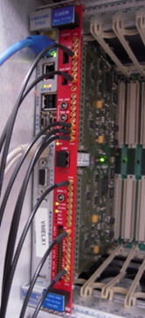
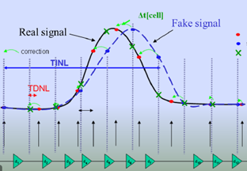
DRS4, (Domino Ring Sampler), introduced by Stefan Ritt, PSI
Principle: Sample & Store an incoming signal in an array of capacitors, waiting for (selective) readout and digitization= bank of Track & Holds. DRS4 can replace old classic TDC, ADC traditional readout. PH and TR measured by the same unit. Used one is capable to digitize 4 input channels at sampling rates 5 Giga-samples per second (GSPS, 200ps/cell). Individual channel depth of 1024 bins and effective range of 12 bits. BW is up to 850 MHz. DRS4 is based on Switch Capacitor Array (SCA). “Aperture” and “random” time jitter. Correction of “aperture” jitter. Noise floor <1 mV/50 Ohm (Slides below are taken from Stefan Ritt (DRS4) and Eric Delagnes (LAPPD).
Switch Capacitor Array (SCA).
DRS4 unit open, (old) version

Slide 18
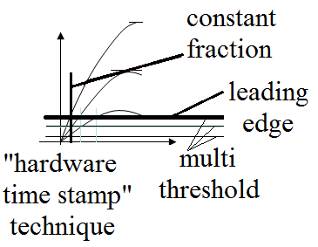
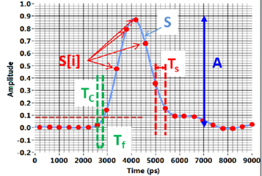
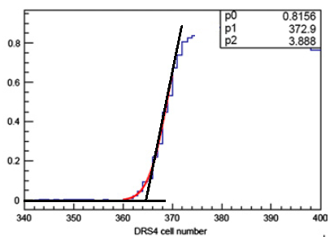
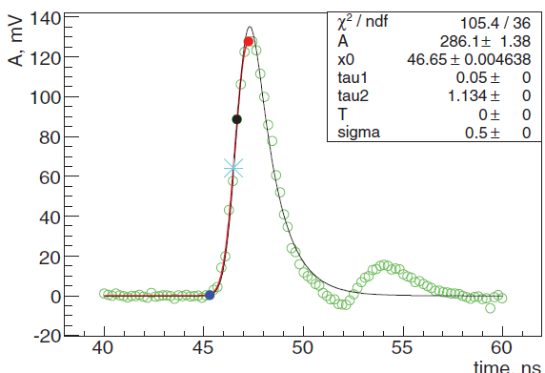
Algorithms for time measurements, “time stamp”
`
sampling
Linear leading
edge approximation cross with X-axis

Slide 19
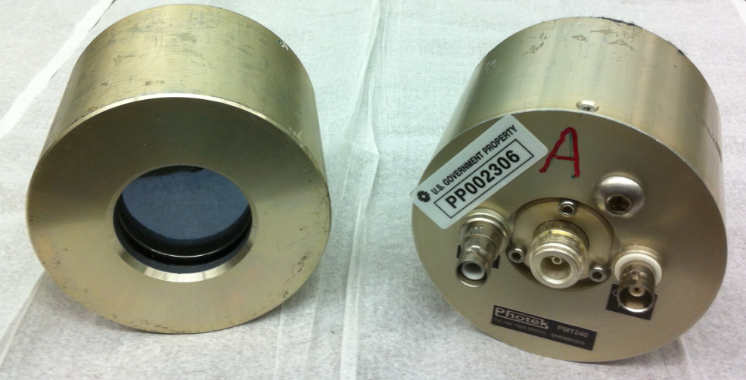
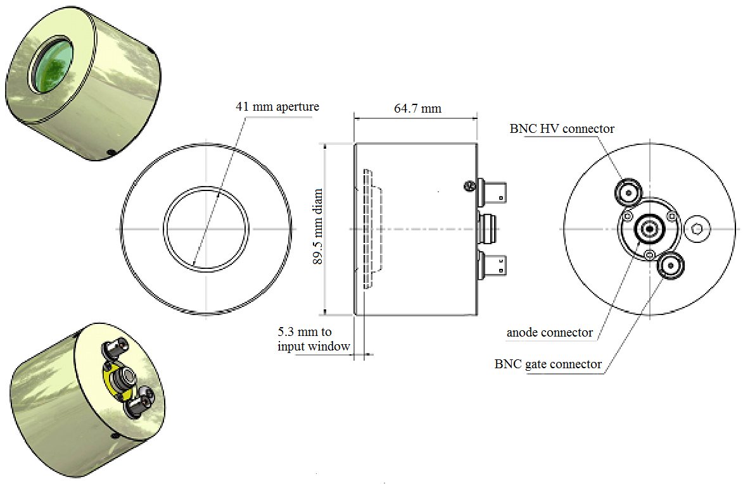
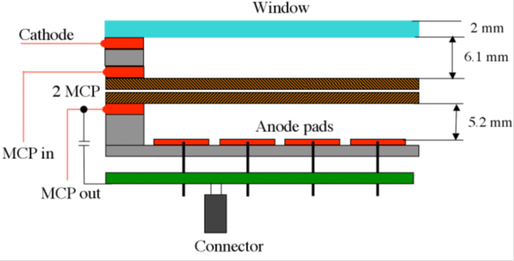
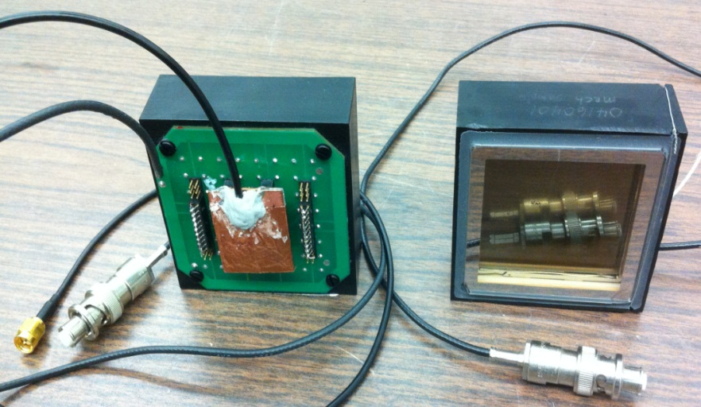
Photek 240 and Photonis MCP-PMT as the SM active element
Photek 240
Timing uniformity across 41 mm diameter PC is ~3ps
Photonis
Timing uniformity across 25x25 mm2 ~30 ps

Slide 20
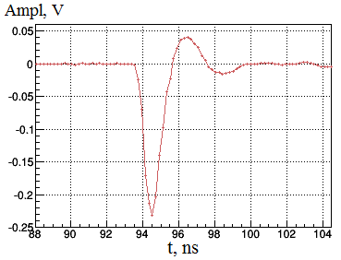
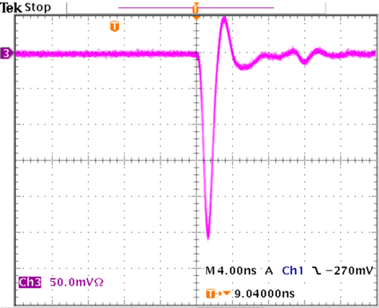
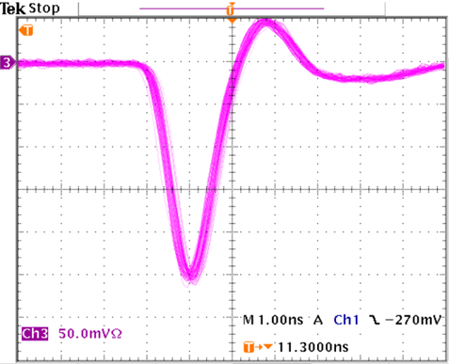
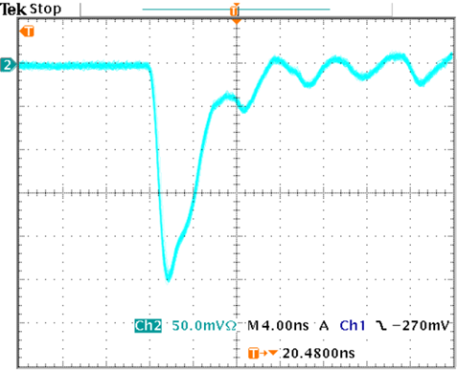
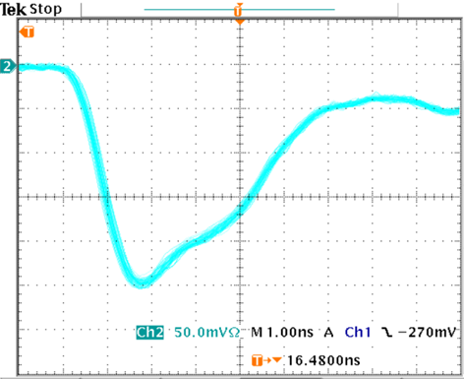
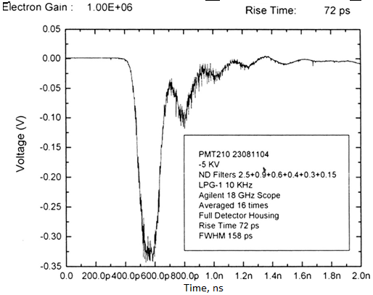
MCP-PMT output signal shapes, FWHM ~ 1 ns
Photek 240
Photek 240
Photek 240,
DRS4 sampling
Photek 210, specs
Photonis
Photonis

Slide 21
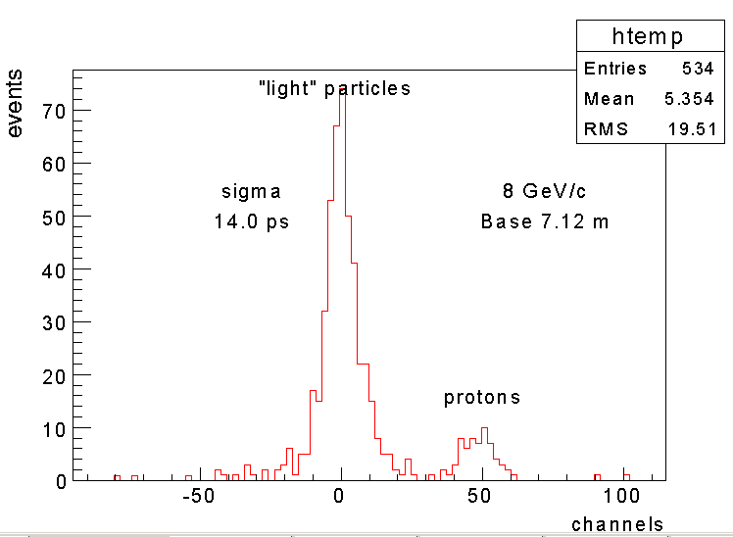
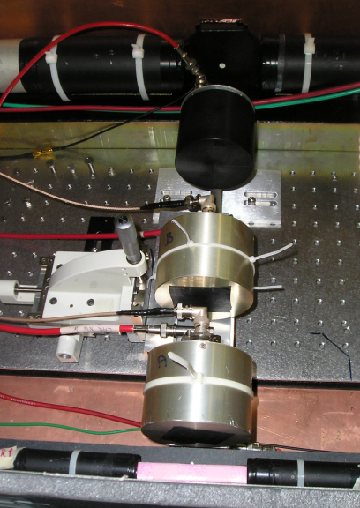
Old TOF result with Photek 240 and Ortec readout
12.4 ps, sigma, obtained in “close” location of both “Start” and “Stop” counters (Photek 240). 120 GeV/c proton beam, normal incidence. Ortec Electronics.
14 ps, sigma, obtained with the same counters with Stop counter located by 7.12 m away from Start counter in a beamline. The secondary beam momentum is 8 GeV/c.
12

Slide 22
January 2014 test beam
`
We used the Fermilab Test Beam Facility (FTBF), which provided proton beams from Fermilab’s Main Injector accelerator at 120 GeV/c, as well as secondary positron beams with 12 GeV/c and 32 GeV/c. Detectors were located inside of a dark box lined with copper foil for RF shielding. Trigger was based on a 10x10 mm2 scintillation counter. The three detectors (two Photek 240 and one Photonis between them) were placed in line. A stack of lead generating a shower, when high energy particle pass through it, was placed before MCP-PMT (Photonis in the picture below). The Photonis detector was swapped by second Photek 240 in some of the measurements, without any modification to the cabling. We name the detectors below as “start” counter (always first Photek 240), upstream (Photonis in the Fig. 3) and downstream shower maximum (SM) detectors. A stack of lead plates can be seen to the left from Photonis detector. For measurements with the positive secondary beams, we selected positron events with the Test Beam Facility’s - gas Cherenkov counter. The fraction of the positrons in the 12 GeV/c positive secondary beam was ~50%.
We found that it is also possible to identify positrons using the signal of the downstream Photek 240. For positron events large signals near the end of the dynamic range of the unattenuated channel were produced. Using positron events selected by the gas Cherenkov counter we found the efficiency of the amplitude selection with the downstream Photek 240 to be ~97%. We have selected positrons with Cherenkov counter with 12 GeV/c beam and downstream SM with 32 GeV/c.

Slide 23
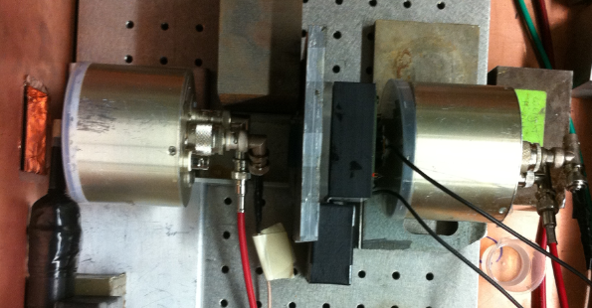
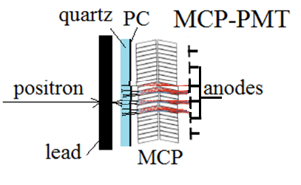


Test beam setup, DRS4 readout.
‘

Slide 24




“Electronics” and TOF MIP time resolution
“Electronics” time resolution always measured first. We have to be sure that electronics does not introduced significant time jitter in our measurements. We split the same signal and apply as “start” and “stop” to measure time jitter. The best we had with Ortec readout was ~2 ps. With DRS4 we have ~5 ps, but Stefan Ritt got ~1ps in the last DRS4 version.
`
“electronics”
for the DRS4
“electronics”
for the DRS4

Slide 25



Events selection, time correction on amplitude
To assign a time stamp for each signal pulse, we first determine the time position of the pulse peak. A Gaussian function is fitted to the pulse maximum using three points before the maximum of the pulse peak and four points after the maximum. The mean value of the Gaussian was used as the time stamp for each pulse. Event selection and pulse cleaning procedure eliminated abnormal pulses in the readout. Large signals above 500 mV were also rejected because they saturated the DRS4 inputs. Pulses with an irregular peak profile were rejected, as well as pulses which experienced a sudden reversal of polarity that is occasionally observed with our readout. We selected the pulses with larger than 20 mV amplitude for future analysis. Events containing more than one pulse within our readout window were not used.
We observed a linear dependence of the measured time difference between signals of the “start” counter (Photek 240, channel 1) and the Photonis (channel 3) with the amplitude of the Photonis detector signal. Therefore we perform a time correction for each event on the measured amplitude.
`

Slide 26





The SM pulsed height and time resolution, 12 GeV, 32 GeV
Photonis, 12 GeV, 2 mm of quartz, input window, 10 mm of lead
Photonis, 12 GeV,
5.5 mm of quartz,
10 mm of lead
Photonis 12 GeV, 9 mm of quartz,
10 mm of lead
Photonis, 12 GeV

Slide 27



Plans
Lab test of MCPs w/o PC.
Test beam with new prototype: NO PC, 5 MCP layers, 200 x200 mm2 size, strip line readout, PSEC 4.
MCP rad hardness test, especially for borosilicate substrate.
irradiation

Slide 28



Readout: Strip Line or Pixels
`
SL allows less readout channels, 64 instead 1024 in the case. The SL bandwidth is up to few GHz, SL can be serialized. Position X resolution along the line is ~ 1 mm, depends on pixel size. Y position determines by line number. Time resolution of SL is ~ few ps.
We produced few type of SL with propagation speed ~0.4-0.6c. Timing To = (T1 +T2)/2. Position along the line, X = (T1 – T2)/(T1 + T2).

Slide 29





Argonne MCPs, strip line readout, PSEC-4 readout
Strip Line and strip number readout

Slide 30


Slide 31
Summary
We made measurements with different types of MCP PMT as shower maximum detector. The measurements were performed at the Fermilab Test Beam Facility with 120 GeV/c primary proton beam and 12 GeV/c and 32 GeV/c secondary beams. We obtained time resolution for the SM detector based on Photek 240 at the level of 20 – 30 ps. The SM detector, based on the Photonis MCP-PMT, also achieves a very good TR, ~35 ps. We feel that this level of performance, even with a large MCP pore size (diameter ~25 μm), enables the development of SM detectors for collider experiments at a potentially much reduced cost. The success of the LAPPD project in developing affordable MCP’s is encouraging in this respect. More savings are possible if it can be shown that bare MCP’s without an associated photocathode, can give similar timing performance. We plan on performing a future beam test to study that.
Our invented method to make tile - fiber calorimeter (“Optical fiber readout for scintillator calorimeters”; V.I. Kryshkin, A.I. Ronzhin, NIM A247 (1986) 583-585) - used in the lot of experiments – CMS, CDF before, and much more now… We hope that our proposal to use secondary emitters as active elements in shower maximum detectors (as well as in calorimeters) also can find a lot of applications.
Few team started to study proposed approach: Ionization micro channel plates for fast timing of showers in high rate environments, T. Tabarelli de Fatis et al, INFN, 10/8/13 report; Forward CMS upgrade calorimeter collaboration, Burak Bilki et al., FNAL test beam 2014; NICA experiment in JINR…

Slide 32
Acknowledgements
Thanks to Aria Soha for test beam support, Mike Albrow for sharing beam time, Henry Frisch for useful discussion.

Slide 33


