Slide 1
State of the art and perspectives
of CMOS avalanche detectors
Lucio Pancheri
DII, University of Trento & TIFPA-INFN, Italy
CERN seminar
January 20, 2017

Slide 2
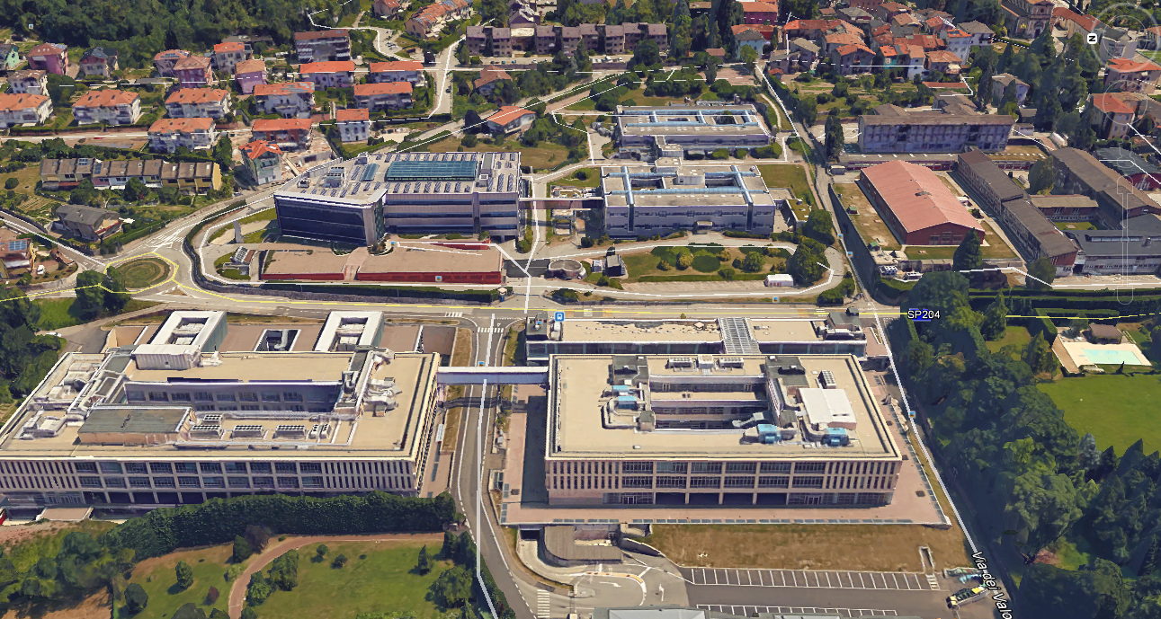
Research on silicon detectors in Trento
Clean room
UniTN
Dept. Physics
FBK
INFN-TIFPA
UniTN
Dept. Industrial
Engineering

Slide 3
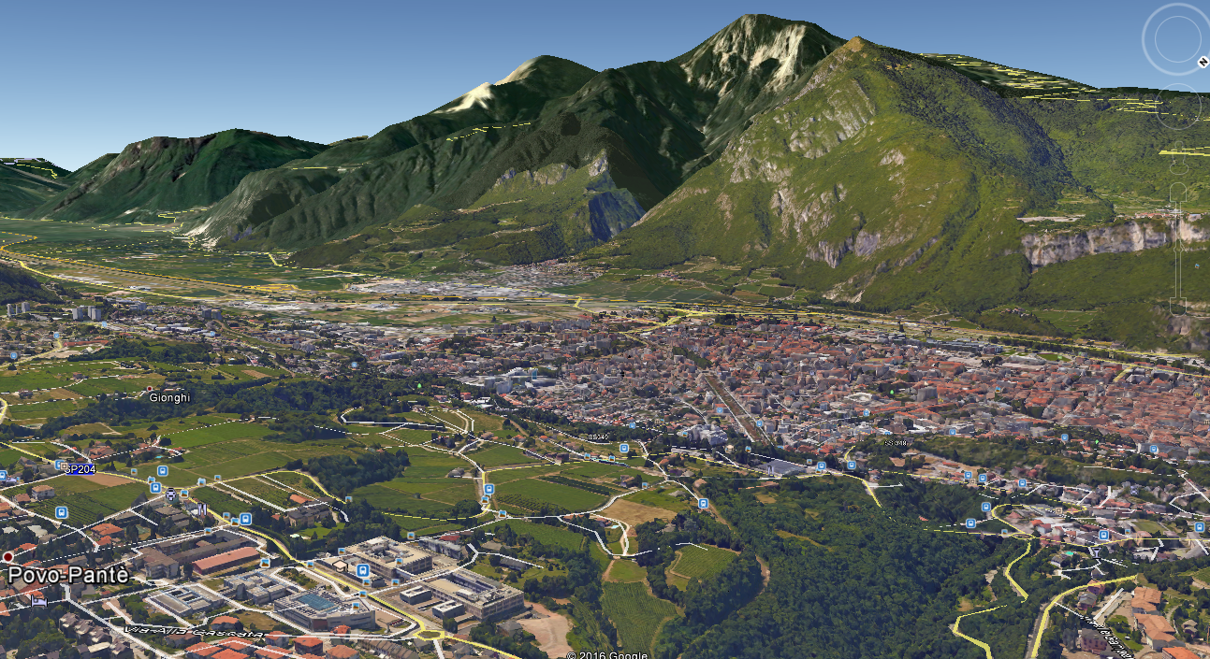
Proton therapy
TIFPA
UniTN
FBK

Slide 4
Outline
Introduction
CMOS-integrated single-photon detectors:
an overview
APiX: Geiger-mode avalanche pixel detectors for ionizing particles
Conclusion and future perspectives

Slide 5
Geiger-mode avalanche detectors
a.k.a. Single-Photon Avalanche Diodes (SPADs), SiPM cell
I_{SPAD}
V_{EX}
V_{BIAS} > V_{BD}
Avalanche
triggering
Quenching
SPAD
R_{Q}
V_{SPAD}
V_{B}
V_{BIAS}
Recharging

Slide 6
Geiger-mode avalanche detectors
1 primary generated electron-hole pair:
very large current pulse ~10⁵ - 10⁶ electrons
Vout
V_{BIAS} > V_{BD}
SPAD
V_{EX}
Vout
R_{Q}
time
events

Slide 7
CMOS SPAD characteristics
Features:
Single-photon sensitivity → shot noise limited
Excellent timing resolution: ~100 ps FWHM
Monolithic integration of SPAD and
processing electronics
Arrays → single-photon imaging
CMOS:

Slide 8
Outline
Introduction
CMOS-integrated single-photon detectors:
an overview
APiX: Geiger-mode avalanche pixel detectors for ionizing particles
Conclusion and future perspectives

Slide 9
CMOS SPADs: early example at EPFL
Process: CMOS 0.8μm
Area: 30μm²
Peak PDE: 20%
DCR: 300 Hz
Timing resolution: 50 ps FWHM
A. Rochas et al., Proc. SPIE 2003

Slide 10
CMOS SPADs: deep submicron
Process: CMOS 130 nm
Area: 50μm²
Peak PDE: 33%
DCR: 40 Hz
Timing resolution: 237 ps FWHM
J. Richardson et al., IEEE Trans. Electron Dev. 2011

Slide 11
CMOS SPADs: high efficiency
Process: CMOS 350nm
Imaging with custom
implantation
Area: 700μm²
Peak PDE: > 50%
DCR: 50 Hz
Timing resolution: 142 ps FWHM
D. Bronzi et al., Proc. IEEE ESSDERC 2012

Slide 12
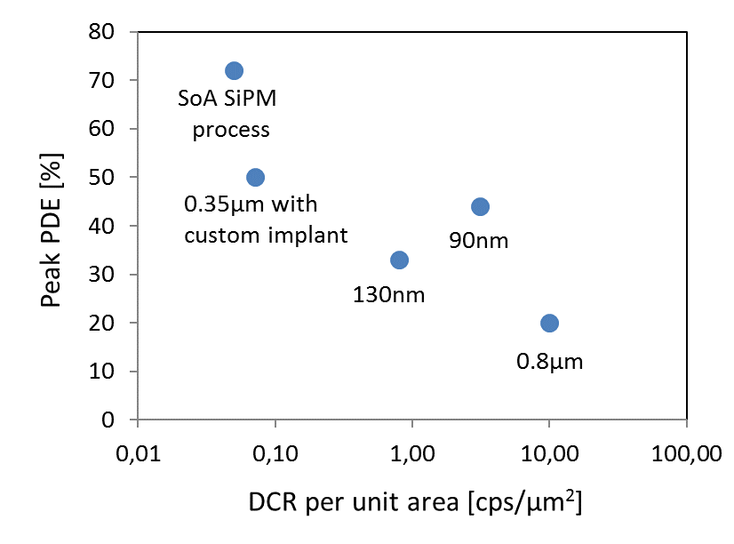
Summary and comparison with SiPM
SiPM:
For major manufacturers
PDE > 70% (single cell, not
considering FF)
DCR ~ 50 kHz/mm²
With customization, CMOS can approach SiPM performance
For a complete overview, see D. Bronzi, et al., IEEE Sensors J. 2016

Slide 13
SPAD array applications
Time-Of-Flight optical ranging, LIDAR
Fluorescence spectroscopy
Raman spectroscopy
Gamma ray detection (PET)
Quantum cryptography
…

Slide 14
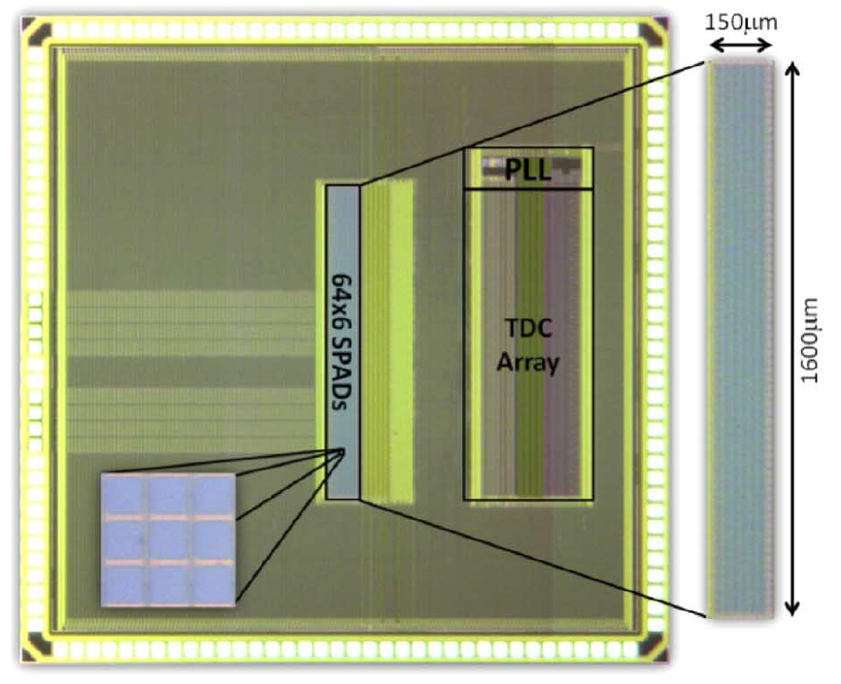
Time-of-Flight optical ranging
Automotive LIDAR developed
by Toyota
180nm CMOS
SPAD array with integrated TDCs
70% array Fill Factor
Distance range: 100 m
C. Niclass et al., IEEE J. Solid-State
Circuits, 2013

Slide 15
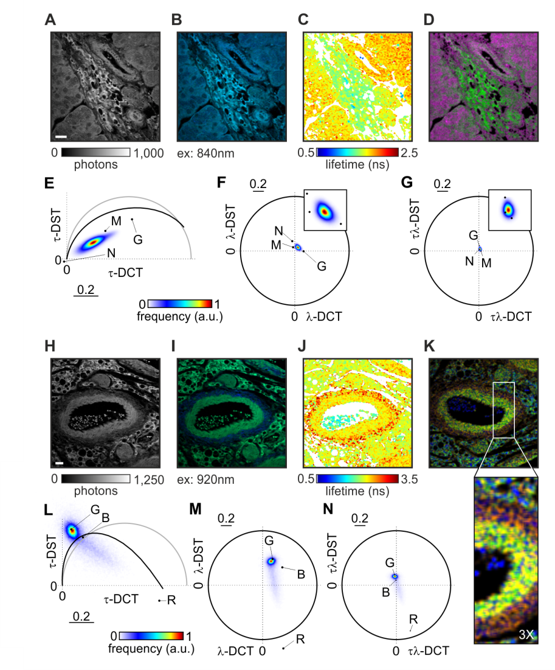
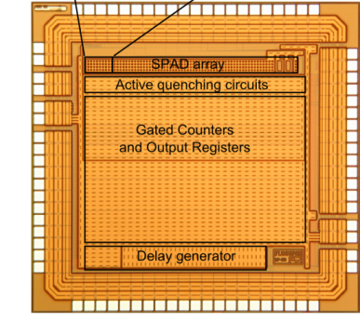
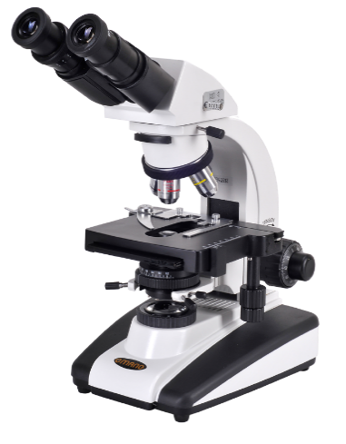
Fluorescence microscopy
Multi-parametric fluorescence imaging
350nm CMOS (AMS)
4-line SPAD array
Sub-ns gated counters
36% Fill Factor
Intensity
Color
Lifetime
Label-free imaging of unstained liver tissue excised from a tumorogenic murine model
M. Popleteeva et al., Opt. Expr, 2015

Slide 16
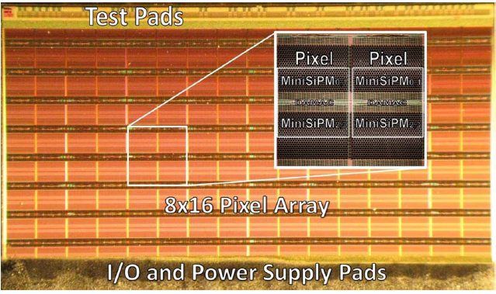
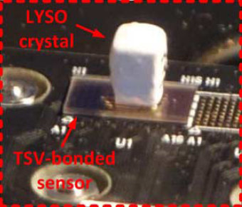
Digital SiPMs for PET
SPADNET project (EU FP7)
130nm CMOS process
Large pixels including 180 SPADs
(Mini-SiPM)
integrated TDCs
42.6 % pixel Fill Factor
L. Braga et al., IEEE J. Solid-State Circuits, 2014

Slide 17
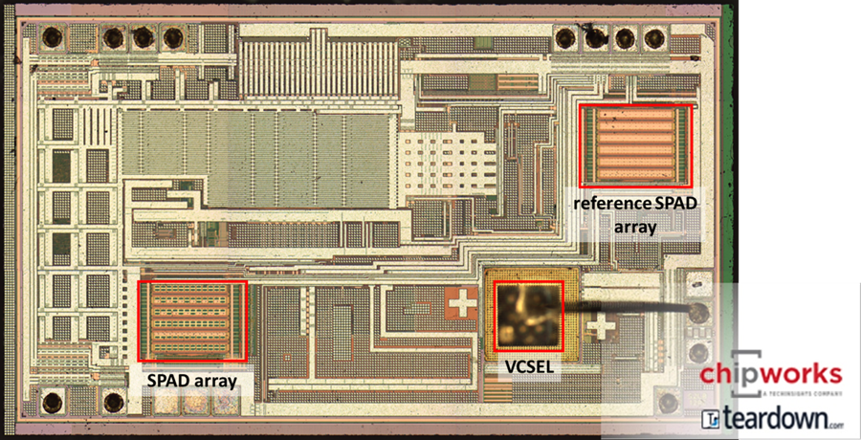
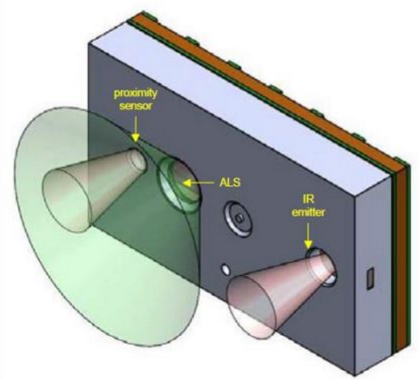
First consumer products: ST ToF sensor
Proximity sensor based on SPAD array and pulsed VCSEL
Presented in 2014
Mobile applications
(mounted on iPhone7)
Low power
Short range (15 cm)

Slide 18
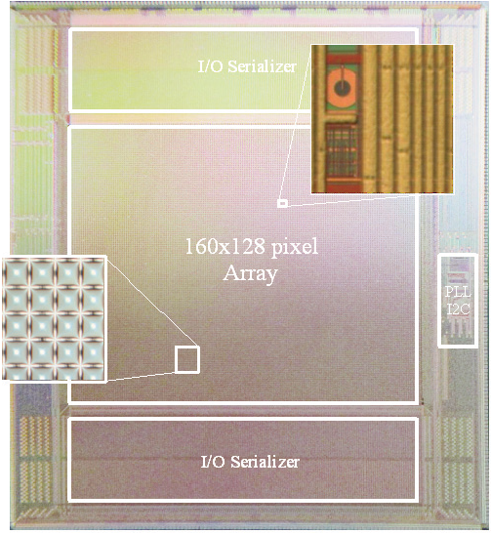
SPAD image sensor
MegaFrame EU project (FP6)
160 x 128 pixel array
Technology: 130nm CMOS
In-pixel Time-to-Digital Conv.
140ps timing resolution
Pixel pitch: 50um
Fill factor: 1%
C. Veerappan et al., ISSCC 2011

Slide 19
Improving the Fill Factor
16μm x 16μm pixel
65nm CMOS
binary pixel
(7 transistors)
SPAD deep nwell sharing
Improved SPAD GR
61% Fill Factor
I. Gyongy et al., IEDM 2016

Slide 20
Deep APD
Panasonic project
110nm CMOS
Backside illumination
Avalanche multiplication
region below electronics
Pixel pitch 3.8μm
4 transistors / pixel
Linear and binary mode
M. Mori et al., ISSCC 2016

Slide 21
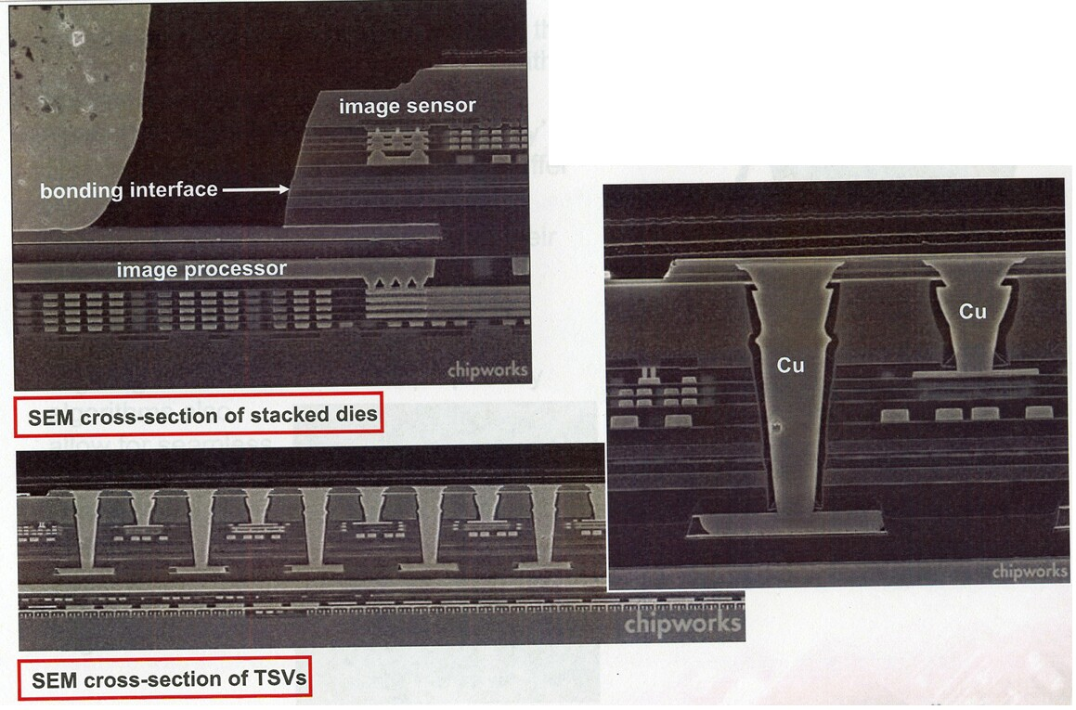
3D integration
High density interconnections successfully demonstrated for image sensors
Sony 13 Mpixel stacked image
sensor (2013)
electroiq.com

Slide 22
3D-integrated SPAD image sensor 1
MIT Lincoln Laboratory
25μm pitch
180nm CMOS +
custom (APDs)
7-bit counter/pixel
Backside illumination
10 - 20% detection efficiency
(limited by optical cross-talk)
B. Aull et al., IEEE Sensors J., 2015

Slide 23
3D-integrated SPAD image sensor 2
7.83μm pitch
65nm CMOS (top) +
40nm CMOS (bottom)
2 6-bit counters/pixel
Backside illumination
45% Fill Factor
T. Al Abbas et al., IEDM 2016

Slide 24
Outline
Introduction
CMOS-integrated single-photon detectors:
an overview
APiX: Geiger-mode avalanche pixel detectors for ionizing particles
Conclusion and future perspectives

Slide 25
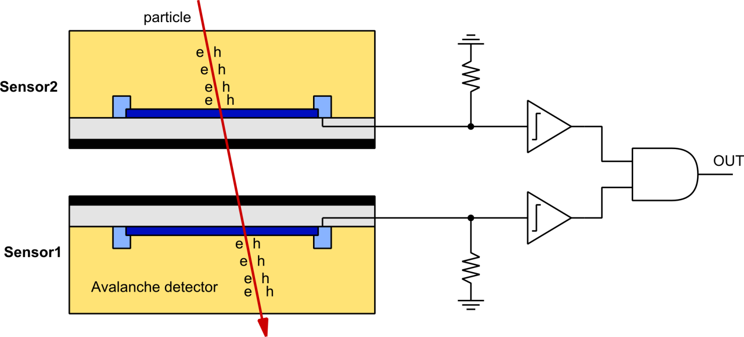
APiX particle detector concept
Quenching
Particle
detection
Discriminators
Coincidence
detector
Dark counts
Two Geiger-mode avalanche detectors in coincidence:
DCR = DCR₁ x DCR₂ x 2ΔT
In-pixel coincidence: integrated electronics is needed:
CMOS avalanche detectors
V. Saveliev, US Patent. 8,269,181, 2012 N. D’Ascenzo et al., JINST 2014

Slide 26
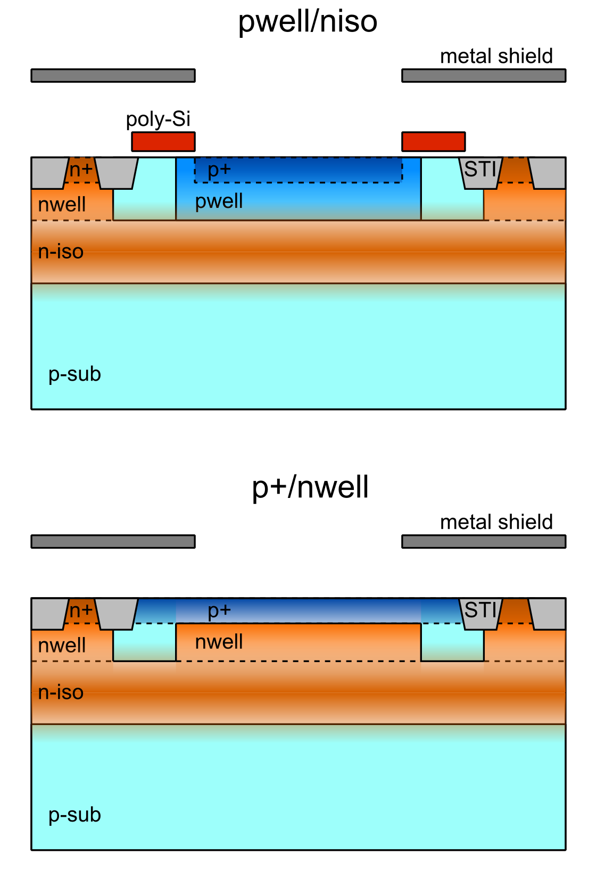
SPADs in 150nm CMOS process
Standard CMOS process – no modifications
Avalanche diodes in deep nwell: isolated from substrate
Type 1:
Shallow step junction
Active thickness ~ 1μm
Type2:
Deep graded junction
Active thickness ~ 1.5μm
L. Pancheri, D. Stoppa, ESSDERC 2011

Slide 27
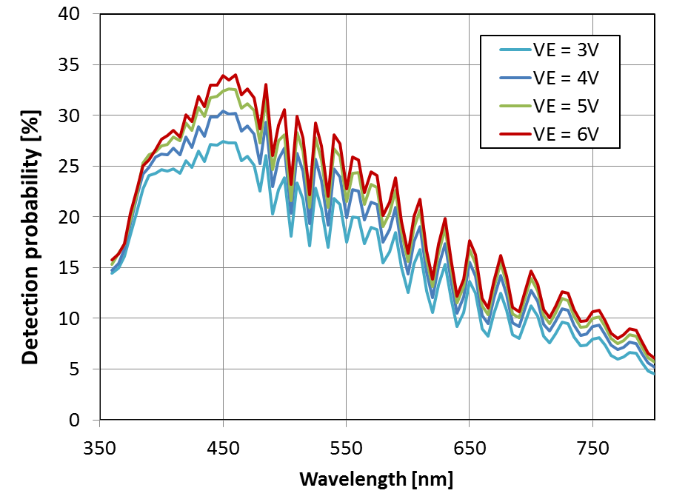
Photo-Detection Efficiency
Type 1: p+/nwell
Type 2: pwell/niso
Shallower junction:
better NUV – Blue efficiency
Wider depletion region:
Better red-IR efficiency
L. Pancheri et al., J. Selected Topics in Quantum Electron, 2015

Slide 28
Single-photon timing resolution
Measured on 10-μm devices, with blue laser (470nm), 70ps FWHM
Type 1: 60ps FWHM Type 2: 170ps FWHM

Slide 29
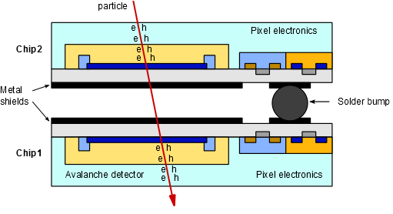
Proof-of-concept demonstrator
2-layer pixel cross section:
Electronic readout on both layers
Metal shielding from optical cross-talk
Vertical interconnection by bump bonding

Slide 30
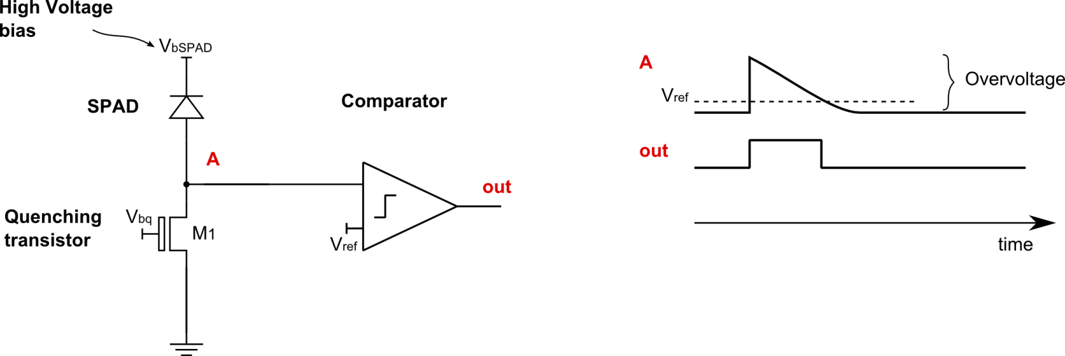
Pixel architecture
High voltage V_{bSPAD} applied at nwell
Maximum voltage at node A: V_{ov} = V_{bSPAD} – V_{BD}
Small capacitance at node A
Passive quenching with constant current recharge

Slide 31
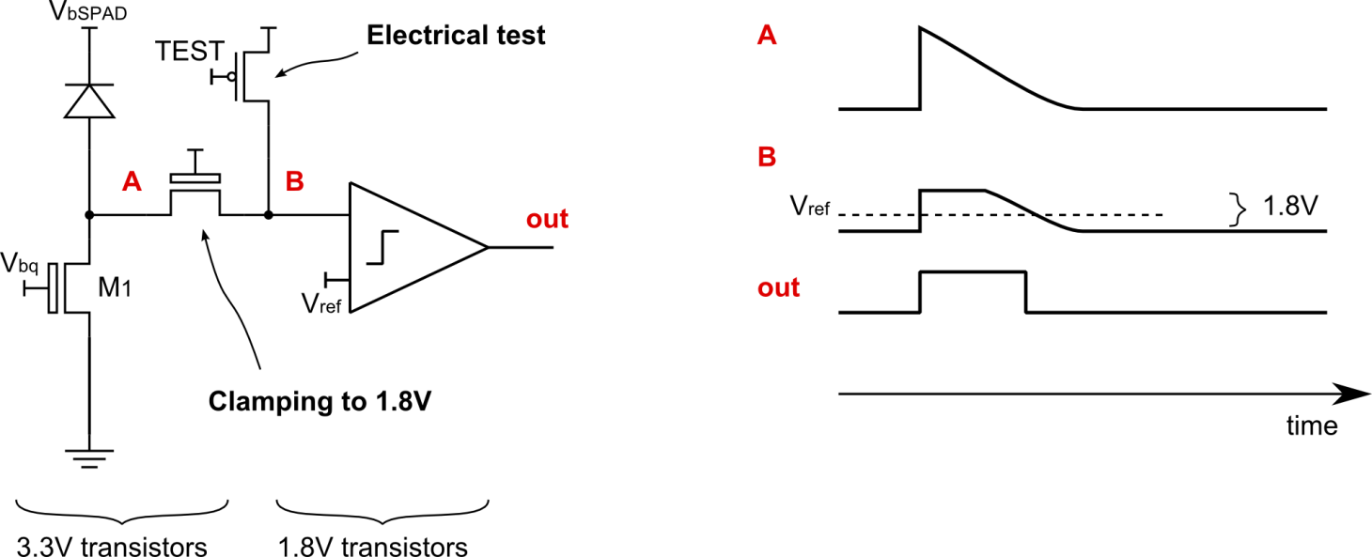
Pixel architecture
Front-end transistors: 3.3V → Maximum overvoltage 3.3V
Digital circuitry: 1.8V compact – fast – low-power

Slide 32
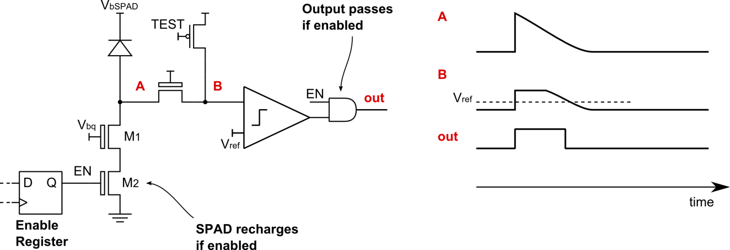
Pixel architecture: enable register
Pixels can be individually disabled:
M₂ disables recharge
Output and gate blocks output pulses

Slide 33
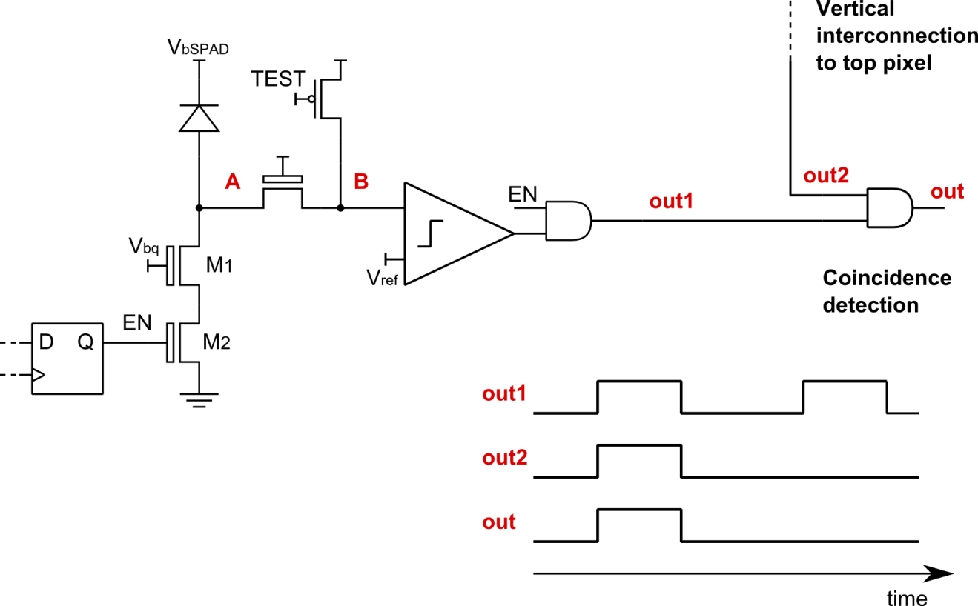
Pixel architecture: coincidence
Coincidence with top-layer pixel

Slide 34
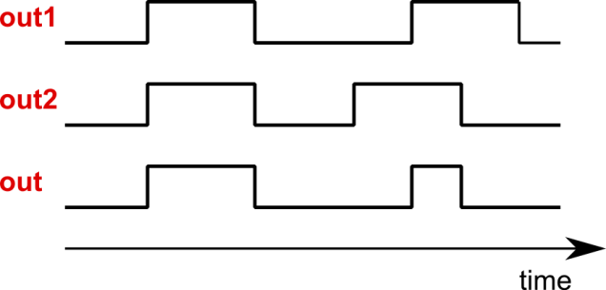
Pixel architecture: coincidence
Real coincidence
Accidental coincidence

Slide 35
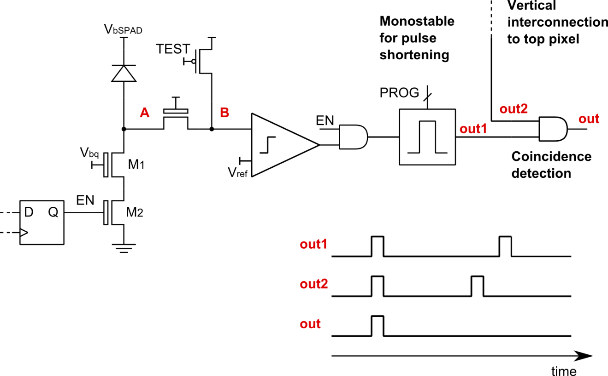
Pixel architecture: monostable
Pulse shortening: reduces the rate of accidental coincidence
Programmable pulse width: 750ps, 1.5ns, 10ns

Slide 36
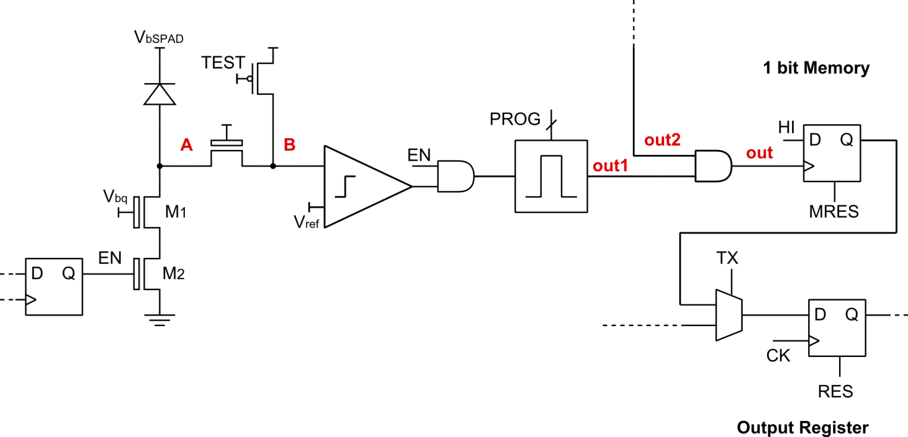
Pixel architecture: storage
Global shutter operation:
  Fast transfer from memory to output register
  Simultaneous accumulation and data output

Slide 37
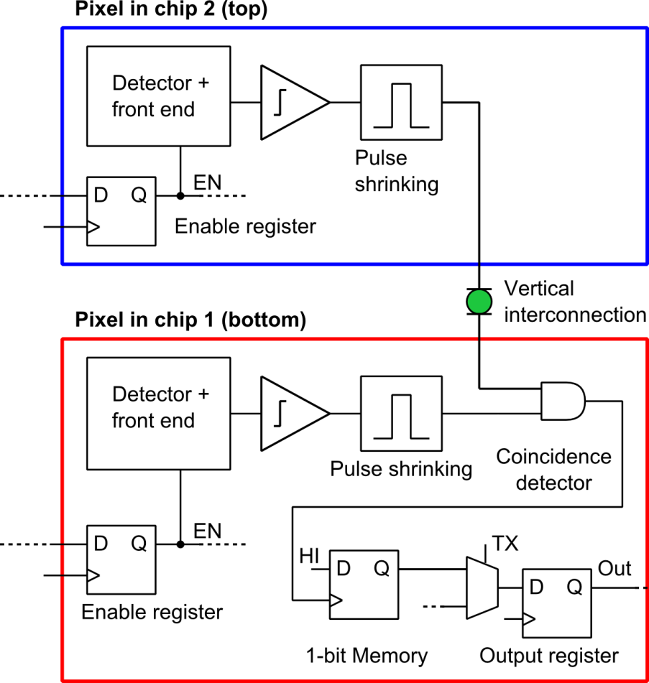
2-level pixel schematic
Top pixel: subset
of bottom pixel

Slide 38
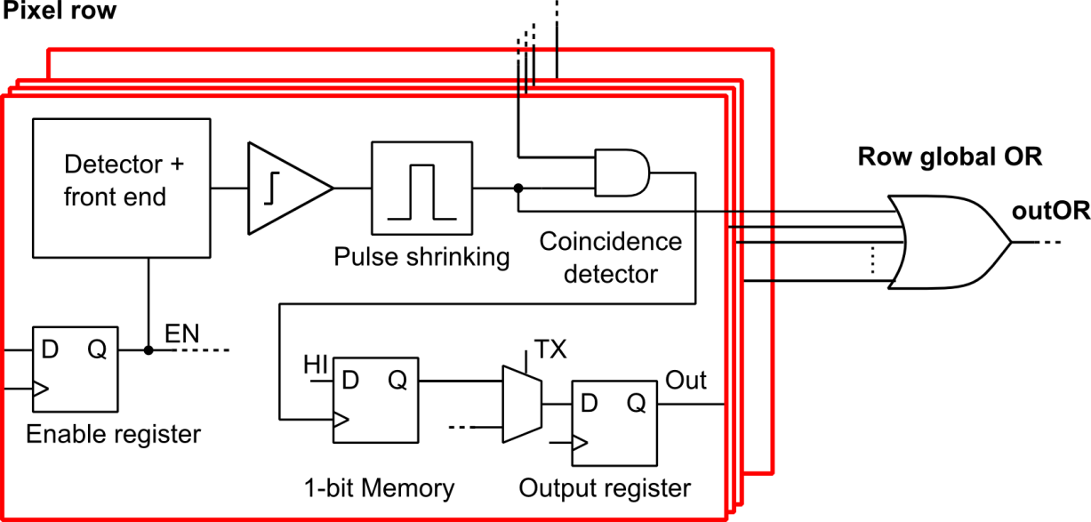
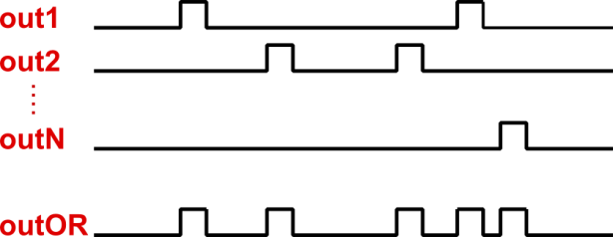
Sensor architecture: row-wise OR
Test output outOR:
combination of all the active
(enabled) pixels in the row

Slide 39
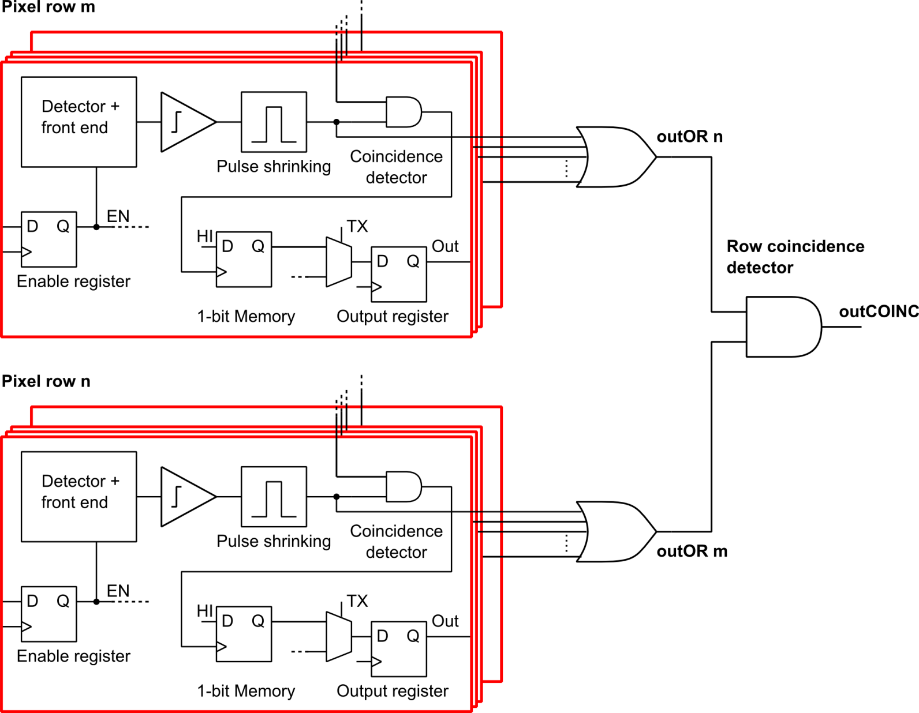
Row-wise coincidence circuit
Test coincidence in the sensor plane
m and n can be arbitrarily selected

Slide 40
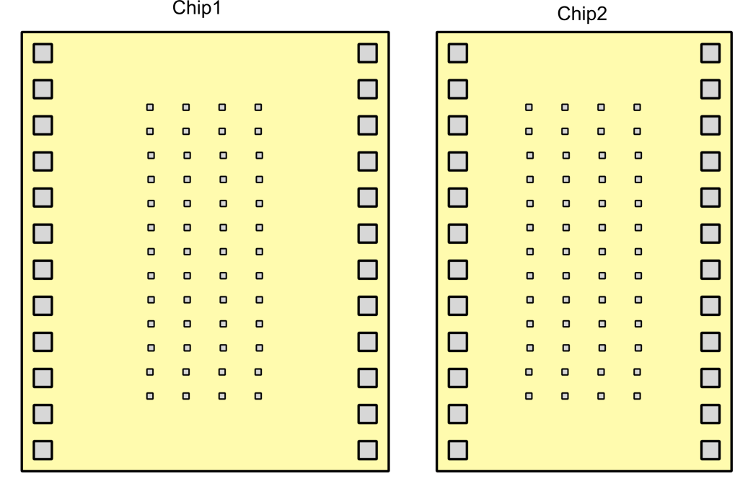
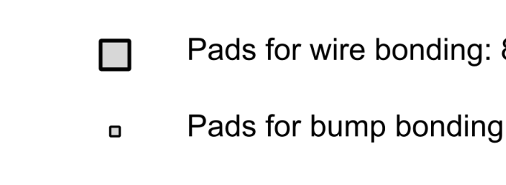
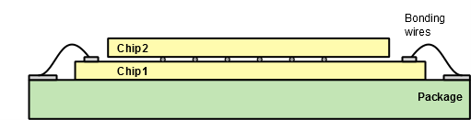
Sensor floorplan
Bottom chip
Top chip
Wire bonding pads on chip 2: pre-integration test.
Top chip
Final assembly
Bottom chip

Slide 41
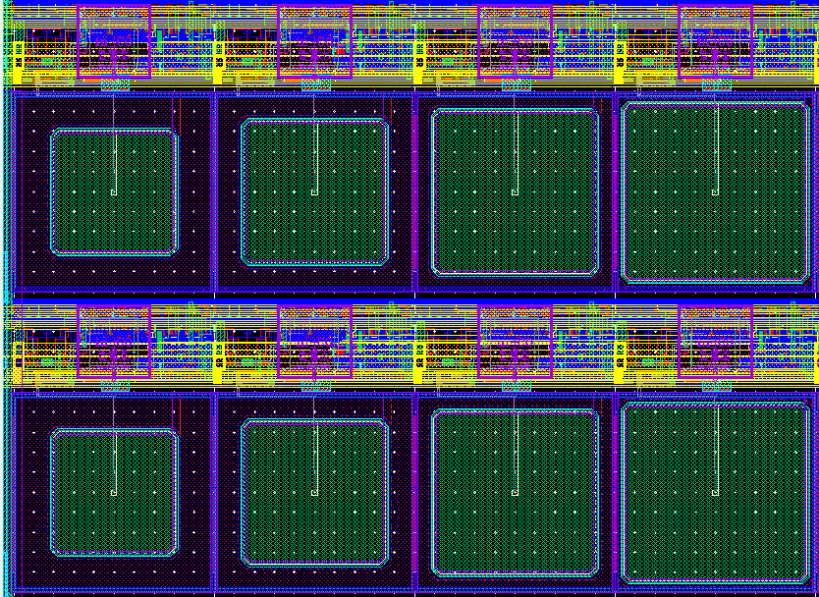
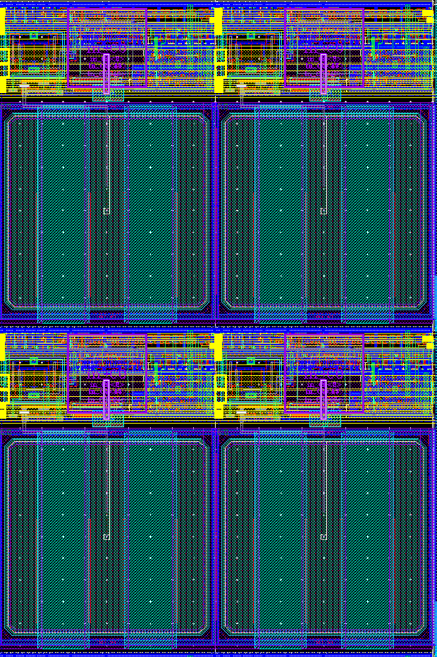
Pixel array
16 x 48 pixel array
Pixel size: 50μm x 75μm
Splittings in detector type and area
Bump bonding pad
30μm
x
30μm
35μm
x
35μm
40μm
x
40μm
43μm
x
45μm
Pixels with different detector area
(unshielded)
Pixels with shielded detectors

Slide 42
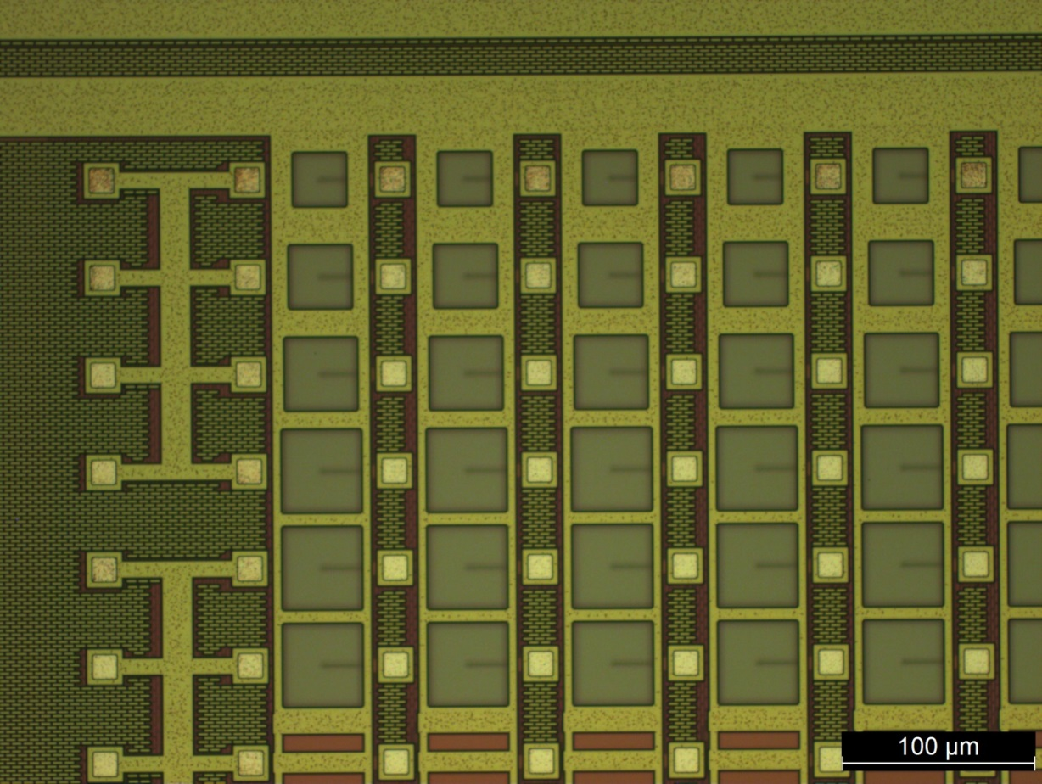
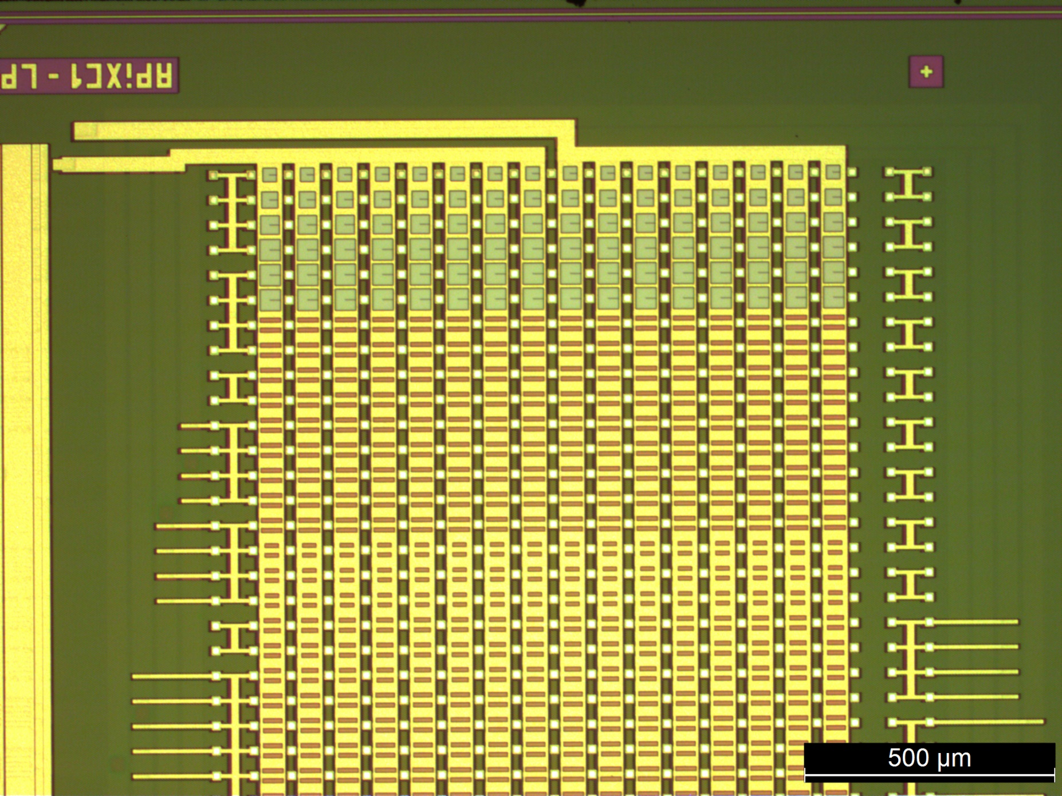
Bottom chip - Micrographs
Shielded
Unshielded

Slide 43
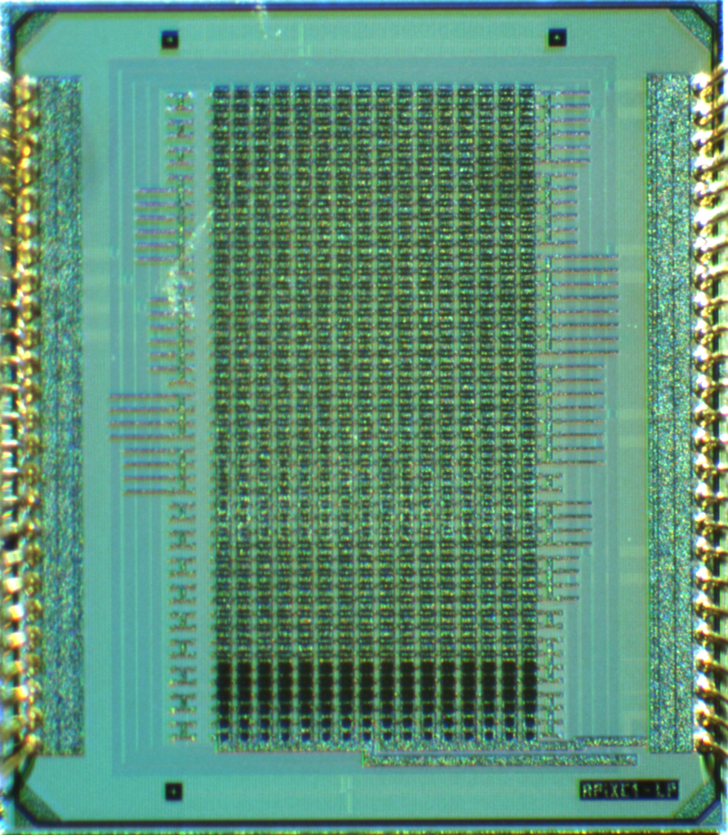
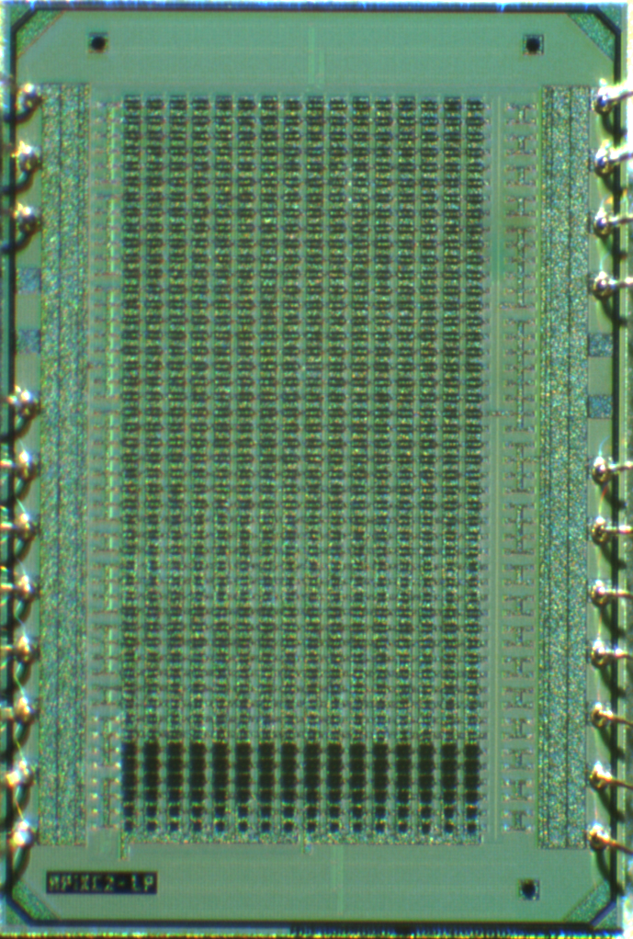
Sensor micrographs
Bottom chip
Top chip

Slide 44
Experimental results - summary
Characterization of single-layer sensors:
Core supply current (at 1.8V): 8mA
Breakdown voltage uniformity
Dark count rate
In-plane coincidence
Timing resolution
Cross-talk
Vertically integrated sensors with bump bonding (IZM):
Coincidence dark counts
Test with beta source
Test beam

Slide 45
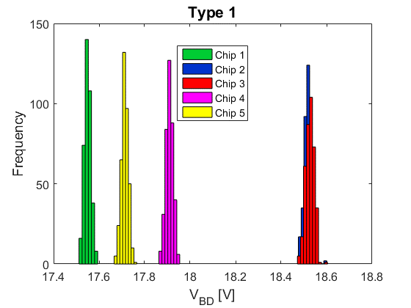
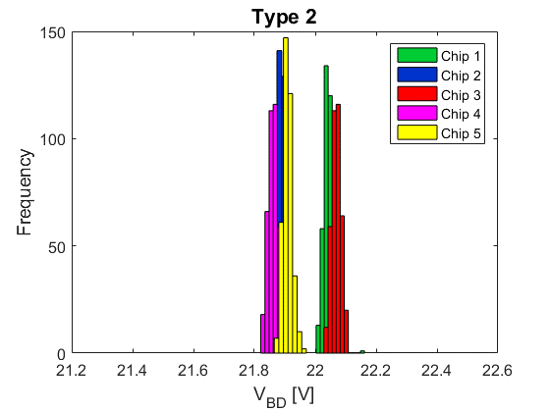
Breakdown voltage uniformity
Measurements on
5 sample chips x 2 types x 196 devices per chip
Very good uniformity on-chip (σ < 20mV)
Large difference (1V) between different chips for type 1

Slide 46
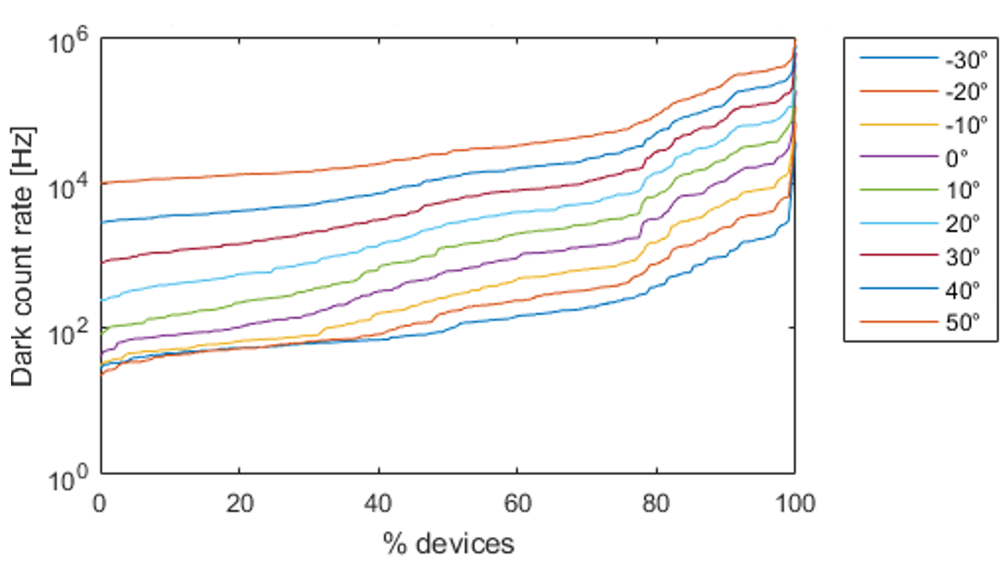
DCR distribution
Active area: 43μm x 45μm
DCR distribution spans 2 orders of magnitude at RT
Median value at 20°C: 2.8kHz - MHz/mm²

Slide 47
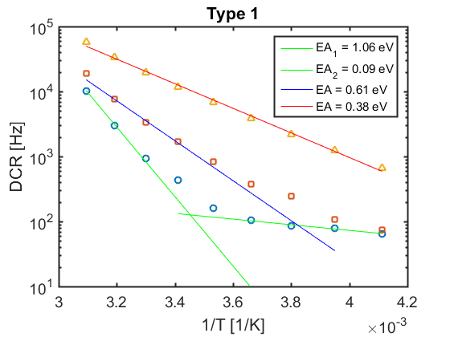
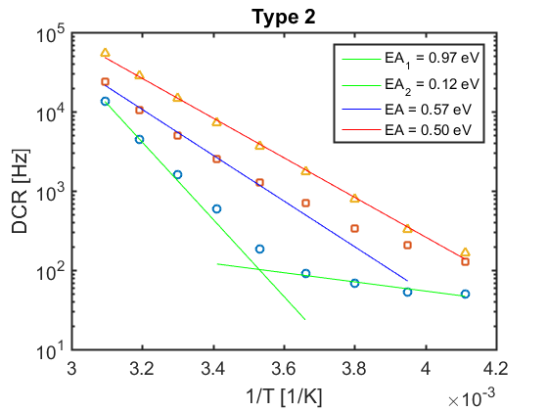
DCR temperature dependence
Trap-assisted tunneling: E_{A} < E_{G}/2
Devices with 43μm x 45μm active area, but different DCR
Measurements from -30°C to 50°C with 10°C steps
Overvoltage: V_{OV} = 3.3V

Slide 48
DCR temperature dependence
SRH generation E_{A} ~ E_{G}/2

Slide 49
DCR temperature dependence
Injection from neutral regions: E_{A} ~ E_{G}

Slide 50
DCR temperature dependence
Band – to – band tunneling: E_{A} → 0

Slide 51
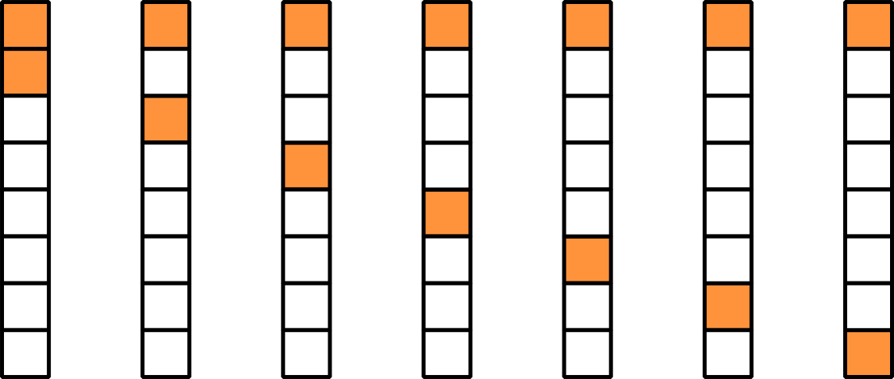
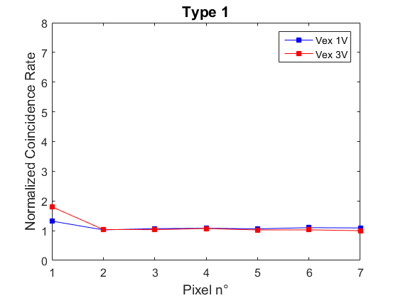
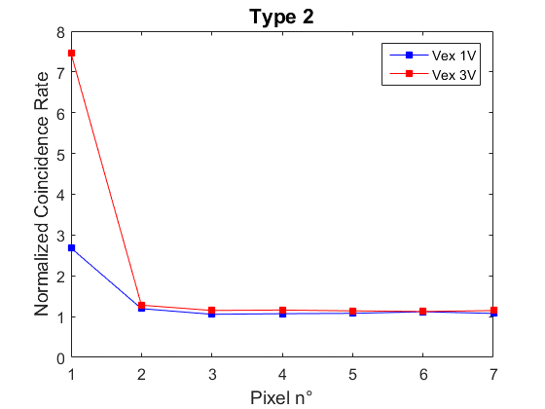

Coincidence detection
Count rate in coincidence between
two pixels in the same column
Normalized rate:
1 2 3 4 5 6 7
$$\frac{CR_{Meas}}{2∙CR_{1}∙CR_{2}∙∆T}$$
Cross-talk
Cross-talk

Slide 52
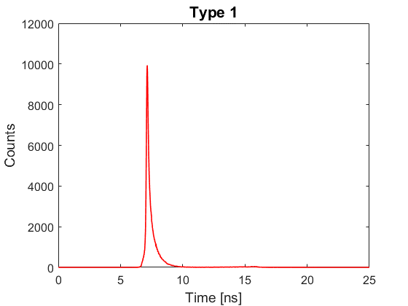
Timing resolution
IR laser (780nm)
50ps FWHM
V_{EX} = 1V
208ps FWHM
Diffuser
Sensor
Row coinc.
output
Timing histogram between laser trigger and sensor coincidence output
N.B. Design not optimized for timing
2 pixels enabled

Slide 53
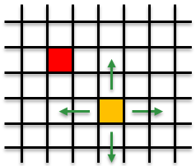
Crosstalk characterization
Crosstalk coefficient
CRm = DCRe ∙ DCRd ∙ 2∆T + K ∙ ( DCRe + DCRd )
Emitter (fixed)
Detector (scan)
Crosstalk map – Type 1, 25µm thickness

Slide 54
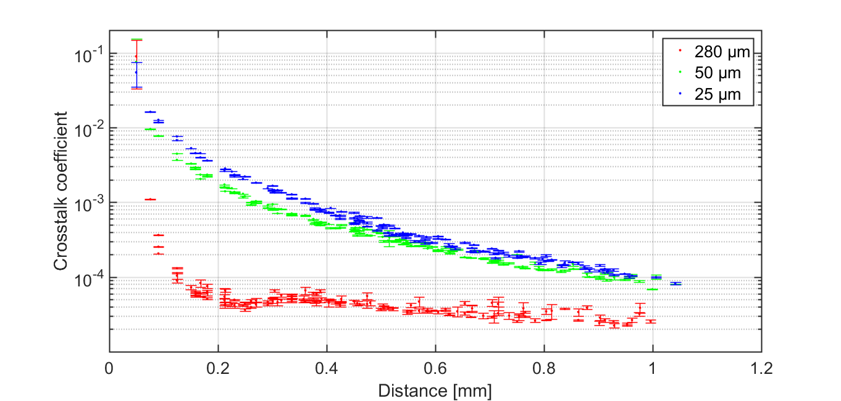

Crosstalk vs substrate thickness

Slide 55
Dark Count Rate and cross-talk
Die thickness: 280 µm
Large detectors
T = 20°C
V_{EX} = 3.3V
Median DCR increase of 70% due to cross-talk:
from 2.8kHz to 4.8kHz
A. Ficorella, et a., Proc. IEEE ESSDERC, 2016

Slide 56
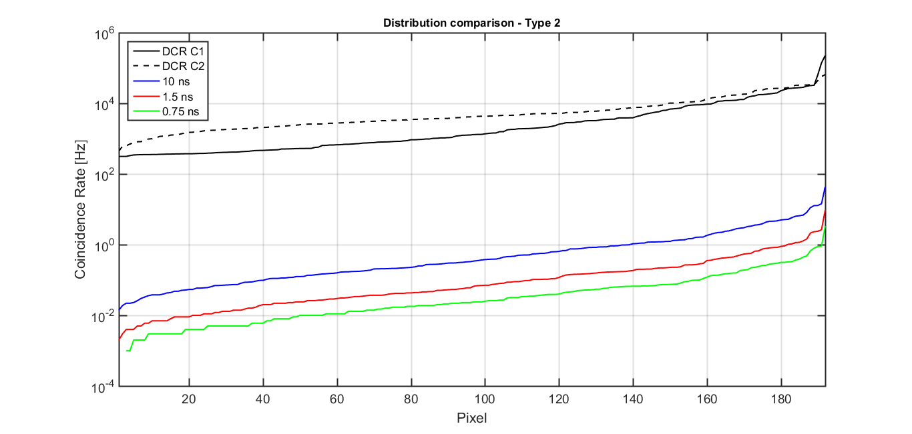
Vertically-integrated assembly
Dark Count Rate vs. coincidence time ΔT
DCR_{COINC} = DCR₁ x DCR₂ x 2ΔT
T = 20°C
ΔT = 1.5ns
ΔT = 10ns
ΔT = 0.75ns
DCR_{COINC} = 27 counts/s mm²

Slide 57
β-source measurements
⁹⁰Sr β source – 37kBq at 2mm distance from sensor
V_{EX} = 2V T = 5°C Δt = 0.75ns
β count rate ~10,7 Hz/mm²
~ 40 mHz/pixel

Slide 58

Test beam at CERN
Test at CERN SPS north area facility (H4 beam line)
Two APIX under test + auxiliary Beam Tracker detector
Positrons and π⁺ beams at 50, 100, 150, 200 and 300 GeV

Slide 59


Test beam – hit maps
Noisy pixel disabled
Unshielded pixels disabled

Slide 60
APiX - Summary
Strengths:
Can be thinned to a few microns: low material budget
Timing resolution
Low power consumption
Early signal digitization
Weaknesses:
Radiation tolerance (still to be assessed)
Efficiency: guard ring and in-pixel electronics
Cost and availability of 3D integration technologies

Slide 61
Current - future work
Current prototype:
  Test beam data analysis (in progress)
  Radiation hardness studies
Design of new prototype:
  Improved fill factor
  Larger array
  Optimized timing
  Optimized power consumption

Slide 62
Summary
Higly parallel SPAD systems require high-density digital circuit for high efficiency
SPAD technology in deep sub-micron processes is evolving driven by consumer applications: investments
Maximum efficiency: 3D integration. Optical cross-talk is still an issue in systems with very high FF
Concept of charged-particles direct detection with Geiger-mode detectors in coincidence is feasible
Efficiency is still an issue, but timing can be very good
Development in deep-submicron SPADs and 3D integration can the key for a full exploitation of this concept

Slide 63
Acknowledgements
APiX2 project
“Development of an Avalanche Pixel Sensor for tracking applications”
Funded by INFN – CSN5
Project coordinator: Pier Simone Marrocchesi, INFN Pisa and
University of Siena
Partners:
TIFPA and University of Trento,
INFN Pavia and University Pavia,
INFN Padova and University of Padova,
Laboratoire APC, Université Paris-Diderot/CNRS

