Slide 1
photocatodes

Slide 2
CsI Information needed by Thomas S.
-Dimension of sensitive area and connectivity ring (Au) around in case you want to go for this option ← See next Slide, yes for the ring - Au Preferred
–uniform layer or grid-like pattern ( mask needed) ← Uniform Thin (5-6nm) Layer
-coatings materials ← Cr
-layer thicknesses ← 10nm
-Number of samples to be done ← Two samples, the two windows we got already from Thomas P.

Slide 3
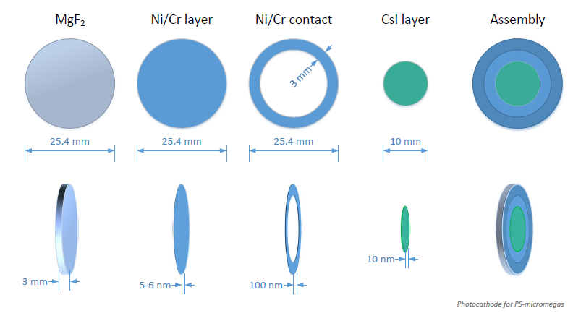
Dimensions

Slide 4
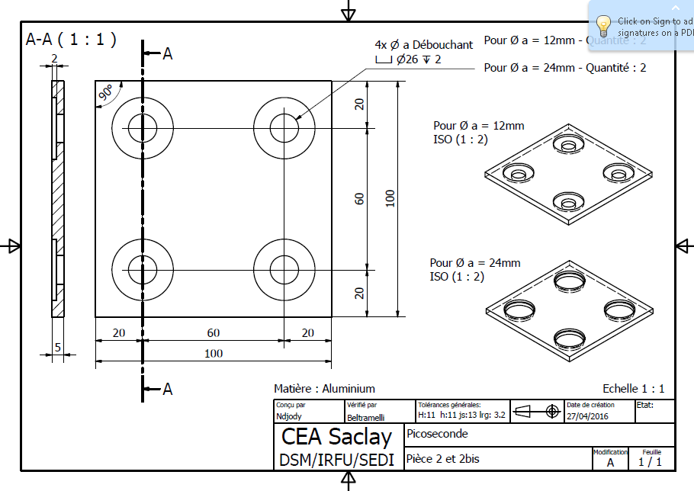
Masks (produced by Saclay, one available for CERN)

Slide 5
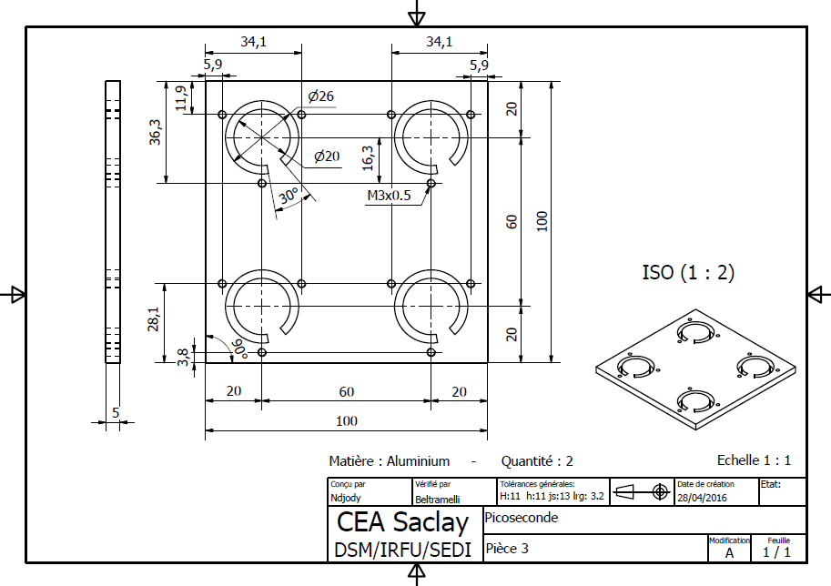
Masks (produced by Saclay, one available for CERN)

