Slide 1
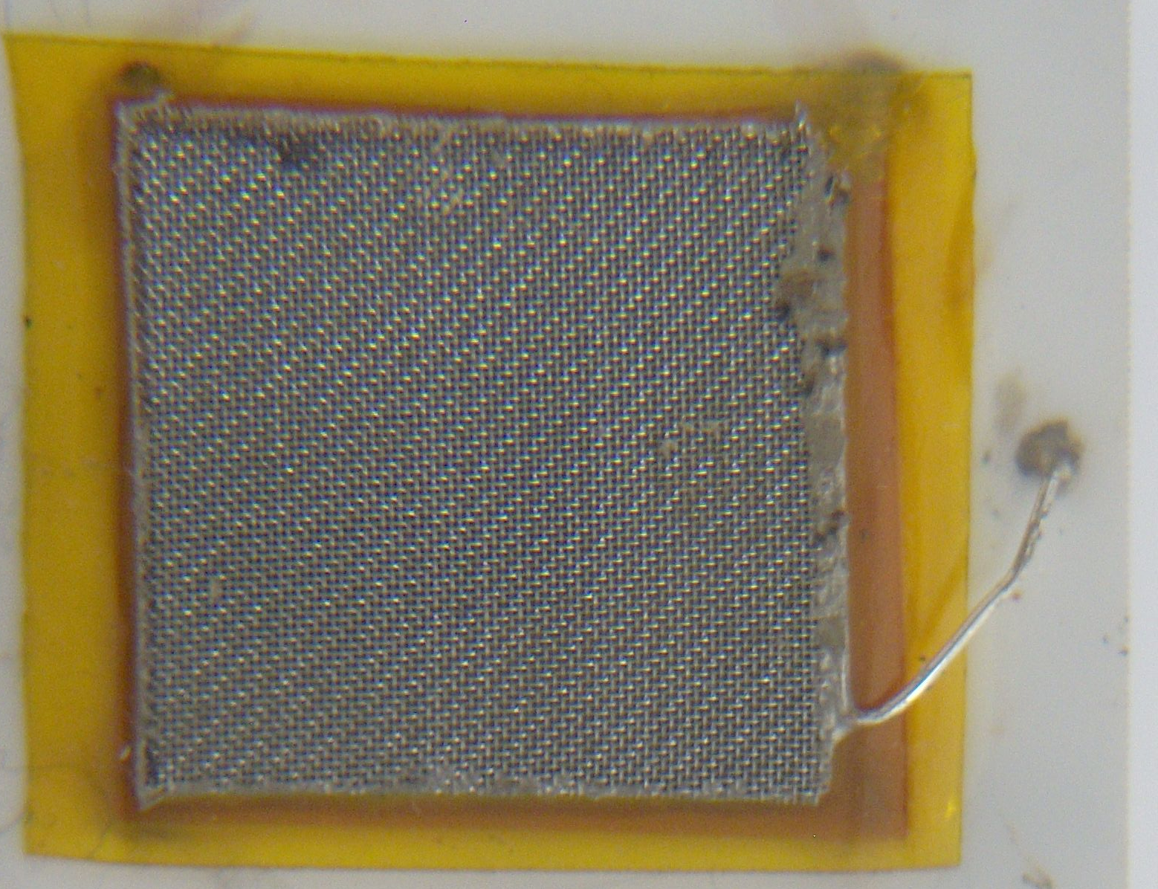
Multiple connections are potentially very beneficial
This very simple hook up may be the best as it minimizes interconnect and significantly lowers inductance. Thick bond wires are a good idea. Some kind of tape bonds would be even better. More than one bond per site might be a good alternative. (purpose for pairs of circles) FMN
3, .035” holes for
.025” square post pins

