Slide 1
Some Mods to the APD/ASIC Test Box
Manny Morales, U Penn
Kirk McDonald, Princeton U
January 30, 2019

Slide 2
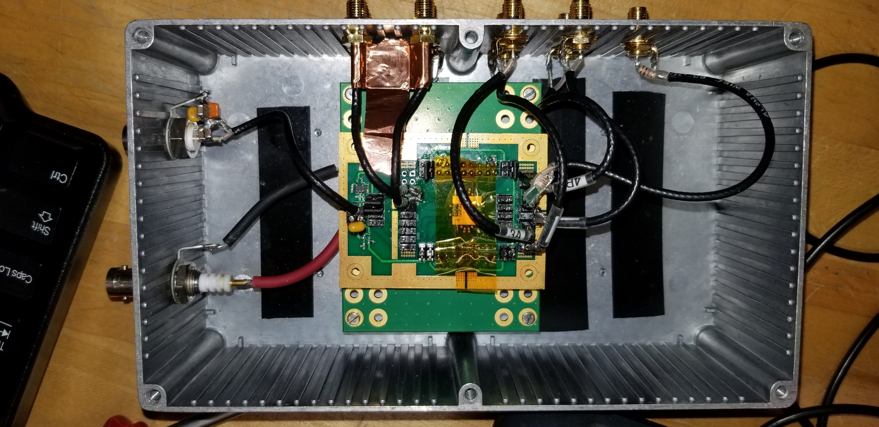
SMA panel mounts now have coax-cable termination (not soldered leads)
DC power cable shortened
Mitch suggests that all 8 SMA signal connectors be in a row up high = present location of the upper 4 connectors

Slide 3
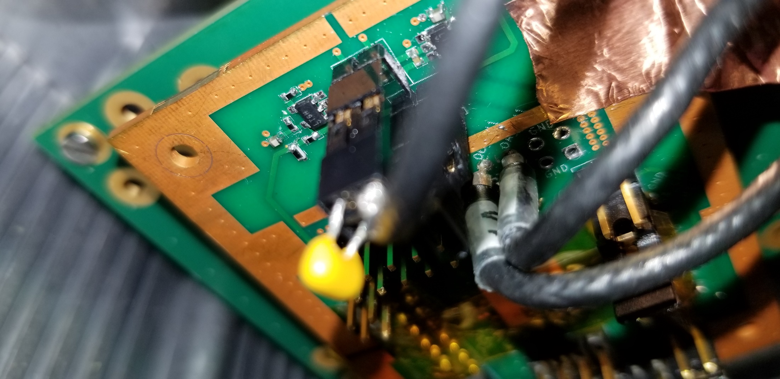
Signal coax cables now soldered to holes on PC board (instead of to a socket that mated to pins on the PC board)

Slide 4
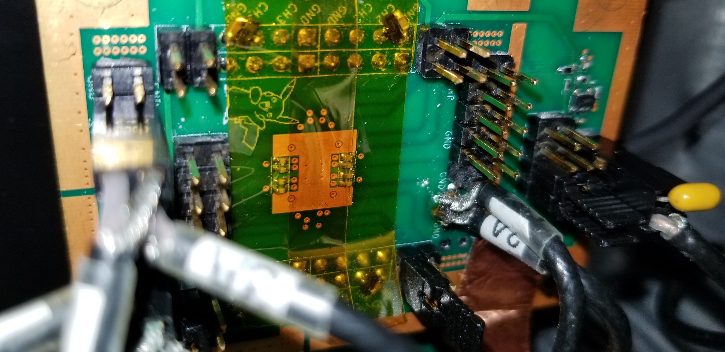
Signal coax grounds now soldered to holes on PC board (instead of to a socket that mated to pins on the PC board)

Slide 5
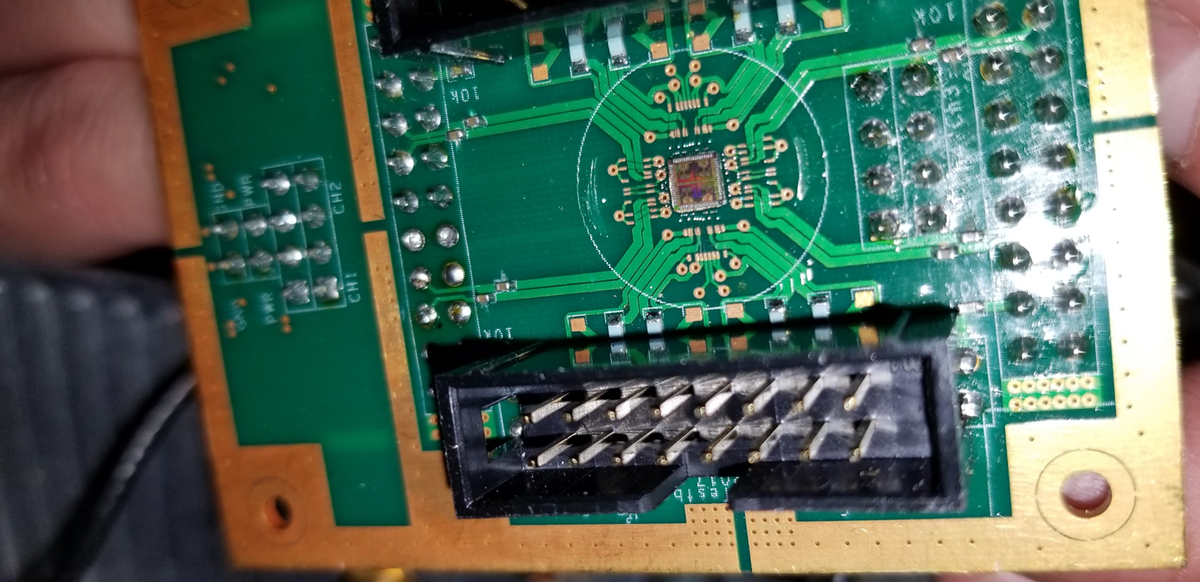
Pins
Coax center conductors
Coax grounds

