Slide 1
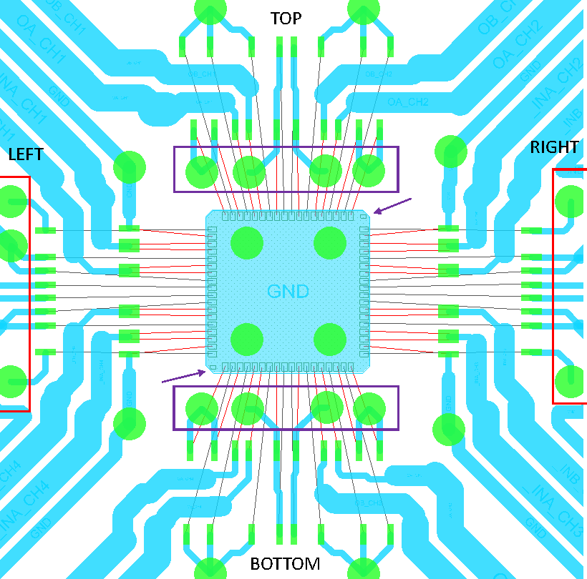


GND
GND
4.0 V
2.2 V
4.0 V
GND
GND

Slide 2
I think this is the voltage regulator layout, but I don’t know where appropriate test points would be.

