Slide 1
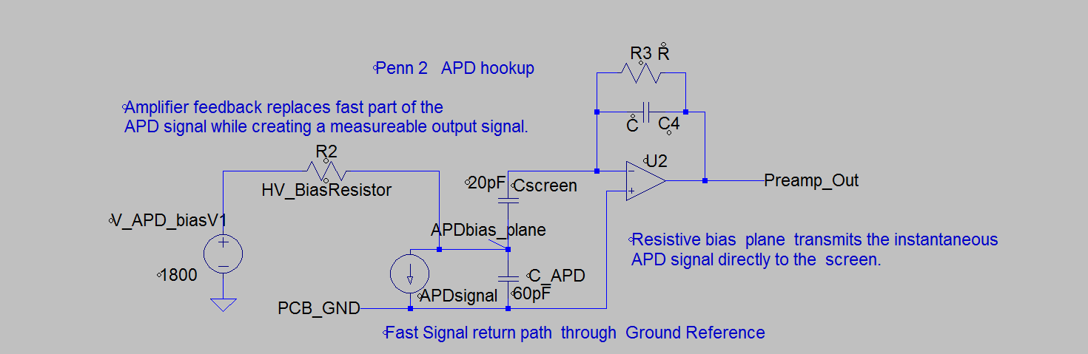
Signal path between APD and Amplifier on
Penn 1 and Penn 2.
Well defined signal and return path across APD. Ionization signal impressed on screen
And referenced to Amplifier Ground.

Slide 2
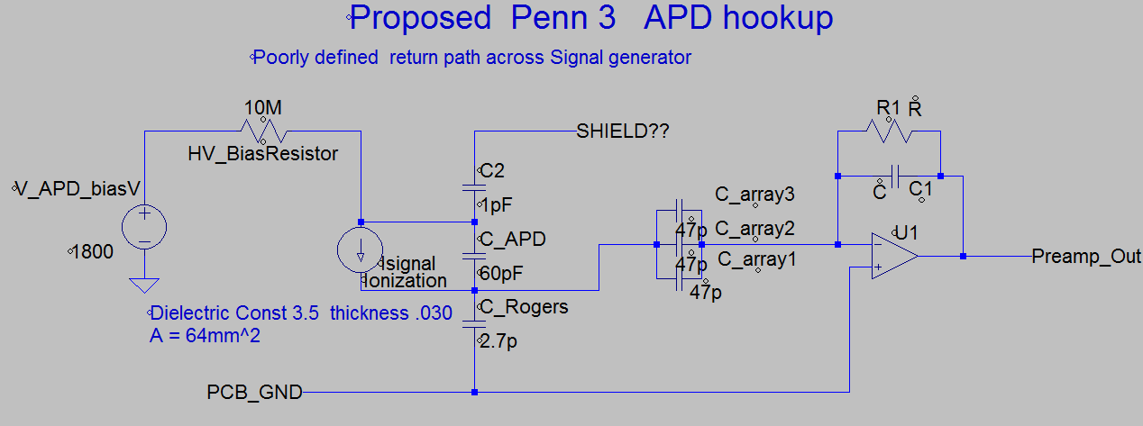
Proposed New APD Hookup
APD signal return path is not clear.
Poorly defined voltage reference for the signal.

