Slide 1
Rework of an APD Preamp
Godwin Mayers
U Penn
Feb. 17, 2017
Documentation on the U Penn Fast-Timing Preamp:
http://physics.princeton.edu/~mcdonald/LHC/Newcomer/fast_timing_aplifier_V3.pdf
http://physics.princeton.edu/~mcdonald/LHC/Newcomer/fast_preamp_BFR1_v0.docx
More photos of the rework:
http://physics.princeton.edu/~mcdonald/LHC/Newcomer/Godwin%20Mayers/

Slide 2
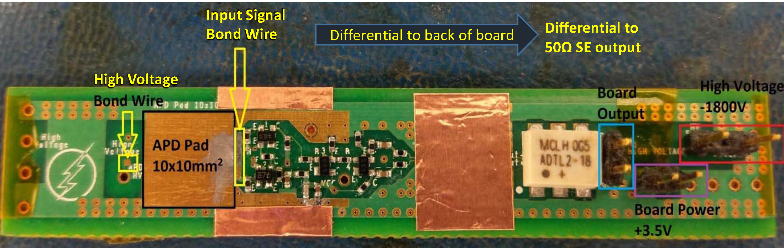
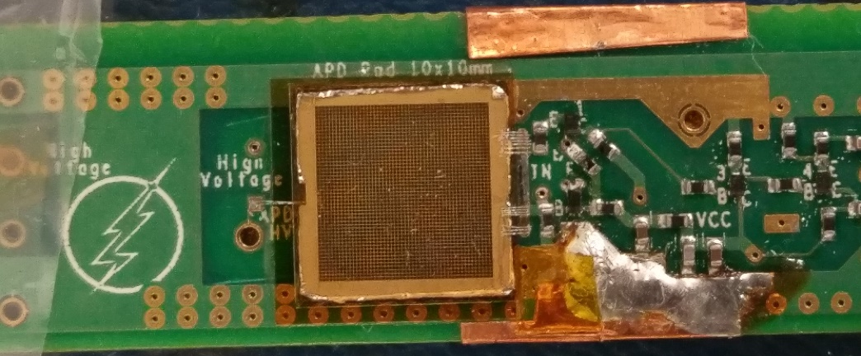
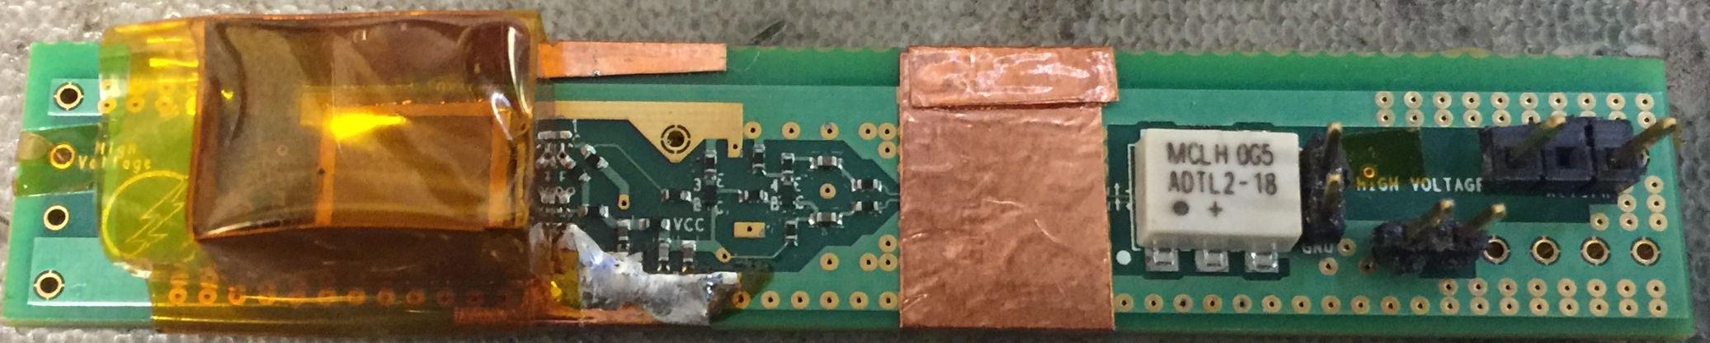
Stuffed preamp PCB:
Preamp PCB with RMD 8x8 mm² APD
1st transistor needing replacement
Preamp PCB with RMD 8x8 mm² APD + Mylar tent to protect the APD:

Slide 3
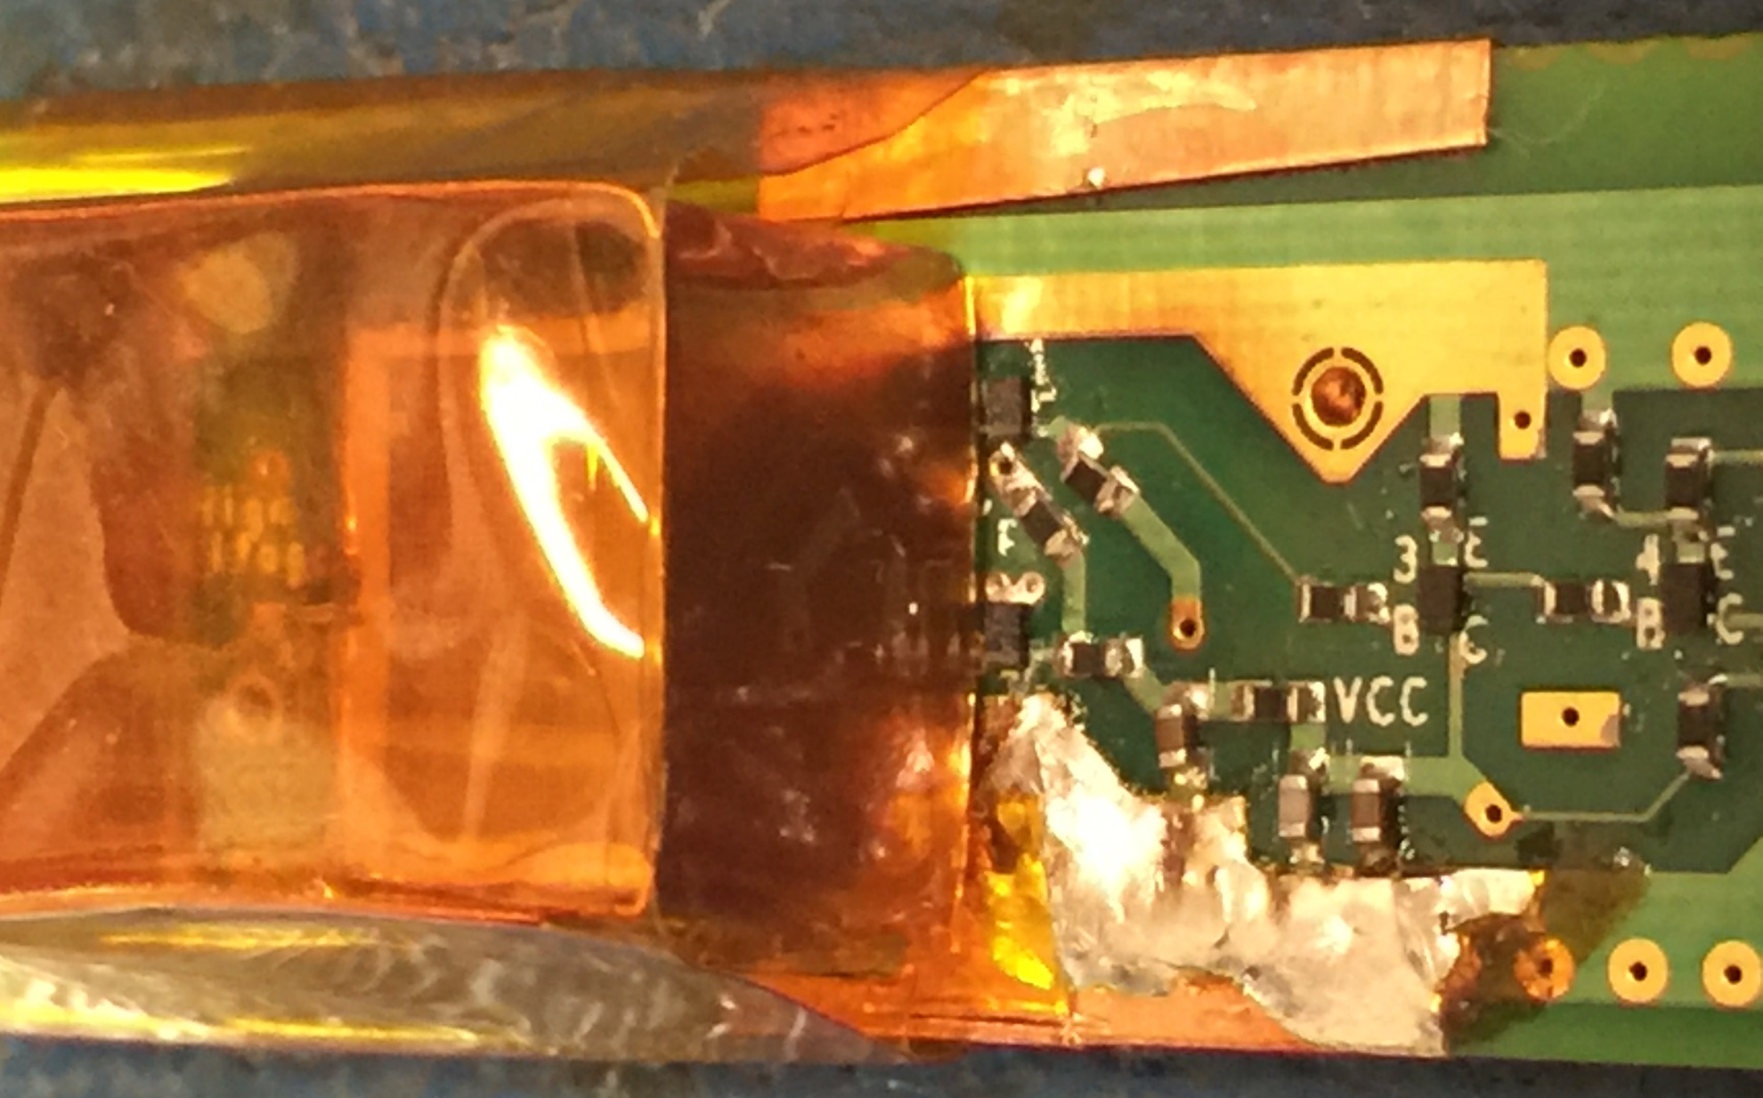
Component needing replacement:

Slide 4
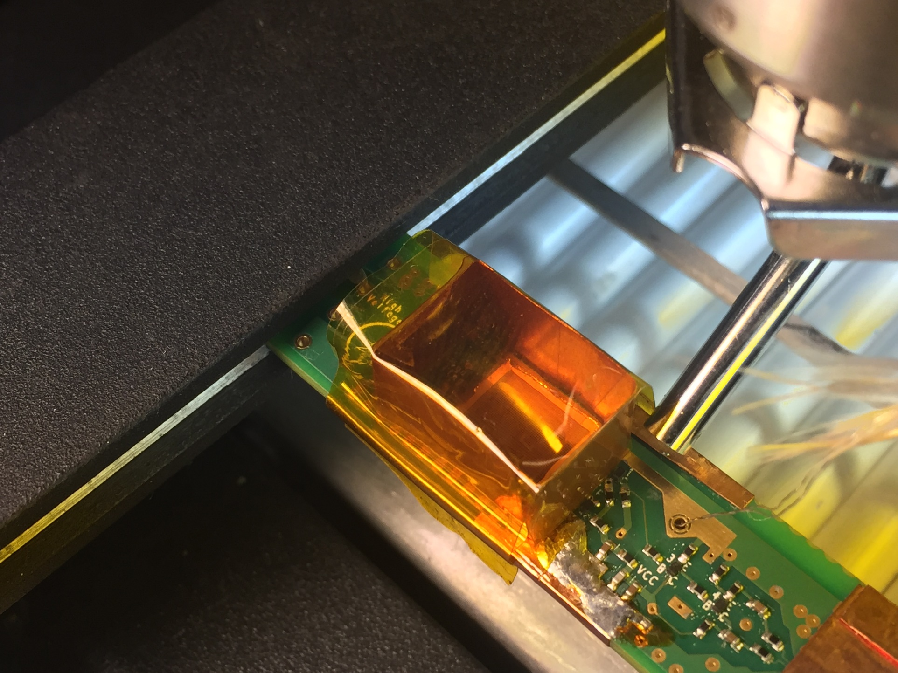
Preamp PCB on the rework station:

