Slide 1
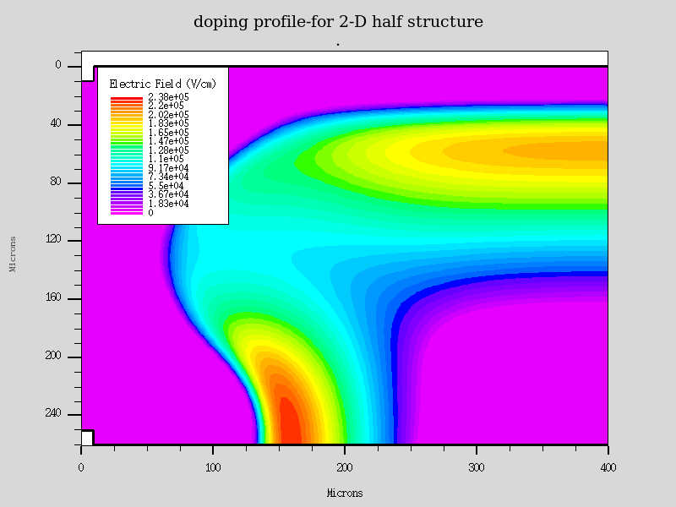
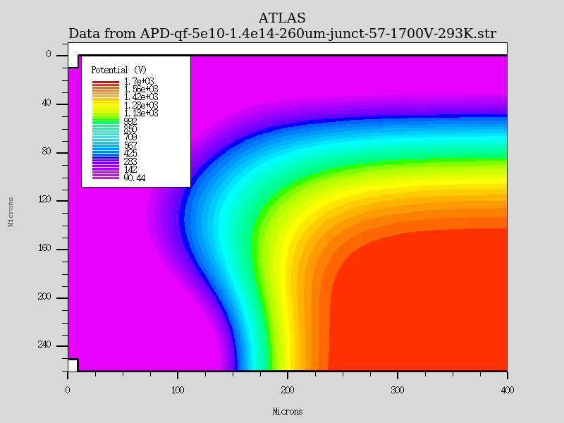
2D simulations
Ranjiit (7.12.2016)
  2D simulations show extremely high field on back side (higher than on front side!)
    ??…should be visible in TCT scans as region at edge on backside should have higher gain (signal) as signals obtained from central sensor area (which has not been observed) ??
    ??...earlier breakdown expected from this plot?

Slide 2
2D simulation
Maybe geometry/doping distribution not fully correct?

Slide 3
Doping profiles
Doping profiles
  A-B - 420
  C-D - 400
  E-F

Slide 4
Conclude
Need some re-design of the 2D model?

