Slide 1

Temperature dependence of 4-mm² RMD APD time resolution
C. Lu
Princeton University
(12/21/2012)

Slide 2
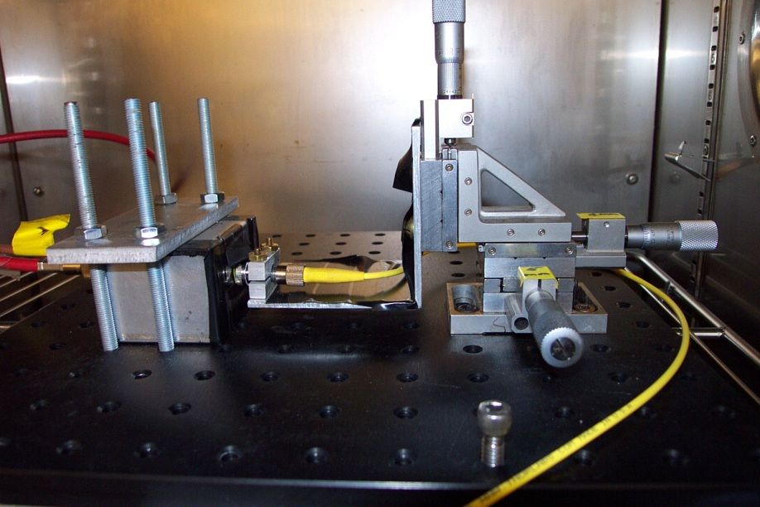
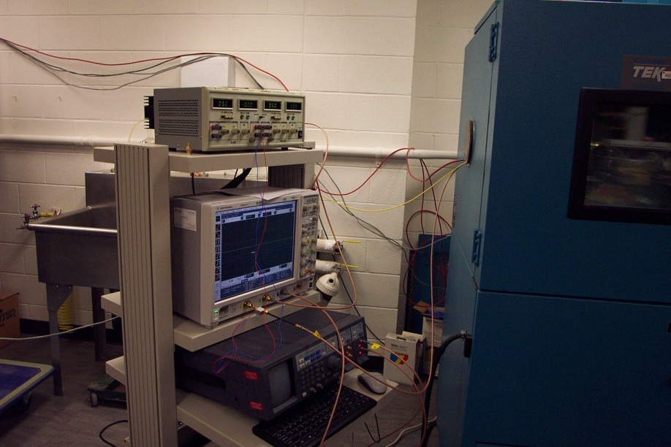
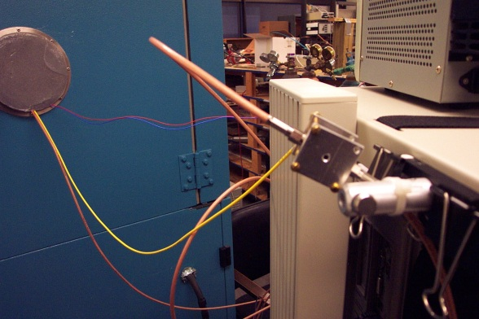
Test setup
An environmental chamber is employed to create a temperature controlled test environment. The temperature can be set from -30C to 30C.
APD and VCSEL(980nm) laser diode are placed inside of the E.C.
Internal view of the E.C.
E.C. chamber
APD box (4mm²)
Optical fiber
VCSEL laser diode box
Collimation lens (Thorlabs CFC-11X-B)

Slide 3
Laser pulse calibration
Use Thorlabs PM100USB Power and Energy meter to measure the laser diode output, then calculate the photon number per pulse.
With 5V, 10Mhz drive pulse the measured laser beam power is 40nJ, with 3V measured 17nJ.
Pulse width is ~1ns (rise and fall time ~ 0.5ns).

Slide 4
Temperature dependence of RMD 4-mm² APD time resolution
This result is for ~5000 photoelectrons/pulse, which is ~ 1 MIP equivalent. Lowering temperature helps to improve the time resolution: from 25ps @ 30°C down to 17ps @ -20°C (for fixed voltage, = -1750 in this study).
We also plotted the APD pulse size vs. temperature, which indicates the APD gain decreases as temperature increases.
This study does not clarify the effect of temperature on time resolution at fixed gain, nor on the maximum APD gain without breakdown.

Slide 5
Estimation of P.E. number for laser pulse
The excel file object below shows how to estimate the number of photoelectrons from laser pulse. Open this object in excel (right click on the table, then Worksheet Object, Open) , it converts the “Pulse power (W)” to “# of P.E./pulse”.

Slide 6
Temperature dependence of RMD 4-mm² APD time resolution (cont’d)

Slide 7
Cross check with Fe-55 source
It would be useful if we can use other method to check the # of photoelectron/pulse obtained via power meter.
Since Fe-55 source emits 5.9keV x-ray, we know the full energy peak from Fe-55 source should @ 5900/3.6 = 1640 e’s. We compared the signal size obtained from laser beam and Fe-55 source, we found the discrepancy is very big. According to the ratio of the electrons: 5000/1640 ~ 3, the laser signal should be three times larger than the Fe-55 full energy peak, but the test result shows the ratio is only ~ 0.6!
Fe55 source spectrum measured by ZX60 amplifier. This spectrum was 20°C test result.

Slide 8
Cross check with Fe-55 source (cont’d)
One possible source, which is responsible for this large discrepancy, could be due to our electronics. The preamplifier we used in the test is mini-circuits ZX60 fast amplifier, which is not charge sensitive preamplifier. The output signal amplitude will strongly depend on the input signal shape.
Fe-55 photoelectrons are almost coming from a single spot (within 1μm), but laser pulse produced photoelectrons spread over the entire 60 μm range. The later pulse shape is fatter than the former as shown above. We need to get fast charge sensitive preamplifier to check this hypothesis. (One candidate is in the paper Mickel sent to me: RAL 108A preamplifier with HP 5582A shaping amplifier. )

