Slide 1
S/N Issue of Mesh APD
Changguo Lu
Princeton University
3/2/2016

Slide 2
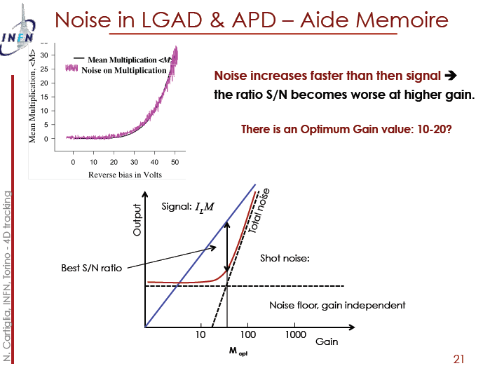
N. Cartiglia, INFN, Torino, 2/15-19/2016 -
4D tracking
Noise in LGAD & APD – Aide Memoire
According to this argument it raises a series question about the application of
APD to the fast timing: LGAD 10~20 gain is better than high gain APD (>100).

Slide 3
If the detector can provide good S/N even when its signal is small, we still can use a good amplifier (high gain and low noise figure) to get a large enough signal.
We have tested following five commercial amplifiers; obviously, the Wenteq is the best.
[The custom amplifier developed at U Penn is even better.]
Ampommerlifier | Bandwidth(MHz) | Gain |  |  |  | Noise figure
Wenteq ABL0100-01-5010 | 10 - 1000 | 50 dB |  |  |  | 1.0 dB
ZFL-2500+ | 500 - 2500 | 28 dB |  |  |  | 6 ~ 8.6 dB
ZKL-1R5+ | 10 - 1500 | 40 |  |  |  | 3.0 dB
ZX60-33LN-S+ | 50 - 3000 | 100 | 1000 | 2000 | 3000 | 1.1 dB
 |  | 21.9 | 18.8 | 14.5 | 11.9
ZVA-213 | 800 - 21000 | 26 |  |  |  | 2.5 ~ 4.7 dB

Slide 4
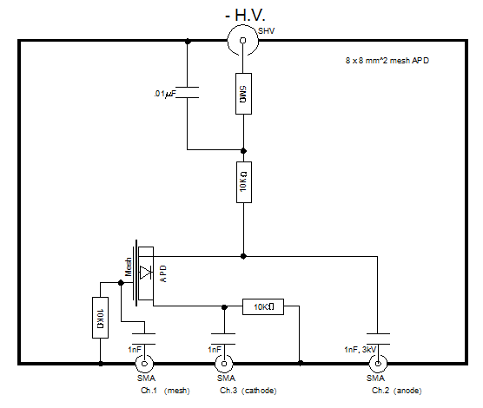
Test S/N for Mesh APD with Agilent MSO9404A Scope
The test circuit used with an RMD 8×8 mm² APD, with mesh electrode, is the following:
Three outputs are connected to scope via SMA cables.
The VCSEL 980-nm laser diode is triggered by an HP 8131A pulser with fixed pulse shape; the laser light is transferred via optical fiber to a focusing lens, which is placed in front of APD.
The entire APD test box and focusing lens is located inside an environmental chamber, which used primarily as a dark box/Faraday cage.

Slide 5
RMS noise of APD signal
We noticed that the measured rms noise with digital scope depends on the scope scale used in the measurement (so-called digitization error). We have to understand this behavior first. We leave the scope connected to APD electrode while we change the scope’s scale, and observe measured rms noise as follows:
The rms noise is linear with the vertical scale of the scope.
Of course, if we measure S/N using the scope with the same vertical scale for both signal and rms noise, there is no additional normalization required, and we can directly use the measured signal and rms-noise values in the calculation.

Slide 6
S/N of Mesh APD
In the plot of S/N and Gain vs. HV below, the S/N ratio is still improving at the maximum HV we have tested, -1800V, which is close to the APD breakdown voltage.
An optimum S/N value of 10-20 is not the case for an RMD APD.

