Slide 1

Use of an Agilent MSO9404A Scope as the DAQ system to measure APD time resolution with laser diode
- Step by Step instructions
C. Lu
Princeton University
(3/30/2015)

Slide 2
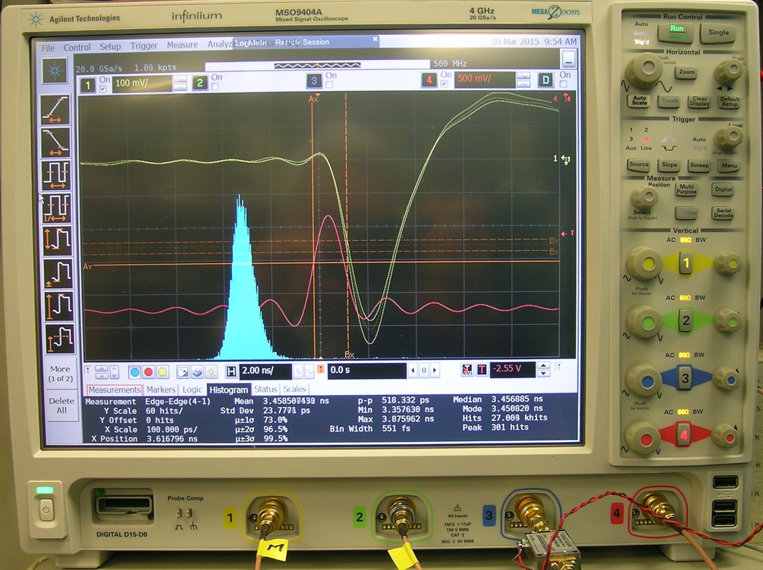
Scope image
The test procedure shown here is for laser diode/RMD 64mm^2 mesh APD setup.
Laser diode is triggered by a pulse generator HP8131A.
Channel #1: APD mesh signal after Wenteq 5008 amplifier;
Channel #4: trigger signal from HP8131A.

Slide 3
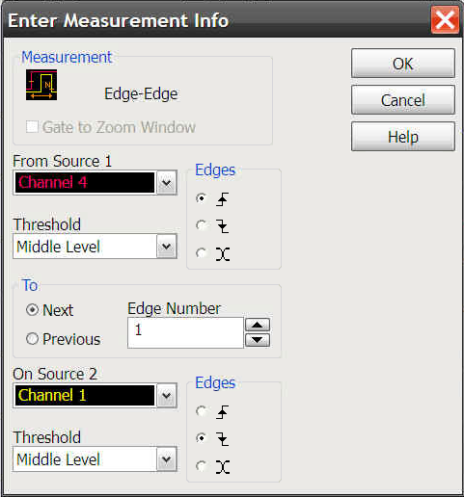
Set up the timing measurement
Click the measurement control button (Measure) on the top menu bar:
Then on the pull down menu select Time|Edge – Edge, the following page will pop-up:

Slide 4
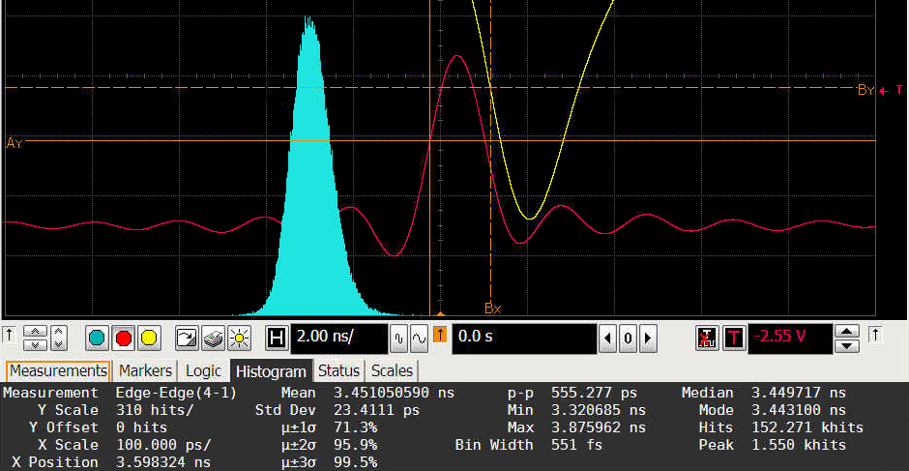
Set up the timing measurement
Select the sources for your timing measurement, here we select Channel4 rising leading edge at its middle level and Channel 1 falling leading edge at its middle level, then OK. It measures the time difference between these two references.
On the screen will be accumulating a histogram of this measurement as shown below:

Slide 5
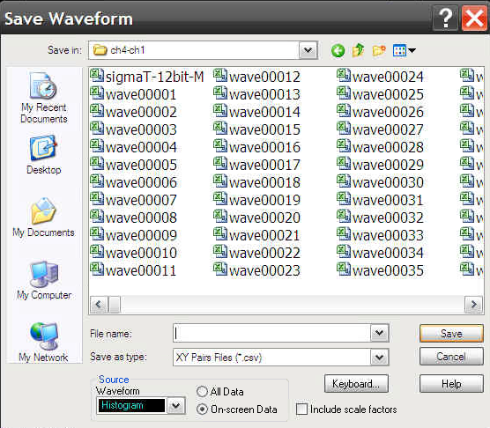
Get results from the timing measurement
By click on Histogram button on the bottom menu bar of the screen we can immediately get the timing measurement results, such as: Std Dev 23.4111 ps, Total Hits 152.271 khits, etc.
To save the histogram data move the mouse into the histogram, then right click, on the pop-up window choose Save Waveform | To File, and on the Save Waveform window select Source Waveform as Histogram, and enter the name of the saved file (as XY Pairs Files (*.csv)):
Use excel to open this .csv file.

