Slide 1

APD time resolution study with beam splitter
C. Lu
Princeton University
(5/29/2015)

Slide 2
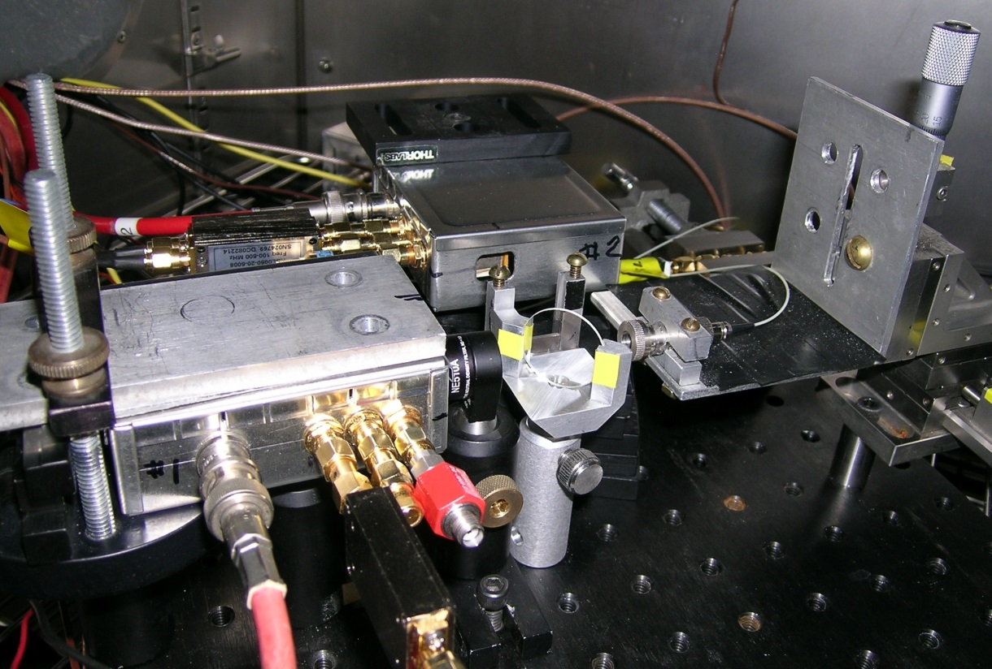
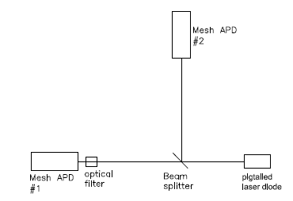
Beam splitter test setup

Slide 3
Sketch by Thomas Tsang
http://physics.princeton.edu/~mcdonald/LHC/Tsang/APD_8x8mm_mesh_screen_111512k.ppt
Mesh Screen (“top” side)
Output to Scope
Kapton Tape, 0.002 in.
- HV connected to “top” (p-side)
p⁺
APD
Small n-side contact on original APD
Ground
n+
Sintered Au layer (“bottom” side)
Al₂O₃ Substrate
Contact between screen and n+ side made by Au epoxy thru hole in Kapton

Slide 4
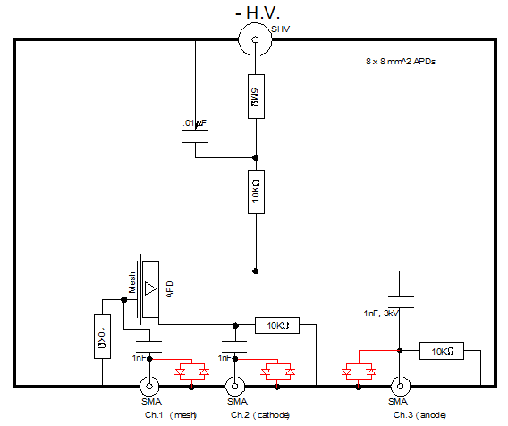
APD test box
Ch 1 = Mesh Ch2 = n-side cathode Ch 3 = p-side anode

Slide 5
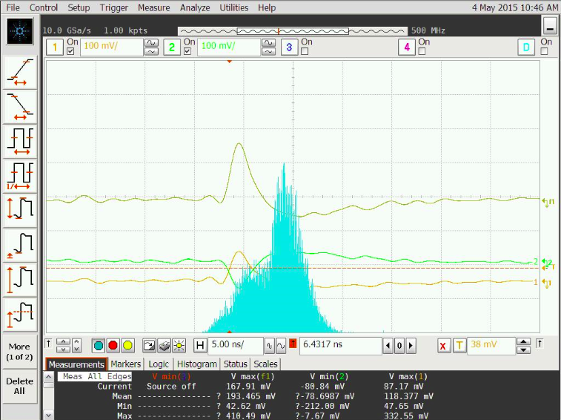
Measured Fe-55 spectrum
Wenteq 5008 amplifiers used in the test. Spectrum of Fe-55 for APD #2, HV @ -1800V:
APD #1 has thicker layer of epoxy on the mesh, which absorbs Fe55 x-ray, so the counting rate is quite low, we didn’t record its Fe55 spectrum.
Ch#1 – APD#2 cathode;
Ch#2 – APD#2 mesh;
Ch#3 – APD#1 mesh;
Ch#4 – trigger;
Func1 – Ch#1 – Ch#2;
Histogram of Func1 – See next slide for details.
Func1=Ch#1-Ch#2

Slide 6
Measured Fe-55 spectrum
Measured spectrum for Fe-55, HV @ -1800V.
Fe-55 peak is at ~210 mV, which corresponds to 5900/3.6=1639 e-h pairs.
In a 60-μm silicon layer, a MIP particle can create ~6000 e-h pairs.
We should adjust laser intensity to 6000/1639 = 3.7 times Fe-55 peak,
~ 210 mV*3.7 = 780 mV, to mimic MIP signal.

Slide 7
Time resolution
Adjust HP pulser’s output to tune the laser beam intensity until V_{Func1} is in neighborhood of 780 mV. For APD #1 only mesh signal is available, so we adjust its mesh signal size close to APD #2 mesh signal: 365mV.
After this adjustment both channels can mimic MIP signal with laser beam. Measure time resolution between these two APDs.
dt = APD#2 mesh to APD#1 mesh
s(dt) = 16.9 ps
dt = APD#2 Func1 to APD#1 mesh
[Func1 = mesh - cathode]
s(dt) = 15.6 ps
Thus we can deduce the single-APD time resolution = 15.6/2 = 11 ps.
dt = APD#2 cathode to APD#1 mesh
s(dt) = 17.3 ps

Slide 8
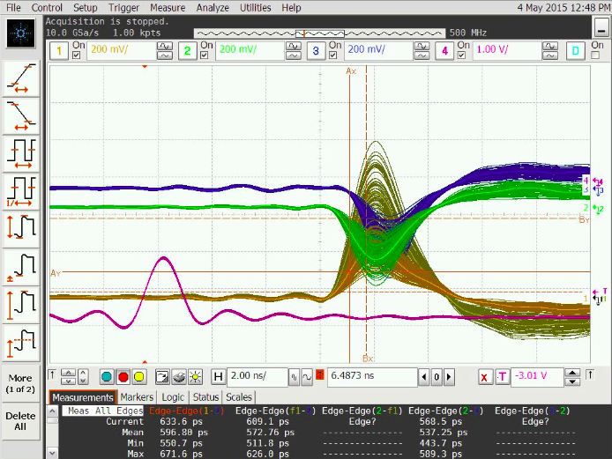
Illustration of dt measurement
The following is a screen capture of the time measurement, several dozens of events are overlapped.
Measure dt of APD#2 cathode to APD#1 mesh
Ch#3: APD#1 mesh
Ch#2: APD#2 mesh
Ch#1: APD#2 cathode

Slide 9
Cathode termination effect on mesh signal
Fe-55 spectrum measured on mesh electrode, cathode output terminated by 50 Ohm.
Note that 0 V signal is at the right in the plots.
Fe-55 spectrum measured on
mesh electrode, cathode
output terminated by 0 Ohm.
Signal is larger than 50 Ohm
termination scenario.

Slide 10
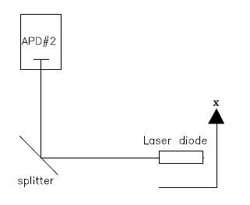
Interesting observation of the induced signal on anode
We have noticed that when we shift the laser beam along with x-direction, the induced signal on anode is also shifting along with time. This phenomenon must relate to the mechanism of signal formation in the APD.
For this test we only use APD#2, all three channels available on the Agilent scope are hooked up to this APD: mesh(ch#1), cathode(ch#2) and anode(ch#3), leave the 4th one as the trigger channel.
x direction
Mesh Screen (“top” side)
Output to Scope
Kapton Tape, 0.002 in.
- HV connected to pin at one corner
P⁺
APD
Small n-side contact on original APD
Ground
Sintered Au layer (“bottom” side)
Al₂O₃ Substrate
Contact between screen and n+ side made by Au epoxy thru hole in Kapton

Slide 11
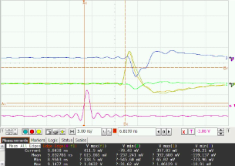
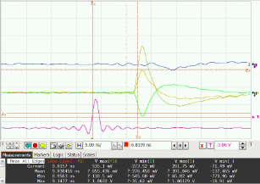
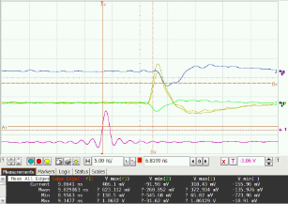
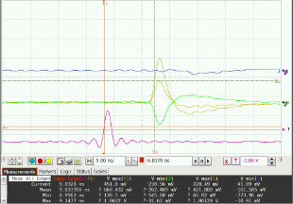
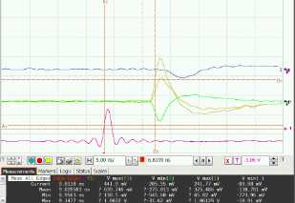
Interesting observation of the induced signal on anode
Notice how this anode signal is shifting while moving beam spot position along x direction
x = 2 mm
7 mm
anode
trigger
3 mm
9 mm
The mesh and cathode signals are not shifting except the cathode signal at 2 mm shows little bit latter.
5 mm
Func = cathode - mesh
anode
cathode
mesh
trigger

Slide 12
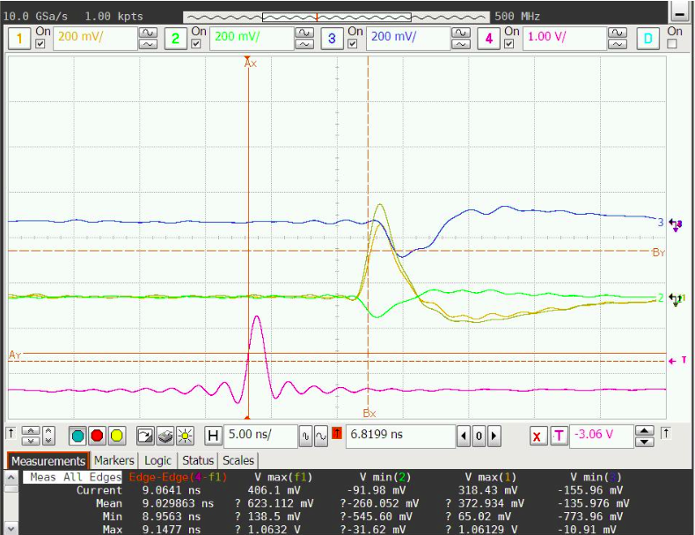




Timing of the induced signal on various electrodes
The induced signal on the electrodes are due to the movement of the source charge in the APD, so it is hard to understand why the time of the anode signal is so later than the signals on other electrodes? The screen captures on previous slide also reveal the time interval between laser diode trigger signal and Function signal (cathode – mesh):
Summary see next slide.
x = 3 mm
trigger
9.0298ns

Slide 13
Time Walk
Timing of the induced signal on mesh/cathode
Five different x locations:
x (mm) | 1 | 2 | 4 | 6 | 8
Dt (ns) | 9.0328 | 9.0299 | 9.0285 | 9.0305 | 9.0334
The mean value of Dt = 9.0310 ns, s(Dt) = 0.0018 ns
We can see the timing of the mesh and cathode signal is not shifting with laser spot position, only anode signal is wandering around.
Full width of time walk of the mesh/cathode signal is only 5 ps

Slide 14
Possible explanation of the anode behavior
On my report made on 2/5/2015 “Signal from anode, cathode and mesh of RMD 8x8mm mesh APD” the scanned signal amplitude distribution was presented. I attach five slides from that report in the following:
Please note the coordinate system of 2/5/2015 test is somewhat different from this recent test, therefore when you compare the signal variation with x you should only pay attention to the relative x variation, not the absolute x value.

Slide 15
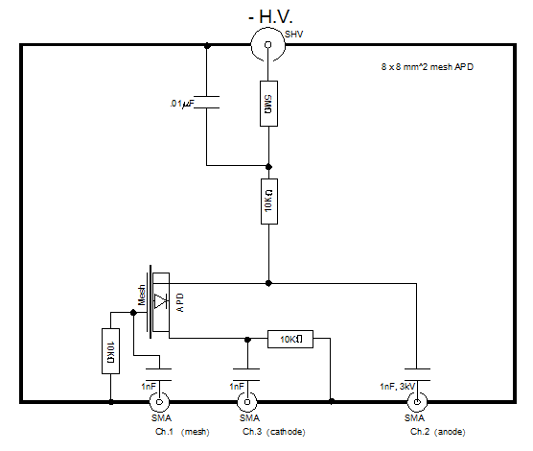
“Signal from anode, cathode and mesh of RMD 8x8 mm² mesh APD” – slide #2
To understand the signal formation of APD we have to gather more information, which includes the difference of the signal size and shape on various electrodes.
For a 64 mm² mesh APD we can get three signals from Anode, Cathode and Mesh, respectively. With the help of Agilent digital scope we also can get various combination of these signals in real time, such as cathode-mesh, anode-mesh, etc.

Slide 16
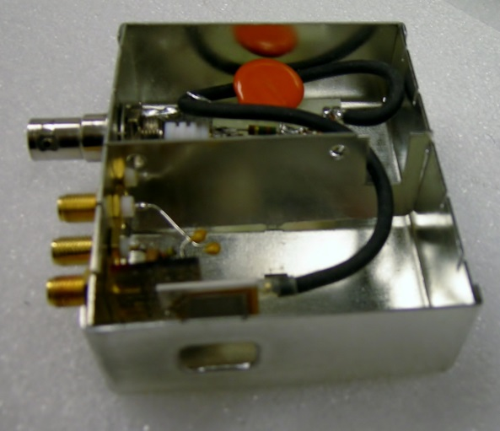
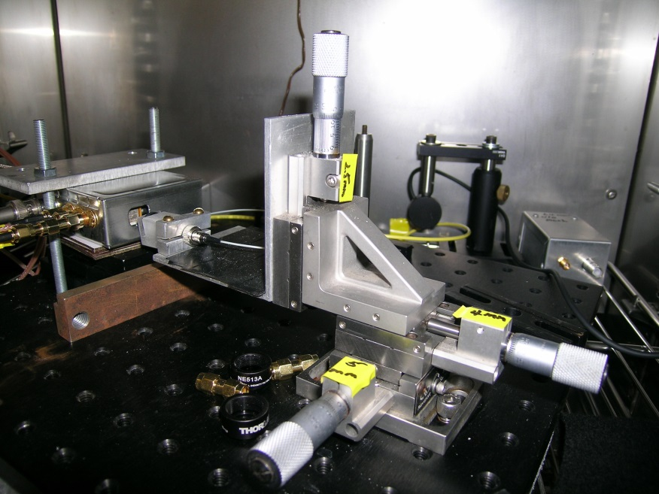
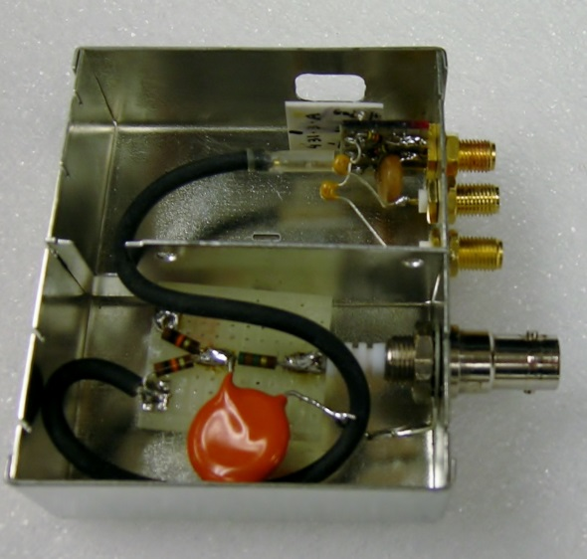
Test setup
“Signal from anode, cathode and mesh of RMD 8x8 mm² mesh APD” – slide #3
Lens of laser diode
Front view of mesh APD
x
Back view of mesh APD
Test box
Box open window
Mesh APD
y
Coordinate system used in this test

Slide 17
Test setup
“Signal from anode, cathode and mesh of RMD 8x8 mm² mesh APD” – slide #4
The Laser Diode used in this test is WSLP-980-010m-4-PD fiber coupled laser diode, 9-nm, 10-mW laser diode, 6-μm thick, 80-cm long fiber.
The trigger pulse is coming from HP8131A pulse generator. Parameters used are:
V_{high} = 0;
V_{low} = -3.6V (varies later);
Width = 0.5 ns;
Freq = 10 kHz.
All three channels use Wenteq 5008 amplifier.
-1750 V is applied to the 64 mm² mesh APD.
The lens of the laser diode is mounted on an x-y stage, thus the laser beam can move along with x and y direction.
The tested mesh APD S/N: 431-3-A.

Slide 18
“Signal from anode, cathode and mesh of RMD 8x8 mm² mesh APD” – slide #5
Scan results from various channels
We scan a 64 mm² mesh APD along with x and y directions for various channels: Cathode, Mesh, Anode, Cathode-Mesh and Anode-Mesh as shown below: Cathode-Mesh signal has wide flat distribution both on x and y directions:
Anode readout pin is at x = 10 mm

Slide 19
“Signal from anode, cathode and mesh of RMD 8x8 mm² mesh APD” – slide #6
Induced signal vs. beam position
This plot clearly shows induced current on cathode electrode is almost the mirror image of the induced current on anode + mesh electrodes. The induced signal from cathode is the largest one.
If we combine all three signals together and produce a signal = Cathode – (Mesh + Anode), we can double the signal size, also can reduce common mode noise, that can further improve the time resolution. In the following tests we use Cathode-Mesh signal to measure the time resolution, it does show better results.
Next slide is Dick’s sketch of mesh APD, it can helps us to understand above statement.

Slide 20
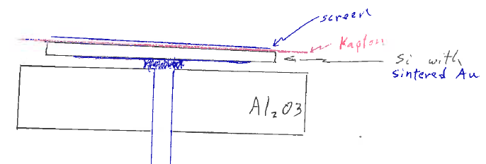
“Signal from anode, cathode and mesh of RMD 8x8 mm² mesh APD” – slide #7
Dick’s sketch of mesh APD
= mesh
APD
Cathode electrode
According to Dick’s sketch if we believe the induced signal model we can see that the cathode electrode should be the best place to obtain the induced signal because the bottom electrode is Au-sintered and covers entire back side (8x8 mm²), there is no other electrode in between this electrode and the P-N junction.
The anode side mesh electrode, although covers the entire APD active area, but there is anode electrode in between the mesh and P-N junction, therefore the induced signal on mesh electrode is partly shielded by the anode. This picture is strongly endorsed by our test result on the previous slide.

Slide 21
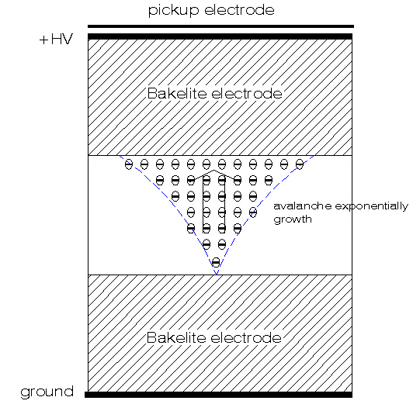
Possible explanation of the strange timing behavior of the anode
(See my old report “Simulation of RMD APD with VTCAD” 10/29/2012)
The signal obtained on APD’s electrodes is not due to either electron or holes collected on the electrodes. It is the induced signal originated by the avalanche at the P-N junction. The mechanism is very similar to RPC chamber*, which is explained in the following:
The movement of the charge in the electric field induces a current signal on the pickup electrode.
According to Ramo’s theorem:
where e₀ is the electrons charge, N(t) is the number of electrons presented at time t, v is the electron drift velocity, E_{w} (weighting field) is the electric field in the gap if we set the pickup electrode to V_{w} and ground all other electrodes.
Induced signal mechanism in RPC chamber
* Induced signal in RPC, C. Lu, SNIC Symposium, SLAC, Stanford, California, 3-6 April, 2006. http://www.slac.stanford.edu/econf/C0604032/papers/0201.PDF

Slide 22
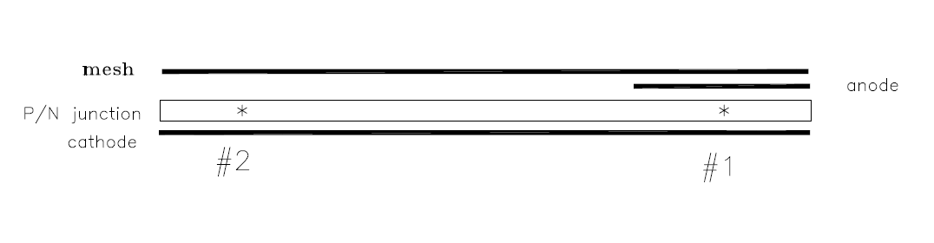
Possible explanation … (Cont’d)
The difference between RPC and APD is: for the former gas avalanche taking place in the high electric field region, for the latter both electron and ion can produce avalanche, but because the electron/ion is moving in the opposite direction, two induced signals will be added together. Therefore the basic signal formation mechanism should be similar.
If we readout on anode we should set the anode electrode to V_{w,} set all others to ground, then calculate the weighting field.
Since the anode surface P-type doping density is lower (see slide 23), its resistivity is high, the effective anode area is limited to a small region surrounding the pin, we model this as illustrated in above sketch. For the avalanche #1, the weighting field is normal there, so the induced signal looks normal, timing is no strange. But for the avalanche #2, the weighting field formed by anode and all other grounded electrodes is distorted from parallel geometry, quantitatively we can understand why the induced signal is much latter and its leading edge slope is much slower.

Slide 23
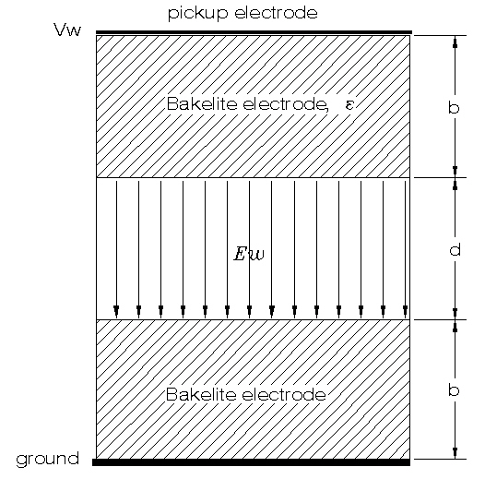
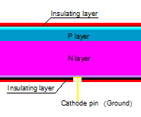
Similarity of APD & RPC weighting field
P-N junction
T_{silicon}
The similarity between these two illustrations is very clear: the P-N junction → Gas gap; other silicon material → Bakelite electrodes.

Slide 24
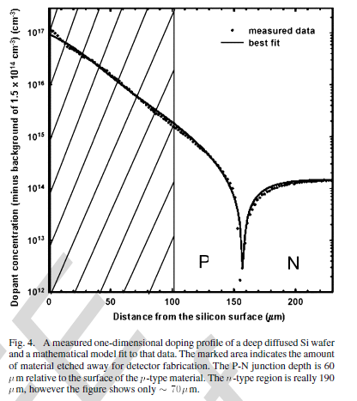
Doping profile
The doping profile is extracted from RMD IEEE NS October, 2006 paper. We add a thin layer of high density doping to each side of the APD: P side 10¹⁹ (will change it to 10¹⁷), N side 10¹⁸ (will change it to 10²¹).
Measured APD doping profile
Anode side resistivity is much higher than cathode side due to doping density difference, only small region around the anode readout pin can efficiently collecting signal, it will rapidly decrease as shown on slide #17.

Slide 25
Suggested improvement to the RMD APD
In this design HV electrodes are isolated from signal pick up electrodes.
Based on this idea RMD immediately developed large area mesh APD device, which greatly improve the signal uniformity and reduce time walk effect.

