Slide 1
Gain & Time Jitter Study for Wenteq Amplifier
Changguo Lu
7/23/2013

Slide 2
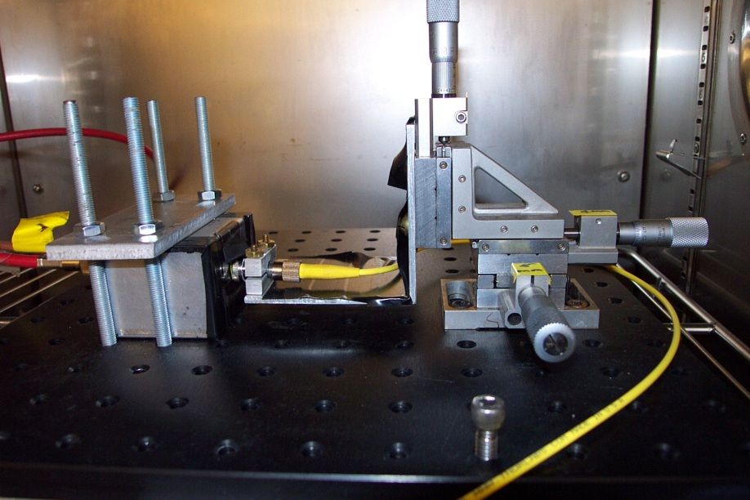
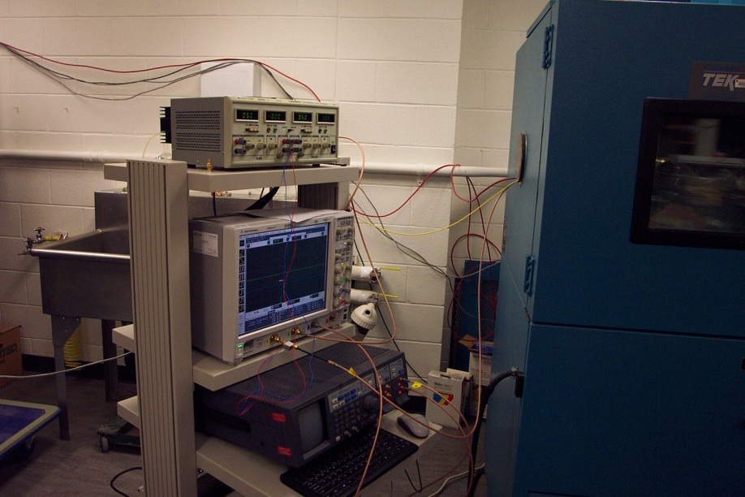

Test setup
Test APD, VCSEL and its collimator is in an environmental chamber (EC). They are in the dark.
Internal view of the EC.
EC chamber
APD test box (64mm^2 APD)
LeCroy Pulse generator
Optical fiber
Collimation lens (Thorlabs CFC-11X-B)
Agilent digital scope

Slide 3
Parameters used in the test
Use the pulse coming from a 64mm^2 mesh APD with VCSEL laser pulse to test the gain and time resolution.
The VCSEL laser diode is activated by LeCroy pulser with the following parameters:
V = 1.05V; width = 0.9ns; Leading edge = 0.25ns; Trailing edge = 0.25ns; Frequency = 50kHz.
APD HV = -1750V.

Slide 4
Fe-55 full energy spectrum
Fe-55 full energy peak at -50mV
Fe-55 full energy peak at -145mV
The peak spectrum of Fe-55 is quite different for mesh APD and plain APD.

Slide 5
VCSEL trigger signal V = 1.05V
# of MIPs = 576/50*1640/6000 ~3.1 MIPs
Time resolution = 20.1ps

Slide 6
VCSEL pulse p.e. estimation
Since we already calibrated the laser beam power, we can convert the signal amplitude unit to # of photons in each pulse:
Repetition rate of laser diode is R = 10 MHz, 980nm photon energy is E₉₈₀ = 2.03E-19 J, MIP equivalent # of photo-electron = 6000, transmittance of mesh/Kapton = X_{transmit}, and we assume that Q.E. of APD = 35%:
@Trigger pulse = 1.05V, VCSEL output power P(W) =0.48*10⁻⁶ W,
The conversion fact from laser beam power P(W) to # of MIP is:
# of MIPs = P(W)/R(Hz)/E₉₈₀ (J)*QE*X_{transmit} /6000
= 0.48*10⁻⁶ *0.35*X_{transmit} /(10⁷ *2.03*10⁻¹⁹*6000)
= 13.8X_{transmit}
We already use Fe-55 source calibrated VCSEL laser beam, @V=1.05V, the equivalent # of MIPs ~3.1 (see previous slide),
3.1 = 13.8X_{transmit}
⇒ X_{transmit} = 3.1/13.8 = 22.5%, the transmittance is small, but reasonable.

Slide 7
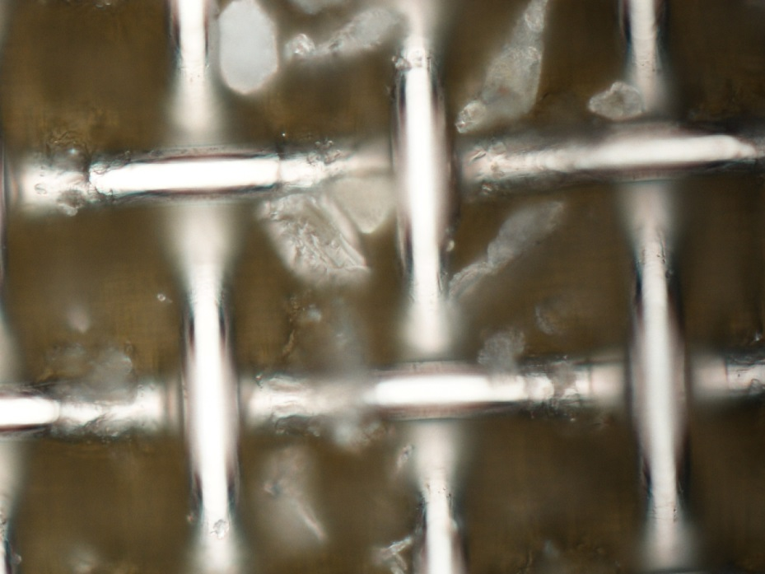
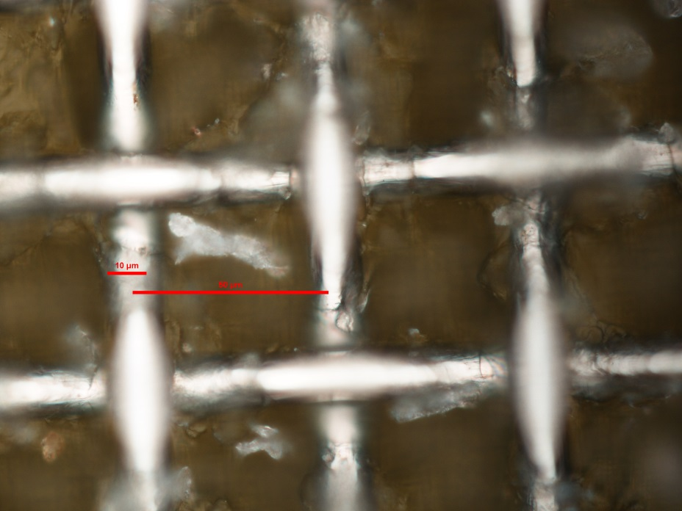
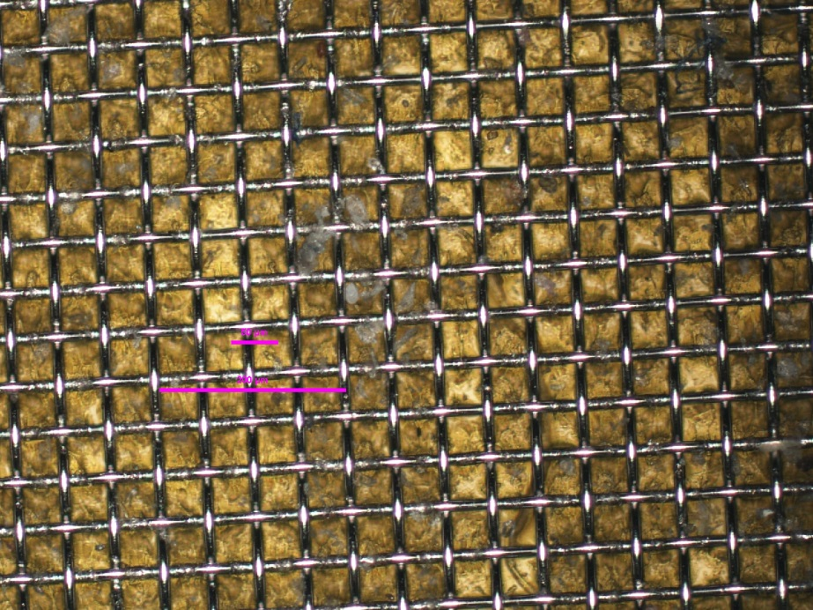
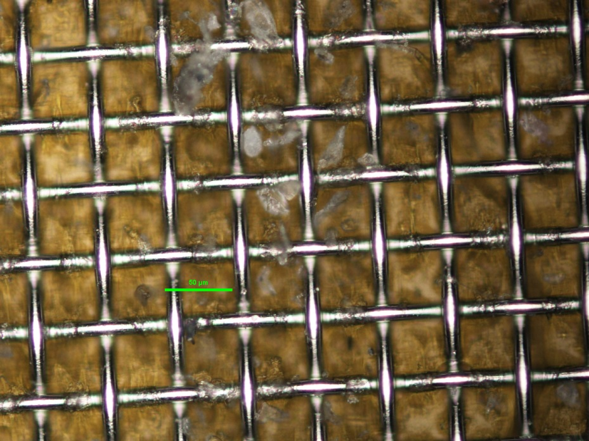
Why the mesh/Kapton transmittance so small?
Under microscope see a lot of unknown substance between mesh wires

Slide 8
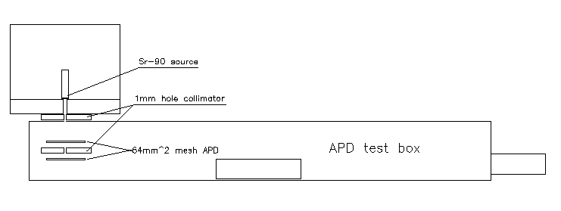
Sr-90 source test
Two APDs coincidence trigger, top APD is a sick APD, on left is the spectrum for bottom APD.

