Slide 1
Test Sebastian’s new APD telescope box
C. Lu
12/2/2013

Slide 2
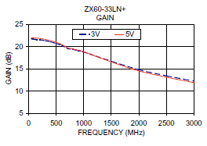
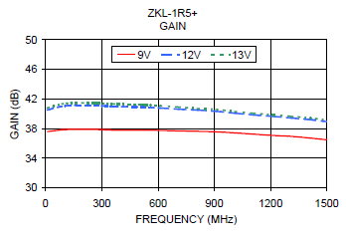
I have tested Sebastian’s new APD beam test telescope with both VCSEL laser pulse and Sr-90 source. The amplifier used in this test is mini-circuits ZKL-1R5+.
Their major differences are summarized in the table below, detailed data sheets see the next two slides.
Amplifier | Bandwidth | Gain
ZX60-33LN+ | 50 – 3000MHz
ZKL-1R5+ | 10 – 1500MHz

Slide 3
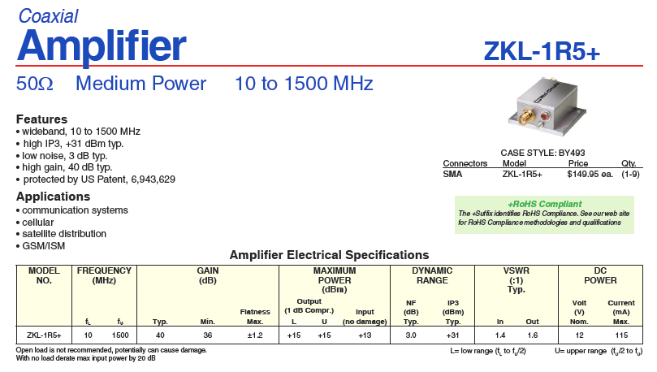

Slide 4
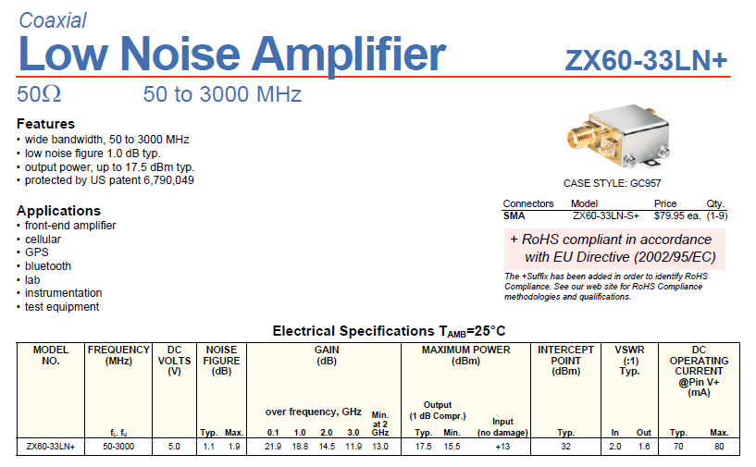

Slide 5
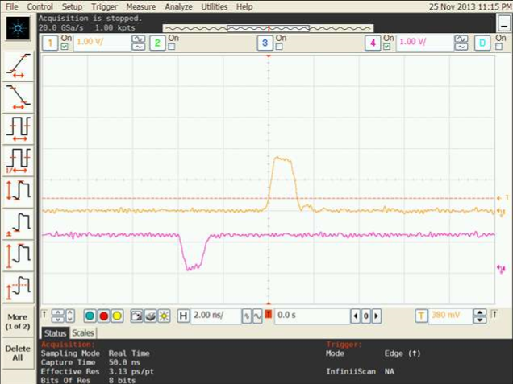
Calibrate ZKL-1R5+ amplifier (10~1500MHz, 35~40db)
~1.75V amplitude
Amplifier gain ~ 1.75/1*50
= 87.5 ~ 38.8db
~1V amplitude
Complement of the input signal
1/50 attenuator
ZKL-1R5+ amp.

Slide 6
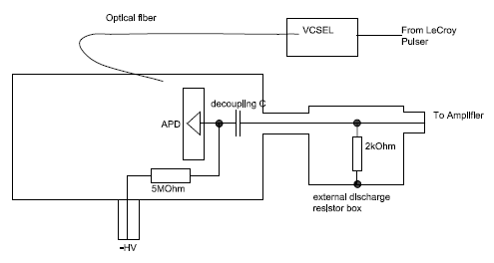
Modified APD telescope test box
On last Friday we conducted a VCSEL pulse test on this telescope box, unfortunately we blew up a mini-circuits ZX60 amplifier. It was due to missing a discharge resistor at the output port of the test box. When we unplug/plug a cable from the port, some charge accumulated on the output decoupling capacitor blew out the amplifier.
A temporarily solution to prevent this discharge is adding a 2kOhm resistor externally, as shown below:

Slide 7
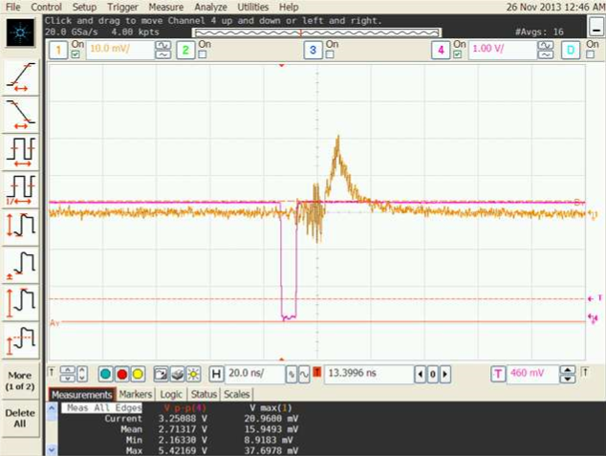
VCSEL test results of the modified APD telescope test box.
APD #1:
Output signal from ZKL-1R5+ amplifier/mesh APD.
VCSEL trigger pulse from LeCroy pulser (complement pulse)

Slide 8
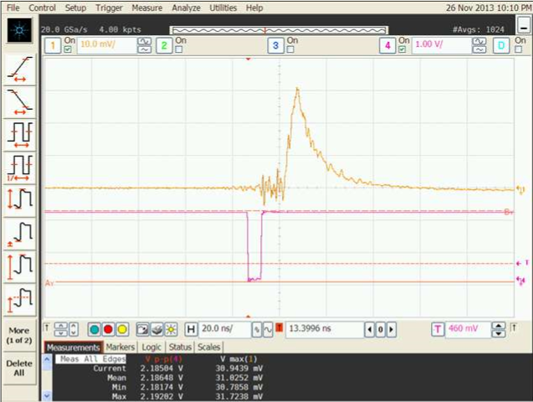
VCSEL test results of the modified APD telescope test box.
APD #2:
Output signal from ZKL-1R5+ amplifier/mesh APD.
VCSEL trigger pulse from LeCroy pulser (complement pulse)

Slide 9
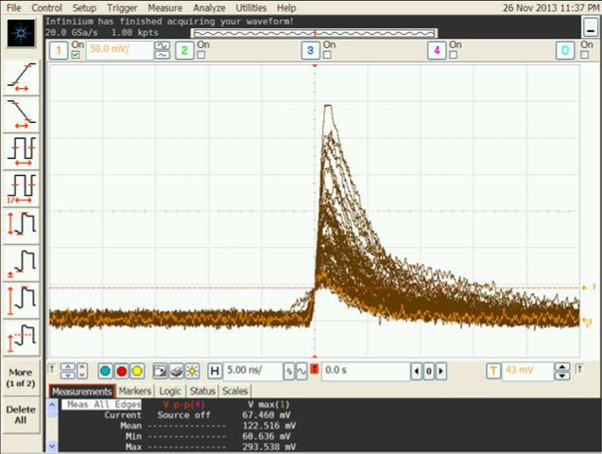
Sr-90 test results of the modified APD telescope test box.
ZKL-1R5+ amp, APD #1:

Slide 10
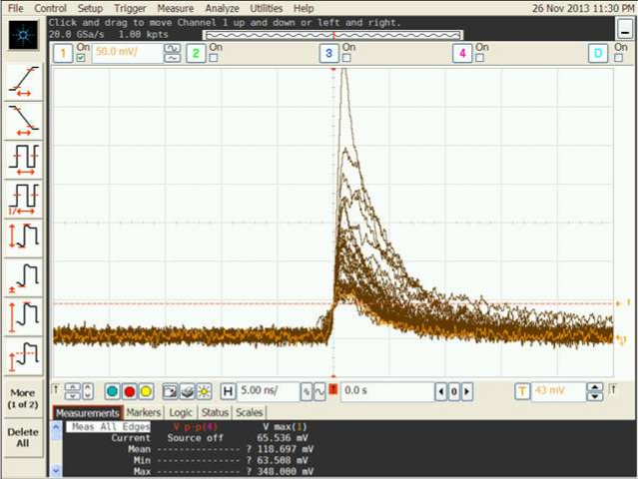
Sr-90 test results of the modified APD telescope test box.
ZKL-1R5+ amp, APD #2:

