Slide 1

Noise reduction technique in APD time resolution measurement
C. Lu
Princeton University
(5/13/2012)

Slide 2
Digital scope in high resolution mode
Agilent digital scope has a “High Resolution Mode”, which performs box-car averaging, averaging adjacent samples within a single capture of a waveform. This averaging provides lower noise and higher (vertical) resolution samples for the waveform.
Normal resolution mode, full BW @ 4GHz, sampling rate 20GSa/sec.
I use these two points as the zero crossing references.
High resolution mode, BW reduced to 1.1GHz, sampling rate reduced to 5GSa/sec.

Slide 3
Time resolution with high resolution mode
Waveform data files are available here: http://physics.princeton.edu/babar/fasttiming/05122012/4mm/1750V/
There are three subdirectories: ../No smooth; ../9bits and ../10bits, they are for three resolution modes. The data analysis results are as follows:
Scope Mode | Band width | Sampling rate | Single APD time resolution (ps)
Normal | 4GHz | 20Gsa/sec | 10.7
9 bits | 4GHz | 20GSa/sec | 9.9
10 bits | 1.12GHz | 5GSa/sec | 8.3

Slide 4
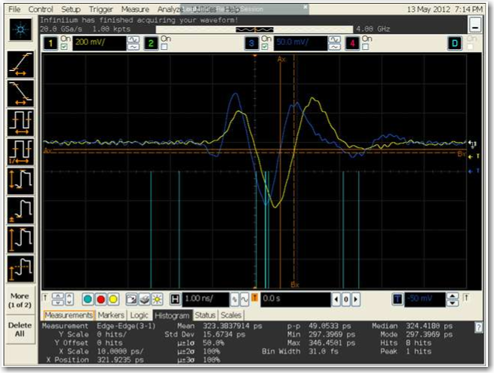
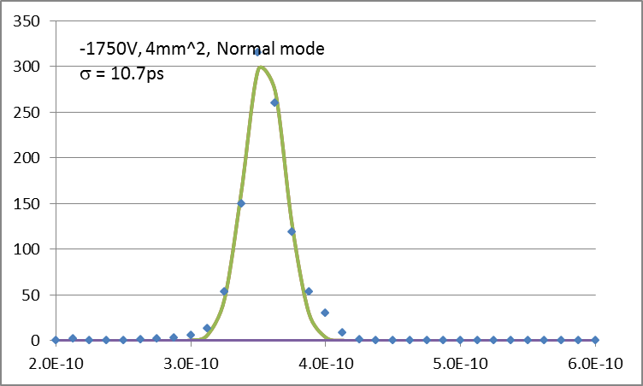
Normal mode

Slide 5
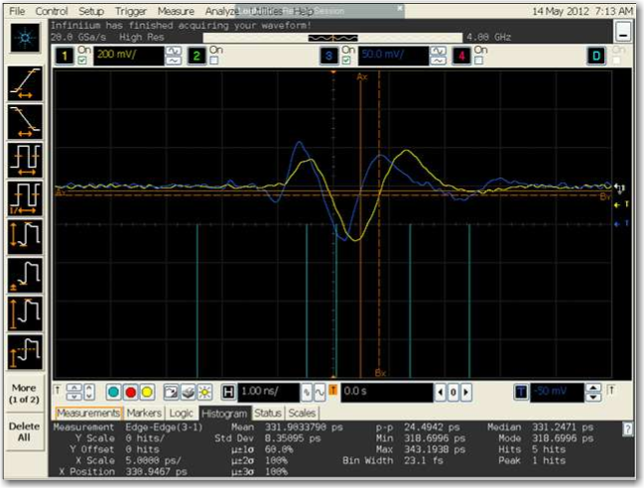
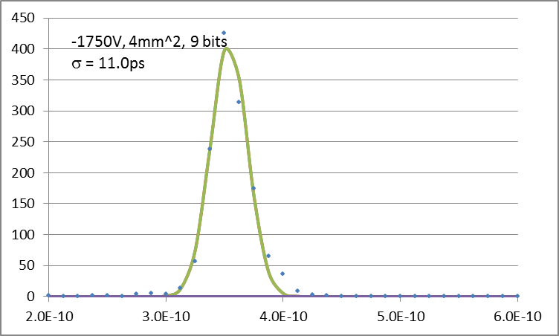
9 bits mode

Slide 6
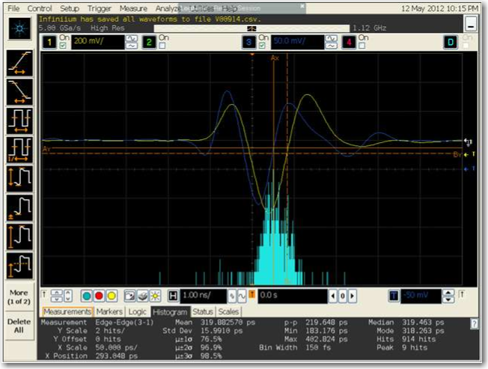
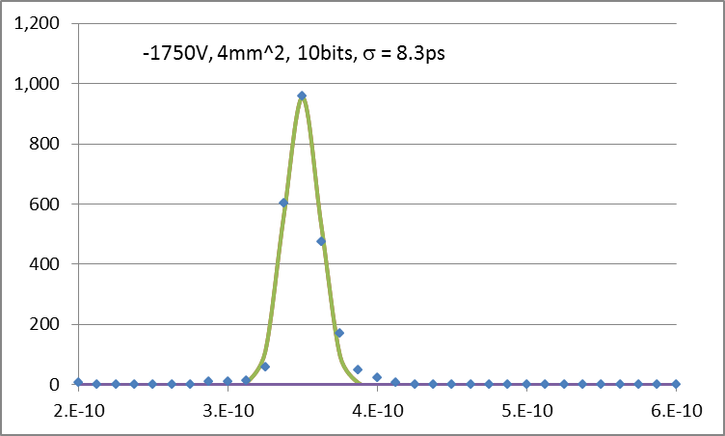
10 bits mode

Slide 7
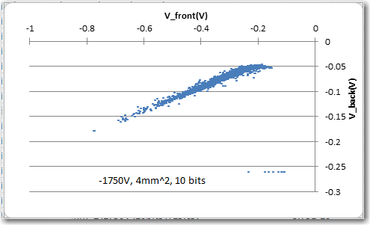
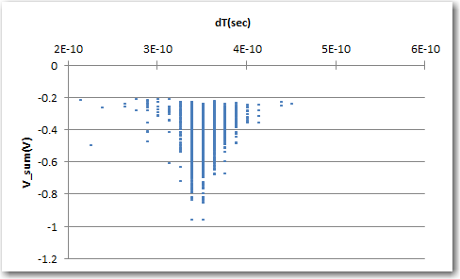
10 bits mode
Scatter plot of two APD’s signal amplitudes
Scatter plot of dT vs. sum of two APDs signals.

Slide 8
Summary
H.V. (V) | Resolution mode | Time resolution (ps)
-1800V | Normal | 15.3
 | 9 bits | 13.7
 | 10 bits | 12.9
-1775V | Normal | 12.9
 | 9 bits | 10.8
 | 10 bits | 9.7
-1750V | Normal | 10.7
 | 9 bits | 9.9
 | 10 bits | 8.3

