Slide 1

Noise reduction technique in APD time resolution measurement
C. Lu
Princeton University
(5/15/2012)

Slide 2
Digital scope in high resolution mode
Agilent digital scope has a “High Resolution Mode”, which performs box-car averaging, averaging adjacent samples within a single capture of a waveform. This averaging provides lower noise and higher (vertical) resolution samples for the waveform.
Normal resolution mode, full BW @ 4GHz, sampling rate 20 GSa/sec.
I use these two points as the zero crossing references.
High resolution mode, BW reduced to 1.1 GHz, sampling rate reduced to 5 GSa/sec.

Slide 3
Time resolution with high resolution mode
Waveform data files are available here: http://physics.princeton.edu/babar/fasttiming/05122012/4mm/1750V/
There are three subdirectories: ../No smooth; ../9bits and ../10bits, they are for three resolution modes. The data analysis results are as follows:
Scope Mode | Band width | Sampling rate | Single APD time resolution (ps)
Normal | 4GHz | 20Gsa/sec | 10.7
9 bit | 4GHz | 20GSa/sec | 9.9
10 bit | 1.12GHz | 5GSa/sec | 8.3

Slide 4
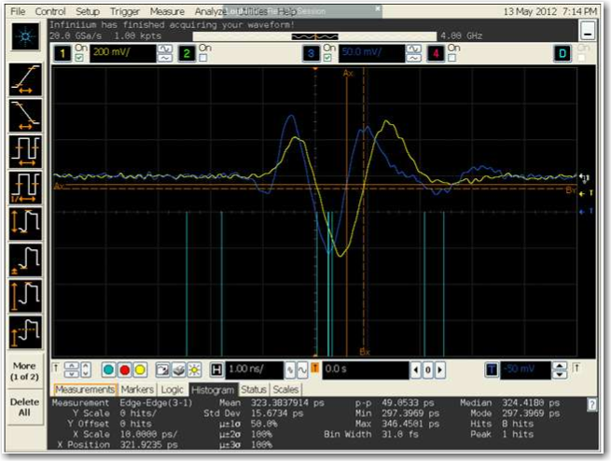
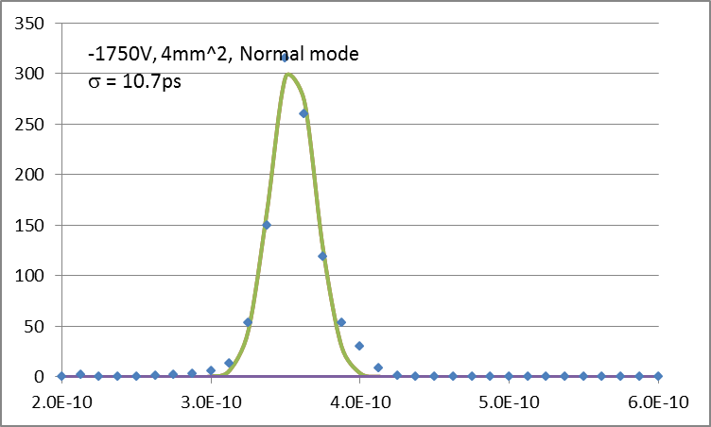
Normal mode

Slide 5
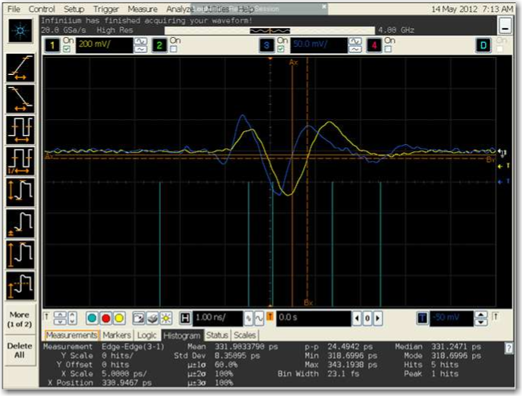
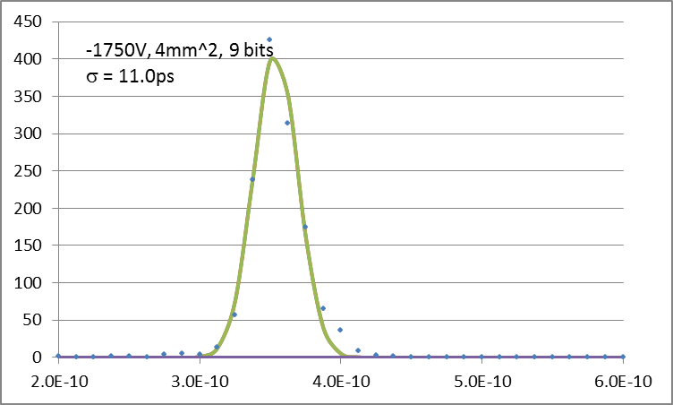
9 bit mode

Slide 6
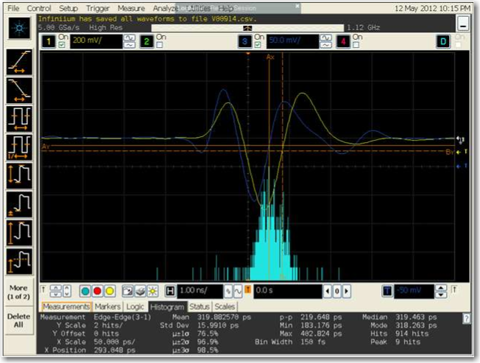
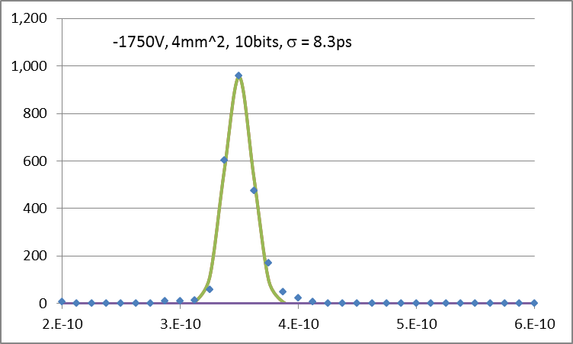
10 bit mode

Slide 7
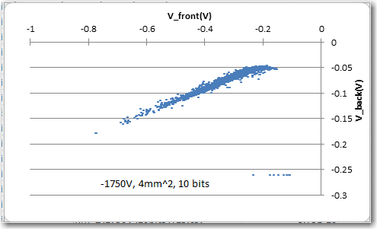
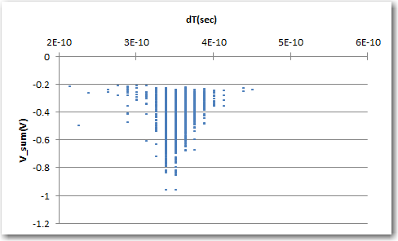
10 bit mode
Scatter plot of two APD’s signal amplitudes
Scatter plot of dT vs. sum of two APDs signals.

Slide 8
Summary
H.V. (V) | Resolution mode | Time resolution (ps)
-1800V | Normal | 15.3
 | 9 bit | 13.7
 | 10 bit | 12.9
-1775V | Normal | 12.9
 | 9 bit | 10.8
 | 10 bit | 9.7
-1750V | Normal | 10.7
 | 9 bit | 9.9
 | 10 bit | 8.3
-1725V | Normal | 10.96
 | 9 bit | 9.4
 | 10 bit | 7.1

Slide 9
Discussion
We have calibrated the APD gain with Fe-55 source. At 1725 V and 1800 V the APD gains are ~ 50 and ~ 200, respectively.
We saw the trend of lower HV corresponding to better time resolution. As the trigger condition are fixed for all these tests, at lower high voltage the events passing the trigger need to have larger primary e/hole pairs, that might reduce the primary statistical error.

Slide 10
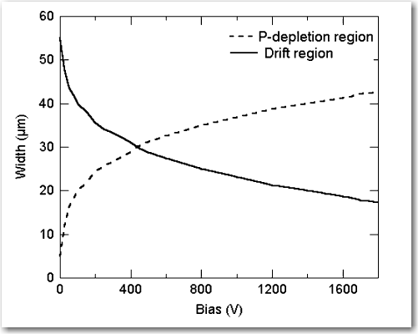
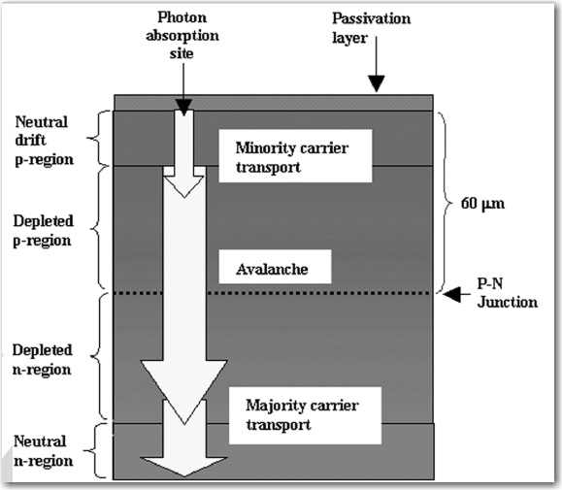
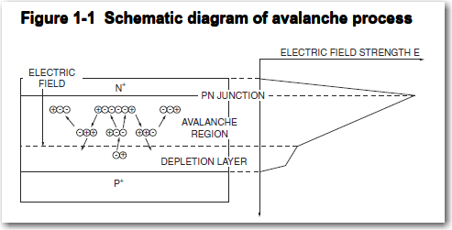
Discussion (cont’d)
Typical electron mobility in silicon at room temperature is 1400 cm² /(V*s).
At ~ 1800 V, the P-depletion region is ~ 30 μm.
The APD avalanche multiplication starts at electric field strength ~ 2x10⁵ V/cm, if we assume the E-field in the depletion region is 1/3 of this number, it would be ~7x10⁴ V/cm.
The total drift time range across the P-depletion region would be 30x10⁻⁴ cm/ (1400x7x10⁴cm/s) = ~ 30 ps.
This will contribute to the intrinsic time resolution of the APD.
Charged particle
Statistics of the primary ionization in this layer will dominate the time resolution.

