Slide 1

Test U Penn & Princeton APD/Amp
C. Lu
Princeton University
(7/24/2015)

Slide 2
Test setup
Mitch and Manny have sent us an APD/Amplifier box, in which a 64mm² mesh APD and a U Penn transimpedance amplifier are assembled together.
We used an Fe-55 source and Sr-90 source to test this box.
We also tested a Princeton APD test box under similar condition in order to be able to compare their performances.
The Princeton test box holds a 64mm² mesh APD; three electrodes: mesh, cathode and anode were connected to three SMA connectors to output signals.
We also used a VCSEL laser diode beam to test the timing feature of the amplifier.
A Wenteq 5008 amplifier has been tested with this LD beam; I forgot to test the U Penn amplifier with this arrangement, but will make it up later.

Slide 3
U Penn test box
Fe-55 source test (-1800 V)

Slide 4
U Penn test box
Sr-90 source test (-1800 V)

Slide 5
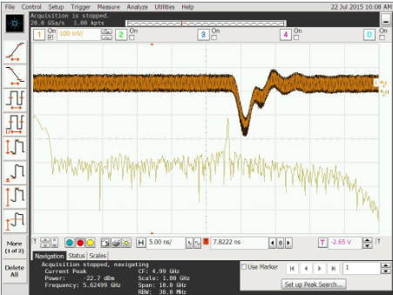
U Penn test box
Laser beam test (-1800 V)
We can see a 5.62 GHz oscillation; on the FFT spectrum it shows a peak around 5.62 GHz.
If we use B/W limit on the oscilloscope this high frequency oscillation can be eliminated completely.

Slide 6
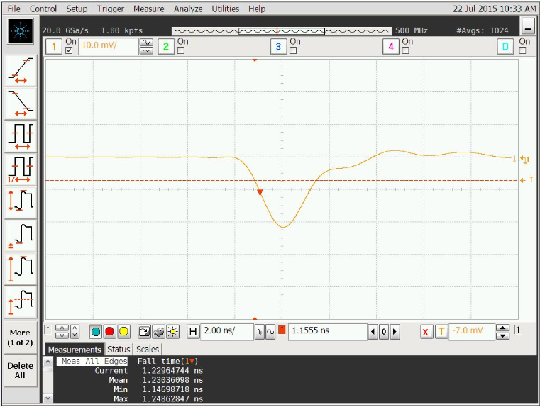
U Penn test box
Leading edge of Fe-55 signal
We can see the leading edge of Fe55 source waveform is 1.24 ns.
The B/W limit is set at 500 MHz.

Slide 7
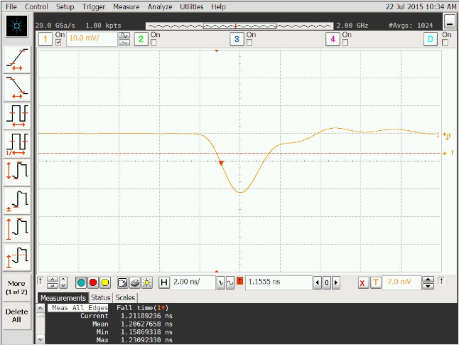
U Penn test box
Leading edge of Fe55 signal
We can see the leading edge of Fe55 source waveform is 1.206 ns.
The B/W limit is set at 2 GHz.

Slide 8
Princeton test box
Fe55 signal from all electrodes.
No oscillation can be seen here.

Slide 9
Princeton test box
Histogram of Fe55 signal
With Wenteq 5008 amplifier the signal is larger: ~ 0.2 V.
If use this result to compare U Penn test box, the gain ratio is ~ 0.15/0.023 = 6.51

Slide 10
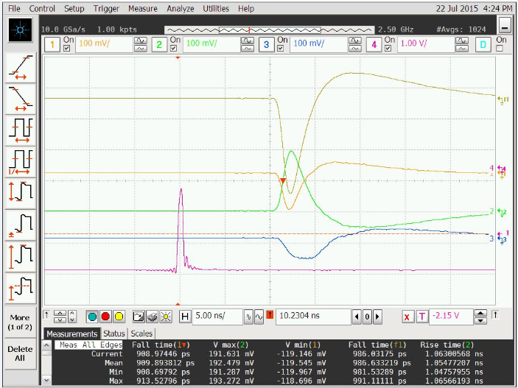
Princeton test box (Wenteq 5008)
Use laser beam to test leading edges of Princeton test box with Wenteq 5008 amplifier:
In this screen capture we can see mesh, cathode and function (mesh-cathode) signal’s leading edge:
Ch#1(mesh) 909 ps;
CH#2(cathode) 1.05 ns;
Func1: 987 ps.

Slide 11
S/N comparison
We compared S/N for U Penn and Wenteq amplifiers for Fe55, Sr90 and LD beam.
Princeton test box (Wenteq5008)
Fe-55 (Mesh) | Scale (mV/div) | Noise(rms) (mV) | Full peak (mV) | Leading edge(ns) | S/N
 | 50 | 3.05 | -81.5 | 1.1 | 26.7
 | 100 | 3.02 | -85 | 1.07 | 28.1

Slide 12
S/N comparison (Cont’d)
U Penn test box
Fe-55 | Scale (mV/div) | Noise(rms) (mV) | Full peak (mV) | Leading edge(ns) | S/N
 | 10 | 0.43 | -19.5 | 1.23 | 45.0
 | 20 | 0.43 | -18.1 | 1.20 | 42.0
U Penn amplifier has better S/N performance according to Fe-55 test result.

Slide 13
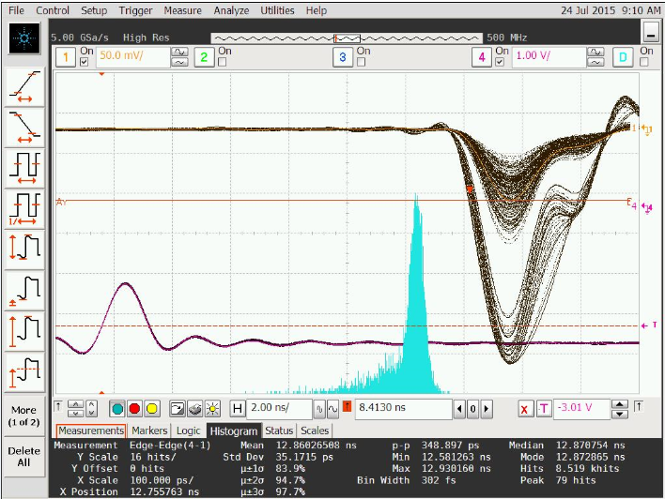
An interesting observation w/ LD test
With laser diode test I observed a very interesting phenomenon:
U Penn’s test box, laser beam signal shows two black bands, one is smaller signal’s band, the other is larger signal band.
Measured dt between trigger and APD signal has Std. Dev = 35 ps.
The double amplitude does affect the time resolution, looks the main peak resolution is much better than the overall resolution 35 ps.
dt histogram

Slide 14
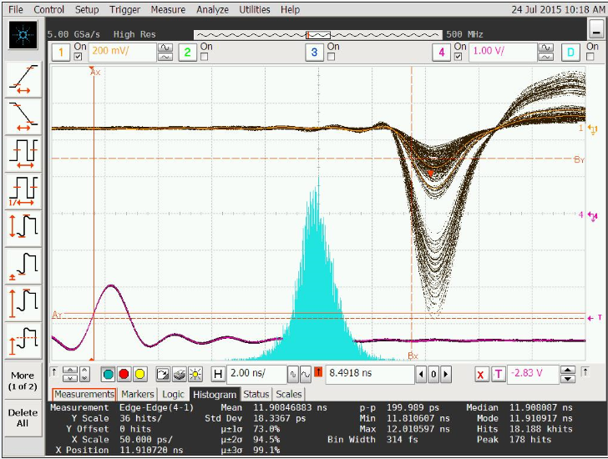
AN interesting observation w/ LD test (Cont’d)
Princeton test box also shows two black bands. Measured dt between trigger and APD signal has Std. Dev = 18.3 ps.
In previous laser beam test we never noticed such double amplitude peak spectrum. Looks the double amplitude peak does not affect the time resolution, here we still get a single Gaussian with Std Dev = 18.3 ps.
dt histogram

Slide 15
Add a ZX-60 amplifier after U Penn’s amp.
U Penn’s amplifier gain is smaller than Wenteq 5008, but S/N is better.
To boost the signal size we add an additional amplifier, Mini-Circuits ZX-60 amplifier.
The APD signal is increased by a factor of 10.

