Slide 1

Test APD/Wenteq amplifer with various interface scenarios
C. Lu
Princeton University
(7/12/2015)

Slide 2
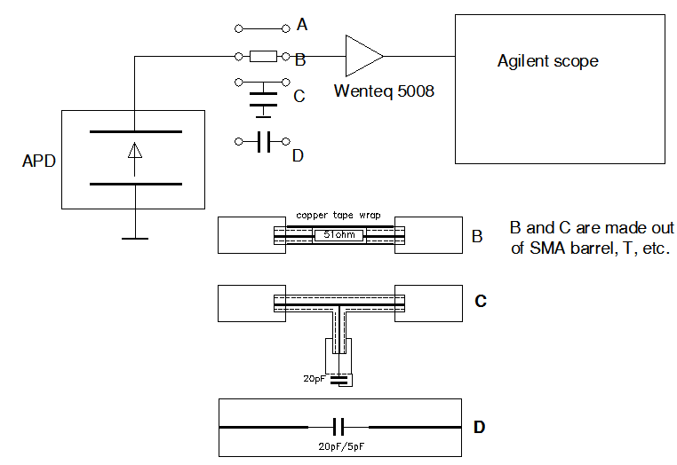
Test setup
Based on induced signal model the APD can be simplified as a current source.
To better understand the APD signal formation and the readout amplifier influence on the output signal, I used the setup as shown above. The tests are for four scenarios:
Direct connection;
Thru a 51W resistor;
Connect a 20pF capacitor to the ground.
Add a 20pF/5pF capacitor in serious with amplifier.

Slide 3
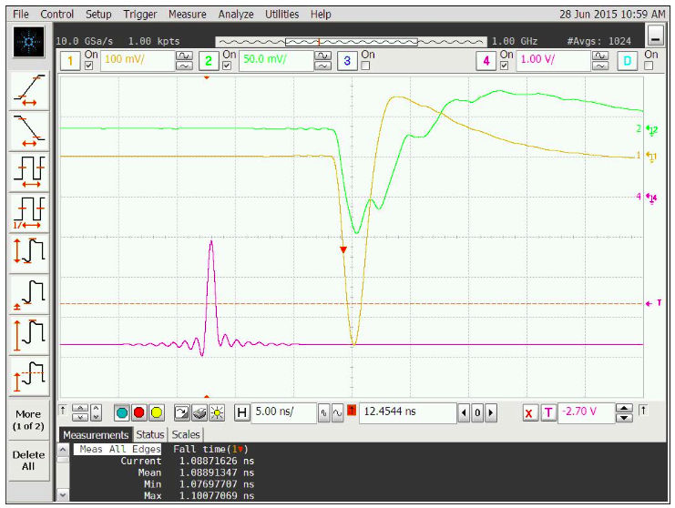
Direct connect APD mesh electrode to Wenteq (A)
Ch#1: Mesh
Ch#2:
Anode
B/W limit 1GHz, average mode

Slide 4
Add a 51 W resistor in front of Wenteq (B)
Bandwidth limit 1GHz, average mode
Compare to direct connection case we found that adding 51 W reduces the amplitude of mesh signal from -0.54V to -0.37V.

Slide 5
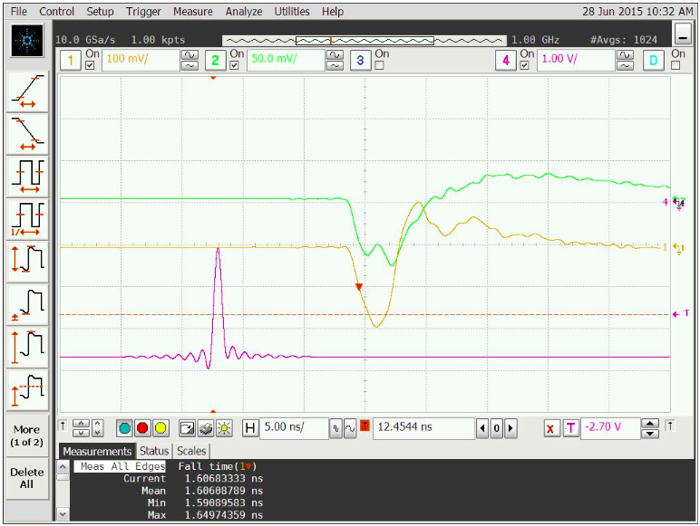
Add a parallel 20pF capacitor in front of Wenteq (C)
Ch#1: Mesh
Ch#2: Anode
Bandwidth limit 1GHz, average mode
Note the leading edge (falling edge) is much slower (1.606ns).
The another observation is anode signal shape is somewhat different .

Slide 6
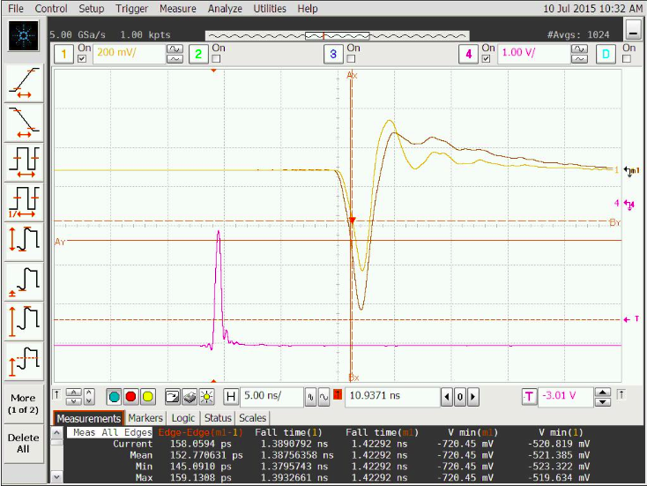
Add a 20pF capacitor in series with input of Wenteq (D1)
Ch#1: Mesh
Ch#2: Anode
Bandwidth limit 1GHz, average mode
Note the leading edge (falling edge) is similar:
w/o 20pF 1.42ns
w/ 20pF 1.38pF
The trailing edge of w/ 20pF case has larger overshooting ringing.

Slide 7
Add a 5pF capacitor in series with input of Wenteq (D2)
I didn’t record the screen capture for 5pF case, but I did recorded the waveform as shown on left.
The peak amplitude is much reduced: -0.279V, the leading time is similar: 1.45ns.
Adding capacitor in front of amplifier in series will reduce the output signal’s amplitude, but the leading edge timing is similar.

Slide 8
Signal to Noise ratio
We have measured the baseline rms noise of the waveforms for three scenarios: w/o; 20pF and 5pF.
Capacitor(pF) | Signal(mV) | Rms noise (mV) | S/N
w/o | -720 | 7.6 | 95
5 | -250 | 6.9 | 36
20 | -520 | 7.6 | 68
Because the rms noise won’t change much, but the signal size reduced significantly, adding capacitor in series to the amplifier will degrade S/N.

Slide 9
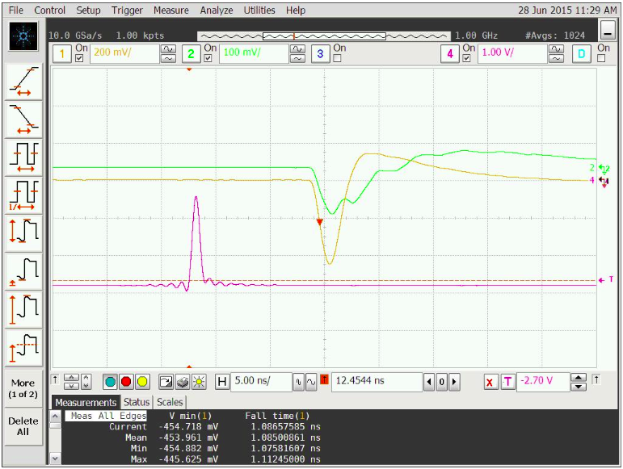
Change laser diode trigger signal width
Ch#1: Mesh
Ch#2: Anode
Bandwidth limit 1GHz.
Change L.D. trigger pulse width from 600ps to 800ps, but reduce the pulse amplitude, to get similar mesh signal amplitude.
Note the leading edge and the trailing edge are similar for 600ps and 800ps (compare to slide #3).
800ps trigger pulse width

Slide 10
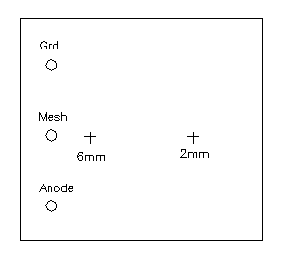
Change laser beam spot position

