Slide 1

Test APD/Wenteq amplifier with various interface scenarios
C. Lu
Princeton University
(6/29/2015)

Slide 2
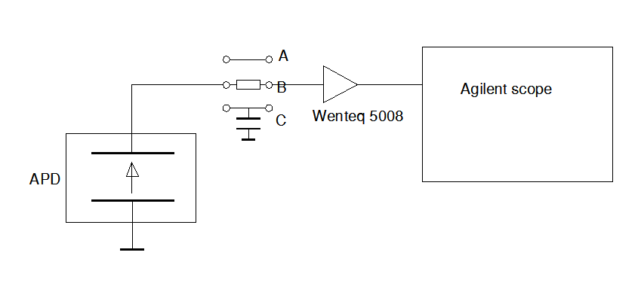
Test setup
Based on induced signal model the APD can be simplified as a current source.
To better understand the APD signal formation and the readout amplifier influence on the output signal, I used the setup as shown above. The tests are for three scenarios:
Direct connection;
Thru a 51W resistor;
Connect a 20pF capacitor to the ground.

Slide 3
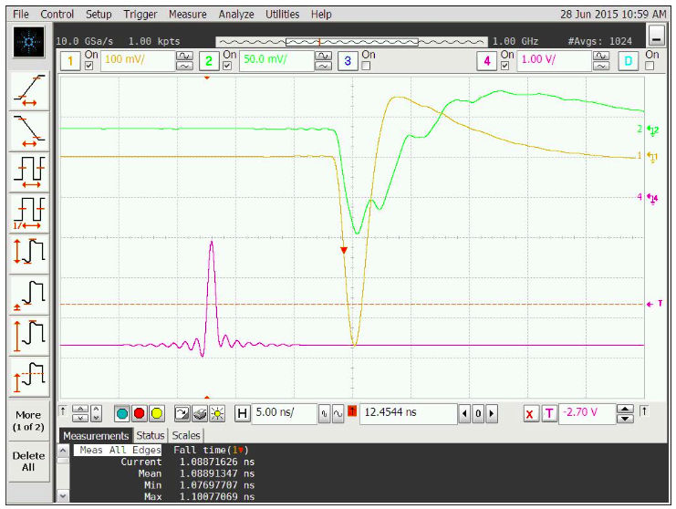
Direct connect APD mesh electrode to Wenteq
Ch#1: Mesh
Ch#2:
Anode
B/W limit 1GHz, average mode

Slide 4
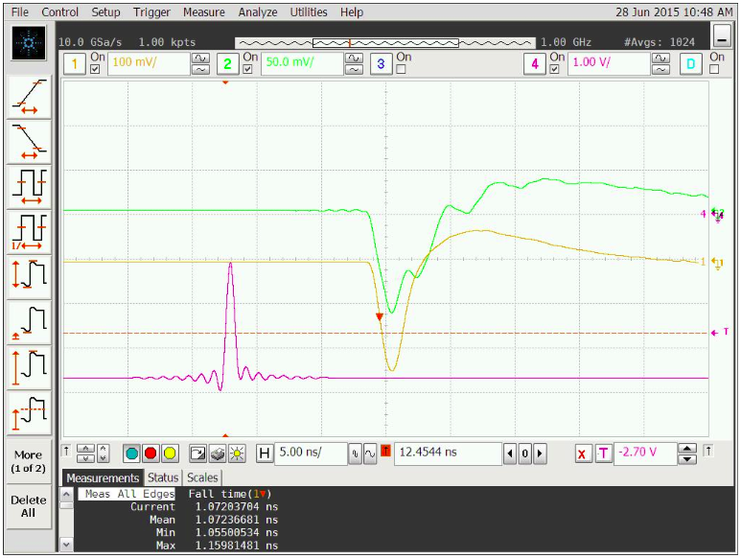
Add a 51 W resistor in front of Wenteq
Ch#1: Mesh
Ch#2:
Anode
B/W limit 1GHz, average mode
Note the leading edge (falling edge) is similar to direct connection, but the trailing edge is slower.

Slide 5
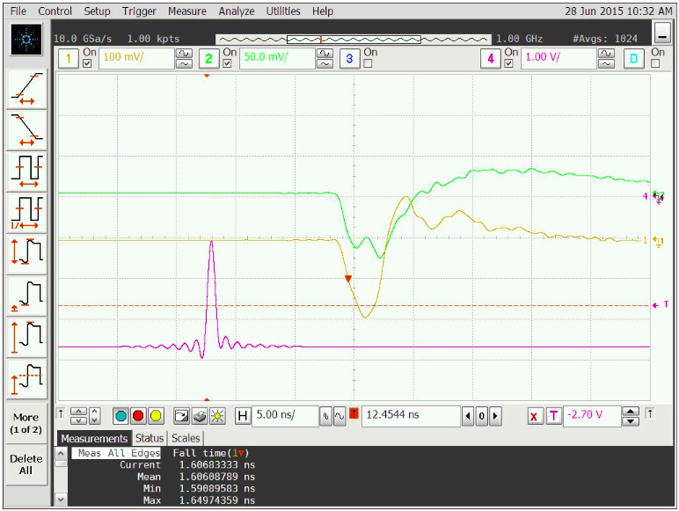
Add a 20pF capacitor in front of Wenteq
Ch#1: Mesh
Ch#2: Anode
Bandwidth limit 1GHz, average mode
Note the leading edge (falling edge) is much slower (1.606ns).
The another observation is anode signal shape is somewhat different .

Slide 6
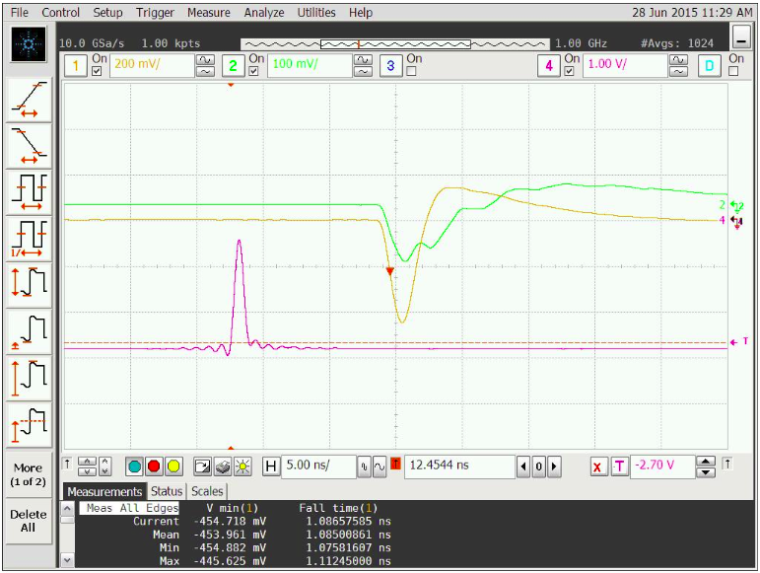
Change laser diode trigger signal width
Ch#1: Mesh
Ch#2: Anode
Bandwidth limit 1GHz.
Change L.D. trigger pulse width from 600ps to 800ps, but reduce the pulse amplitude, to get similar mesh signal amplitude.
Note the leading edge and the trailing edge are similar for 600ps and 800ps (compare to slide #3). This is a rather surprising result.
800ps trigger pulse width

