Slide 1

Test Mesh APD under various amplifier scenarios
C. Lu
Princeton University
(8/18/2015)

Slide 2
Test setup
Beam test shows 2x2 APD and 8x8 mesh APD signal shapes are quite different. 2x2 APD signal pulse is sharper and narrower. Is there anything related to the amplifier?
To clarify this we did the following test in the lab:
Test a 8x8 mm^2 mesh APD with 20db attenuator + Wenteq 5008 amplifier;
Test 8x8 mm^2 mesh APD with a ACLM4601 limiter to protect the scope, ACLM limiter specs see next page;
Test 8x8 mm^2 mesh APD direct with scope.
The laser pulse width is 600ps.

Slide 3
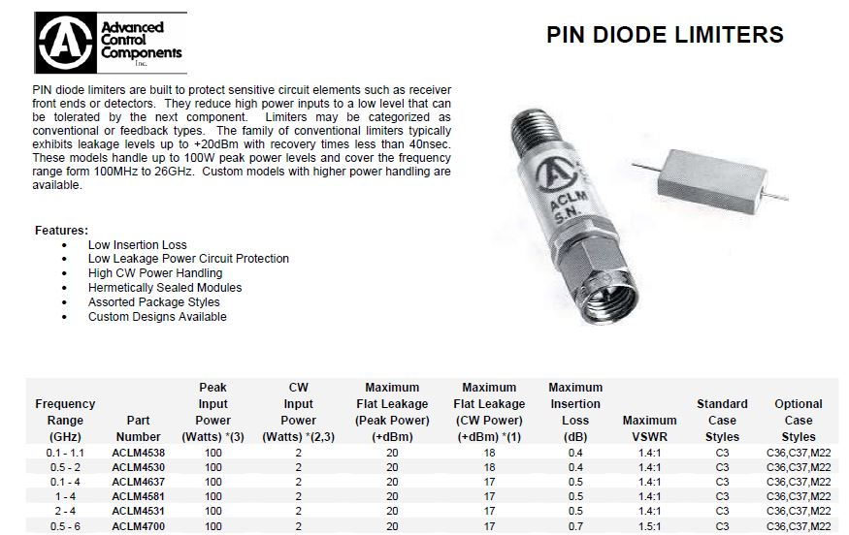
ACLM pin diode limiter

Slide 4
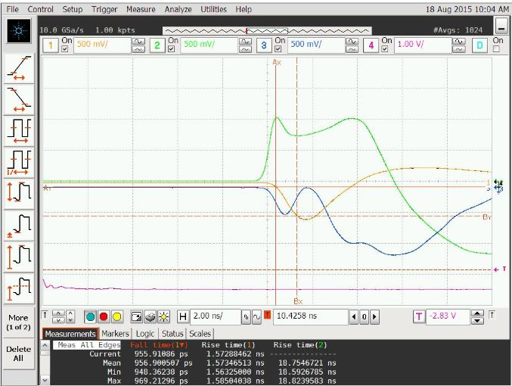
20db + Wenteq 5008
Falling time 957ps.

Slide 5
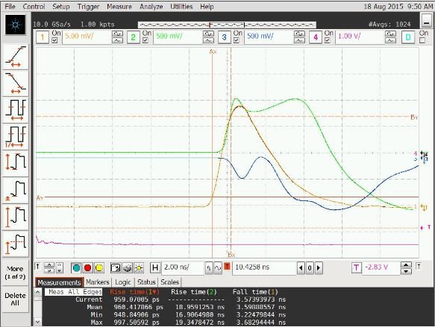
w/ ACLM4601 limiter
Falling time 968ps.

Slide 6
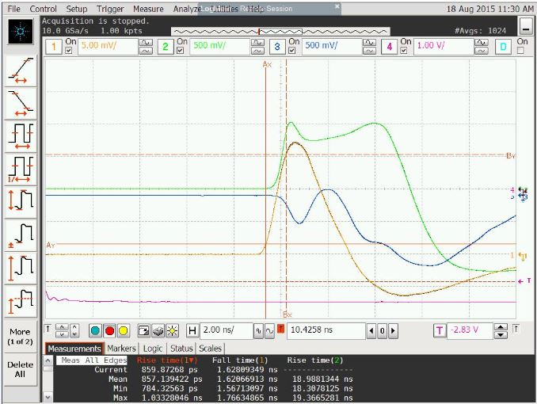
w/o amplifier or limiter
Rise time 857ps.
Without any amplifier and ACLM limiter the rise time is the fastest.

