Slide 1

Temperature dependence of 4 mm² RMD APD time resolution
C. Lu
Princeton University
(1/10/2013)

Slide 2
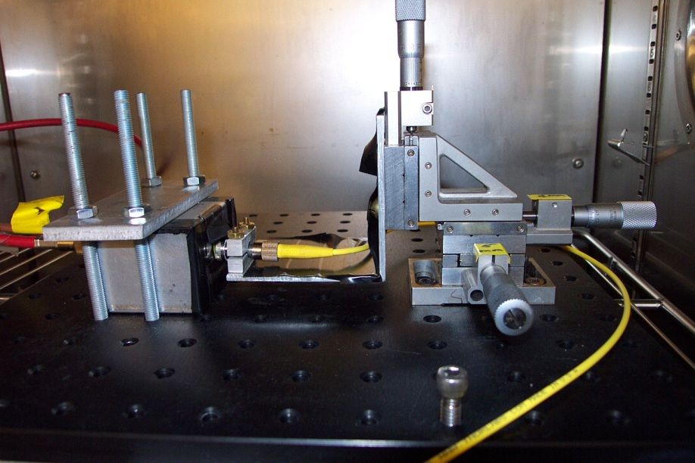
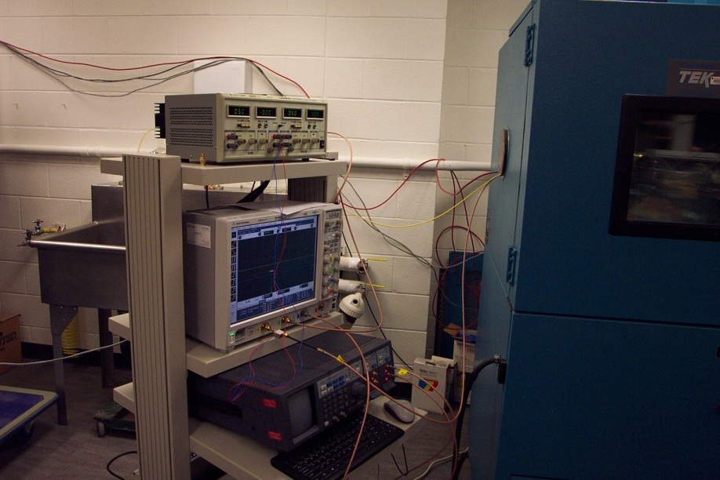
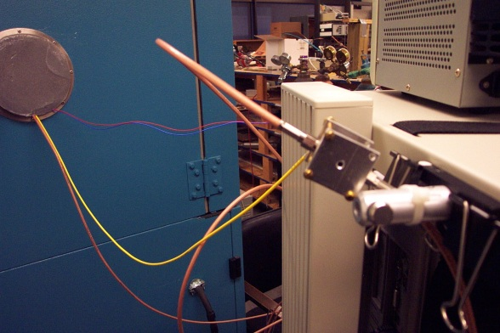
Test setup
An environmental chamber (E.C.) is employed to create a temperature controlled test environment. The temperature can be set from -30C to 30C.
APD and VCSEL (980nm) laser diode are placed inside of the E.C.
Internal view of the E.C.
E.C. chamber
APD box (4mm^2)
Optical fiber
VCSEL laser diode box
Collimation lens (Thorlabs CFC-11X-B)

Slide 3
Laser pulse calibration
Use Thorlabs PM100USB Power and Energy meter to measure the laser diode output, then calculate the photon number per pulse.
With 1Mhz, 1ns drive pulse the measured laser beam power vs. driving pulse voltage shows good linearity after V ≥ 1.5 V.
Pulse(V) | Laser(W) | # of photons
2 | 6.24E-10 | 3102.3
2.2 | 7.43E-10 | 3696.8
2.5 | 9.29E-10 | 4623.2
3 | 1.25E-09 | 6234.2
3.5 | 1.57E-09 | 7830.0
4 | 1.88E-09 | 9375.7
4.5 | 2.2E-09 | 10956.5
5 | 2.47E-09 | 12291.5

Slide 4
ZX60 calibration (# of e’s/mV)
ZX60 is not a charge sensitive amplifier, however we would like to check if within our application range, there is a good linearity between input signal (# of e’s) and output pulse amplitude (mV).
Input 1ns pulse, integrating the pulse area to get the total number of electrons in the pulse (assume 50 Ω impedance).
It shows very good linearity. In the time resolution test the output signal’s amplitude from ZX60 is in the range of 5-60 mV, so is in the calibrated range.

Slide 5
Temperature dependence of RMD 4 mm² APD time resolution (cont’d)

Slide 6
Temperature dependence of RMD 4 mm² APD time resolution
This result is tested with -5 V, 1ns pulse, which is ~ 12000 photons/pulse. Lowering temperature helps to improve the time resolution: from 25 ps @ 30°C down to 17 ps @ -20°C. We also plotted the APD pulse size vs. temperature, which indicates the APD gain decreases with the temperature.

Slide 7
Time resolution for MIP
This result is tested with 5 V, 1 ns pulse, which is ~ 12000 photons/pulse. To get the # of P.E. in a laser pulse we have to know the Q.E. of the APD. This is still not accurately known. According to E-mail exchange with Mickel, I looked two extreme scenarios:
The upper limit of the Q.E. is 43.8%, which is the absorption in a 60um thick silicon layer for 980 nm photon, set all other fact to 1;
The lower limit is (43.8 * 58)% = 25.4%. 58% is the Q.E. previously reported by RMD.
To derive the time resolution of MIP signal from the laser beam pulse, we also need a model of time resolution vs. # of P.E. According to previous discussion we have two models:
Time resolution will vary with S/N. Because we already have experimental evidence that the noise keeps more or less constant when the temperature varies, in this model the time resolution will vary with 1/S (i.e. 1/APD gain);
Pure statistical model, time resolution will vary with 1/sqrt(S).

Slide 8
MIP time solution of APD in various scenarios

Slide 9
APD Gain
Since we already calibrated the ZX60 sensitivity (slide #4): # of e’s = 9189*V(mV)-4552, based on various QE assumptions, we now can calculate the APD gain: (input laser pulse = 1.1x10⁴ photons/pulse)
The gain looks pretty low ??
# of e’s = 9189*V(mV)-4552

Slide 10
APD Gain (cont’d)
Dick mentioned a rule of thumb for APD gain vs. temperature: 1°C decrease equivalent to 2 V HV raise. That infers that to get same gain from -20 °C to 20 °C the HV needs raise 80 V. Our test confirms this rule:

