Slide 1

Simulation of RMD APD with VTCAD
C. Lu
Princeton University
(10/29/2012)

Slide 2
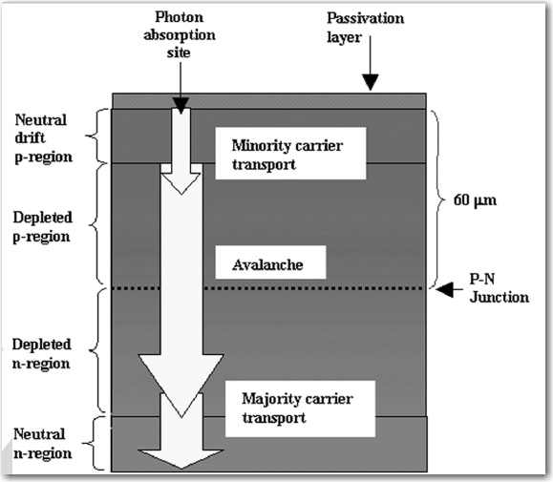
RMD deep diffused APD structure
Cross-sectional view of RMD deep diffused APD.
Reexamination of deep defused silicon avalanche photodiode gain and quantum efficiency
Mickel McClish, et al.
IEEE Transaction on Nuclear Science, Vol. 53, No. 5, Oct. 2006

Slide 3
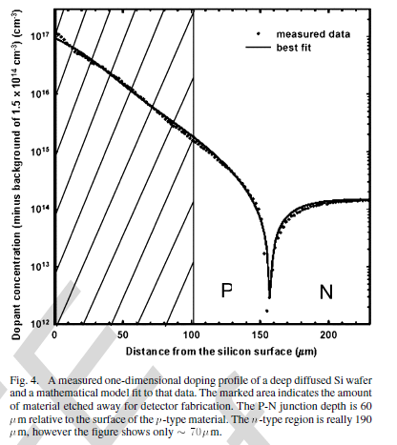
RMD deep diffused APD structure in simulation
Cathode +HV
Anode -HV
Removed
Avalanche region,
V
E

Slide 4
VTCAD and Genius software
The semiconductor device simulator used in this study is VisualTCAD (VTCAD), which is the latest graphical user interface for the Genius device simulator. All the physical models and options in Genius simulator are accessible with VisualTCAD.
Briefly speaking in our simulation Genius uses Drift-Diffusion (DDML1) solver, the lattice temperature keeps constant though out the solve procedure.
The primary function of DDML1 is to solve two sets of partial differential equations: Poisson's equation, and the hole and electron continuity equations.
According to the software vender DDML1 is suitable for PN diode, BJT transistor and long gate MOSFET simulation.
The results shown here are just a novice user’s preliminary exercise.

Slide 5
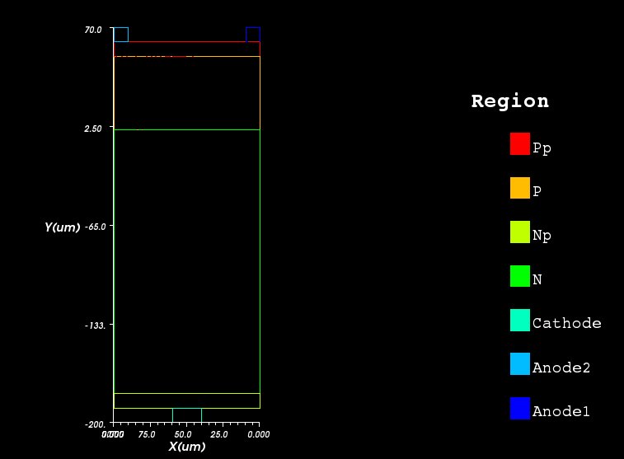
RMD APD device model in simulation
It takes long time to run a large model simulation, we started with a smaller size APD, 0.1 mm wide, 0.25 mm thick, with a mesh dimension less than 2 μm. (The high doping regions used here are larger than RMD APD real number: Pp and Np ~ 1-2 μm, but it doesn’t matter here.
High doping density P region
Doping P region
High doping density N region
Doping density N region
Aluminum cathode
Aluminum anode #2
Aluminum anode #1

Slide 6
Doping profile
The doping profile is extracted from RMD IEEE NS October, 2006 paper. We add a thin layer of high density doping to each side of the APD: P side 10¹⁹ (will change it to 10¹⁷), N side 10¹⁸ (will change it to 10²¹).
Measured APD doping profile

Slide 7
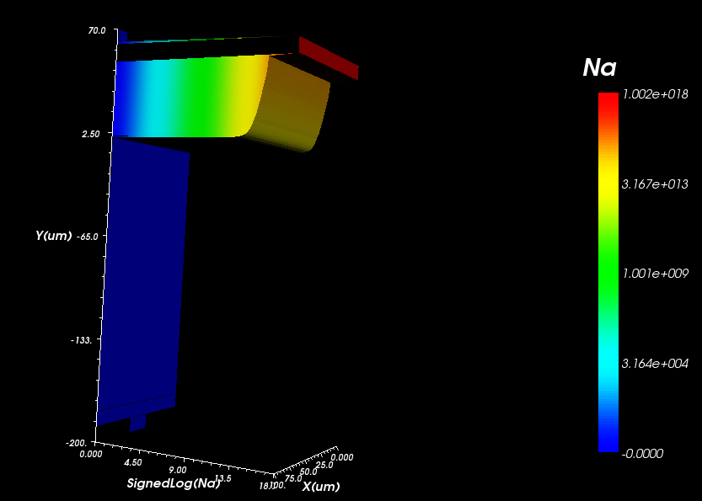
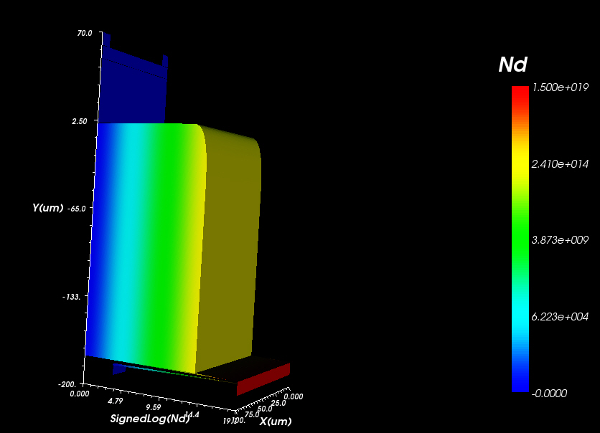
Results from simulation
1. Doping profile
donor
acceptor

Slide 8
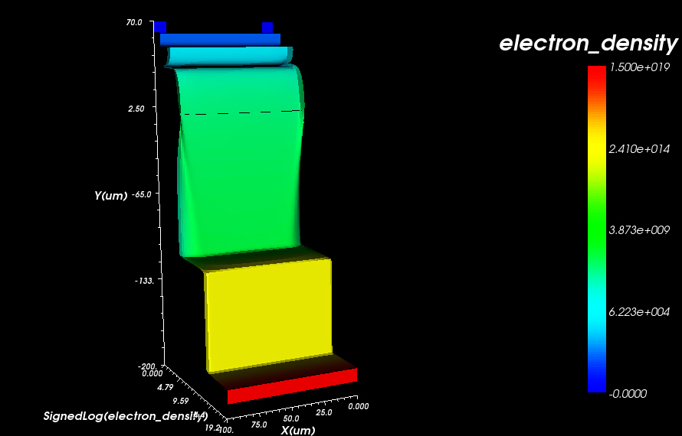
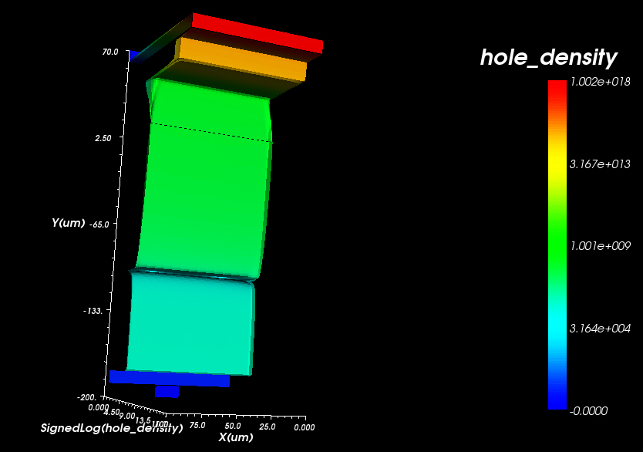
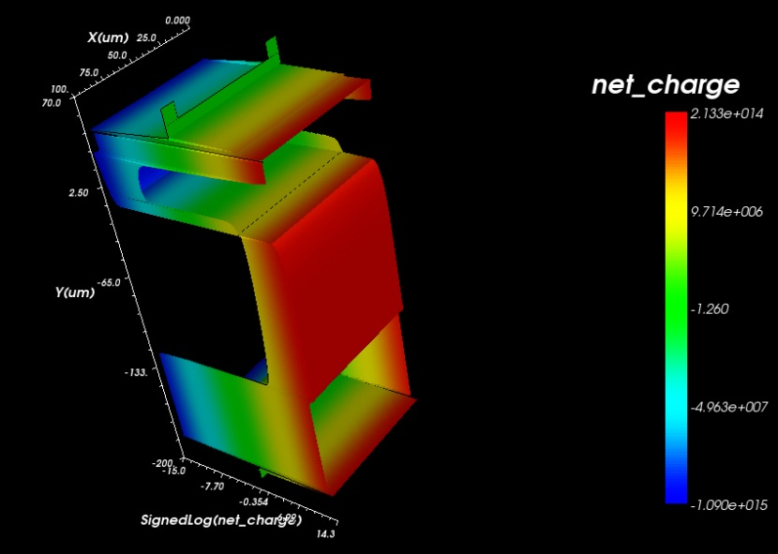
Results from simulation
2. Electron, hole and net charge distribution
Net charge distribution

Slide 9
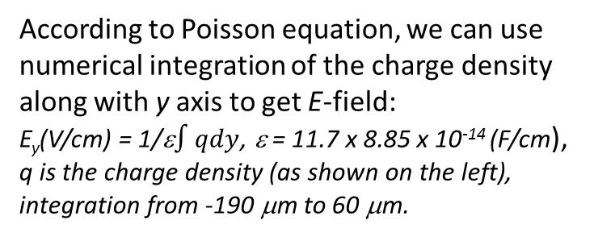
Calculation of E-field in the APD
Extract the net charge distribution along with the central line of the APD model (x kept at 50 μm, y from -190 μm to 60 μm):
According to Poisson equation, we can use numerical integration of the charge density along with y axis to get E-field:
E_{y}(V/cm) = 1/ε$∫qdy$, ε = 11.7 x 8.85 x 10⁻¹⁴ (F/cm),
q is the charge density (as shown on the left),
integration from -190 μm to 60 μm.
Net charge distribution along with the central line (y axis direction).
The maximum E-field for -1500V bias is ~189 kV/cm.

Slide 10
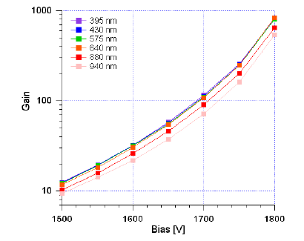
Avalanche region in APD
To estimate the thickness of the avalanche region in APD, we assume the avalanche starts at bias -1500 V. On previous slide we have shown that at -1500 V the maximum E-field is ~ 189 kV/cm, thus we can draw a line on the right plot, estimate the thickness of the avalanche region t.
At -1700 V, t ~ 30 μm,
-1750 V, t ~ 33.8 μm,
-1800 V, t ~ 36.3 μm,
-1900 V, t ~ 42.5 μm.
(M. McClish et al. IEEETNS 53 (2006) 1)

Slide 11
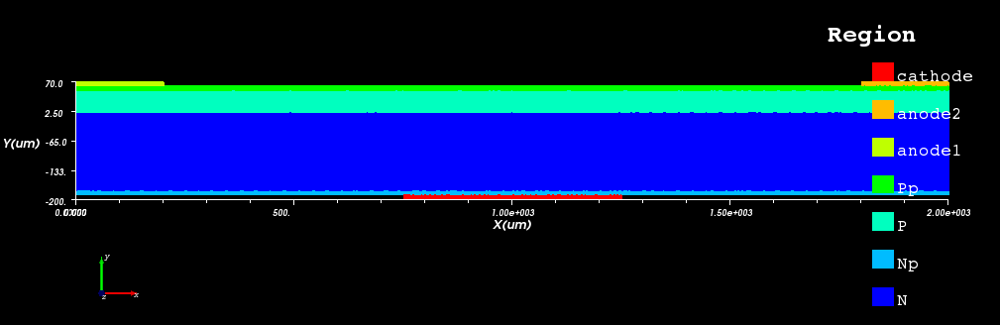
Full size APD (2mm) simulation
Still 2D model, 2mm wide, P side 50 μm normal doping region and 10 μm high doping on the surface, N side 180 μm normal doping, 10 μm high doping on the surface. Anode electrodes 0.2 mm wide on two sides, cathode 0.5 mm wide at the center.
The simulation is under way; will report later. The most interesting issue for the full size APD simulation is the electrode’s dimension effect on the E-field and current collection.

Slide 12
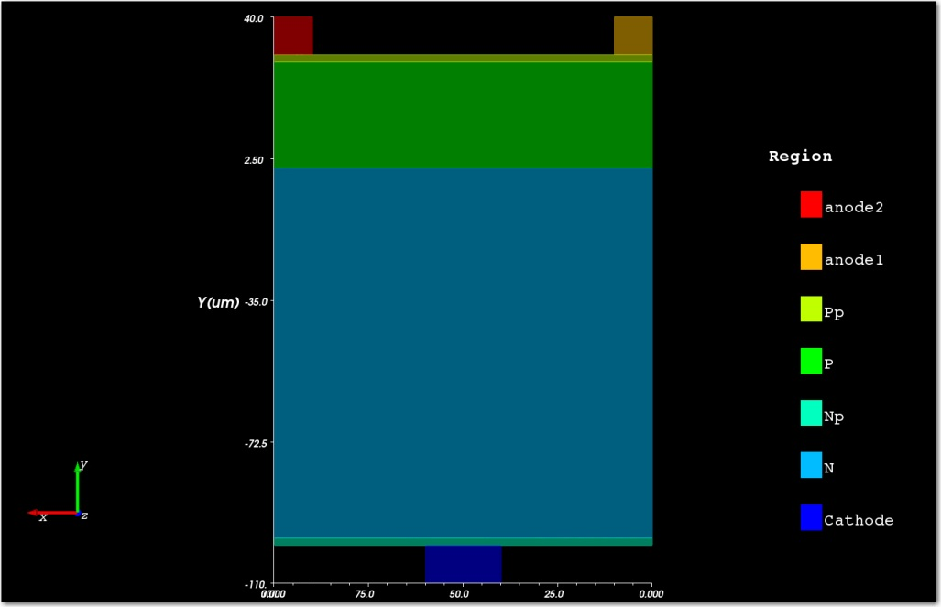
Role of APD electrodes
The role of APD electrodes are two fold: distribute HV to form E-field in APD; pick up induced signal from avalanche.
To fulfill the first role, a thin layer of high doping on both side of APD should be enough. The VTCAD simulation supports this view. We have ran the simulation for two models: one model has the high doping layers (2um 1E+17/cm^3 for P-side, 2 um 1E+18/cm^3 for N-side) and the other model does not have these high doping layers. We put their potential distribution together in following slides for comparison.
Model w/ high doping layers: Pp and Np.

Slide 13
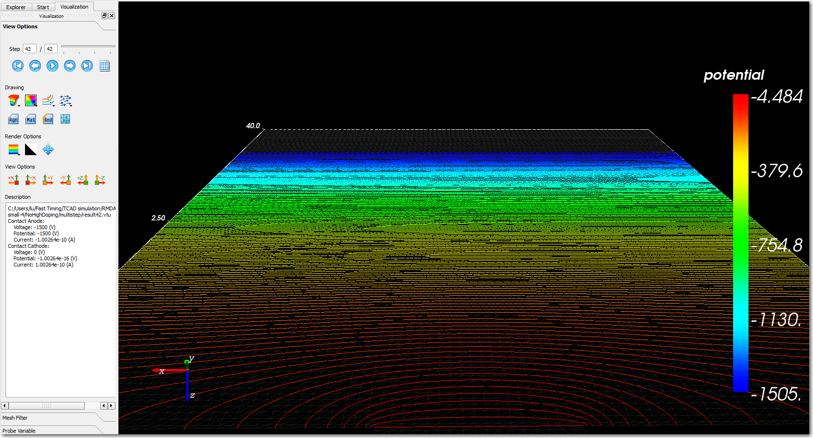
W/o high doping layers
We can clearly see the bottom cathode vicinity the equipotential lines are curved. Next slide shows the top two anode regions have similar distortion.

Slide 14
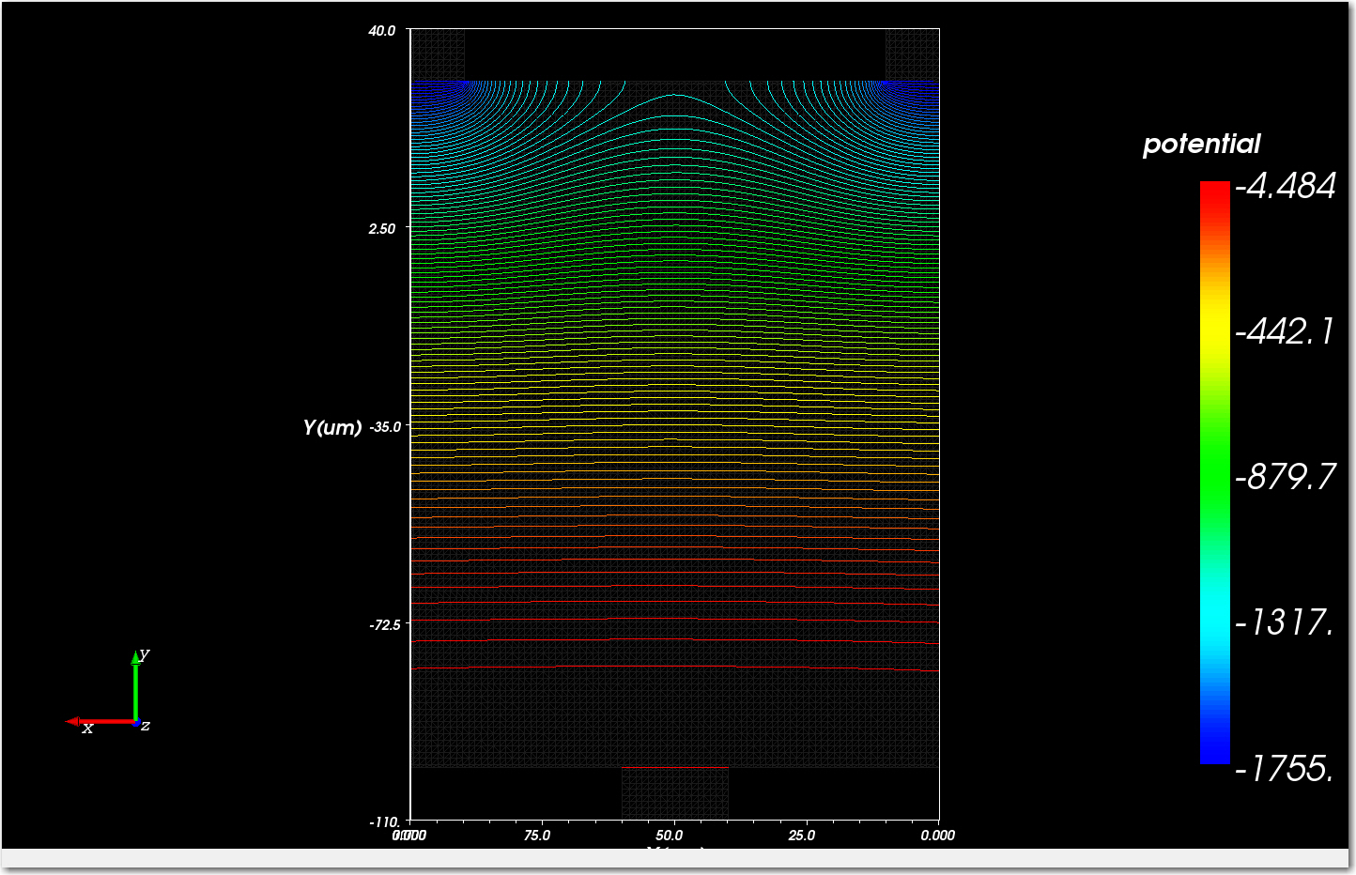
W/o high doping layers
W/o high doping layers at two upper corners the equipotential lines are distorted.

Slide 15
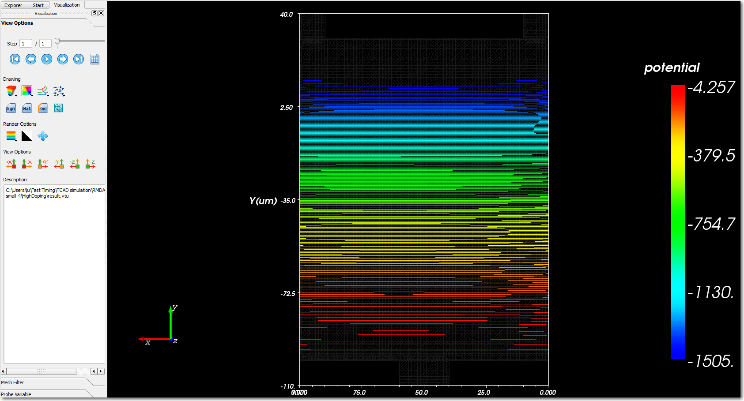
With high doping layers
Potential is uniformly distributed throughout entire APD. There is no distortion at two anodes (two top corners) and one cathode (center of bottom) vicinities. Therefore high doping layers are good enough to keep E-field uniform along with x direction, avalanche size uniform throghout entire APD volume.

Slide 16
2-nd role of APD electrodes
Pick up induced signal produced by avalanche in the high E-field P-N junction layer.
The signal is readout thru the electrodes and sent to fast electronics. High resistivity material is not suitable for this task, it will ruin the timing performance and signal uniformity. In the present test done by Thomas, we have two types of pick up electrodes: Indium ring and thin Aluminum coating.
Since the indium ring is surrounding the entire APD peripheral, the avalanche in the APD P-N junction will induce almost same signal, which is not sensitive to the position of the avalanche. This explains why we see Thomas’s scan result is quite uniform.

Slide 17
Suggested improvement to the RMD APD
In this design HV electrodes are isolated from signal pick up electrodes. Since high doping layers will shield part of the signal, we don’t want the resistivity of these layers too low. The signal ground and HV ground might can be connected together, so we can save one pin.

Slide 18
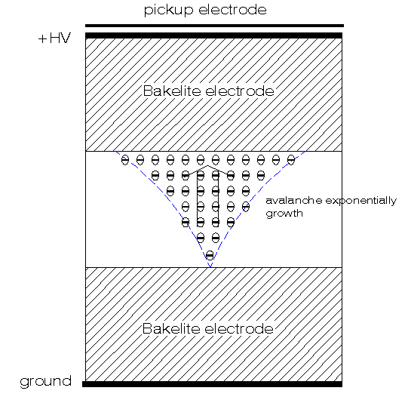
Induced signal mechanism
The signal obtained on APD’s electrodes is not due to either electron or holes collected on the electrodes. It is the induced signal originated by the avalanche at the P-N junction. The mechanism is very similar to RPC chamber*.
The movement of the charge in the electric field induces a current signal on the pickup electrode.
According to Ramo’s theorem:
where e₀ is the electrons charge, N(t) is the number of electrons presented at time t, v is the electron drift velocity, E_{w} (weighting field) is the electric field in the gap if we set the pickup electrode to V_{w} and ground all other electrodes.
Induced signal mechanism in RPC chamber
* Induced signal in RPC, C. Lu, SNIC Symposium, SLAC, Stanford, California, 3-6 April, 2006. http://www.slac.stanford.edu/econf/C0604032/papers/0201.PDF

Slide 19
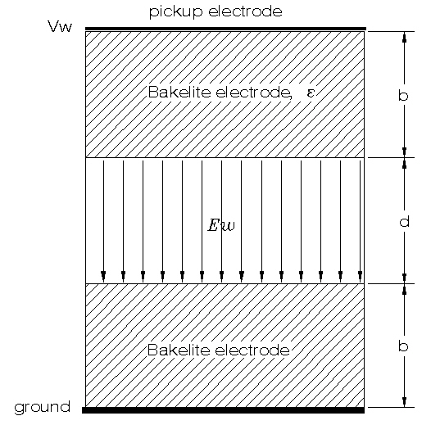
Derivation of the weighting field
E_{w} (weighting field) is the electric field in the gap if we set the pickup electrode to V_{w} and ground all other electrodes. Refer to the figure below, the weighting field can be easily derived: Assume d1=b, d2=d, d3=b, and ε₁=ε₃=ε, ε₂=1, to satisfy the following condition
we derive the following weighting field
d₁, ε₁
d₂, ε₂
d₃, ε₃

Slide 20
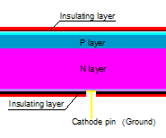
Derivation of the weighting field for APD
P-N junction
T_{silicon}
The similarity between these two illustrations is very clear: the P-N junction → Gas gap; other silicon material → Bakelite electrodes.

Slide 21
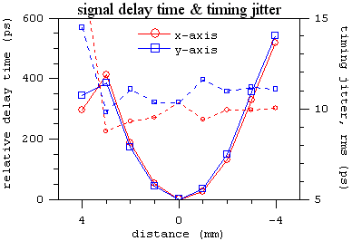
What causes huge time walk?
Thomas test shows the Indium ring APD has huge time walk along with both x and y direction. The time walk is so large, there is no decent signal transmission delay can explain it. One possible explanation could be due to the existence of a very low E-field in front of the P-N junction (see right plot below). After applied Indium ring it may alter the doping profile, therefore causes the E-field distortion.
Very small E-field region here
(Thomas Tsang, 10/22/2012)

Slide 22
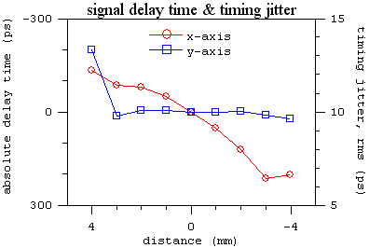
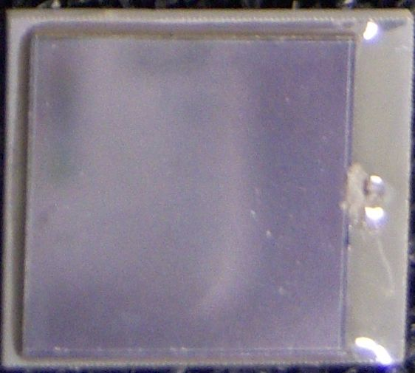
What causes huge time walk?
Aluminum coating APD shows different behavior regarding to the time walk.
← + x-position
(Thomas Tsang, 10/22/2012)
Along with the blue line seems no P-N layer distortion has been brought in by aluminum coating, but along with the red line, from left to right there is a thickening of the low E-field layer tendency, thus causes the time walk increasing accordingly.

Slide 23
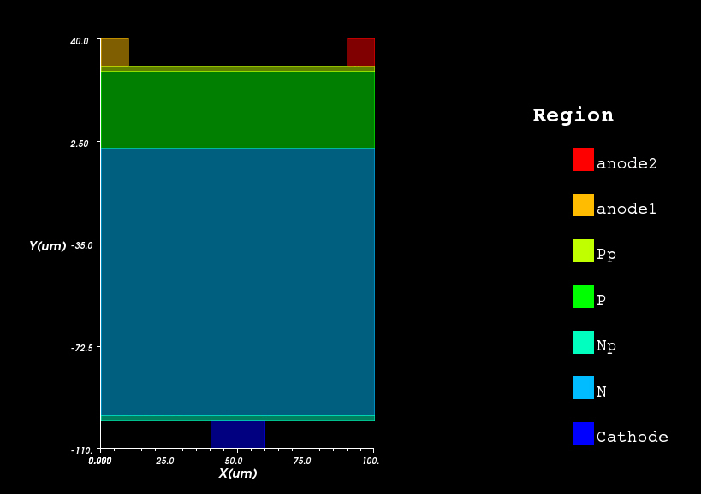
Solution to eliminate time walk
The solution to the time walk might be removing the extra P-type silicon layer in front of the P-N junction. We can make the P-side entrance of APD already has large enough E-field, so the photoelectron created at anywhere in this region can be pulled to P-N junction region right after it is created, thus completely removed the large time walk origin.
Photon entrance point of APD
Suggested APD layout: thin high doping layers 2μm Pp and Np; 28μm P layer, 98μm N layer.

