Slide 1

Simulation of RMD APD with VTCAD
C. Lu
Princeton University
(10/24/2012)

Slide 2
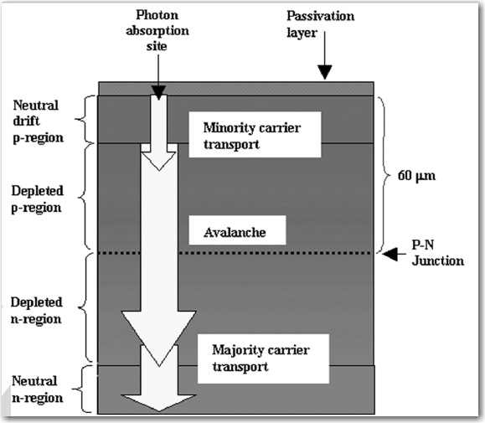
RMD deep diffused APD structure
Cross-sectional view of RMD deep diffused APD.
Reexamination of deep defused silicon avalanche photodiode gain and quantum efficiency
Mickel McClish, et al.
IEEE Transaction on Nuclear Science, Vol. 53, No. 5, Oct. 2006

Slide 3
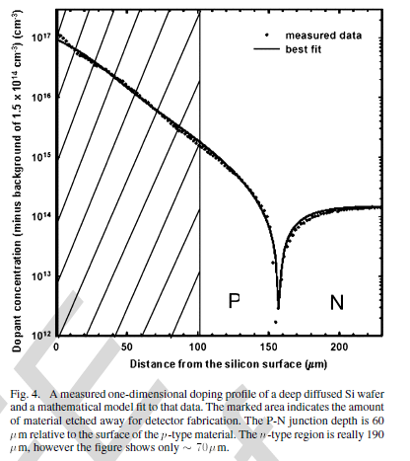
RMD deep diffused APD structure in simulation
Cathode +HV
Anode -HV
Removed
Avalanche region,
V
E

Slide 4
VTCAD and Genius software
The semiconductor device simulator used in this study is VisualTCAD (VTCAD), which is the latest graphical user interface for the Genius device simulator. All the physical models and options in Genius simulator are accessible with VisualTCAD.
Briefly speaking in our simulation Genius uses Drift-Diffusion (DDML1) solver, the lattice temperature keeps constant though out the solve procedure.
The primary function of DDML1 is to solve two sets of partial differential equations: Poisson's equation, and the hole and electron continuity equations.
According to the software vender DDML1 is suitable for PN diode, BJT transistor and long gate MOSFET simulation.
The results shown here are just a novice user’s preliminary exercise.

Slide 5
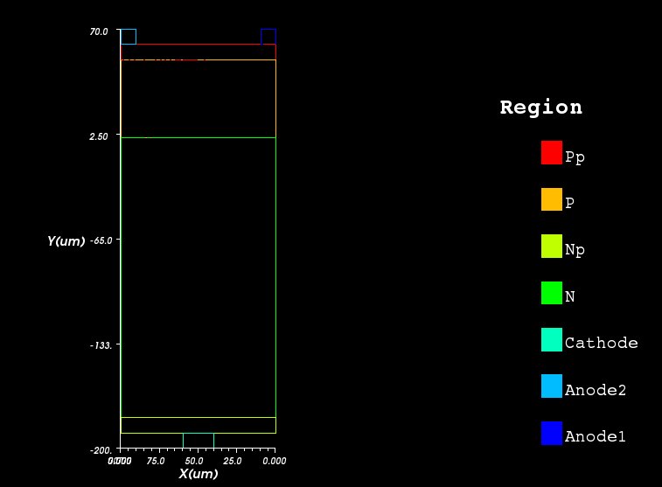
RMD APD device model in simulation
It takes long time to run a large model simulation, we started with a smaller size APD, 0.1 mm wide, 0.25 mm thick, with a mesh dimension less than 2 μm. (The high doping regions used here are larger than RMD APD real number: Pp and Np ~ 1-2 μm, but it doesn’t matter here.
High doping density P region
Doping P region
High doping density N region
Doping density N region
Aluminum cathode
Aluminum anode #2
Aluminum anode #1

Slide 6
Doping profile
The doping profile is extracted from RMD IEEE NS October, 2006 paper. We add a thin layer of high density doping to each side of the APD: P side 10¹⁹ (will change it to 10¹⁷), N side 10¹⁸ (will change it to 10²¹).
Measured APD doping profile

Slide 7
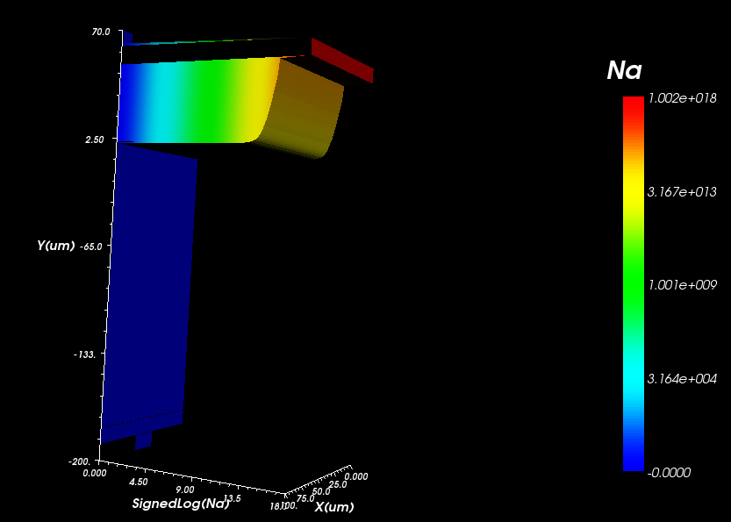
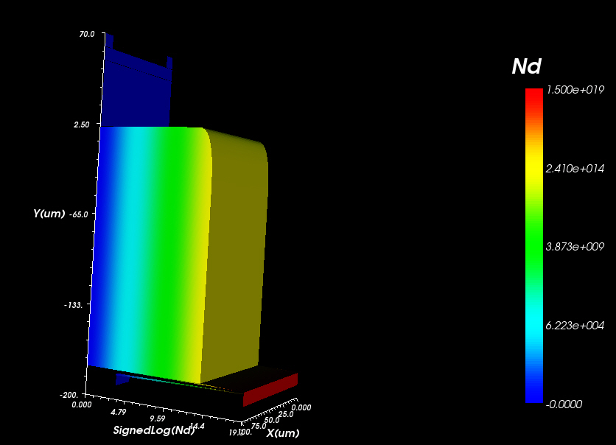
Results from simulation
1. Doping profile
donor
acceptor

Slide 8
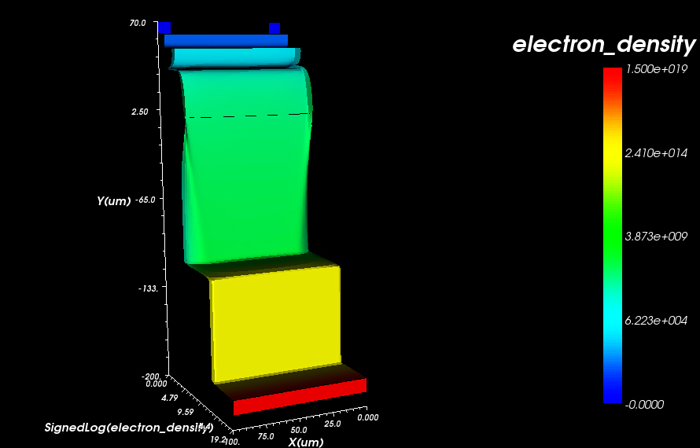
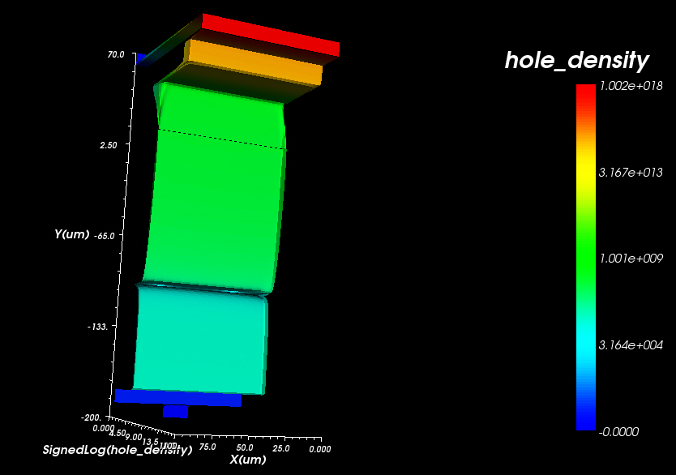
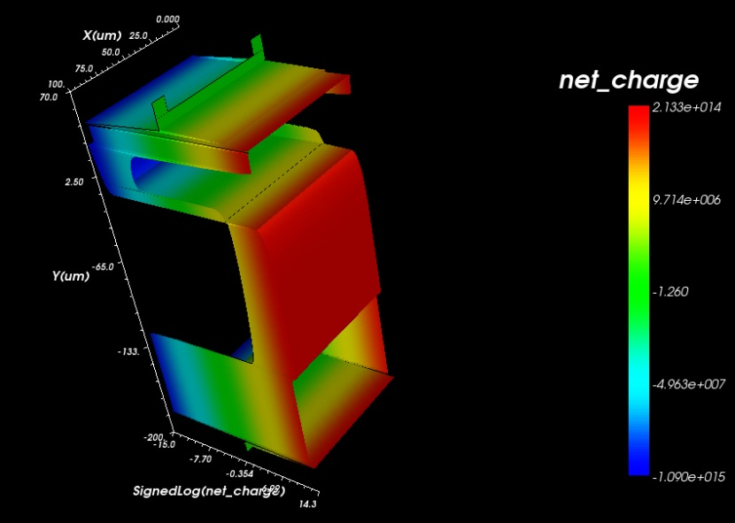
Results from simulation
2. Electron, hole and net charge distribution
Net charge distribution

Slide 9
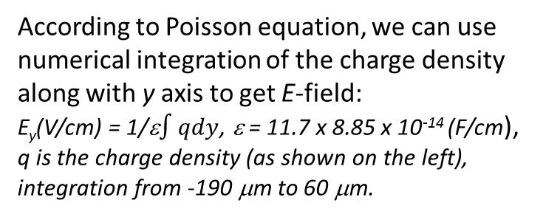
Calculation of E-field in the APD
Extract the net charge distribution along with the central line of the APD model (x kept at 50 μm, y from -190 μm to 60 μm):
According to Poisson equation, we can use numerical integration of the charge density along with y axis to get E-field:
E_{y}(V/cm) = 1/ε$∫qdy$, ε = 11.7 x 8.85 x 10⁻¹⁴ (F/cm),
q is the charge density (as shown on the left),
integration from -190 μm to 60 μm.
Net charge distribution along with the central line (y axis direction).
The maximum E-field for -1500V bias is ~189 kV/cm.

Slide 10
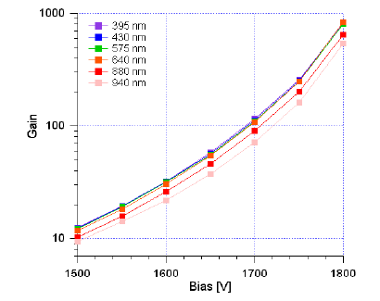
Avalanche region in APD
To estimate the thickness of the avalanche region in APD, we assume the avalanche starts at bias -1500 V. On previous slide we have shown that at -1500 V the maximum E-field is ~ 189 kV/cm, thus we can draw a line on the right plot, estimate the thickness of the avalanche region t.
At -1700 V, t ~ 30 μm,
-1750 V, t ~ 33.8 μm,
-1800 V, t ~ 36.3 μm,
-1900 V, t ~ 42.5 μm.
(M. McClish et al. IEEETNS 53 (2006) 1)

Slide 11
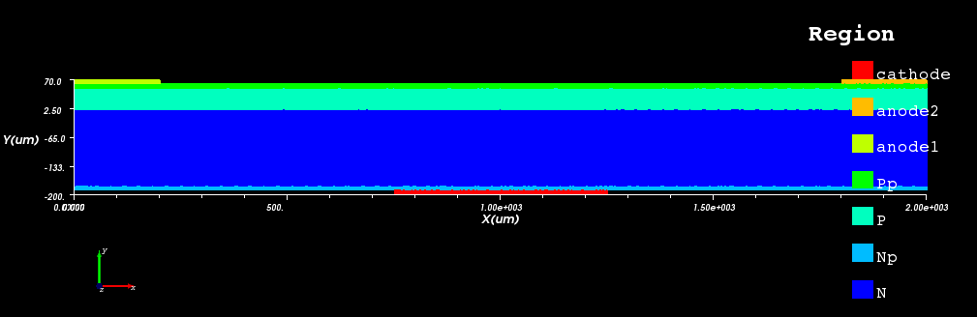
Full size APD (2mm) simulation
Still 2D model, 2mm wide, P side 50 μm normal doping region and 10 μm high doping on the surface, N side 180 μm normal doping, 10 μm high doping on the surface. Anode electrodes 0.2 mm wide on two sides, cathode 0.5 mm wide at the center.
The simulation is under way; will report later. The most interesting issue for the full size APD simulation is the electrode’s dimension effect on the E-field and current collection.

